Slide 1
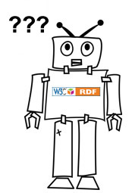
x RDF
RDFS
OWL
What does a client "know?"
X
Schema (terminology; Tbox):
foaf:Person rdfs:subClassOf foaf:Agent.
Data (assertions; Abox):
<http://orcid.org/0000-0003-0328-0792> rdf:type foaf:Person.
<http://orcid.org/0000-0003-2445-1511> rdf:type foaf:Person.
?
Materialized triples:
<http://orcid.org/0000-0003-0328-0792> rdf:type foaf:Agent.
<http://orcid.org/0000-0003-2445-1511> rdf:type foaf:Agent.

