Slide 1
Semantic Web for the Working Ontologist
Chapter 13: Ontologies on the Web

Slide 2
Data on the Web
Schemas:
schema.org http://schema.org/
Open Graph Protocol http://ogp.me/
Good Relations Ontology http://www.heppresearch.com/
Formats:
RDFa (W3C Recommendation)
Microformats http://microformats.org/
JSON LD (W3C Recommendation; does not completely intersect with RDF) http://json-ld.org/ https://www.w3.org/TR/json-ld/

Slide 3
RDFa extraction demo
http://bioimages.vanderbilt.edu/baskauf/11926.htm
View page source
Go to W3C RDFa Validator: https://www.w3.org/2012/pyRdfa/Validator.html
Paste in URL, or upload from saved HTML file.

Slide 4
Supposed Good Relations RDF
http://www.bestbuy.com/site/apple-apple-watch-sport-42mm-space-gray-aluminum-case-space-gray-sports-band/4274802.p?id=1219733906250&skuId=4274802
Check page source for RDFa
https://www.w3.org/2012/pyRdfa/Validator.html
Open Graph protocol, not Good Relations
Significant lack of commitment to “pure” RDF (use of literals for everything)
Could not find GR at sears.com, kmart.com, etc.

Slide 5
Taking a look at Good Relations
Source is at http://www.heppnetz.de/ontologies/goodrelations/v1.html
RDF/XML on GitHub
Turtle on GitHub
Ugliness; look at in Protégé
Note that cardinality is given in literals, not OWL definitions (???)
Note the usual problem of competing schemas and attempt to reconcile with schema.org

Slide 6
The literal problem
ex:flyingPig ex:hasMeasurement “21”^^xsd:integer.
The datatyping lets us know that the literal is a number.
But what kind of measurement is this? What are the units?

Slide 7
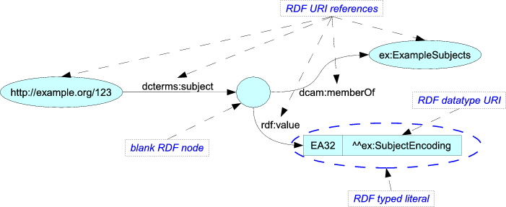
Reification examples: rdf:value and DCMI RDF model
https://www.w3.org/TR/rdf-schema/#ch_value
http://dublincore.org/documents/dc-rdf/

Slide 8
Reification of price specification
plush:Offering_1
gs:hasCurrencyValue
“19”^^xsd:float
gr:hasPriceSpecification
plush:PriceSpec_1
gr:hasCurrency
gs:hasUnitOfMeasurement
“C62”
“USD”^^xsd:string
(by the job)

Slide 9
Describing services
CONSTRUCT {
?o gr:includesObject _:n .
_:n rdf:type gr:TypeAndQuantityNode.
_:n gr:amountOfThisGood "1.0"^^xsd:float.
_:n gr:hasUnitOfMeasurement "C62"^^xsd:string.
_:n gr:typeOfGood ?p.}
WHERE
{
?o rdf:type gr:Offering.
?o gr:includes ?p. }
gr:ProductOrService
rdf:type
plush:Service_1
gr:includes
plush:Offering_1
“1.0”^^xsd:float
rdf:type
gr:includesObject
plush:PriceSpec_1
gr:amountOfThisGood
gr:Offering
gs:hasUnitOfMeasurement
rdf:type
“C62”^^xsd:string
gr:TypeAndQuantityNode
(by the job; datatyped this time???)

Slide 10
What good does this do?
Well, it provides an automatic way to say stuff that we were too lazy to assert explicitly.
Unfortunately, can’t be expressed in OWL, so what’s the point of building the ontology?
SPIN rules allow SPARQL “rules” to be “ontologized”

Slide 11
owl:Ontology and owl:imports
Example:
dcterms:hasPart and dcterms:isPartOf
There is no semantic relationship between these two terms, although they seem to be inverses.
my:ontology a owl:Ontology;
owl:imports <http://purl.org/dc/terms/>.
dcterms:hasPart owl:inverseOf dcterms:isPartOf.

Slide 12
Quantities, Units, and Dimensions (QUDT)
Global reference for units
Conversion services
Dimension verification

Slide 13
owl:allValuesFrom to restrict possible values
qudt:Unit a owl:Class ;
rdfs:subClassOf
[ a owl:Restriction ;
owl:allValuesFrom qudt:QuantityKind ;
owl:onProperty qudt:quantityKind
] .
qudt:quantityKind a owl:ObjectProperty .
qudt:QuantityKind a owl:Class .
operating on:
vocab-units:Foot a qudt:Unit ;
qudt:quantityKind vocab-quantities:Length .
entails:
vocab-quantities:Length a qudt:QuantityKind .
(any reason why we couldn’t have just said that?)

Slide 14
Conversion services
Apply SPIN rules; again, not really done using OWL
But what is gained by embedding these in the ontology as opposed to just telling people how to do the SPARQL?

Slide 15
Dimension verification
Again, depends on SPIN rules that could have just been done by telling people what SPARQL queries to run.

Slide 16
CHEBI, an OBO ontology
http://www.obofoundry.org/
Water: http://www.ontobee.org/ontology/CHEBI?iri=http://purl.obolibrary.org/obo/CHEBI_15377

