Slide 1
Linked Data: Structured Data on the Web
Chapter 1: The Linked Data Web
Steve Baskauf 2016-09-12

Slide 2
Things we would like to enable a "machine" to do with Linked Data
Acquire data from other sources, possibly by following links.
Merge those data with our data
"Learn" things that weren't apparent before the data were merged.
Expose our data in a way that would allow others to link to it.
The first three items are what we do with a Web browser and our brains via documents and the World Wide Web. In this group, we want to figure out how to do the same thing automatically with software.

Slide 3
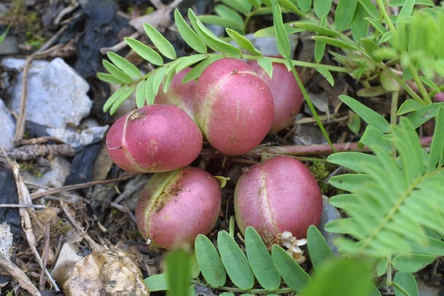

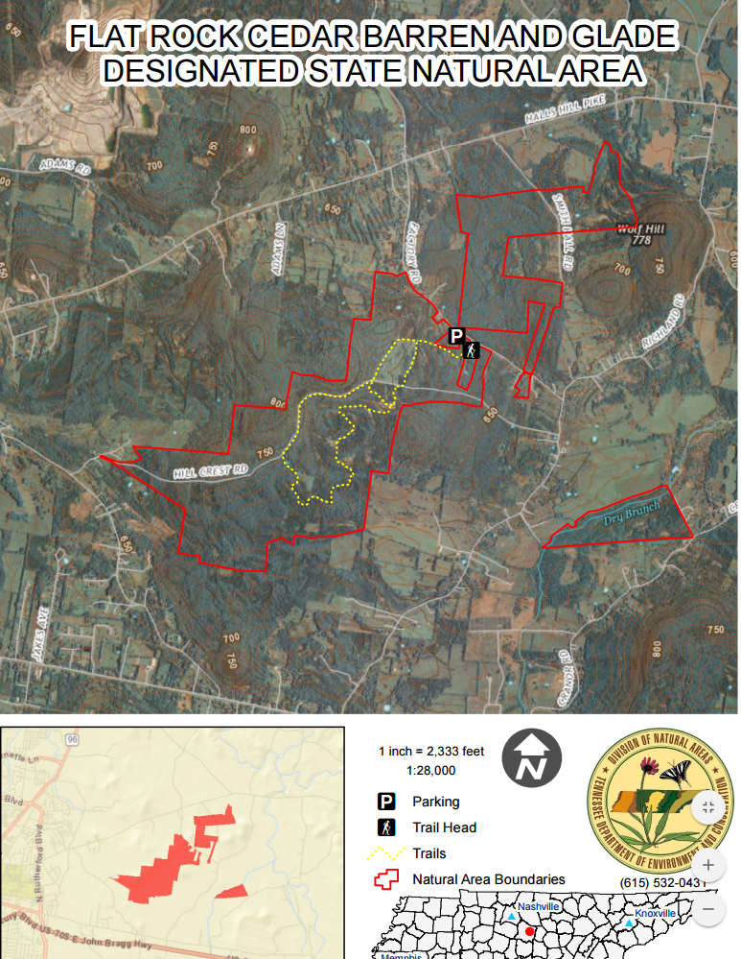

Example of linked resources
image
journal article
location
photographer

Slide 4
Human-readable metadata
Baskauf's image number 25041
Photographed at Flat Rock Cedar Glades and Barrens State Natural Area.
Created by Steve Baskauf
See the article "Population Genetics of Astragalus bibullatus (Fabaceae) Using AFLPs"
Questions:
What are the licensing terms of the image?
Where does Steve Baskauf work?
What is the latitude and longitude of Flat Rock Cedar Glade?
Who wrote ""Population Genetics of Astragalus bibullatus (Fabaceae) Using AFLPs"

Slide 5
Graph-based view of the metadata
http://bioimages.vanderbilt.edu/baskauf/25041
(the image)
dwciri:inDescribedPlace
http://sws.geonames.org/8617492/
foaf:creator
rdfs:seeAlso
(Flat Rock Cedar Glade preserve)
http://orcid.org/0000-0003-4365-3135
(Steve Baskauf)
http://dx.doi.org/10.1093/jhered/esp033
(Population Genetics of Astragalus…)

Slide 6
Machine-readable metadata
<http://bioimages.vanderbilt.edu/baskauf/25041>
dwciri:inDescribedPlace <http://sws.geonames.org/8617492/>;
foaf:creator <http://orcid.org/0000-0003-4365-3135>;
rdfs:seeAlso <http://dx.doi.org/10.1093/jhered/esp033>.
From these data, a machine could answer all of these questions:
What are the licensing terms of the image?
Where does Steve Baskauf work?
What is the latitude and longitude of Flat Rock Cedar Glade?
Who wrote ""Population Genetics of Astragalus bibullatus (Fabaceae) Using AFLPs"

Slide 7
Things we might want to say about bonobos, represented as a graph
Mammal
is a
Bonobo
"Szympans karłowaty"@pl
has the label

Slide 8
How do we know that what you mean by "mammal" is the same as what I mean by "mammal"?
Go to http://umbel.org and find a standard reference concept for mammal. The URI is a globally unique identifier for that concept. (It may or may not be a URL that can actually be used in a browser.)
This is Linked Data Principle #1.
http://umbel.org/umbel/rc/Mammal
is a
Bonobo
"Szympans karłowaty"@pl
has the label

Slide 9
How do we know that what you mean by "is a" is the same as what I mean by "is a"?
Use the standard W3C URI for specifying the class of a thing:
http://www.w3.org/1999/02/22-rdf-syntax-ns#type and another standard URI for labels.
http://umbel.org/umbel/rc/Mammal
Bonobo
http://www.w3.org/1999/02/22-rdf-syntax-ns#type
"Szympans karłowaty"@pl
http://www.w3.org/2000/01/rdf-schema#label
These URIs are too long !!!

Slide 10
We can make a URI shorter and easier to read by abbreviating it
Namespace abbreviations:
rdf: = http://www.w3.org/1999/02/22-rdf-syntax-ns#
rdfs: = http://www.w3.org/2000/01/rdf-schema#
umbel-rc: = http://dbpedia.org//umbel.org/umbel/rc/
rdf:type
or a
umbel-rc:Mammal
Bonobo
"Szympans karłowaty"@pl
rdfs:label
There is a special abbreviation for rdf:type, "a"

Slide 11
Literals are text strings, perhaps in a specific language
Literals are enclosed in quotation marks and may have a language tag. In this case, one might want to have many labels in different languages.
umbel-rc:Mammal
a
Bonobo
"pl" is the ISO 639-1 language code for Polish
"Szympans karłowaty"@pl
rdfs:label

Slide 12
Keep in mind that when you see a namespace followed by a colon, it's a globally unique URI, not a literal.
URIs may be constructed so that there last part makes sense to humans, but they don't have to. For example: https://www.wikidata.org/wiki/Q7377 a.k.a. wikidata:Q7377
wikidata:Q7377
rdf:type
Bonobo
"Szympans karłowaty"@pl
rdfs:label

Slide 13
HTTP URIs start with "http:" or "https:"
You might be able to find out something about them in a web browser.
This is Linked Data Principle #2.
Try http://dbpedia.org/resource/Bonobo
rdf:type
umbel-rc:Mammal
dbr:Bonobo
rdfs:label
"Szympans karłowaty"@pl

Slide 14


Linked Data Principle #3: Provide useful information when someone looks up a URI. "Look up" means an interaction across the Internet mediated by Hypertext Transfer Protocol (HTTP). It's called "dereferencing a URI". (People also say "resolving" a URI.)
HTTP GET http://dbpedia.org/resource/Bonobo
Accept: text/html
asking for a web page
Image from Clipart Panda
Client software
(a.k.a. the "machine")
In this case, the client is a web browser. It displays the returned body as a web page.
Image from Clipart Kid
HTTP Status: 200 OK
Body:
<?xml version="1.0" encoding="UTF-8" ?><!DOCTYPE html PUBLIC "-//W3C//DTD XHTML+RDFa 1.0//EN" "http://www.w3.org/MarkUp/DTD/xhtml-rdfa-1.dtd"><html xmlns="http://www.w3.org/1999/xhtml" xmlns:dbpprop="http://dbpedia.org/property/"
…
Web server

Slide 15
How can we see what's going on when a client interacts with a server?
The book shows how to use the command-line utility cURL. A more user-friendly option is client called Postman, a Chrome extension (google "postman plugin").
This time, let's ask for machine-readable data instead of a web page
HTTP GET http://dbpedia.org/resource/Bonobo
Accept: text/turtle

Slide 16
Excerpts from the served RDF/Turtle file:
# here's all the namespace abbreviations:
@prefix rdf: <http://www.w3.org/1999/02/22-rdf-syntax-ns#> .
@prefix rdfs: <http://www.w3.org/2000/01/rdf-schema#> .
@prefix dbr: <http://dbpedia.org/resource/> .
# Here's the actual graph data:
dbr:Bonobo rdf:type umbel-rc:Mammal .
dbr:Bonobo rdfs:label "Szympans kar\u0142owaty"@pl .
Remember that this is an abbreviation for rdf:type
umbel-rc:Mammal
a
dbr:Bonobo
"Szympans karłowaty"@pl
rdfs:label

Slide 17
Ways we talk about links:
# Here's the actual graph data:
dbr:Bonobo rdf:type umbel-rc:Mammal .
dbr:Bonobo
umbel-rc:Mammal
rdf:type
node arc node
generic graph terminology
subject property value
Dublin Core model
subject predicate object
RDF model
entity attribute value
EAV database model

Slide 18
Linked Data Principle #4: Include links to other URIs. (Learn new stuff!)
We know that baskauf:kitty is the same kind of thing as dbr:Bonobo
We infer that both are also instances of class umbel-rc:Vertebrate
umbel-rc:Vertebrate
baskauf:kitty
rdfs:subClassOf
This is a link made by UMBEL
This is a link made by me
a
umbel-rc:Mammal
dbr:Bonobo
a
This is a link made by DBpedia

