Slide 1
Discovering Linked Data
Steve Baskauf 2017-04-03

Slide 2
Things we would like to enable a "machine" to do with Linked Data
Acquire data from other sources, possibly by following links.
Merge those data with our data
"Learn" things that weren't apparent before the data were merged.
Expose our data in a way that would allow others to use it.
The first three items are what we do with a Web browser and our brains via documents and the World Wide Web. In this group, we want to figure out how to do the same thing automatically with software.

Slide 3
Discovery of information about individual resources

Slide 4

Imagine we are a Linked Data client (software with access to the Web)
We discover this triple:
<https://www.flickr.com/photos/30365320@N04/4108946604/> foaf:depicts <http://lod.vanderbilt.edu/historyart/site/Lingyansi>.
We would like to know what
http://lod.vanderbilt.edu/historyart/site/Lingyansi
denotes.

Slide 5
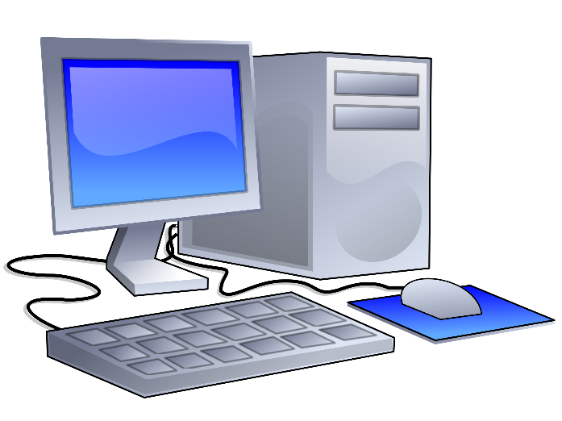

HTTP protocol Hypertext Transfer Protocol (HTTP), used to carry out an interaction across the Internet. mediated by. Retrieving information using HTTP GET is called "dereferencing a URI". (People also say "resolving" a URI.)
HTTP GET http://dbpedia.org/resource/Bonobo
Accept: text/html
asking for a web page
Image from Clipart Panda
Client software
(a.k.a. the "machine")
In this case, the client is a web browser. It displays the returned body as a web page.
Image from Clipart Kid
HTTP Status: 200 OK
Body:
<?xml version="1.0" encoding="UTF-8" ?><!DOCTYPE html PUBLIC "-//W3C//DTD XHTML+RDFa 1.0//EN" "http://www.w3.org/MarkUp/DTD/xhtml-rdfa-1.dtd"><html xmlns="http://www.w3.org/1999/xhtml" xmlns:dbpprop="http://dbpedia.org/property/"
…
Web server

Slide 6
How can we see what's going on when a client interacts with a server?
A user-friendly option is client called Postman, a Chrome extension (google "postman plugin"). Another is Advanced REST client (PC only). Command line option: curl
Postman carries out the entire dialog without interaction, Advanced REST client carries out each step one at a time. Behavior of curl depends on selected options
HTTP GET http://vanderbilt.edu/
Accept: text/html
Using curl: curl -v -L -H "Accept:text/html" http://vanderbilt.edu/
HTTP GET http://dbpedia.org/resource/Bonobo
Accept: text/html or text/turtle
Using curl: curl -v -L -H "Accept:text/turtle" http://dbpedia.org/resource/Bonobo

Slide 7
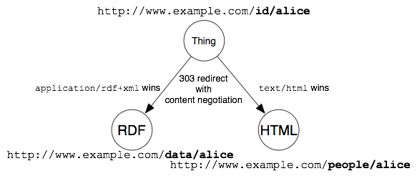
Content negotiation
We dereference a URI for a non-information resource (vase, temple, plant) and say whether we want a human-readable web page (text/html) or machine-readable metadata (e.g. text/turtle or application/rdf+xml). The server uses a 303 redirect to send us to the right URI for an information resource about the non-information resource.
How can we make this happen????

Slide 8
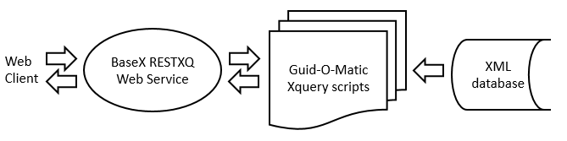
Guid-O-Matic web service with content negotiation
New blog post at http://baskauf.blogspot.com/2017/03/a-web-service-with-content-negotiation.html
Runs on localhost (local computer), not on Internet (yet). URIs start with http://localhost:8984/

Slide 9
Test G-O-M server
Browser: What does it ask for? http://localhost:8984/header
Turn on Developer tools and reload.
Test with curl or Advanced REST Client:
http://localhost:8984/Lingyansi
Accept: text/html
Using curl: curl -v -H "Accept:text/html" http://localhost:8984/Lingyansi
Let it follow it's nose:
Using curl: curl -v -L -H "Accept:text/html" http://localhost:8984/Lingyansi
Try machine-readable (turtle):
Using curl: curl -v -L -H "Accept:text/turtle" http://localhost:8984/Lingyansi

Slide 10
This is not what we want !?!
Eventually Tracy will get some domain name where her data will be served from, e.g.
http://lod.vanderbilt.edu/historyart/site/
will replace
http://localhost:8984/
so that
http://lod.vanderbilt.edu/historyart/site/Lingyansi
will produce the result that we currently get from
http://localhost:8984/Lingyansi
on the local computer. Then Linked Data clients can discover more stuff by "following their nose".

Slide 11
Things we would like to enable a "machine" to do with Linked Data
Acquire data from other sources, possibly by following links.
Merge those data with our data
"Learn" things that weren't apparent before the data were merged.
Expose our data in a way that would allow others to use it.
The first three items are what we do with a Web browser and our brains via documents and the World Wide Web. In this group, we want to figure out how to do the same thing automatically with software.

Slide 12
Discovery of information about RDF Datasets

Slide 13
More nose following: VoID (Vocabulary of Interlinked Datasets)
The VoID vocabulary is concerned with metadata about RDF datsets.
It is not a W3C Recommendation, but is widely used and is documented with a W3C Interest Group Note: https://www.w3.org/TR/void/
The goal is to allow a Linked Data client to discover a VoID dataset description that will help it to determine the fitness of use and to discover all of the resources in that dataset.
We could use this triple:
<http://lod.vanderbilt.edu/historyart/site/Lingyansi> void:inDataset <http://lod.vanderbilt.edu/historyart/site/>.
to lead a client to the VoID dataset description.

Slide 14
Example of a VoID description
This description is online at http://bioimages.vanderbilt.edu/index.rdf as RDF/XML (serialized here as Turtle). I once hoped that the server could be set up to lead clients to this file via content negotiation for http://bioimages.vanderbilt.edu/
<http://bioimages.vanderbilt.edu/> dcterms:created "2002-10-21"; dcterms:creator <http://biocol.org/urn:lsid:biocol.org:col:35115>; dcterms:description "This collection contains approximately 13 000 images, primarily of live plants, although a few other organisms are represented. There are also a number of images of North American ecoregions."; dcterms:publisher <http://biocol.org/urn:lsid:biocol.org:col:35115>; dcterms:title "Bioimages image database"; dcterms:type <http://purl.org/dc/dcmitype/Dataset>; void:exampleResource <http://bioimages.vanderbilt.edu/baskauf/66921>, <http://bioimages.vanderbilt.edu/ind-baskauf/67304>; void:rootResource <http://bioimages.vanderbilt.edu/rdf/images.rss>, <http://bioimages.vanderbilt.edu/rdf/individuals.rss>; a void:Dataset; rdfs:seeAlso <http://bioimages.vanderbilt.edu/rdf/images.rss>, <http://bioimages.vanderbilt.edu/rdf/individuals.rss>; foaf:homepage <http://bioimages.vanderbilt.edu/index.htm>; foaf:isPrimaryTopicOf <http://bioimages.vanderbilt.edu/index.htm>, <http://bioimages.vanderbilt.edu/index.rdf>.
<http://bioimages.vanderbilt.edu/index.rdf> dcterms:language "en"; dc:format "application/rdf+xml";
dcterms:modified "2015-05-22"; dcterms:references <http://bioimages.vanderbilt.edu/>.

Slide 15
More stuff to put in the VoID description
The data are available at a SPARQL endpoint:
<http://bioimages.vanderbilt.edu/> void:sparqlEndpoint <http://rdf.library.vanderbilt.edu/sparql>.
The data are available as a data dump at:
<http://bioimages.vanderbilt.edu/> void:dataDump <https://github.com/baskaufs/Bioimages/raw/master/bioimages-rdf.zip>.

Slide 16
Discovery of information about triplestores (SPARQL endpoints)

Slide 17
SPARQL 1.1 Service Description Recommendation
A W3C Recommendation from 2013: https://www.w3.org/TR/sparql11-service-description/
Let's look at the description for http://rdf.library.vanderbilt.edu/sparql using Postman
Notice the properties from the service description vocabulary
Notice the instance of http://www.w3.org/ns/ldp#RDFSource (more later)
Try http://localhost:9999/blazegraph/sparql
Notice this provides a ton of info on the default graph.
How does one control what an endpoint reports?

Slide 18
Existential question: What is http://bioimages.vanderbilt.edu/ ?
a void:Dataset ? (must be RDF triples)
a dcmitype:Dataset ? (can be a dataset in any form)
a website ?
the images in a website?
More questions:
Who owns it? (Copyright)
What is the license for it? (CC0 for data, not for images)

Slide 19
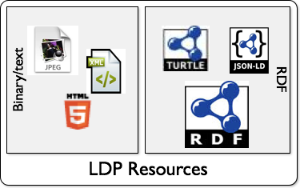
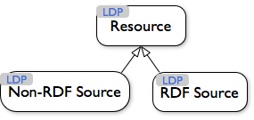
W3C Linked Data Platform (LDP)
W3C Recommendation 2015 https://www.w3.org/TR/ldp/
Vocabulary at https://www.w3.org/ns/ldp
Primer at https://www.w3.org/TR/ldp-primer/
Best practices at https://www.w3.org/TR/ldp-bp/
Describes "containers"
Images © W3C https://www.w3.org/TR/ldp/

Slide 20
W3C Linked Data Platform (LDP) continued
See Section 5.1 for description of containers: "There are multiple types of containers defined to support a variety of use cases, all that support a base set of capabilities. The contents of a container is defined by a set of triples in its representation (and state) called the containment triples that follow a fixed pattern. "
HTTP Link header used by servers to assert their support of LDP specification (more than a web server):
see https://www.w3.org/TR/ldp/#ldpc-container
Turtle required as a response type. JSON-LD must be supported if asked for.
Does anybody use this? Where? How?

Slide 21
W3C Data Catalog Vocabulary (DCAT) Recommendation
Recommendation in 2014 https://www.w3.org/TR/vocab-dcat/
A data catalog describes datasets and distributions
A dataset is a collection of data from a single provider, available for access or download
A distribution is a specific available form of a dataset (e.g. downloadable CSV, API, SPARQL endpoint)
catalog-> dataset -> distribution -> download URL/accessURL
How many people actually use this? Where? How?

Slide 22
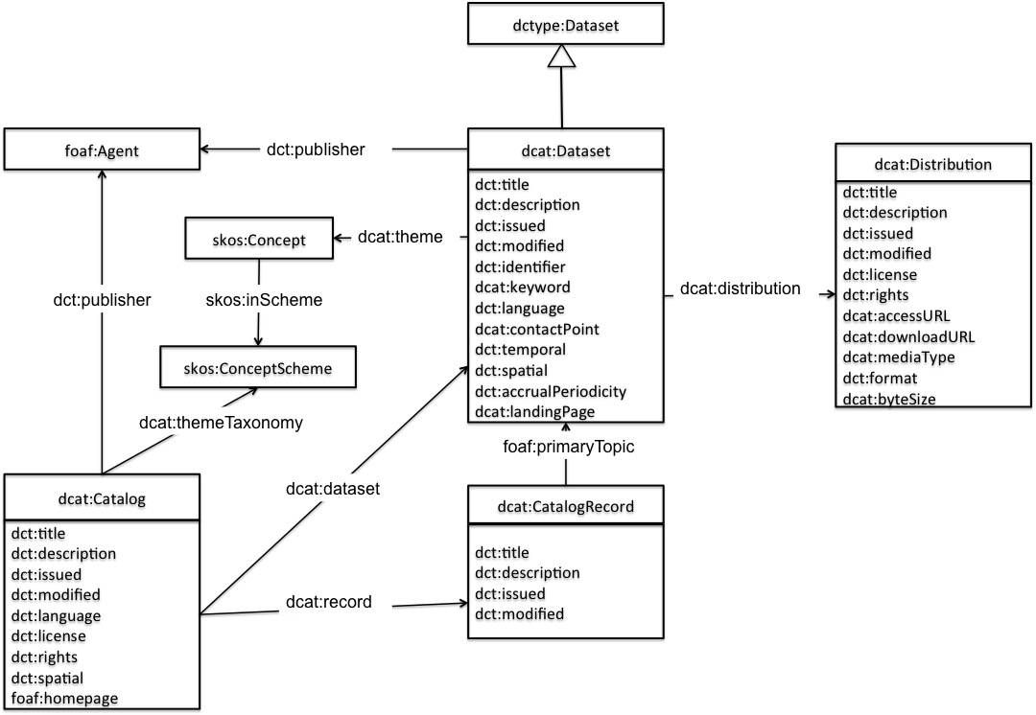
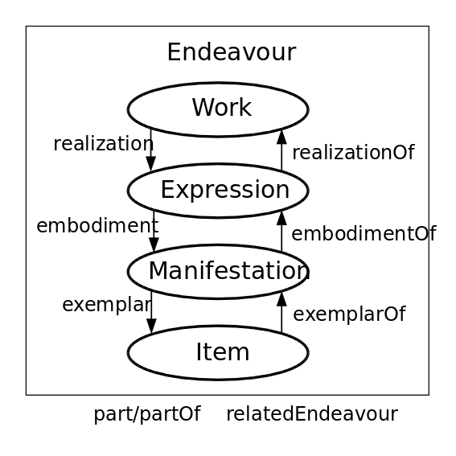
Compare DCAT model with FRBR
W3C Data Catalog Vocabulary (DCAT) model
Functional Requirements for Bibliographic Records (FRBR) model

