Slide 1
Building Web Apps from RDF Data
Steve Baskauf 2017-04-10

Slide 2
Today:
Look at how I hacked the Chinese temple web page to make a map of temple locations.
Hear from Winona Salesky about how she is using SPARQL results from Dave Michaelson's syriaca.org data.
See how I "munged" Veronica's data using Xquery to link the vase metadata to the scene controlled vocabulary that we created.
Try to hack the Chinese temple web page to retrieve vase data.

Slide 3
1. Mapping the Chinese temples

Slide 4
Accessing the web page and script
Run it at
http://bioimages.vanderbilt.edu/building-map.html
Download building-map.html and building-map.js from
https://github.com/HeardLibrary/semantic-web/tree/master/2016-fall/tang-song
Double-click to load into browser; load both files into text editor to hack.

Slide 5

querying process (via HTTP)
Remote client
GET http://rdf.library.vanderbilt.edu/sparql?query=SELECT+%3Fplace+WHERE+%7B%0D%0A++++%3Fplace+a+geo%3ASpatialThing.%0D%0A+++++%7D%0D%0A
ACCEPT: application/sparql-results+xml
<?xml version='1.0' encoding='UTF-8'?>
<sparql xmlns='http://www.w3.org/2005/sparql-results#'>
<head>
<variable name='place'/>
</head>
<results>
<result>
<binding name='place'>
<uri>http://lod.vanderbilt.edu/historyart/site/Anchansi</uri>
</binding>
</result>
…
Image from Clipart Panda
"API"
"endpoint"
triple store (graph database)
http://rdf.library.vanderbilt.edu/sparql
http://example.org/Lingyansi
"Tang to Qing"@en
a geo:SpatialThing
rdfs:label
rdf:value
"灵岩寺"@zh-Hans
dcterms:temporal
_:edbde6f9-62f0-4922-a1f3-e4bfa379303d
a dcterms:PeriodOfTime
Application (Callimachus/Blazegraph)

Slide 6
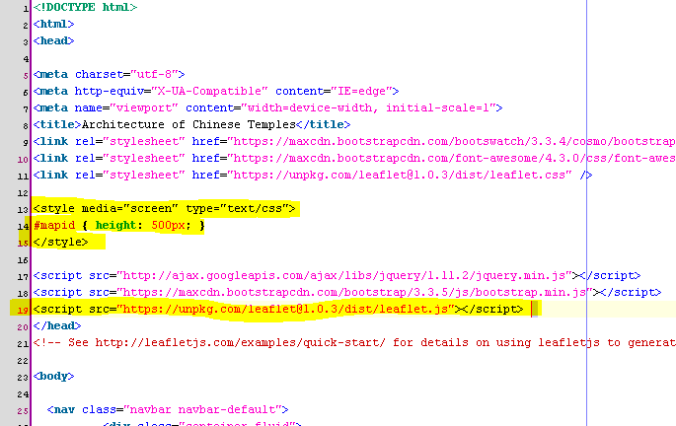
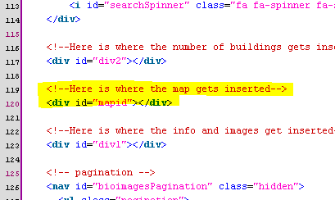
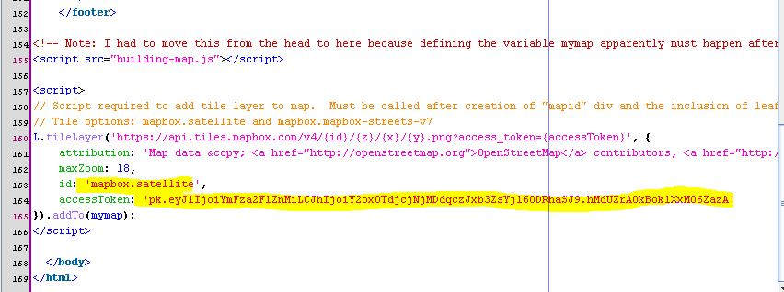
Set up the HTML for leaflet.js
Pick a canned map tile style.
Need to sign up for a Mapbox access token.

Slide 7

Client/SPARQL endpoint interactions: menu setup
What provinces are in the data?
Fujian, Gansu, Guangdong, …
…
What sites are in province, dynasty?
Image from Clipart Panda
Anchan Monastery, Baiyu Palace, …
…
Client software
(Javascript)
Image from Clipart Kid
Triple store

Slide 8
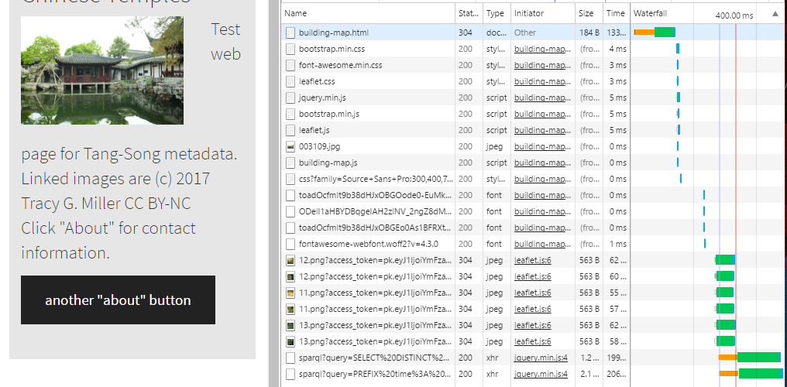
Page load "waterfall"
Load the map tiles
SPARQL query to get province names
SPARQL query to get site information

Slide 9
Client/SPARQL endpoint interactions: Search button click
Find buildings at site; give names, lat/long
List names.
Retrieve Google maps for lat/long.
Put drop pin on map.
What images are there for that building?
Retrieve thumbs from Flickr
Image from Clipart Panda
Client software
(Javascript)
4831068639_b3110fc98a_b.jpg, …
…
Image from Clipart Kid
Triple store
Main Hall, Mountain Gate, …
…

Slide 10
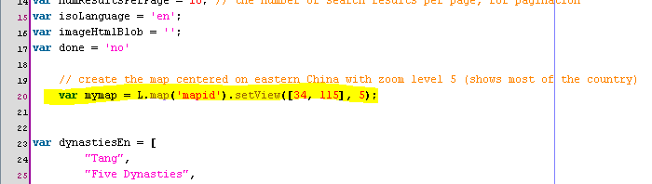
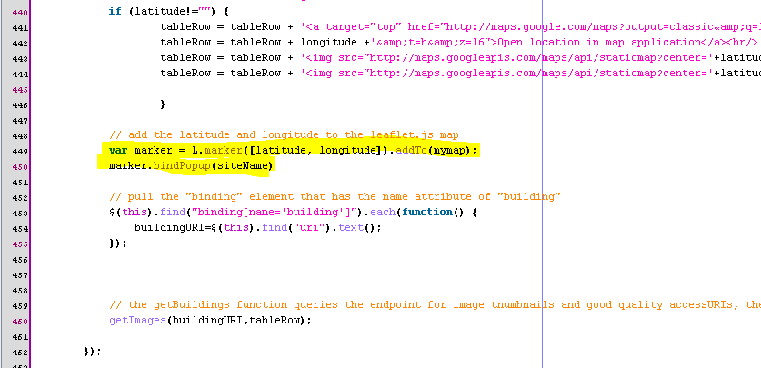
Javascript to insert map and markers
For whatever reason, this method doesn't work inside a jQuery function. The "clear markers method doesn't either!
Fortunately, the methods to insert a marker do.

Slide 11
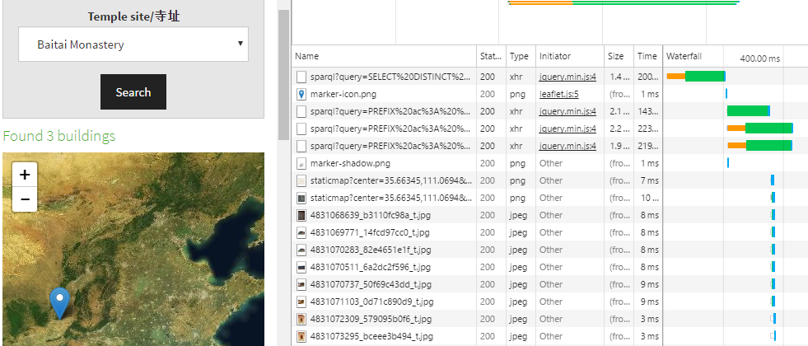
Search button "waterfall"
SPARQL query to get buildings at site
SPARQL queries to get data on each of the three buildings at the site
Put the marker on the map
Load the thumbnails for the Flickr images
So far I have failed to be able to clear the markers except by reloading the page! ☹

Slide 12
2. Winona's turn

Slide 13
Visualizations for Syriaca.org
http://wwwb.library.vanderbilt.edu/exist/apps/srophe/spear/browse.html?view=relations
http://wwwb.library.vanderbilt.edu/exist/apps/srophe/modules/d3sparql/index.html

Slide 14
3. Munging the vase data

Slide 15
Graph for Veronica's vase data
vase
side A
side B
a scene
a scene
possibly
another scene

Slide 16
(vase)
http://lod.vanderbilt.edu/vase/08-6q
a dcterms:PhysicalResource
crm:P59_has_section
(side)
_:bnode1
a crm:E46_Section_Definition
geo:location
(scene)
_:bnode2
a scene type
a crm:E38_Image
has

Slide 17
Controlled vocabulary
apulianscene:Dionysiac
a skos:Concept
skos:prefLabel "Dionysiac"@en
skos:broader
apulianscene:processionDionysiac
a skos:Concept
skos:prefLabel "Procession (Dionysiac)"@en
skos:broader
Cannot create link to a blank node in a separate file !!!!
apulianscene:DiningDionysiac
dcterms:subject
a skos:Concept
skos:prefLabel "Dining (Dionysiac)"@en
Dataset
_:bnode2
a crm:E38_Image
"DINING (DIONYSIAC)"
dc:subject
(scene)

Slide 18
http://lod.vanderbilt.edu/vase/08-6q
http://lod.vanderbilt.edu/vase/08-6q
a dcterms:PhysicalResource
a dcterms:PhysicalResource
(vase)
(vase)
crm:P59_has_section
crm:P59_has_section
_:bnode1
http://lod.vanderbilt.edu/vase/08-6q#a
a crm:E46_Section_Definition
a crm:E46_Section_Definition
(side)
(side)
geo:location
geo:location
_:bnode2
http://lod.vanderbilt.edu/scene/17b12dfd-7e0d-41d3-a3e9-e22ffc9b27c0
a crm:E38_Image
a crm:E38_Image
(scene)
(scene)
UUID generator:
https://github.com/HeardLibrary/semantic-web/blob/master/vase/scene-only/uuid.xlsx

Slide 19
What needs to be matched?
Scene RDF/Turtle:
<http://lod.vanderbilt.edu/scene/2c7bca52-7bc6-4d9f-99b1-8d73aa067187>
geo:location <http://lod.vanderbilt.edu/vase/6-95#a>;
dcterms:identifier "2c7bca52-7bc6-4d9f-99b1-8d73aa067187";
dc:subject "DINING (DIONYSIAC), THEATER (?)";
dcterms:description "A young satyr stands facing R holding an oinochoe and a kalathos, a reclining, torso-nude youth ..."@en;
rdfs:comment "A young satyr stands facing R holding an oinochoe and a kalathos, a reclining, torso-nude youth with ..."@en;
a crm:E38_Image.
Controlled vocabulary RDF/Turtle:
<http://lod.vanderbilt.edu/apulian/scene/DiningDionysiac>
skos:inScheme apulianscene:;
rdfs:isDefinedBy apulianscene:;
rdfs:label "DINING (DIONYSIAC)";
skos:prefLabel "DINING (DIONYSIAC)";
skos:hiddenLabel "DINING(DIONYSIAC)";
skos:broader apulianscene:Dining;
skos:broader apulianscene:Dionysiac;
rdfs:comment "At least one figure - usually male - reclining on a dining couch with Dionysiac accoutrements ..."@en;
skos:definition "At least one figure - usually male - reclining on a dining couch with Dionysiac accoutrements ..."@en;
a skos:Concept.

Slide 20
Xquery script to match and generate links
https://github.com/HeardLibrary/semantic-web/blob/master/vase/scene-cv/munge-vase.xq
(: Read in the CSV files :)
let $metadataDoc := file:read-text('file:///c:/github/semantic-web/vase/vase-only/vase.csv')
let $xmlMetadata := csv:parse($metadataDoc, map { 'header' : true(),'separator' : ',' })
let $vaseMetadata := $xmlMetadata/csv/record
let $metadataDoc := file:read-text('file:///c:/github/semantic-web/vase/scene-cv/scene.csv')
let $xmlMetadata := csv:parse($metadataDoc, map { 'header' : true(),'separator' : ',' })
let $cvData := $xmlMetadata/csv/record

Slide 21
Xquery script (cont.)
(: Construct XML about the vase sides :)
let $vases :=
for $vase in $vaseMetadata
return <vase>
<vase-id>{$vase/local_unique_identifier/text()}</vase-id>
<side>{
<side-id>{$vase/side_A_identifier/text()}</side-id>,
for $scene in tokenize($vase/SCENE_TYPE_A/text(),',')
return (<cv-string>{functx:trim($scene)}</cv-string>)
}</side>
<side>{
<side-id>{$vase/side_B_identifier/text()}</side-id>,
for $scene in tokenize($vase/SCENE_TYPE_B/text(),',')
return <cv-string>{functx:trim($scene)}</cv-string>
}</side>
</vase>
Resulting XML:
<vase>
<vase-id>01-1qq</vase-id>
<side>
<side-id>ca767657-be1c-4488-aa1d-24602729a4ce</side-id>
<cv-string>THEATER</cv-string>
<cv-string>DIONYSOS</cv-string>
</side>
<side>
<side-id>1ef29793-f2c9-46d9-b139-fe57ec5e8e8e</side-id>
<cv-string>PROCESSION (DIONYSIAC)</cv-string>
</side>
</vase>

Slide 22
Xquery script (cont.)
return
(: Output a single string that is the Turtle (actually, Ntriples) file. :)
file:write-text("c:\github\semantic-web\vase\scene-cv\cv-link.ttl",string-join
(
for $side in $vases//side, $cv in $cvData
where $cv//pref_label/text() = $side//cv-string/text() or $cv//alt_label/text() = $side//cv-string/text() or $cv//hide_label/text() = $side//cv-string/text()
return concat("<http://lod.vanderbilt.edu/scene/",$side//side-id/text(),"> <http://purl.org/dc/terms/subject> <http://lod.vanderbilt.edu/apulian/scene/",$cv//local_name/text(),'>.&#xa;')
)
)
Resulting RDF/Ntriples:
<http://lod.vanderbilt.edu/scene/9fd59d8c-e071-45b6-b921-54fb5fd0532a> <http://purl.org/dc/terms/subject> <http://lod.vanderbilt.edu/apulian/scene/Mythological>.
<http://lod.vanderbilt.edu/scene/9fd59d8c-e071-45b6-b921-54fb5fd0532a> <http://purl.org/dc/terms/subject> <http://lod.vanderbilt.edu/apulian/scene/ProcessionDionysiac>.
<http://lod.vanderbilt.edu/scene/85f85fc0-d47a-4cb7-809f-c9bc3ad17475> <http://purl.org/dc/terms/subject> <http://lod.vanderbilt.edu/apulian/scene/Dining>.

Slide 23
4. Hack temple web page for vases

Slide 24
Vase graph model
http://lod.vanderbilt.edu/vase/08-6q
apulianscene:
a dcterms:PhysicalResource
a skos:ConceptScheme
(vase)
dc:date
(controlled
vocabulary)
skos:hasTopConcept
crm:P59_has_section
_:1 (-375 to -350)
a dcterms:PeriodOfTime
(date range)
http://lod.vanderbilt.edu/vase/08-6q#a
apulianscene:Dionysiac
a crm:E46_Section_Definition
a skos:Concept
(side)
(general
concept)
skos:broader
(use skos:broader*
for property path
including zero
steps)
geo:location
dcterms:subject
http://lod.vanderbilt.edu/scene/82672b9d-afb5-41bb-9967-2cb7cfef5e11
apulianscene:ProcessionDionysiac
a skos:Concept
a crm:E38_Image
(specific
concept)
(scene)

Slide 25
Run some queries at the Heard Library SPARQL endpoint
http://rdf.library.vanderbilt.edu/sparql?view
Note: the Callimachus SPARQL endpoint "remembers" CURIE prefix abbreviations (namespaces). Most endpoints don't. Here's all of the ones we are likely to need:
PREFIX rdf: <http://www.w3.org/1999/02/22-rdf-syntax-ns#>
PREFIX rdfs: <http://www.w3.org/2000/01/rdf-schema#>
PREFIX xsd: <http://www.w3.org/2001/XMLSchema#>
PREFIX skos: <http://www.w3.org/2004/02/skos/core#>
PREFIX dc: <http://purl.org/dc/elements/1.1/>
PREFIX dcterms: <http://purl.org/dc/terms/>
PREFIX schema: <http://schema.org/>
PREFIX foaf: <http://xmlns.com/foaf/0.1/>
PREFIX geo: <http://www.w3.org/2003/01/geo/wgs84_pos#>
PREFIX crm: <http://www.cidoc-crm.org/cidoc-crm/>
PREFIX gvp: <http://vocab.getty.edu/>
PREFIX dwc: <http://rs.tdwg.org/dwc/terms/>
PREFIX apulianscene: <http://lod.vanderbilt.edu/apulian/scene/>
PREFIX vase: <http://lod.vanderbilt.edu/vase/>
PREFIX scene: <http://lod.vanderbilt.edu/scene/>
select distinct ?class where {
vase:08-6q rdf:type ?class.
}
LIMIT 10

Slide 26
What aspects of vases/scenes do we want to screen by and retrieve?
Probably controlled vocabulary scene type terms
Maybe some aspects of the vase? (creator, museum, dates)
Retrieve Trendell ID, scene descriptions?

Slide 27
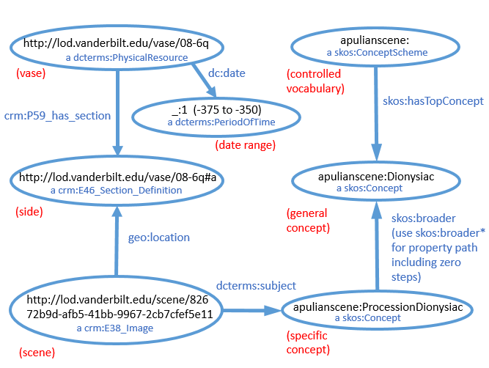
Compare query to graph model:
Each triple pattern in the query graph pattern represents one arrow in the graph model.
select distinct ?museum where {
?subject skos:broader* apulianscene:Battle.
?scene dcterms:subject ?subject.
?scene geo:location ?side.
?vase crm:P59_has_section ?side.
?vase dwc:collectionCode ?museum.
}
Any variable in here can be replaced by a string in the javascript.

Slide 28
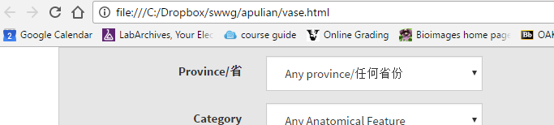
Hack the web page
The HTML page must be served from a http:// URL, not https:// (e.g. GitHub). It can also be loaded in your browser as a local file.
Here's the HTML that sets up the dropdown:
<div class="form-group">
<label for="box1" class="col-sm-4 control-label">Province/省</label>
<div class="col-sm-5">
<select name="provinceDropdown" id="box1" class="form-control">
<option value='?province' selected='selected'>Any province/任何省份</option>
</select>
</div>
</div>

Slide 29
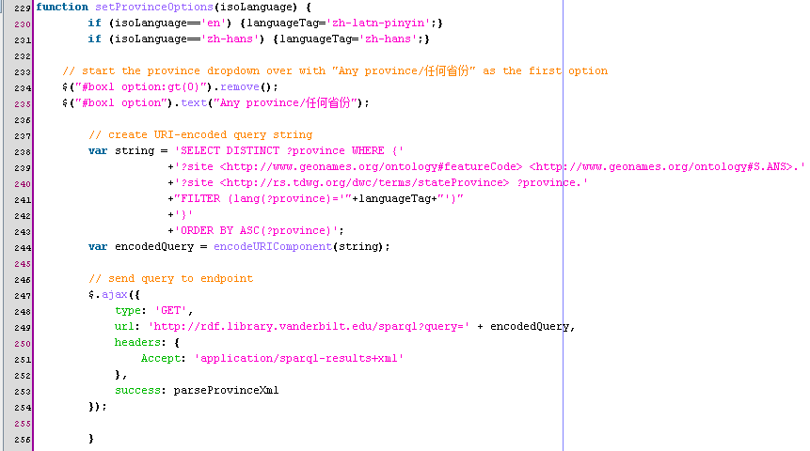
Hack the javascript (query)
Put in the SPARQL query that gets the dropdown options that you want:

Slide 30
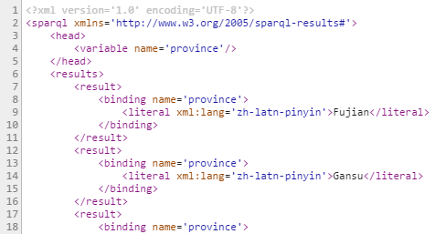
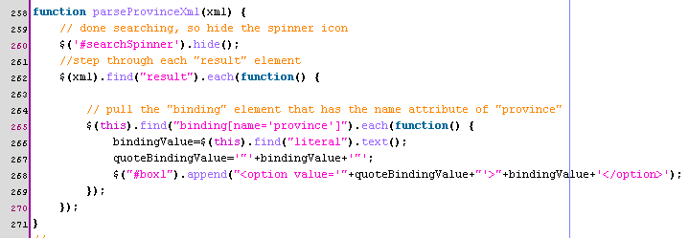
Hack the javascript (response)
XML is the only SPARQL response type supported by Callimachus. JSON =simpler
The binding name has to match the variable used in the query, e.g. "?province"
The resource type has to match, e.g. "uri" or "literal"

Slide 31
Hacking tools
Chrome developer tools, Console tab for errors.
alert("string"); Javascript to make a popup
Calamachus paste-in box to test Javascript-generated queries.

