Slide 1
SPARQL tests of vase data and named graphs
Steve Baskauf 2017-03-27

Slide 2
ex:Lingyansi
rdfs:label "灵岩寺"@zh-Hans;
dcterms:temporal _:2 ;
a geo:SpatialThing.
_:2 rdf:value "Tang Dynasty to Ching Dynasty"@en;
a dcterms:PeriodOfTime.
text document (serialized as RDF/Turtle)
loading process
http://example.org/Lingyansi
"Tang to Qing"@en
a geo:SpatialThing
rdfs:label
rdf:value
"灵岩寺"@zh-Hans
dcterms:temporal
_:edbde6f9-62f0-4922-a1f3-e4bfa379303d
a dcterms:PeriodOfTime
triple store (graph database)

Slide 3
Load two files into Blazegraph using the GUI interface
vase.ttl
scene-cv.ttl

Slide 4

querying process (via HTTP)
Remote client
GET http://rdf.library.vanderbilt.edu/sparql?query=SELECT+%3Fplace+WHERE+%7B%0D%0A++++%3Fplace+a+geo%3ASpatialThing.%0D%0A+++++%7D%0D%0A
ACCEPT: application/sparql-results+xml
<?xml version='1.0' encoding='UTF-8'?>
<sparql xmlns='http://www.w3.org/2005/sparql-results#'>
<head>
<variable name='place'/>
</head>
<results>
<result>
<binding name='place'>
<uri>http://lod.vanderbilt.edu/historyart/site/Anchansi</uri>
</binding>
</result>
…
Image from Clipart Panda
"API"
"endpoint"
triple store (graph database)
http://rdf.library.vanderbilt.edu/sparql
http://example.org/Lingyansi
"Tang to Qing"@en
a geo:SpatialThing
rdfs:label
rdf:value
"灵岩寺"@zh-Hans
dcterms:temporal
_:edbde6f9-62f0-4922-a1f3-e4bfa379303d
a dcterms:PeriodOfTime
Server application (Callimachus/Blazegraph)

Slide 5
Explore the scene controlled vocabulary
Query to find out what scene concepts are broader than AdornmentNuptial:
PREFIX apulianscene: <http://lod.vanderbilt.edu/apulian/scene/>
PREFIX skos: <http://www.w3.org/2004/02/skos/core#>
SELECT DISTINCT ?broaderConcept
WHERE {
apulianscene:AdornmentNuptial skos:broader ?broaderConcept.
}
Query to find out what scenes have Adornment as a broader concept:
PREFIX apulianscene: <http://lod.vanderbilt.edu/apulian/scene/>
PREFIX skos: <http://www.w3.org/2004/02/skos/core#>
SELECT DISTINCT ?narrowConcept
WHERE {
?narrowConcept skos:broader apulianscene:Adornment.
}
Property paths: add a star after skos:broader to include 0 steps.

Slide 6
Explore the vases
Query find some scenes:
PREFIX apulianscene: <http://lod.vanderbilt.edu/apulian/scene/>
PREFIX skos: <http://www.w3.org/2004/02/skos/core#>
PREFIX dc: <http://purl.org/dc/elements/1.1/>
PREFIX dcterms: <http://purl.org/dc/terms/>
PREFIX vase: <http://lod.Vanderbilt.edu/vase/>
PREFIX geo: <http://www.w3.org/2003/01/geo/wgs84_pos#>
PREFIX crm: <http://www.cidoc-crm.org/cidoc-crm/>
PREFIX rdfs: <http://www.w3.org/2000/01/rdf-schema#>
SELECT DISTINCT ?sceneDescription
WHERE {
?scene a crm:E38_Image.
?scene dcterms:description ?sceneDescription.
}
Query to find scenes with dc:subject of “MANTLE FIGRUES”:
SELECT DISTINCT ?sceneDescription
WHERE {
?scene a crm:E38_Image.
?scene dc:subject "MANTLE FIGURES".
?scene dcterms:description ?sceneDescription.
}

Slide 7
Explore the vases (cont.)
Query to find vases with scenes on either side with dc:subject of “MANTLE FIGRUES”:
SELECT DISTINCT ?trendallID
WHERE {
?scene a crm:E38_Image.
?scene dc:subject "MANTLE FIGURES".
?scene geo:location ?side.
?vase crm:P59_has_section ?side.
?vase dcterms:identifier ?trendallID.
}
Use regular expressions to find scene CV terms whose rdfs:label is included within the dc:subject string of a scene on a vase:
SELECT DISTINCT ?vaseSubject ?cvTerm
WHERE {
?scene a crm:E38_Image.
?scene dc:subject ?vaseSubject.
?cvTerm rdfs:label ?label.
FILTER regex(?vaseSubject, ?label)
}

Slide 8
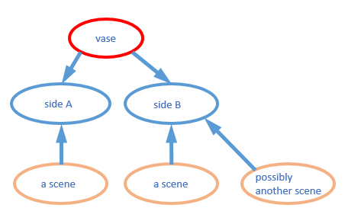
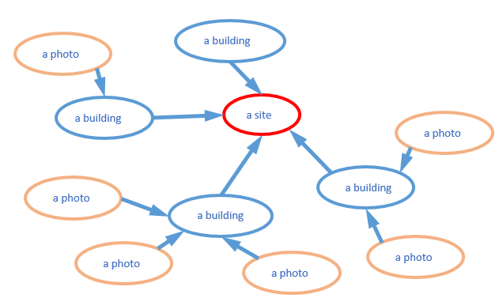
http://lod.vanderbilt.edu/apulian
http://lod.vanderbilt.edu/temple
Named graphs in the graph database (triple store)

Slide 9
Loading named graphs
Blog post discusses setting up, loading, and querying named graphs in 3 kinds of triplestores
http://baskauf.blogspot.com/2017/02/sparql-weirdness-of-unnamed-graphs.html
SPARQL query is for reading from a triplestore.
SPARQL update is for writing to a triplestore. (GUI is another option.)
LOAD <file:///c:/test/rdf/tang-song/tang-song.ttl> INTO GRAPH <http://tang-song/>
LOAD <file:///c:/test/rdf/bioimages/organisms.rdf> INTO GRAPH <http://bioimages.vanderbilt.edu/>

Slide 10
Querying named graphs
Query to find out what named graphs are in a triple store:
select distinct ?graph where {
GRAPH ?graph{?s ?p ?o.}
}
Query to find out what states are in the default dataset:
PREFIX dwc: <http://rs.tdwg.org/dwc/terms/>
SELECT DISTINCT ?state WHERE {
?s dwc:stateProvince ?state.
}
Restrict graph pattern to a particular named graph:
PREFIX dwc: <http://rs.tdwg.org/dwc/terms/>
SELECT DISTINCT ?state WHERE {
GRAPH <http://bioimages.vanderbilt.edu/> {?s dwc:stateProvince ?state.}
}

Slide 11
Querying named graphs (cont.)
Specify what graphs should constitute the default graph (applies to all triple patterns):
PREFIX dwc: <http://rs.tdwg.org/dwc/terms/>
SELECT DISTINCT ?state
FROM <http://bioimages.vanderbilt.edu/>
WHERE {
?s dwc:stateProvince ?state.
}
FROM NAMED keywords include a named graph in the default graph only when that graph is explicitly specified.

