Slide 1
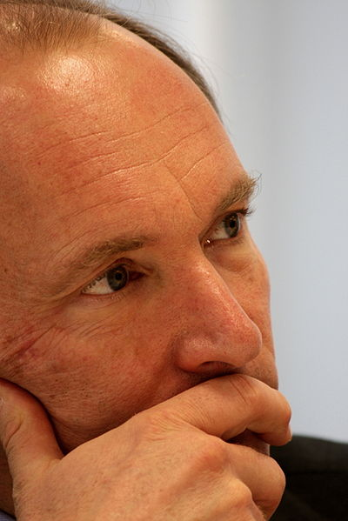
I have a dream
for the Web [in which computers] become capable of analyzing all the data on the Web – the content, links, and transactions between people and computers. A "Semantic Web", which makes this possible, has yet to emerge, but when it does, the day-to-day mechanisms of trade, bureaucracy and our daily lives will be handled by machines talking to machines. The "intelligent agents" people have touted for ages will finally materialize.
Tim Berners-Lee 1999
Image by Paul Clarke, Wikimedia Commons, CC-BY

Slide 2
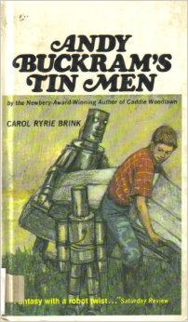
"It is not easy to build a robot, and only very clever boys should try it."
Carol Ryrie Brink (1966) Andy Buckram's Tin Men.
How cool would it be to make
the intelligent agents come
into existence ?!

Slide 3


The Baskauf Rule for Technology
Adopting new technology requires that it do something better than the old technology
W3C Resource Description Framework http://www.w3.org/RDF/
W3C Semantic Web Activity http://www.w3.org/2001/sw/ logos used according to usage guidelines

Slide 4
What does RDF and SPARQL do better than traditional databases and SQL?
If the answer is "nothing", then we shouldn't waste our time using it!

Slide 5
RDF is an abstract, graph-based model
Triples are represented in text as serializations.
Two serializations are W3C Recommendations:
XML (media type: application/rdf+xml)
Turtle (media type: text/turtle)
also RDFa and JSON-LD (but we won't look at these today)
RDF/XML plays well with XML tools like XSLT and Xquery, but isn't very readable
RDF/Turtle is easier for humans to read.
SPARQL is based on Turtle syntax.

Slide 6
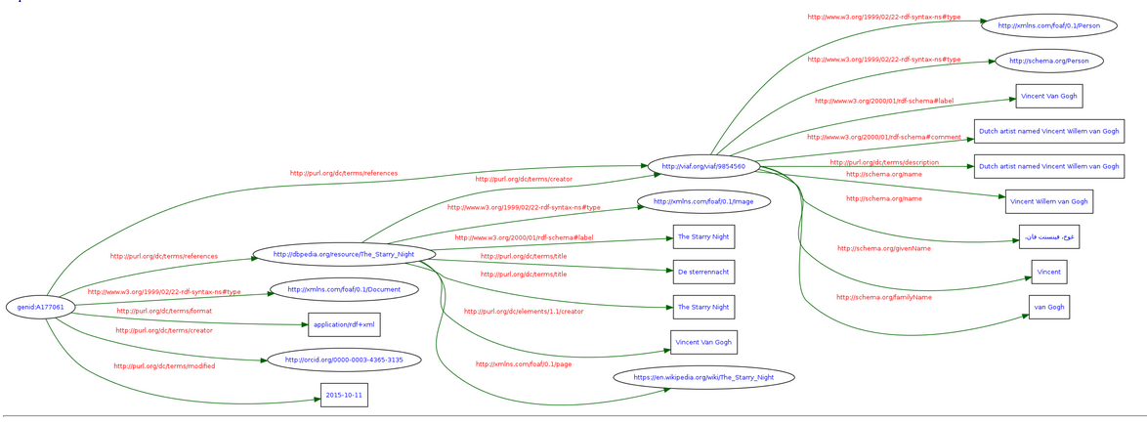
W3C RDF/XML Validation/visualization Service
http://www.w3.org/RDF/Validator/
Load RDF/XML file from
https://gist.github.com/baskaufs/609978f931b96c610f86
Graph model of data in van-gogh.rdf
IRIs=ovals, literals=rectangles, predicates=arrows

Slide 7
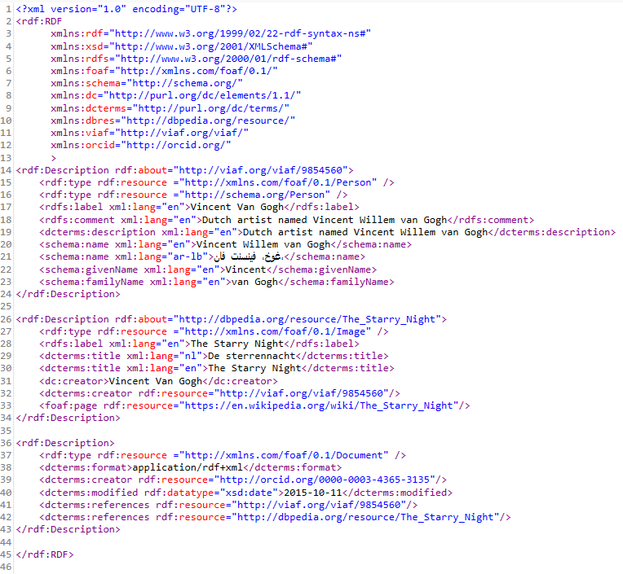
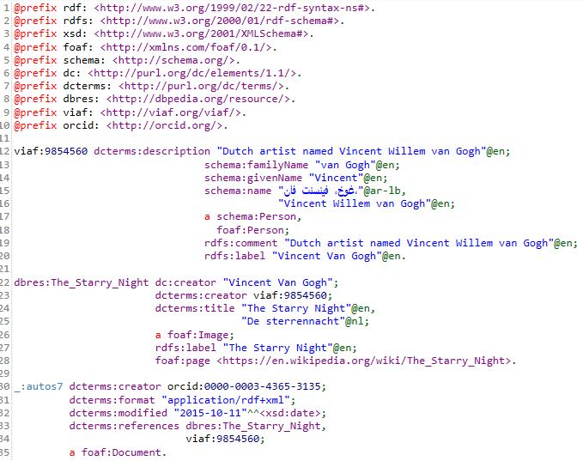
Serializations of the data
XML
Turtle
Namespace
abbreviations
abbreviated
IRIs
type
blank (anonymous) node

Slide 8
Database table
painting | painter | year
The Starry Night | Vincent van Gogh | 1889
Birth of Venus | Sandro Botticelli | 1485
<table>
<record>
<painting>The Starry Night</painting>
<painter>Vincent van Gogh</painter>
<year>1889</year>
</record>
<record>
<painting>Birth of Venus</painting>
<painter>Sandro Botticelli</painter>
<year>1485</year>
</record>
</table>
XML
IRIs denote resources.
The resource that is denoted is the referent.
RDF (Turtle serialization)
dbres:The_Starry_Night dcterms:creator viaf:9854560; dcterms:created "1889"^^xsd:gYear. <http://dbpedia.org/resource/The_Birth_of_Venus_(Botticelli)> dcterms:creator viaf:19686406; dcterms:created "1485"^^xsd:gYear.

Slide 9
RDF "means" something.
dbres:The_Starry_Night dcterms:creator viaf:9854560.
denotes the actual painting
entitled "The Starry Night"
denotes the actual person whose
name was "Vincent van Gogh"
denotes the relationship of a subject resource having a maker who is the object agent.

Slide 10
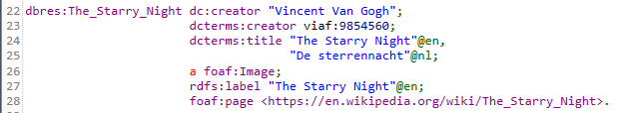
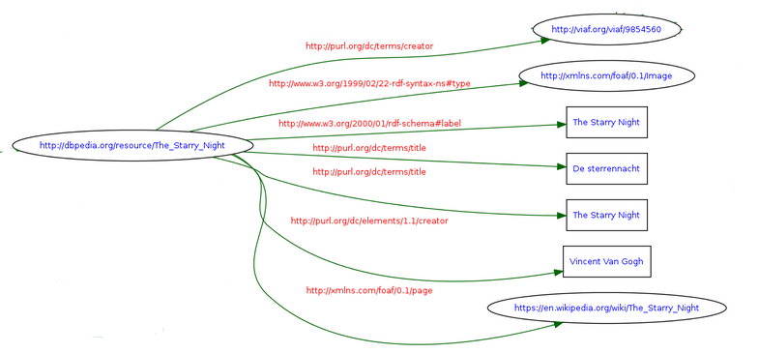
simple literal (denotes a string of characters with NO meaning)
IRI (denotes the person,
Vincent van Gogh)
non-information resource
(a painting;
not deliverable
via Internet)
information resource
(web page;
deliverable via Internet)

