Slide 1
Chapter 10: Simple Knowledge Organization System (SKOS)
A W3C Recommendation for organizing thesaruri and other similar things

Slide 2
What’s the difference between an ontology and a thesaurus?
An ontology is mostly for machines, while a thesaurus is mostly for people.
Ontologies deal with classes and properties. Thesauri deal with concepts.
The purpose of an ontology is to set out a formalized representation of the world. The purpose of an ontology is to help an indexer and a searcher choose the same term for the same concept.
Ontologies can be about real stuff; thesauri are about what’s in our heads.

Slide 3
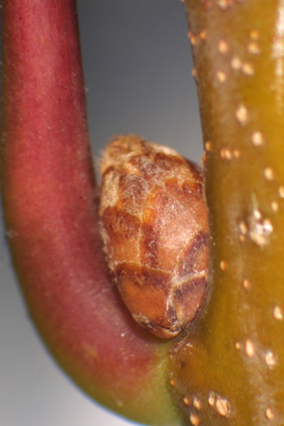
What’s this?
An ontology might say “it’s a still image”
<http://bioimages.vanderbilt.edu/baskauf/13155> rdf:type dcmitype:StillImage.
or
<http://bioimages.vanderbilt.edu/baskauf/13155> a dcmitype:StillImage.
A thesaurus might say “it’s a picture of an axillary bud”
<http://bioimages.vanderbilt.edu/baskauf/13155> Iptc4xmpExt:CVterm stdview:010303.

Slide 4
How are categories described in ontologies and thesauri?
The type (value of rdf:type; defined in an ontology):
dcmitype:StillImage
dcterms:description "Examples include paintings, drawings, graphic designs, plans and maps. Recommended best practice is to assign the type Text to images of textual materials. Instances of the type Still Image must also be describable as instances of the broader type Image."@en;
rdfs:comment "A static visual representation."@en;
rdfs:label "Still Image"@en;
rdfs:subClassOf dcmitype:Image;
a rdfs:Class.
The controlled value term (value of Iptc4xmpExt:CVterm; defined in a thesaurus):
stdview:010303
skos:definition "I.C.3. close-up of winter twig showing leaf scar and lateral bud (vertical orientation)"@en;
skos:prefLabel "close-up of winter twig showing leaf scar/bud "@en;
skos:inScheme stdview:01;
skos:broader stdview:0103;
a skos:Concept.

Slide 5
Entailments (RDFS and OWL vs. SKOS)
<http://bioimages.vanderbilt.edu/baskauf/13155> a dcmitype:StillImage.
entails
<http://bioimages.vanderbilt.edu/baskauf/13155> a dcmitype:Image.
because
dcmitype:StillImage rdfs:subclassOf dcmitype:Image.
“picture of an axillary bud”
<http://bioimages.vanderbilt.edu/baskauf/13155> Iptc4xmpExt:CVterm stdview:010303.
does not entail “twig”
<http://bioimages.vanderbilt.edu/baskauf/13155> Iptc4xmpExt:CVterm stdview:0103.
even though
stdview:010303 skos:broader stdview:0103.
But it suggests to you gently that the broader category might also be a good category for your picture.

Slide 6
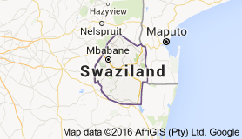
Getty Thesaurus of Geographic Names (TGN) vs. GeoNames
TGN defines skos:Concept instances; GeoNames defines gn:Feature instances.
tgn:7001725 is a concept about Swaziland (or maybe Swaziland’s name).
geon:934841 is the Kingdom of Swaziland (or maybe its location).
A SKOS concept can be linked to the thing it’s about using a property from the FOAF vocabulary:
tgn:7001725 foaf:focus geon:934841.

Slide 7
tgn: = <http://vocab.getty.edu/tgn/>
skos:ConceptScheme
tgn:
rdf:type
skos:inScheme
“Africa"@en
skos:prefLabel
tgn:7001242
skos:inScheme
rdf:type
skos:Concept
skos:broader
rdf:type
tgn:7001725
skos:prefLabel
skos:altLabel
skos:prefLabel
"Swaziland"@en
"Свазиленд"@ru
"Kingdom of Swaziland"@en

Slide 8
Other features
skos:hiddenLabel (when the label is “bad”)
skos:equivalentConcept (to relate the same concepts from different schemes)
skos:closeMatch (to relate similar concepts)
Subclass relationships between SKOS labels and rdfs:label
Semantic entailments among concept relations
Disjoint class declarations and other messy stuff
SKOSXL for provenance plus complex semantics

