Slide 1
Source Name
Every annotation table must start with the Source Name column, which defines the input of your table. This input value must be a unique identifier for an organism or a sample. The number of Source Name columns per table is limited to one.
Source Name
And continues here
Organism1
Annotated
workflow
Sample1
…
Workflow starts with these

Slide 2
Characteristic
Characteristic columns describe inherent properties of the source material, e.g., a certain strain or ecotype, but also the temperature an organism was exposed to. There is no limitation for the number of Characteristics columns per table.
Characteristics
name in
brackets
Source Name
Characteristic
Characteristic
[strain]
[Label text]
Organism1
Col0
If there is no
value for the
respective
source,
always leave
blank
Sample 1
smpl-1
…
…
…

Slide 3
Factor
Use Factor columns to track the experimental conditions that govern your study. Precisely, Factors describe independent variables that result in the respective output of your experiment when all remaining parameters for treatment and analysis were identical.
Most of the time, factors are the most important building blocks for downstream computational analysis.
Factor name in
brackets
Factor
[temperature]
32°C
Experimetnal
Pipeline
-80°C
…

Slide 4
Parameter
Parameter columns describe steps in your experimental workflow, e.g., the temperature or extraction buffer used for your assay. Multiple Parameter columns form a protocol. There is no limitation for the number of Parameter columns per table.
Parameter name
In brackets
Extraction protocol
Parameter
[Extraction buffer]
Parameter
[Extraction
buffer volume]
Parameter
[Temperature]
Parameter
[…]
Tris-HCl
10 ml
30 °C
…

Slide 5

Component
Use these columns to list anything physical of a protocol that can be consumed, e.g. instrument names, software names, or reagents names.
Component
[Software]
Component name
in brackets
Agilent MassHunter
…

Slide 6
Protocol Columns
Protocol Type columns define the type according to your preferred public repository. Use Protocol REF columns to reference the protocol used in this table. The number of columns for each subtype is limited to one per table. These columns extend control for protocol parsing.
A. thaliana growth protocol
Parameter
[Night
duration]
Parameter
[Day
duration]
Parameter
[Growth
duration]
Parameter
[…]
Protocol REF
A. thaliana
growth
protocol.txt
8h
16h
10 days
…

Slide 7


Output Columns
Output columns allow to specify the exact output for your process. Per table only one output column is allowed, which can either be a Sample Name, a Raw Data File or a Derived Data File. Data files can be sources for computational workflows. The value of this column must be a unique identifier.
Derived Data File
Sample Name
Raw Data File
Extract1
Ath1.wiff
Proc1.csv
Annotated
workflow
OR
annotated
Computational
analysis
Annotated
workflow
OR
OR
Lysate1
Ath2.wiff
Proc2.csv

Slide 8

Source Name
Every annotation table must start with the Source Name column, which defines the input of your table. This input value must be a unique identifier for an organism or a sample. The number of Source Name columns per table is limited to one.

Slide 9
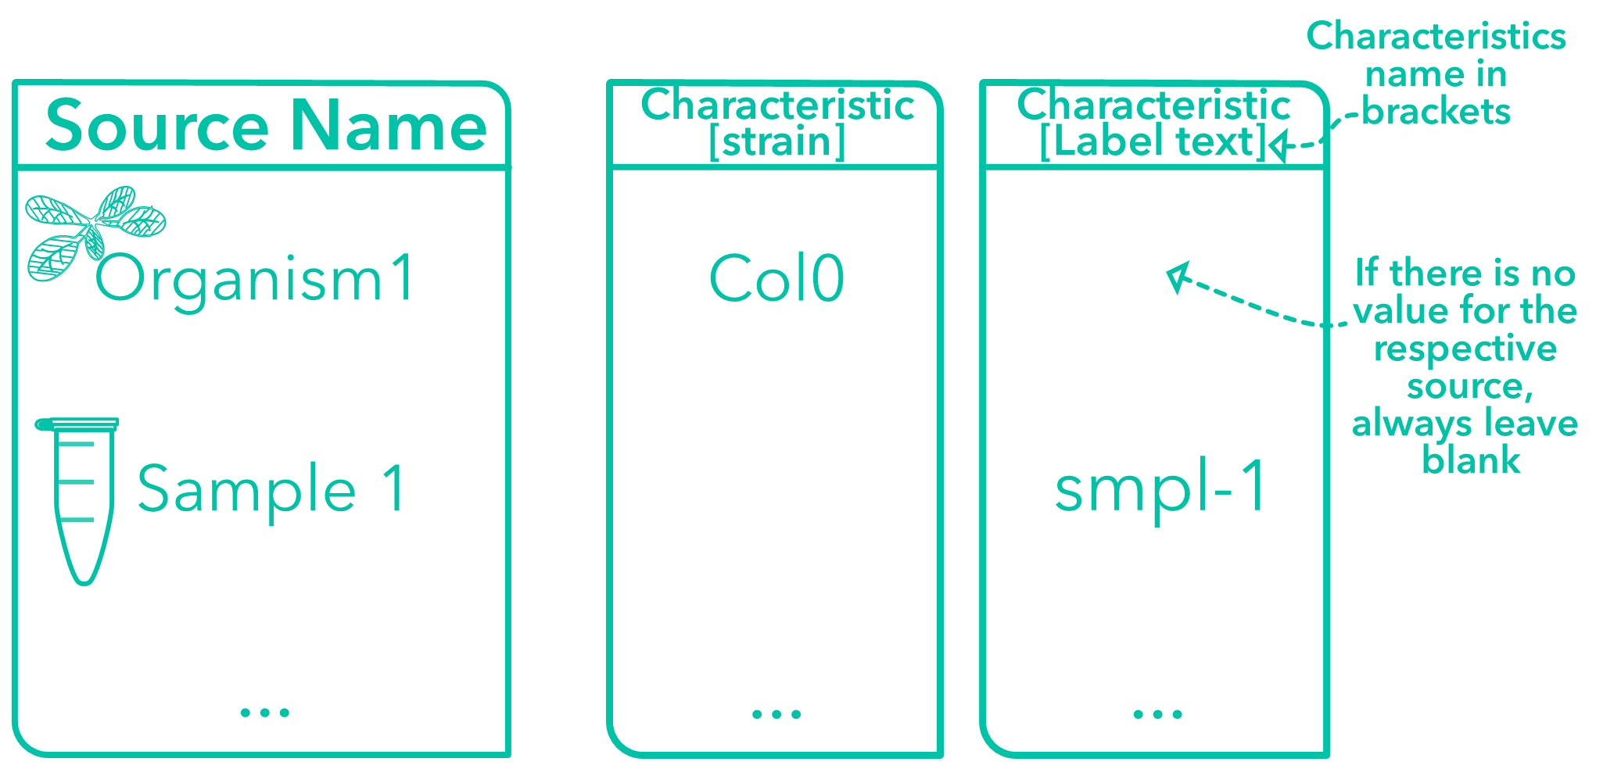
Characteristic
Characteristic columns describe inherent properties of the source material, e.g., a certain strain or ecotype, but also the temperature an organism was exposed to. There is no limitation for the number of Characteristic columns per table.

Slide 10

Factor
Use Factor columns to describe independent variables that determine the specific output of your experiment when process and analysis were identical. Most of the time, factors are the most important building blocks for downstream computational analysis.

Slide 11
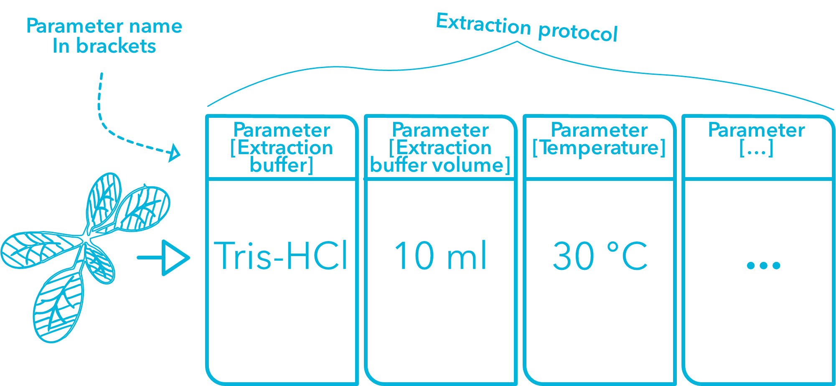
Parameter
Parameter columns describe steps in your experimental workflow, e.g., the temperature or extraction buffer used for your assay. Multiple Parameter columns form a protocol. There is no limitation for the number of Parameter columns per table.

Slide 12

Component
Use these columns to list anything physical of a protocol that can be consumed, e.g. instrument names, software names, or reagents names.

Slide 13
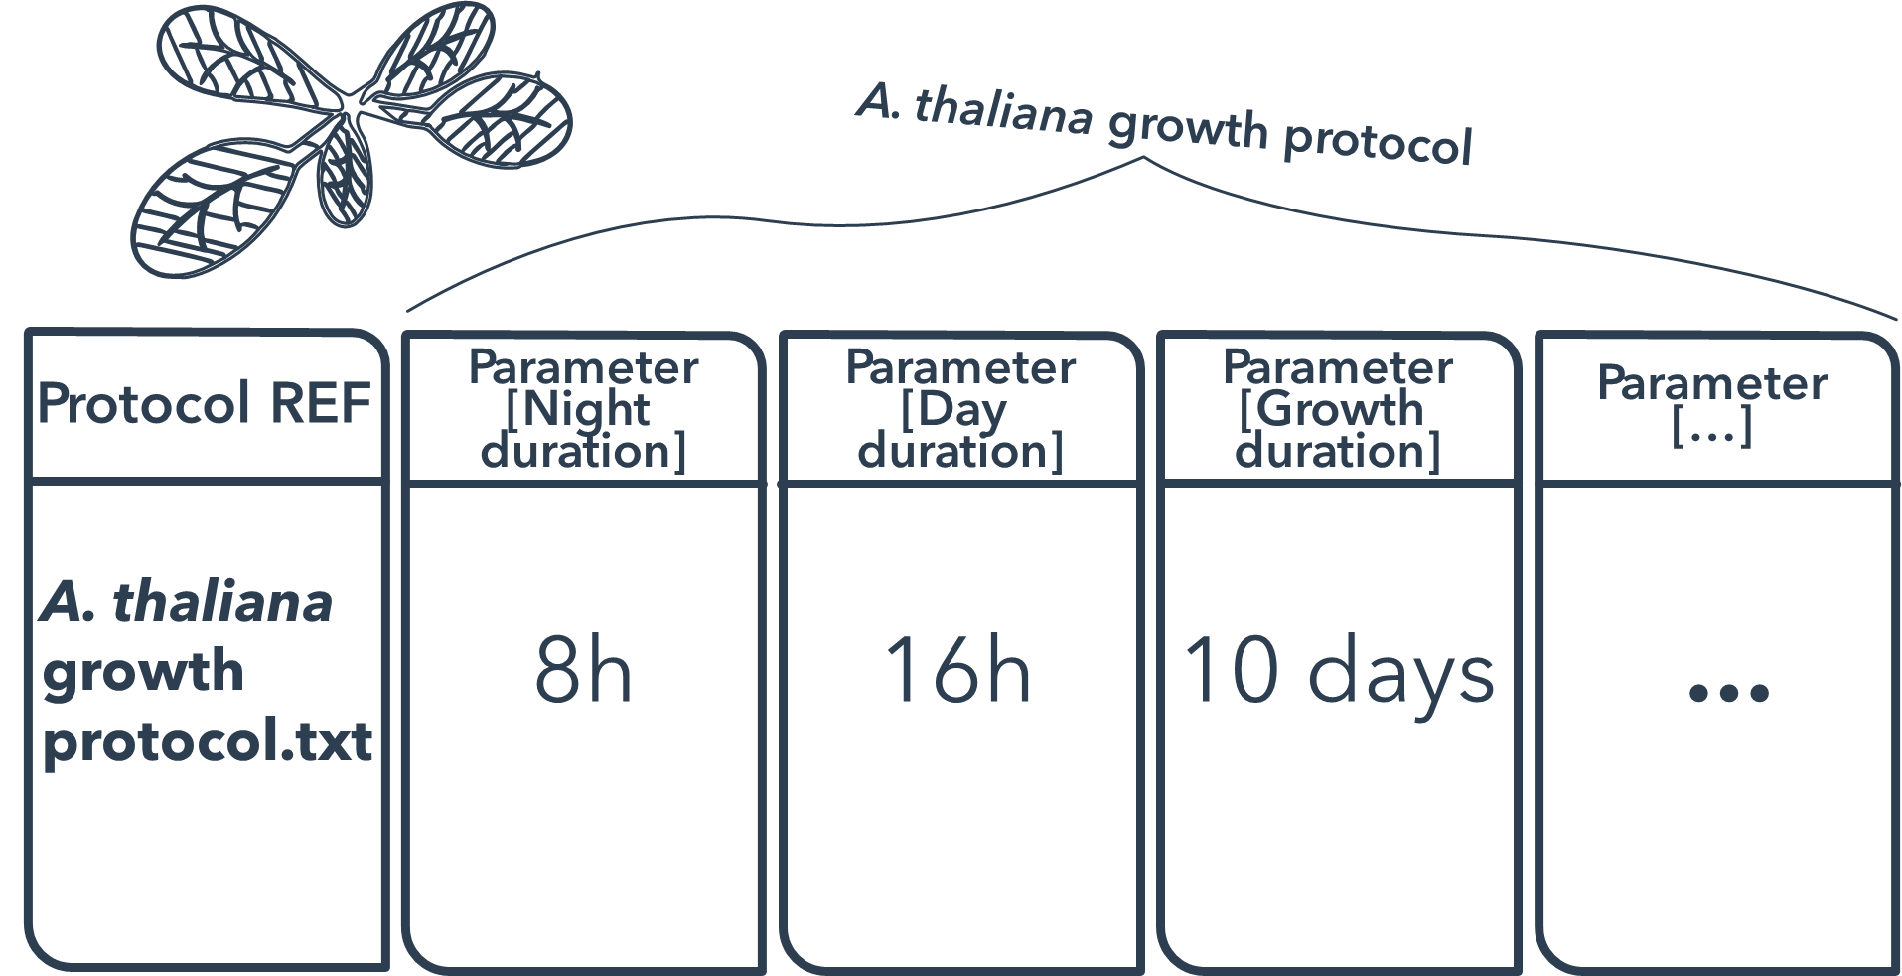
Protocol Columns
Protocol columns extend control for protocol parsing. Use Protocol REF columns to reference the protocol used in this table, i.e., the name of the protocol. Protocol Type columns define the type according to your preferred public repository, e.g., a growth protocol. The number of columns for each subtype is limited to one per table.

Slide 14

Output Columns
Output columns allow to specify the exact output for your process. Per table only one output column is allowed, which can either be a Sample Name, a Raw Data File or a Derived Data File. Data files can be sources for computational workflows. The value of this column must be a unique identifier.

Slide 15
