Slide 1


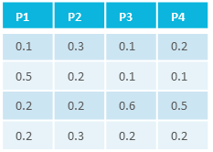


investigation
administrative metadata
Fig1
<study1>
resources
C₁
C₂
C₃
…
C_{n}
studies
…
protocols
sample material or data
<assay1>
dataset
P₁
P₂
P₃
…
P_{n}
intensity
assays
…
protocols
measurement data
m/z
<study/assay>
script / code / …
result files
workflows
<workflow1>
<run1>
CWL
…
<workflow1>
result files
<run2>
<workflow2>
runs
data files
computation / tools / processing
<run1>
…
CWL
Notes:
Figure: Folder and file layout in Annotated Research Contexts (ARCs, left) and schematic depictions of the respective content sections. The top-level investigation metadata file (investigation sollte top left damit I -> S -> A) contains administrative metadata about the whole ARC, e.g. the names of collaborators and the instututions they are part of. The studies folder (green) contains one or multiple study subfolders, which are used to track provenance of the contained resource and protocol files, as well as study metadata files that annotate the genesis of biological samples and other material (right). Analogously, the assays folder (yellow) contains one or multiple assay subfolders, which are used to track provenance of the contained datasets and protocol files, as well as assay metadata files that annotate the genesis of measurement data and other result files starting from study material or datasets (right). The workflows folder (blue) contains Common Workflow Language (CWL) descriptions of e.g. analysis scripts or tools, while the runs folder contains CWL descriptions of the actual analysis that was performed, therefore making the whole computational pipeline used in the ARC runnable and therefore reproducible.

Slide 2
Fig2
Source
Characteristic [organism]
Parameter [instrument model]
Data
Sp1
´Arabidopsis thaliana’
´TripleTOF4600’
sp1.raw
Sp2
´Arabidopsis thaliana’
´TripleTOF4600’
sp2.raw
Sp3
´Arabidopsis thaliana’
´TripleTOF4600’
sp3.raw
Sp4
´Arabidopsis thaliana’
´TripleTOF4600’
sp4.raw
Sp5
´Arabidopsis thaliana’
´TripleTOF4600’
sp5.raw
A
B
C
D
Notes:
ISA terms / table example

Slide 3





Fig3
ARC
clustering.cwl
output.xlsx
sequence-analysis.cwl
…
visualization.cwl
figure.pdf
…
CWL
<mapping routine>
workflows/
cluster.py
workflows/
plotting.R
Galaxy
local
Notes:
Automated workflows (QC and computational analysis)

Slide 4



Fig4
facility operator
add measurement dataset
fix dataset folder position
curator
add name of collaborator 1
main
set up new ARC
merge
collaborator name
merge
measurement
add analysis script
Notes:
Example ARC commit history The directed acyclic graph (DAG) of a simple commit-based work environment with 3 branches that eventually get merged into the main branch. Circles depict commits as nodes in the DAG. After the first commit in the main (bottom) branch named ‘Set up new ARC’, two new branches are created: c1-name, where a single commit is added that adds the name of a collaborator to the ARC metadata, and measurements, where two commits that place a dataset file in the ARC and fix its position. Both branches are eventually merged into the main branch with a merge commit. After incorporating the commits from the 2 branches, work continues directly on the main branch with a commit that adds an analysis script. Work on these branches is independent from each other until the merges and can be asynchronously performed by different collaborators.

Slide 5

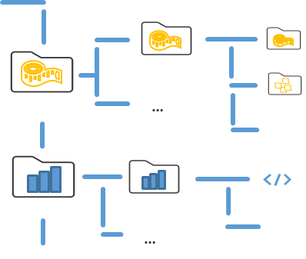
Fig5
local
PLANTdataHUB repository
ARC
Issues
facility operator
…
CWL
filing issues
…
individual project
ARC
Issues
….
….
….
Notes:
local ARC -> project on HUB (with repo and issues)

Slide 6
Fig6
PLANTdataHUB repository
ARC
no person records
set up new ARC
missing email
add contributor
all checks pass
High quality ARC
add email
QC badges
Notes:
Figure: Publication Flow
Left: Continuous Quality Control in a commit-based workflow. Circles depict commits as nodes in the direct acyclic graph (DAG) that comprises the commit history. Everytime changes are committed to the DAG, an event is triggered that causes the pipeline runner – a program that executes other quality control checking programs in the context of a given commit – to perform quality control measures and return the results (middle) as a report. Based on these results, corrective commits can be added to the DAG until all checks are passed. If that is the case, the ARC can be considered as being of (metadata) high quality and eligible for publication. The publication can then be triggered manually, which will export the ARC metadata as a metadata record to InvenioRDM, which will then issue a Digital Object Identifier (DOI, right)

Slide 7



Fig6
PLANTdataHUB repository
ARC
no person records
InvenioRDM
set up new ARC
missing email
add contributor
all checks pass
High quality ARC
ARC-Json
add email
QC badges
Notes:
Figure: Publication Flow
Left: Continuous Quality Control in a commit-based workflow. Circles depict commits as nodes in the direct acyclic graph (DAG) that comprises the commit history. Everytime changes are committed to the DAG, an event is triggered that causes the pipeline runner – a program that executes other quality control checking programs in the context of a given commit – to perform quality control measures and return the results (middle) as a report. Based on these results, corrective commits can be added to the DAG until all checks are passed. If that is the case, the ARC can be considered as being of (metadata) high quality and eligible for publication. The publication can then be triggered manually, which will export the ARC metadata as a metadata record to InvenioRDM, which will then issue a Digital Object Identifier (DOI, right)

Slide 8

Fig7
ARC tool chain
(D)
write
read
dataset search
(A)
(B)
ARC
(C)
ISA-Tab
CWL
ARC registry
data publication
Keycloak AAI
ARC-Json
endpoint repositories
GIT
on-premise platforms
Notes:
Ich denke hier braucht man (A) bis (D) labels, weil schon echt viel auf dem bild los ist.
Figure : The PLANTdataHUB platform infrastructure. (A) A Keycloak instance acts as a gateway Authorization and Authentication Infrastructure (AAI). Users can choose their identity provider of choice and use a unified account across all federated PLANTdataHUB instances. (B) The Git-based Annotated Research Context (ARC) is stored and hosted a central Gitlab instance that offers collaboration and project management tools. Additionally, many tools for working with ARCs, e.g. the ARC registry – a service for searching ARCs based on their metadata – are available. (C) ARCs can be exported to other endpoint repositories or to a connected InvenioRDM instance which issues DOIs for publication. (D) ??

Slide 9
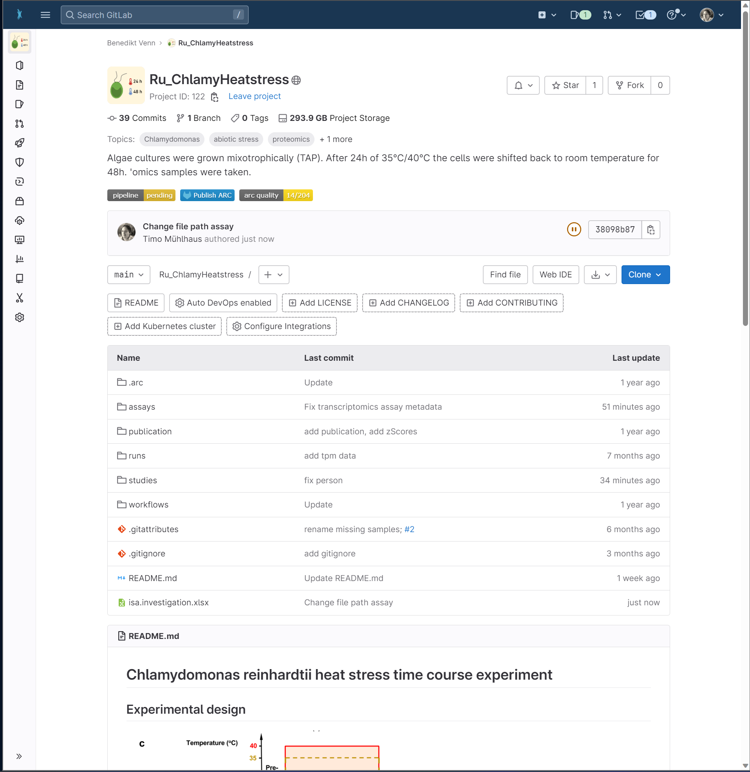
Fig8

Slide 10
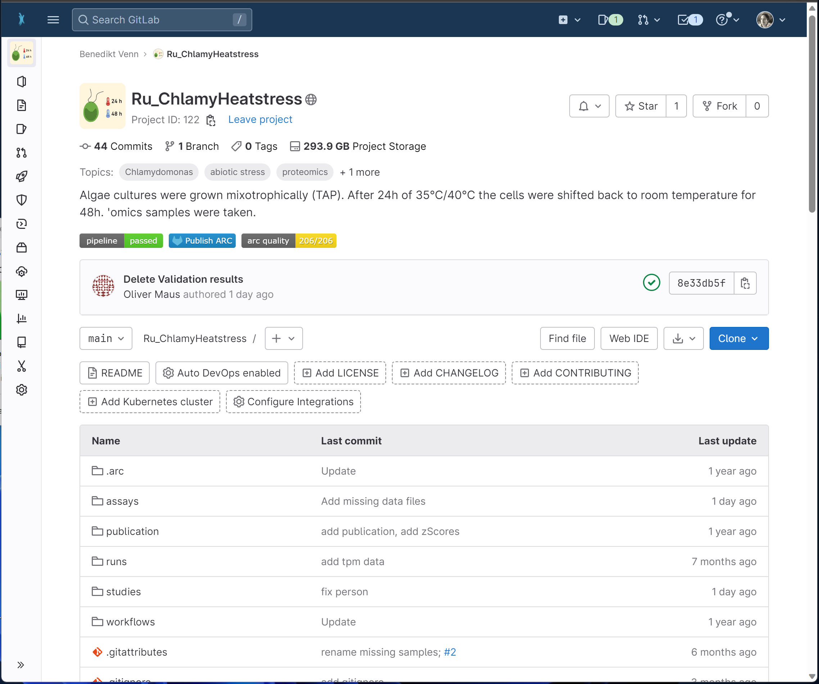

Slide 12
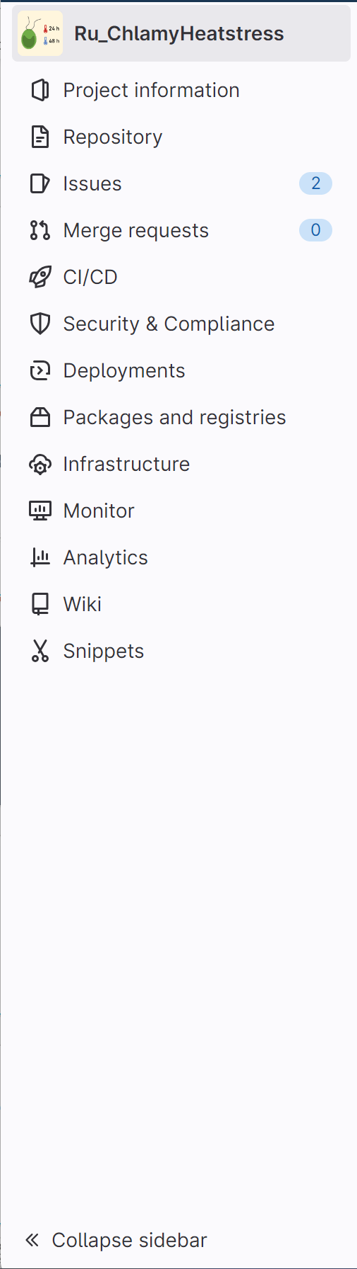
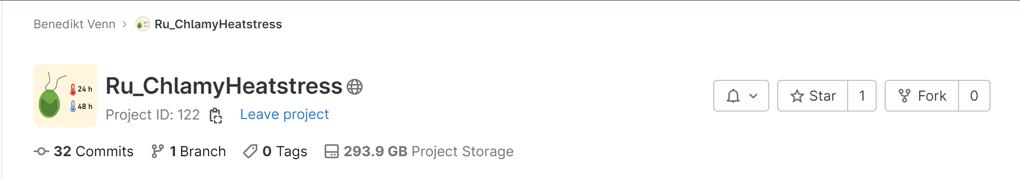
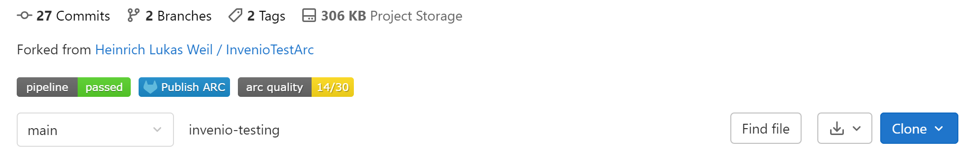
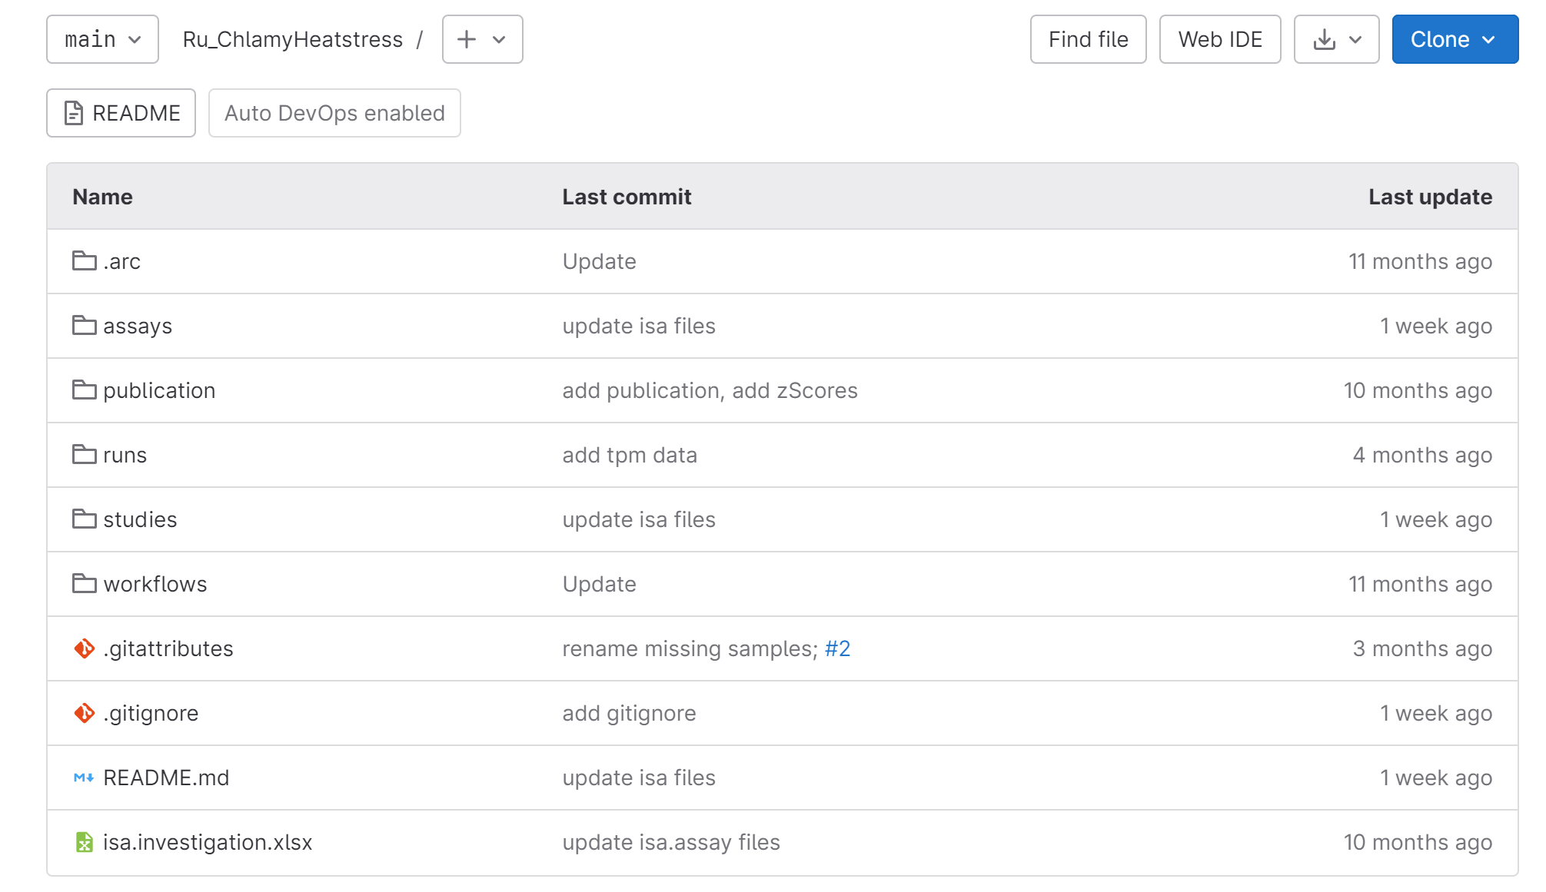
Gitlab as a collaborative research platform

Slide 13
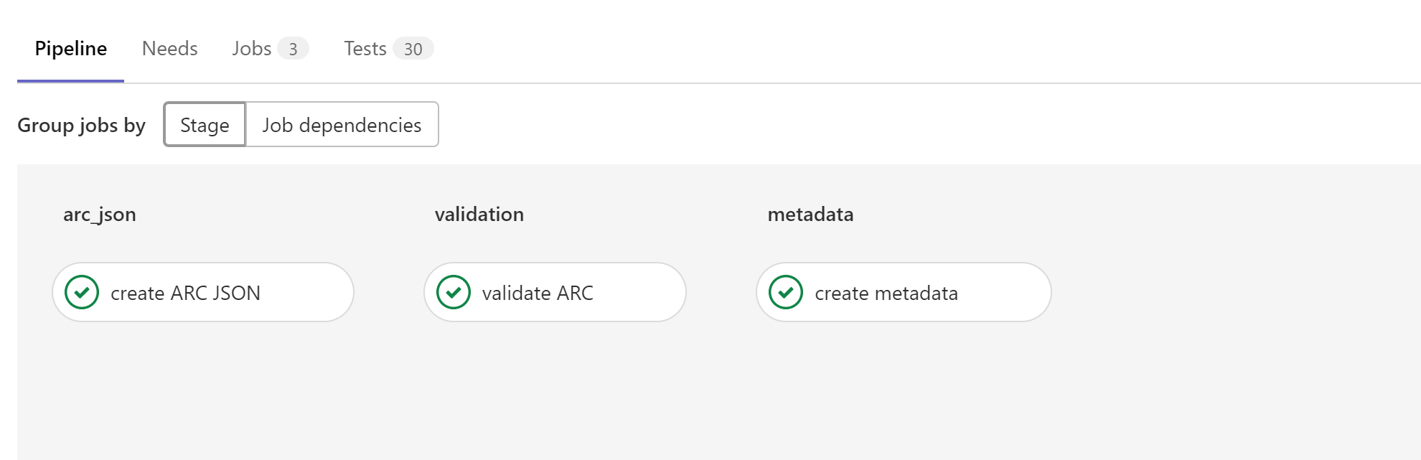
Gitlab as a collaborative research platform

Slide 14
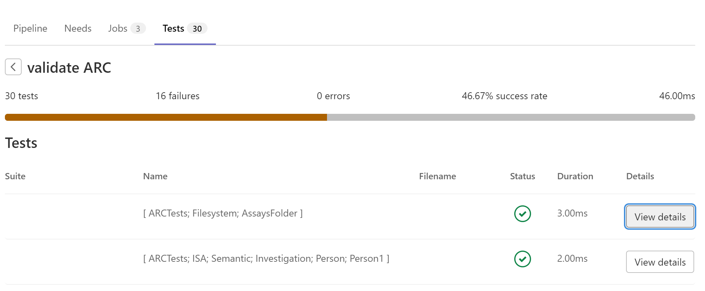
Gitlab as a collaborative research platform

Slide 15
<study1>
resources
C₁
C₂
C₃
…
C_{n}
…
protocols
sample material or data
studies
<assay1>
dataset
P₁
P₂
P₃
…
P_{n}
intensity
assays
…
protocols
measurement data
m/z
<study/assay>
script / code / …
result files
workflows
<workflow1>
<run1>
CWL
…
<workflow1>
result files
<run2>
<workflow2>
runs
data files
computation / tools / processing
<run1>
…
CWL
administrative metadata
investigation
Notes:
Figure: Folder and file layout in Annotated Research Contexts (ARCs, left) and schematic depictions of the respective content sections. The top-level investigation metadata file (investigation sollte top left damit I -> S -> A) contains administrative metadata about the whole ARC, e.g. the names of collaborators and the instututions they are part of. The studies folder (green) contains one or multiple study subfolders, which are used to track provenance of the contained resource and protocol files, as well as study metadata files that annotate the genesis of biological samples and other material (right). Analogously, the assays folder (yellow) contains one or multiple assay subfolders, which are used to track provenance of the contained datasets and protocol files, as well as assay metadata files that annotate the genesis of measurement data and other result files starting from study material or datasets (right). The workflows folder (blue) contains Common Workflow Language (CWL) descriptions of e.g. analysis scripts or tools, while the runs folder contains CWL descriptions of the actual analysis that was performed, therefore making the whole computational pipeline used in the ARC runnable and therefore reproducible.

Slide 16
clustering.cwl
output.xlsx
ARC data
sequence-analysis.cwl
visualization.cwl
figure.pdf
GALAXY Europe
DE.NBI
local PC
<sequencing program>
workflows/cluster.py
workflows/plotting.R
Notes:
Automated workflows (QC and computational analysis)

