Slide 1
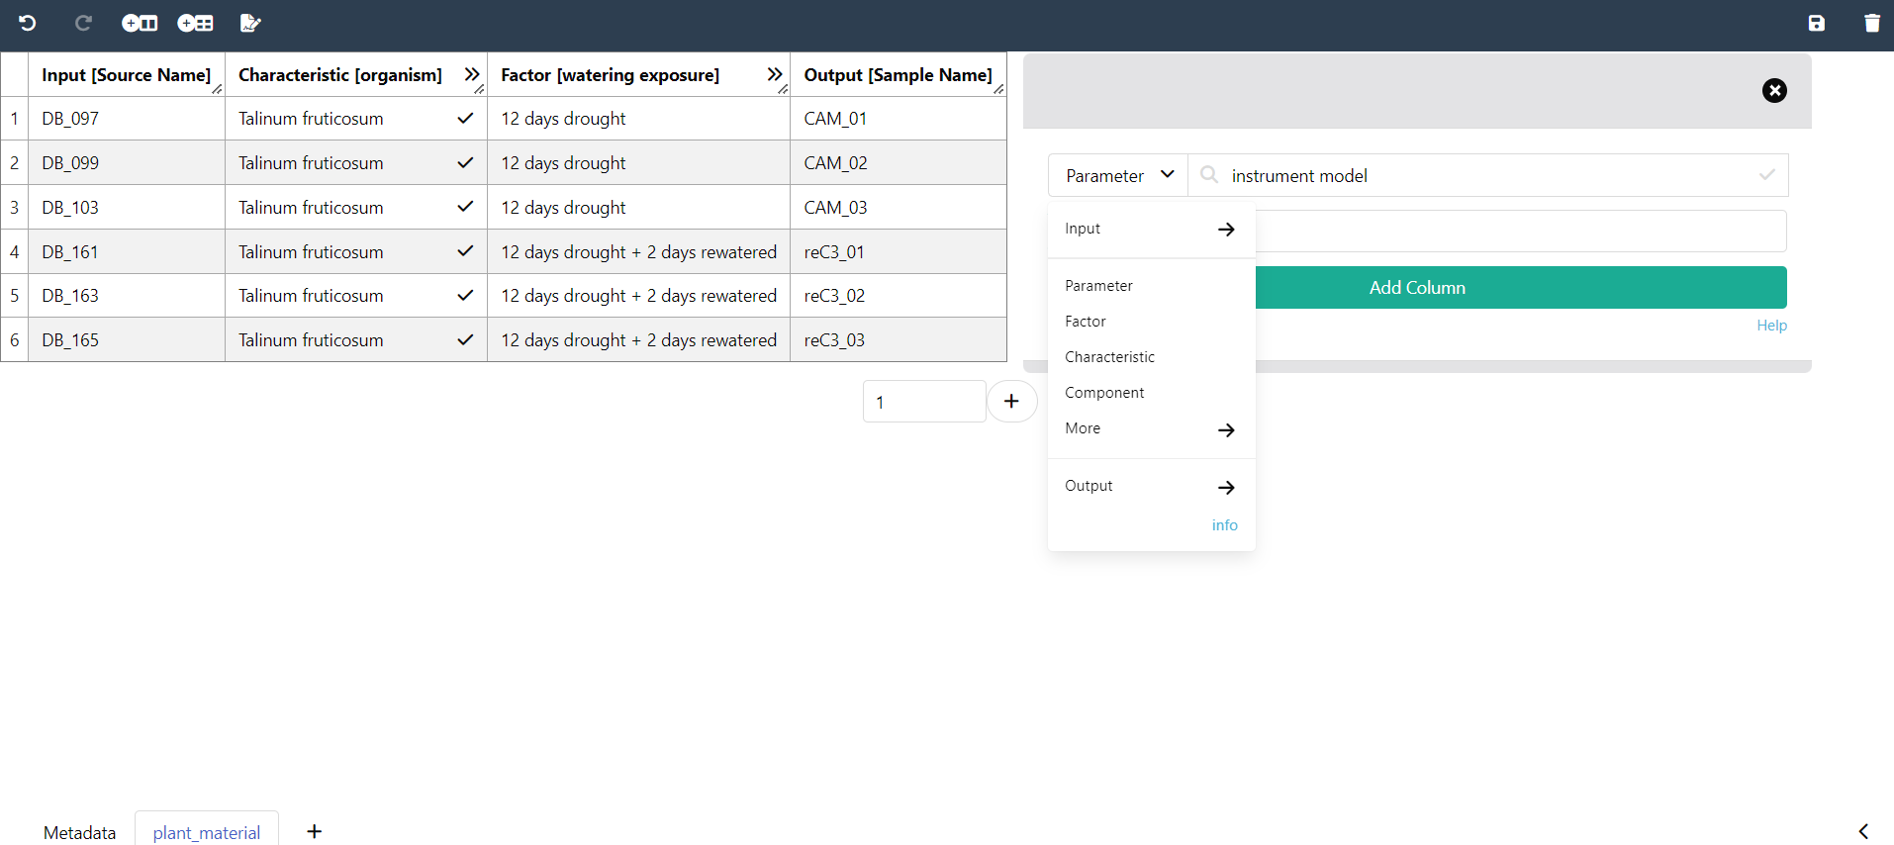
Widgets
New Parameter
Factor
Output
Input
Characteristic
Sidebar

