Slide 1
Cisco Unified -
* Application Server
* Application Designer
* Media Engine
Development Training
Learn the platform to create VoIP applications

Slide 2
Agenda: What’s Covered?
Overview
Architecture of the Platform
Understanding the Application Runtime
Platform Administration
Developing Applications
Examples of Applications

Slide 3
Training Objectives
Educate you one the Cisco Unified Application Server architecture and design
Train you on how to use the Cisco Unified Application Designer to build applications
And…
Notes:
For More Information on Cisco’s Information Classification, please visit:
http://wwwin.cisco.com/infosec/policies/info_class.shtml
Information Classification Examples:
Cisco Public Information
Personal e-mail, press releases, billboards, non-entitled website information
Cisco Confidential
Business e-mail, internal website information, most business documents
Cisco Highly Confidential—Controlled Access
Security information, employee HR information, strategic planning, limited financial forecasting
Cisco Restricted—Redistribution Prohibited
Mergers and acquisitions, corporate financial information

Slide 4
Training Objectives – Most Importantly
Leave you with the necessary materials and understanding to effectively utilize the Cisco Unified Application Server installation to build and deploy innovative IP telephony applications.

Slide 5
Overview
Core Elements:
  Application Server
  Application Designer
  Media Engine
What can the platform do?
Historical context of the platform

Slide 6
Core Elements Defined
The Application Server is a server-side solution designed from the ground up to host IPT applications.
A Windows-based client application used to rapidly build and deploy applications to the Application Server.
The Media Engine is a server-side solution to provide rich media processing, tightly-integrated into the Application Server.

Slide 7
What can it do?
Allow a developer to very quickly and easily create VoIP applications!
  Media Control
  Call Control
  Cisco IP Phone XSI Commands
  Back-end data integration
  CallManager APIs
  Extremely extensible for custom integration points

Slide 8
History Repeats Itself
IP telephony as a technology has matured but developmental tools have not.
  As technologies grow in complexity, tools which abstract the underlying complexities must follow.
The first web applications were:
  CGI-based (first generation technology)
  Hard to build
  Hard to manage
  Hard to deploy
Lack of a robust platform and toolset hinders adoption until…
  Frameworks and toolsets like ASP, ColdFusion, etc....
  Web application servers like WebLogic, WebSphere, etc…

Slide 9
Cisco Unified Application Server
Presents a new model for developing and deploying integrated, media-rich IP telephony applications.
Eliminates the mystery of telephony and the underlying communications platform enabling developers to leverage convergence for innovation.
Uniquely blends ease-of-use and power by allowing developers to quickly build applications without taking anything away from developer freedom.
Delivers a secure, stable, and scalable runtime platform
The Application Server allows you to focus on delivering value without worrying about the details of how the telephony components work.

Slide 10
Architecture of the Platform
System Architecture
Language Architecture
Application Lifecycle

Slide 11
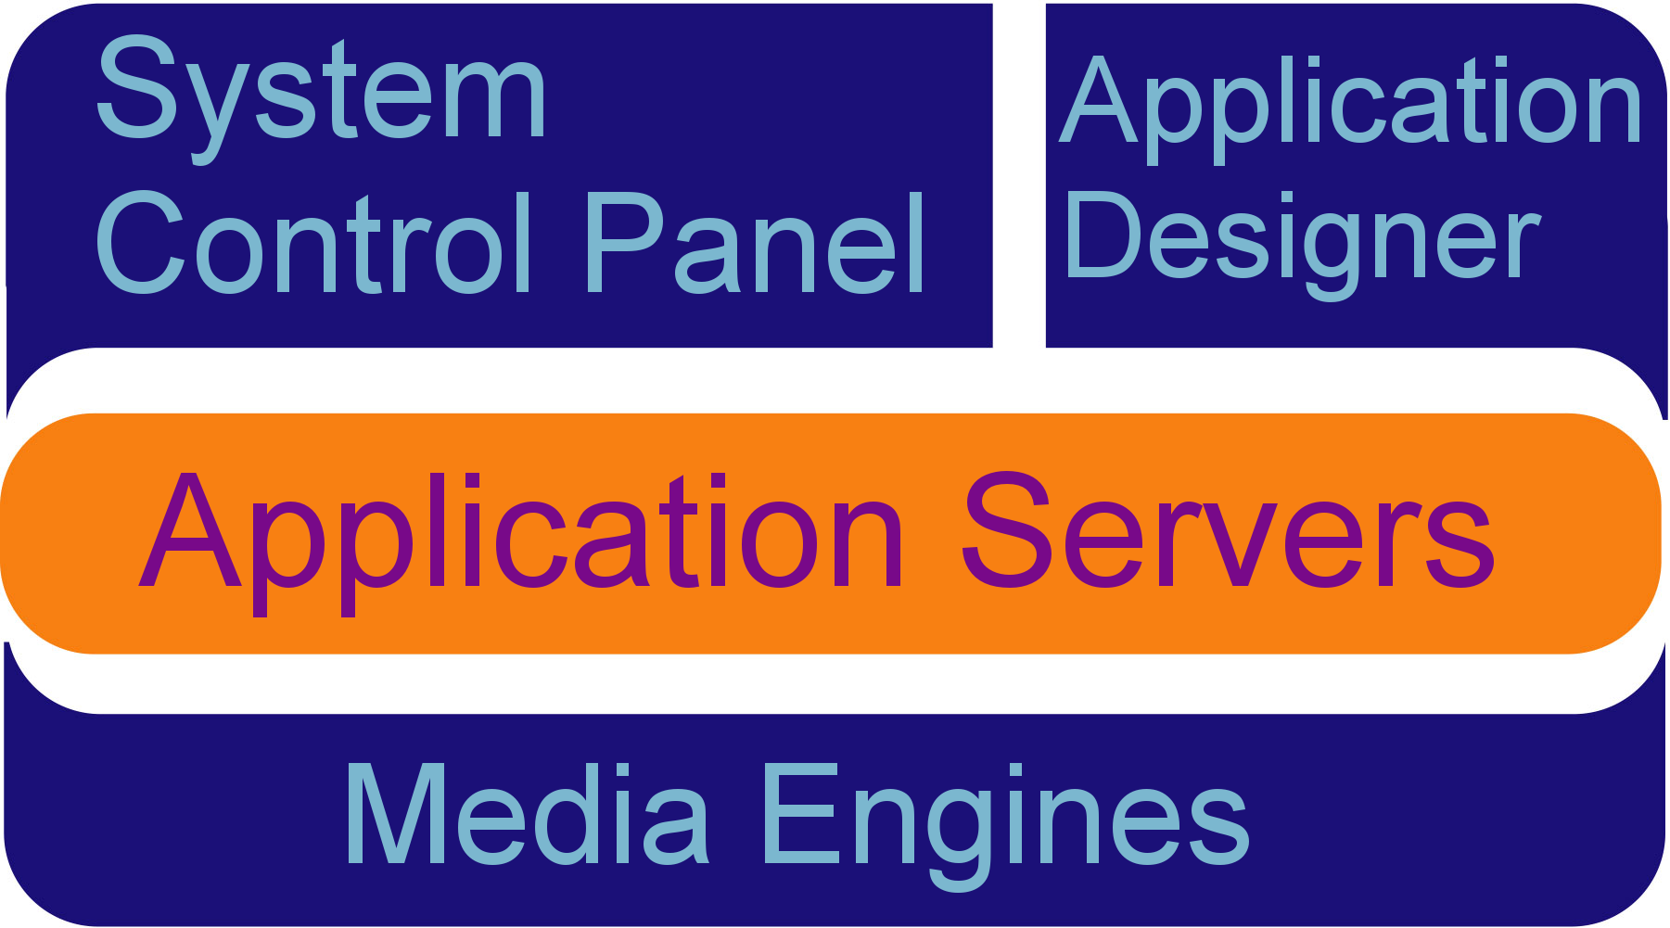
System Architecture
Application Server is the heart of the system.
Media Engines provide audio stream control.
Application Designer enable developers to build applications.
PHP
(Server)
C#
(Client)
C#, Java
(Server)
C++
(Server)

Slide 12
Cisco Unified Application Server
Core of the platform.
Applications are stored and execute within the Application Server.
Application scripts are assembled from an XML intermediate language into in-memory compiled code ready for execution.
A virtual machine inside the application server manages the execution of the application.
Facilitates communication with external systems through “protocol providers”.

Slide 13
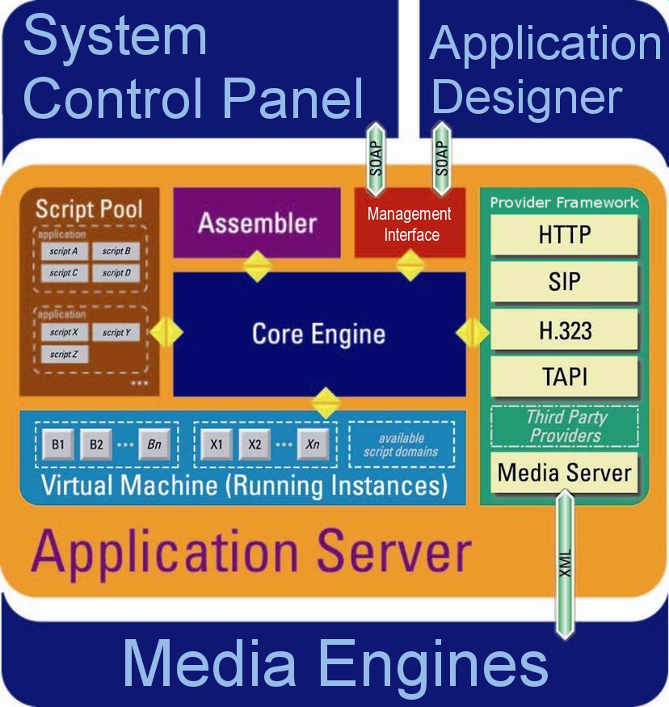
Application Server – Internal Components

Slide 14
Protocol Providers
Provide the “glue” between the Application Server and external systems.
Functional equivalent of a Unix daemon process or Windows service.
Able to persist data and maintain state.
Expose Events and Actions to application layer.
Visible to developer through the Application Designer.

Slide 15
Cisco Unified Media Engine
Software implementation of digital signaling processor (DSP).
Originates and terminates voice media streams on behalf of applications.
Tightly coupled with the Metreos Application Server via an XML RPC interface.
Capable of processing up to 240 (soon 400) distinct media streams.
Scalable independent of the application server.
All media processing capabilities exposed in an easy-to-use manner inside of Application Designer.

Slide 16
Media Engine Feature Highlights
Scalability
  Up to 240 (soon 400) concurrent connections per box.
  Scales independent of application server nodes.
IVR
  Play and Record in VOX and WAV format.
  Play multiple prompts in sequence.
  DTMF detection; in-band (including RFC2833) and out-of-band.
  Complex “termination” conditions.
Conferencing
  Individual conferee mute and kick.
  Conference recording. Up to 64 concurrent conferences being recorded per box.
Advanced Features
  Multicast support for IVR.
  Speech support using Nuance or Speechworks.
  Low bit-rate coders (G.723 and G.729a).
  Text-to-speech using embedded Neospeech server

Slide 17
System Control Panel
Web-based management console for configured the Application Server, which includes:
  Manage applications
  Manage protocol providers
  Manage media engines
  Manage telephony servers
  License management
  User management
  Diagnostics

Slide 18
Application Designer
Visually construct communications business logic.
  Extensive catalog of communications actions.
  Abstracts and consolidates IP telephony protocols into the Metreos CallControl API (SIP, H.323, JTAPI, SCCP).
  Encapsulates common technology interfaces for modern applications: LDAP, SQL, Web Services, CCM APIs, …
Single tool for building complete IPT applications.
Targeted at someone with a few years programming experience.
Integrated with the Application Server for instant deployment
Comprehensive reference designs.
  Accelerate developer learning curve.

Slide 19
Application Designer – Key Features
Graphical Application Definition
Application Integrity Checks
Extensible Toolbox
Embedded Code
One-Click Deployment
Runtime Debugging
Instant Web Services Integration

Slide 20
Architecture of the Platform
System Architecture
Language Architecture
Application Lifecycle

Slide 21
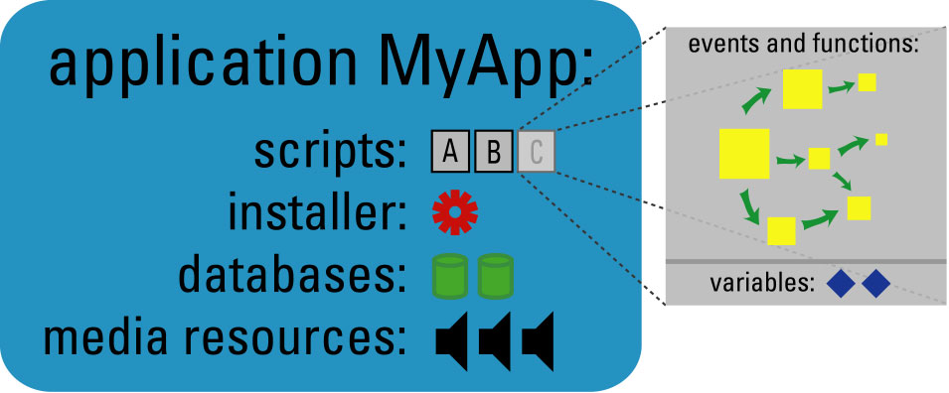
Application Elements
Scripts contain all application logic and flow.
Installer defines the configuration required for the application.
Databases are SQL creation scripts for database tables.
Media resources include audio prompts and voice recognition grammar files.
Custom code libraries used to extend the toolbox.

Slide 22
Application Elements - Scripts
Any number of scripts can be contained by one application.
A script is part
  Visual business logic
  .NET C# code of scripting complexity
Each running script can be visualized as using a single ‘virtual’ thread.
  Individual scripts execute serially.
  The Application Runtime manages a thread pool, so a single thread is not used for each running script instance.

Slide 23
Application Elements - Installer
The installer file is a formal declaration of every item that is configurable.
Predefined types of immediate use to developer
  String
  Password
  Number
  Enumeration
  Array
  Hashtable
  Table
Declared configuration items show up in the mceadmin control panel.

Slide 24
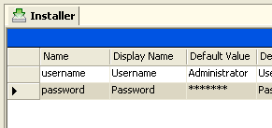
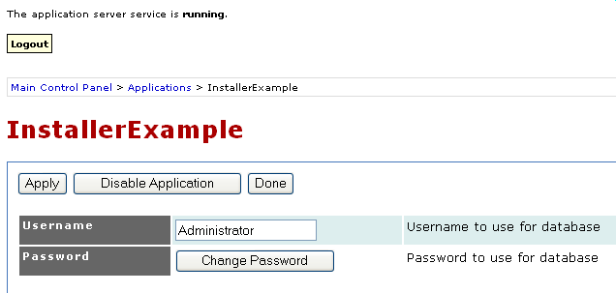
Installer – From Developer to Administrator
Developer defines the installer in the Application Designer.
The administrator can then configure these items on the web portal.

Slide 25
Application Elements – Databases
Database installer files are used to define databases that are guaranteed to be available on the Application Server.
  Upon deploying application, database scripts are executed against embedded MySQL database
  Script simply consists of SQL defining tables, commands (CREATE TABLE, INSERT, UPDATE, DELETE, etc)
Internal databases such as these were designed to give developers to provide a powerful tool for coordination of state among scripts.

Slide 26
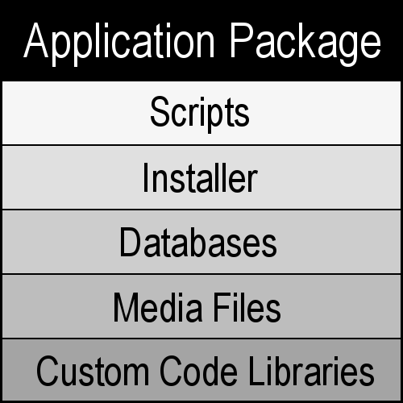
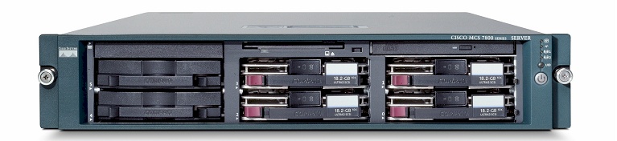

Application Elements – Media Resources
Media Resources come in two forms
  Audio file (.wav or .vox)
  Voice Recognition Grammar file
Audio files are provisioned from the Application Server to all configured Media Engines.
Application Server
Media Engines

Slide 27
Application Elements – Custom Code Libraries
Any .NET custom code library used by the application is sent along with the package and automatically loaded along with the compiled scripts.
Applications are loaded into their own context along with any custom code libraries, allowing different versions of libraries to coexist on one Application Server.
  AppDomains are the underlying .NET technology allowing this separation of applications.
  Every installed application gets its own AppDomain.

Slide 28
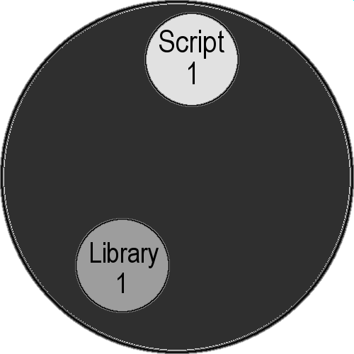
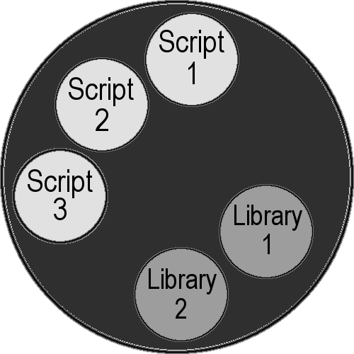
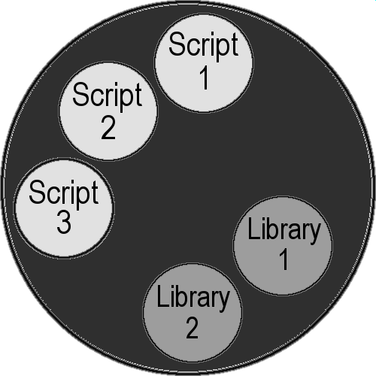
.NET AppDomains and CU Application Environment
AppDomains are completely stand-alone and protected from one another, but many can exist and run within a single process.
Because of strong separation, AppDomains can break unexpectedly with no impact on other AppDomains
Existing App
Existing App

Slide 29
Application Package
All these elements are packaged into a single file.
The file has an .MCA file extension.
The MCA package uses the TAR archive format and is the functional equivalent of a Java JAR file.
The Application Designer handles the packaging automatically for the developer during the build process.
The command line tool ‘mca.exe’ can be used to manually build and extract MCA archive packages.

Slide 30
Architecture of the Platform
System Architecture
Language Architecture
Application Lifecycle

Slide 31
Application Lifecycle
The application lifecycle is the sequence of events that are intrinsic to developing and deploying an application with the platform.

Slide 32
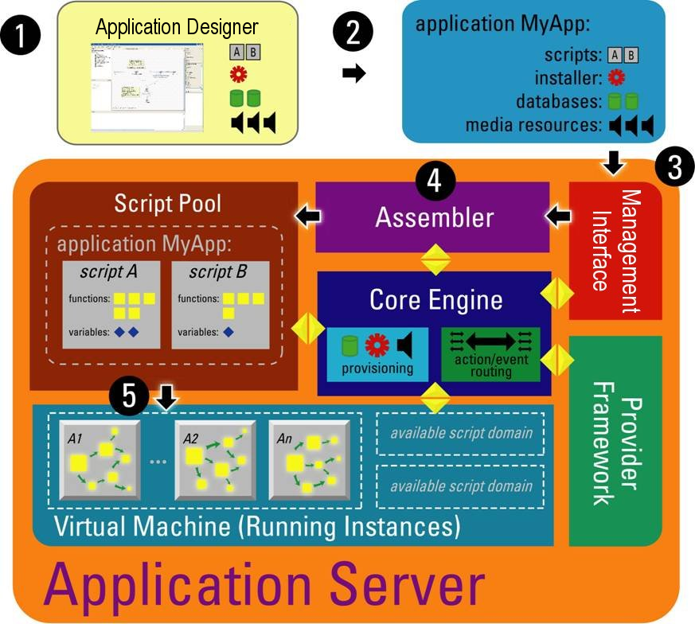
Application Lifecycle
Development
Build
  Compilation
  Packaging
Deployment
Installation
  Extraction
  Provisioning
Execution

Slide 33
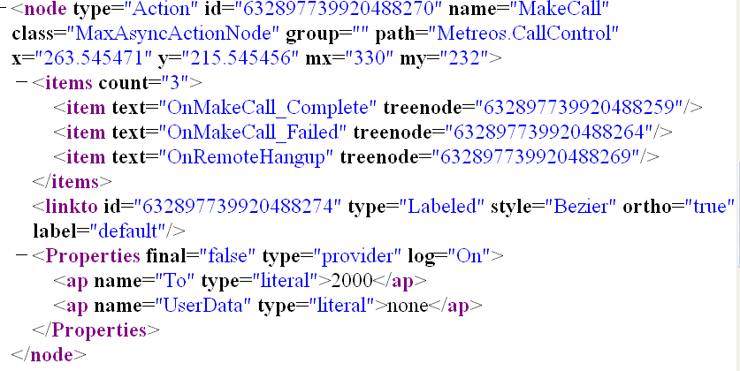
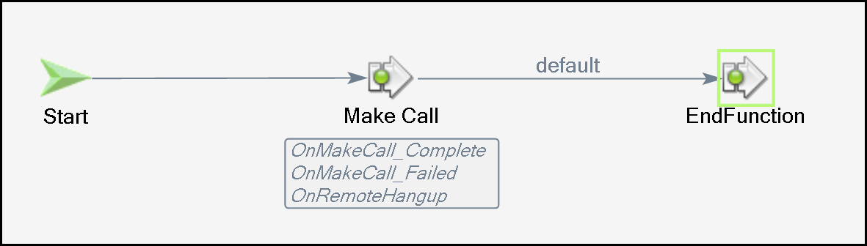
Application Lifecycle – Development
Applications are created in the designer, and saved to XML files.

Slide 34
Application Lifecycle - Build
Once an application is free of errors, then the build process can be initiated in the Designer.
Information pertaining to application flow and logic is assembled into XML conforming to a certain schema.
This XML language is readable by the Application Server.

Slide 35

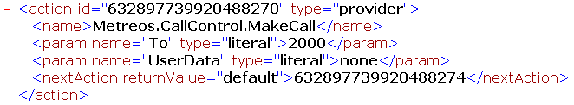

Application Lifecycle – What Happens In a Build?

Slide 36

Application Lifecycle - Deployment
Deploying an application is a one-click process.
A deployed application is ready for execution immediately after deployment.

Slide 37
Application Lifecycle - Installation
Once the application package arrives at the Application Server, the package is extracted into the appropriate folder structure.
The AppDomain is created.
Standard and custom libraries are loaded into the AppDomain.
Any code snippets defined in a script are also converted into a library and loaded.

Slide 38

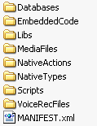

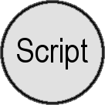
Application Lifecycle – Installation Diagram

Slide 39
Application Lifecycle - Execution
Code is ready to be executed.
When a script is started, individual actions are executed as defined by the script.
Because any number of scripts can be running in parallel, the Runtime Environment allocates a number of worker threads to process actions within the scripts.

Slide 40
Applications
Execution Model
Application Script Elements

Slide 41
Execution Model: Action-Event
Applications are driven by a concept known as the action-event model.
Applications communicate with Application Server through actions.
The Application Server sends information to the applications using events.

Slide 42
Execution Model - Actions
Application scripts do work through actions.
Scripts are constructed by linking actions together, creating the business logic of the application.
Actions provide developers with programmatic constructs present in virtually all programming languages.
Actions allow scripts to send data to the outside world or carry out specialized application logic.
Three are three types of actions:
  Core
  Native
  Provider

Slide 43
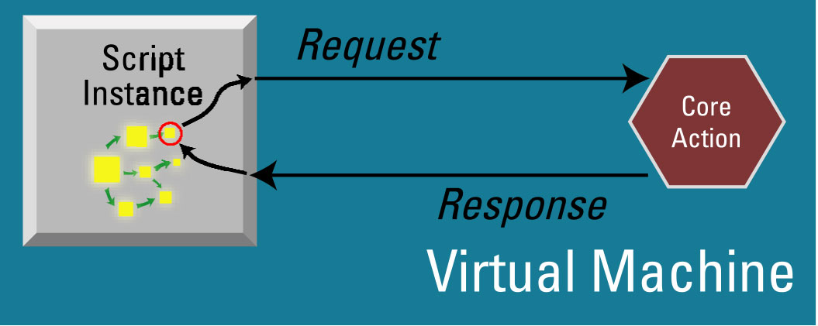
Actions - Core
Execute synchronously.
Handled natively by the virtual machine.
Represent fundamental functionality:
  End Script, End Function, Loop, Call Function
  Send Events, Forward All Events

Slide 44
Actions - Native
Key building block for all developers using the Application Designer.
  Developers of the core platform use native actions to grow the standard toolkit!
  All other developers extend the core platform using native actions to meet need of custom application.
Executes synchronously.
  When being executed, the script is halted.
Execution never leaves the context of AppDomain.
Execution logic provided by a .NET assembly.

Slide 45
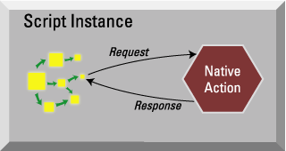
Actions – Native
When the runtime encounters a native action:
  Virtual machine recognizes native action.
  Virtual machine has previously loaded the assembly and invokes the Execute() method of the native action.
  Execution leaves the virtual machine and executes the code for that native action.
  Method finishes and virtual machine continues.

Slide 46
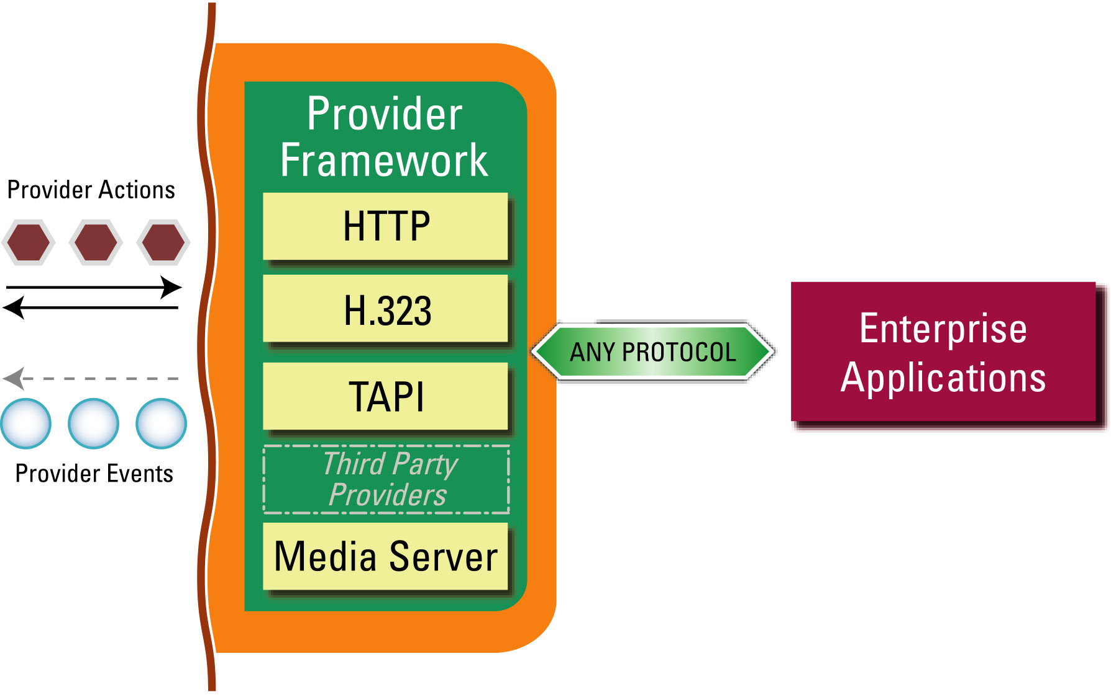
Actions - Provider
Recall that a protocol provider facilitates communication between external systems and applications.
Providers execute within their own virtual process space, and are entirely separated from the virtual machine.
Provider actions:
  Synchronous
  Asynchronous

Slide 47
Provider Actions - Synchronous
Virtual machine constructs a provider message.
Virtual machine sends provider message to Application Server
  A timer is started (5 seconds by default).
Application Server routes message to the correct provider
Provider sends a final response.
  If provider never sends a response, or the response is sent after the timer, then the application execution will have carried on before this step.

Slide 48
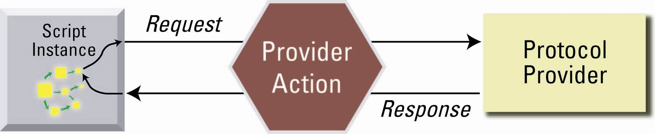
Provider Actions - Synchronous
Diagram of communication between application and provider for synchronous action:

Slide 49
Provider Actions - Asynchronous
Virtual machine constructs a provider message.
Virtual machine sends provider message to Application Server.
  A timer is started (5 seconds by default).
Application Server routes provider message to the correct provider.
Provider sends a provisional response.
  If provider never sends a response, or the response is sent after the timer, then the application execution will have carried on before this step.
Provider finishes processing the action request and sends a final response in the form of an asynchronous event callback.

Slide 50
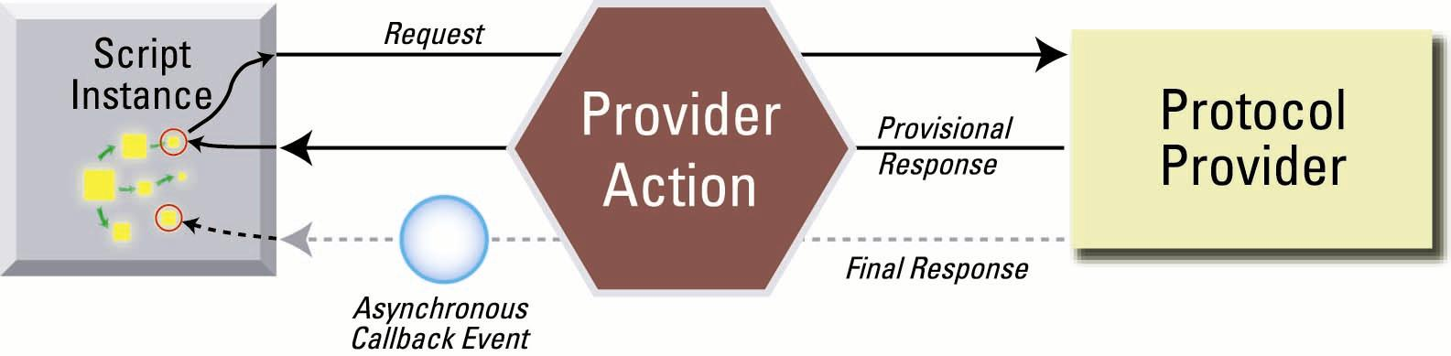
Provider Actions - Asynchronous
Diagram of communication between application and provider for asynchronous action:

Slide 51
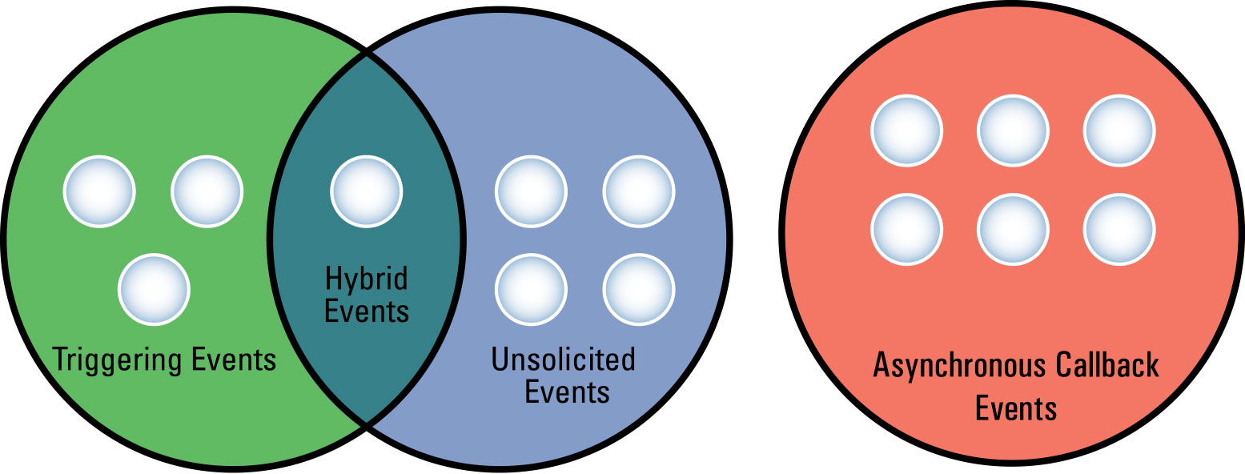
Events
Three types of events with the Application Server:
  Triggering
  Unsolicited
  Asynchronous Callback
Hybrid events are those which may either be triggering or unsolicited (e.g., Http.GotRequest)

Slide 52
Events
An event is a signal designed to communicate with applications.
  A triggering event causes a new script to begin execution.
  Unsolicited and asynchronous events are sent to running applications
Events are comprised of two parts:
  Event name
  Event parameters
The combination of name and parameters create an event signature.

Slide 53
Event Signatures
Event signatures are a fundamental part of administration for applications.
An administrator can use elements of the event signature to configure an application’s external triggering criteria.
  Triggering event signatures define the criteria that must be met for a script to start.
  Unsolicited and asynchronous callback event signatures define which handler function to use for the event.
Triggering event signatures must be unique across the entire Application Server.
Unsolicited and asynchronous callback event signatures must be unique within a script.

Slide 54
Event Signature Example
A script is installed which triggers with a Metreos.CallControl.IncomingCall event.
The IncomingCall event consists of the following event parameters:
  To
  OriginalTo
  From
  CallId
An administrator can use the To parameter to decide what dialed number will cause this script to execute, i.e., 2000.

Slide 55
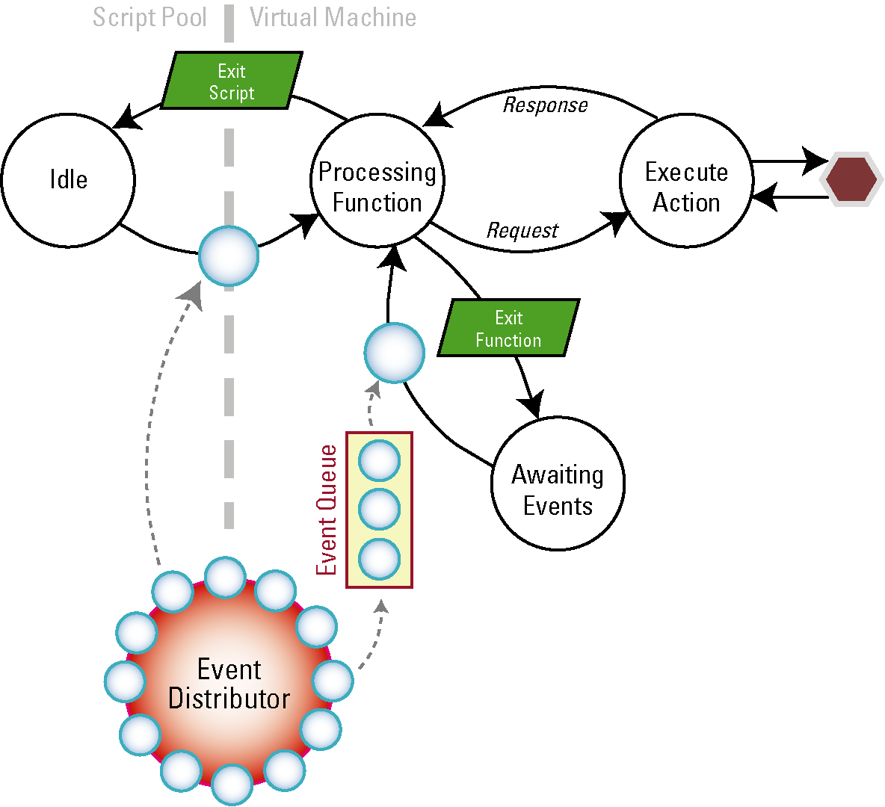
Execution Model Diagram

Slide 56
Script Elements
Applications
Databases
Installer
Scripts
Media Resources
Functions
Global Variables
Event Handlers
Actions
Local Variables

Slide 57
Application Script Elements
Application scripts contain these primary elements:
  Trigger: Indicates when a new instance of an application should begin.
  Functions: Logical grouping of functionality defined using actions. Optionally, functions may be flagged as event handlers.
  Variables: Encapsulate data within the script and may be scoped locally to the function or globally to the script.
  Actions: Execute finite pieces of logic on behalf of the script (e.g., make a phone call)

Slide 58
Administration
Administration Terminology
Environment Configuration
Applications, Providers, Media & Telephony Servers
Troubleshooting

Slide 59
Administration Technology
mceadmin – The common name for the web management console.
Application – An application is contained within an MCA file and installed either via the Application Designer or mceadmin.
Provider – A extension module
Media Firmware License – A license that unlocks media resources within the media engine firmware making features available to the system.
Telephony Server – A component that defines a link to a Cisco CallManager, Cisco SIP Domain, IETF SIP Domain, or H.323 gateway.

Slide 60
mceadmin Overview
Tasks are segmented into 3 main groups:
  Environment – System service parameters, global configuration of software.
  Components – Management of applications, providers, media engines, and telephony servers.
  Logs – Log file management and download.

Slide 61
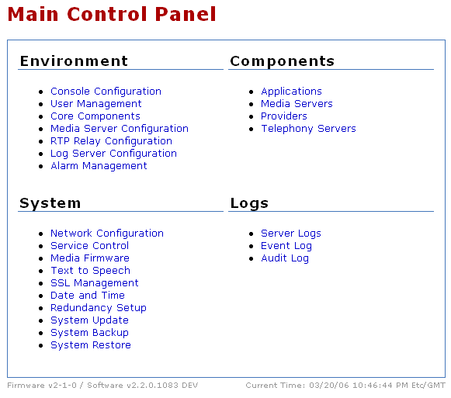
Mceadmin Main Page
Current Firmware and Software Versions
Current Date & Time

Slide 62

mceadmin Navigation
Breadcrumbs will show you were you are in mceadmin.
Above the logout button, a status will be displayed indicating whether mceadmin is currently communicating with the Application Server.
Status
Breadcrumbs

Slide 63
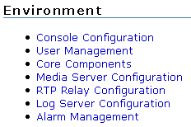
Administration
Administration Terminology
Environment Configuration
Applications, Providers, Media & Telephony Servers
Troubleshooting

Slide 64
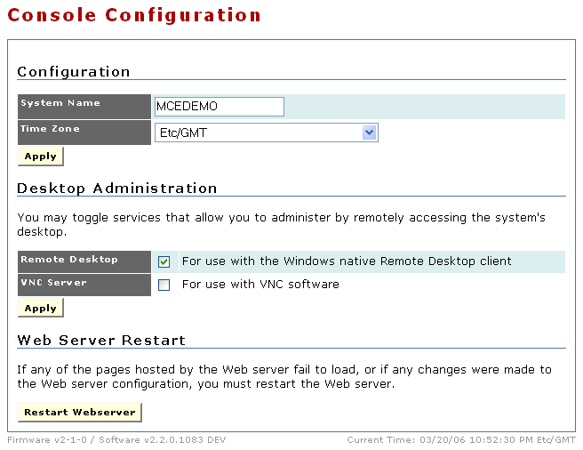
Environment – Console Configuration
Basic system settings and remote access configuration.
Control which remote access solution to use
Restart Apache if necessary

Slide 65
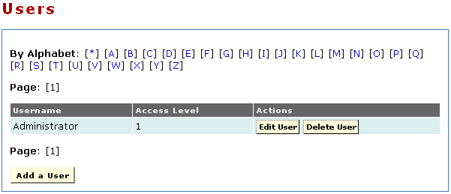
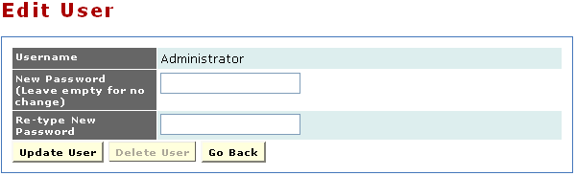
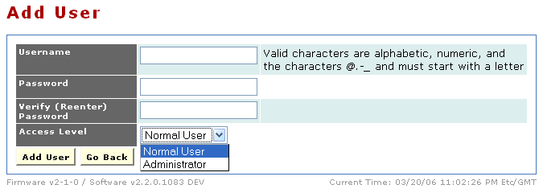
Environment – User Management
Control administrative and developer access.
Active User List
Access Level for
New User

Slide 66
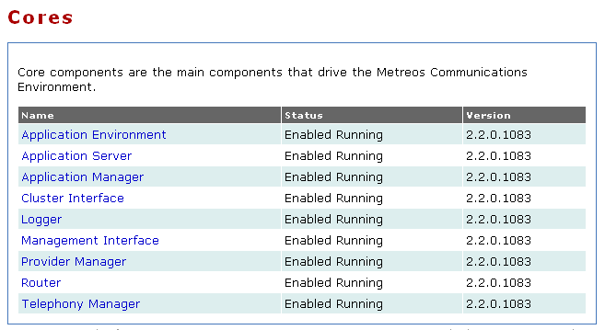
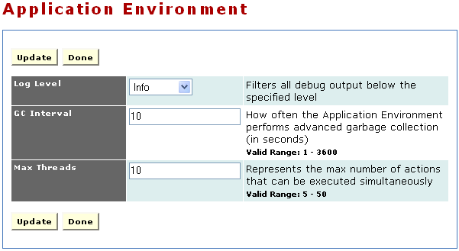
Environment – Core Components Configuration
Set system-level parameters that control the operation of Application Server
Is the component operational?
Some config options have input criteria as shown here.
Indicates which core component to edit
Available config options

Slide 67
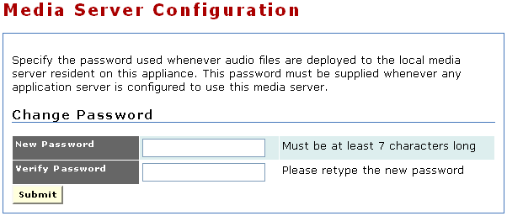
Environment – Media Engine Configuraton
Controls the local password used to deploy media files to the local media server.

Slide 68
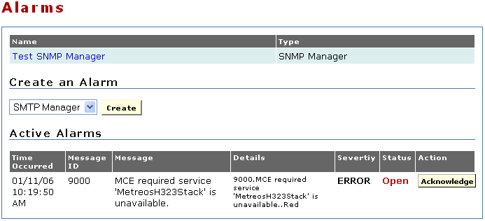
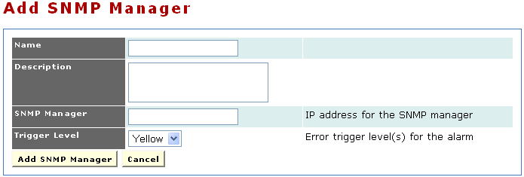
Environment – Alarm Management
Add/Remove alarm destinations (SNMP or SMTP) and manage active alarms.
Existing alarm destinations already configured
Active alarms (if any)

Slide 69
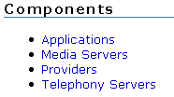
Administration
Administration Terminology
Environment Configuration
Applications, Providers, Media & Telephony Servers
Troubleshooting

Slide 70
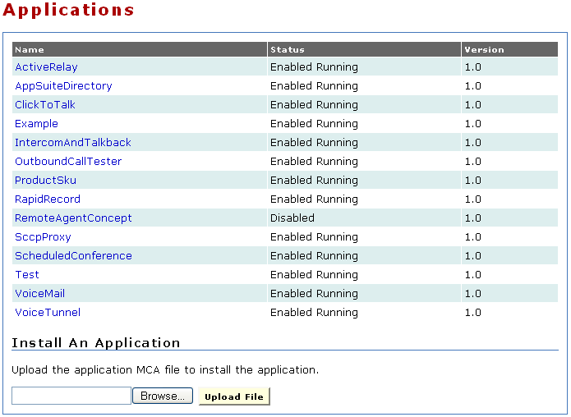
Components – Application Management
Install and manage applications
Is the application operational?
Currently installed applications
Current version of the application
Install a new application

Slide 71
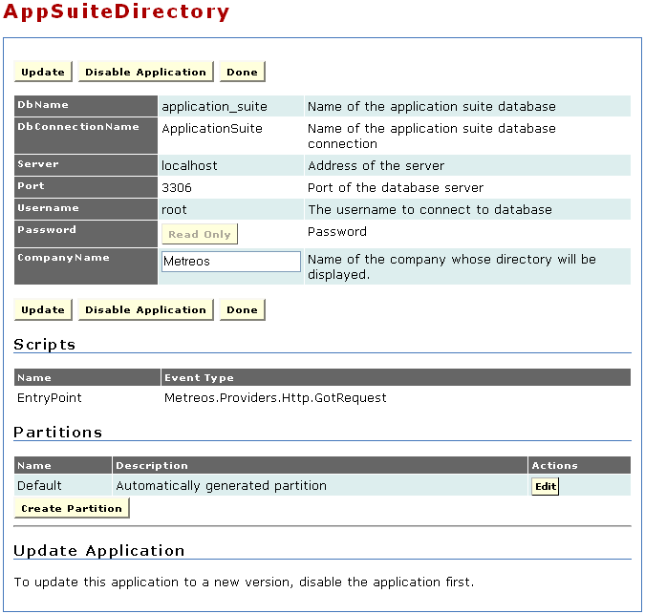
Components – Application Management
Configuring an application.
Application controls
Global config for all partitions
List of the scripts in the app
Application partitions

Slide 72
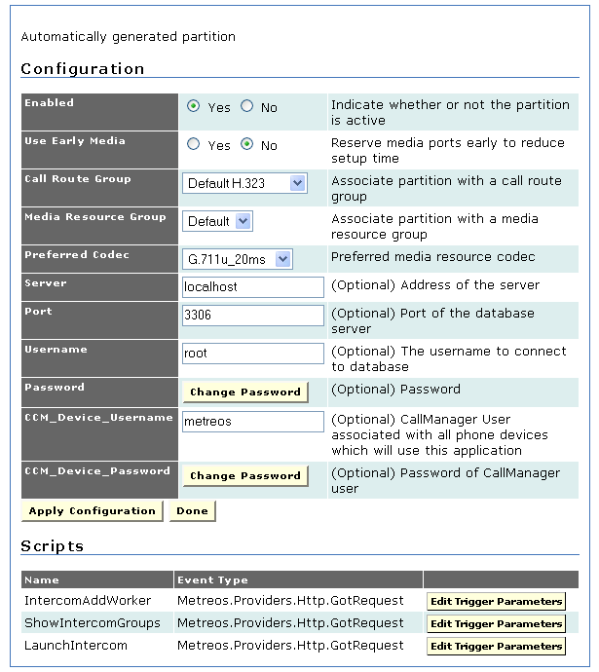
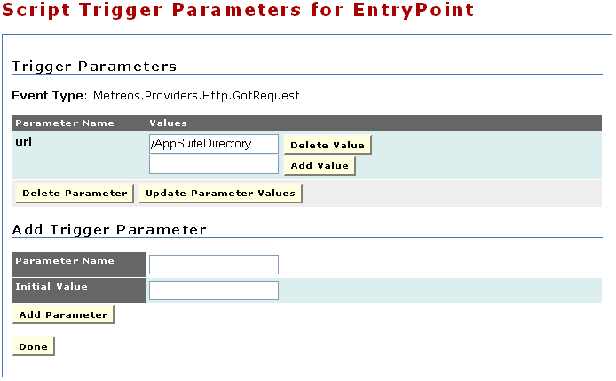
Components – Application Management
Editing a partition brings up partition-specific configuration information and trigger parameters.
Partition specific config
Edit existing trigger parameters
Add new trigger parameters

Slide 73
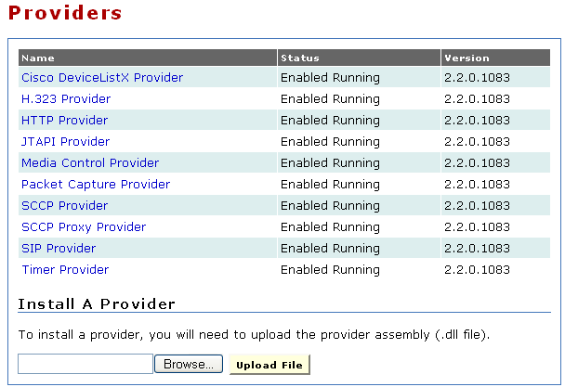
Components – Provider Management
Install and manage providers
Is provider operational?
Currently installed providers
Current version of the provider
Install a new application

Slide 74
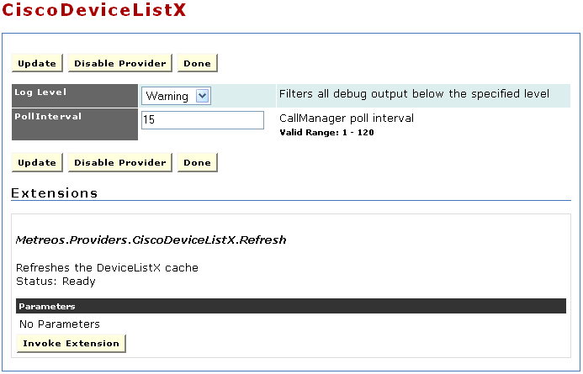
Components – Provider Management
Edit provider configuration and invoke provider extensions.
Provider controls
Provider configuration
Tell the provider to do something

Slide 75
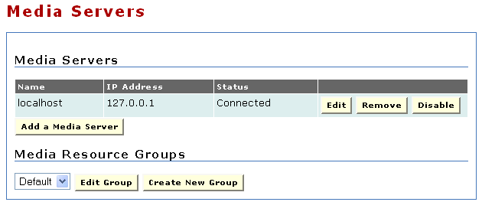
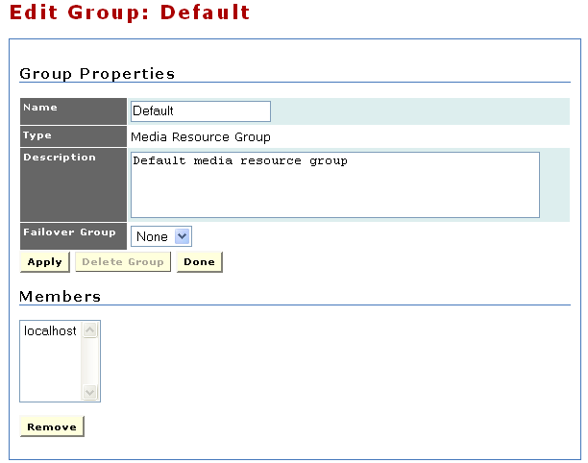
Components – Media Engines
Add and remove Media Engines. If a Media Engine is listed here, the Application Server on the appliance maintains a connection to it.
Existing media engines
Edit or create media resource groups
Group members

Slide 76
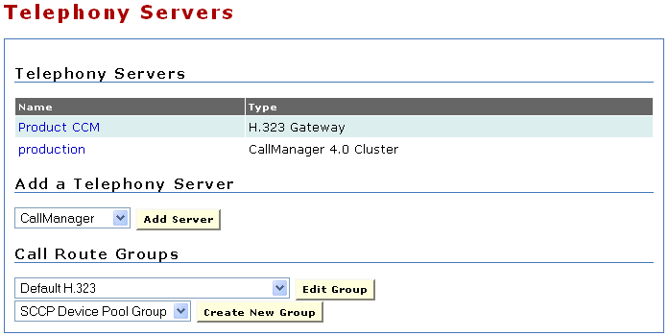
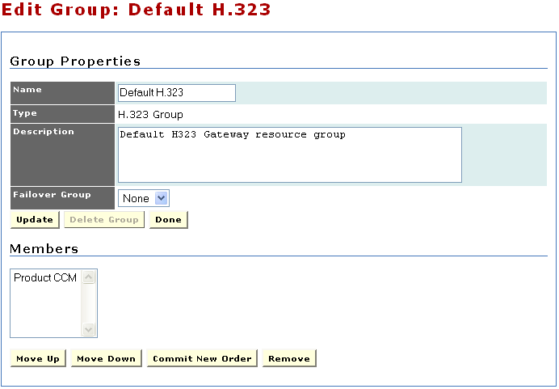
Components – Telephony Servers
Add, remove, and edit telephony servers.
Add and edit call route groups.
Existing telephony servers
Add new server
Add and edit call route groups
Edit group membership and priority

Slide 77

Administration
Administration Terminology
Environment Configuration
Applications, Providers, Media & Telephony Servers
Troubleshooting

Slide 78
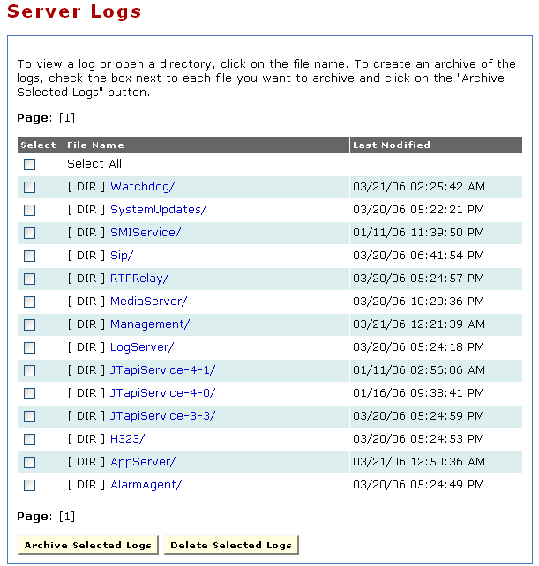
Troubleshooting – Viewing Log Files
Download, view, and delete logs on the system
Existing log file directories
Log operations

Slide 79
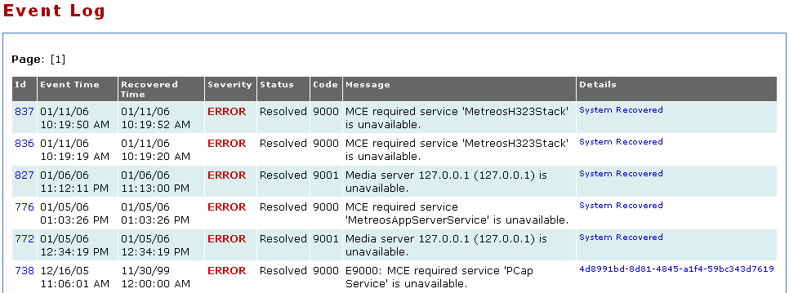
Troubleshooting – The Event Log
Provides a list of system-wide events and whether those events have been resolved.

Slide 80
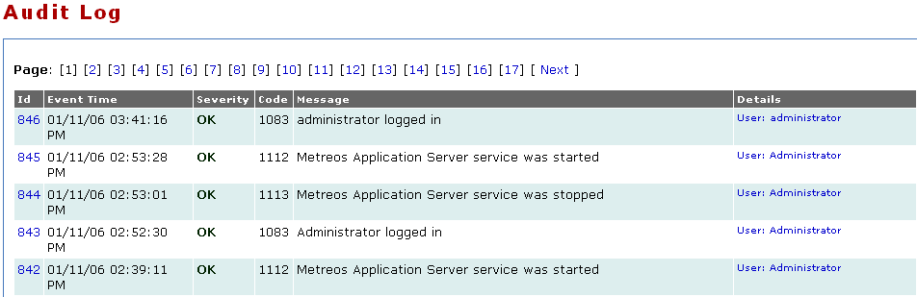
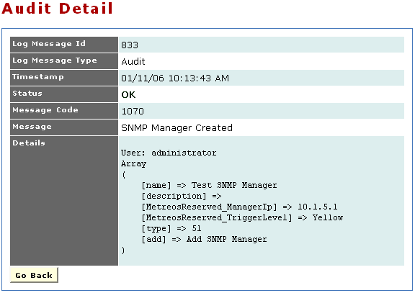
Troubleshooting – Audit Log (Who to blame?)
Every management operation is recorded.
Provides a detailed view as to what has changed on the system and by whom.

Slide 81
Extending the Platform
Extensibility
Building Native Actions
Building Native Types
Building Protocol Providers

Slide 82
Extensibility
Some applications can be constructed entirely within the Application Designer.
If the developer wishes to extend the capabilities of the platform, there are three options:
  Native Actions
  Native Types
  Protocol Providers
Extensions may be built using .NET-enable languages:
  C#, C++, VB, Python, Java, etc.
The choice of which type of extension to build is based on the general requirements of what the extension must provide.

Slide 83
Native Actions vs. Protocol Providers
Native Actions
  Are light-weight and easy to build.
  Execute within the same context as the script instance itself.
Protocol Providers
  Can generate events.
  Can maintain state.
  Can create threads.
  Are more complex to build.
Developers should build a protocol provider when:
  They need to monitor external systems for events.
  They need to maintain state independent of script instances.

Slide 84
Native Types
Allow developers to extend the type system provided by the Application Server.
Native types provide the functionality behind variables.
Native types are easy to build.
Developres should build a native type when:
  There is a need to store complex data in a single variable.

Slide 85
Action/Event Package Definition
Describe the inputs and outputs of native actions, types, and providers.
Metadata extracted from the code is used by the Application Designer to populate the toolbox.
The action/event package metadata is embedded into the native action, type, or provider assembly using .NET attributes.
[Action("OpenDatabase", false, "Open Database", "Create a DB connection.")]
public string Execute(
SessionData sessionData,
IConfigUtility configUtility)
{
// Do Something Useful
}

Slide 86
Adding Extensions to the Designer
Add the custom assembly as a reference to the application project.
The Application Designer will inspect the assembly for Action/Event attributes.
Populates the list of actions and events available for use in that project accordingly.

Slide 87
Extending the Platform
Extensibility
Building Native Actions
Building Native Types
Building Protocol Providers

Slide 88
Implementing a Native Action
Key namespaces:
  Metreos.Core
  Metreos.Interfaces
  Metreos.LoggingFramework
  Metreos.AppliacationFramework
  Metreos.PackageGeneratorCore.Attributes
6 Basic Steps:
  Create a new class that implements INativeAction
  Decorate the class with a PackageDeclAttribute
  Add set properties for any input parameters and decorate those properties with ActionParamFieldAttributes
  Add get properties for any output parameters and decorate with ResultDataFieldAttributes
  Override the Execute method with custom code
  Decorate the Execute method with an ActionAttribute
  Add a LogWriter Log property that defines a set accessor

Slide 89
Extending the Platform
Extensibility
Building Native Actions
Building Native Types
Building Protocol Providers

Slide 90
Implementing a Native Type
Key namespaces:
  Metreos.ApplicationFramework
  Metreos.PackageGeneratorCore.Attributes
2 Basic Steps:
  Create a new class that implements IVariable
  Implement the Parse method

Slide 91
Extending the Platform
Extensibility
Building Native Actions
Building Native Types
Building Protocol Providers

Slide 92
Implementing a Protocol Provider
Key namespaces:
  Metreos.Core
  Metreos.Interfaces
  Metreos.Messaging
  Metreos.LoggingFramework
  Metreos.ProviderFramework
  Metreos.PackageGeneratorCore.Attributes
Implementation is more complex than either a Native Action or Type, but follows a very straight forward pattern.

Slide 93
Implementing a Protocol Provider
Create a new class that derives from ProviderBase
Decorate the class with a ProviderDeclAttribute and PackageDeclAttribute
Override the Initialize, RefreshConfiguration, OnStartup, OnShutdown, and Cleanup methods with custom code
Implement action handling methods and decorate those methods with ActionAttribute, ActionParamAttributes, and ResultDataAttributes
Decorate the methods which generate events with the EventAttribute and EventParamAttributes

Slide 94
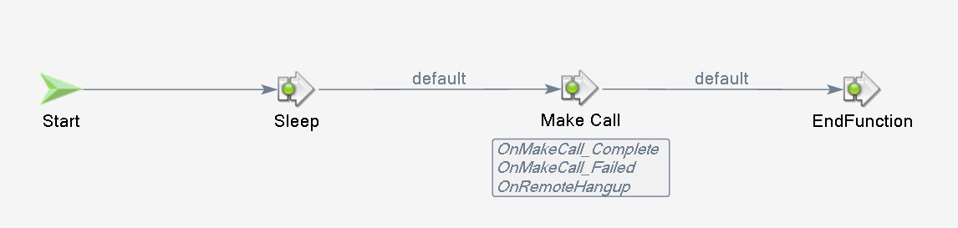

Example Application Walkthrough
HTTP request comes into the Application Server.
Application pauses.
A call is made.
When the call completes, the call is hung up.
HTTP Request
Call Complete

Slide 95









Application Execution – Animation

Slide 96
Basic Application
Walkthrough of Basic Telephony Application…

Slide 97
Cisco Unified -
* Application Server
* Application Designer
* Media Engine
Development Training
Thank You!

