Slide 1
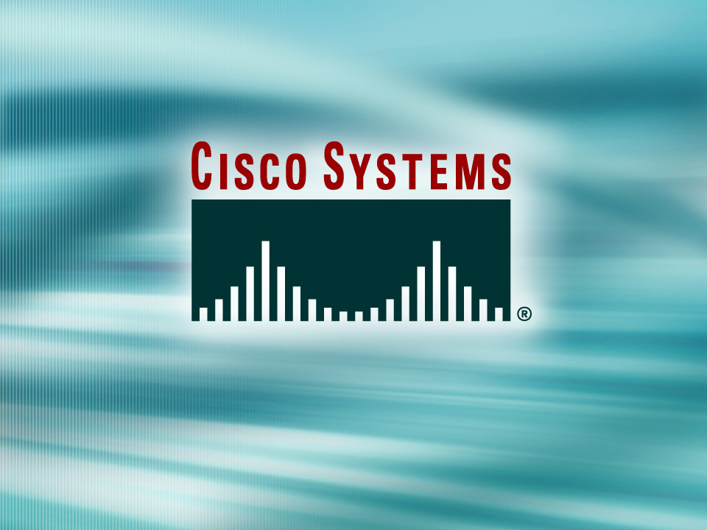
TAC Training
© 2006, Cisco Systems, Inc. All rights reserved.
Notes:
Cisco Unified Application Environment
TAC Training

Slide 2
Cisco Unified Application Environment
TAC Training
Presenters:
Daniel Bethke
CUAE Engineering
dbethke@cisco.com

Slide 3
Introduction
Over the next few days we will discuss the
Cisco Unified Application Environment, focusing on the Cisco Unified Application Server and also touching on it interacts with the Cisco Unified Media Engine.
This will prepare TAC to field questions and troubleshoot issues that will arise from customer deployments.

Slide 4
Objective
After completing this training you will be able to:
  Describe the fundamentals of the Application Environment
  Configure an Application Server
  Troubleshoot issues that customers may raise

Slide 5
Training Agenda
  Day 1: Introduction to the CUAE
  (Cisco Unified Application Environment)
  Day 2: CUAE Integration Demo/Labs
  Day 3: Troubleshooting

Slide 6
Today’s Agenda
  Day 1:
  Introduction to the Technology
  Introduction to System Control Panel (MCEAdmin)
  MCEAdmin: Environment Settings
  MCEAdmin: System Settings
  MCEAdmin: Components
  MCEAdmin: Logs

Slide 7
INTRODUCTION TO THE TECHNOLOGY
Core Elements

Slide 8
Core Elements Overview
Cisco Unified Application Environment
Core Elements:
  Application Server
  Media Engine
  Application Designer
  System Control Panel
Notes:
The Cisco Unified Application Environment is a feature-rich platform for developing and hosting IP telephony applications. It includes: an application runtime environment, which controls media and external resources under the direction of custom telephony applications; one or more media servers to process, mix, analyze, and route digital audio data; a GUI-based design tool, the Cisco Unified Application Designer, which is used to develop and debug IP telephony applications; and a Web browser-based interface that System administrators can use to manage the Cisco Unified Application Environment.
These core elements of the Cisco Unified Application Environment are called:
Application Server
Media Engine
Application Designer
System Control Panel (a.k.a MCEAdmin)
Advances Services will support the Application Designer and the applications created with it
TAC will be supporting Application Server (and System Control Panel) and the Media Engine.

Slide 9
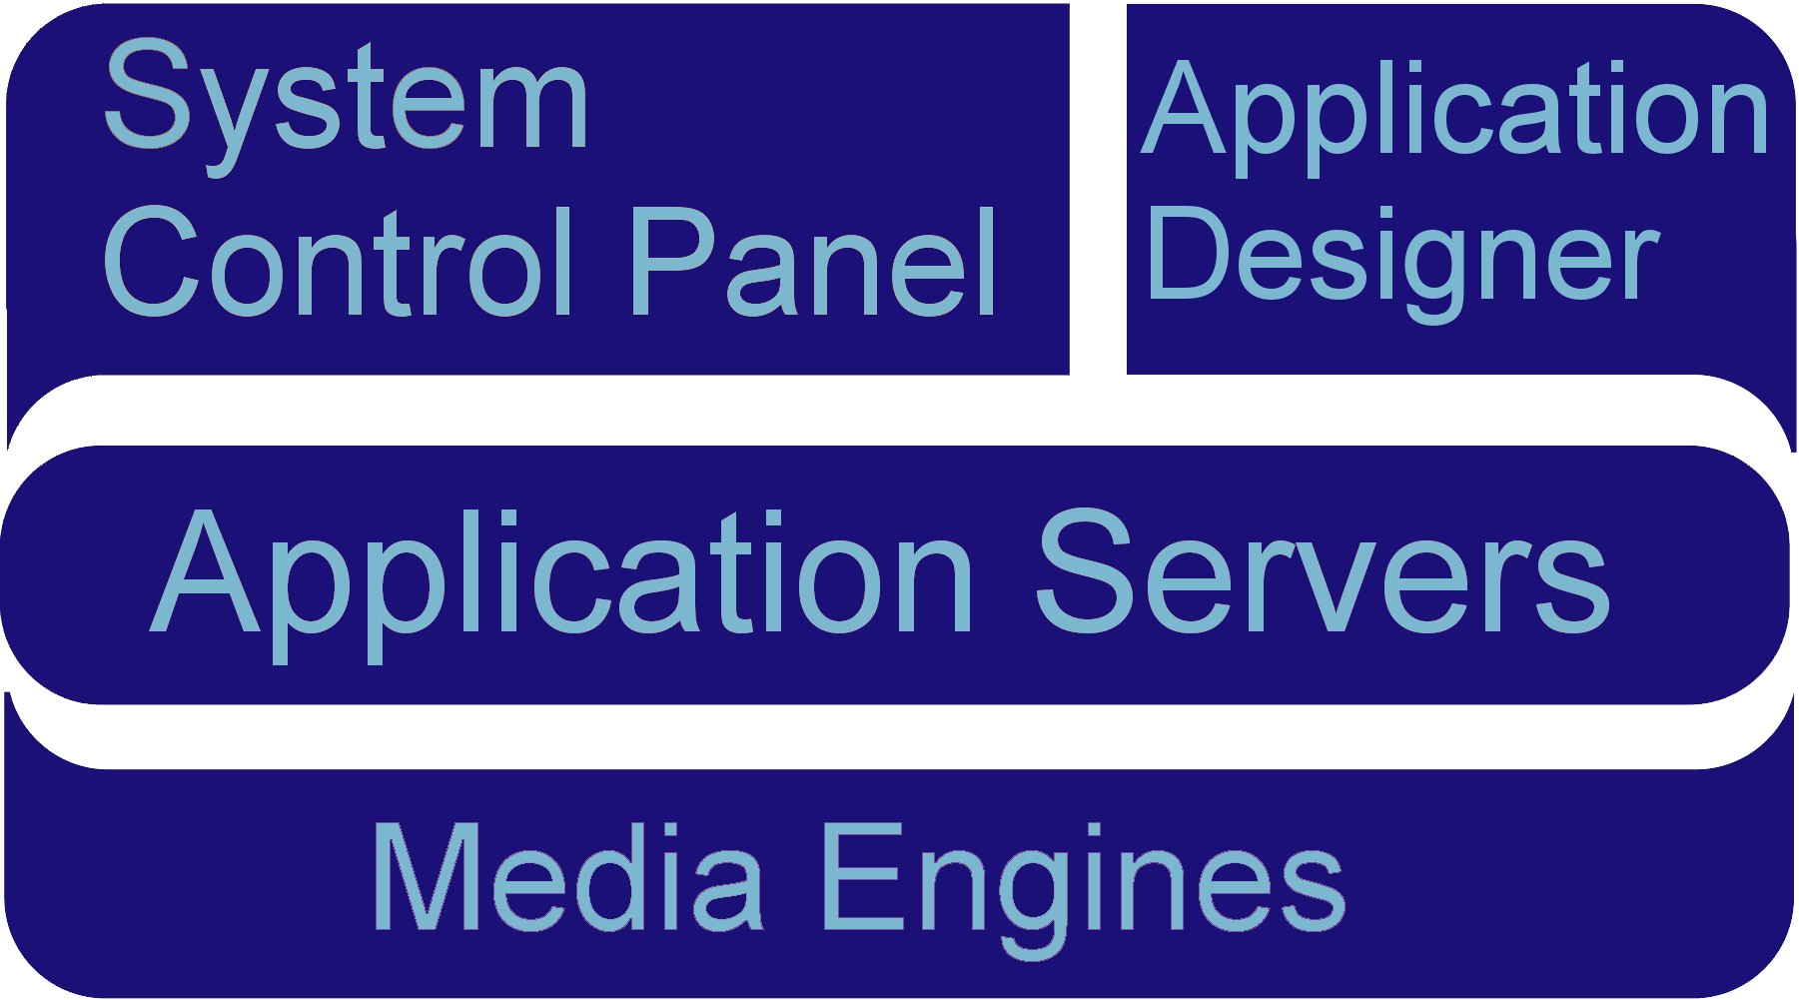
Core Elements
System Control Panel manages configurations.
Application Designer enable developers to build applications.
Application Server is the heart of the system.
Media Engines provide audio stream control.
PHP
(Server)
C#
(Client)
C#, Java
(Server)
C++
(Server)

Slide 10
Core Elements Formally Defined
Application Designer
  A Windows-based client application used to rapidly build and deploy applications to the Application Server.
Application Server
  A server-side solution designed from the ground up to host IP telephony applications.
Media Engine
  A server-side solution to provide rich media processing, tightly-integrated into the Application Server.
System Control Panel
  A web-based management tool hosted on the Application Server that provides administrative configuration and reporting options.
Notes:
The Application Designer is a Windows-based client application used to rapidly build and deploy applications to the Application Server.
Application Designer Requirements:
Windows 2000 / 2003 / XP
.NET Framework v1.1
Microsoft Web Services Extensions
The Application Server is a server-side solution designed from the ground up to host IP telephony applications. It presents a new model for developing and deploying integrated, media-rich IP telephony applications. The Application Server eliminates the mystery of telephony and the underlying communications platform enabling developers to leverage convergence for innovation. In layman’s terms, the Application Server is the heart of the system.
Application Server Requirements:
MCS 7845H-1 in Oct. 2006, 7845H-2, 7825, 7835 in January-April ‘07 timeframe.
Windows 2003 Server
.NET Framework v1.1
J2SE v1.5
Apache v1.3 (with PHP)
MySQL v4.1
The Media Engine is a server-side solution to provide rich media processing, tightly-integrated into the Application Server. Essentially, the Media Engine provides audio stream control.
Media Engine Requirements:
MCS 7845H-1 in Oct. 2006, 7845H-2, 7825, 7835 in January-April ’07 timeframe.
Windows 2003 Server
The System Control Panel is a web-based management tool hosted on the Application Server that provides administrative configuration and reporting options.
Application Designer Requirements:
Web Browser

Slide 11
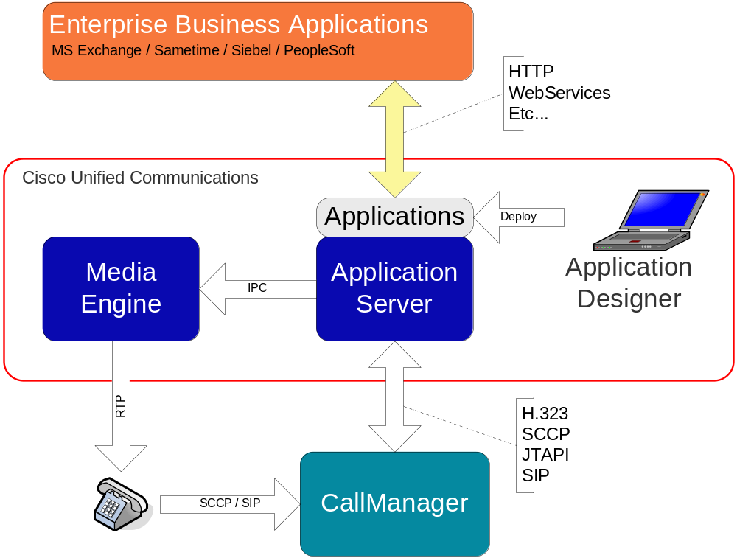
CUAE Combines Voice and Data
CUAE brings voice to data applications …
… and data to voice applications
Enabling truly unique IP communications applications to be built, deployed, and managed

Slide 12

INTRODUCTION TO THE TECHNOLOGY
Core Elements: Application Server

Slide 13
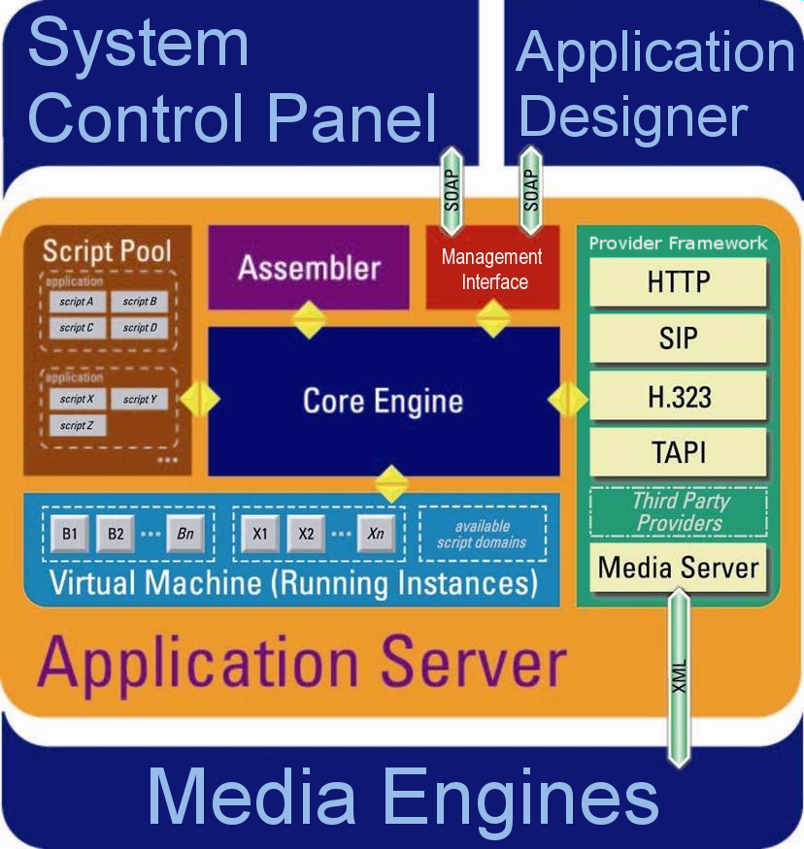
Application Server – Internal Components

Slide 14
Cisco Unified Application Server
Core of the platform.
Applications are stored and
execute within the Application
Server.
Application scripts are assembled
from an XML intermediate language
into in-memory compiled code
ready for execution.
A virtual machine inside the
application server manages the
execution of the application.
Facilitates communication with external systems through protocol providers in the Provider Framework.
Notes:
The Cisco Unified Application Server is the core of the platform. It starts, executes, terminates, and manages application script execution. Each application operates in its own runtime environment; for every application there is a separate virtual machine on which the application scripts run.

Slide 15
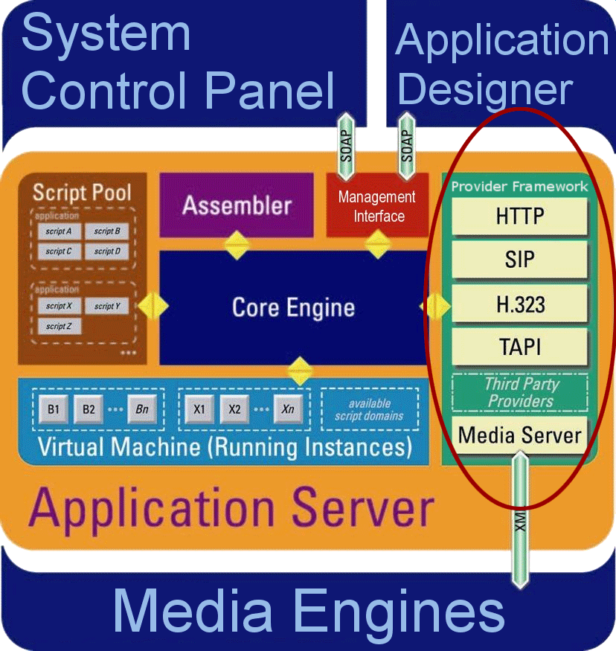
Application Server: Protocol Providers
Provide the “glue” between the
Application Server and
external systems.
Functional equivalent of a
Unix daemon process or
Windows service.
Able to persist data and
maintain state.
Expose Events and Actions to application layer.
Visible to developer through the Application Designer.

Slide 16
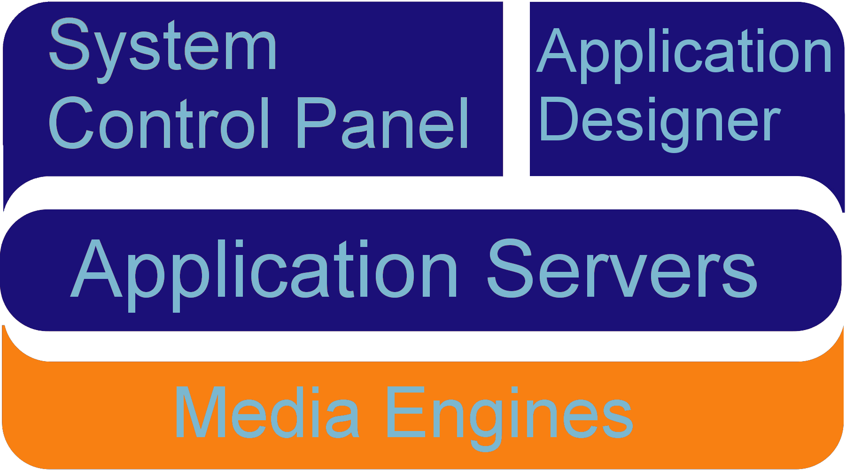
INTRODUCTION TO THE TECHNOLOGY
Core Elements: Media Engine

Slide 17
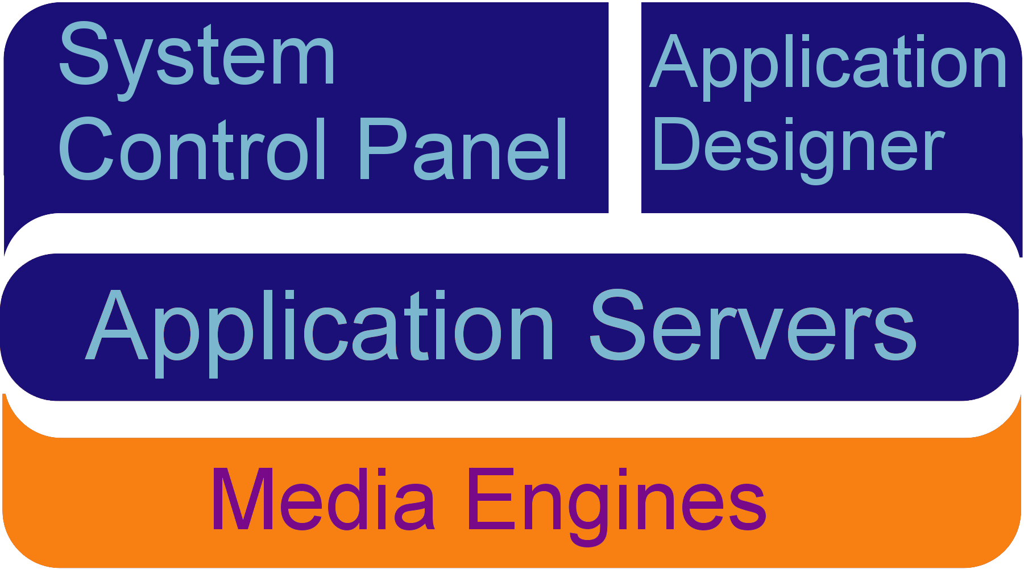
Cisco Unified Media Engine
Software implementation of
digital signaling processor (DSP).
Originates and terminates
voice media streams on behalf
of applications.
Tightly coupled with the Application Server via
an XML RPC interface.
Capable of processing up to 240 (soon 400) distinct media streams.
Scalable independent of the application server.
All media processing capabilities exposed in an
easy-to-use manner inside of Application Designer.

Slide 18
Media Engine Feature Highlights
Scalability
  Up to 240 (soon 400) concurrent connections per box.
  Scales independent of application server nodes.
IVR
  Play and Record in VOX and WAV format.
  Play multiple prompts in sequence.
  DTMF detection; in-band (including RFC2833) and out-of-band.
  Complex “termination” conditions.
Conferencing
  Individual conferee mute and kick.
  Conference recording. Up to 64 concurrent conferences being recorded per box.
Advanced Features
  Multicast support for IVR.
  Speech support using Nuance or Speechworks.
  Low bit-rate coders (G.723 and G.729a).
  Text-to-speech using embedded Neospeech server

Slide 19
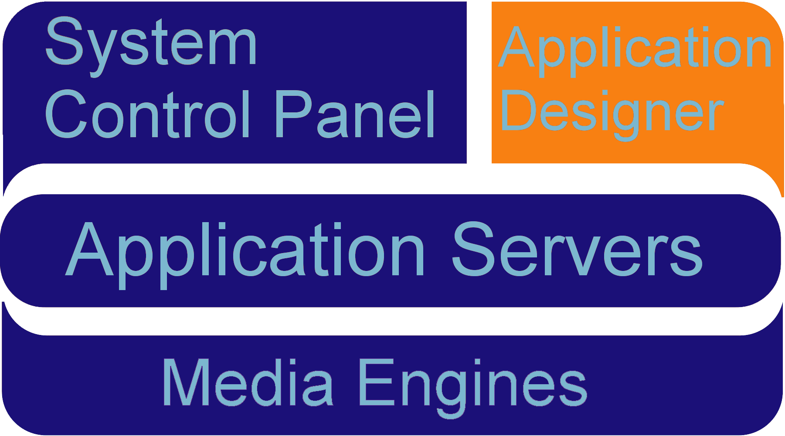
INTRODUCTION TO THE TECHNOLOGY
Core Elements: Application Designer

Slide 20
Application Designer
Visually construct communications
business logic.
  Extensive catalog of communications
  actions.
  Abstracts and consolidates
  IP telephony protocols
  (SIP, H.323, JTAPI, SCCP) into
  the CallControl API.
  Encapsulates common technology interfaces for modern applications: LDAP, SQL, Web Services, CCM APIs, …
Single tool for building complete IPT applications.
Targeted at someone with a few years programming experience.
Integrated with the Application Server for instant deployment.

Slide 21
Application Designer – Key Features
Graphical Application Definition
Application Integrity Checks
Extensible Toolbox
Embedded Code
One-Click Deployment
Runtime Debugging
Instant Web Services Integration

Slide 22
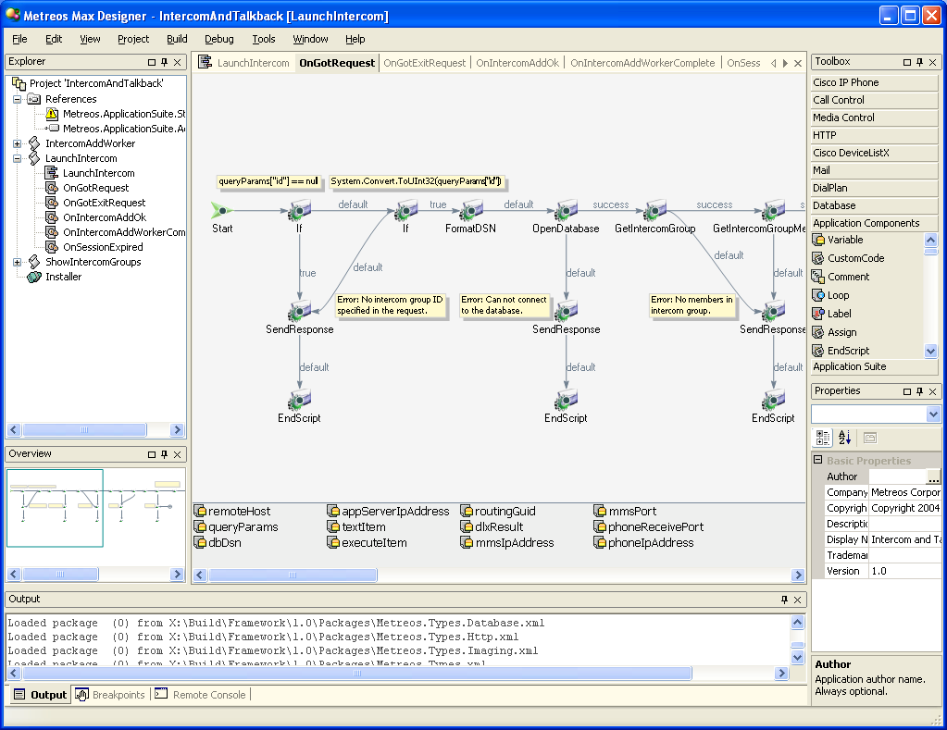
Application Designer

Slide 23
Application Designer
Explorer pane (tree view)
  Shows scripts, functions, and other resources
  Indicates which resource is currently being edited
Primary window
  Each tab (canvas) represents a function in the current script
  View may change depending on resource selected
Toolbar
  Customizable collections of actions
Properties
  Provides extensive configurability for all items
Output
  Shows the status and log of the current operation (i.e. Build)

Slide 24
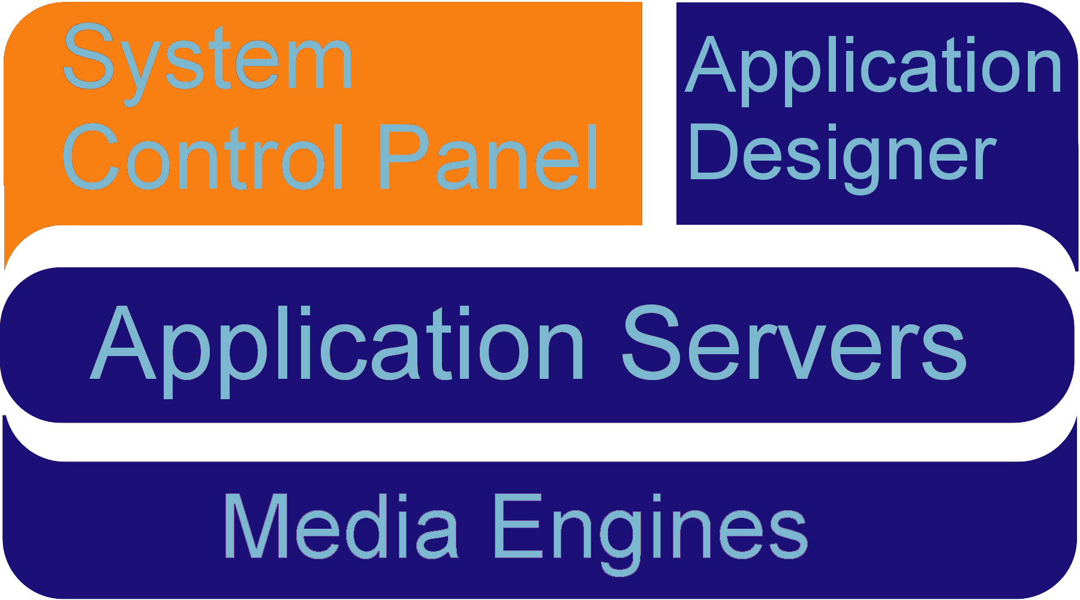
INTRODUCTION TO THE TECHNOLOGY
Core Elements: System Control Panel

Slide 25
System Control Panel Overview
Web-based management console for configuring the Application Server:
  Manage applications
  Manage protocol providers
  Manage media engines
  Manage telephony servers
  Network settings
  System Backup/Restore
  License management
  User management
  Logs and Diagnostics

Slide 26
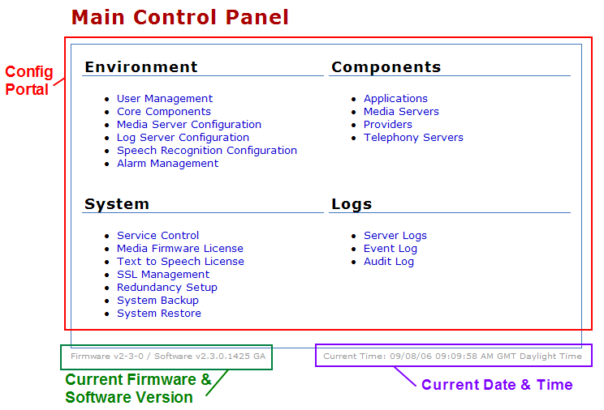
System Control Panel: Main Page

Slide 27
INTRODUCTION TO THE SYSTEM CONTROL PANEL
a.k.a. MCEAdmin

Slide 28

MCEADMIN: Navigation
Breadcrumbs will show you where you are at in mceadmin.
Above the logout button a status will be displayed indicating whether mceadmin is currently communicating with the application server.
Status
Breadcrumbs

Slide 29
MCEADMIN: Layout
Tasks are segmented into four main groups:
Environment – System service parameters, global configuration of software.
Components – Management of applications, providers, media servers, and telephony servers.
System – Platform related tasks such as network setup, date & time configuration, and licensing.
Logs – Log file management and download.

Slide 30
MCEADMIN: Main Page

Slide 31
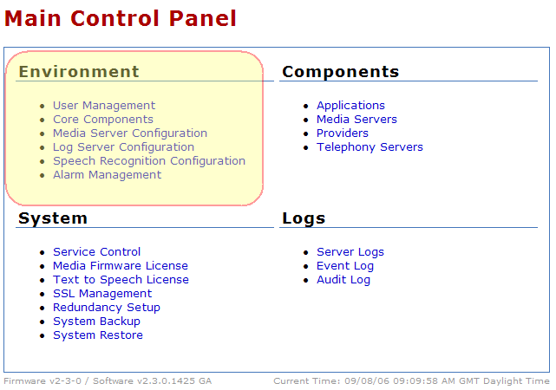
MCEADMIN: Environment Settings

Slide 32
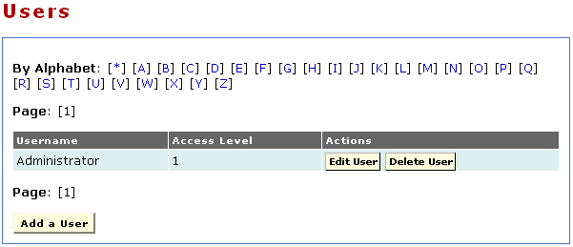
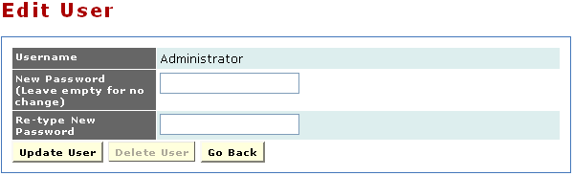
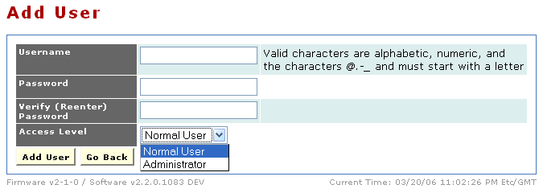
Environment: User Management
Active User List
Access Level for
New User

Slide 33
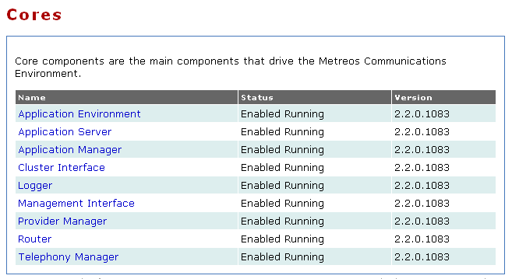
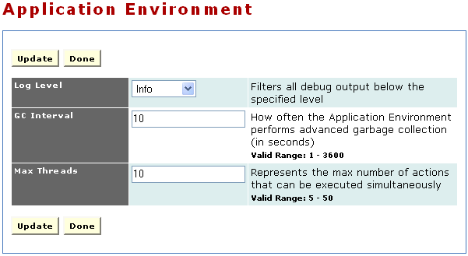
Environment: Core Components
Is the component operational?
Some config options have input criteria as shown here.
Indicates which core component to edit
Available config options
Notes:
Core components are the main components that drive the Cisco Unified Application Environment.
• Application Server — Contains all core components and serves as a bootstrap loader for the other core elements.
• Provider Manager — Manages loading and unloading of providers.
• Router — Routes actions and events between providers and applications.
• Telephony Manager — Manages the details of establishing and terminating calls.
• Application Manager — Manages the installation and removal of applications.
• Management Interface — Notifies the core engine of changes to the application server configuration.
• Application Environment — A virtual machine providing a runtime environment in which IP telephony applications can be executed.
• Logger — Manages log messages.
The following sections provide details on each of the core components.
Application Environment
When an application script is executed, it runs in its own environment segregated from all other components and applications by virtue of process boundaries provided by the Application Environment. This section also contains a config item that will be used often for support, the Application Environment Log LevelIf one is troubleshooting an application, turning up this log level will provide more details about the application environment.
Application Server
The Cisco Unified Application Server starts, executes, terminates, and manages application script execution. Each application operates in its own runtime environment; for every application there separate virtual machine on which the application scripts run. You can configure the Cisco Unified Application Server to host any applications created by the Application Designer. An application normally includes configuration items that are unique to deployment and which you must configure after the application is installed. All application configuration occurs at the partition level, as explained in the next section.
Application Manager
The Application Manager’s primary responsibility is to manage applications as they progress through the application life cycle. It unpackages applications and creates the application runtime environment on behalf of applications, as well as routing debugger commands to the appropriate application. You can use the Application Manager to install an application by uploading a Cisco Unified installation package through the management console. The system automatically unpackages the installer and performs the installation process.
Logger
The Logger manages log messages. The Cisco Unified Logger uses trace listeners to route log messages to various log sinks based on configurable criteria. The standard logs packaged with the Application
Runtime Environment are:
• Debug Logger — Writes logs to the Windows debug queue. A third-party application, DebugView
available from SysInternals is required to view it. DebugView is available at
http://www.sysinternals.com/ntw2k/freeware/debugview.shtml.
• Console Logger — Writes logs to the console (stdout).
• Event Logger — Writes logs to the Windows event log.
• File Logger — Writes logs to a file.
• TCP Logger — Writes logs to any number of TCP connections, such as the remote console feature
of the Cisco Unified Application Designer.
• Log Server Logger — Centralized repository for all logs in a production environment.

Slide 34
Environment: Core Components
Is the component operational?
Some config options have input criteria as shown here.
Indicates which core component to edit
Available config options
Notes:
Management Interface
The Management Interface listens on a socket (8120 by default) and accepts TCP connections from the management console. The console uses this interface to notify the core engine of changes to the Application Runtime Environment configuration. The management interface exposes the following functions:
• Execute provider extensions (special actions exposed by the provider for management purposes).
• Enable and disable applications.
• Install and uninstall applications.
• Enable and disable providers.
• Install/uninstall providers.
• Add and remove media servers.
• Add and remove Cisco Unified CallManager clusters.
Provider Manager
The Provider Manager is responsible for instantiating and managing providers. Similar to a system process or daemon, a provider typically opens network ports and allows the Application Runtime Environment to communicate with other devices on a network. You can use the Provider Manager to load and unload providers and to manage basic administrative tasks; for example, monitoring providers to ensure that they are running.
Router
In the Cisco Unified system, applications specify sets of triggering criteria. After an instance of an application is triggered, the router retains the state of that instance and routes subsequent events until the instance terminates.
Telephony Manager
IP telephony applications require complex protocols to establish connections between devices, exchange messages among them, and disconnect them when appropriate. The Telephony Manager streamlines this process for the user by abstracting implementation details.
The Telephony Manager also allows you to enable and disable sandboxing. Sandboxing is a system-level, fail-safe capability that ensures system resources do not remain in use after a script ends. If a script stops prematurely, it might not be able to terminate outstanding calls, and the media resources for those calls would remain in use. In such an event, sandboxing permits the Telephony Manager to release media resources. Sandboxing is globally disabled by default, but can be enabled on the Telephony Manager Configuration page. Ensure that sandboxing is disabled if you have an application in which control of the call is transferred from one script to another. In such cases, the call is still in progress and media resources are retained after the original script instance terminates. The Telephony Manager detects that the original script has terminated but the media has not been released. If sandboxing is enabled, the Telephony Manager releases the media on behalf of the original script and terminates the call.

Slide 35
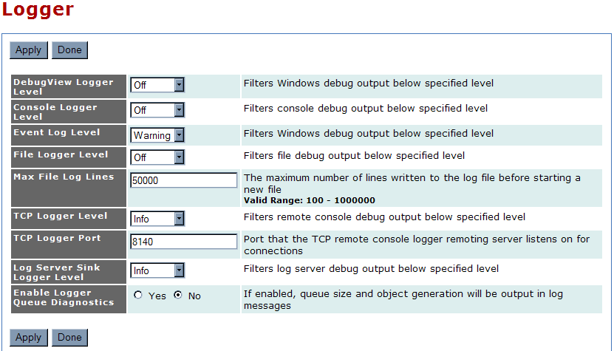
Logs: Server Log: Setting Log Level
Notes:
When beginning to troubleshoot, it is often a good idea to increase the log levels to ‘verbose’.
To set the log level:
1. Go to Main Control Panel -> Core Components -> Application Environment
Increase the level of logs generated by the Application Environment to ‘verbose’
2. Go to Main Control Panel -> Core Components -> Logger
Increase the Log Server Sink to ‘verbose’ otherwise higher level logs will be filtered.
Logger
The Logger manages log messages. The Cisco Unified Logger uses trace listeners to route log messages
to various log sinks based on configurable criteria. The standard logs packaged with the Application
Runtime Environment are:
• Debug Logger — Writes logs to the Windows debug queue. A third-party application, DebugView available from SysInternals is required to view it. DebugView is available at http://www.sysinternals.com/ntw2k/freeware/debugview.shtml.
• Console Logger — Writes logs to the console (stdout).
• Event Logger — Writes logs to the Windows event log.
• File Logger — Writes logs to a file.
• TCP Logger — Writes logs to any number of TCP connections, such as the remote console feature of the Cisco Unified Application Designer.
• Log Server Sink Logger — Centralized repository for all logs in a production environment. This controls the log level you see in Main Control Panel > Server Logs
Log Level Descriptions:
Off - No logging
Error - Only error messages written to log
Warning - Only warning and error messages written to log
Information - Warning, error, and terse event information messages written to the log
Verbose - Warning, error, and detailed event information messages to the log

Slide 36
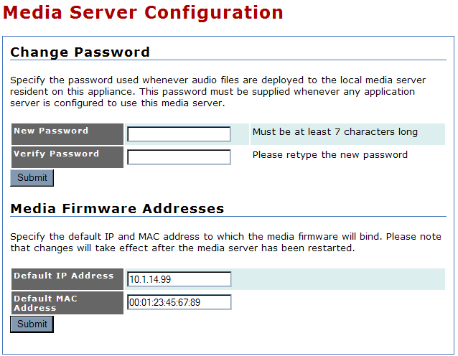
Environment: Media Server Configuration

Slide 37
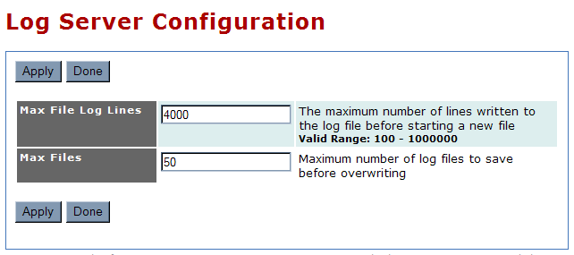
Environment: Log Server Configuration

Slide 38
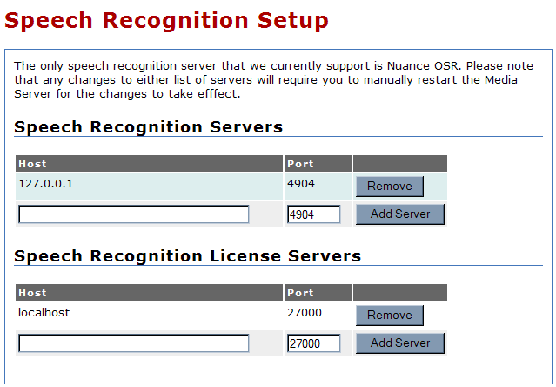
Environment: Speech Recognition Configuration
Notes:
Remember to restart the Media Engine when any changes are made to either list of Speech Recognition Servers

Slide 39
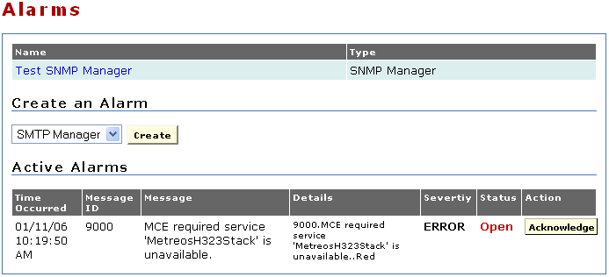
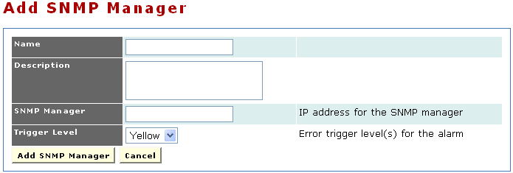
Environment: Alarm Management
Add/Remove alarm destinations (SNMP or SMTP) and manage active alarms.
Existing alarm destinations already configured
Active alarms (if any)
Notes:
Add/Remove alarm destinations (SNMP or SMTP) and manage active alarms.
Two types of alarm managers are supported as destinations. Below are the alarm manager types and the fields required to configure them:
SMTP
Name - Name of alarm
Description - Description of alarm
Recipient - Email address to which to send alarm message
Sender - Email address from which to send alarm message
Server - IP address of SMTP server
Username (Optional) - User name for outbound SMTP authentication
Password (Optional) - Password for outbound SMTP authentication
Server Port - SMTP server port (default is 25)
Trigger Level - Event level that triggers alarm
SNMP
Name - Name of alarm
Description - Description of alarm
SNMP Manager - IP address of SNMP manager
Trigger Level - Event level that triggers alarm

Slide 40
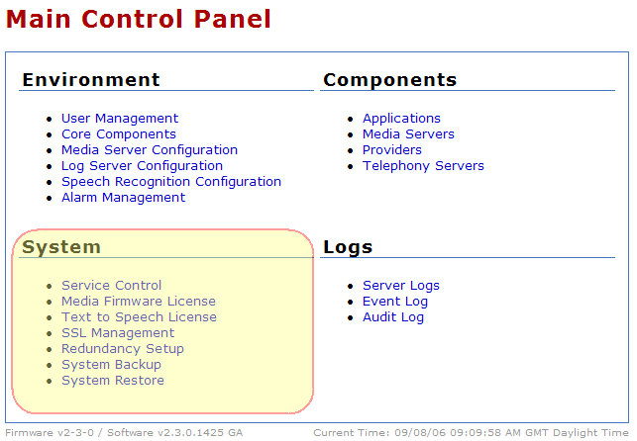
MCEADMIN: System Settings

Slide 41
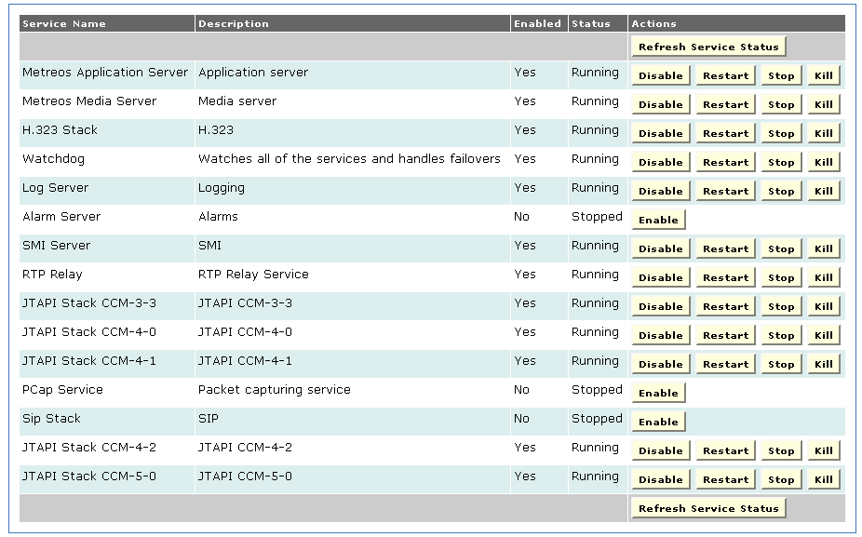
System: Service Control
Enable, Disable, Start, Stop platform services
Service Status
Service
Name
Service
Control
Notes:
The following information is presented for each service:
• Service Name — Name of service
• Description — Explanation of service
• Enabled — Indication of whether the service is active
• Status:
Running — Service is available
Stop Pending — Service is shutting down
Stopped — Service is not available
Start Pending — Service is starting up
• Action:
Disable — Make service available (disallows automatic start at reboot)
Restart — Stop and restart
Stop — Make service unavailable
Enable — Allow automatic start at reboot
Start — Make service available
An enabled service automatically starts when the system is rebooted; a disabled service does not. When
a service is disabled, the system automatically stops it.
To perform an action on a service, click the desired button to the right of the action.

Slide 42
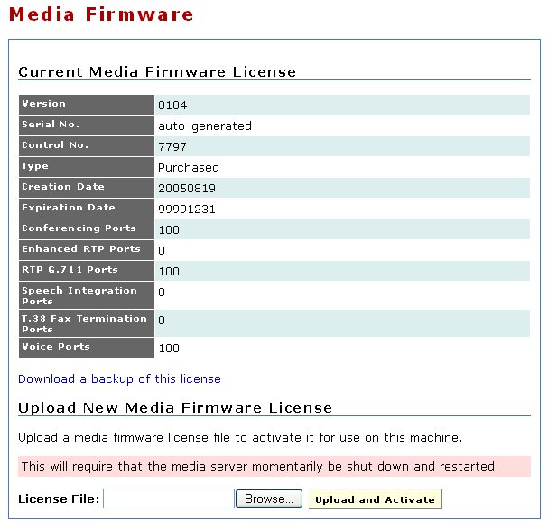
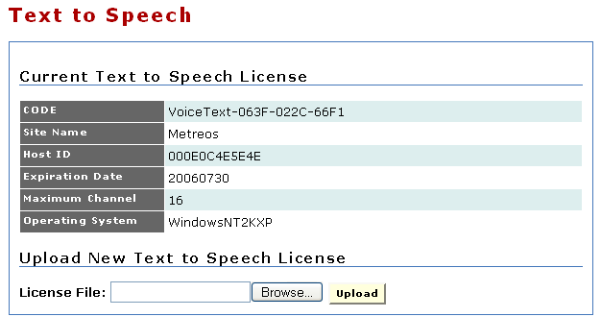
System: Firmware Licensing
Install licenses to unlock media and TTS ports
Current license details
Install a new media firmware or TTS license
Notes:
Be sure that the Media Server is running before you apply a media firmware license.
Once the license is applied, the server must be manually rebooted.
Questions regarding new licenses and issues with licenses should be sent to cume-license-support@cisco.com
Technical Description of each resource
RTP - Represents one (1) send/receive G.711 RTP stream
Enhanced RTP - Augments an RTP resource (1 RTP component is required to use 1 Enhanced RTP). Represents one (1) send/receive low-bite rate RTP stream, such as G.723 or G.729.
Conference - When an HMP mixes the audio of some number of RTP or enhanced RTP streams, it must use one (1) conference resource per participant. It must also use a conference resource per virtual Voice participant.
Voice - A media operation on top of an RTP, enhanced RTP, or Conference resource, such as playing media, recording, digit detection, etc.
Speech - Augments a voice resource (1 Voice component is required to use Speech). Speech (CSP) is used as an add-on to a Voice Resource.
With CSP, one can also stream out file chunks real-time based on the incoming media on an RTP/eRTP resource, as well as providing 'cleaning' operations on the voice quality. CSP also provides a 'barge-on-voice' ability, which is very accurate compared to non-silence, in determining if someone is talking

Slide 43
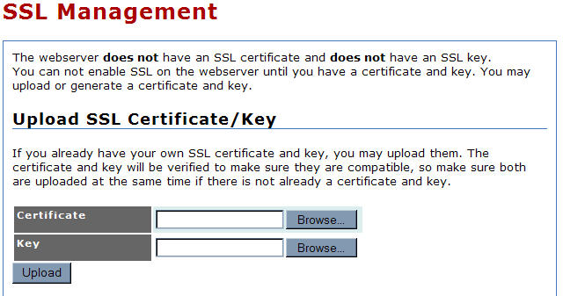
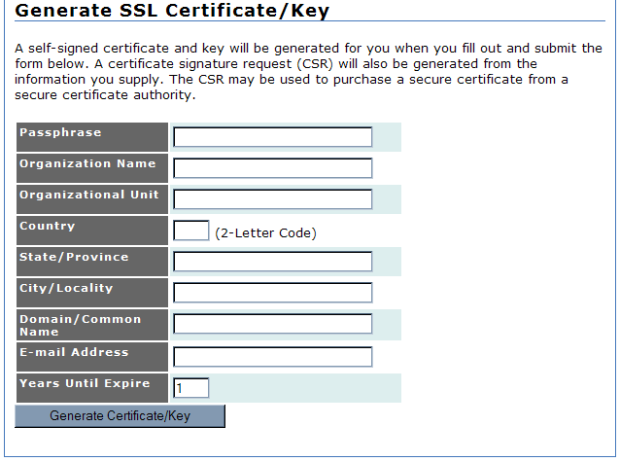
System: SSL Management
Notes:
The management console web server does not have an SSL certificate or SSL key. To enable SSL on the
server, you must generate or upload a certificate and key.
Open the SSL Management page to manage SSL certificates and keys.
If you already have your own SSL certificate and key, they are verified upon upload to make sure that
they are compatible. Make sure you upload them at the same time.
If you do not already have your own SSL certificate and key, A self-signed certificate and key will be generated for you when you fill out and submit the Generate SSL Certificate/Key form. A certificate signature request (CSR) will also be generated from the information you supply. The CSR may be used to purchase a secure certificate from a secure certificate authority.

Slide 44
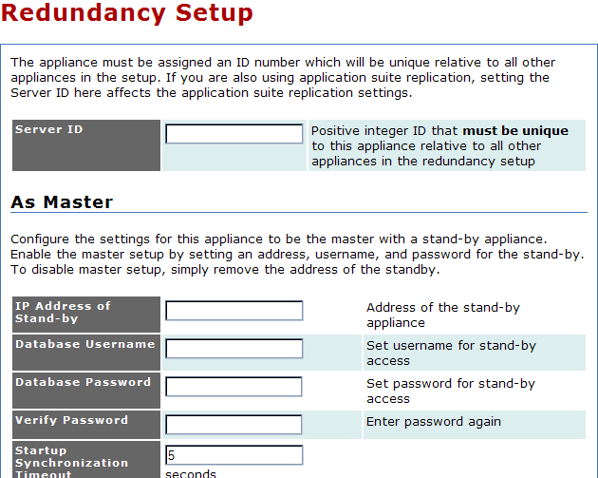
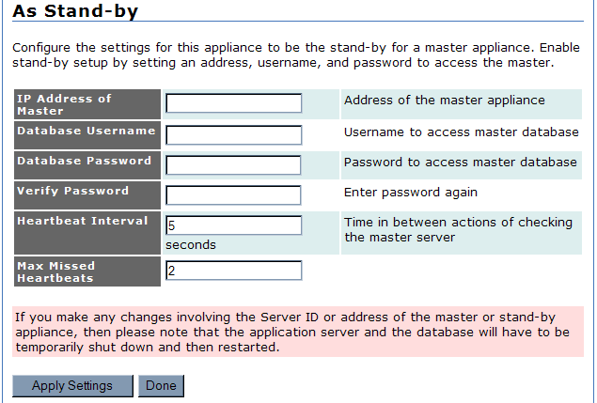
System: Redundancy Setup
Notes:
Cisco Unified Application Environment supports redundant operations. You can configure a master and
stand-by application server; the stand-by server then attempts to contact the master server every few
seconds. If a configured number of attempts fails, the stand-by server takes over.
Use the Redundancy Setup page to assign a unique ID number for each of the application
servers and to configure the master and stand-by servers.
The appliance must be assigned an ID number which will be unique relative to all other appliances in the setup. If you are also using application suite replication, setting the Server ID here affects the application suite replication settings.
It is possible to configure the settings for the appliance to be the master with a stand-by appliance. Enable the master setup by setting an address, username, and password for the stand-by. To disable master setup, simply remove the address of the standby.
Similarly, it is possible to configure the settings for the appliance to be the stand-by for a master appliance. Enable stand-by setup by setting the IP address of the master, username, password, heartbeat interval, and the maximum number of heartbeats missed.
Be aware, if you make any changes involving the Server ID or address of the master or stand-by appliance, then please note that the application server and the database will have to be temporarily shut down and then restarted.

Slide 45
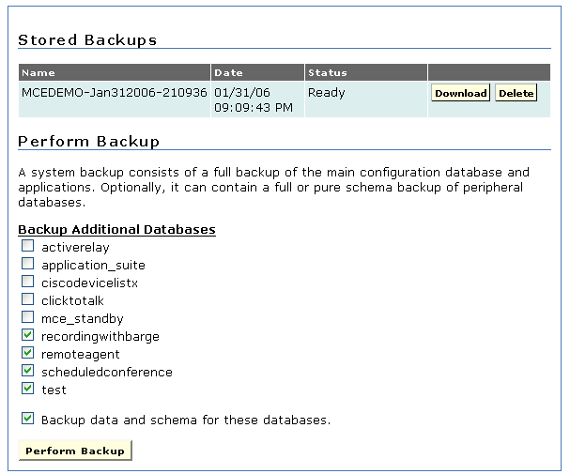
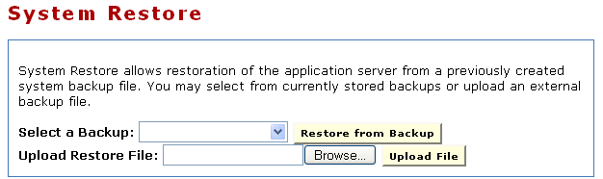
System: System Backup/Restore
Save and load configuration settings for an appliance.
View Existing Backups
Restore an existing backup or from a backup file
Backup additional databases and schemas

Slide 46
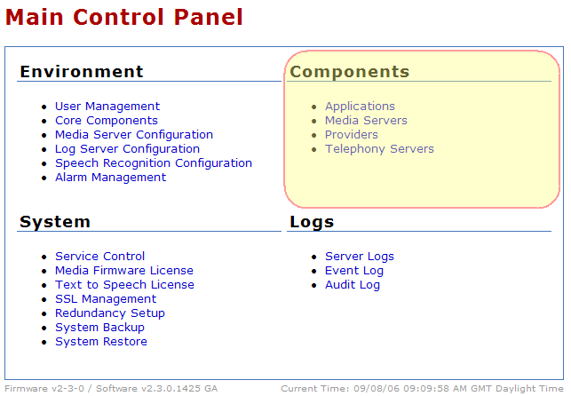
MCEADMIN: Components Settings

Slide 47
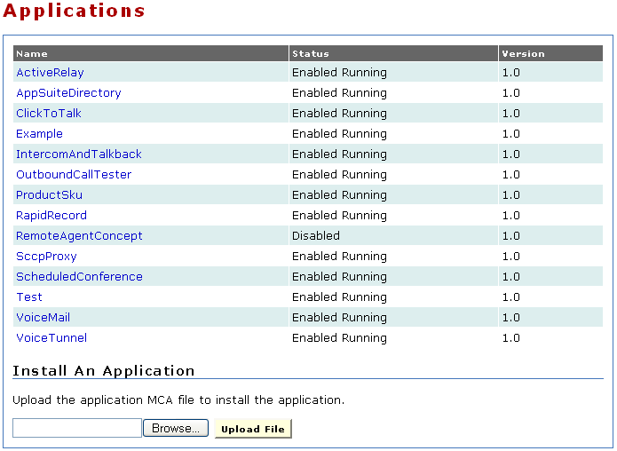
Components: Applications
Install and manage applications.
Is the application operational?
Currently installed applications
Current version of the application
Install a new application
Notes:
The Applications link in the Components section allows the administrator to install and uninstall applications.
The page displays the application name, the status, and the version. The application name is displayed as a link.
An application usually includes configuration items that are unique to your deployment and which you
must configure after the application is installed. To configure these settings, click on the application name.

Slide 48
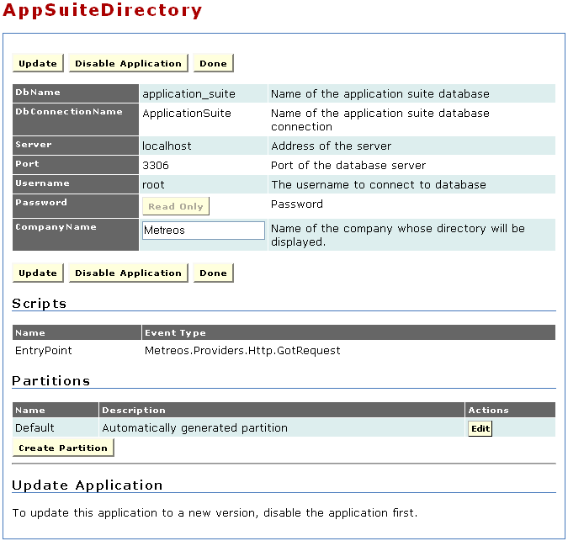
Components: Applications (continued)
Application controls
Global config for all partitions
List of the scripts in the app
Application partitions
Notes:
On the application’s configuration page, there are several sections. The top section displays the global configurations, which are applied to all partitions. The section in the middle, labeled Scripts, lists the scripts that make up the application. Under the Scripts section is a section for Partitions.
Partitions are flexible and can be useful in a variety of situations. For example, if an application is intended to serve end-users located on distinct Cisco Unified CallManager clusters, it is desirable for all call control and media streams to terminate to the cluster and the corresponding network and telephony resources. At the same time, it may be desirable to have another configurable protocol on the application, such as LDAP, which makes reference to the same central location, regardless of the partition. Each partition is associated with a call route group and media resource group. By defining unique call route groups and media resource groups, you can identify the partitions that use individual media servers. For each partition, you can also determine which Cisco Unified CallManager cluster is used for making calls by specifying a call route group that corresponds to the particular telephony protocol and group.
Application configuration occurs at the partition level. A partition is essentially a configuration profile for an application. Applications can support multiple partitions, enabling you to create and execute multiple versions (configurations) of the same application on a single Cisco Unified Application server. Clicking the edit button next to a partition will bring up a configuration page that applies specifically to that partition.

Slide 49
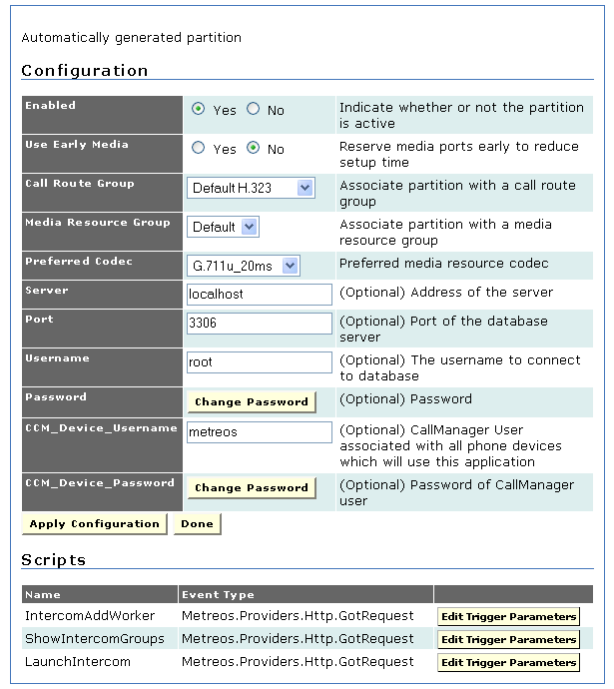
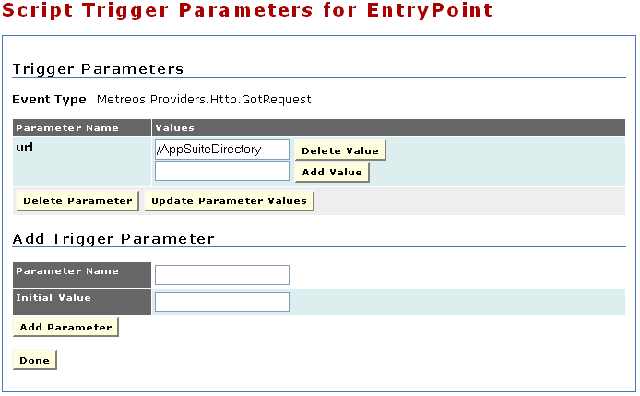
Components: Applications (continued)
Editing a partition brings up partition specific config information and trigger parameters.
Partition-specific config
Edit existing trigger parameters
Add new trigger parameters
Notes:
Configuration
Inside application’s configuration page, the administrator can specify settings specific to that partition. In addition to settings that every partition must have, there are additional items to be configured depending on the application’s design.
The common partition configurations are :
Enable - Indication of whether or not the partition is active
Reserve Media Early - Field in which to reserve media ports early to reduce setup time.
Call Route Group - Used by an application only when making outbound calls. The protocol of the inbound call is determined by a combination of Cisco Unified CallManager configuration and triggering parameters on the partitioned script.
Media Resource Group - Media server group that is closest in proximity to IP endpoints that will be using this application.
Preferred Codec - Preferred media resource codec.
Scripts
Each application is also associated with scripts, which are partitioned along with the application. Because multiple scripts may execute actions through the same protocol, you must specify the conditions under which a partitioned script should initiate action. For example, assume that two applications are installed, each with its own script and partition, and that
both scripts trigger on an HTTP request. You must specify which condition (triggering parameter) causes the first script to trigger, and which causes the second script to trigger. You could configure one script to trigger when a request to the URL <serverIP>/AppSuiteDirectory is made, but trigger a different script when a request to a different URL is received.
Triggers
Trigger parameters always have a name that you use in the administrative interface (case-insensitive). The Parameter Name is the name of the field type and the Initial Value is the value that will be compared to the event when it actually occurs.
Some common examples of parameter names are:
Metreos.CallControl.IncomingCall
To (example Initial Value 2000)
From (example Initial Value 2000)
OriginalTo (example Initial Value 2000)
Metreos.Providers.Http.GotRequest
Url (example Initial Value /MyAppTrigger)
**You can’t use CallManager syntax for the call control trigger parameters; however, you can use regular expressions.
Example: regex:7[0-9*#] [0-9*#] [0-9*#] , which would be = 7XXX
** One can also use lists of literal trigger values (regex can’t be a part of a list)

Slide 50
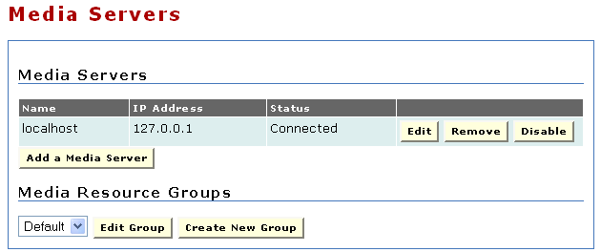
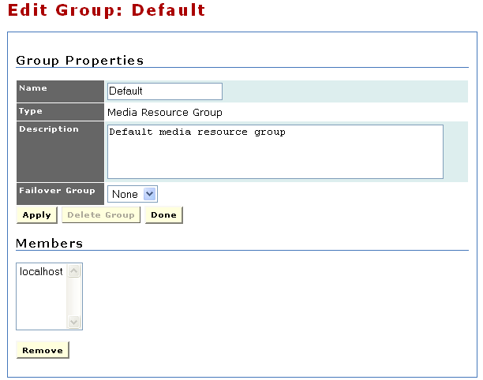
Components: Media Servers
Add and remove media servers. If a media server is listed here, the application server on the appliance maintains a connection to it.
Existing media servers
Edit or create media resource groups
Group members
Notes:
Use the Media Servers page to create and configure media servers as well as media server groups. Each media server must be associated with at least one group, but it can be associated with multiple groups. In facet, A media server cannot be used unless it is associated with a group. If removed from a group, it must be reassigned before an application can access it; if not explicitly added to a group, it will be inaccessible. The members of each group can be managed by selecting the name of the Media resource group from the drop-down and clicking the edit button.
A media server group is a container for a collection of one or more media servers. The system provides a default media server group, but if more than one group is required, then multiple groups can be created. Furthermore, if multiple groups are defined, one group can be specified as a failover group for the other one.
When adding a new media server, the commons configurations are:
Name - Name of media server
IP Address - IP address of media server
Password - Password for access to media server
Connection - Type Method of connecting to media server (unless otherwise instructed, use IPC)
Add to Group - Group to which media server is assigned

Slide 51
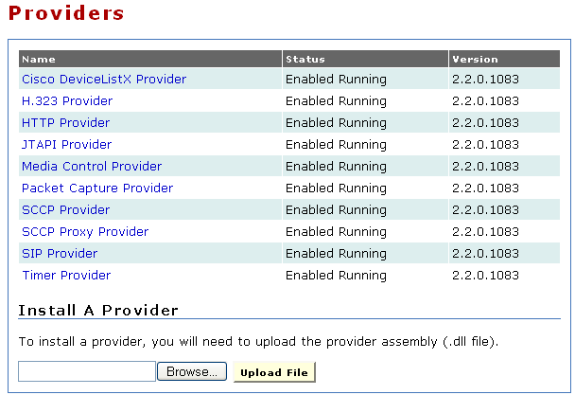
Components: Providers
Install and manage providers.
Is provider operational?
Currently installed providers
Current version of the provider
Install a new provider
Notes:
The Provider Manager is responsible for instantiating and managing providers. Similar to a system process or daemon, a provider typically opens network ports and allows the Application Runtime Environment to communicate with other devices on a network. The administrator can use the Providers page to display the list of providers shipped with the Cisco Unified Application Server, the status of each provider (Enabled Running or Disabled), and the version number. Clicking on the provider name launches the configuration page for that provider. Disabling the provider allows for its subsequent uninstallation, which resets it back to its default configuration settings and makes it unavailable. Restarting the application server will automatically restart the provider.

Slide 52
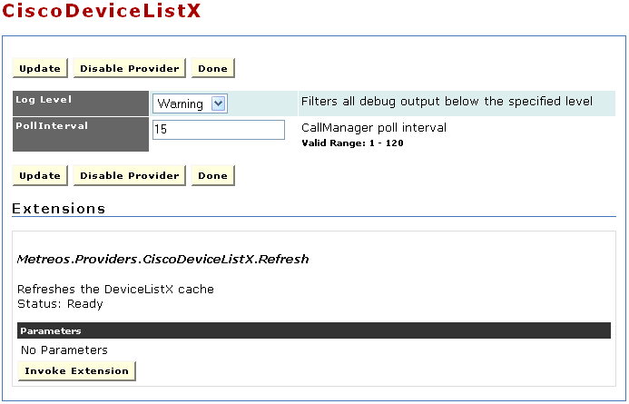
Components: Providers
Edit provider configuration and invoke provider extensions.
Provider controls
Provider configuration
Tell the provider to do something
Notes:
Each provider configuration page includes following sections:
• Configuration — Configurable parameters for the provider.
• Extensions — Special actions exposed by the provider and invoked only through the Management Console rather than by a script (not all providers have extensions)
The default installed providers and their settings are as follows:
• CiscoDeviceListX Provider
Log Level - Type and amount of information the system writes to the log for each component
Poll Interval - Interval in minutes between requests sent to Call Manager to refresh device information (cache refresh)
• H323Provider
Log Level - Type and amount of information the system writes to the log for each component
Port - Port Number of the port on which H323 listens
EnableStackDebugging - Field in which to enable StackDebugger, a tool that writes logs to a file for H.323 diagnostics
StackDebuggingLogLevel - Log level specifying detail of logs written by the StackDebugger (valid values are 0 – 5, where 0 disables debugging, and 5 maximizes debugging)
StackDebuggingLogFile - Name of log file for the StackDebuggingLog function
EnableProcessWindow - Field in which to configure H323 to write debug output to a window rather than a log file
• HTTP Provider
Log Level - Type and amount of information the system writes to the log for each component
Name - Name of HTTP provider
Port - Port Number of the port on which the provider listens
Session Expiration Minutes - Number of inactive minutes before the session is automatically terminated
Session Cleanup Minutes - Interval between clean-up of resources for terminated sessions in minutes
• JTAPI Provider
Log Level - Type and amount of information the system writes to the log for each component
Monitor Devices - Devices to monitor
User name - User with permission to monitor specified devices
Password - Password for user with permission to monitor the specified devices
CTI Manager - IP address of CTI manager
Backup CTI Manager - IP address of backup CTI manager
Max Calls per Device - Maximum number of calls allowed on any first-party CTI Port device (this value must match the equivalent value in Cisco CallManager)
Server version - Cisco Unified CallManager release
Advertise Low-bitrate Codecs - Indication of whether devices should be registered with G.723.1 and G.729a support

Slide 53
Components: Providers
Edit provider configuration and invoke provider extensions.
Provider controls
Provider configuration
Tell the provider to do something
Notes:
• Media Control Provider
Log Level - Type and amount of information the system writes to the log for each component
Connect Timeout - Interval in milliseconds before a connection is deemed unsuccessful and the system attempts to retry
Heartbeat Interval - Interval, in seconds, between heartbeat signals to a media server
Heartbeat Skew - Interval, in seconds, MediaControlProvider waits for a response to the heartbeat signal
DiagInboundConnectMessages - Inbound connect messages written to the Log Server.
DiagOutboundConnectMessages - Outbound connect messages written to the Log Server.
DiagOutboundDisconnectMessages - Outbound disconnect messages written to the Log Server.
DiagOutboundCommandMessages - Outbound command messages written to the Log Server.
DiagInboundResponseMessages - Responses written to the Log Server.
DiagHeartbeatResourceInfo - Heartbeat signal information written to the Log Server.
• SCCP Provider
Log Level - Filter for all debug output (below the specified level)
MaxBurst - Maximum registration messages per burst (5) (valid range: 1 - 2147483647)
InterBurstDelayMs - Milliseconds between bursts (1000) (valid range: 0 - 2147483647)
CallManagerPort - Port on which Cisco Unified CallManagers listen for registrations (2000) (valid range: 1024 - 32767)
AdvertiseLowBitRateCodecs - Indication of whether devices should also be registered with G.729a support (No)
MusicOnHoldOption - Indication of whether Music-On-Hold is enabled
LogCallVerbose - Verbose logging for call (Yes)
LogCallManagerVerbose - Verbose logging for CallManager (No)
LogConnectionVerbose - Verbose logging for connection (No)
LogDiscoveryVerbose - Verbose logging for discovery (No)
LogRegistrationVerbose - Verbose logging for registration (Yes)
LogSystemVerbose - Verbose logging for system (No)
• SIP Provider
Log Level - Filter for all debug output (below the specified level)
DefaultOutboundFromNumber - Default From number for outbound call
SIPTrunkIP - SIP Trunk IP address for outbound call (should match the IP used for SIP Trunk in CallManager)
SIPTrunkPort - SIP Trunk port for outbound call (should match the port used for SIP Trunk in CallManager)
MinRegistrationPort - Minimum TCP port number to use for registration with SIP server (valid range: 1024 - 65535)
MaxRegistrationPort - Maximum TCP port number to use for registration with SIP server (valid range: 1024 - 65535)
ServiceLogLevel - SIP service log level (0=Off, 1=Error, 2=Warning, 3=Info, 4=Verbose, valid range: 0 - 4)
LogTimingStat - Timing statistics (enabled when set to true)
• Timer Provider
Log Level - Type and amount of information the system writes to the log for each component
Enable Minute Events - Field in which to enable minute by minute timer events (enabled when set to true)
Enable Hour Events - Field in which to enable hourly timer events (enabled when set to true)
Enable Daily Events - Field in which to enable daily timer events will be generated (enabled when set to true)

Slide 54
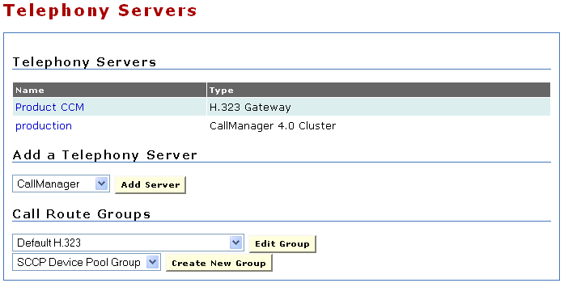
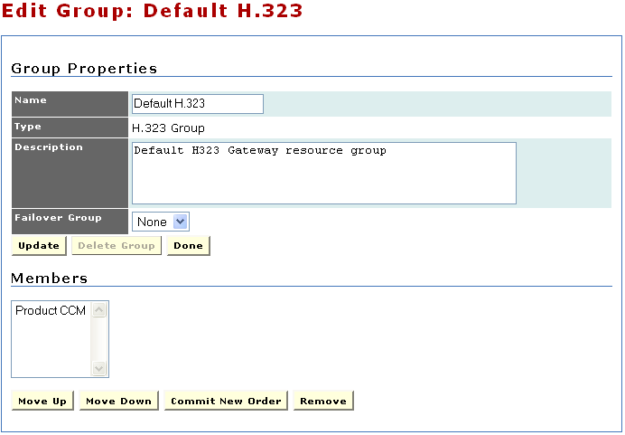
Components: Telephony Servers
Add, remove, and edit telephony servers.
Add and edit call route groups.
Existing telephony servers
Add new server
Add and edit call route groups
Edit group membership and priority
Notes:
Every IP telephony system must contain at least one telephony server. The Management Console
provides a telephony server configuration page for adding and configuring telephony servers and devices
on those servers.
The Application Server supports several types of telephony servers:
H.323 gateways — Telephony servers, which are used exclusively with H.323.
CallManager — Multipurpose telephony server devices supporting SCCP and CTI in the Cisco Unified system.
Cisco SIP domain—Defines a SIP interface into Cisco Unified CallManager. By creating a Cisco SIP domain, you can use SIP trunks and SIP devices that the Cisco Unified Application Server creates in Cisco Unified CallManager.
IETF SIP domain—Defines a telephony server that supports IETF-specific SIP.
When adding a telephony server, however, all of its devices must be associated with one
or more call route groups.
Just as a media server group functions as a container for media servers, a call route group functions as a
container for telephony devices. Each telephony device must belong to one or more groups.
Creating a call route group is optional; the system provides a default call route group to be used if
multiple groups are not needed.

Slide 55
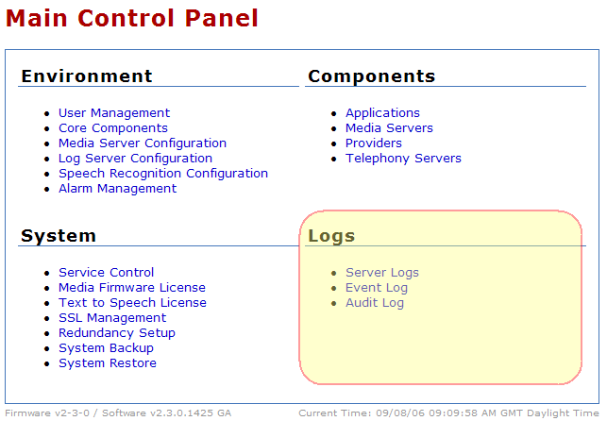
MCEADMIN: Logs Settings
Notes:
The following management console logs provide diagnostic information:
• Server Logs — Information about server activity.
• Event Log — Information about system events (e.g. H.323 stack is unavailable).
• Audit Log — All Application Environment activity. (this stamps who did what so you know who to blame)
The Cisco Unified Application Environment supports log level filtering. The log level determines the amount of recorded detail about logged events

Slide 56
Logs: Server Log: Setting Log Level
To increase the log level visit these two places:
Core Components -> Application Environment
Then, increase the level of logs generated by the Application Environment to ‘verbose’
Core Components -> Logger
Then, increase the Log Server Sink to ‘verbose’
Notes:
When beginning to troubleshoot, it is often a good idea to increase the log levels to ‘verbose’.
To set the log level:
1. Go to Main Control Panel -> Core Components -> Application Environment
Increase the level of logs generated by the Application Environment to ‘verbose’
2. Go to Main Control Panel -> Core Components -> Logger
Increase the Log Server Sink to ‘verbose’ otherwise higher level logs will be filtered.
Logger
The Logger manages log messages. The Cisco Unified Logger uses trace listeners to route log messages
to various log sinks based on configurable criteria. The standard logs packaged with the Application
Runtime Environment are:
• Debug Logger — Writes logs to the Windows debug queue. A third-party application, DebugView available from SysInternals is required to view it. DebugView is available at http://www.sysinternals.com/ntw2k/freeware/debugview.shtml.
• Console Logger — Writes logs to the console (stdout).
• Event Logger — Writes logs to the Windows event log.
• File Logger — Writes logs to a file.
• TCP Logger — Writes logs to any number of TCP connections, such as the remote console feature of the Cisco Unified Application Designer.
• Log Server Sink Logger — Centralized repository for all logs in a production environment. This controls the log level you see in Main Control Panel > Server Logs
Log Level Descriptions:
Off - No logging
Error - Only error messages written to log
Warning - Only warning and error messages written to log
Information - Warning, error, and terse event information messages written to the log
Verbose - Warning, error, and detailed event information messages to the log

Slide 57
Logs: Server Log: Setting Log Level (cont)
Difference between default Info Log Level and Verbose Log Level
14:50:04(29): Info: HP Placing call 1000005 to: 200004@10.89.31.42
14:50:04(29): Info: HP Initiated call: 1000005 = ip$localhost/25132
14:50:05(95): Info: HP SetMedia(1000005,rx:10.89.31.144:20488,tx:G711u,20,{G711a:2030,G711u:2030})
14:50:06(04): Warning: HandleMakeCall-5 No handler registered for 'Metreos.CallControl.StartTx' event
14:50:06(04): Warning: HandleMakeCall-5 No handler registered for 'Metreos.CallControl.StartRx' event
16:07:06(00): Info: HandleMakeCall-6 Starting script 'fff5592f-177d-4837-8aa6-1a3b99e56d45' (i=0)
16:07:06(01): Info: HP Placing call 1000006 to: 200004@10.89.31.42
16:07:06(01): Info: HP Initiated call: 1000006 = ip$localhost/25133
16:07:06(03): Info: HandleMakeCall-6 App: (3948) MakeCall application successfully initiated the call...
16:07:08(93): Info: HP SetMedia(1000006,rx:10.89.31.144:20490,tx:G711u,20,{G711a:2030,G711u:2030})
16:07:09(01): Info: MakeCall Enqueuing non-triggering event: Metreos.CallControl.StartTx
16:07:09(01): Warning: HandleMakeCall-6 No handler registered for 'Metreos.CallControl.StartTx' event
16:07:09(01): Info: MakeCall Enqueuing non-triggering event: Metreos.CallControl.StartRx
16:07:09(03): Warning: HandleMakeCall-6 No handler registered for 'Metreos.CallControl.StartRx' event
16:07:09(03): Info: MakeCall Enqueuing non-triggering event: Metreos.CallControl.MakeCall_Complete
16:07:09(03): Info: HandleMakeCall-6 App: (3808) The call made by the MakeCall application completed. Playing sample wav file.
16:07:09(10): Info: HandleMakeCall-6 App: (3948) The play command in MakeCall was initiated successfully...
16:07:11(18): Info: MakeCall Enqueuing non-triggering event: Metreos.MediaControl.Play_Complete
16:07:11(20): Info: HandleMakeCall-6 App: (3808) The play in the MakeCall application completed successfully. Hanging up the called party...
16:07:11(29): Info: HandleMakeCall-6 Script exited normally: fff5592f-177d-4837-8aa6-1a3b99e56d45
Notes:
Here is an example of the log entries from a simple MakeCall application when the Log Level is at the default Info Log Level
and at the Verbose Log Level.
Notice the additional entries that were logged.

Slide 58
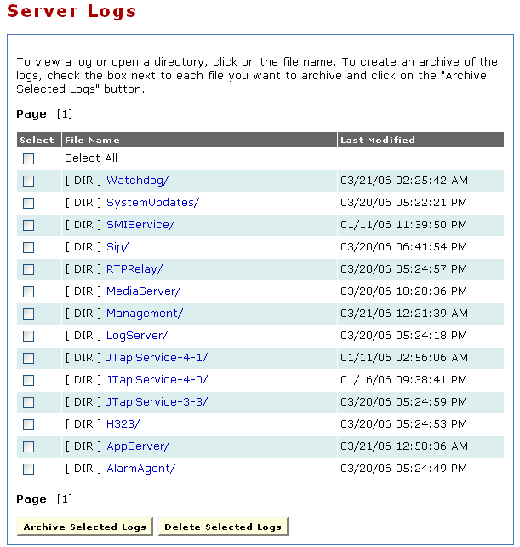
Logs: Server Log
Download, view, and delete logs on the system
Existing log file directories
Log operations
Notes:
There are many logs kept under the server logs heading.
On this page, you will find folders for the existing logs.
When a customer calls in to raise an issue, one of the first things to ask for is all the logs.
The simplest way to do this is click the Select All checkbox at the top of the table.
This will place a checkmark next to all the logs.
Then, click the Archive Selected Logs button.
You will be taken to a page that allows you to download the logs which the customer can then email to support.
Most important log is AppServer; however, the MediaServer log and the individual Protocol Provider logs are important as well.

Slide 59
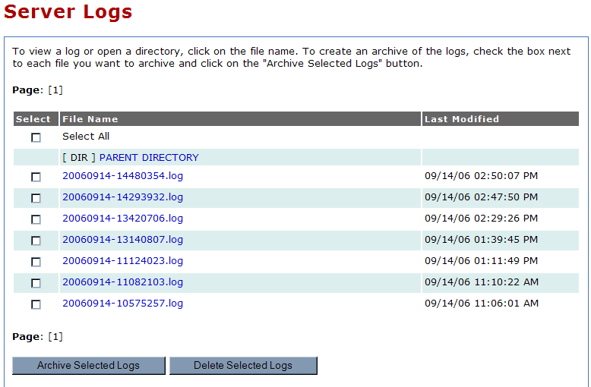
Logs: Server Logs: AppServer
Notes:
The AppServer logs will be looked at the most.
When there is a problem, this is one of the first places you check. Often it helps to increase the log level to Verbose.

Slide 60
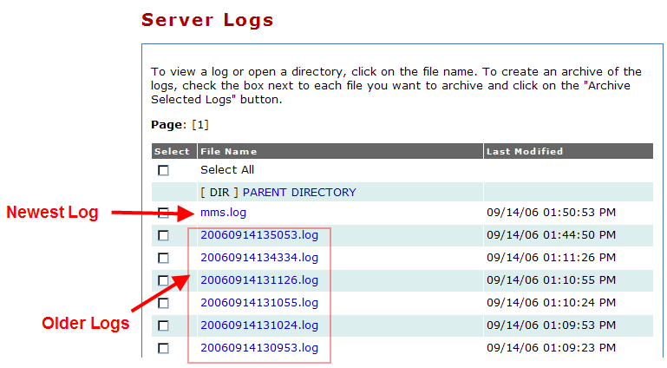
Logs: Server Log: MediaServer

Slide 61
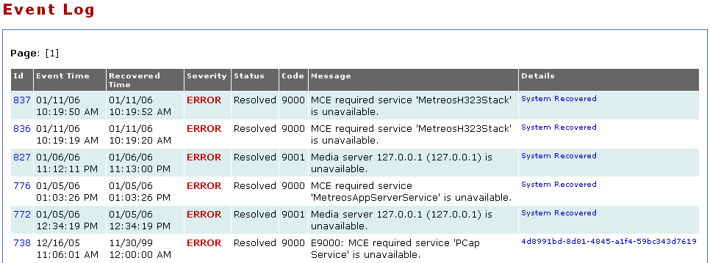
Logs: Event Log
Provides a list of system wide events and whether those events have been resolved.

Slide 62
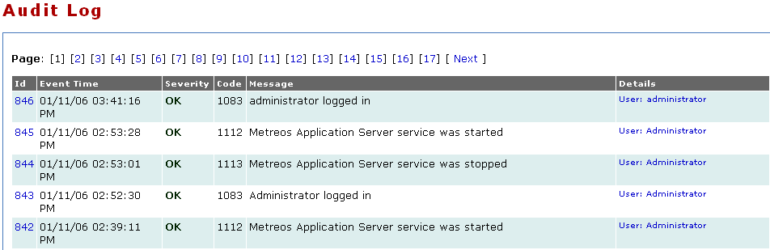

Logs: Audit Log
Every management operation is recorded.
Provides a detailed view as to what has changed on the system and by whom.

Slide 63

Topologies

Slide 64

Topologies

Slide 65

Topologies

Slide 66

Topologies

Slide 67

Integration Application - MakeCall

Slide 68

Integration Application - MakeCall

Slide 69

Integration Application - AnswerCall

Slide 70

Integration Application - AnswerCall

Slide 71
Summary
The core elements of the Cisco Unified Application Environment are called:
Application Server
Media Engine
Application Designer
System Control Panel (a.k.a MCEAdmin)
Advances Services will support the Application Designer and the applications created with it.
TAC will be supporting Application Server (and System Control Panel) and the Media Engine.
The logs are an invaluable resource for troubleshooting… we will see more about them tomorrow

Slide 72
Escalation and Contact Info
Emergency Contacts
page-cuae-brt@epage.cisco.com
page-cuae-eng@epage.cisco.com
Non-Emergency Contacts
cuae-eng@cisco.com
Notes:
Emergency Contacts
page-cuae-brt@epage.cisco.com
page-cuae-eng@epage.cisco.com
Non-Emergency Contacts
cuae-eng@cisco.com
cs-cuae@cisco.com - this mailer is intended for general questions about the cuae products, and will be used by TAC, SE's, Cisco Acct teams, Advanced Services, and others in the field to ask general questions about product features, basic configurations, roadmaps, etc.
cse-dev-cuae@cisco.com – this mailer is intended primarily for presenting technical or troubleshooting related issues into the product development team (engineering). This is used primarily by TAC and AS to get help from engineering for a non-critical issue. A TAC engineer may use this alias first, prior to escalating a case directly to engineering.

Slide 73
Questions??

Slide 74
Thank you
  End of Day 1
Notes:
Add text

