Slide 1
Notes:
Cisco Unified Application Environment
ThunderCracker Release (2.4)
Presenter:
Daniel Bethke
CUAE Engineering
dbethke@cisco.com

Slide 2
Cisco Unified Application Environment
ThunderCracker Release (2.4)
Presenter:
Daniel Bethke
CUAE Engineering
dbethke@cisco.com

Slide 3
Introduction
We will discuss the Cisco Unified Application Environment, focusing on the Cisco Unified Application Server and also touching on it interacts with the Cisco Unified Media Engine.
This will help prepare you to field questions and troubleshoot issues that will arise about the product.

Slide 4
Objective
After completing this training you will be able to:
  Describe the fundamentals of the Application Environment
  Configure an Application Server
  Troubleshoot issues that customers may raise

Slide 5
Agenda
  Part 1:
  Positioning
  New Additions
  Introduction to the Technology
  Introduction to System Control Panel (MCEAdmin)
  MCEAdmin: Local Environment
  MCEAdmin: System Settings
  MCEAdmin: Components
  MCEAdmin: Logs

Slide 6
Positioning Within Cisco Product Portfolio
The current positioning of Cisco’s unified communications product line is:
The Cisco Unified Communications system of voice, video, and IP communications products and applications enables organizations to communicate more effectively—helping them streamline business processes, reach the right resource the first time, and increase profitability. The Cisco Unified Communications system is part of an integrated solution for organizations of all sizes that also includes network infrastructure, security, and network management products, wireless connectivity, and a lifecycle services approach, along with flexible deployment and outsourced management options, end-user and partner financing packages, and third-party communications applications.
The positioning of the CUAE complements the top-line product positioning by focusing on streamlining business processes. The CUAE’s positioning is differentiated by its focus on applications as the enabler of these benefits:
The Cisco Unified Application Environment enables the rapid development, reliable execution and automated management of applications that converge voice and video with enterprise applications and data. Organizations can use these new converged applications to improve communications, transform business processes and create competitive advantage.

Slide 7
New Additions since 2.3.x
Downloadable SDK
Dev documentation
Dev support site
License enforcement
Cisco branding
CUCM 6.x support
CUPS 1.x/6.x support
Application localizability
Support for the following new hardware types
7845 H2/I2
7835 H2/I2
7825 H2/I2
7816
Notes:
SDK
Installation packages (CUAE Client/Server, CUCM, CUPS) for development use only
Sample applications w/ source code
Documentation
Developer website
License Enforcement
Addition of license Enforcement
Standard, Enhanced and Premium versions
Cisco Branding
CUCM 6.0 Support
CUCM 5.0 Feature set
CUPS 6.0 Support
Mechanism for subscribing to user presence
Localizability
End-user perspective only
Administrators and developers must be fluent in English
Apps developed using the CUAE can be localized to all languages supported by Ohio system release. TTS Supported language set may be constrained by availability of TTS dictionaries.
.NET 2.0 Support
Production Packaging
7845, 7835, 7825, 7816
HP and IBM Gen 1 & 2
Windows 2003 Server (MCS-OS version from Durant)
SDK Packaging
Generic Windows XP Pro “Intel” Desktop (not AMD)

Slide 8
INTRODUCTION TO THE TECHNOLOGY
Core Elements

Slide 9
Core Elements Overview
Cisco Unified Application Environment
Core Elements:
  Application Server
  Media Engine
  Application Designer
  System Control Panel
Notes:
The Cisco Unified Application Environment is a development and runtime platform designed for creating, deploying, and executing converged voice and data applications. It is integrated with Cisco Unified Communications Manager and Cisco Unified Presence.
It includes:
an application runtime environment, which controls media and external resources under the direction of custom telephony applications
one or more media servers to process, mix, analyze, and route digital audio data
a GUI-based design tool, the Cisco Unified Application Designer, which is used to develop and debug IP telephony applications
a Web browser-based interface that System administrators can use to manage the Cisco Unified Application Environment.
These core elements of the Cisco Unified Application Environment are called:
Application Server
Media Engine
Application Designer
System Control Panel (a.k.a MCEAdmin)
Advances Services will support the Application Designer and the applications created with it
TAC will be supporting the Application Server (and System Control Panel) and the Media Engine configuration.

Slide 10
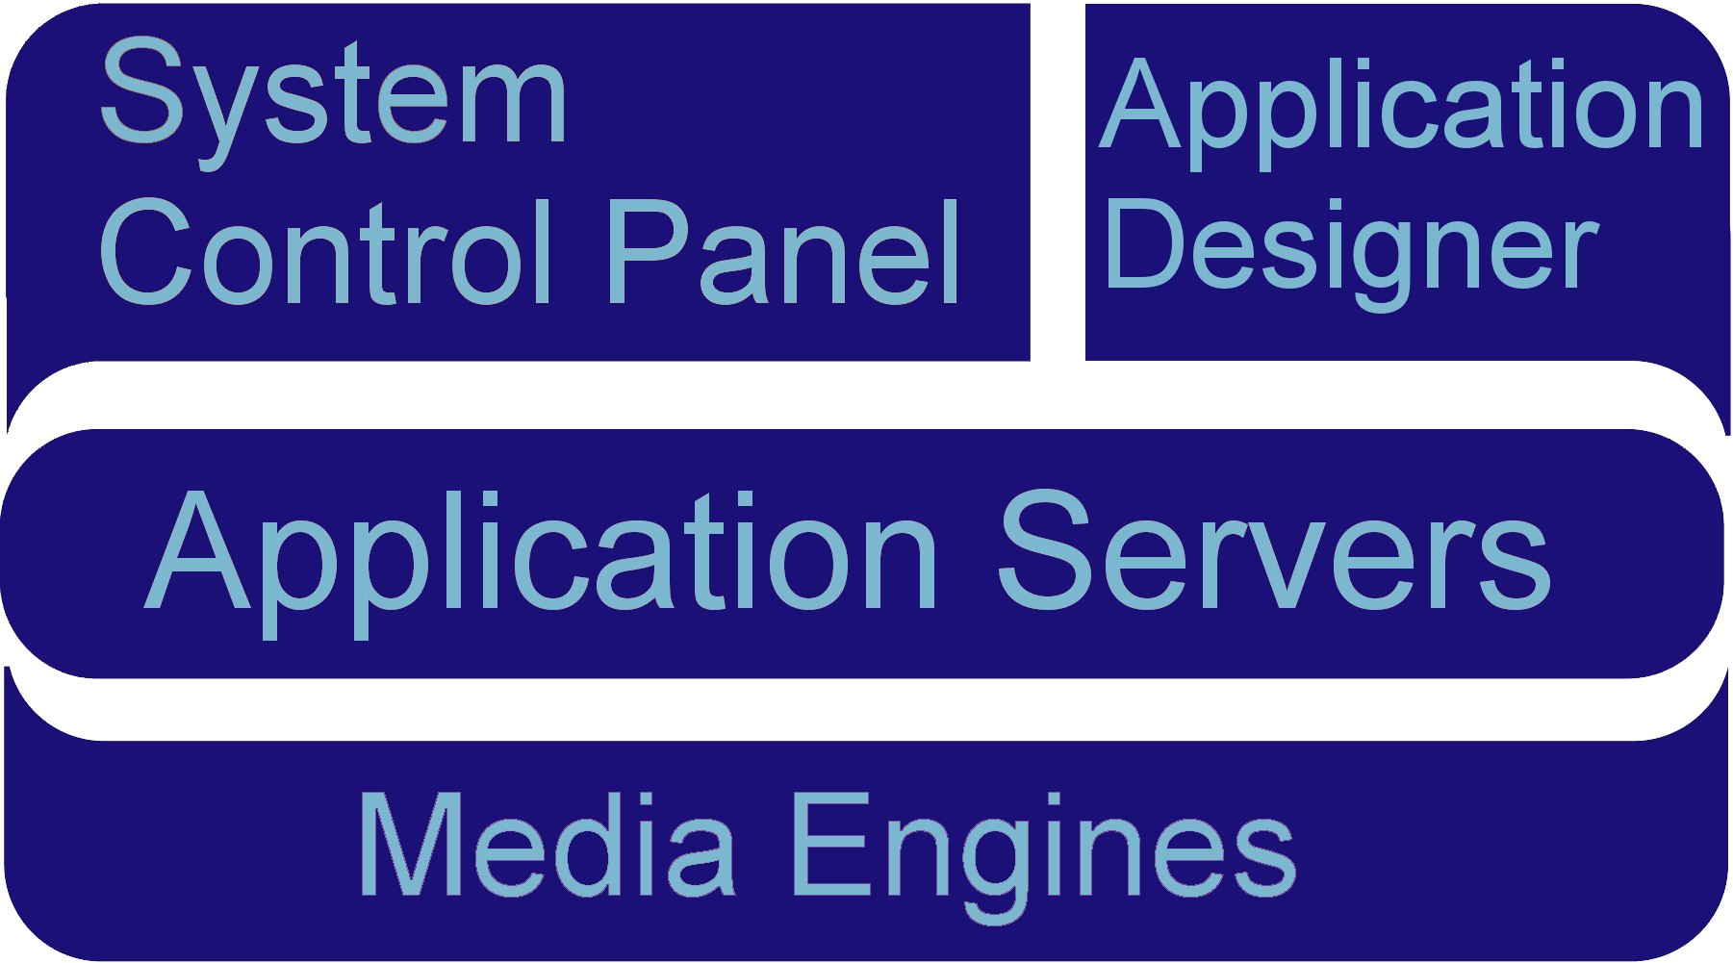
Core Elements
System Control Panel manages configurations.
Application Designer enable developers to build applications.
Application Server is the heart of the system.
Media Engines provide audio stream control.
PHP
(Server)
C#
(Client)
C#, Java
(Server)
C++
(Server)

Slide 11
Core Elements Formally Defined
Application Designer
  A Windows-based client application used to rapidly build and deploy applications to the Application Server.
Application Server
  A server-side solution designed from the ground up to host IP telephony applications.
Media Engine
  A server-side solution to provide rich media processing, tightly-integrated into the Application Server.
System Control Panel
  A web-based management tool hosted on the Application Server that provides administrative configuration and reporting options.
Notes:
The Cisco Unified Application Designer is a PC-based client application which runs on Windows XP Pro. It is a visual Integrated Development Environment (IDE) which allows application designers to:
• Develop applications that combine voice and video with enterprise applications and data.
• Install applications directly from the PC or build an application package file.
• Load applications developed with the Cisco Unified Application Designer through the management
console.
The Application Server is a server-side solution designed from the ground up to host IP telephony applications. It runs on Cisco Media Convergence (MCS) servers, and provides these functions:
• Originates and receives calls over various IP telephony protocols.
• Provides application management.
• Starts, executes, manages, and terminates application scripts that are operating in their own runtime environment on their own virtual machines.
• Hosts protocol providers that provide an interface to applications for systems outside the application environment.
• Controls Cisco Unified Media Engines to process, mix, analyze, and route digital audio data.
The Cisco Unified Media Engine is a software-only server which provides media processing capabilities for applications that are developed using the Cisco Unified Application Designer. It runs on the Cisco Media Convergence (MCS) servers and provides these functions:
• Perform flexible deployment of Cisco Unified Application Servers and Cisco Unified Media
Engines, by determining the appropriate number and configuration of servers at the time of
deployment.
• Avoid latency and bandwidth issues, by allowing you to distribute media engines closer to the media endpoints used for a particular application, as media engines may generate considerable Real-time Transport Protocol (RTP) traffic.
The Cisco Unified Application Environment management console is a web-based interface that you must use to administer the Cisco Unified Application Server and Cisco Unified Media Engine.
The following browsers are supported:
• Microsoft Internet Explorer (IE) 6.0 and 7.0
• Mozilla Firefox

Slide 12
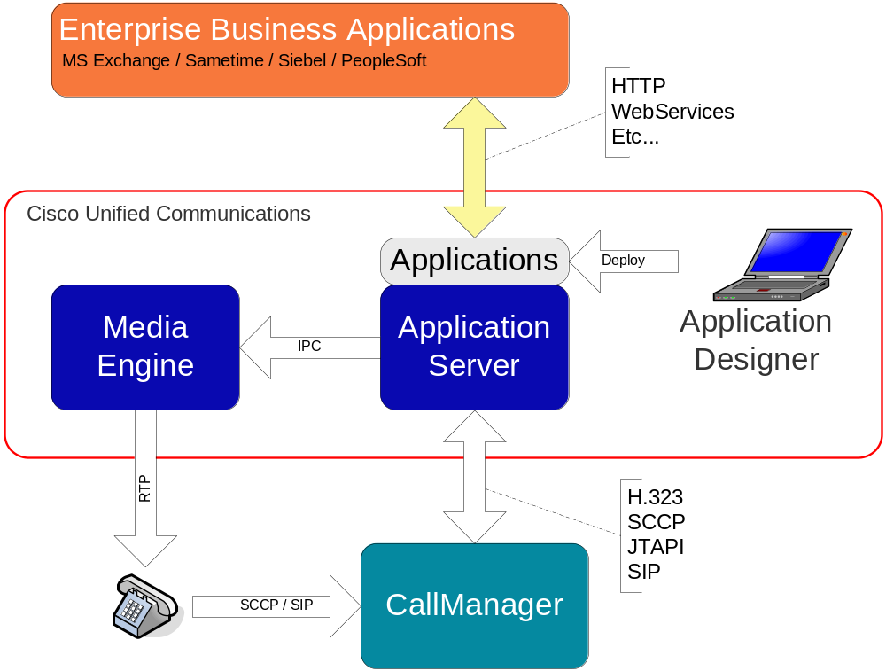
CUAE Combines Voice and Data
CUAE brings voice to data applications …
… and data to voice applications
Enabling truly unique IP communications applications to be built, deployed, and managed

Slide 13

INTRODUCTION TO THE TECHNOLOGY
Core Elements: Application Server

Slide 14
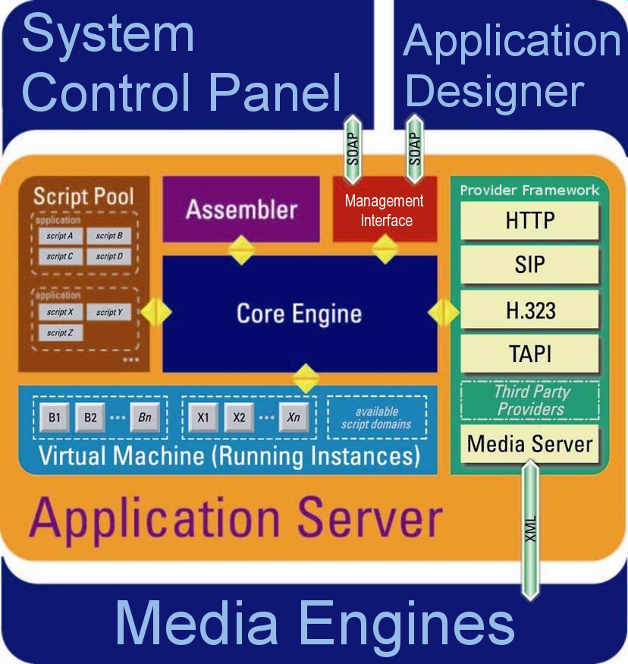
Application Server – Internal Components

Slide 15
Cisco Unified Application Server
Core of the platform.
Applications are stored and
execute within the Application
Server.
Application scripts are
assembled from an XML
intermediate language
into in-memory compiled code.
A virtual machine inside the
application server manages the
execution of the application.
Communicates with external systems through protocol providers in the Provider Framework.
Notes:
The Cisco Unified Application Server is the core of the platform. It starts, executes, terminates, and manages application script execution. Each application operates in its own runtime environment; for every application there is a separate virtual machine on which the application scripts run.

Slide 16
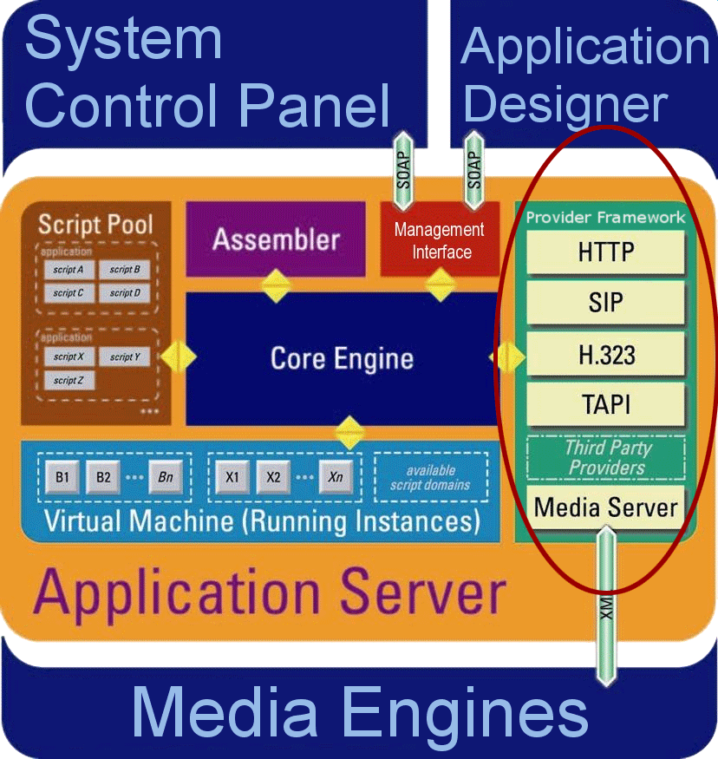
Application Server: Protocol Providers
Provide the “glue” between the
Application Server and
external systems.
Functional equivalent of a
Unix daemon process or
Windows service.
Able to persist data and
maintain state.
Expose Events and Actions to application layer.
Visible to developer through the Application Designer.

Slide 17
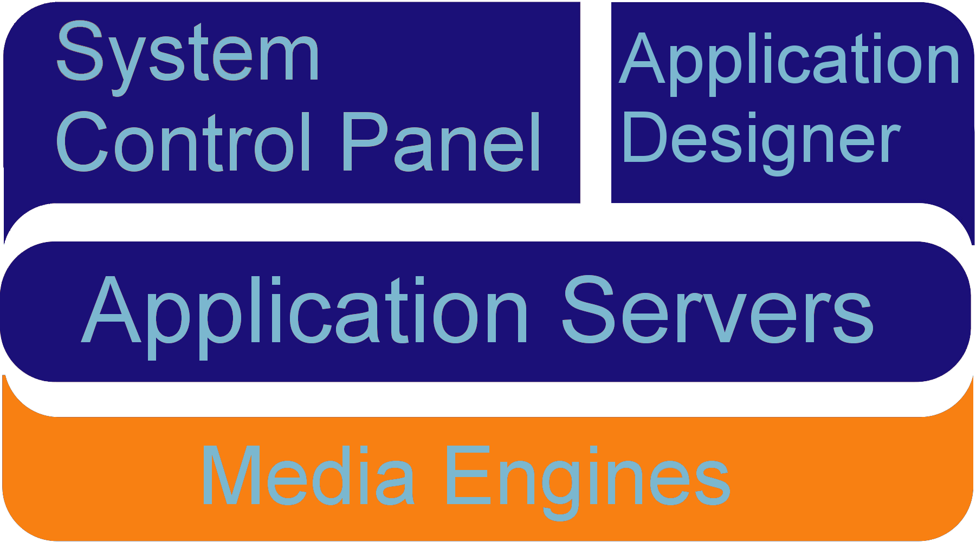
INTRODUCTION TO THE TECHNOLOGY
Core Elements: Media Engine

Slide 18
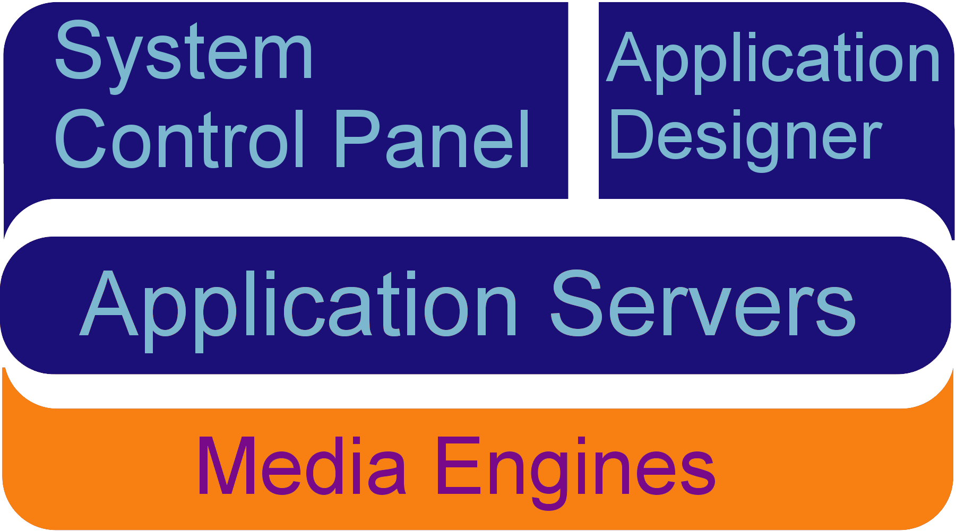
Cisco Unified Media Engine
Software implementation of
digital signaling processor (DSP).
Originates and terminates
voice media streams on behalf
of applications.
Tightly coupled with the Application Server via
an XML RPC interface.
Capable of processing up to 240 (soon 400) distinct media streams.
Scalable independent of the application server.
All media processing capabilities exposed in an
easy-to-use manner inside of Application Designer.

Slide 19
Media Engine Feature Highlights
Scalability
  Up to 240 (soon 500) concurrent IP connections per box.
  Scales independent of application server nodes.
IVR
  Play and Record in VOX and WAV format.
  Play multiple prerecorded or TTS prompts in sequence.
  DTMF detection; in-band (including RFC2833) and out-of-band.
  Complex media termination conditions.
Conferencing
  Conference mute and kick, coach/pupil etc.
  Conference recording. Up to 64 concurrent conferences being recorded per box.
Advanced Features
  Multicast support for IVR.
  Speech recognition support using Nuance or Speechworks.
  Low bit-rate coders (G.723 and G.729a).
  Text-to-speech using embedded Neospeech server

Slide 20
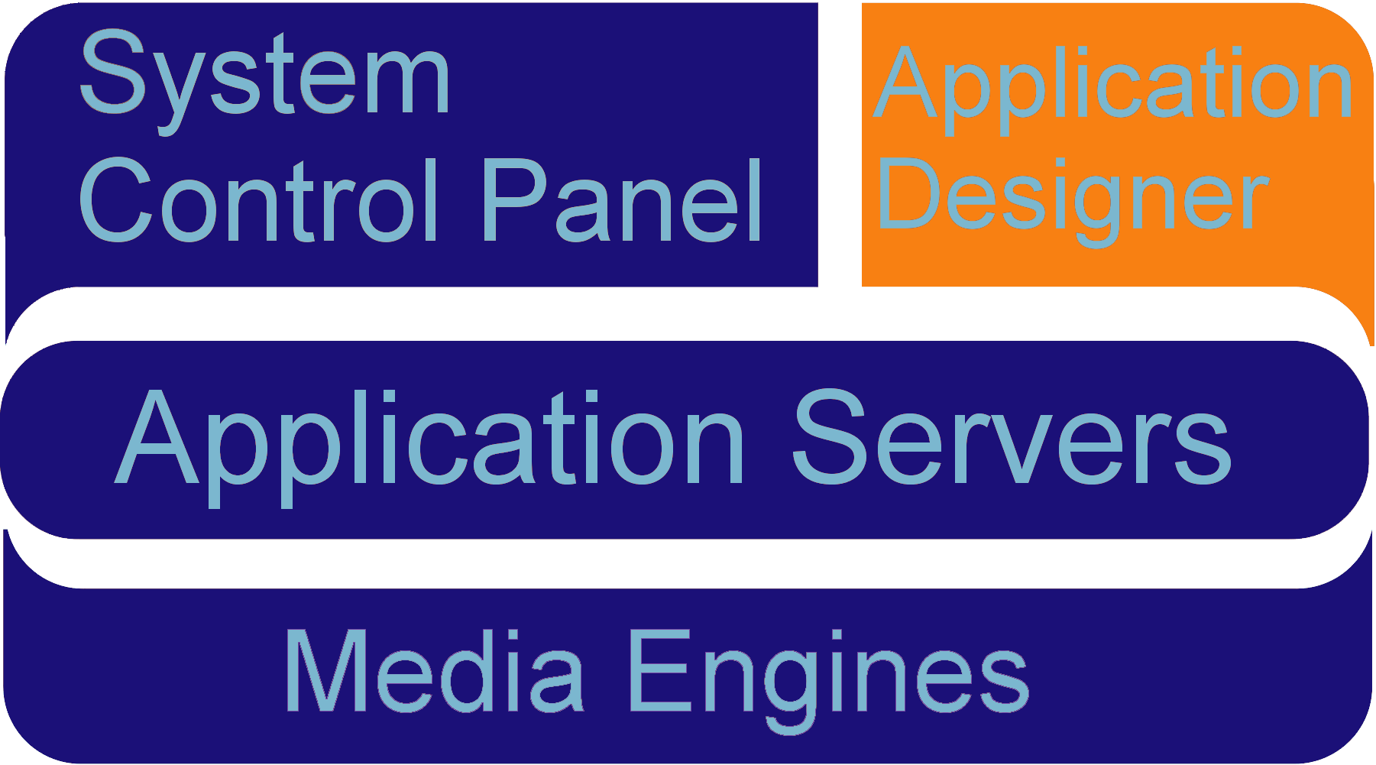
INTRODUCTION TO THE TECHNOLOGY
Core Elements: Application Designer

Slide 21
Application Designer
Visually construct communications
business logic.
  Extensive catalog of communications
  actions.
  Abstracts and consolidates
  IP telephony protocols
  (SIP, H.323, JTAPI, SCCP) into
  the CallControl API.
  Encapsulates common technology interfaces for modern applications: LDAP, SQL, Web Services, CCM APIs, …
Single tool for building complete IPT applications.
Targeted at someone with a few years programming experience.
Integrated with the Application Server for instant deployment.

Slide 22
Application Designer – Key Features
Graphical Application Definition
Application Integrity Checks
Extensible Toolbox
Embedded Code
One-Click Deployment
Runtime Debugging
Instant Web Services Integration

Slide 23
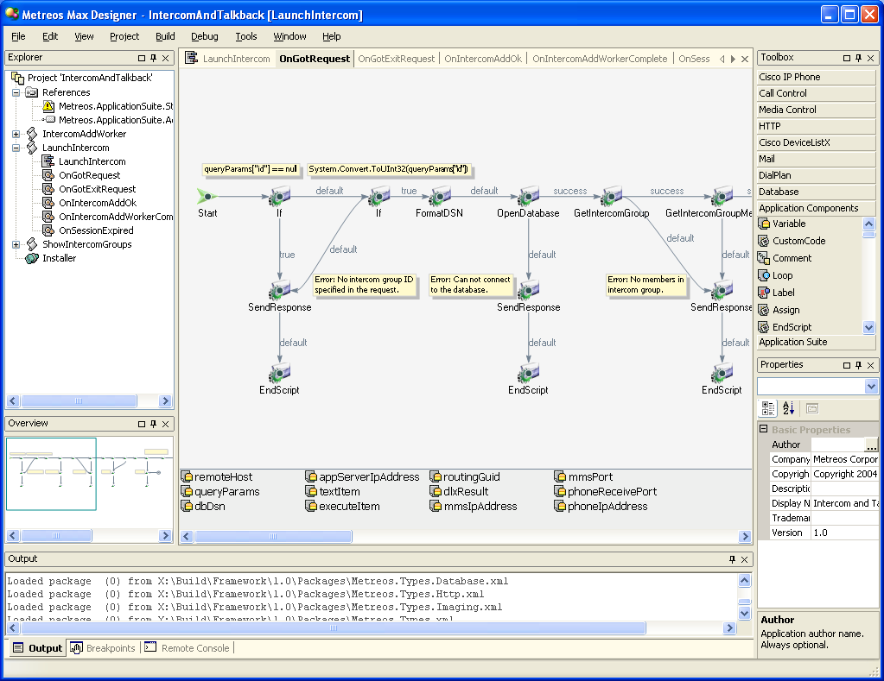
Application Designer

Slide 24
Application Designer
Explorer pane (tree view)
  Shows scripts, functions, and other resources
  Indicates which resource is currently being edited
Primary window
  Each tab (canvas) represents a function in the current script
  View may change depending on resource selected
Toolbar
  Customizable collections of actions
Properties
  Provides extensive configurability for all items
Output
  Shows the status and log of the current operation (i.e. Build)

Slide 25
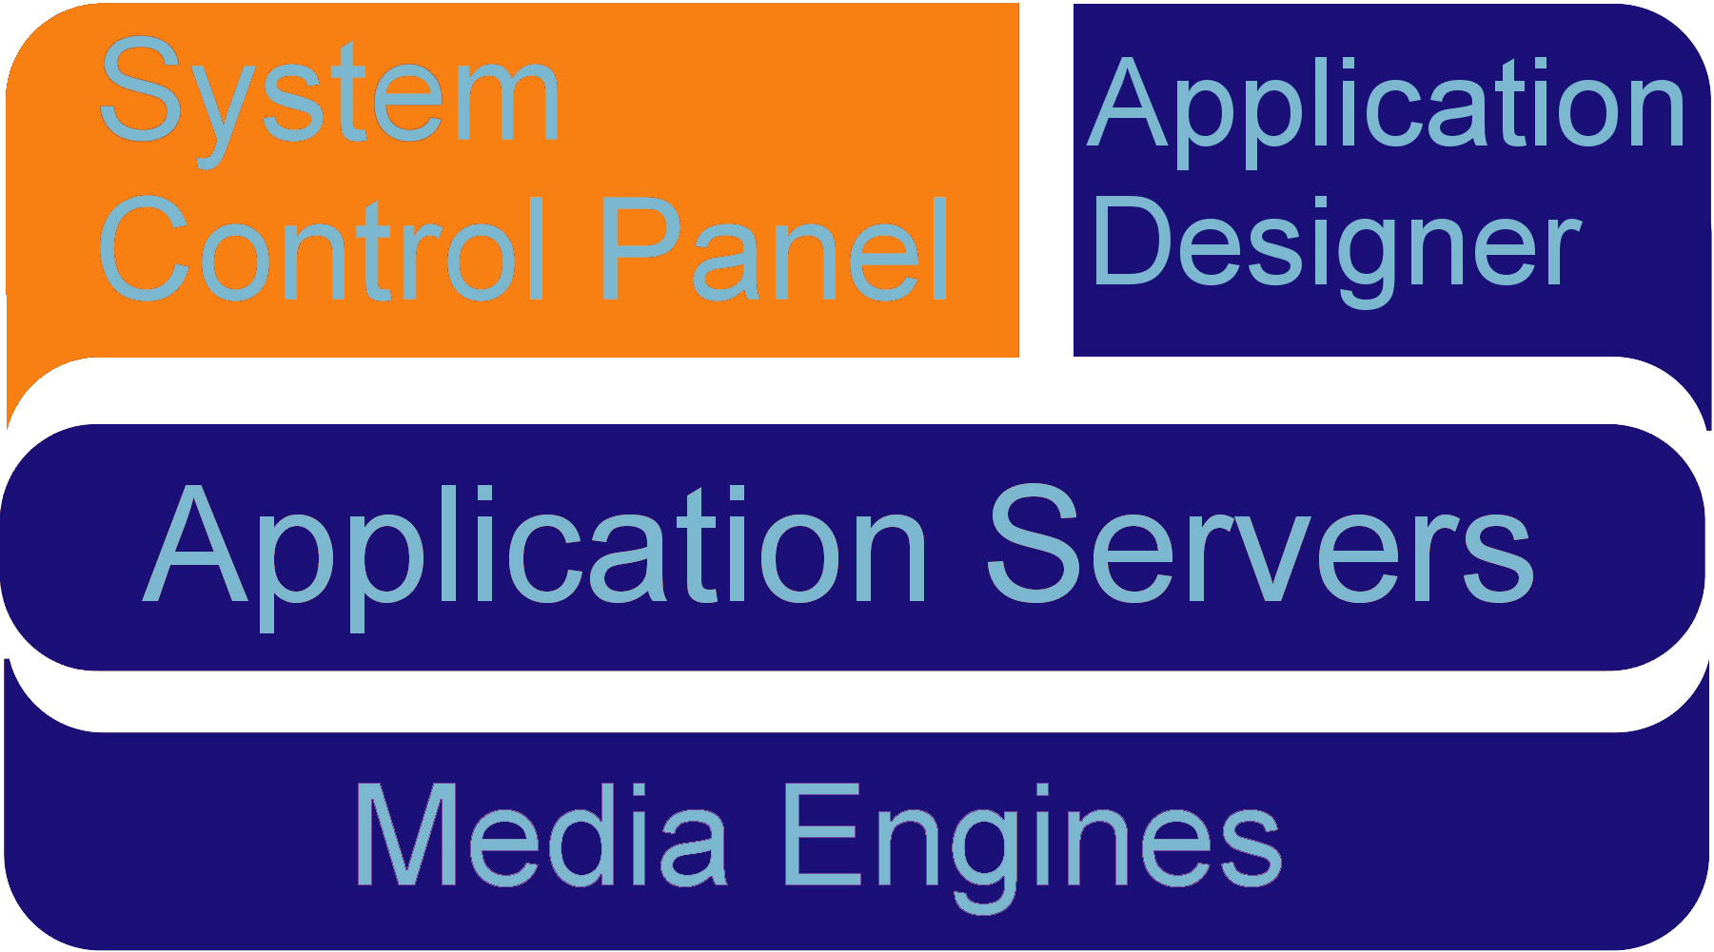
INTRODUCTION TO THE TECHNOLOGY
Core Elements: System Control Panel

Slide 26
System Control Panel Overview
Web-based management console for configuring the Application Server:
  Manage applications
  Manage protocol providers
  Manage media engines
  Manage telephony servers
  Alarm and Statistics Monitoring
  System Backup/Restore
  License management
  User management
  Logs and Diagnostics

Slide 27
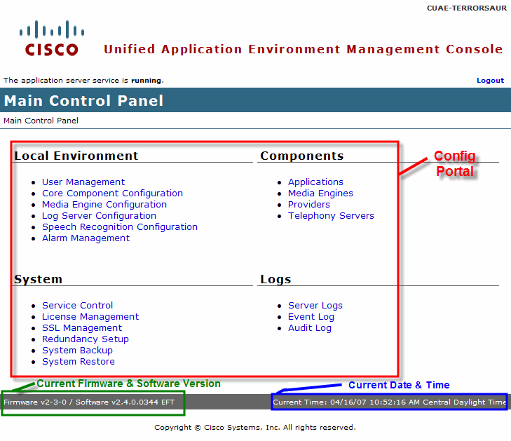
System Control Panel: Main Page

Slide 28
INTRODUCTION TO THE SYSTEM CONTROL PANEL
a.k.a. MCEAdmin

Slide 29

MCEADMIN: Navigation
Breadcrumbs will show you where you are at in mceadmin.
Above the logout button a status will be displayed indicating whether mceadmin is currently communicating with the application server.
Status
Breadcrumbs

Slide 30
MCEADMIN: Layout
Tasks are segmented into four main groups:
Local Environment – System service parameters, global configuration of software, Alarm management.
Components – Management of applications, providers, media servers, and telephony servers.
System – Platform related tasks such as licensing, service control, cluster configuration, backup/restore.
Logs – Log file management and download.

Slide 31
MCEADMIN: Main Page

Slide 32
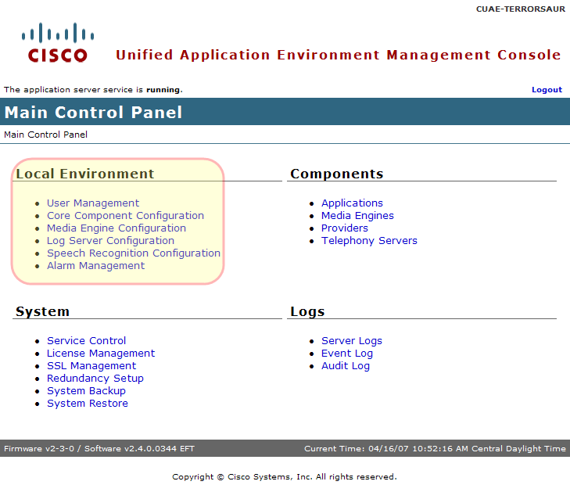
MCEADMIN: Environment Settings
Notes:
The Local Environment group contains links these Cisco Unified Application Environment
configuration pages:
• User Management
• Core Component Configuration
• Media Engine Configuration
• Log Server Configuration
• Speech Recognition Configuration
• Alarm Management

Slide 33
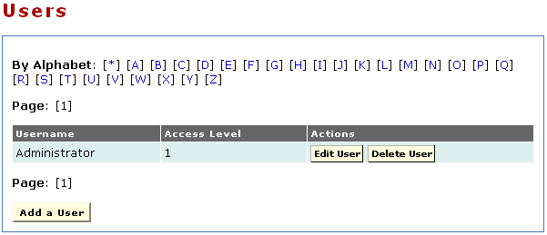
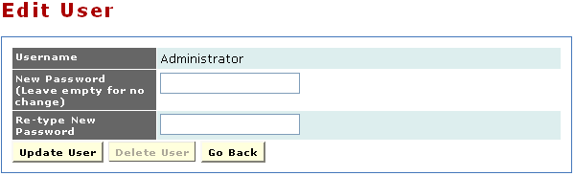
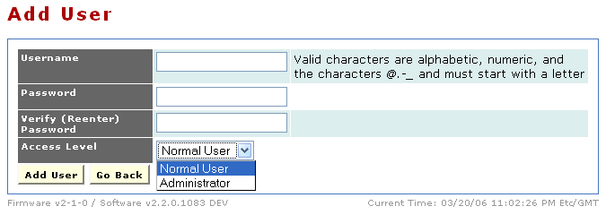
Environment: User Management
Active User List
Access Level for
New User
Notes:
A user account is required for each user who will access the system. By creating a different account for each user, you can ensure that audit logs will accurately record each user’s interactions with the system.
From the Main Control Panel, open the Users page to add users and to list existing users
and their access levels.

Slide 34
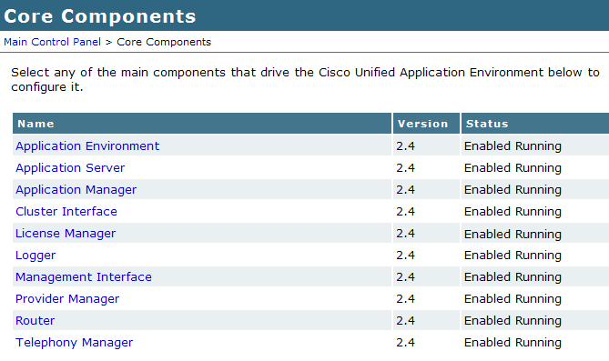
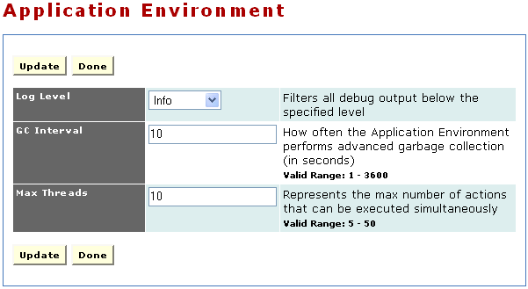
Environment: Core Components
Is the component operational?
Some config options have input criteria as shown here.
Indicates which core component to edit
Available config options

Slide 35
Environment: Core Components
Notes:
Core components are the main components that drive the Cisco Unified Application Environment.
• Application Environment — A virtual machine providing a runtime environment in which IP telephony applications can be executed.
• Application Server — Contains all core components and serves as a bootstrap loader for the other core elements.
• Application Manager — Manages the installation and removal of applications.
• Cluster Interface — Manages CUAE clustering
• License Manager — Manages applying and verifying licenses
• Logger — Manages log messages.
• Management Interface — Notifies the core engine of changes to the application server configuration.
• Provider Manager — Manages loading and unloading of providers.
• Router — Routes actions and events between providers and applications.
• Telephony Manager — Manages the details of establishing and terminating calls.
Application Environment
When an application script is executed, it runs in its own environment segregated from all other components and applications by virtue of process boundaries provided by the Application Environment. This section also contains a config item that will be used often for support, the Application Environment Log Level. If one is troubleshooting an application, turning up this log level will provide more details about the application environment.
Application Server
The Cisco Unified Application Server starts, executes, terminates, and manages application script execution. Each application operates in its own runtime environment; for every application there separate virtual machine on which the application scripts run. You can configure the Cisco Unified Application Server to host any applications created by the Application Designer. An application normally includes configuration items that are unique to deployment and which you must configure after the application is installed. All application configuration occurs at the partition level, as explained in the next section.
Application Manager
The Application Manager’s primary responsibility is to manage applications as they progress through the application life cycle. It unpackages applications and creates the application runtime environment on behalf of applications, as well as routing debugger commands to the appropriate application. You can use the Application Manager to install an application by uploading a Cisco Unified installation package through the management console. The system automatically unpackages the installer and performs the installation process.
Cluster Interface
The Cluster Interface is responsible for managing the intra-server TCP connections used for fault tolerance in conjunction with MySQL database replication. It employs a proprietary clustering protocol to determine master and stand-by relationships. The Cluster Interface is designed to support any number of Application servers running as both master and standby. In this scenario, all the servers are "hot" but are also prepared to back up their specific master server in the event of a failure.
In the event of master server failure, the Cluster Interface on the standby server will use the configuration data replicated from the master server to augment its own call control device configuration (i.e. SIP phones, CTI ports, etc). In this way, a standby server will register and assume control of all call control devices the master server controlled before it failed. Upon recovery of the master server, the Cluster Interface ensures graceful de-registration of the failed-over devices and then signals the master server to begin registering the devices once they have been relinquished by the standby server.

Slide 36
This slide intentionally left blank
Notes:
License Manager
The License Manager configures the behavior of the licensing subsystem. All license administration is be done through the system control panel. The Core Component page allows the administrator to specify the logging level for messages that will appear in the logs.
Logger
The Logger manages log messages. The Cisco Unified Logger uses trace listeners to route log messages to various log sinks based on configurable criteria. The standard logs packaged with the Application Runtime Environment are:
• TCP Logger — Writes logs to any number of TCP connections, such as the remote console feature
of the Cisco Unified Application Designer.
• TCP Logger Port — Port that the TCP remote console logger remoting server listens on for connections.
• Log Server Sink Logger Level — Filters log server debug output below specified level.
Management Interface
The Management Interface listens on a socket (8120 by default) and accepts TCP connections from the management console. The console uses this interface to notify the core engine of changes to the Application Runtime Environment configuration. The management interface exposes the following functions:
• Execute provider extensions (special actions exposed by the provider for management purposes).
• Enable and disable applications.
• Install and uninstall applications.
• Enable and disable providers.
• Install/uninstall providers.
• Add and remove media servers.
• Add and remove Cisco Unified Communications Manager clusters.
Provider Manager
The Provider Manager is responsible for instantiating and managing providers. Similar to a system process or daemon, a provider typically opens network ports and allows the Application Runtime Environment to communicate with other devices on a network. You can use the Provider Manager to load and unload providers and to manage basic administrative tasks; for example, monitoring providers to ensure that they are running.
Router
In the Cisco Unified system, applications specify sets of triggering criteria. After an instance of an application is triggered, the router retains the state of that instance and routes subsequent events until the instance terminates.
Telephony Manager
IP telephony applications require complex protocols to establish connections between devices, exchange messages among them, and disconnect them when appropriate. The Telephony Manager streamlines this process for the user by abstracting implementation details.
The Telephony Manager also allows you to enable and disable sandboxing. Sandboxing is a system-level, fail-safe capability that ensures system resources do not remain in use after a script ends. If a script stops prematurely, it might not be able to terminate outstanding calls, and the media resources for those calls would remain in use. In such an event, sandboxing permits the Telephony Manager to release media resources. Sandboxing is globally disabled by default, but can be enabled on the Telephony Manager Configuration page. Ensure that sandboxing is disabled if you have an application in which control of the call is transferred from one script to another. In such cases, the call is still in progress and media resources are retained after the original script instance terminates. The Telephony Manager detects that the original script has terminated but the media has not been released. If sandboxing is enabled, the Telephony Manager releases the media on behalf of the original script and terminates the call.

Slide 37
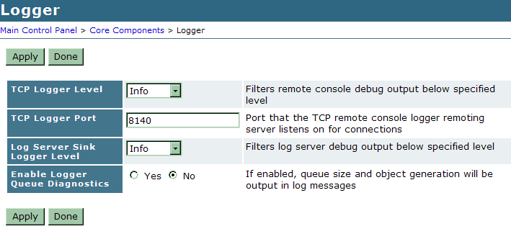
Logs: Server Log: Setting Log Level
Notes:
When beginning to troubleshoot, it is often a good idea to increase the log levels to ‘verbose’.
To set the log level:
1. Go to Main Control Panel -> Core Components -> Application Environment
Increase the level of logs generated by the Application Environment to ‘verbose’
2. Go to Main Control Panel -> Core Components -> Logger
Increase the Log Server Sink to ‘verbose’ otherwise higher level logs will be filtered.
Log Level Descriptions:
Off - No logging
Error - Only error messages written to log
Warning - Only warning and error messages written to log
Information - Warning, error, and terse event information messages written to the log
Verbose - Warning, error, and detailed event information messages to the log

Slide 38
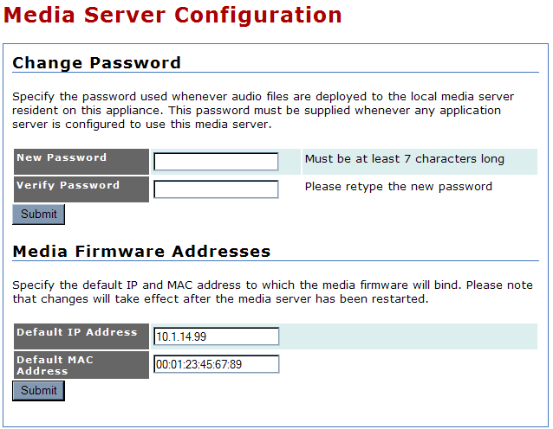
Environment: Media Server Configuration
Notes:
To configure a media engine to work with the application server, you must:
• Assign the media engine password that the application server uses to deploy media files to media engines when an application is installed.
The password is checked each time you add a media engine entry by way of the Media Engines page in the management console. If the media engine password is changed while an application server is controlling a media engine, then the password must be updated in the management console; otherwise the application may fail to execute.
• Enter the default IP address and MAC address to which the media firmware will bind.
Because the hardware running on the media engine can have more than one network adapter, these fields enable you to determine the network adapter to be used. If a different adaptor is needed, you should update both the IP address and MAC address fields. Changing the IP address causes the Real-time Transfer Protocol (RTP) streams sent to the media engine to use the new IP address, enabling you to assign different functions to different network adaptors on the media engine.

Slide 39
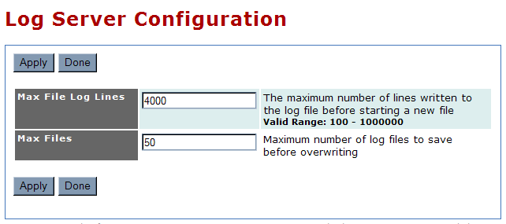
Environment: Log Server Configuration
Notes:
open the Log Server Configuration page to specify the
maximum size and number of log files

Slide 40
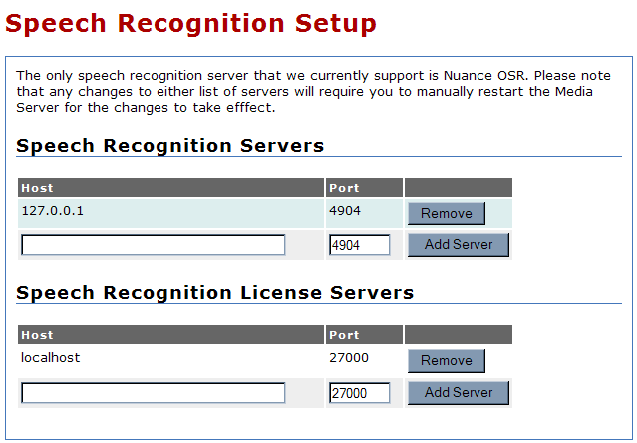
Environment: Speech Recognition Configuration
Notes:
The Cisco Unified Application Environment supports the Nuance Open Speech Recognizer (Nuance OSR) for speech recognition. If an installed application requires speech recognition capabilities, then you must identify the Nuance OSR servers. Whenever the application performs a speech recognition operation, the identified servers perform the operation.
Remember to restart the Media Engine when any changes are made to either list of Speech Recognition Servers

Slide 41
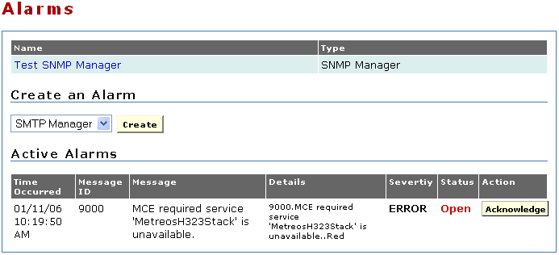
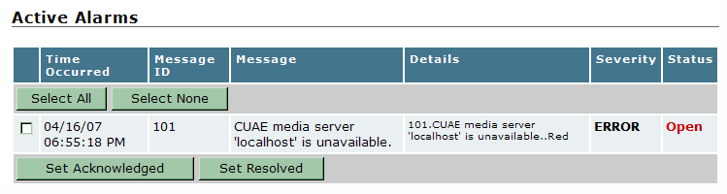
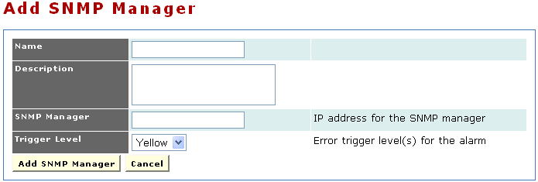
Environment: Alarm Management
Add/Remove alarm destinations (SNMP or SMTP) and manage active alarms.
Existing alarm destinations already configured
Active alarms (if any)
Notes:
Add/Remove alarm destinations (SNMP or SMTP) and manage active alarms.
Two types of alarm managers are supported as destinations. Below are the alarm manager types and the fields required to configure them:
SMTP
Name - Name of alarm
Description - Description of alarm
Recipient - Email address to which to send alarm message
Sender - Email address from which to send alarm message
Server - IP address of SMTP server
Username (Optional) - User name for outbound SMTP authentication
Password (Optional) - Password for outbound SMTP authentication
Server Port - SMTP server port (default is 25)
Trigger Level - Event level that triggers alarm
SNMP
Name - Name of alarm
Description - Description of alarm
SNMP Manager - IP address of SNMP manager
Trigger Level - Event level that triggers alarm

Slide 42
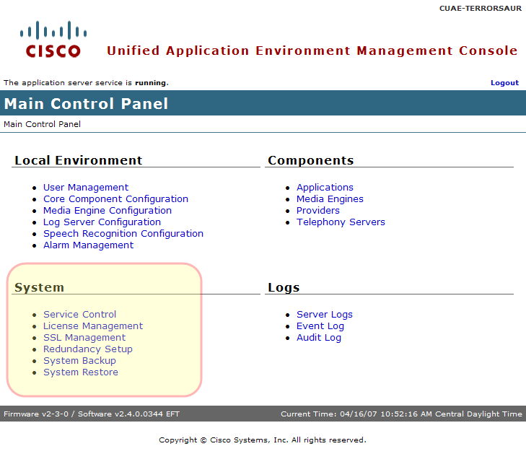
MCEADMIN: System Settings

Slide 43
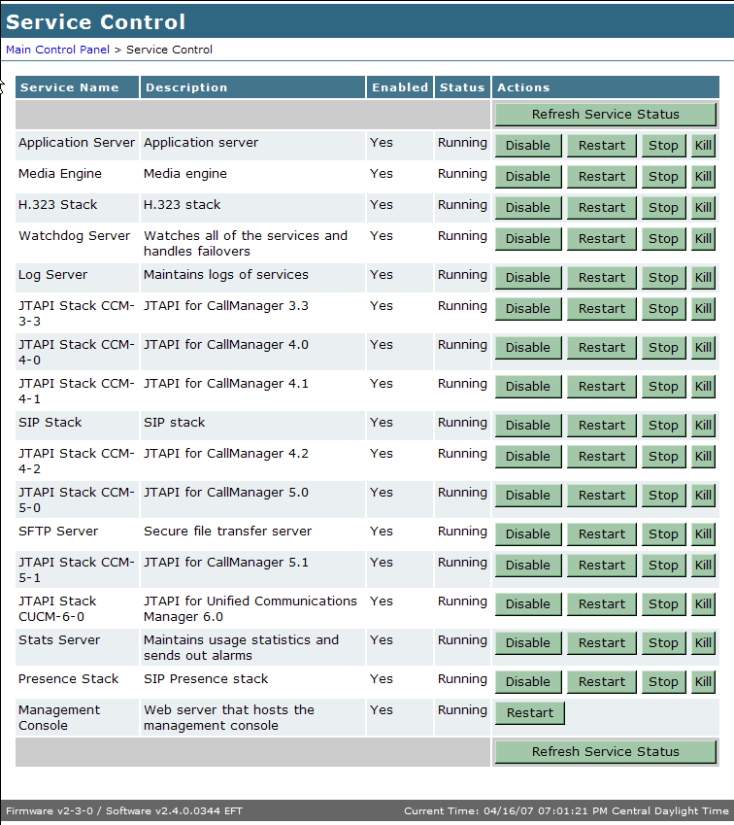
System: Service Control
Enable, Disable, Start, Stop platform services
Service Status
Service
Name
Service
Control
Notes:
The Service Control page is used to enable, disable, stop, restart, or kill services that run
on the application server. Under normal circumstances, it should not be necessary to perform these
functions; these functions are required only in these instances:
• You have modified configuration parameters using the management console, and a message has
indicated that you must restart a particular service for the configuration change to take effect.
• A service is not functioning properly.
• A Cisco support representative has asked you to restart a service to help debug an issue.
The following information is presented for each service:
• Service Name — Name of service
• Description — Explanation of service
• Enabled — Indication of whether the service is active
• Status:
Running — Service is available
Stop Pending — Service is shutting down
Stopped — Service is not available
Start Pending — Service is starting up
• Action:
Disable — Make service available (disallows automatic start at reboot)
Restart — Stop and restart
Stop — Make service unavailable
Enable — Allow automatic start at reboot
Start — Make service available
An enabled service automatically starts when the system is rebooted; a disabled service does not. When
a service is disabled, the system automatically stops it.
To perform an action on a service, click the desired button to the right of the action.

Slide 44
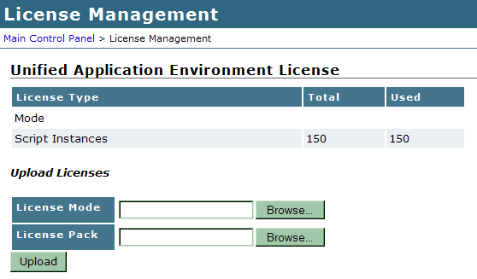
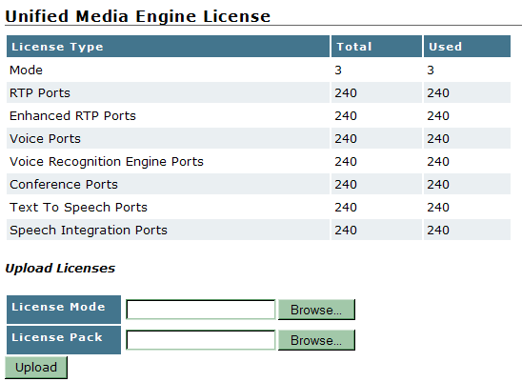
System: License Management
Install licenses to unlock Application Server and Media Engine
Current license details
Install a new media firmware or TTS license
Notes:
The license management page is used to enforce licenses for the Cisco Unified Application Environment server and the Cisco Unified Application Engine.
Once the license is applied, the server must be manually rebooted.
Questions regarding new licenses and issues with licenses
should be sent to cume-license-support@cisco.com
Technical Description of each resource
RTP - Represents one (1) send/receive G.711 RTP stream
Enhanced RTP - Augments an RTP resource (1 RTP component is required to use 1 Enhanced RTP). Represents one (1) send/receive low-bite rate RTP stream, such as G.723 or G.729.
Voice - A media operation on top of an RTP, enhanced RTP, or Conference resource, such as playing media, recording, digit detection, etc.
Conference - When an HMP mixes the audio of some number of RTP or enhanced RTP streams, it must use one (1) conference resource per participant. It must also use a conference resource per virtual Voice participant.
Speech - Augments a voice resource (1 Voice component is required to use Speech). Speech (CSP) is used as an add-on to a Voice Resource.
With CSP, one can also stream out file chunks real-time based on the incoming media on an RTP/eRTP resource, as well as providing 'cleaning' operations on the voice quality. CSP also provides a 'barge-on-voice' ability, which is very accurate compared to non-silence, in determining if someone is talking

Slide 45
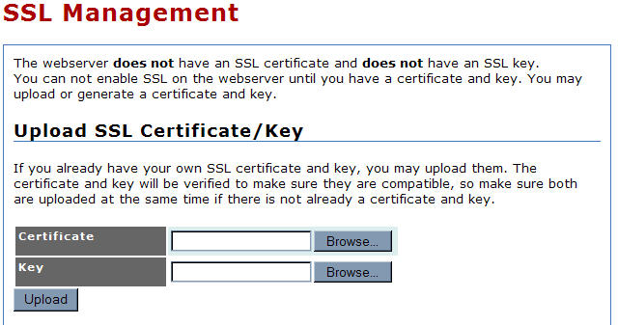
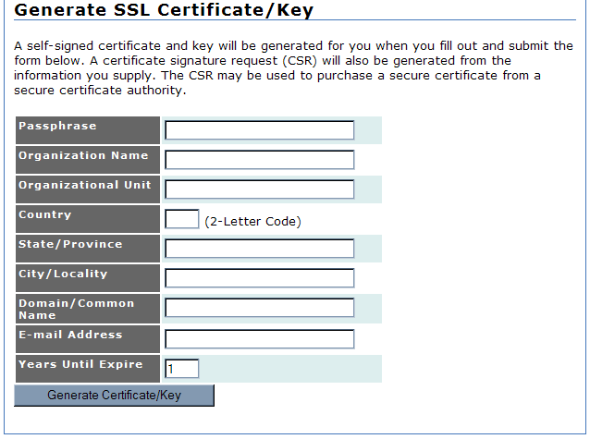
System: SSL Management
Notes:
The management console web server does not have an SSL certificate or SSL key. To enable SSL on the
server, you must generate or upload a certificate and key.
Open the SSL Management page to manage SSL certificates and keys.
If you already have your own SSL certificate and key, they are verified upon upload to make sure that
they are compatible. Make sure you upload them at the same time.
If you do not already have your own SSL certificate and key, A self-signed certificate and key will be generated for you when you fill out and submit the Generate SSL Certificate/Key form. A certificate signature request (CSR) will also be generated from the information you supply. The CSR may be used to purchase a secure certificate from a secure certificate authority.

Slide 46
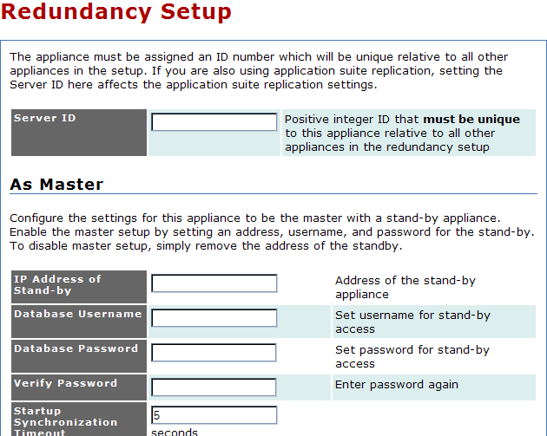
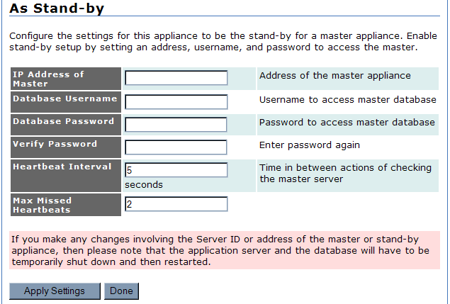
System: Redundancy Setup
Notes:
Cisco Unified Application Environment supports redundant operations. You can configure a master and
stand-by application server; the stand-by server then attempts to contact the master server every few
seconds. If a configured number of attempts fails, the stand-by server takes over.
Use the Redundancy Setup page to assign a unique ID number for each of the application
servers and to configure the master and stand-by servers.
The appliance must be assigned an ID number which will be unique relative to all other appliances in the setup. If you are also using application suite replication, setting the Server ID here affects the application suite replication settings.
It is possible to configure the settings for the appliance to be the master with a stand-by appliance. Enable the master setup by setting an address, username, and password for the stand-by. To disable master setup, simply remove the address of the standby.
Similarly, it is possible to configure the settings for the appliance to be the stand-by for a master appliance. Enable stand-by setup by setting the IP address of the master, username, password, heartbeat interval, and the maximum number of heartbeats missed.
Be aware, if you make any changes involving the Server ID or address of the master or stand-by appliance, then please note that the application server and the database will have to be temporarily shut down and then restarted.

Slide 47
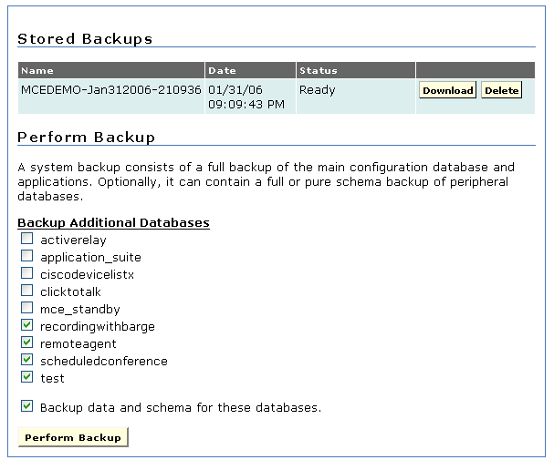
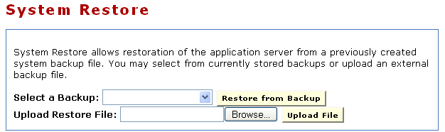
System: System Backup/Restore
Save and load configuration settings for an appliance.
View Existing Backups
Restore an existing backup or from a backup file
Backup additional databases and schemas
Notes:
Use the system backup feature to take a snapshot of the current configuration settings in the management
console, to save applications, and to save application configurations. A system backup generates a tar
file that can be stored in a safe location.
Use the system restore feature to install and activate a previously-generated system backup file,

Slide 48
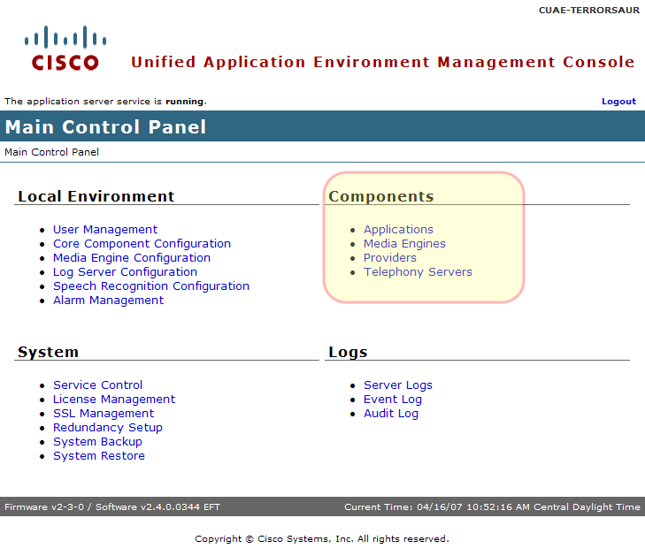
MCEADMIN: Components Settings

Slide 49
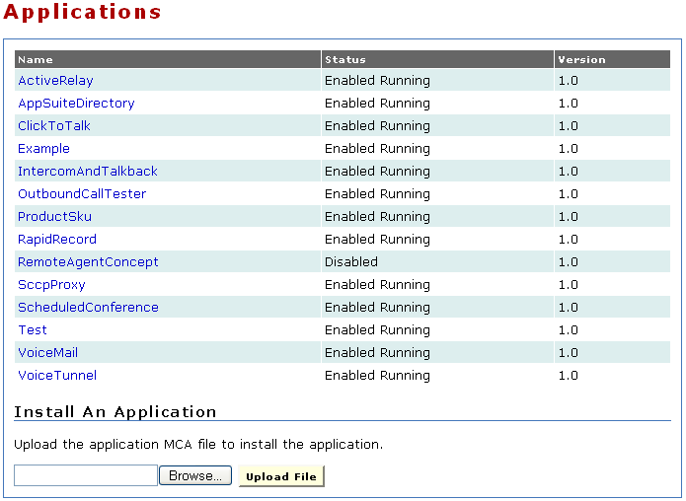
Components: Applications
Install and manage applications.
Is the application operational?
Currently installed applications
Current version of the application
Install a new application
Notes:
The Applications link in the Components section allows the administrator to install and uninstall applications. The page displays the application name, the status, and the version. The application name is displayed as a link. An application usually includes configuration items that are unique to your deployment and which you must configure after the application is installed. To configure these settings, click on the application name.

Slide 50
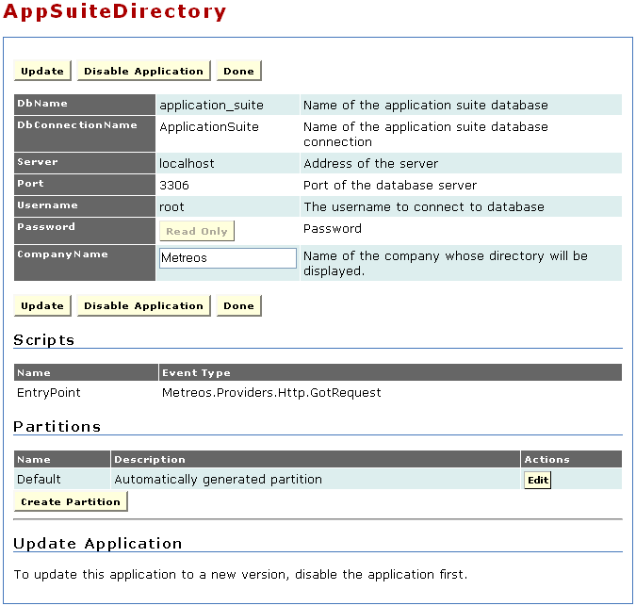
Components: Applications (continued)
Application controls
Global config for all partitions
List of the scripts in the app
Application partitions
Notes:
On the application’s configuration page, there are several sections. The top section displays the global configurations, which are applied to all partitions. The section in the middle, labeled Scripts, lists the scripts that make up the application. Under the Scripts section is a section for Partitions.
Partitions are flexible and can be useful in a variety of situations. For example, if an application is intended to serve end-users located on distinct Cisco Unified Communications Manager clusters, it is often desirable for all call control and media streams to terminate to the network and telephony resources contained within each cluster. At the same time, it may be desirable to have another configurable protocol on the application, such as LDAP, which makes reference to the same central location, regardless of the partition.
Each partition is associated with a call route group and media resource group. By defining unique call route groups and media resource groups, you can identify the partitions that use individual media engines. For each partition, you can also determine which Cisco Unified Communications Manager cluster is used for making calls by specifying a call route group that corresponds to the particular telephony protocol and group.
Each application is also associated with scripts, which are partitioned along with the application. Because multiple scripts can execute actions through the same protocol, you must specify the conditions under which a partitioned script should initiate action.
For example, assume that an application has one script and three partitions and activates on an IncomingCall trigger. The default partition has no triggering parameters and can act as a catch-all for events which do not match other partitions.
The application server determines the best match handler for a given event. Other partitions take effect if their trigger parameters are activated. For example, if Partition 2 specifies to=2000, then when a call comes in for extension 2000, partition 2 will activate. If no trigger matches, the default partition will be active.
A partition is similar to a configuration template for a script and applies these rules:
• The application developer sets the event that triggers a script. The event applies to all partitions and
cannot be changed.
• All installed script partitions across all applications are treated as equal.
• If any two partitions have identical triggering criteria, either one may trigger; therefore, it is
important that all partitions have unique triggering criteria.
• The router will match the handler that best fits the events. For example, if partition A specifies
to=2000 and partition B specifies to=2000 and from=1000, then a call from 1000 to 2000 triggers B.

Slide 51
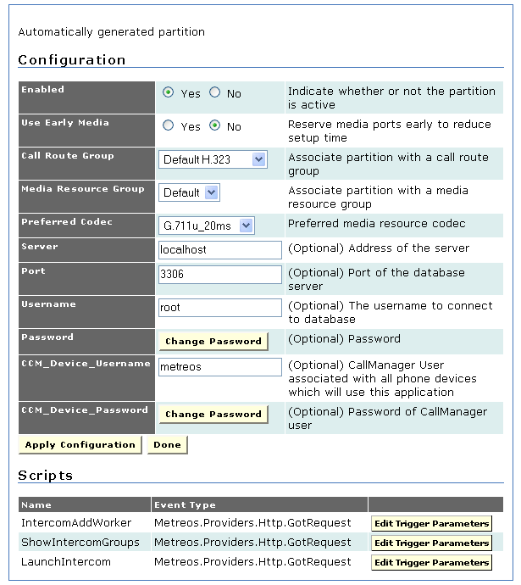
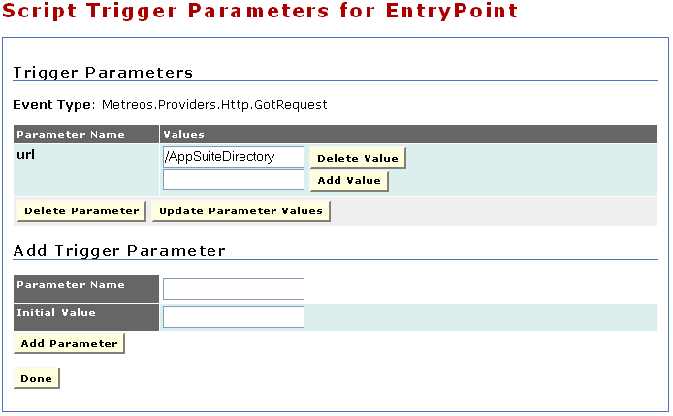
Components: Applications (continued)
Editing a partition brings up partition specific config information and trigger parameters.
Partition-specific config
Edit existing trigger parameters
Add new trigger parameters
Notes:
Configuration
Inside application’s configuration page, the administrator can specify settings specific to that partition. In addition to settings that every partition must have, there are additional items to be configured depending on the application’s design.
The common partition configurations are :
Enable - Indication of whether or not the partition is active
Reserve Media Early - Field in which to reserve media ports early to reduce setup time.
Call Route Group - Used by an application only when making outbound calls. The protocol of the inbound call is determined by a combination of Cisco Unified CallManager configuration and triggering parameters on the partitioned script.
Media Resource Group - Media server group that is closest in proximity to IP endpoints that will be using this application.
Preferred Codec - Preferred media resource codec.
Scripts
Each application is also associated with scripts, which are partitioned along with the application. Because multiple scripts may execute actions through the same protocol, you must specify the conditions under which a partitioned script should initiate action. For example, assume that two applications are installed, each with its own script and partition, and that
both scripts trigger on an HTTP request. You must specify which condition (triggering parameter) causes the first script to trigger, and which causes the second script to trigger. You could configure one script to trigger when a request to the URL <serverIP>/AppSuiteDirectory is made, but trigger a different script when a request to a different URL is received.
Triggers
Trigger parameters always have a name that you use in the administrative interface (case-insensitive). The Parameter Name is the name of the field type and the Initial Value is the value that will be compared to the event when it actually occurs.
Can not use CallManager syntax for the call control trigger parameters; however, you can use regular expressions.
Triggers can be
• Single value (to 2000)
• Value List —(to 2000, 2001, or 2003)
• Single Regular Expression — 2000-2999 (regex:2[0-9][0-9][0-9]).
Note A regular expression is indicated by adding regex: before the expression. You cannot mix literal values and regular expressions in a list. Only a single regular expression can be used as a trigger parameter for a given partition.
The syntax [0-9] in a regular expression is equivalent to the Cisco Unified Communications Manager X notation used in route patterns and CTI Route point line numbers.

Slide 52
This slide intentionally left blank
Notes:
Some common examples of parameter names are:
Metreos.CallControl.IncomingCall
To - Called party, or last redirected number if redirected
From - Number of the calling party
OriginalTo - Original called party, even if redirected
DisplayName - Textual display name associated with the calling part
Metreos.Providers.Http.GotRequest
URL Path portion of the requested URL. Must begin with a front slash (/).
Hostname - Host portion of the requested URL. Does not contain port information.
Host - Host portion of the requested URL. Might contain port information.
Port - Port portion of the requested URL
Body - Content of the request
Method Request method— either GET or POST
Query - Query string portion of the requested URL
RemoteHost - IP address and port of the remote client
RemoteIPAddress - IP address of the remote client

Slide 53
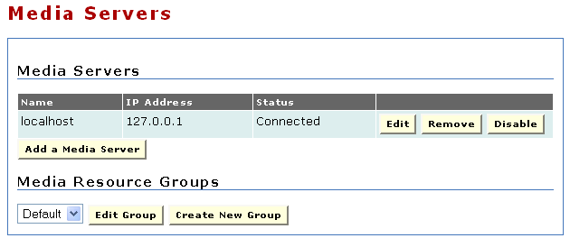
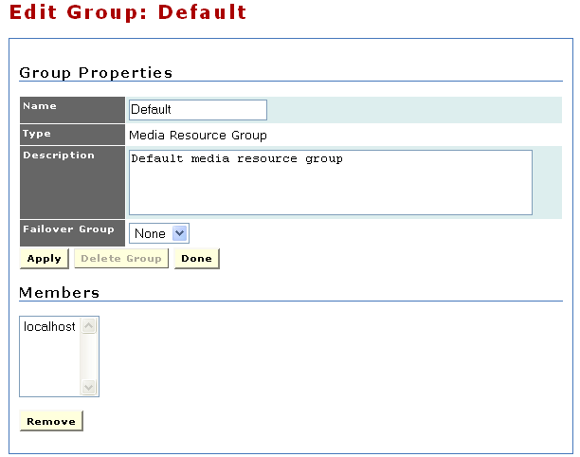
Components: Media Servers
Add and remove media servers. If a media server is listed here, the application server on the appliance maintains a connection to it.
Existing media servers
Edit or create media resource groups
Group members
Notes:
For the Cisco Unified Application Environment to act as a media endpoint, a Cisco Unified Media Engine must be present and the Cisco Unified Application Environment must be configured to use the engine. The decision to use a media engine depends on the needs of the application. Applications that place or answer calls typically require a media engine.
This page is used to create and configure media servers as well as media server groups.
To be available for use by applications, each media engine must be placed in at least one media resource group, which is assigned within the application partition. A media resource group is a container for a collection of media engines. All media engines are placed automatically into the Default media resource group, and all application partitions can use the default group. It is not necessary to create custom media resource groups; however, if multiple groups are defined, one group can be specified as a failover group for the other one.
Creating custom media resource groups is recommended in the following cases:
• Diverse geography—If a single Cisco Unified Application Environment provides call control for calls that originate and terminate in different countries, it is desirable to use media engines that are physically located in each country to service the calls directed to that country. For example, a push-to-talk application may reside on the Cisco Unified Application Server in New York but be triggered by a user in India to call another phone number in India. If all media engines in India are assigned to a custom media resource group, the application can be instructed to use the servers in the India media resource group to process calls that originate and terminate in India.
• Resource guarantees—Some applications, such as scheduled conferencing, are sensitive to resource utilization and may not recover well from unexpected loss of media resources due to the demands of other applications. To reserve the needed resources, you can assign specific media engines to a custom media resource group. The application then reserves the resources of the custom media resource group.
When adding a new media server, the commons configurations are:
Name - Name of media server
IP Address - IP address of media server
Password - Password for access to media server
Connection - Type Method of connecting to media server (unless otherwise instructed, use IPC)
Add to Group - Group to which media server is assigned

Slide 54
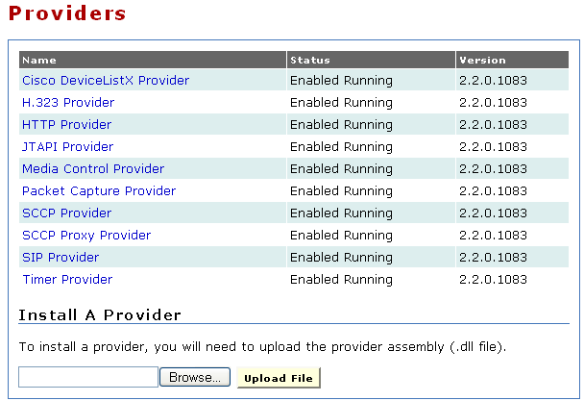
Components: Providers
Install and manage providers.
Is provider operational?
Currently installed providers
Current version of the provider
Install a new provider
Notes:
The Provider Manager is responsible for instantiating and managing providers. Similar to a system process or daemon, a provider typically opens network ports and allows the Application Runtime Environment to communicate with other devices on a network. The administrator can use the Providers page to display the list of providers shipped with the Cisco Unified Application Server, the status of each provider (Enabled Running or Disabled), and the version number. Clicking on the provider name launches the configuration page for that provider. Disabling the provider allows for its subsequent uninstallation, which resets it back to its default configuration settings and makes it unavailable. Restarting the application server will automatically restart the provider.

Slide 55
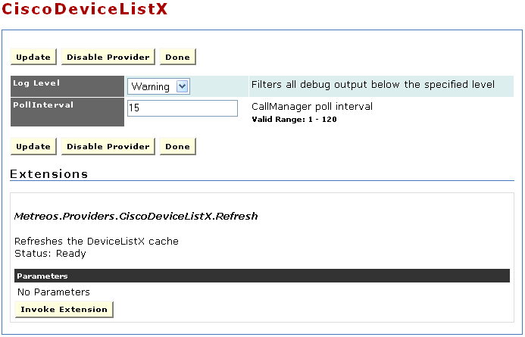
Components: Providers
Edit provider configuration and invoke provider extensions.
Provider controls
Provider configuration
Tell the provider to do something
Notes:
Each provider configuration page includes following sections:
• Configuration — Configurable parameters for the provider.
• Extensions — Special actions exposed by the provider and invoked only through the Management Console rather than by a script (not all providers have extensions)
The default installed providers and their settings are as follows:
• CiscoDeviceListX Provider
Log Level - Type and amount of information the system writes to the log for each component
Poll Interval - Interval in minutes between requests sent to Call Manager to refresh device information (cache refresh)
• H323Provider
Log Level - Type and amount of information the system writes to the log for each component
Port - Port Number of the port on which H323 listens
EnableStackDebugging - Field in which to enable StackDebugger, a tool that writes logs to a file for H.323 diagnostics
StackDebuggingLogLevel - Log level specifying detail of logs written by the StackDebugger (valid values are 0 – 5, where 0 disables debugging, and 5 maximizes debugging)
StackDebuggingLogFile - Name of log file for the StackDebuggingLog function
EnableProcessWindow - Field in which to configure H323 to write debug output to a window rather than a log file
• HTTP Provider
Log Level - Type and amount of information the system writes to the log for each component
Name - Name of HTTP provider
Port - Port Number of the port on which the provider listens
Session Expiration Minutes - Number of inactive minutes before the session is automatically terminated
Session Cleanup Minutes - Interval between clean-up of resources for terminated sessions in minutes
• JTAPI Provider
Log Level - Type and amount of information the system writes to the log for each component
Monitor Devices - Devices to monitor
User name - User with permission to monitor specified devices
Password - Password for user with permission to monitor the specified devices
CTI Manager - IP address of CTI manager
Backup CTI Manager - IP address of backup CTI manager
Max Calls per Device - Maximum number of calls allowed on any first-party CTI Port device (this value must match the equivalent value in Cisco CallManager)
Server version - Cisco Unified CallManager release
Advertise Low-bitrate Codecs - Indication of whether devices should be registered with G.723.1 and G.729a support

Slide 56
This slide intentionally left blank
Notes:
• Media Control Provider
Log Level - Type and amount of information the system writes to the log for each component
Connect Timeout - Interval in milliseconds before a connection is deemed unsuccessful and the system attempts to retry
Heartbeat Interval - Interval, in seconds, between heartbeat signals to a media server
Heartbeat Skew - Interval, in seconds, MediaControlProvider waits for a response to the heartbeat signal
DiagInboundConnectMessages - Inbound connect messages written to the Log Server.
DiagOutboundConnectMessages - Outbound connect messages written to the Log Server.
DiagOutboundDisconnectMessages - Outbound disconnect messages written to the Log Server.
DiagOutboundCommandMessages - Outbound command messages written to the Log Server.
DiagInboundResponseMessages - Responses written to the Log Server.
DiagHeartbeatResourceInfo - Heartbeat signal information written to the Log Server.
• SCCP Provider
Log Level - Filter for all debug output (below the specified level)
MaxBurst - Maximum registration messages per burst (5) (valid range: 1 - 2147483647)
InterBurstDelayMs - Milliseconds between bursts (1000) (valid range: 0 - 2147483647)
CallManagerPort - Port on which Cisco Unified CallManagers listen for registrations (2000) (valid range: 1024 - 32767)
AdvertiseLowBitRateCodecs - Indication of whether devices should also be registered with G.729a support (No)
MusicOnHoldOption - Indication of whether Music-On-Hold is enabled
LogCallVerbose - Verbose logging for call (Yes)
LogCallManagerVerbose - Verbose logging for CallManager (No)
LogConnectionVerbose - Verbose logging for connection (No)
LogDiscoveryVerbose - Verbose logging for discovery (No)
LogRegistrationVerbose - Verbose logging for registration (Yes)
LogSystemVerbose - Verbose logging for system (No)
• SIP Provider
Log Level - Filter for all debug output (below the specified level)
DefaultOutboundFromNumber - Default From number for outbound call
SIPTrunkIP - SIP Trunk IP address for outbound call (should match the IP used for SIP Trunk in CallManager)
SIPTrunkPort - SIP Trunk port for outbound call (should match the port used for SIP Trunk in CallManager)
MinRegistrationPort - Minimum TCP port number to use for registration with SIP server (valid range: 1024 - 65535)
MaxRegistrationPort - Maximum TCP port number to use for registration with SIP server (valid range: 1024 - 65535)
ServiceLogLevel - SIP service log level (0=Off, 1=Error, 2=Warning, 3=Info, 4=Verbose, valid range: 0 - 4)
LogTimingStat - Timing statistics (enabled when set to true)
• Timer Provider
Log Level - Type and amount of information the system writes to the log for each component
Enable Minute Events - Field in which to enable minute by minute timer events (enabled when set to true)
Enable Hour Events - Field in which to enable hourly timer events (enabled when set to true)
Enable Daily Events - Field in which to enable daily timer events will be generated (enabled when set to true)

Slide 57
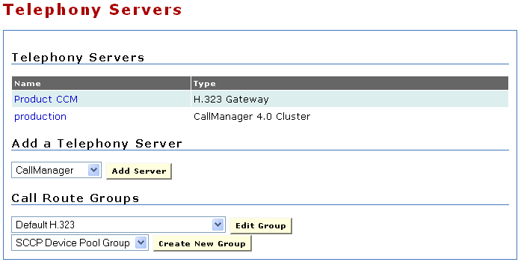
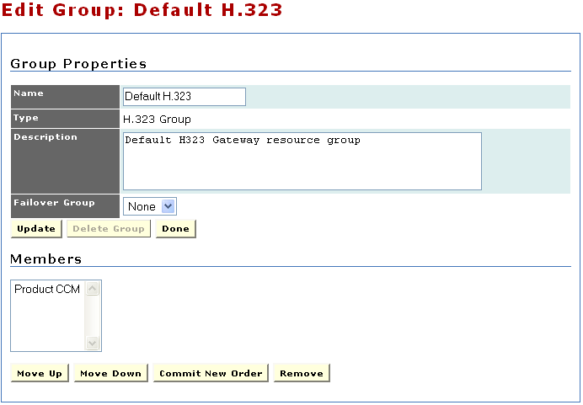
Components: Telephony Servers
Add, remove, and edit telephony servers.
Add and edit call route groups.
Existing telephony servers
Add new server
Add and edit call route groups
Edit group membership and priority
Notes:
Every IP telephony system must contain at least one telephony server. The Management Console
provides a telephony server configuration page for adding and configuring telephony servers and devices
on those servers.
The Application Server supports several types of telephony servers:
Unified Communications Server — Multipurpose telephony server devices supporting SCCP and CTI in the Cisco Unified system.
Cisco SIP domain—Defines a SIP interface into Cisco Unified CallManager. By creating a Cisco SIP domain, you can use SIP trunks and SIP devices that the Cisco Unified Application Server creates in Cisco Unified CallManager.
IETF SIP domain—Defines a telephony server that supports IETF-specific SIP.
H.323 gateways — Telephony servers, which are used exclusively with H.323.
When adding a telephony server, however, all of its devices must be associated with one or more call route groups.
When you configure SIP, you must configure the Cisco Unified Application Servers with two IP addresses, and be sure to configure the SIP Provider with one of the two IP addresses
Just as a media server group functions as a container for media servers, a call route group functions as a container for telephony devices. Each telephony device must belong to one or more groups. Creating a call route group is optional; the system provides a default call route group to be used if multiple groups are not needed.

Slide 58
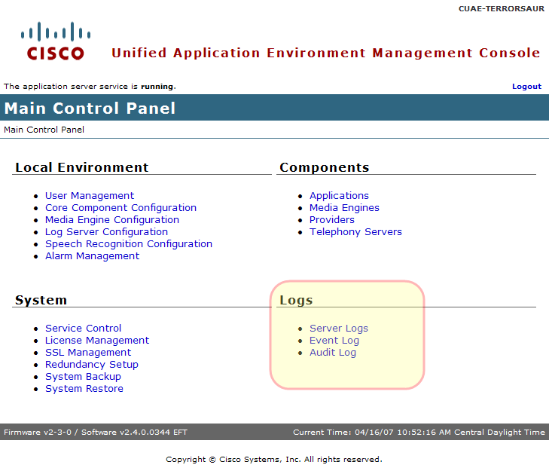
MCEADMIN: Logs Settings
Notes:
The following management console logs provide diagnostic information:
• Server Logs — Information about server activity.
• Event Log — Information about system events (e.g. H.323 stack is unavailable).
• Audit Log — All Application Environment activity. (this stamps who did what so you know who to blame)
The Cisco Unified Application Environment supports log level filtering. The log level determines the amount of recorded detail about logged events

Slide 59
Logs: Server Log: Setting Log Level
To increase the log level visit these two places:
Core Components -> Application Environment
Then, increase the level of logs generated by the Application Environment to ‘verbose’
Core Components -> Logger
Then, increase the Log Server Sink to ‘verbose’
Notes:
When beginning to troubleshoot, it is often a good idea to increase the log levels to ‘verbose’.
To set the log level:
1. Go to Main Control Panel -> Core Components -> Application Environment
Increase the level of logs generated by the Application Environment to ‘verbose’
2. Go to Main Control Panel -> Core Components -> Logger
Increase the Log Server Sink to ‘verbose’ otherwise higher level logs will be filtered.
Logger
The Logger manages log messages. The Cisco Unified Logger uses trace listeners to route log messages to various log sinks based on configurable criteria. The standard logs packaged with the Application Runtime Environment are:
• TCP Logger — Writes logs to any number of TCP connections, such as the remote console feature
of the Cisco Unified Application Designer.
• TCP Logger Port — Port that the TCP remote console logger remoting server listens on for connections.
• Log Server Sink Logger Level — Filters log server debug output below specified level.
Log Level Descriptions:
Off - No logging
Error - Only error messages written to log
Warning - Only warning and error messages written to log
Information - Warning, error, and terse event information messages written to the log
Verbose - Warning, error, and detailed event information messages to the log

Slide 60
Logs: Server Log: Setting Log Level (cont)
Difference between default Info Log Level and Verbose Log Level
10:29:56(90): Info: HandleMakeCall-1 Application: (5580) The MakeCall application successfully initiated the call...
10:29:57(31): Info: TM Enqueuing event (1000002): Metreos.CallControl.GotCapabilities
10:29:57(32): Info: HP SetMedia(1000002,rx:10.89.31.144:20482,tx:G711u,20,{G711a:2030,G711u:2030})
10:29:57(32): Info: TM Enqueuing event (1000002): Metreos.CallControl.MediaEstablished
10:29:57(32): Info: TM Call '1000002' switching to state map: OutboundCall_WaitTxRx
10:29:57(32): Info: TM Enqueuing event (1000002): Metreos.CallControl.MediaEstablished
10:29:56(90): Info: HandleMakeCall-1 Application: (5580) The MakeCall application successfully initiated the call...
10:29:56(90): Verbose: HandleMakeCall-1 Executing action 'Metreos.Providers.Http.SendResponse' (632929999374687988)
10:29:56(90): Verbose: HandleMakeCall-1 Got success response for 'Metreos.Providers.Http.SendResponse' (632929999374687988)
10:29:56(90): Verbose: HandleMakeCall-1 Executing action 'Metreos.ApplicationControl.EndFunction' (632929999374687992)
10:29:57(31): Info: TM Enqueuing event (1000002): Metreos.CallControl.GotCapabilities
10:29:57(31): Verbose: TM GotCapabilities (1000002):
G711a: 10, 20, 30
G711u: 10, 20, 30
10:29:57(31): Verbose: TM Executing state: dd3e96f2aa33:1000002:20 (SelectTxCodec)
10:29:57(31): Verbose: TM Beginning Tx codec selection (1000002).
Local caps:
G711a: 20 30
G711u: 20 30
Remote caps:
G711a: 10 20 30
G711u: 10 20 30
10:29:57(31): Verbose: TM Selected Tx codec (1000002): G711u:20
10:29:57(31): Verbose: TM Executing state: dd3e96f2aa33:1000002:25 (ReserveConnection)
10:29:57(31): Verbose: MCP connect message sent successfully
10:29:57(31): Verbose: MCP Sending success response (1:345)
10:29:57(31): Verbose: TM Enqueuing 'success' (1000002) response from Metreos.MediaControl
10:29:57(32): Verbose: TM Executing state: dd3e96f2aa33:1000002:30 (SetMedia)
10:29:57(32): Info: HP SetMedia(1000002,rx:10.89.31.144:20482,tx:G711u,20,{G711a:2030,G711u:2030})
10:29:57(32): Verbose: HP OnMediaEstablished(ip$localhost/26489=>1000002,Receive,tx::0,rx:G711u,20)
10:29:57(32): Verbose: TM Enqueuing 'success' (1000002) response from Metreos.CallControl.H323
10:29:57(32): Info: TM Enqueuing event (1000002): Metreos.CallControl.MediaEstablished
10:29:57(32): Verbose: TM Executing state: dd3e96f2aa33:1000002:35 (Wait)
10:29:57(32): Verbose: HP OnMediaEstablished(ip$localhost/26489=>1000002,Transmit,tx:10.89.31.25:18268,rx:Unspecified,0)
10:29:57(32): Info: TM Call '1000002' switching to state map: OutboundCall_WaitTxRx
10:29:57(32): Info: TM Enqueuing event (1000002): Metreos.CallControl.MediaEstablished
Notes:
Here is an example of the log entries from a simple MakeCall application when the Log Level is at the default Info Log Level
and at the Verbose Log Level.
Notice the additional entries that were logged.

Slide 61
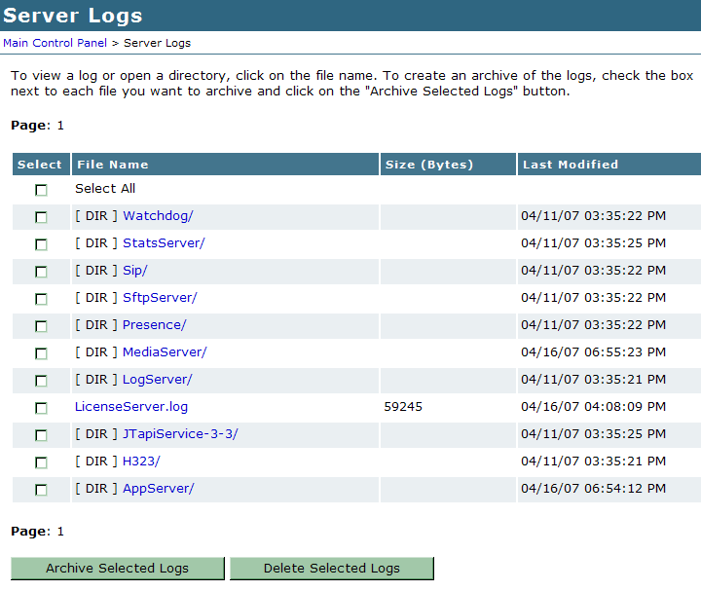
Logs: Server Log
Download, view, and delete logs on the system
Existing log file directories
Log operations
Notes:
There are many logs kept under the server logs heading.
On this page, you will find folders for the existing logs.
When a customer calls in to raise an issue, one of the first things to ask for is all the logs.
The simplest way to do this is click the Select All checkbox at the top of the table.
This will place a checkmark next to all the logs.
Then, click the Archive Selected Logs button.
You will be taken to a page that allows you to download the logs which the customer can then email to support.
First log to check is AppServer log is AppServer.

Slide 62
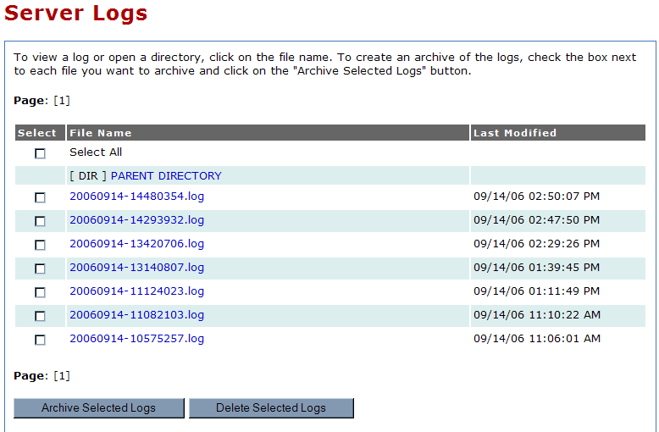
Logs: Server Logs: AppServer
Notes:
The AppServer logs will be looked at the most.
When there is a problem, this is one of the first places you check. Often it helps to increase the log level to Verbose.

Slide 63
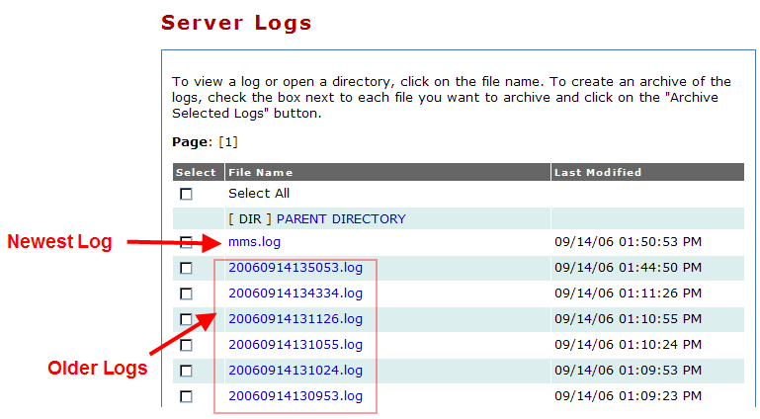
Logs: Server Log: MediaServer

Slide 64
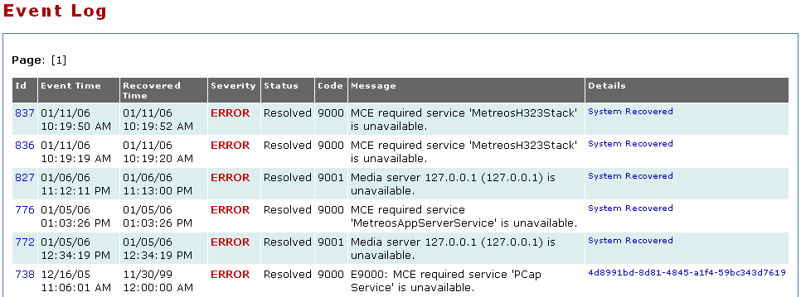
Logs: Event Log
Provides a list of system wide events and whether those events have been resolved.

Slide 65
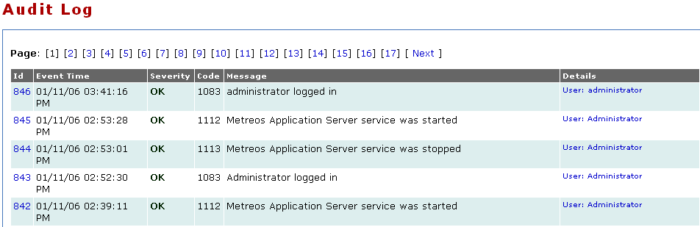

Logs: Audit Log
Every management operation is recorded.
Provides a detailed view as to what has changed on the system and by whom.

Slide 66

Topologies
Notes:
In this topology, a single physical server operates as an application server or combined application server and media engine, and is integrated with a single Cisco Unified Communications Manager cluster
This configuration is appropriate when the following conditions apply:
• The Cisco Unified Application Environment must support a single Cisco Unified Communications Manager cluster.
• Fewer than 400 simultaneous media streams are required, and the projected amount of media stream traffic between IP endpoints (IP phones, H.323/MGCP gateways, Music on Hold (MOH) servers, and hardware and software conference bridges) and the media engine is not expected to add excessive network load.
• Redundancy is not required for the application server or media engine.

Slide 67

Topologies
Notes:
In this topology, a single physical server operates as an application server or combined application server and media engine and is integrated with multiple Cisco Unified Communications Manager clusters.
This configuration is appropriate when these conditions apply:
• The Cisco Unified Application Environment must support multiple Cisco Unified Communications Manager clusters.
• Fewer than 400 simultaneous media streams are required and the projected amount of media stream traffic between IP endpoints (IP phones, H.323/MGCP gateways, Music on Hold (MOH) servers, and hardware and software conference bridges) and the media engine is not expected to add excessive network load.
• Redundancy is not required for the application server or media engine.

Slide 68

Topologies
Notes:
In this topology, a single application server controls multiple media engines and is integrated with
multiple Cisco Unified Communications Manager clusters
NOTE: To avoid latency and bandwidth issues, it is recommended that you distribute media engines close to the
media endpoints used for a particular application.
This configuration is appropriate when these conditions apply:
• The Cisco Unified Application Environment must support multiple Cisco Unified Communications
Manager clusters.
• More than 400 simultaneous media streams are required and the projected amount of media stream traffic between IP endpoints (IP phones, H.323/MGCP gateways, Music on Hold (MOH) servers, and hardware and software conference bridges) and the media engine could potentially add excessive network load across WAN links.
• Redundancy is not required for the application server, but is required for the media engine.

Slide 69

Topologies
Notes:
In this topology, a single application server controls multiple media engines and is integrated with
multiple Cisco Unified Communications Manager clusters
NOTE: To avoid latency and bandwidth issues, it is recommended that you distribute media engines close to the
media endpoints used for a particular application.
This configuration is appropriate when these conditions apply:
• The Cisco Unified Application Environment must support multiple Cisco Unified Communications
Manager clusters.
• More than 400 simultaneous media streams are required and the projected amount of media stream traffic between IP endpoints (IP phones, H.323/MGCP gateways, Music on Hold (MOH) servers, and hardware and software conference bridges) and the media engine could potentially add excessive network load across WAN links.
• Redundancy is required for both the application server and the media engine.

Slide 70

Integration Application - MakeCall

Slide 71

Integration Application - MakeCall

Slide 72

Integration Application - AnswerCall

Slide 73

Integration Application - AnswerCall

Slide 74
Summary
The core elements of the Cisco Unified Application Environment are called:
Application Server
Media Engine
Application Designer
System Control Panel (a.k.a MCEAdmin)
Advances Services will support the Application Designer and the applications created with it.
TAC will be supporting Application Server (and System Control Panel) and the Media Engine.
The logs are an invaluable resource for troubleshooting… we will see more about them tomorrow

Slide 75
Escalation and Contact Info
Emergency Contacts
page-cuae-brt@epage.cisco.com
page-cuae-eng@epage.cisco.com
Non-Emergency Contacts
cs-cuae@cisco.com
cuae-interest@cisco.com
http://zed.cisco.com/confluence/display/CUAE/Home
Notes:
Emergency Contacts
page-cuae-brt@epage.cisco.com
page-cuae-eng@epage.cisco.com
Non-Emergency Contacts
cuae-interest@cisco.com
cs-cuae@cisco.com - this mailer is intended for general questions about the cuae products, and will be used by TAC, SE's, Cisco Acct teams, Advanced Services, and others in the field to ask general questions about product features, basic configurations, roadmaps, etc.
cse-dev-cuae@cisco.com – this mailer is intended primarily for presenting technical or troubleshooting related issues into the product development team (engineering). This is used primarily by TAC and AS to get help from engineering for a non-critical issue. A TAC engineer may use this alias first, prior to escalating a case directly to engineering.
cuae-dev@yahoogroups.com – mailer used to communicate with other developers.
http://zed.cisco.com/confluence/display/CUAE/Home - This is the wiki page for the product. Lots of good docs and info there.

Slide 76
Questions??

Slide 77
Thank you
  fin
Notes:
Add text

