Slide 1
CUAE:
Salesforce & Cisco
Integration

Slide 2

Application Design Walkthrough
Salesforce Integration with CallManager/CUAE

Slide 3
Salesforce Integration
Salesforce is not an application used solely by call centers by any means, but most applications built for SF are geared towards the call center.
What if the CUAE could bridge Salesforce and CallManager together for richer and seamless functionality, while creating an infrastructure for future partner-developed applications?

Slide 4
Cisco & Salesforce Provide Free Code
Previously, Cisco & Salesforce have teamed up and created prototypes that bridge CME/IPCC, and offer the prototype code for free.
Riding on top of that effort, a prototype is in mid-way development for the CCM/CUAE. The code will be offered for free as a substantial kickstart for other CUAE development practice to add their own value.

Slide 5
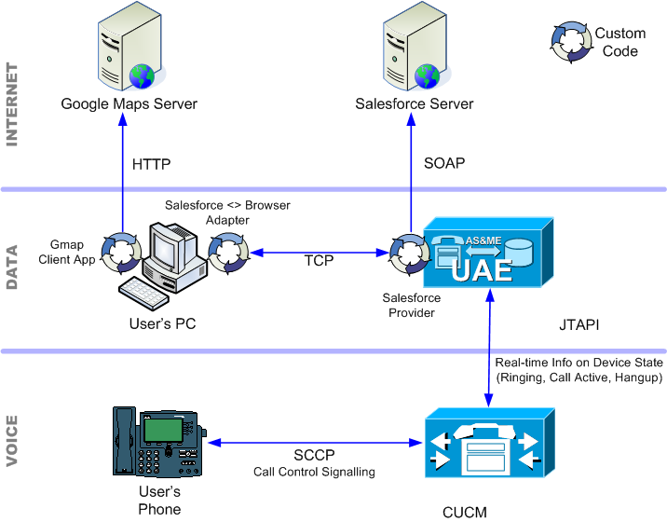

Application Architecture

Slide 6
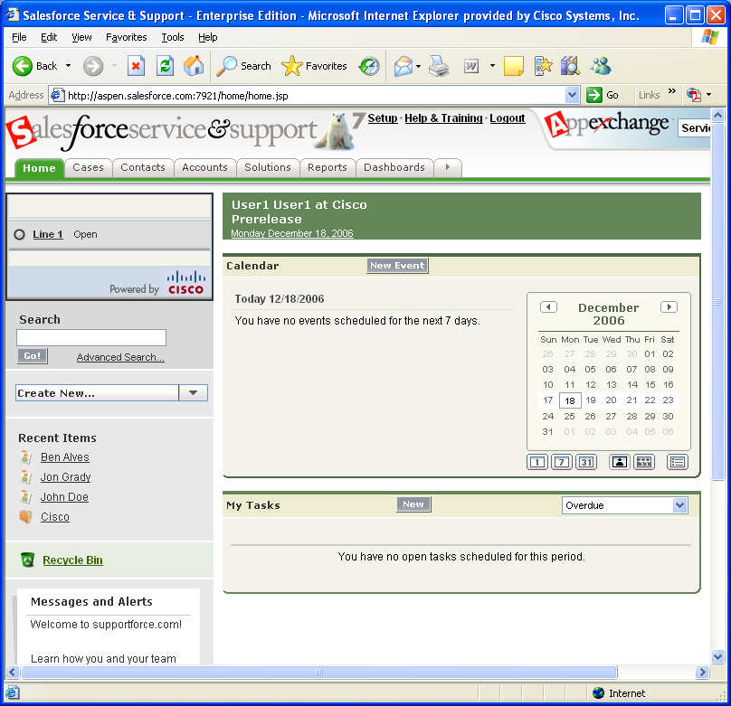
Salesforce with Call Widget

Slide 7
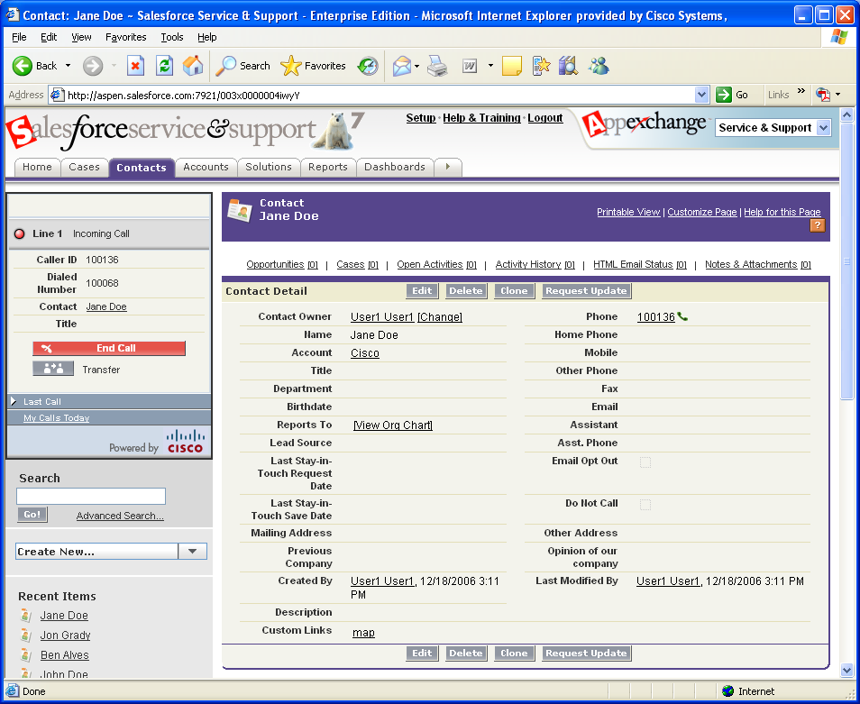
User Receives Call – Customer Screen Pop

Slide 8
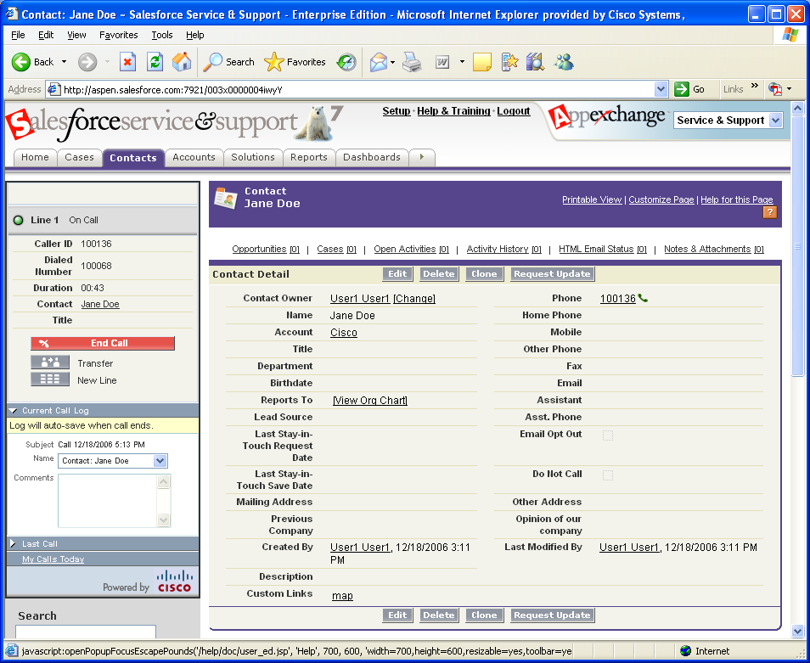
User Answers Call – Add Comments

Slide 9
Salesforce-Driven Google Map
In addition to the ‘Call Widget’, a Google Map will appear if a pop-up ‘toast’ is clicked in the taskbar.
This CUAE application will lookup which contact is calling from the Salesforce.com database, and send the address down to the Google Map when a call comes in to the user’s phone.
Resellers are also identified on the map. If one click’s the reseller’s balloon, a conference will be made with the user, the contact calling in, and the reseller.

Slide 10
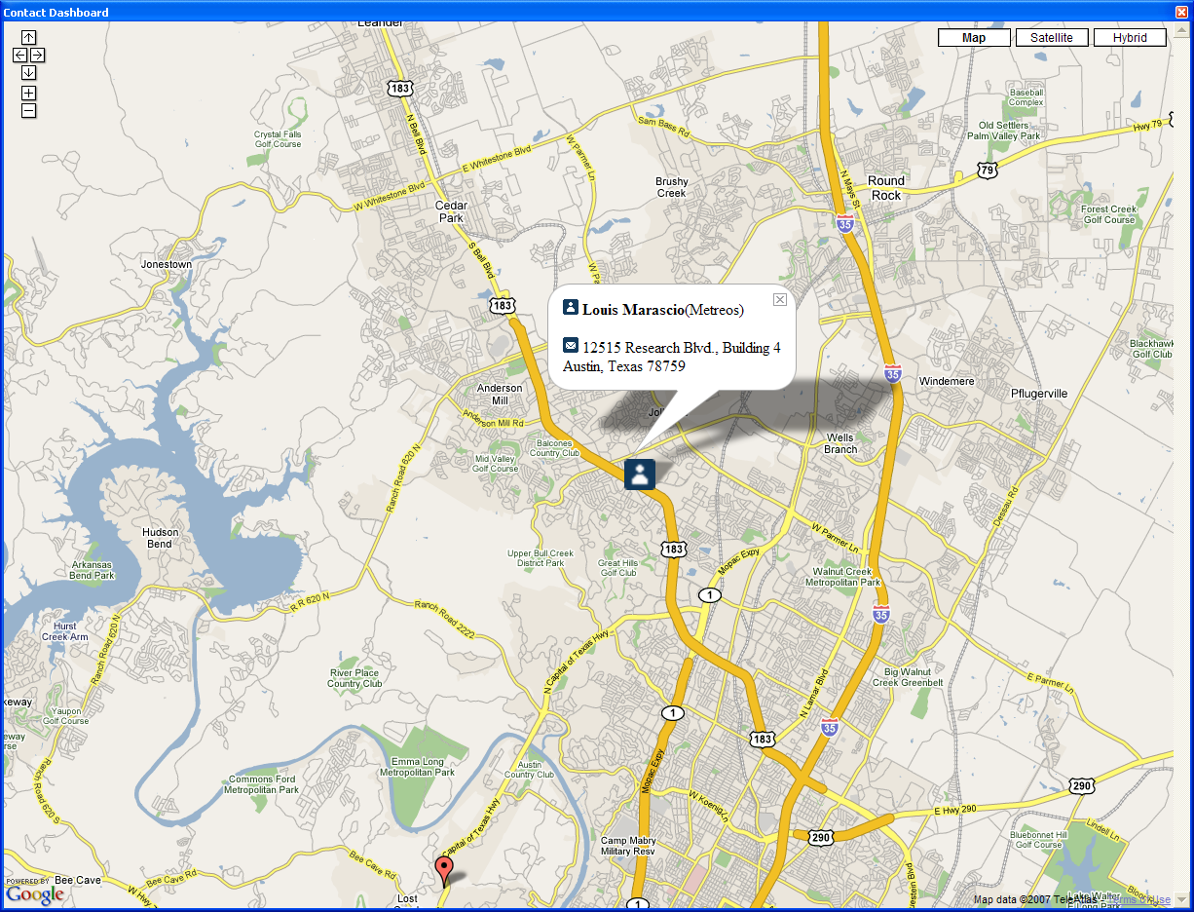

Initial Showing of Google Map Client
Step 1: ‘Toast’ pops up over Taskbar
Step 2: Clicking Toast causes Google Map to show with Caller marked on map

Slide 11
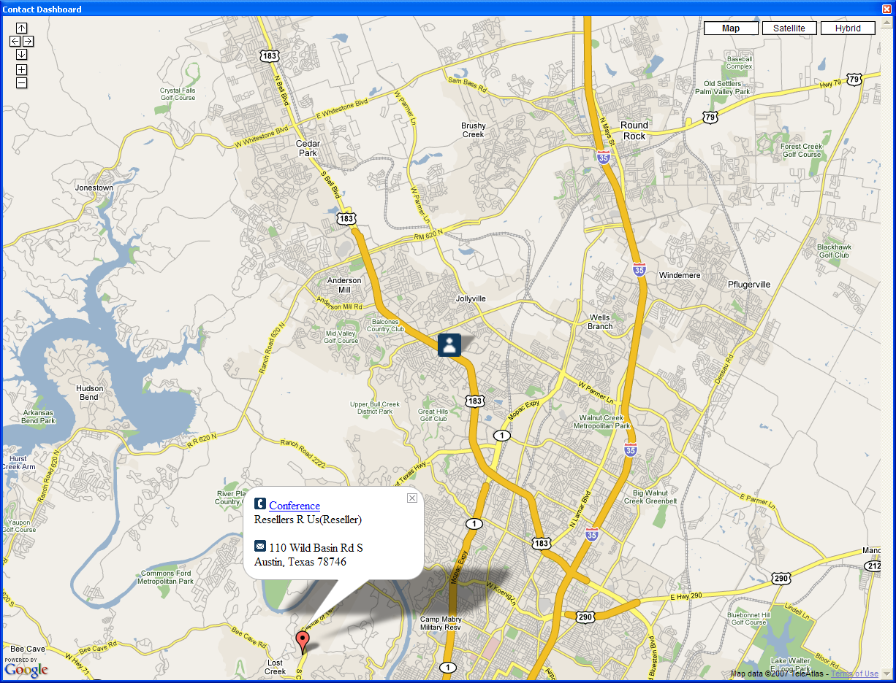
Reseller Marker Clicked (Conference)

Slide 12
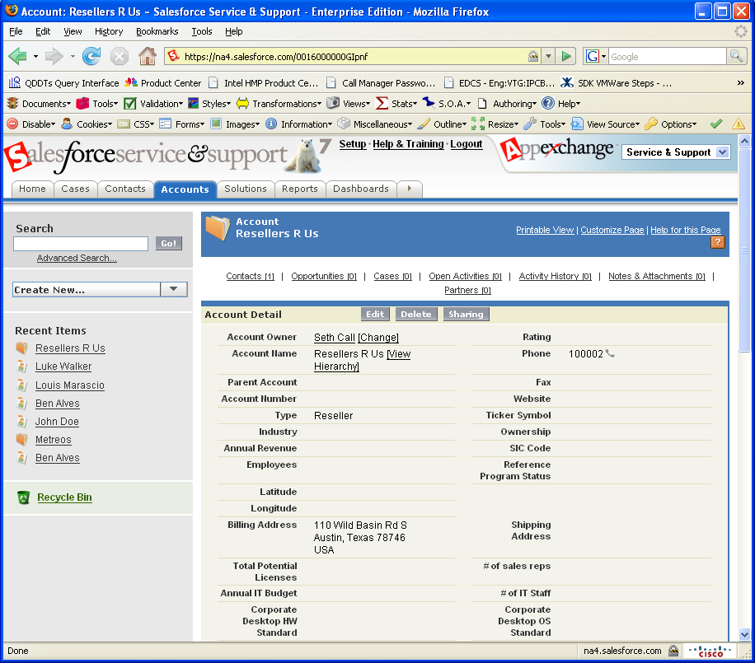
The Google Map is populated from Salesforce.com data

Slide 13
Administrator View of Active Calls
Because all knowledge of calls through this application is contained in a central location (the CUAE), it’s a straightforward task to create a small database to store these active calls.
By creating this database, a new application can be created for managers, who can watch all active calls.
The CUAE’s primary competency is control over calls and media, so it’s also straightforward to add control over these calls for the manager, such as the ability to listen or barge into a particular call.
The dashboard of calls is updated in real-time as calls go active and inactive, using Web 2.0 technologies.

Slide 14
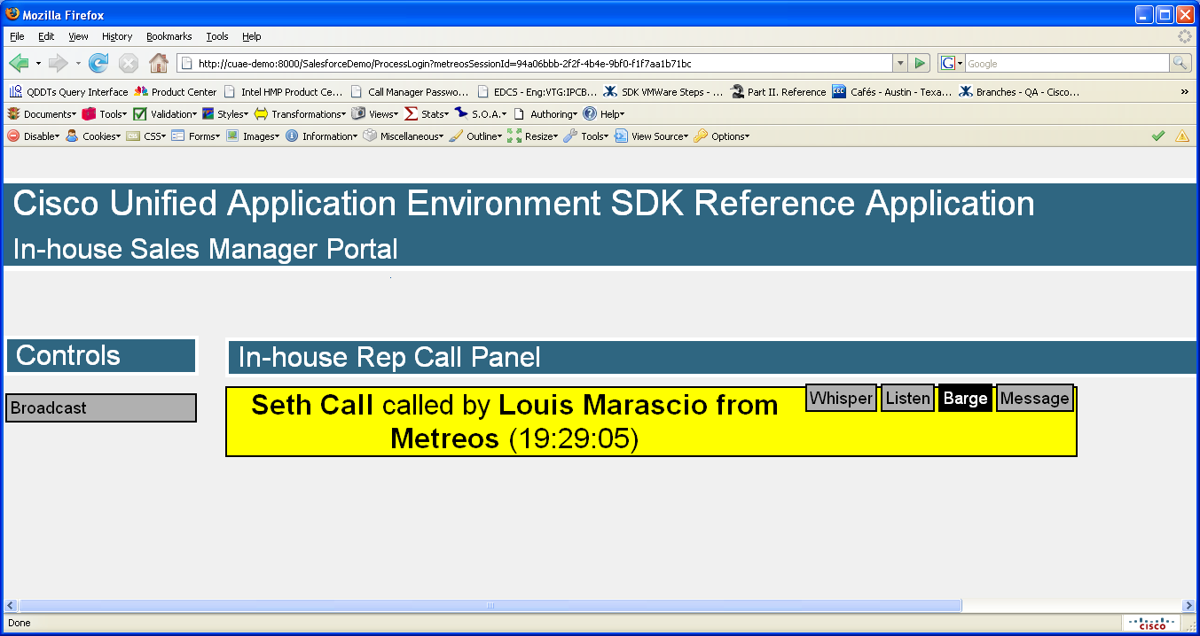
Administrative Control Panel of Calls

