Slide 1


Slide 2
Rapid Application Development for Unified Communications
Seth Call, call@cisco.com
Senior Software Engineer & Developer Evangelist

Slide 3

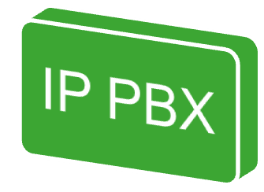
Multiple Protocols
H.323
SIP
CTI
Notes:
Often to be useful, more that one protocol is needed to complete to create a relevant application.
SIP is certainly solidifying as the 1st-party protocol of choice
CTI/TAPI still very relevant for 3rd-party device monitoring
H.323 is very widely supported and is still valid alternative to SIP

Slide 4
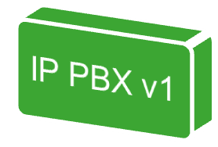

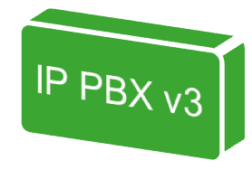
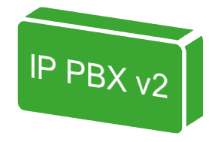
Versioned Protocols
CTI
H.323
SIP
CTI
H.323
SIP
CTI
H.323
SIP
Notes:
Implementing more than one telephony protocol is hard enough: maintaining interoperability between all the different versions of the IP PBX increases the difficulty of the product by an order of magnitude.
Software must be ‘version aware’

Slide 5
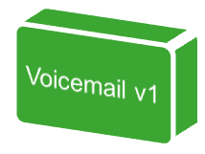
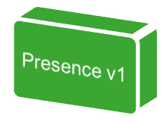

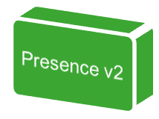
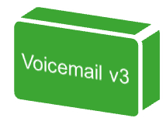

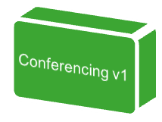
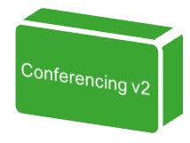

The Rest of Unified Communications
CTI
H.323
SIP
CTI
H.323
SIP
CTI
H.323
SIP
Notes:
The IP PBX isn’t the only relevant element in the network any longer. One needs hooks into voicemail, conferencing, presence, and other servers—and of course versioning is an issue still.

Slide 6

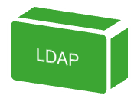

The Rest of the World
CTI
SOAP
H.323
SIP
CTI
LDAP
H.323
SIP
CTI
H.323
SQL
SIP
Notes:
You have to go beyond just the voice network to create relevant, business-process altering applications. Data and Voice must merge.
This resulting image is meant to highlight the inherent nastiness of supporting everything under the sun.

Slide 7

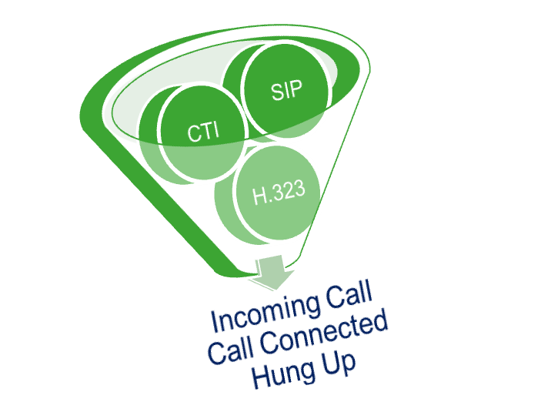


Abstract Telephony Protocols
Notes:
A common framework must exist to abstract the complexity of all these various protocols, version-related differences, and data protocols.
At the same time, this common framework should also bring all these disparate technologies to the same programmatically level, creating a consistent and cohesive development environment.
This slide shows the ‘funneling’ of disparate telephony protocols into a common set of relevant messages.

Slide 8
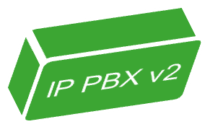
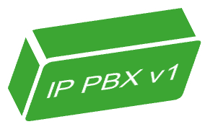
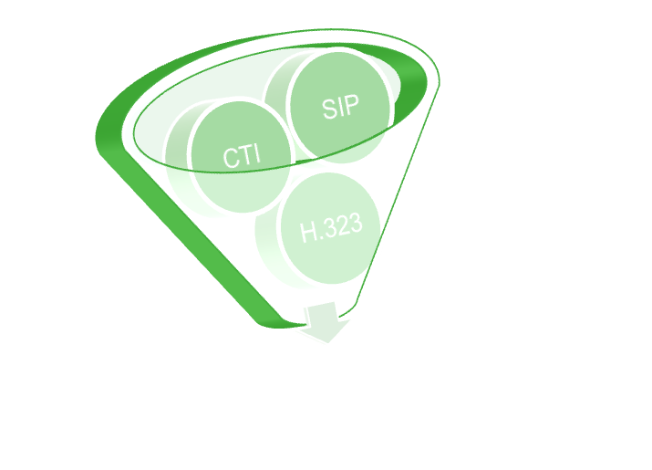
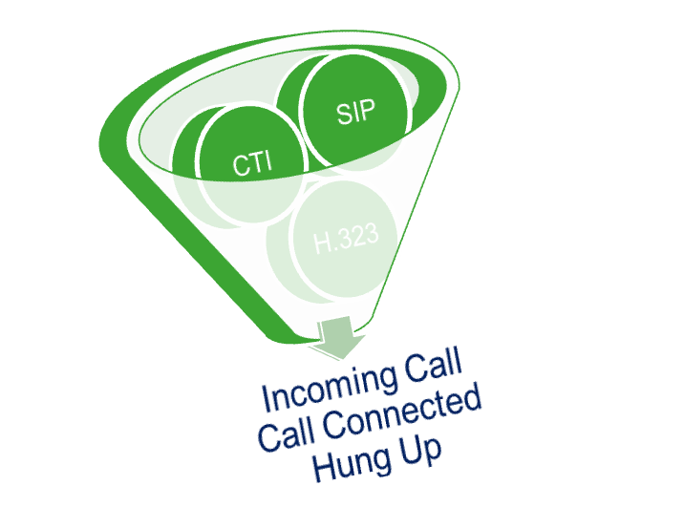
Abstract Version
Notes:
Versioning should also be abstracted away from the developer.

Slide 9
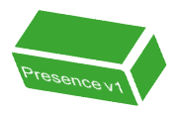

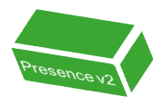
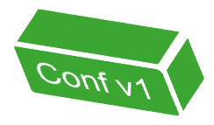

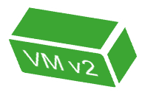
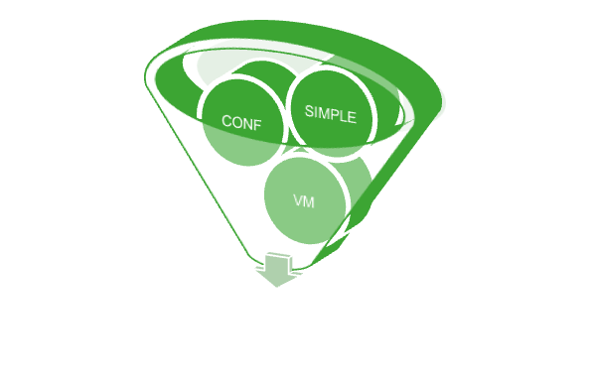
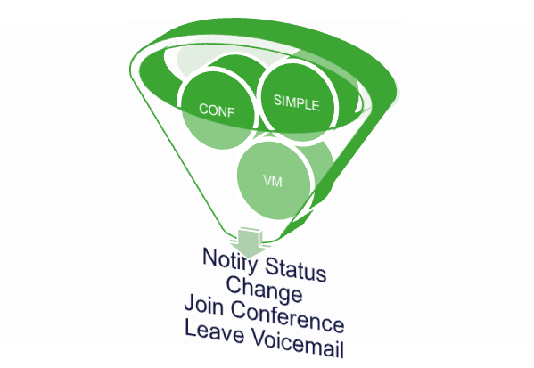
Abstract Unified Communications
Notes:
The other elements of the Unified Communications framework should of course be abstracted into messages that are relevant to their purpose, and also versioning of this various technologies should be accounted for.

Slide 10
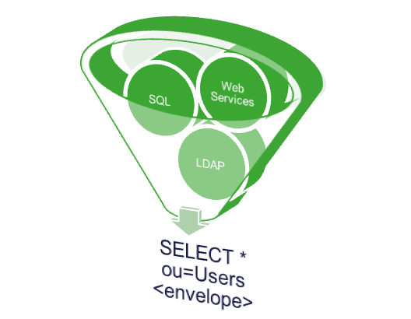
Integrate All That Other Stuff
Notes:
Data must be brought into the common framework as well. Web Services, Databases, and LDAP all should be brought to the same level as voice abstraction. If this is not done, merging voice into data becomes an obstacle to development.

Slide 11
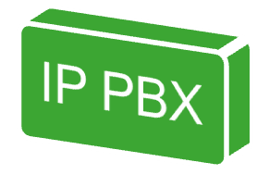
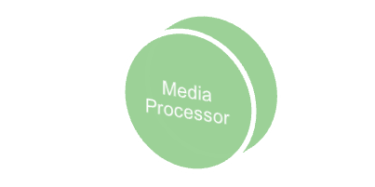
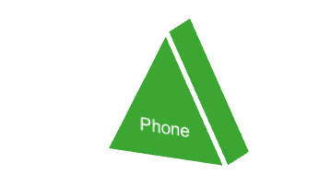
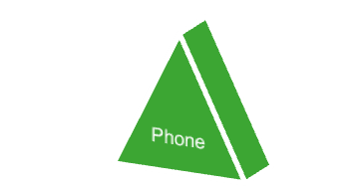
Media is Integral Part of IPT
Media-rich functionality requires a dedicated and powerful media processor.
  Speech Recognition
  Conferencing
  Text-to-speech
SIP
SIP
SIP
Notes:
Unified Communications is all about media—audio, video, messaging, etc. Constantly new features are being added to the processing of these media streams, such as text-to-speech, conferencing, speech recognition, and now even speech dictation.
Media processing is intensive, and tends to require low-level programming to optimize it appropriately.

Slide 12


UC Customers = High Standards
Does Your App:
  Behave Redundantly?
  Failover & Failback?
  Leverage their UC Infrastructure Redundancy and Failover?
SIP
CLUSTERING
CLUSTERING
SIP
Notes:
Everything before this slide are really not that different than obstacles in development in general. These following ones are more unique or specific at least to Unified Communications.
UC Customers have high standards. Customers expect 100% uptime for UC applications. 100% uptime means you have to have redundancy solved, failover solved, and additionally, your software needs to leverage the redundancy and failover capabilities of the UC infrastructure!
This all adds up to make a tall order for anyone thinking to enter the world of Unified Communications.

Slide 13
A Platform Generates its Own Requirements
Deployment of Applications
Management of Platform & Applications
Extensibility of Platform
Localizability of Platform Applications
Testing Framework
Documentation Framework
Virtualization/Emulation of UC components
Notes:
By virtue of building a framework to satisfy all the other requirements, you are signing a contract with the user that this platform will satisfy the bulk of their needs.
So listed here are all the other things people expect of a platform, at a minimum…

Slide 14
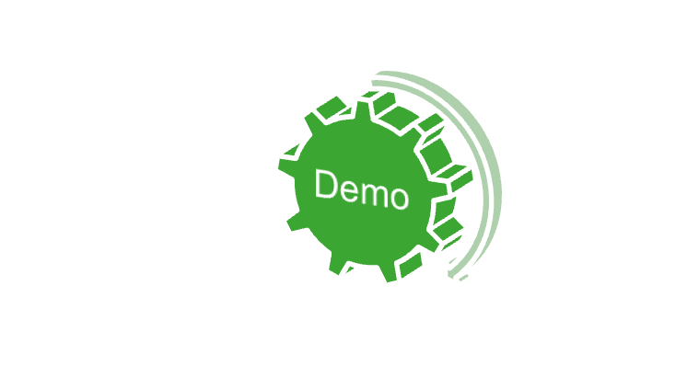
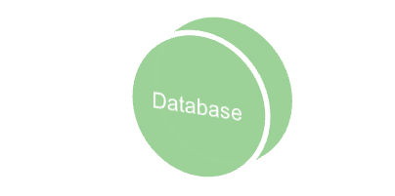
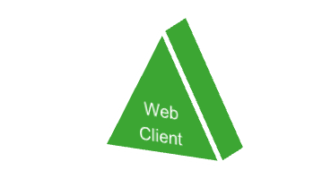

Demo Application – Conference w/ Web
Environmental Setup:
  IP PBX installed. UC Dev Platform installed, no apps.
  Dial route set for 6000 from IP PBX to Platform
  Ruby on Rails environment installed on PC, no apps.
SIP
SQL
SQL
HTTP
Notes:
Everything before this slide are really not that different than obstacles in development in general. These following ones are more unique or specific at least to Unified Communications.
UC Customers have high standards. Customers expect 100% uptime for UC applications. 100% uptime means you have to have redundancy solved, failover solved, and additionally, your software needs to leverage the redundancy and failover capabilities of the UC infrastructure!
This all adds up to make a tall order for anyone thinking to enter the world of Unified Communications.

Slide 15
CU Application Environment
Resource Pointers:
  CUAE Free SDK Software: http://www.cisco.com/web/developer/cuae/content/download.html
  Yahoo Groups:
  http://tech.groups.yahoo.com/group/cuae-dev/
  IRC Channel:
  irc.dal.net #cuae
Seth Call, call@cisco.com
Senior Software Engineer & Developer Evangelist

