Slide 1
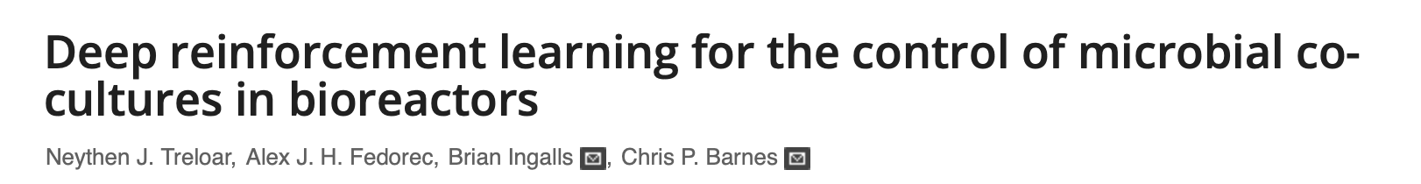
Bioreactor control

Slide 2
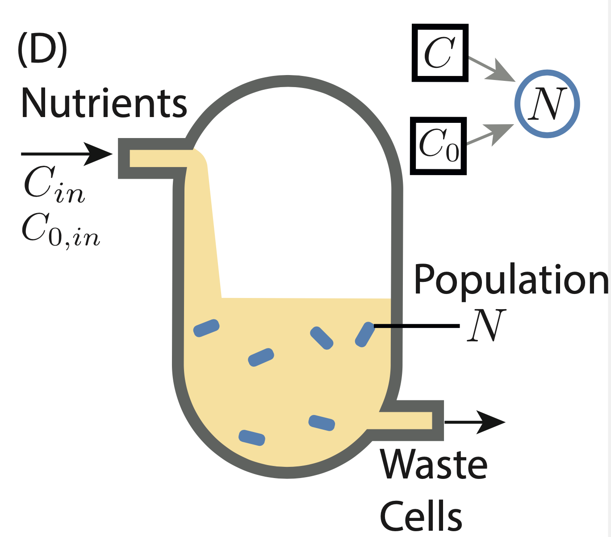
Motivation
We can use genetically engineered cells to produce useful products e.g. Insulin

Slide 3
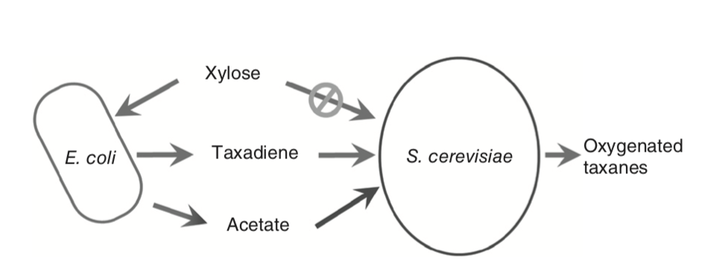
Motivation
Co-cultures have been shown to perform better at many functions
Production of ethanol for Biofuels, using two E.coli strains [1] and four yeast strains [2]
Fermentation of xylose and glucose [3]
Co-cultures allow us to divide the metabolic load exerted by complex reaction pathways [4]
Image reproduced from [4]
[1] Hyun-Dong Shin et al. “Escherichia coli binary culture engineered for direct fermentation of hemicellulose to a biofuel” (2010 )
[2] Garima Goyal et al. “Simultaneous cell growth and ethanol production from cellulose by an engineered yeast consortium displaying a functional mini-cellulosome” (2011)
[3] Mark A Eiteman, Sarah A Lee, and Elliot Altman. “A co-fermentation strategy to consume sugar mixtures effectively” (2008)
[4] Kang Zhou et al. “Distributing a metabolic pathway among a microbial consortium enhances production of natural products” (2015)

Slide 4
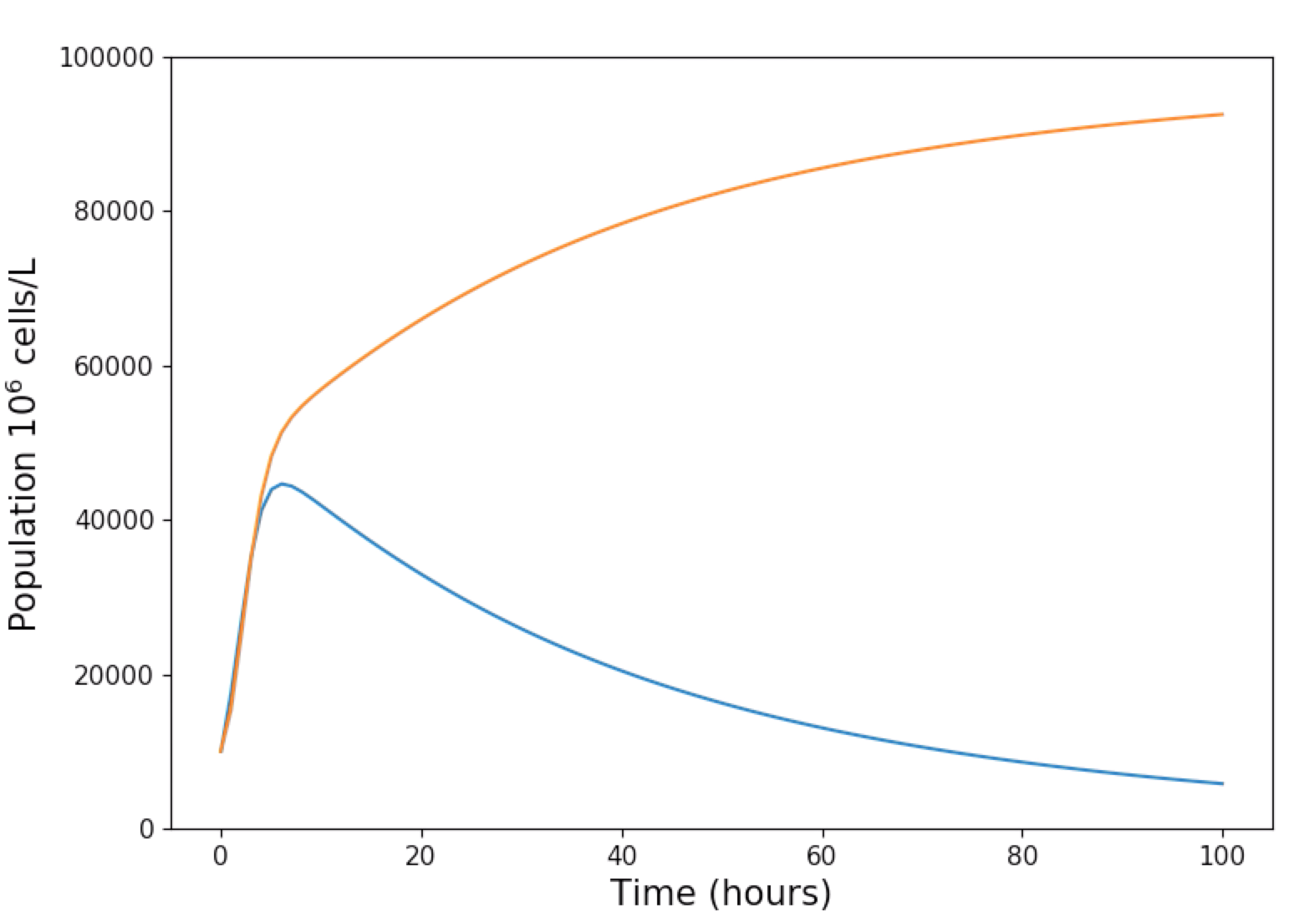
Motivation
Barriers to the adoption of co-cultures include:
Competitive exclusion
Hard to predict long term behavior, due to factors such as genetic drift [5]
The increasing difficulty to establish a stable system as the number of populations is increased [6]
[5] Matthew S Croughan, Konstantin B Konstantinov, and Charles Cooney. “The future of industrial bioprocessing: Batch or continuous?” (2015)
[6] Jasmine Shong, Manuel Rafael Jimenez Diaz, and Cynthia H Collins. “Towards synthetic microbial consortia for bioprocessing” (2012)

Slide 5
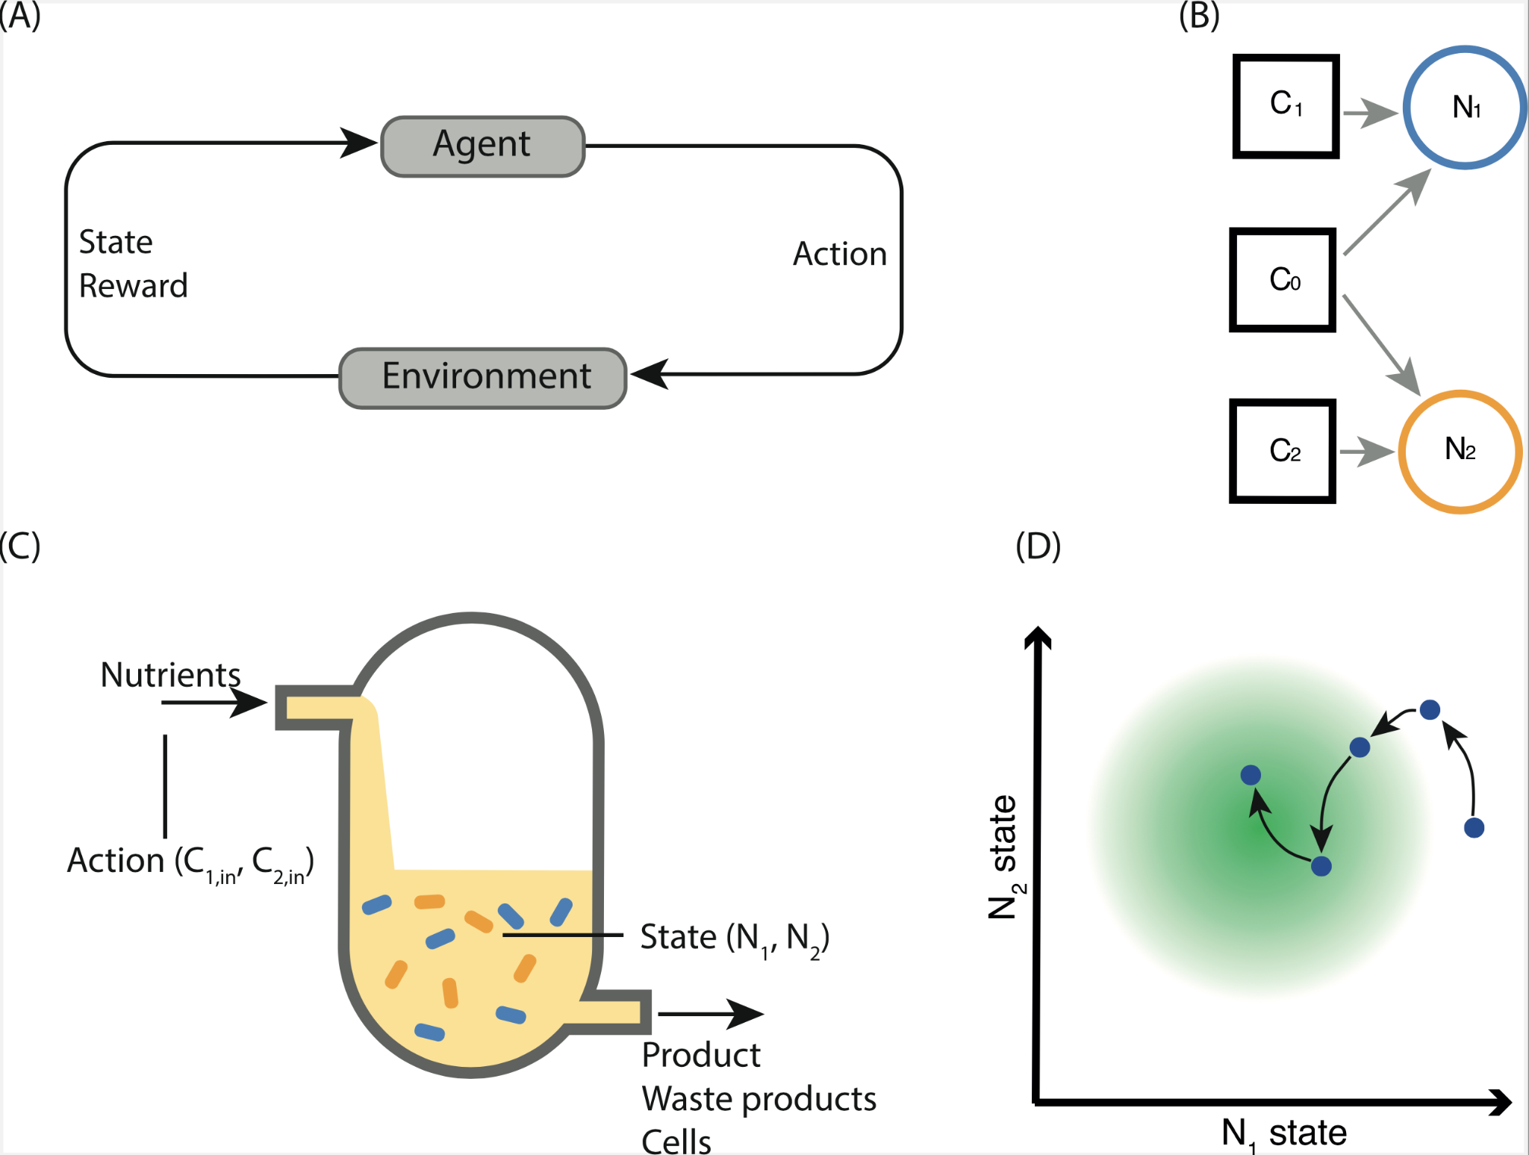
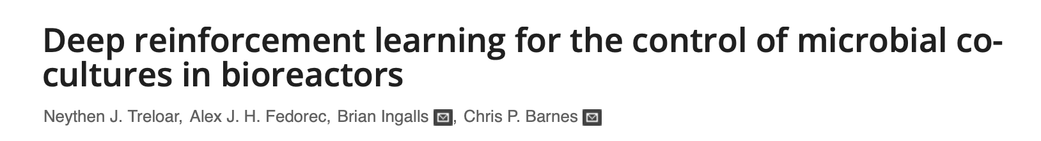
System setup

Slide 6
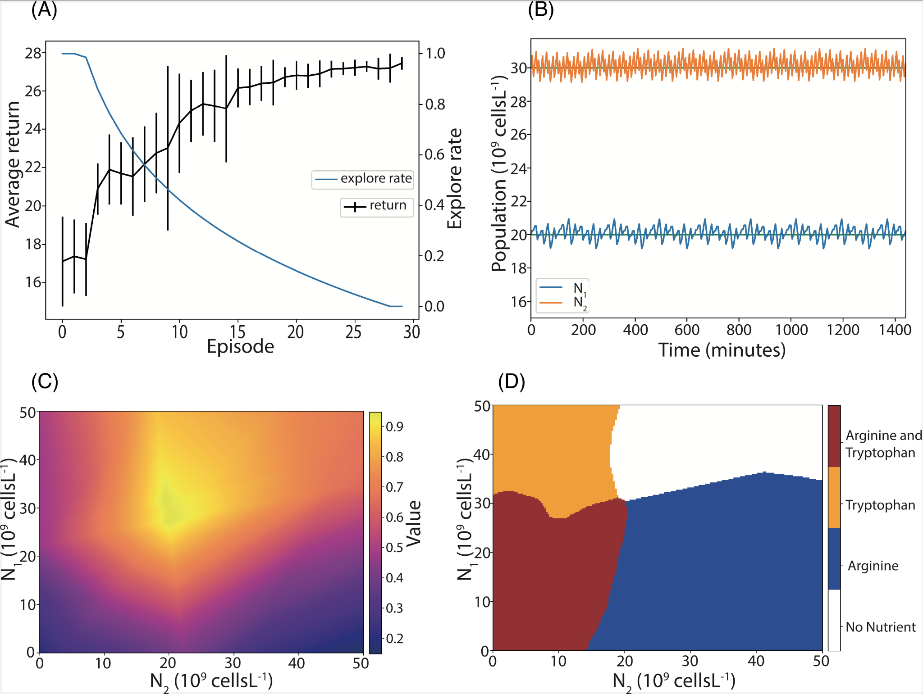
Control

Slide 7
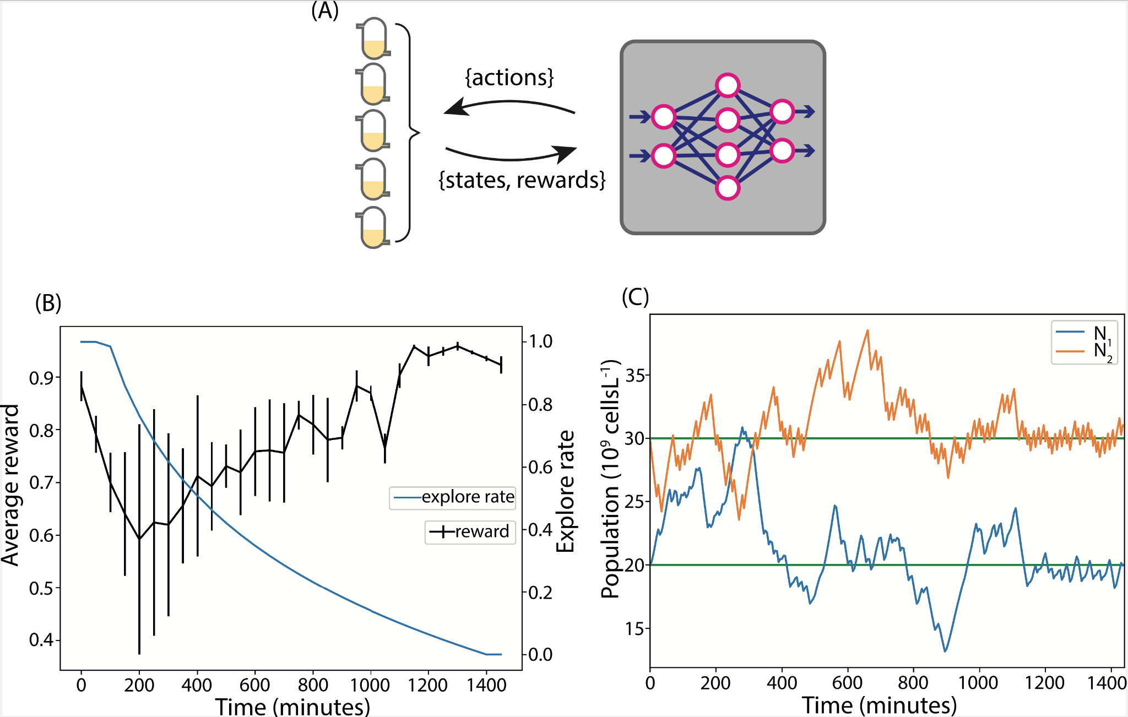
Data efficiency

Slide 8
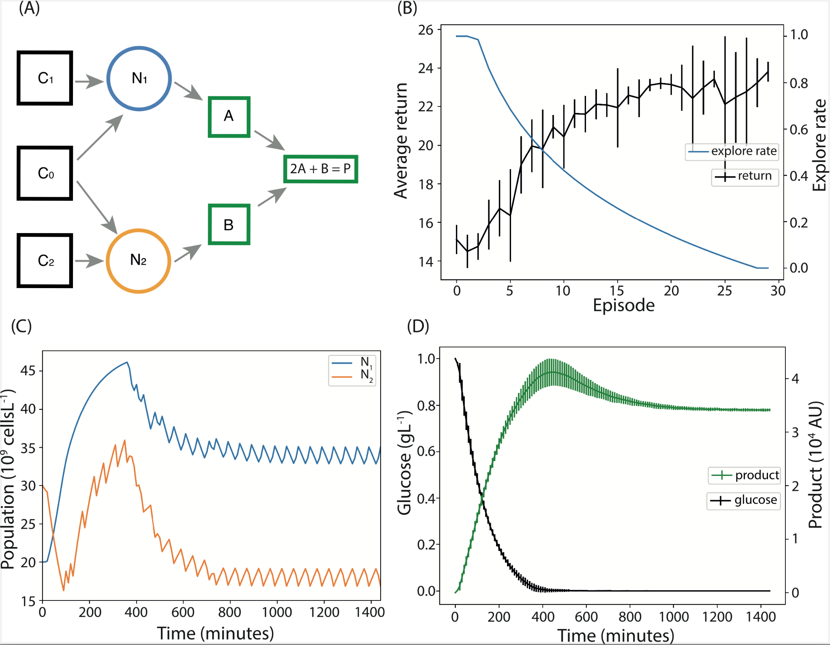
Product optimisation

Slide 9
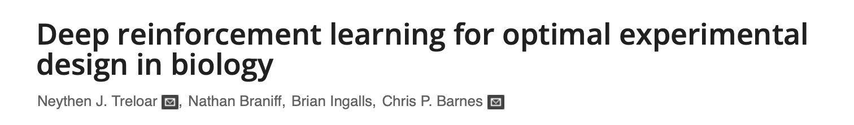
Optimal experimental design

