Slide 1
Sentiment Analysis Project
Adam Walters, Ian ZhAng, Henry Fong

Slide 2
Introduction
We analyzed text written by ChatGPT 3.5.
Prompt: “Write a 300 word memento on the future of AI”.
Did 6 times, each with slightly different perspectives to write from.
Perspectives: Technical, None, Human, Pessimist, Optimist, Neutral.
Chose this text due to the irony, and to see ChatGPT’s “opinion”.
We utilized TF-IDF analysis to find word relevance.
Used the qdap library for sentiment analysis using polarity.

Slide 3
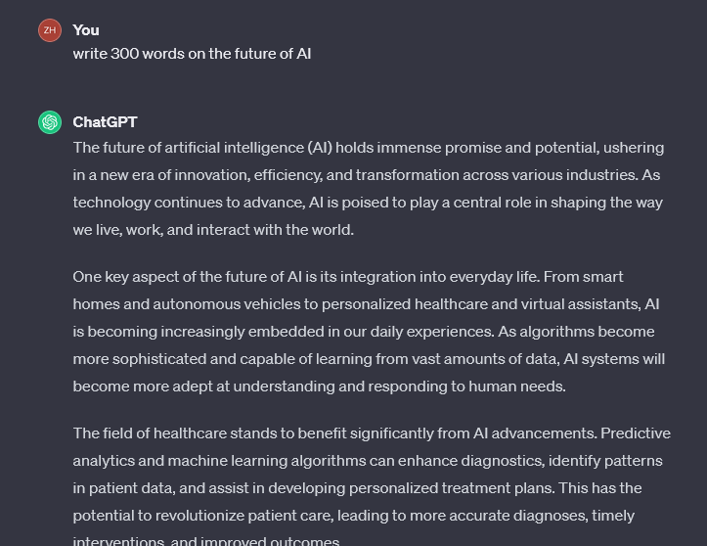
Example Prompt & Text

Slide 4
Data and Data Prep Process
ChatGPT’s responses were copied into an excel file, given a number and perspective, then exported as a csv file.
Each response is roughly 250 words because ChatGPT can’t count.
After importing data, it was put into a corpus to be cleaned using tm_map() for TF-IDF
We cleaned out any unknown words or characters, whitespace, stop words, etc.
Then we turned the cleaned Corpus into a Term Document matrix.

Slide 5
TF-IDF analysis
We hypothesized that ChatGPT’s responses would include a lot of AI buzzwords that would take primary relevance.
The ten most significant terms across all of the responses were as follows:
Computer, Human, Just, Dance, Learn, Fear, Stage, Get, Tech, Stuff.
Fear is interesting, as ChatGPT acknowledges the concerns around the future of AI
Our hypothesis was somewhat correct, however words that induce feelings like Dance, Learn and Fear were also prevalent.

Slide 6
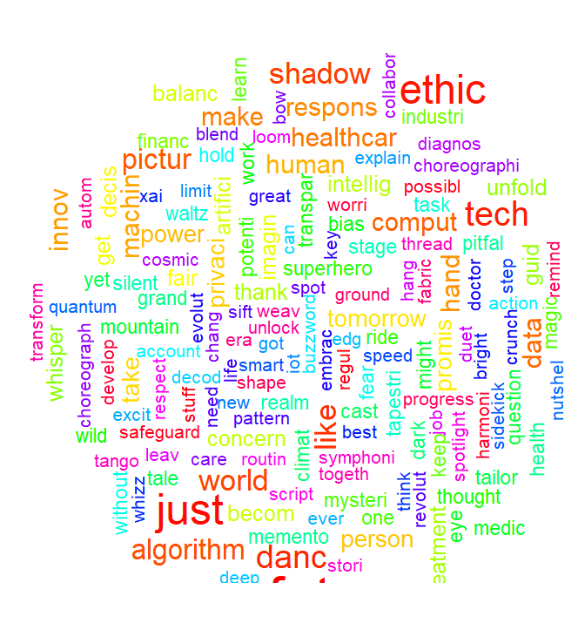
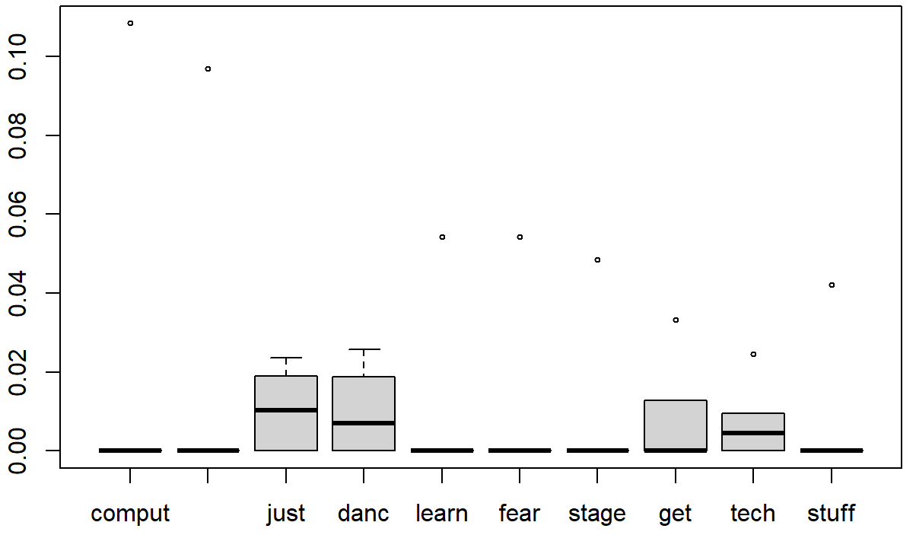
TF-IDF Visualizations

Slide 7
Data Prep for Sentiment analysis
After importing the data, we cleaned the Responses column of the data frame directly, with no Corpus.
The polarity function was applied to the response column, grouped by its number to ensure proper grouping.
The 2 words before and after were considered to affect polarity

Slide 8
Sentiment Analysis
We hypothesized that ChatGPT would write positively about the future of AI.
After applying polarity function, we got the following polarities:
0.6268, 0.6260, 0.6266, -0.7526, 1.0596, 0.0796
4 of the responses were strongly positive, with the response asking for a optimistic view being the most so.
The 1 strongly negative response was requested with a pessimistic view.
The final score that is barely above 0 was requested to be a neutral view, which ChatGPT succeeded on based on polarity.

Slide 9
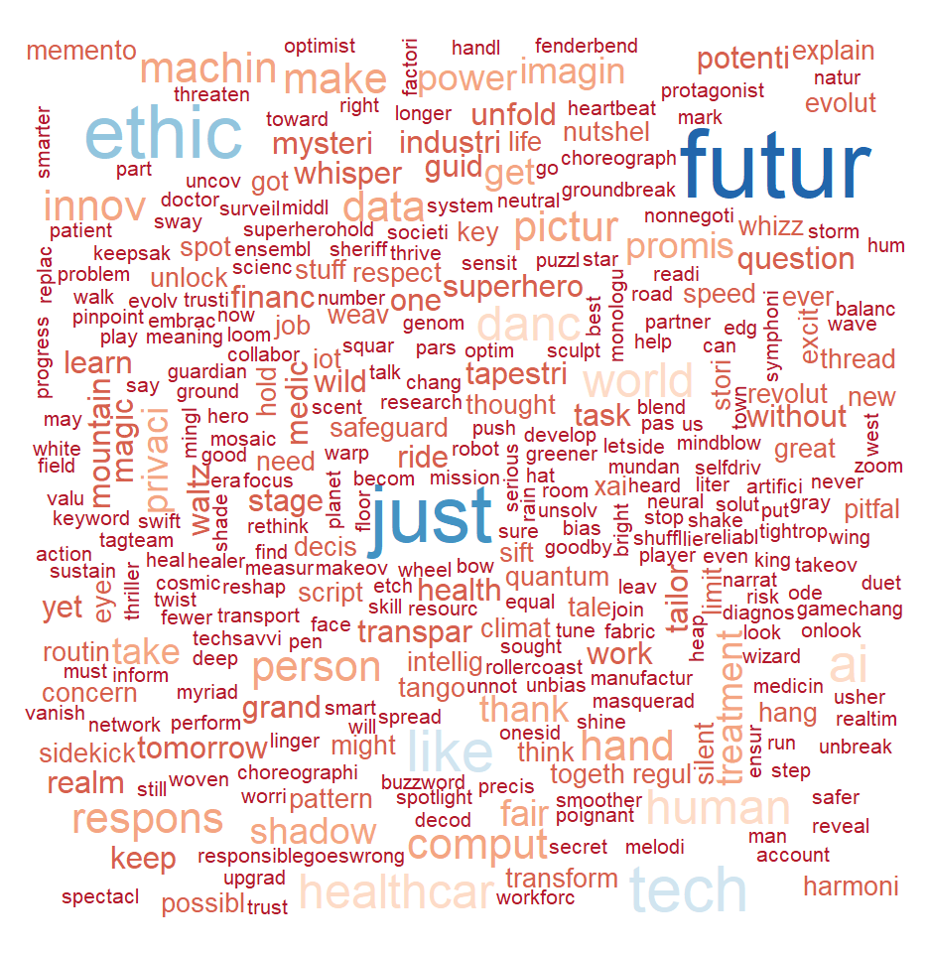
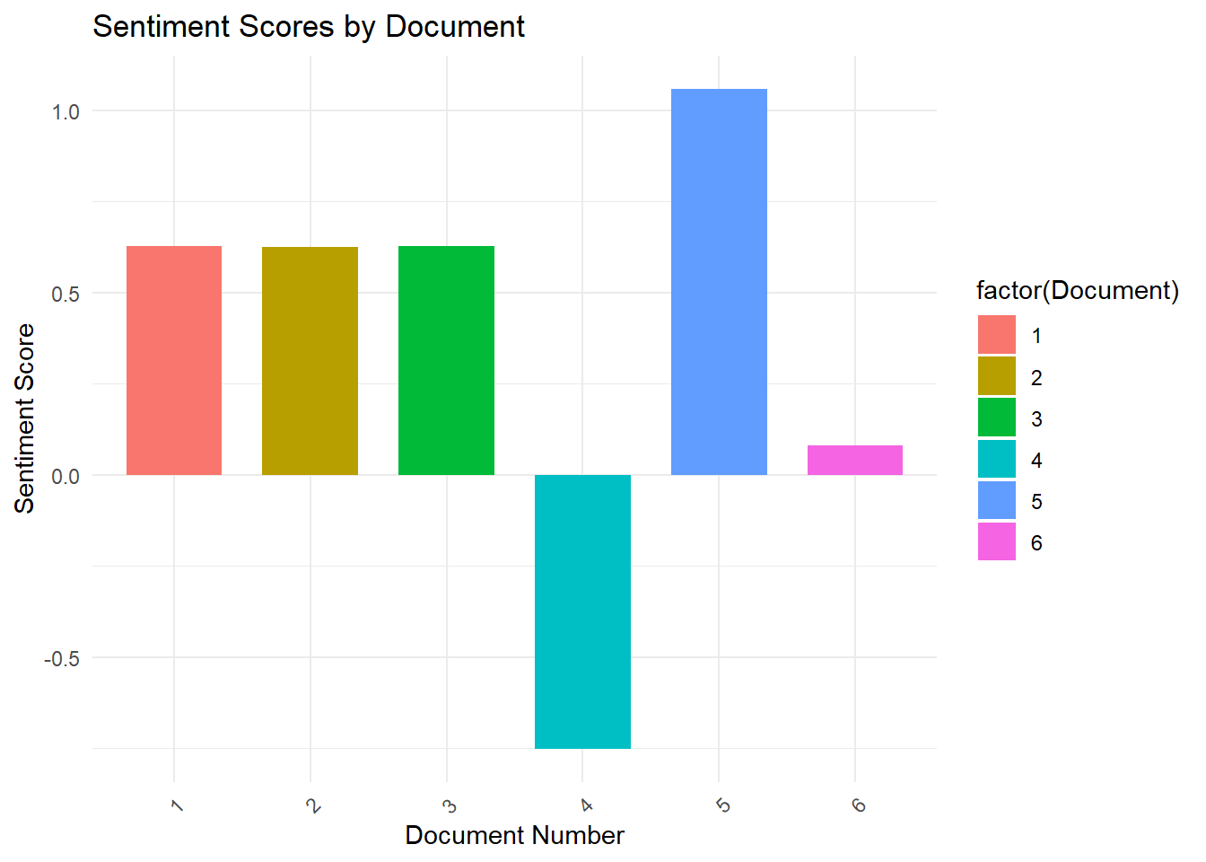
Sentiment Visualizations

Slide 10
Insights and Conclusion
ChatGPT has a positive view on the future of AI unless prompted to have a neutral or negative stance.
Only 1 word with a negative connotation was among the most relevant.
ChatGPT addresses the ethics of AI, despite being one.

Slide 11
Discussion
The mementos were written by ChatGPT, a generative AI model and the closest thing yet to many peoples fears of AI.
Overall, the project was a success, as ChatGPT had a clear “opinion” on the future of AI.
Future projects with a similar aim should use get more text to analyze, and more diverse prompts.

Slide 12
References
OpenAI. (n.d.). Chatgpt. ChatGPT. https://openai.com/chatgpt

