Slide 1
Carbon Dioxide Concentrations at Mona Loa Observatory
Adam M. Wilson

Slide 2
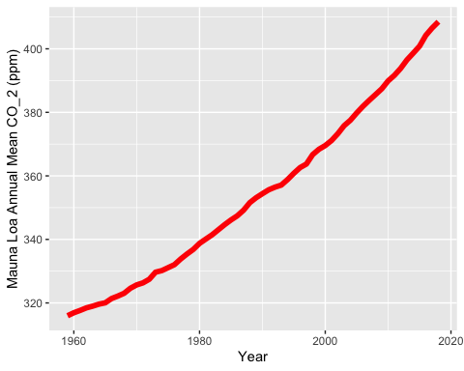
Annual Mean Carbon Dioxide Concentrations 1959-Present

Slide 3
Top Five Annual Mean Carbon Dioxide Concentrations at Mona Loa
## save_kable will have the best result with magick installed.

Slide 4
