Slide 1
Carbon Dioxide Concentrations at Mona Loa Observatory
Adam M. Wilson

Slide 2
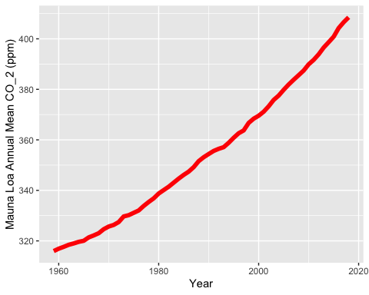
Annual Mean Carbon Dioxide Concentrations 1959-Present

Slide 3
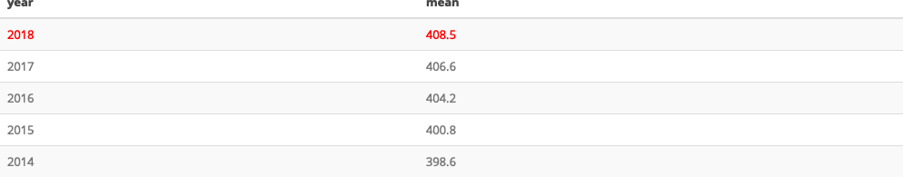
Top Five Annual Mean Carbon Dioxide Concentrations at Mona Loa

