Slide 1
Data Wrangling
Country | 2011 | 2012 | 2013
FR | 7000 | 6900 | 7000
DE | 5800 | 6000 | 6200
US | 15000 | 14000 | 13000

Slide 2
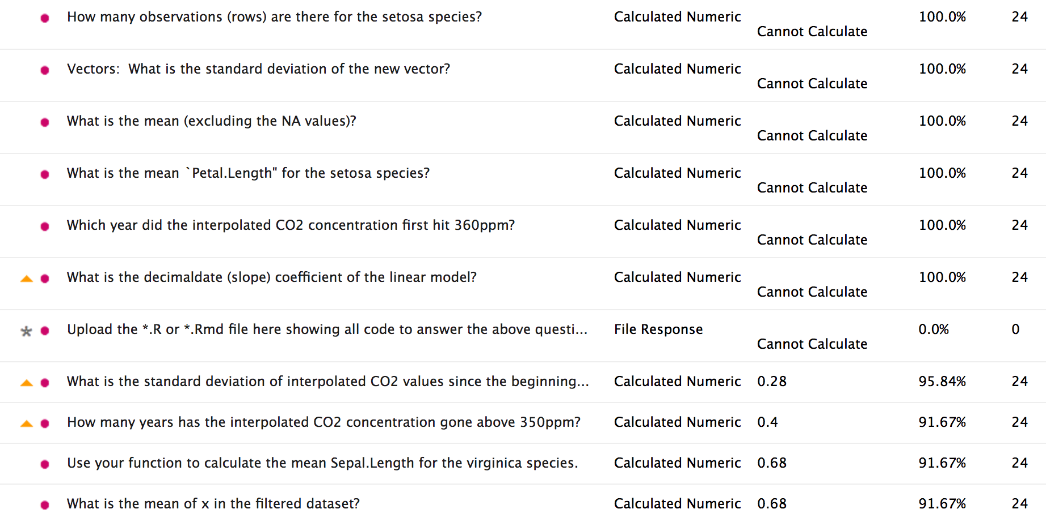
Homework summary

Slide 3
From Graphical User Interface (GUI) to scripting/programming
Write Code
Productivity
Point-and-click
Don’t Extrapolate from Homework #1!
Time

Slide 4
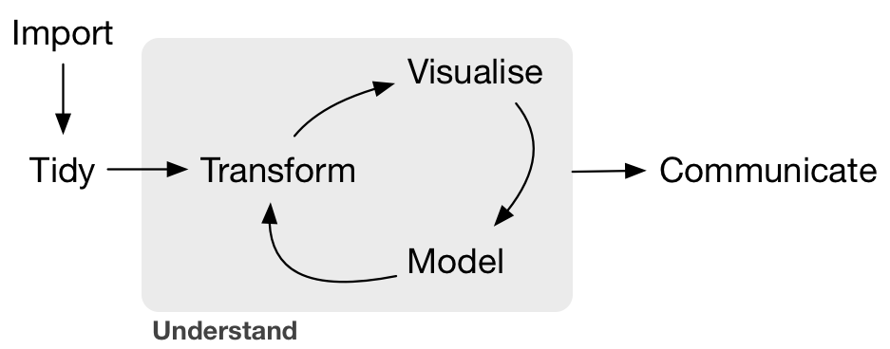
Data Wrangling: Two Goals
1
Make data suitable to use with a particular piece of software
2
Reveal information
--Grolemund & Wickham, R for Data Science, O'Reilly 2016

Slide 5
Wrangling
Munging
Janitor Work
Manipulation
Transformation
50-80%
of your time?

Slide 6
Two packages to help you work with the structure of data
tidyr
dplyr
Slides modified from RStudio Data Wrangling Workshop https://www.rstudio.com/resources/webinars/data-wrangling-with-r-and-rstudio/

Slide 7
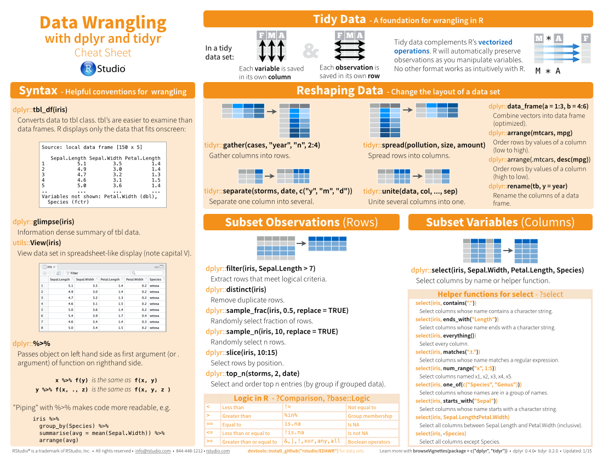
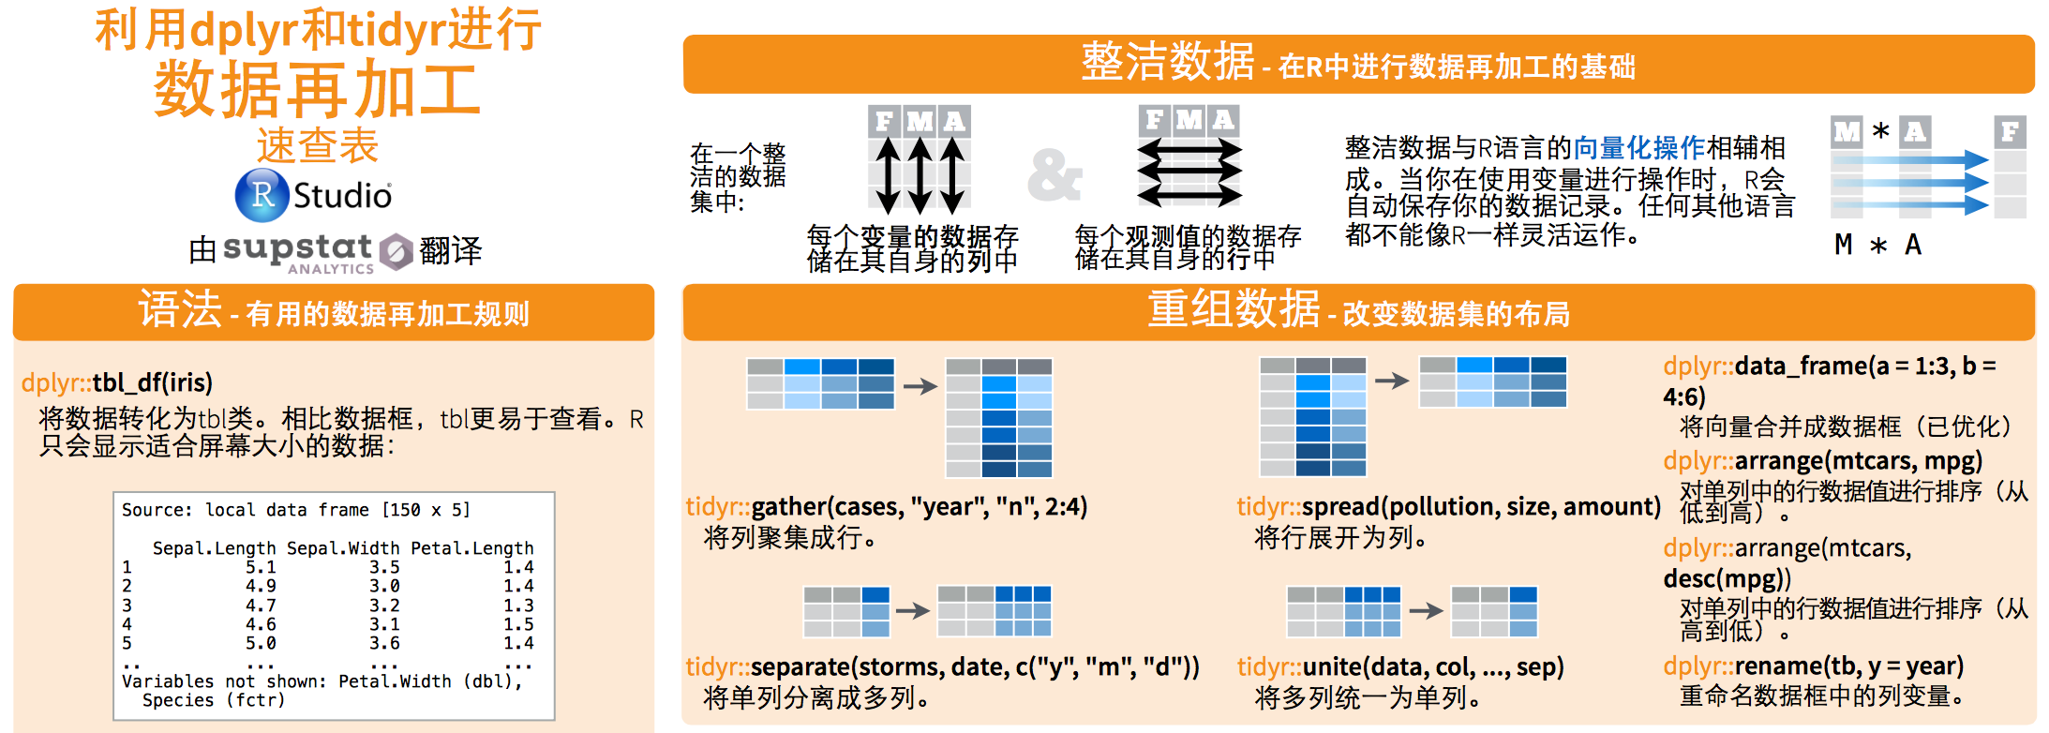
http://www.rstudio.com/resources/cheatsheets/
Also in Chinese…

Slide 8
Data sets come in many formats
…but R (often) prefers just one

Slide 9
EDAWR
An R package with all of the data sets that shown in this lecture.
# install.packages("devtools")
# devtools::install_github("rstudio/EDAWR")
library(EDAWR)
?storms
?cases
?pollution
?tb

Slide 10

devtools::install_github("rstudio/EDAWR") library(EDAWR)
storms
pollution
cases
storm | wind | pressure | date
Alberto | 110 | 1007 | 2000-08-12
Alex | 45 | 1009 | 1998-07-30
Allison | 65 | 1005 | 1995-06-04
Ana | 40 | 1013 | 1997-07-01
Arlene | 50 | 1010 | 1999-06-13
Arthur | 45 | 1010 | 1996-06-21
Country | 2011 | 2012 | 2013
FR | 7000 | 6900 | 7000
DE | 5800 | 6000 | 6200
US | 15000 | 14000 | 13000
city | particle size | amount (µg/m³)
New York | large | 23
New York | small | 14
London | large | 22
London | small | 16
Beijing | large | 121
Beijing | small | 56
Storm name
Wind Speed (mph)
Air pressure
Date
Country
Year
Count
City
Amount of Large Particles
Amount of Small particles

Slide 11
devtools::install_github("rstudio/EDAWR") library(EDAWR)
storms
pollution
cases
storm | wind | pressure | date
Alberto | 110 | 1007 | 2000-08-12
Alex | 45 | 1009 | 1998-07-30
Allison | 65 | 1005 | 1995-06-04
Ana | 40 | 1013 | 1997-07-01
Arlene | 50 | 1010 | 1999-06-13
Arthur | 45 | 1010 | 1996-06-21
Country | 2011 | 2012 | 2013
FR | 7000 | 6900 | 7000
DE | 5800 | 6000 | 6200
US | 15000 | 14000 | 13000
city | particle size | amount (µg/m³)
New York | large | 23
New York | small | 14
London | large | 22
London | small | 16
Beijing | large | 121
Beijing | small | 56
storms$storm
storms$wind
storms$pressure
storms$date
cases$country
names(cases)[-1]
unlist(cases[1:3, 2:4])
pollution$city[1,3,5]
pollution$amount[1,3,5]
pollution$amount[2,4,6]

Slide 12
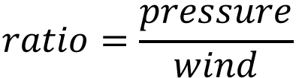
Adding/modifying columns
$$ratio=\frac{pressure}{wind}$$
storms
storm | wind | pressure | date
Alberto | 110 | 1007 | 2000-08-12
Alex | 45 | 1009 | 1998-07-30
Allison | 65 | 1005 | 1995-06-04
Ana | 40 | 1013 | 1997-07-01
Arlene | 50 | 1010 | 1999-06-13
Arthur | 45 | 1010 | 1996-06-21
storms$pressure / storms$wind
wind
110
45
65
40
50
45
pressure
1007
1009
1005
1013
1010
1010
950
1003
987
1004
1006
1000
/ | 110
/ | 45
/ | 65
/ | 40
/ | 50
/ | 45
8.6
22.3
15.2
25.1
20.1
22.2

Slide 13
Tidy data
storms
1
storm | wind | pressure | date
Alberto | 110 | 1007 | 2000-08-12
Alex | 45 | 1009 | 1998-07-30
Allison | 65 | 1005 | 1995-06-04
Ana | 40 | 1013 | 1997-07-01
Arlene | 50 | 1010 | 1999-06-13
Arthur | 45 | 1010 | 1996-06-21
Each variable is saved in its own column.
2
Each observation is saved in its own row.
3
Each "type" of observation stored in a single table (here, storms).

Slide 14
Recap: Tidy data
1
Variables in columns, observations in rows, each type in a table
2
Easy to access variables
3
Automatically preserves observations

Slide 15
tidyr

Slide 16
Tidyr: A package that reshapes the layout of tables.
tidyr
Two main functions: gather() and spread()
# install.packages("tidyr")
library(tidyr)
?gather
?spread

Slide 17
Your Turn
Imagine how this data would look if it were tidy with three variables: country, year, n
cases
Country | 2011 | 2012 | 2013
FR | 7000 | 6900 | 7000
DE | 5800 | 6000 | 6200
US | 15000 | 14000 | 13000
Country | 2011 | 2012 | 2013
FR | 7000 | 6900 | 7000
DE | 5800 | 6000 | 6200
US | 15000 | 14000 | 13000

Slide 18
Country | 2011 | 2012 | 2013
FR | 7000 | 6900 | 7000
DE | 5800 | 6000 | 6200
US | 15000 | 14000 | 13000

Slide 19
Country | 2011 | 2012 | 2013
FR | 7000 | 6900 | 7000
DE | 5800 | 6000 | 6200
US | 15000 | 14000 | 13000
Country | Year | n
FR | 2011 | 7000
DE | 2011 | 5800
US | 2011 | 15000
FR | 2012 | 6900
DE | 2012 | 6000
US | 2012 | 14000
FR | 2013 | 7000
DE | 2013 | 6200
US | 2013 | 13000

Slide 20
Country | 2011 | 2012 | 2013
FR | 7000 | 6900 | 7000
DE | 5800 | 6000 | 6200
US | 15000 | 14000 | 13000
Country | Year | n
FR | 2011 | 7000
DE | 2011 | 5800
US | 2011 | 15000
FR | 2012 | 6900
DE | 2012 | 6000
US | 2012 | 14000
FR | 2013 | 7000
DE | 2013 | 6200
US | 2013 | 13000

Slide 21
Country | 2011 | 2012 | 2013
FR | 7000 | 6900 | 7000
DE | 5800 | 6000 | 6200
US | 15000 | 14000 | 13000
Country | Year | n
FR | 2011 | 7000
DE | 2011 | 5800
US | 2011 | 15000
FR | 2012 | 6900
DE | 2012 | 6000
US | 2012 | 14000
FR | 2013 | 7000
DE | 2013 | 6200
US | 2013 | 13000

Slide 22
Country | 2011 | 2012 | 2013
FR | 7000 | 6900 | 7000
DE | 5800 | 6000 | 6200
US | 15000 | 14000 | 13000
Country | Year | n
FR | 2011 | 7000
DE | 2011 | 5800
US | 2011 | 15000
FR | 2012 | 6900
DE | 2012 | 6000
US | 2012 | 14000
FR | 2013 | 7000
DE | 2013 | 6200
US | 2013 | 13000

Slide 23
Country | 2011 | 2012 | 2013
FR | 7000 | 6900 | 7000
DE | 5800 | 6000 | 6200
US | 15000 | 14000 | 13000
Country | Year | n
FR | 2011 | 7000
DE | 2011 | 5800
US | 2011 | 15000
FR | 2012 | 6900
DE | 2012 | 6000
US | 2012 | 14000
FR | 2013 | 7000
DE | 2013 | 6200
US | 2013 | 13000

Slide 24
Country | 2011 | 2012 | 2013
FR | 7000 | 6900 | 7000
DE | 5800 | 6000 | 6200
US | 15000 | 14000 | 13000
Country | Year | n
FR | 2011 | 7000
DE | 2011 | 5800
US | 2011 | 15000
FR | 2012 | 6900
DE | 2012 | 6000
US | 2012 | 14000
FR | 2013 | 7000
DE | 2013 | 6200
US | 2013 | 13000

Slide 25
Country | 2011 | 2012 | 2013
FR | 7000 | 6900 | 7000
DE | 5800 | 6000 | 6200
US | 15000 | 14000 | 13000
Country | Year | n
FR | 2011 | 7000
DE | 2011 | 5800
US | 2011 | 15000
FR | 2012 | 6900
DE | 2012 | 6000
US | 2012 | 14000
FR | 2013 | 7000
DE | 2013 | 6200
US | 2013 | 13000

Slide 26
Country | 2011 | 2012 | 2013
FR | 7000 | 6900 | 7000
DE | 5800 | 6000 | 6200
US | 15000 | 14000 | 13000
Country | Year | n
FR | 2011 | 7000
DE | 2011 | 5800
US | 2011 | 15000
FR | 2012 | 6900
DE | 2012 | 6000
US | 2012 | 14000
FR | 2013 | 7000
DE | 2013 | 6200
US | 2013 | 13000

Slide 27
Country | 2011 | 2012 | 2013
FR | 7000 | 6900 | 7000
DE | 5800 | 6000 | 6200
US | 15000 | 14000 | 13000
Country | Year | n
FR | 2011 | 7000
DE | 2011 | 5800
US | 2011 | 15000
FR | 2012 | 6900
DE | 2012 | 6000
US | 2012 | 14000
FR | 2013 | 7000
DE | 2013 | 6200
US | 2013 | 13000

Slide 28
Country | 2011 | 2012 | 2013
FR | 7000 | 6900 | 7000
DE | 5800 | 6000 | 6200
US | 15000 | 14000 | 13000
Country | Year | n
FR | 2011 | 7000
DE | 2011 | 5800
US | 2011 | 15000
FR | 2012 | 6900
DE | 2012 | 6000
US | 2012 | 14000
FR | 2013 | 7000
DE | 2013 | 6200
US | 2013 | 13000

Slide 29
Country | 2011 | 2012 | 2013
FR | 7000 | 6900 | 7000
DE | 5800 | 6000 | 6200
US | 15000 | 14000 | 13000
Country | Year | n
FR | 2011 | 7000
DE | 2011 | 5800
US | 2011 | 15000
FR | 2012 | 6900
DE | 2012 | 6000
US | 2012 | 14000
FR | 2013 | 7000
DE | 2013 | 6200
US | 2013 | 13000

Slide 30
Country | 2011 | 2012 | 2013
FR | 7000 | 6900 | 7000
DE | 5800 | 6000 | 6200
US | 15000 | 14000 | 13000
Country | Year | n
FR | 2011 | 7000
DE | 2011 | 5800
US | 2011 | 15000
FR | 2012 | 6900
DE | 2012 | 6000
US | 2012 | 14000
FR | 2013 | 7000
DE | 2013 | 6200
US | 2013 | 13000
gather()

Slide 31
Country | 2011 | 2012 | 2013
FR | 7000 | 6900 | 7000
DE | 5800 | 6000 | 6200
US | 15000 | 14000 | 13000
Country | Year | n
FR | 2011 | 7000
DE | 2011 | 5800
US | 2011 | 15000
FR | 2012 | 6900
DE | 2012 | 6000
US | 2012 | 14000
FR | 2013 | 7000
DE | 2013 | 6200
US | 2013 | 13000

Slide 32
key (former column names)
Country | 2011 | 2012 | 2013
FR | 7000 | 6900 | 7000
DE | 5800 | 6000 | 6200
US | 15000 | 14000 | 13000
Country | Year | n
FR | 2011 | 7000
DE | 2011 | 5800
US | 2011 | 15000
FR | 2012 | 6900
DE | 2012 | 6000
US | 2012 | 14000
FR | 2013 | 7000
DE | 2013 | 6200
US | 2013 | 13000

Slide 33
key
value (former cells)
Country | 2011 | 2012 | 2013
FR | 7000 | 6900 | 7000
DE | 5800 | 6000 | 6200
US | 15000 | 14000 | 13000
Country | Year | n
FR | 2011 | 7000
DE | 2011 | 5800
US | 2011 | 15000
FR | 2012 | 6900
DE | 2012 | 6000
US | 2012 | 14000
FR | 2013 | 7000
DE | 2013 | 6200
US | 2013 | 13000

Slide 34
gather()
Collapses multiple columns into two columns:
a key column that contains the former column names
a value column that contains the former column cells
gather(cases, "year", "n", 2:4)
data frame
to reshape
name of the new key column
(a character string)
names or numeric indexes of columns to collapse
name of the new value column
(a character string)

Slide 35
gather(cases, "year", "n", 2:4)
## country 2011 2012 2013
## 1 FR 7000 6900 7000
## 2 DE 5800 6000 6200
## 3 US 15000 14000 13000
## country year n
## 1 FR 2011 7000
## 2 DE 2011 5800
## 3 US 2011 15000
## 4 FR 2012 6900
## 5 DE 2012 6000
## 6 US 2012 14000
## 7 FR 2013 7000
## 8 DE 2013 6200
## 9 US 2013 13000

Slide 36
Your Turn
Imagine how the pollution data set would look tidy with three variables: city, large, small
pollution
city | size | amount
New York | large | 23
New York | small | 14
London | large | 22
London | small | 16
Beijing | large | 121
Beijing | small | 56
city | particle size | amount (µg/m³)
New York | large | 23
New York | small | 14
London | large | 22
London | small | 16
Beijing | large | 121
Beijing | small | 56

Slide 37
city | size | amount
New York | large | 23
New York | small | 14
London | large | 22
London | small | 16
Beijing | large | 121
Beijing | small | 56

Slide 38
city | size | amount
New York | large | 23
New York | small | 14
London | large | 22
London | small | 16
Beijing | large | 121
Beijing | small | 56
city | large | small
New York | 23 | 14
London | 22 | 16
Beijing | 121 | 56

Slide 39
city | size | amount
New York | large | 23
New York | small | 14
London | large | 22
London | small | 16
Beijing | large | 121
Beijing | small | 56
city | large | small
New York | 23 | 14
London | 22 | 16
Beijing | 121 | 56

Slide 40
city | size | amount
New York | large | 23
New York | small | 14
London | large | 22
London | small | 16
Beijing | large | 121
Beijing | small | 56
city | large | small
New York | 23 | 14
London | 22 | 16
Beijing | 121 | 56

Slide 41
city | size | amount
New York | large | 23
New York | small | 14
London | large | 22
London | small | 16
Beijing | large | 121
Beijing | small | 56
city | large | small
New York | 23 | 14
London | 22 | 16
Beijing | 121 | 56

Slide 42
city | size | amount
New York | large | 23
New York | small | 14
London | large | 22
London | small | 16
Beijing | large | 121
Beijing | small | 56
city | large | small
New York | 23 | 14
London | 22 | 16
Beijing | 121 | 56

Slide 43
city | size | amount
New York | large | 23
New York | small | 14
London | large | 22
London | small | 16
Beijing | large | 121
Beijing | small | 56
city | large | small
New York | 23 | 14
London | 22 | 16
Beijing | 121 | 56

Slide 44
city | size | amount
New York | large | 23
New York | small | 14
London | large | 22
London | small | 16
Beijing | large | 121
Beijing | small | 56
city | large | small
New York | 23 | 14
London | 22 | 16
Beijing | 121 | 56

Slide 45
city | size | amount
New York | large | 23
New York | small | 14
London | large | 22
London | small | 16
Beijing | large | 121
Beijing | small | 56
city | large | small
New York | 23 | 14
London | 22 | 16
Beijing | 121 | 56

Slide 46
city | size | amount
New York | large | 23
New York | small | 14
London | large | 22
London | small | 16
Beijing | large | 121
Beijing | small | 56
spread()
city | large | small
New York | 23 | 14
London | 22 | 16
Beijing | 121 | 56

Slide 47
key (new column names)
city | size | amount
New York | large | 23
New York | small | 14
London | large | 22
London | small | 16
Beijing | large | 121
Beijing | small | 56
city | large | small
New York | 23 | 14
London | 22 | 16
Beijing | 121 | 56

Slide 48
key
value (new cells)
city | size | amount
New York | large | 23
New York | small | 14
London | large | 22
London | small | 16
Beijing | large | 121
Beijing | small | 56
city | large | small
New York | 23 | 14
London | 22 | 16
Beijing | 121 | 56

Slide 49
spread()
Generates multiple columns from two columns:
each unique value in the key column becomes a column name
each value in the value column becomes a cell in the new columns
spread(pollution, size, amount)
data frame to reshape
column to use for keys (new columns names)
column to use for values (new column cells)

Slide 50
spread(pollution, size, amount)
city | size | amount
New York | large | 23
New York | small | 14
London | large | 22
London | small | 16
Beijing | large | 121
Beijing | small | 56
spread()
city | large | small
New York | 23 | 14
London | 22 | 16
Beijing | 121 | 56
gather()
Separate all variables implied by law, formula or goal

Slide 51
unite() and separate()
There are three more variables hidden in storms:
storms
storm | wind | pressure | date
Alberto | 110 | 1007 | 2000-08-12
Alex | 45 | 1009 | 1998-07-30
Allison | 65 | 1005 | 1995-06-04
Ana | 40 | 1013 | 1997-07-01
Arlene | 50 | 1010 | 1999-06-13
Arthur | 45 | 1010 | 1996-06-21
Year
Month
Day

Slide 52
separate()
Separate splits a column by a character string separator.
separate(storms, date, c("year", "month", "day"), sep = "-")
storms
storms2
storm | wind | pressure | date
Alberto | 110 | 1007 | 2000-08-12
Alex | 45 | 1009 | 1998-07-30
Allison | 65 | 1005 | 1995-06-04
Ana | 40 | 1013 | 1997-07-01
Arlene | 50 | 1010 | 1999-06-13
Arthur | 45 | 1010 | 1996-06-21
storm | wind | pressure | year | month | day
Alberto | 110 | 1007 | 2000 | 08 | 12
Alex | 45 | 1009 | 1998 | 07 | 30
Allison | 65 | 1005 | 1995 | 06 | 04
Ana | 40 | 1013 | 1997 | 07 | 1
Arlene | 50 | 1010 | 1999 | 06 | 13
Arthur | 45 | 1010 | 1996 | 06 | 21

Slide 53
unite()
Unite unites columns into a single column.
unite(storms2, "date", year, month, day, sep = "-")
storms2
storms
storm | wind | pressure | year | month | day
Alberto | 110 | 1007 | 2000 | 08 | 12
Alex | 45 | 1009 | 1998 | 07 | 30
Allison | 65 | 1005 | 1995 | 06 | 04
Ana | 40 | 1013 | 1997 | 07 | 1
Arlene | 50 | 1010 | 1999 | 06 | 13
Arthur | 45 | 1010 | 1996 | 06 | 21
storm | wind | pressure | date
Alberto | 110 | 1007 | 2000-08-12
Alex | 45 | 1009 | 1998-07-30
Allison | 65 | 1005 | 1995-06-04
Ana | 40 | 1013 | 1997-07-01
Arlene | 50 | 1010 | 1999-06-13
Arthur | 45 | 1010 | 1996-06-21

Slide 54



Recap: tidyr
A package that reshapes the layout of data sets.
Make observations from
variables with gather()
Make variables from observations with spread()
Split and merge columns with unite() and separate()
Also reshape2 package

Slide 55
Data sets contain more information than they display

Slide 56
dplyr: A package that helps transform tabular data.
dplyr
# install.packages("dplyr")
library(dplyr)
?select
?filter
?arrange
?mutate
?summarise
?group_by

Slide 57
Ways to access information
1
Extract existing variables.
select()
2
Extract existing observations.
filter()
3
Derive new variables
mutate()
(from existing variables)
4
Change the unit of analysis
summarise()

Slide 58
select()
storms
storm | wind | pressure | date
Alberto | 110 | 1007 | 2000-08-12
Alex | 45 | 1009 | 1998-07-30
Allison | 65 | 1005 | 1995-06-04
Ana | 40 | 1013 | 1997-07-01
Arlene | 50 | 1010 | 1999-06-13
Arthur | 45 | 1010 | 1996-06-21
storm | pressure
Alberto | 1007
Alex | 1009
Allison | 1005
Ana | 1013
Arlene | 1010
Arthur | 1010
select(storms, storm, pressure)

Slide 59
select()
storms
storm | wind | pressure | date
Alberto | 110 | 1007 | 2000-08-12
Alex | 45 | 1009 | 1998-07-30
Allison | 65 | 1005 | 1995-06-04
Ana | 40 | 1013 | 1997-07-01
Arlene | 50 | 1010 | 1999-06-13
Arthur | 45 | 1010 | 1996-06-21
wind | pressure | date
110 | 1007 | 2000-08-12
45 | 1009 | 1998-07-30
65 | 1005 | 1995-06-04
40 | 1013 | 1997-07-01
50 | 1010 | 1999-06-13
45 | 1010 | 1996-06-21
select(storms, -storm)
# see ?select for more

Slide 60
select()
storms
storm | wind | pressure | date
Alberto | 110 | 1007 | 2000-08-12
Alex | 45 | 1009 | 1998-07-30
Allison | 65 | 1005 | 1995-06-04
Ana | 40 | 1013 | 1997-07-01
Arlene | 50 | 1010 | 1999-06-13
Arthur | 45 | 1010 | 1996-06-21
wind | pressure | date
110 | 1007 | 2000-08-12
45 | 1009 | 1998-07-30
65 | 1005 | 1995-06-04
40 | 1013 | 1997-07-01
50 | 1010 | 1999-06-13
45 | 1010 | 1996-06-21
select(storms, wind:date)
# see ?select for more

Slide 61
Useful select functions
- | Select everything but
: | Select range
contains() | Select columns whose name contains a character string
ends_with() | Select columns whose name ends with a string
everything() | Select every column
matches() | Select columns whose name matches a regular expression
num_range() | Select columns named x1, x2, x3, x4, x5
one_of() | Select columns whose names are in a group of names
starts_with() | Select columns whose name starts with a character string
* Blue functions come in dplyr

Slide 62
filter()
storms
storm | wind | pressure | date
Alberto | 110 | 1007 | 2000-08-12
Alex | 45 | 1009 | 1998-07-30
Allison | 65 | 1005 | 1995-06-04
Ana | 40 | 1013 | 1997-07-01
Arlene | 50 | 1010 | 1999-06-13
Arthur | 45 | 1010 | 1996-06-21
storm | wind | pressure | date
Alberto | 110 | 1007 | 2000-08-12
Allison | 65 | 1005 | 1995-06-04
Arlene | 50 | 1010 | 1999-06-13
filter(storms, wind >= 50)

Slide 63
filter()
storms
storm | wind | pressure | date
Alberto | 110 | 1007 | 2000-08-12
Alex | 45 | 1009 | 1998-07-30
Allison | 65 | 1005 | 1995-06-04
Ana | 40 | 1013 | 1997-07-01
Arlene | 50 | 1010 | 1999-06-13
Arthur | 45 | 1010 | 1996-06-21
storm | wind | pressure | date
Alberto | 110 | 1007 | 2000-08-12
Allison | 65 | 1005 | 1995-06-04
filter(storms, wind >= 50,
storm %in% c("Alberto", "Alex", "Allison"))

Slide 64
logical tests in R
?Comparison
?base::Logic
< | Less than
> | Greater than
== | Equal to
<= | Less than or equal to
>= | Greater than or equal to
!= | Not equal to
%in% | Group membership
is.na | Is NA
!is.na | Is not NA
& | boolean and
| | boolean or
xor | exactly or
! | not
any | any true
all | all true

Slide 65
mutate()
storm | wind | pressure | date
Alberto | 110 | 1007 | 2000-08-12
Alex | 45 | 1009 | 1998-07-30
Allison | 65 | 1005 | 1995-06-04
Ana | 40 | 1013 | 1997-07-01
Arlene | 50 | 1010 | 1999-06-13
Arthur | 45 | 1010 | 1996-06-21
storm | wind | pressure | date | ratio
Alberto | 110 | 1007 | 2000-08-12 | 9.15
Alex | 45 | 1009 | 1998-07-30 | 22.42
Allison | 65 | 1005 | 1995-06-04 | 15.46
Ana | 40 | 1013 | 1997-07-01 | 25.32
Arlene | 50 | 1010 | 1999-06-13 | 20.20
Arthur | 45 | 1010 | 1996-06-21 | 22.44
mutate(storms, ratio = pressure / wind)

Slide 66
mutate()
storm | wind | pressure | date
Alberto | 110 | 1007 | 2000-08-12
Alex | 45 | 1009 | 1998-07-30
Allison | 65 | 1005 | 1995-06-04
Ana | 40 | 1013 | 1997-07-01
Arlene | 50 | 1010 | 1999-06-13
Arthur | 45 | 1010 | 1996-06-21
storm | wind | pressure | date | ratio | inverse
Alberto | 110 | 1007 | 2000-08-12 | 9.15 | 0.11
Alex | 45 | 1009 | 1998-07-30 | 22.42 | 0.04
Allison | 65 | 1005 | 1995-06-04 | 15.46 | 0.06
Ana | 40 | 1013 | 1997-07-01 | 25.32 | 0.04
Arlene | 50 | 1010 | 1999-06-13 | 20.20 | 0.05
Arthur | 45 | 1010 | 1996-06-21 | 22.44 | 0.04
mutate(storms, ratio = pressure / wind, inverse = ratio^-1)

Slide 67
Useful mutate functions
* All take a vector of values and return a vector of values
** Blue functions come in dplyr
pmin(), pmax() | Element-wise min and max
cummin(), cummax() | Cumulative min and max
cumsum(), cumprod() | Cumulative sum and product
between() | Are values between a and b?
cume_dist() | Cumulative distribution of values
cumall(), cumany() | Cumulative all and any
cummean() | Cumulative mean
lead(), lag() | Copy with values one position
ntile() | Bin vector into n buckets
dense_rank(), min_rank(), percent_rank(), row_number() | Various ranking methods

Slide 68
"Window" functions
* All take a vector of values and return a vector of values
pmin(), pmax() | Element-wise min and max
cummin(), cummax() | Cumulative min and max
cumsum(), cumprod() | Cumulative sum and product
between() | Are values between a and b?
cume_dist() | Cumulative distribution of values
cumall(), cumany() | Cumulative all and any
cummean() | Cumulative mean
lead(), lag() | Copy with values one position
ntile() | Bin vector into n buckets
dense_rank(), min_rank(), percent_rank(), row_number() | Various ranking methods
1
2
3
4
5
6
1
3
6
10
15
21
cumsum()

Slide 69
summarise()
city | particle size | amount (µg/m³)
New York | large | 23
New York | small | 14
London | large | 22
London | small | 16
Beijing | large | 121
Beijing | small | 56
median | variance
22.5 | 1731.6
pollution %>% summarise(median = median(amount), variance = var(amount))

Slide 70
summarise()
city | particle size | amount (µg/m³)
New York | large | 23
New York | small | 14
London | large | 22
London | small | 16
Beijing | large | 121
Beijing | small | 56
mean | sum | n
42 | 252 | 6
pollution %>% summarise(mean = mean(amount), sum = sum(amount), n = n())

Slide 71
Useful summary functions
* All take a vector of values and return a single value
** Blue functions come in dplyr
min(), max() | Minimum and maximum values
mean() | Mean value
median() | Median value
sum() | Sum of values
var, sd() | Variance and standard deviation of a vector
first() | First value in a vector
last() | Last value in a vector
nth() | Nth value in a vector
n() | The number of values in a vector
n_distinct() | The number of distinct values in a vector

Slide 72
"Summary" functions
* All take a vector of values and return a single value
min(), max() | Minimum and maximum values
mean() | Mean value
median() | Median value
sum() | Sum of values
var, sd() | Variance and standard deviation of a vector
first() | First value in a vector
last() | Last value in a vector
nth() | Nth value in a vector
n() | The number of values in a vector
n_distinct() | The number of distinct values in a vector
1
2
3
4
5
6
21
sum()

Slide 73
arrange()
storms
storm | wind | pressure | date
Alberto | 110 | 1007 | 2000-08-12
Alex | 45 | 1009 | 1998-07-30
Allison | 65 | 1005 | 1995-06-04
Ana | 40 | 1013 | 1997-07-01
Arlene | 50 | 1010 | 1999-06-13
Arthur | 45 | 1010 | 1996-06-21
storm | wind | pressure | date
Ana | 40 | 1013 | 1997-07-01
Alex | 45 | 1009 | 1998-07-30
Arthur | 45 | 1010 | 1996-06-21
Arlene | 50 | 1010 | 1999-06-13
Allison | 65 | 1005 | 1995-06-04
Alberto | 110 | 1007 | 2000-08-12
arrange(storms, wind)

Slide 74
arrange()
storms
storm | wind | pressure | date
Alberto | 110 | 1007 | 2000-08-12
Alex | 45 | 1009 | 1998-07-30
Allison | 65 | 1005 | 1995-06-04
Ana | 40 | 1013 | 1997-07-01
Arlene | 50 | 1010 | 1999-06-13
Arthur | 45 | 1010 | 1996-06-21
storm | wind | pressure | date
Ana | 40 | 1013 | 1997-07-01
Alex | 45 | 1009 | 1998-07-30
Arthur | 45 | 1010 | 1996-06-21
Arlene | 50 | 1010 | 1999-06-13
Allison | 65 | 1005 | 1995-06-04
Alberto | 110 | 1007 | 2000-08-12
arrange(storms, wind)

Slide 75
arrange()
storms
storm | wind | pressure | date
Alberto | 110 | 1007 | 2000-08-12
Alex | 45 | 1009 | 1998-07-30
Allison | 65 | 1005 | 1995-06-04
Ana | 40 | 1013 | 1997-07-01
Arlene | 50 | 1010 | 1999-06-13
Arthur | 45 | 1010 | 1996-06-21
storm | wind | pressure | date
Alberto | 110 | 1007 | 2000-08-12
Allison | 65 | 1005 | 1995-06-04
Arlene | 50 | 1010 | 1999-06-13
Arthur | 45 | 1010 | 1996-06-21
Alex | 45 | 1009 | 1998-07-30
Ana | 40 | 1013 | 1997-07-01
arrange(storms, desc(wind))

Slide 76
arrange()
storms
storm | wind | pressure | date
Alberto | 110 | 1007 | 2000-08-12
Alex | 45 | 1009 | 1998-07-30
Allison | 65 | 1005 | 1995-06-04
Ana | 40 | 1013 | 1997-07-01
Arlene | 50 | 1010 | 1999-06-13
Arthur | 45 | 1010 | 1996-06-21
storm | wind | pressure | date
Ana | 40 | 1013 | 1997-07-01
Alex | 45 | 1009 | 1998-07-30
Arthur | 45 | 1010 | 1996-06-21
Arlene | 50 | 1010 | 1999-06-13
Allison | 65 | 1005 | 1995-06-04
Alberto | 110 | 1007 | 2000-08-12
arrange(storms, wind)

Slide 77
arrange()
storms
storm | wind | pressure | date
Alberto | 110 | 1007 | 2000-08-12
Alex | 45 | 1009 | 1998-07-30
Allison | 65 | 1005 | 1995-06-04
Ana | 40 | 1013 | 1997-07-01
Arlene | 50 | 1010 | 1999-06-13
Arthur | 45 | 1010 | 1996-06-21
storm | wind | pressure | date
Ana | 40 | 1013 | 1997-07-01
Arthur | 45 | 1010 | 1996-06-21
Alex | 45 | 1009 | 1998-07-30
Arlene | 50 | 1010 | 1999-06-13
Allison | 65 | 1005 | 1995-06-04
Alberto | 110 | 1007 | 2000-08-12
arrange(storms, wind, date)

Slide 78
The pipe operator %>%
library(dplyr)
select(tb, child:elderly)
tb %>% select(child:elderly)
These do the
same thing
%>%
tb select( , child:elderly)

Slide 79
Little Bunny FooFoo (a nursery rhyme)
Little bunny Foo Foo
Went hopping through the forest
Scooping up the field mice
And bopping them on the head

Slide 80
Little Bunny FooFoo (a nursery rhyme)
Little bunny Foo Foo
Went hopping through the forest
Scooping up the field mice
And bopping them on the head
Using temporary objects:
T1=hop_through(foo_foo, forest)
T2=scoop_up(T1,field_mice)
T3=bop_on(T2,head)

Slide 81
Little Bunny FooFoo (a nursery rhyme)
Little bunny Foo Foo
Went hopping through the forest
Scooping up the field mice
And bopping them on the head
Using nested function calls:
bop_on(
scoop_up(
hop_through(
foo_foo,
forest
),
field_mice),
head)

Slide 82
Little Bunny FooFoo (a nursery rhyme)
Little bunny Foo Foo
Went hopping through the forest
Scooping up the field mice
And bopping them on the head
Using dplyr pipes:
foo_foo %>%
hop_through(forest) %>%
scoop_up(field_mice) %>%
bop_on(head)
Using pipes usually leads to more transparent code…
No temporary objects to remember / mess up
Reads chronologically

Slide 83
select()
storms
storm | wind | pressure | date
Alberto | 110 | 1007 | 2000-08-12
Alex | 45 | 1009 | 1998-07-30
Allison | 65 | 1005 | 1995-06-04
Ana | 40 | 1013 | 1997-07-01
Arlene | 50 | 1010 | 1999-06-13
Arthur | 45 | 1010 | 1996-06-21
storm | pressure
Alberto | 1007
Alex | 1009
Allison | 1005
Ana | 1013
Arlene | 1010
Arthur | 1010
select(storms, storm, pressure)

Slide 84
select()
storms
storm | wind | pressure | date
Alberto | 110 | 1007 | 2000-08-12
Alex | 45 | 1009 | 1998-07-30
Allison | 65 | 1005 | 1995-06-04
Ana | 40 | 1013 | 1997-07-01
Arlene | 50 | 1010 | 1999-06-13
Arthur | 45 | 1010 | 1996-06-21
storm | pressure
Alberto | 1007
Alex | 1009
Allison | 1005
Ana | 1013
Arlene | 1010
Arthur | 1010
storms %>% select(storm, pressure)

Slide 85
filter()
storms
storm | wind | pressure | date
Alberto | 110 | 1007 | 2000-08-12
Alex | 45 | 1009 | 1998-07-30
Allison | 65 | 1005 | 1995-06-04
Ana | 40 | 1013 | 1997-07-01
Arlene | 50 | 1010 | 1999-06-13
Arthur | 45 | 1010 | 1996-06-21
storm | wind | pressure | date
Alberto | 110 | 1007 | 2000-08-12
Allison | 65 | 1005 | 1995-06-04
Arlene | 50 | 1010 | 1999-06-13
filter(storms, wind >= 50)

Slide 86
filter()
storms
storm | wind | pressure | date
Alberto | 110 | 1007 | 2000-08-12
Alex | 45 | 1009 | 1998-07-30
Allison | 65 | 1005 | 1995-06-04
Ana | 40 | 1013 | 1997-07-01
Arlene | 50 | 1010 | 1999-06-13
Arthur | 45 | 1010 | 1996-06-21
storm | wind | pressure | date
Alberto | 110 | 1007 | 2000-08-12
Allison | 65 | 1005 | 1995-06-04
Arlene | 50 | 1010 | 1999-06-13
storms %>% filter(wind >= 50)

Slide 87
storms
storm | wind | pressure | date
Alberto | 110 | 1007 | 2000-08-12
Alex | 45 | 1009 | 1998-07-30
Allison | 65 | 1005 | 1995-06-04
Ana | 40 | 1013 | 1997-07-01
Arlene | 50 | 1010 | 1999-06-13
Arthur | 45 | 1010 | 1996-06-21
storm | pressure
Alberto | 1007
Allison | 1005
Arlene | 1010
storms %>%
filter(wind >= 50) %>%
select(storm, pressure)

Slide 88
mutate()
storm | wind | pressure | date
Alberto | 110 | 1007 | 2000-08-12
Alex | 45 | 1009 | 1998-07-30
Allison | 65 | 1005 | 1995-06-04
Ana | 40 | 1013 | 1997-07-01
Arlene | 50 | 1010 | 1999-06-13
Arthur | 45 | 1010 | 1996-06-21
?
storms %>%
mutate(ratio = pressure / wind) %>%
select(storm, ratio)

Slide 89
mutate()
storm | wind | pressure | date
Alberto | 110 | 1007 | 2000-08-12
Alex | 45 | 1009 | 1998-07-30
Allison | 65 | 1005 | 1995-06-04
Ana | 40 | 1013 | 1997-07-01
Arlene | 50 | 1010 | 1999-06-13
Arthur | 45 | 1010 | 1996-06-21
storm | ratio
Alberto | 9.15
Alex | 22.42
Allison | 15.46
Ana | 25.32
Arlene | 20.20
Arthur | 22.44
?
storms %>%
mutate(ratio = pressure / wind) %>%
select(storm, ratio)

Slide 90
Shortcut to type %>%
Cmd
+
Shift
+
M
(Mac)
Ctrl
+
Shift
+
M
(Windows)

Slide 91
Unit of analysis

Slide 92
city | particle size | amount (µg/m³)
New York | large | 23
New York | small | 14
London | large | 22
London | small | 16
Beijing | large | 121
Beijing | small | 56
mean | sum | n
42 | 252 | 6
summarize()

Slide 93
city | particle size | amount (µg/m³)
New York | large | 23
New York | small | 14
mean | sum | n
42 | 252 | 6
London | large | 22
London | small | 16
Beijing | large | 121
Beijing | small | 56

Slide 94
mean | sum | n
18.5 | 37 | 2
city | particle size | amount (µg/m³)
New York | large | 23
New York | small | 14
London | large | 22
London | small | 16
19.0 | 38 | 2
Beijing | large | 121
Beijing | small | 56
88.5 | 177 | 2
group_by() + summarise()

Slide 95
group_by()
city | particle size | amount (µg/m³)
New York | large | 23
New York | small | 14
city | particle size | amount (µg/m³)
New York | large | 23
New York | small | 14
London | large | 22
London | small | 16
Beijing | large | 121
Beijing | small | 56
London | large | 22
London | small | 16
Beijing | large | 121
Beijing | small | 56
pollution %>% group_by(city)

Slide 96
pollution %>% group_by(city)
## Source: local data frame [6 x 3]
## Groups: city
##
## city size amount
## 1 New York large 23
## 2 New York small 14
## 3 London large 22
## 4 London small 16
## 5 Beijing large 121
## 6 Beijing small 56

Slide 97
group_by() + summarise()
city | particle size | amount (µg/m³)
New York | large | 23
New York | small | 14
London | large | 22
London | small | 16
Beijing | large | 121
Beijing | small | 56
pollution %>% group_by(city) %>%
summarise(mean = mean(amount), sum = sum(amount), n = n())

Slide 98
city | particle size | amount (µg/m³)
New York | large | 23
New York | small | 14
city | mean | sum | n
New York | 18.5 | 37 | 2
London | large | 22
London | small | 16
London | 19.0 | 38 | 2
Beijing | large | 121
Beijing | small | 56
Beijing | 88.5 | 177 | 2
pollution %>% group_by(city) %>%
summarise(mean = mean(amount), sum = sum(amount), n = n())

Slide 99
city | particle size | amount (µg/m³)
New York | large | 23
New York | small | 14
city | mean | sum | n
New York | 18.5 | 37 | 2
London | 19.0 | 38 | 2
Beijing | 88.5 | 177 | 2
London | large | 22
London | small | 16
Beijing | large | 121
Beijing | small | 56
pollution %>% group_by(city) %>%
summarise(mean = mean(amount), sum = sum(amount), n = n())

Slide 100
city | size | amount
New York | large | 23
New York | small | 14
London | large | 22
London | small | 16
Beijing | large | 121
Beijing | small | 56
city | size | amount
New York | large | 23
New York | small | 14
London | large | 22
London | small | 16
Beijing | large | 121
Beijing | small | 56
city | mean
New York | 18.5
London | 19.0
Beijing | 88.5
pollution %>% group_by(city) %>% summarise(mean = mean(amount))

Slide 101
city | size | amount
New York | large | 23
New York | small | 14
London | large | 22
London | small | 16
Beijing | large | 121
Beijing | small | 56
city | size | amount
New York | large | 23
New York | small | 14
London | large | 22
London | small | 16
Beijing | large | 121
Beijing | small | 56
size | mean
large | 55.3
small | 28.6
pollution %>% group_by(size) %>% summarise(mean = mean(amount))

Slide 102
ungroup()
city | particle size | amount (µg/m³)
New York | large | 23
New York | small | 14
London | large | 22
London | small | 16
Beijing | large | 121
Beijing | small | 56
city | particle size | amount (µg/m³)
New York | large | 23
New York | small | 14
London | large | 22
London | small | 16
Beijing | large | 121
Beijing | small | 56
pollution %>% ungroup()

Slide 103
Hierarchy of information
Larger units of analysis
country | year | sex | cases
Afghanistan | 1999 | female | 1
Afghanistan | 1999 | male | 1
Afghanistan | 2000 | female | 1
Afghanistan | 2000 | male | 1
Brazil | 1999 | female | 2
Brazil | 1999 | male | 2
Brazil | 2000 | female | 2
Brazil | 2000 | male | 2
China | 1999 | female | 3
China | 1999 | male | 3
China | 2000 | female | 3
China | 2000 | male | 3
country | year | sex | cases
Afghanistan | 1999 | female | 1
Afghanistan | 1999 | male | 1
Afghanistan | 2000 | female | 1
Afghanistan | 2000 | male | 1
Brazil | 1999 | female | 2
Brazil | 1999 | male | 2
Brazil | 2000 | female | 2
Brazil | 2000 | male | 2
China | 1999 | female | 3
China | 1999 | male | 3
China | 2000 | female | 3
China | 2000 | male | 3
country | year | cases
Afghanistan | 1999 | 2
Afghanistan | 2000 | 2
Brazil | 1999 | 4
Brazil | 2000 | 4
China | 1999 | 6
China | 1999 | 6
country | cases
Afghanistan | 4
Brazil | 8
China | 12
tb %>%
group_by(country, year) %>%
summarise(cases = sum(cases)) %>%
summarise(cases = sum(cases))

Slide 104



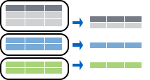
Recap: Information
Extract variables and observations with select() and filter()
Arrange observations, with arrange().
Make new variables, with mutate().
Group observations with group_by() and summarise().

Slide 105
Joining data

Slide 106
dplyr::bind_cols()
y
z
x1 | x2
A | 1
B | 2
C | 3
x1 | x2
B | 2
C | 3
D | 4
x1 | x2 | x1 | x2
A | 1 | B | 2
B | 2 | C | 3
C | 3 | D | 4
+
=
bind_cols(y, z)

Slide 107
dplyr::bind_rows()
y
z
x1 | x2
A | 1
B | 2
C | 3
B | 2
C | 3
D | 4
x1 | x2
A | 1
B | 2
C | 3
x1 | x2
B | 2
C | 3
D | 4
+
=
bind_rows(y, z)

Slide 108
dplyr::union()
y
z
x1 | x2
A | 1
B | 2
C | 3
x1 | x2
B | 2
C | 3
D | 4
x1 | x2
A | 1
B | 2
C | 3
D | 4
+
=
union(y, z)

Slide 109
dplyr::intersect()
y
z
x1 | x2
A | 1
B | 2
C | 3
x1 | x2
B | 2
C | 3
D | 4
x1 | x2
B | 2
C | 3
+
=
intersect(y, z)

Slide 110
dplyr::setdiff()
y
z
x1 | x2
A | 1
B | 2
C | 3
x1 | x2
B | 2
C | 3
D | 4
x1 | x2
A | 1
D | 4
+
=
setdiff(y, z)

Slide 111
left_join(x, y): Return all rows from x, and all columns from x and y. If there are multiple matches between x and y, all combination of the matches are returned. This is a mutating join.
dplyr::left_join()
songs
artists
song | name
Across the Universe | John
Come Together | John
Hello, Goodbye | Paul
Peggy Sue | Buddy
name | plays
George | sitar
John | guitar
Paul | bass
Ringo | drums
song | name | plays
Across the Universe | John | guitar
Come Together | John | guitar
Hello, Goodbye | Paul | bass
Peggy Sue | Buddy | <NA>
+
=
left_join(songs, artists, by = "name")

Slide 112
dplyr::left_join()
songs
artists
song | name
Across the Universe | John
Come Together | John
Hello, Goodbye | Paul
Peggy Sue | Buddy
name | plays
George | sitar
John | guitar
Paul | bass
Ringo | drums
song | name | plays
Across the Universe | John | guitar
Come Together | John | guitar
Hello, Goodbye | Paul | bass
Peggy Sue | Buddy | <NA>
+
=
left_join(songs, artists, by = "name")

Slide 113
dplyr::left_join()
songs2
artists2
song | first | last
Across the Universe | John | Lennon
Come Together | John | Lennon
Hello, Goodbye | Paul | McCartney
Peggy Sue | Buddy | Holly
first | last | plays
George | Harrison | sitar
John | Lennon | guitar
Paul | McCartney | bass
Ringo | Starr | drums
Paul | Simon | guitar
John | Coltranee | sax
song | first | last | plays
Across the Universe | John | Lennon | guitar
Come Together | John | Lennon | guitar
Hello, Goodbye | Paul | McCartney | bass
Peggy Sue | Buddy | Holly | <NA>
+
=
left_join(songs2, artists2, by = c("first", "last"))

Slide 114
dplyr::left_join()
songs2
artists2
song | first | last
Across the Universe | John | Lennon
Come Together | John | Lennon
Hello, Goodbye | Paul | McCartney
Peggy Sue | Buddy | Holly
first | last | plays
George | Harrison | sitar
John | Lennon | guitar
Paul | McCartney | bass
Ringo | Starr | drums
Paul | Simon | guitar
John | Coltrane | sax
song | first | last | plays
Across the Universe | John | Lennon | guitar
Come Together | John | Lennon | guitar
Hello, Goodbye | Paul | McCartney | bass
Peggy Sue | Buddy | Holly | <NA>
+
=
left_join(songs2, artists2, by = c("first", "last"))

Slide 115
left_join()
songs
artists
song | name
Across the Universe | John
Come Together | John
Hello, Goodbye | Paul
Peggy Sue | Buddy
name | plays
George | sitar
John | guitar
Paul | bass
Ringo | drums
song | name | plays
Across the Universe | John | guitar
Come Together | John | guitar
Hello, Goodbye | Paul | bass
Peggy Sue | Buddy | <NA>
+
=
left_join(songs, artists, by = "name")

Slide 116
inner_join(x, y): Return all rows from x where there are matching values in y, and all columns from x and y. If there are multiple matches between x and y, all combination of the matches are returned. This is a mutating join.
inner_join()
songs
artists
song | name
Across the Universe | John
Come Together | John
Hello, Goodbye | Paul
Peggy Sue | Buddy
name | plays
George | sitar
John | guitar
Paul | bass
Ringo | drums
song | name | plays
Across the Universe | John | guitar
Come Together | John | guitar
Hello, Goodbye | Paul | bass
+
=
inner_join(songs, artists, by = "name")

Slide 117
semi_join(x, y): Return all rows from x where there are matching values in y, keeping just columns from x. A semi join differs from an inner join because an inner join will return one row of x for each matching row of y, where a semi join will never duplicate rows of x. This is a filtering join.
semi_join()
songs
artists
song | name
Across the Universe | John
Come Together | John
Hello, Goodbye | Paul
Peggy Sue | Buddy
name | plays
George | sitar
John | guitar
Paul | bass
Ringo | drums
song | name
Across the Universe | John
Come Together | John
Hello, Goodbye | Paul
+
=
semi_join(songs, artists, by = "name")

Slide 118
anti_join(x, y): Return all rows from x where there are not matching values in y, keeping just columns from x. This is a filtering join.
anti_join()
songs
artists
song | name
Across the Universe | John
Come Together | John
Hello, Goodbye | Paul
Peggy Sue | Buddy
name | plays
George | sitar
John | guitar
Paul | bass
Ringo | drums
song | name
Peggy Sue | Buddy
+
=
anti_join(songs, artists, by = "name")
Great Join Cheatsheet: http://stat545.com/bit001_dplyr-cheatsheet.html

Slide 119
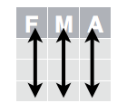
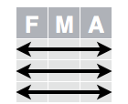

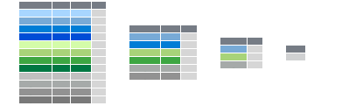
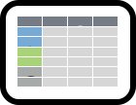
Recap: Best format for analysis
Variables in columns
Observations in rows
Separate all variables implied by law, formula or goal
Unit of analysis matches the unit of analysis implied by law, formula or goal
Single table

Slide 120
Interactive Exercises

