Slide 1
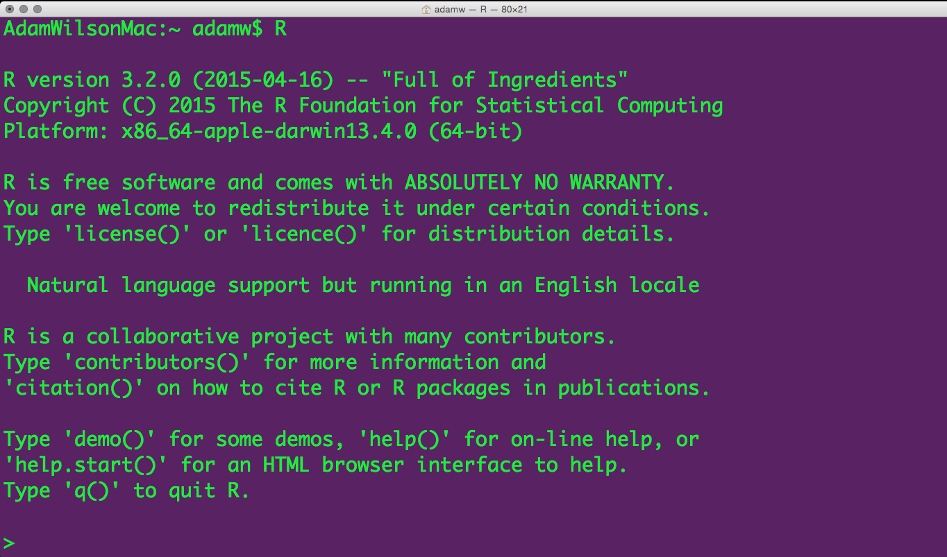
GEO 503: Spatial environmental data analysis with R

Slide 2
Course Objectives
4 Learning Objectives
Become familiar with R programming language
Learn to code geospatial analyses
Learn to develop custom data visualization (especially spatial)
Learn to develop reproducible research workflows
This course is NOT
A statistics course (see GEO 505, etc.).
We will focus on workflow and methods (‘how’ not ‘why’)

Slide 3
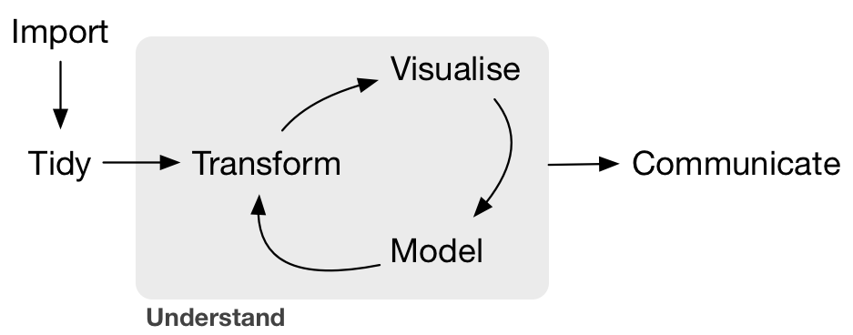
What is Data Science?
--Grolemund & Wickham, R for Data Science, O'Reilly 2016

Slide 4
Typical GUI Workflow
Stata
Graphics
Tables
Summaries
Word
Data 1:
Field Data
Excel
Data 2:
Geotif
ArcGIS

Slide 5
Organized and repeatable workflow (and some example commands)
Scripts
Graphics
Tables
Summaries
‘Raw’ data
Gather
Clean
Prepare
Analysis
‘Raw’ data
Websites
Presentations
Manuscripts
‘Raw’ data
GDAL
GRASS GIS
dplyr
Statistics
Models
BUGS/JAGS
File.download
ROpenSci APIs
xtable
knitr/sweave
rmarkdown
Advisor:
I’ve updated the field data with a few more locations, please re-run that analysis…
New satellite data are available, can you update that figure?
Sure, I can do that
this afternoon…
Adapted from Gandrud (2014) Reproducible Research with R and RStudio.

Slide 6
From Graphical User Interface (GUI)
to scripting/programming
Write Code
Productivity
Point-and-click
My goal in
this course
Time

