Slide 1
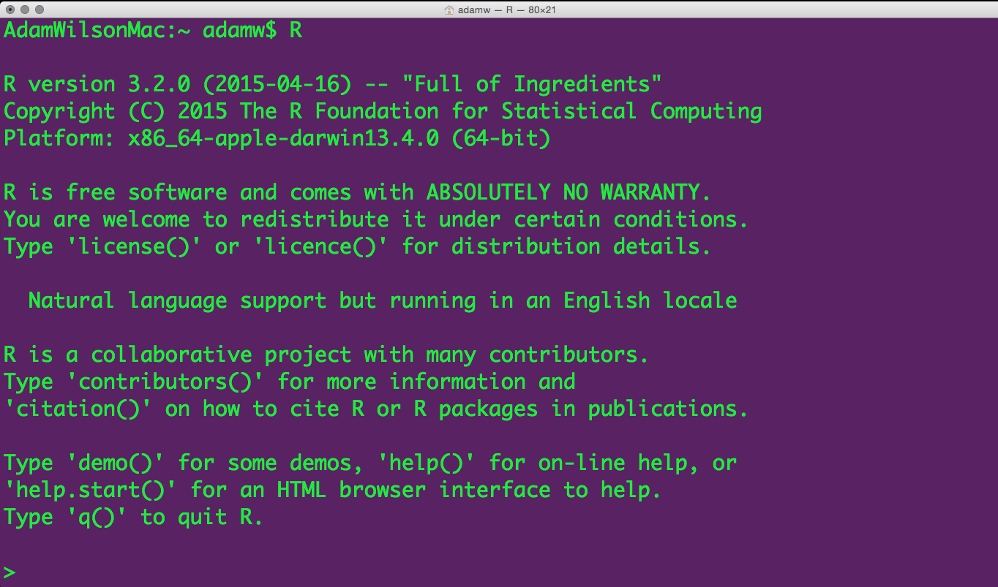
GEO 503: Spatial Data Science (with R)

Slide 2
Course Objectives
4 Learning Objectives
Become familiar with R programming language
Learn to code geospatial analyses
Learn to develop custom data visualization (especially spatial)
Learn to develop reproducible research workflows
This course is NOT
A statistics course (see GEO 505, etc.).
We will focus on workflow and methods (‘how’ not ‘why’)

Slide 3
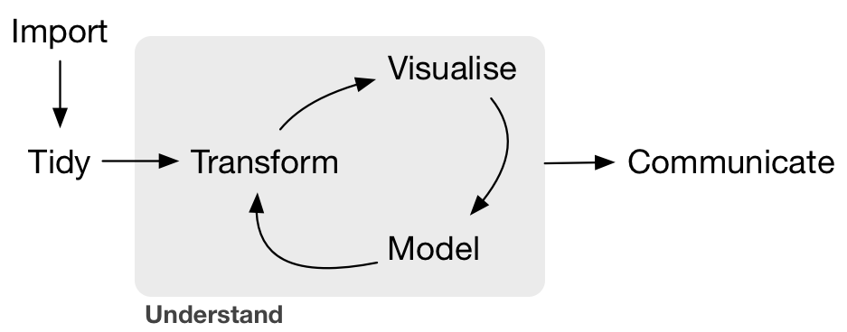
What is Data Science?
--Grolemund & Wickham, R for Data Science, O'Reilly 2016

Slide 4
Typical GUI Workflow
Stata
Graphics
Tables
Summaries
Word
Data 1:
Field Data
Excel
Data 2:
Geotif
ArcGIS

Slide 5
Organized and repeatable workflow (and some example commands)
Scripts
Graphics
Tables
Summaries
‘Raw’ data
Gather
Clean
Prepare
Analysis
‘Raw’ data
Websites
Presentations
Manuscripts
‘Raw’ data
dplyr
tidyr sf
Statistics
Models
file.download
ROpenSci APIs
knitr
Rmarkdown
htmlWidgets
Advisor:
I’ve updated the field data with a few more locations, please re-run that analysis…
New satellite data are available, can you update that figure?
Sure, I can do that
this afternoon…
Adapted from Gandrud (2014) Reproducible Research with R and RStudio.

Slide 6
Programming gives you access to more computer power.
The computer is incredibly fast, accurate, and stupid. Man is unbelievably slow, inaccurate, and brilliant. The marriage of the two is a force beyond calculation.
-- Leo Cherne
The World of Work: Careers and the Future

Slide 7
Course Topics (just a reminder…)
Introduction to R
Introduction to Git
Data Wrangling (dplyr, tidyr, etc)
Handling Spatial Vector Data
Handling Spatial Raster Data
Generating dynamic research outputs (including web publishing and interactive figures)
Interacting with APIs
Building and summarizing statistical models

Slide 8
From Graphical User Interface (GUI) to scripting/programming
Coding
Or at least here?
Productivity
Point-and-click
My goal in
this course
Time

Slide 9
Important products from this course
Public repository of worked examples illustrating solutions to problems in spatial data science (case studies)
Public website (and underlying repository) demonstrating your coding abilities in an independent project
Put these on your CV and share with future employers/advisors!

Slide 10
Project Presentations next week
Many people not yet signed up – Thursday is full

