Slide 1
Animation
Adam M. Wilson

Slide 2
Lead Author: Yihui Xie
Software engineer at Rstudio
PhD Department of Statistics, Iowa State University
Founded Chinese website Capital of Statistics & initiated 1st Chinese R conference
R packages: animation, formatR, and knitr
“I know I cannot eat code, so I cook almost every day to stay away from my computer for two hours.”

Slide 3
Animation package
Makes animations!
probability theory
mathematical statistics
multivariate statistics
nonparametric statistics
sampling survey
linear models
time series
computational statistics
data mining
machine learning
Save to Flash, GIF, HTML pages, PDF and videos

Slide 4
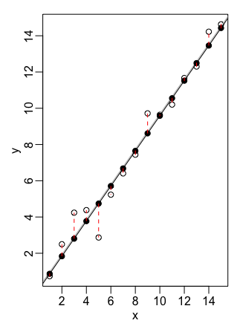
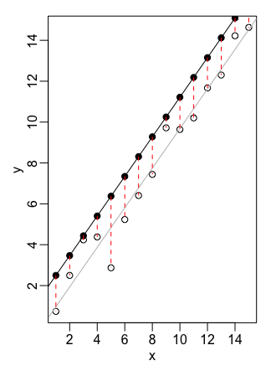
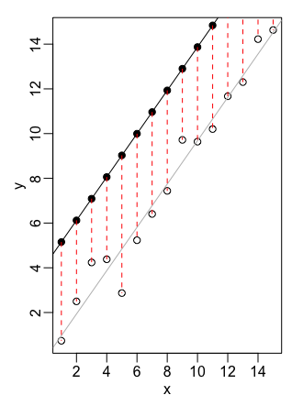
Basic steps…
Uses a ’loop’ to make a series of plots
1
2
3
Package ‘combines’ them into an animation

Slide 5
Example Code: Linear Regression
saveGIF({
ani.options(interval = 0.3, nmax = 50) par( mar = c(4, 4, 0.5, 0.1), mgp = c(2, 0.5, 0), tcl = -0.3)
least.squares() }, img.name = "least.squares", htmlfile = "least.squares.gif", ani.height = 600, ani.width = 1000, title = "Demonstration of Least Squares")
Set visual parameters plot
Run the visualization
Set the output parameters

Slide 6
Example Output

