Slide 1
Carbon Dioxide Concentrations at Mona Loa Observatory
Adam M. Wilson

Slide 2
Table of contents
Annual Mean Carbon Dioxide Concentrations 1959-Present
Top Five Annual Mean Carbon Dioxide Concentrations at Mona Loa

Slide 3
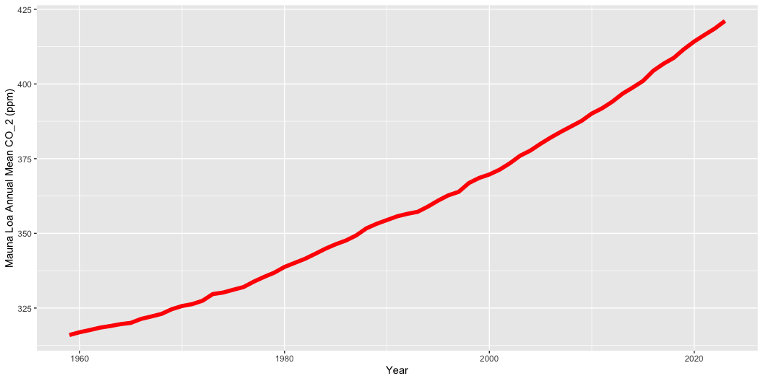
Annual Mean Carbon Dioxide Concentrations 1959-Present

Slide 4
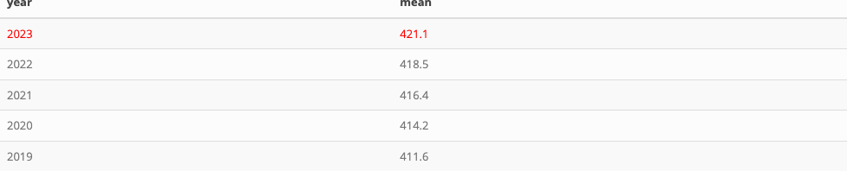
Top Five Annual Mean Carbon Dioxide Concentrations at Mona Loa

