Slide 1
Mauna Loa CO2 Data

Slide 2
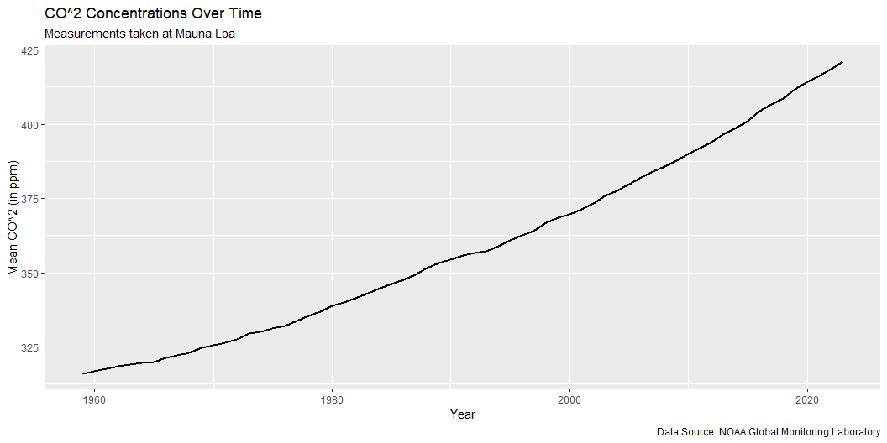
Load packages
Load data from website
Plot CO2 levels over time

Slide 3
year | mean | unc
2023 | 421.08 | 0.12
2022 | 418.53 | 0.12
2021 | 416.41 | 0.12
2020 | 414.21 | 0.12
2019 | 411.65 | 0.12
Table of data

