Slide 1
CS_08 : Carbon Dioxide Concentrations at Mona Loa Observatory
SwethaSakhamuri

Slide 2
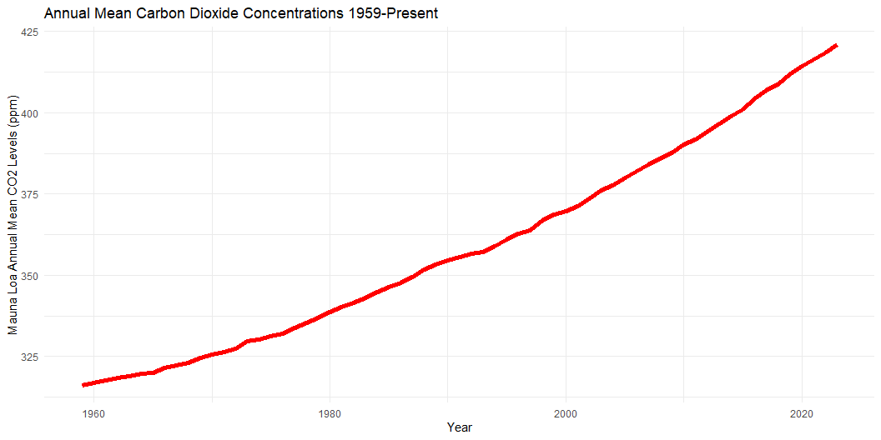

Slide 3
Year | MeanCO2
2023 | 421.08
2022 | 418.53
2021 | 416.41
2020 | 414.21
2019 | 411.65
Mauna Loa CO2 Annual Mean Data

