Slide 1
Mauna Loa Annual Carbon Dioxide Concentration (1959 - Present)
Stephen Sanders

Slide 2
year | mean | unc
1959 | 315.98 | 0.12
1960 | 316.91 | 0.12
1961 | 317.64 | 0.12
1962 | 318.45 | 0.12
1963 | 318.99 | 0.12
1964 | 319.62 | 0.12
Get annual mean CO2 concentration data measured at Mauna Loa from NOAA website
Response [https://gml.noaa.gov/webdata/ccgg/trends/co2/co2_annmean_mlo.txt]
Date: 2024-10-27 05:10
Status: 200
Content-Type: text/plain; charset=UTF-8
Size: 3.65 kB
# --------------------------------------------------------------------
# USE OF NOAA GML DATA
#
# These data are made freely available to the public and the scientific
# community in the belief that their wide dissemination will lead to
# greater understanding and new scientific insights. To ensure that GML
# receives fair credit for their work please include relevant citation
# text in publications. We encourage users to contact the data providers,
# who can provide detailed information about the measurements and
# scientific insight. In cases where the data are central to a
...

Slide 3
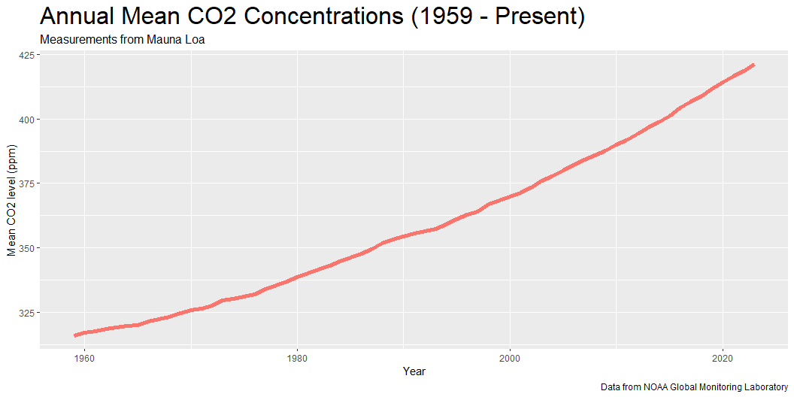
Plot annual mean CO2 concentrations between 1959 and present

Slide 4
Mean CO2 Levels by Decade
Measurements from Mauna Loa
Decade | Mean CO2 (ppm)
1950 | 315.98
1960 | 320.29
1970 | 330.86
1980 | 345.65
1990 | 360.58
2000 | 378.77
2010 | 400.41
2020 | 417.56
Create table of mean CO2 concentrations by decade

