Slide 1
CS_08

Slide 2
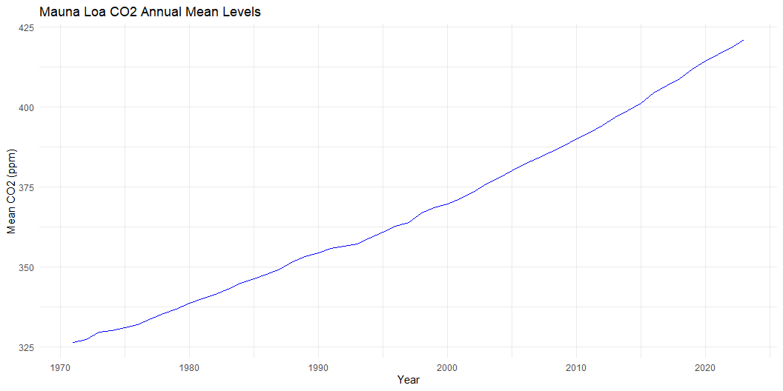
Data Import and Plotting

Slide 3
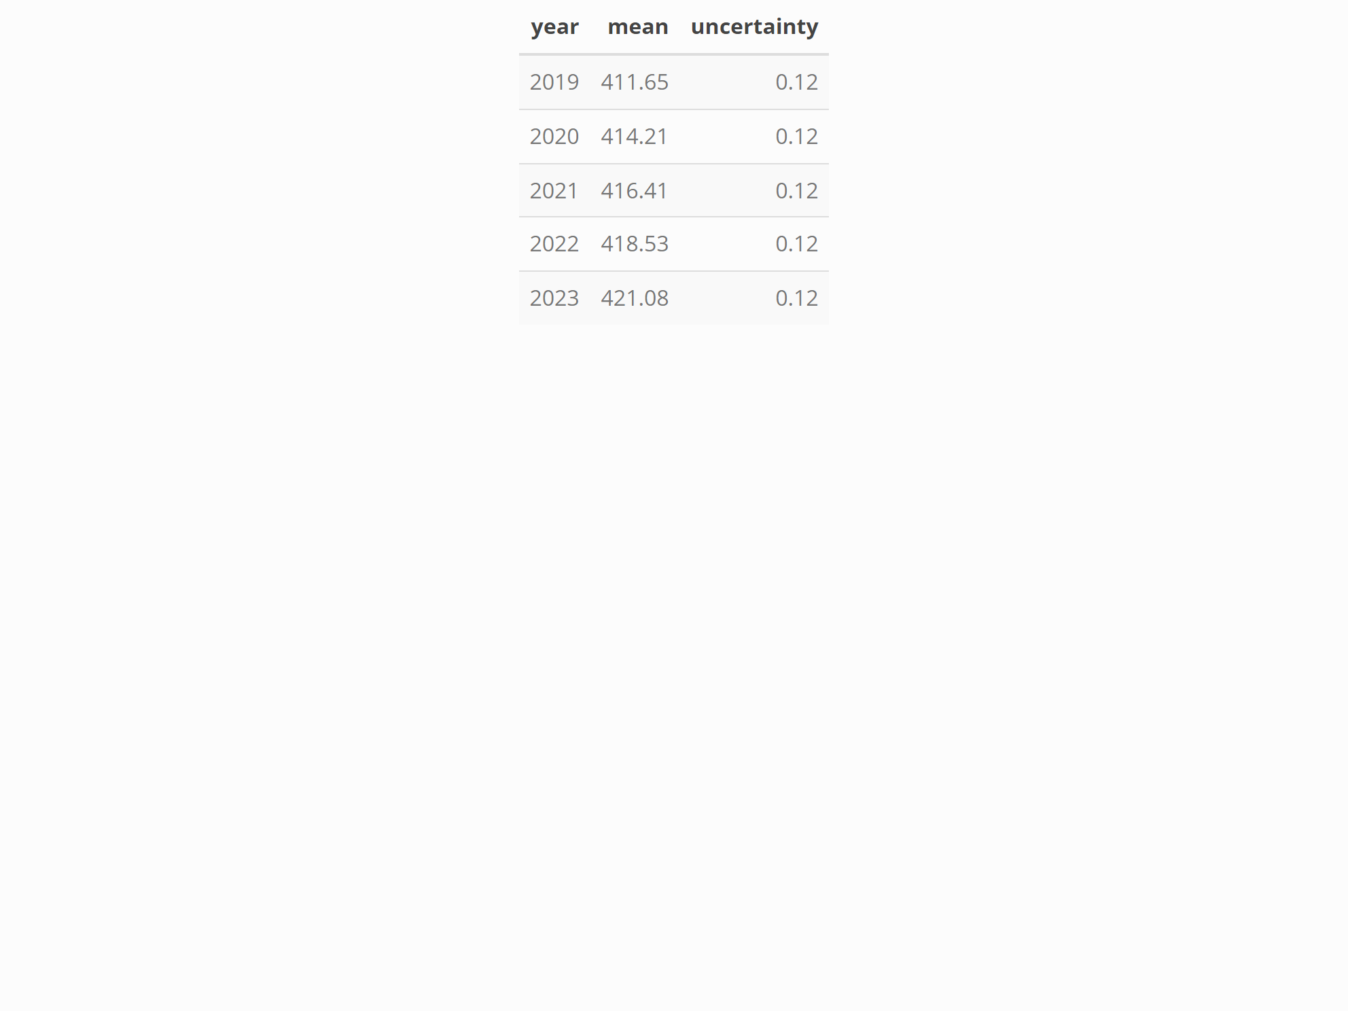
Summary Table

Slide 4
Hidden Calculations Example

