Slide 1


AutoKeras Demo
Adam Wojtulewski
Moffitt Cancer Center
Machine Learning Department
Karolak Lab

Slide 2

What is AutoKeras?
An open source AutoML system based on Keras
It is developed by DATA Lab at Texas A&M University.
Given a set of inputs, provides a Neural Network Architecture and/or Model for given dataset

Slide 3
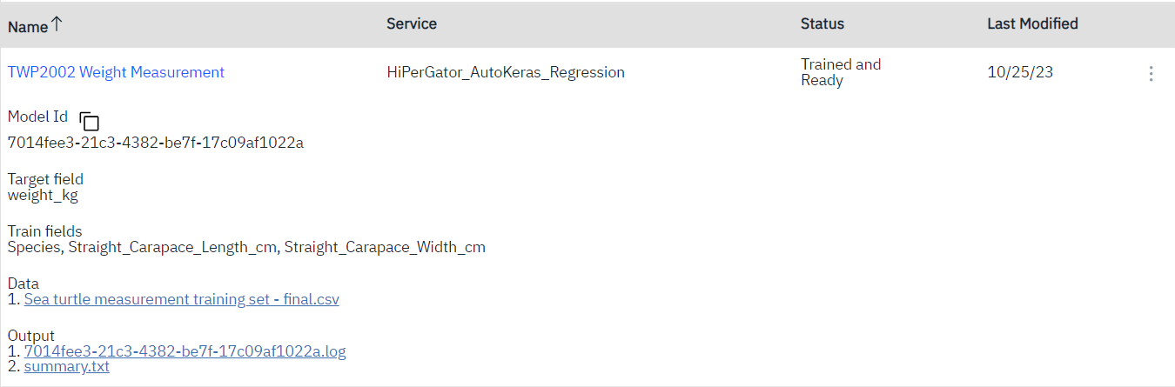

My Introduction to AutoKeras
EEL3872 - AI Fundamentals @ UF
Sea Turtle Conservation AI Project

Slide 4
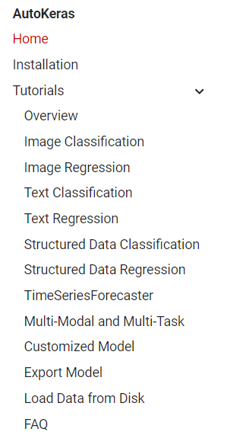
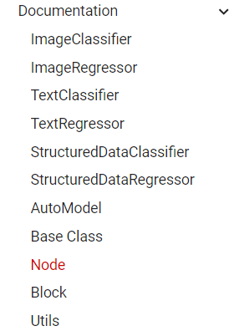
My Introduction to AutoKeras
https://autokeras.com/

Slide 5
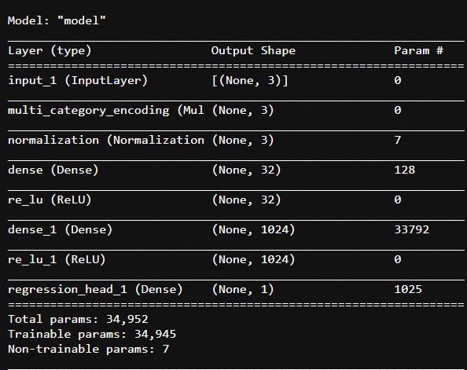
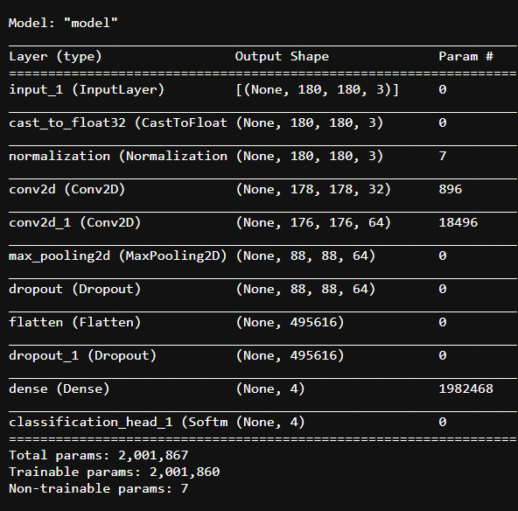
What does an AutoKeras Model Like Like?
Text Input
Image (Classification) Input

Slide 6
Performance Comparision
Custom Neural Network Performance
AutoKeras Performance
Architecture | Percent Accuracy
[4,1] | 0.6154
[8,1] | 0.6923
[12,1] | 0.7231
[16,1] | 0.7385
[20,1] | 0.7077
[40,1] | 0.7071
[120,1] | 0.6154
Mid-70 percent performance for both str and float32 values

Slide 7
Why is this Relevant?
Despite not being perfect, it requires much less data preparation to use the AutoKeras network
For traditional Keras networks, only numerical values are accepted, while for AutoKeras, strings are automatically converted as part of the process

Slide 8

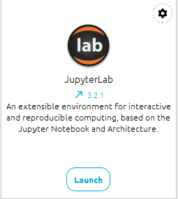

Running my code
Integrated Development Environment (IDE)
Github QR Code
https://www.anaconda.com/download/
https://github.com/AdamWojtul28/Moffitt-Data-Analysis

Slide 9
Thank you
Github QR Code
LinkedIn QR Code
Questions?

