Slide 1

AutoKeras Demo
Adam Wojtulewski
Moffitt Cancer Center
Machine Learning Department
Karolak Lab

Slide 2

What is AutoKeras?
An open source AutoML system based on Keras
It is developed by DATA Lab at Texas A&M University.
Given a set of inputs, provides a Neural Network Architecture and/or Model for given dataset

Slide 3
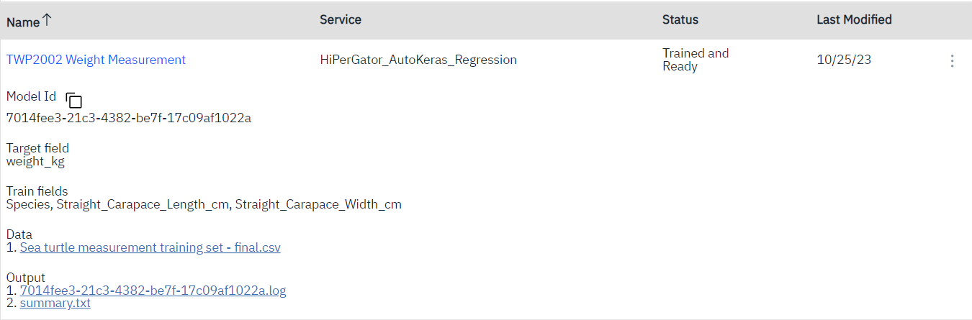

My Introduction to AutoKeras
EEL3872 - AI Fundamentals @ UF
Sea Turtle Conservation AI Project

Slide 4
How does AutoKeras work?
Employs a Neural Architecture Search (NAS) algorithm that selects the most optimal architecture and corresponding parameters over its multiple iterations
How NAS works:
Accept an input training dataset
Optimize and find architectural building blocks (cells), which are automatically learned and may look similar to inception, residual, or squeeze/fire micro-architectures
Continually train and search for more optimized cells

Slide 5
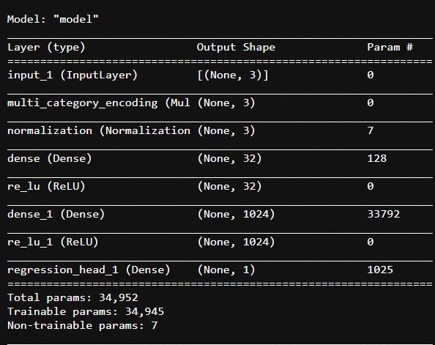
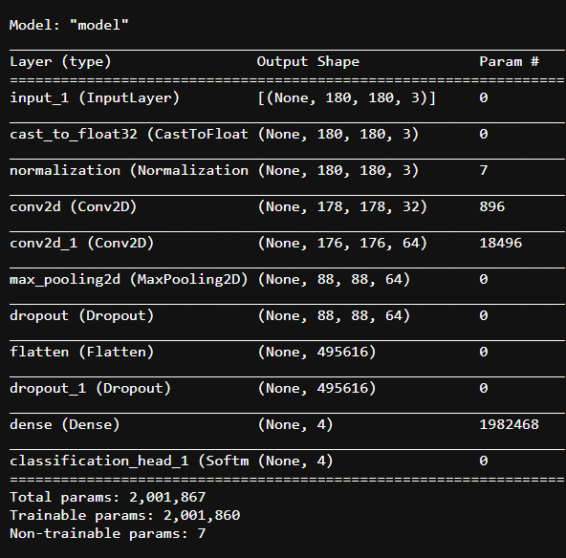
What does an AutoKeras Model Like Like?
Text Input
Image (Classification) Input

Slide 6
Performance Comparision
Custom Neural Network Performance
AutoKeras Performance
Architecture | Percent Accuracy
[4,1] | 0.6154
[8,1] | 0.6923
[12,1] | 0.7231
[16,1] | 0.7385
[20,1] | 0.7077
[40,1] | 0.7071
[120,1] | 0.6154
60-80 percent performance for both str and float32 values
Average performance comparable to Random Forest Classification from Scikit Learn

Slide 7
Why is this Relevant?
Despite not being perfect, it requires much less data preparation to use the AutoKeras network
For traditional Keras networks, only numerical values are accepted, while for AutoKeras, strings are automatically converted as part of the process

Slide 8
Applications
Immediate Use
Hybrid Approach
“can design a novel network architecture that rivals the best human-invented architecture in terms of test set accuracy”
hybrid between a fully automated machine learning solution and one that requires an expert deep learning practitioner
often this approach will lead to better accuracy than what the NAS finds on its own

Slide 9
Conclusion
AutoKeras is a form of AutoAI that utilizes the Neural Architecture Search to quickly and efficiently determine a neural architecture with good performance
Using AutoKeras on its own does not guarantee the development of the best possible model for the dataset, but provides a solid baseline that can be learned from
Through the export functionality, AutoKeras models can be adjusted and fine-tuned in an effort to get better performance
In short, AutoKeras another very useful tool that can be used to streamline the process of model development by providing a solid baseline with good to great performance

Slide 10
AutoKeras (Code) Demo

Slide 11

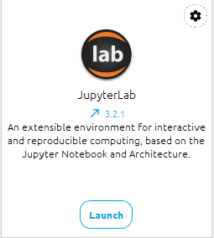

Software Pre-requisites
Integrated Development Environment (IDE)
Github QR Code
https://www.anaconda.com/download/
https://github.com/AdamWojtul28/Moffitt-Data-Analysis

Slide 12

Thank you
Github QR Code
LinkedIn QR Code
Questions?
www.linkedin.com/in/adam-wojtulewski-420522248
https://github.com/AdamWojtul28/Moffitt-Data-Analysis

Slide 13
Sources Consulted
https://pyimagesearch.com/2019/01/07/auto-keras-and-automl-a-getting-started-guide/#:~:text=Both%20Google%27s%20AutoML%20and%20Auto,optimal%20architecture%20and%20corresponding%20parameters.
https://arxiv.org/abs/1611.01578
https://chat.openai.com/share/b3afe850-689e-4b06-9ca7-8bc5772d9e5c
https://stackoverflow.com/questions/43755293/what-does-dense-do

