Slide 1

Model Validation
Workshop
dr Piotr Morawski
Adam Wróbel
Model Risk Management & Control
May 17, 2016

Slide 2
Model Validation
What is this all about?
Enforced on financial institutions by regulators
With aim to ensure that whenever bank use model it is done in appropriate manner
Especially relevant for:
capital requirement related models
used in trading models (front desk)
Development
Idea
Model Validation
Theoretical assumptions
Regulator
External model validation
Development
Implementation
Implementation
Calibration process
Adequacy of the data used
Defining requirements

Slide 3
Credit Risk
What is the credit risk?
Risk of the counterparty defaulting:
Client unable to pay the mortgage
Friend unwilling to pay us back
Lehman Brothers couldn't keep their end of the bargains
Depends on various factors
Quality of the counterparty – Friend with stable income is less risky one
Economy - crisis could decrease company ability to sell its product
Management – company even in very bad financial situation could improve instead of going into the default
How to quantify credit risk?
PD – Probability of Default
LGD – Loss Given Default
EAD – Exposure at Default
Expected Loss = PD * LGD * EAD

Slide 4
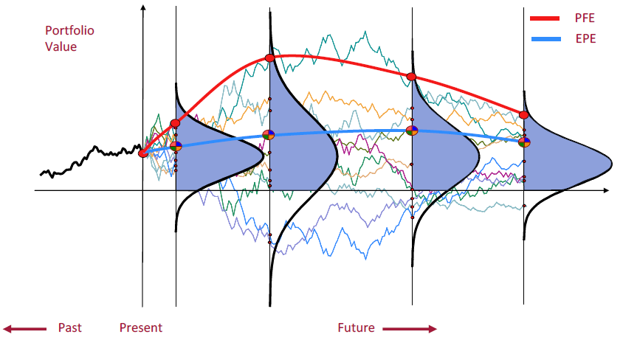
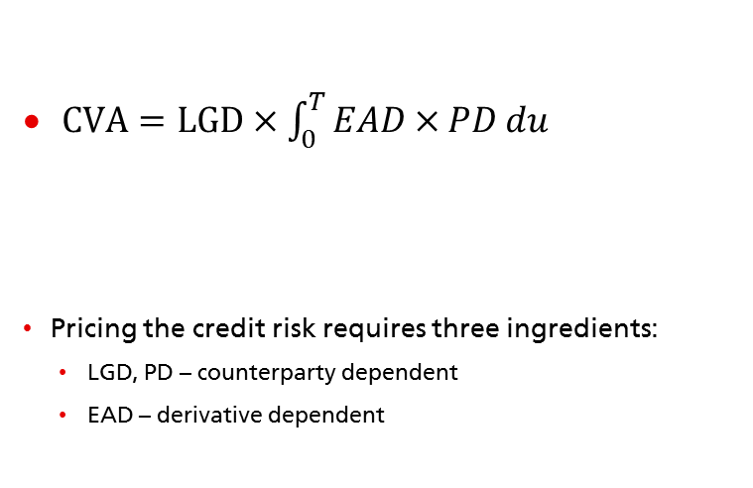
Credit Risk
Credit Risk Pricing
Exposure At Default
$CVA=LGD×\int_{0}^{T}{EAD×}PD du$
Pricing the credit risk requires three ingredients:
LGD, PD – counterparty dependent
EAD – derivative dependent
Loss Given Default
Probability of Default
courtesy of Giovanni Cesari, UBS
Exposure profilling:
Calculating CVA requires knowledge of Trade Value distribution at each point in time
MC simulation can provide very general solution to problem of pricing a derivatives regardless of it's complexity
LGD, PD modelling:
For CVA PD/LGD comes from market implied spread
For other purposes statistical models based on internal or external historical data

Slide 5
R fundamentals
During the workshop we will extensively use R
We will mainly use base functions and dplyr approach for data processing, but obviously you are free to use whatever fit you best during the exercises.
Let's open script "0_R_introduction.R" and get familiar with some functions that we will use

Slide 6
Problem 1
Normally distributed variable?
Most popular assumption done during the modelling
Multiple well know tests could be applied, but should one blindly take test result without looking into the data?
Open script "1_Tests.R" and let's take a closer look
Notes:
This one problem we will show without you writing your own code. All other will be focused on your own work.

Slide 7
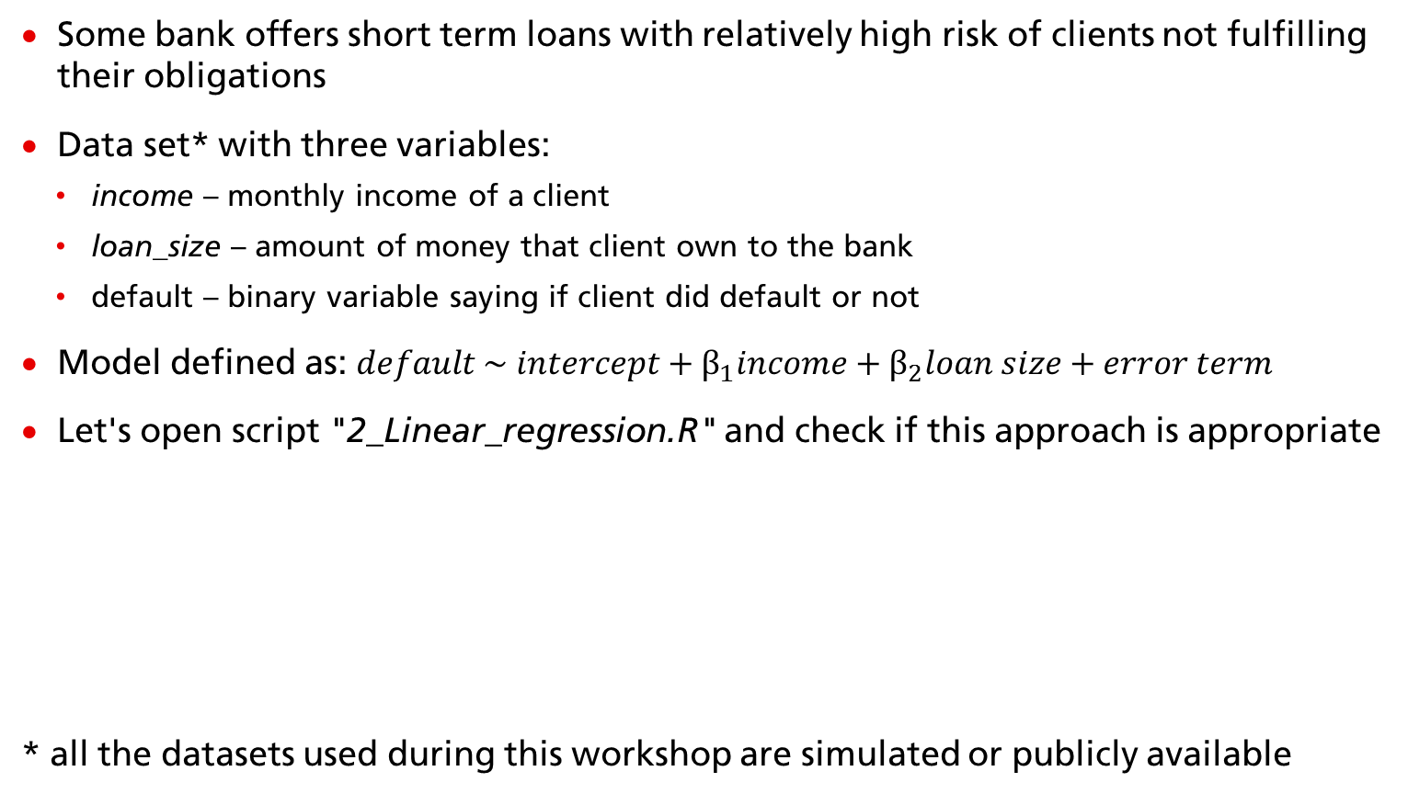
Problem 2
Linear regression used for modelling default probability
Some bank offers short term loans with relatively high risk of clients not fulfilling their obligations
Data set* with three variables:
income – monthly income of a client
loan_size – amount of money that client own to the bank
default – binary variable saying if client did default or not
Model defined as: $default \sim intercept+β_{1}income+β_{2}loan size+error term$
Let's open script "2_Linear_regression.R" and check if this approach is appropriate
* all the datasets used during this workshop are simulated or publicly available

Slide 8

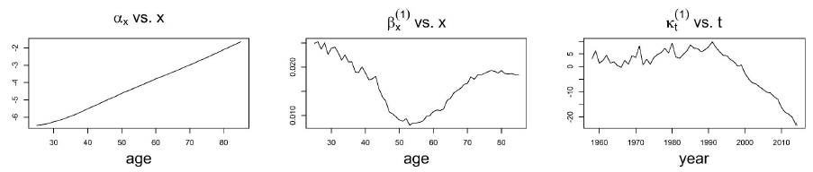
Problem 3
Population death probability modelled by Lee-Carter model ("3_stochastic_mortality.R")
With aim to model death probability of male population of Poland (based on mortality tables)
Generalized Linear Model (GLM)
Number of deaths as modelled variable (assumed binomial distribution)
Logit link function (same as in logistic regression)
Lee-Carter specifically is defined as:
Notes:
Own plot

Slide 9




Tools
What are the main tools used in the industry? What should I learn?
Prototyping the models is most often done in R, SAS, Matlab
Production version of models are often written in C++ and C#
Some models (often those that are used for staff like capital requirements calculation, stress testing) have production implementation in R, SAS, Matlab
Other environments/languages that are also popular are Python and VBA
Where is the future:
R
Python
Notes:
All the logos are official logos from websites of those organizations

Slide 10
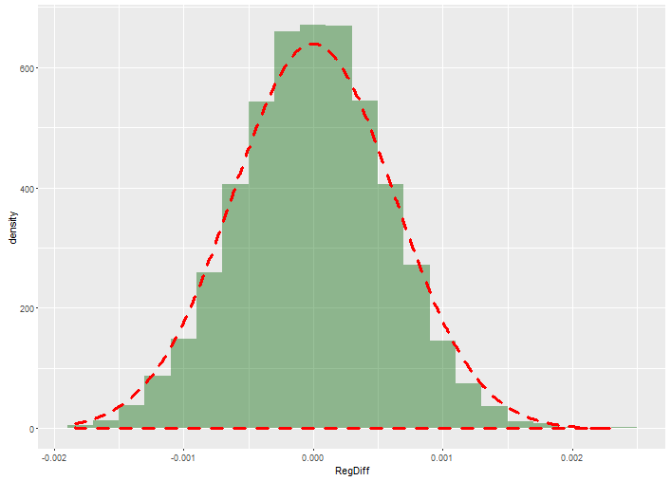
Problem 4
Testing model's prediction power on historical data
We need to model the trade value throughout the whole trade period to know how much we are exposed in case of the counterparty gone bankrupt.
To do that we need to simulate the Risk Factors driving the trade value.
In simple case of stock option the only Risk factor relevant is the price of the underlying stock.
Model: linear model calibrated over the last month of data, used to predict the next day stock price.
Underlying assumption: the stock prices is a Black-Sholes process.
Principle of backtesting: using available market data to compare model prediction against the historical realisation.
Use the script: "4_Backtesting.R"

Slide 11
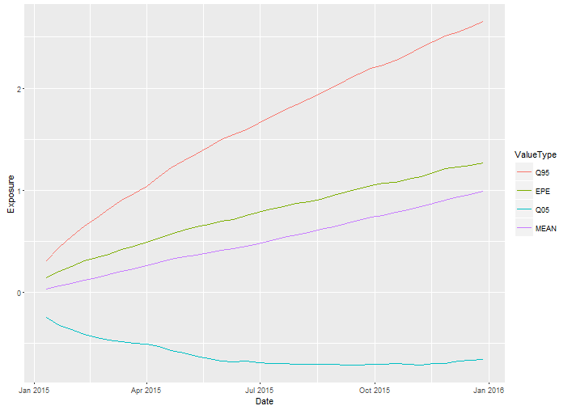
Problem 5
CVA calculation
Profile the exposure of a simple stock call option
Simulate underlying stock movement using MC technique
Measure the Expected Positive Exposure at each point in time
Combine the Exposure profile with Default Probability and Loss Given Default of the counterparty.
Open script: 5_CVA.R

Slide 12
People
Who works in risk modelling/quantitative finance?
Most common background:
Mathematics
Econometrics / Quantitative finance
Physics
PhD's

Slide 13
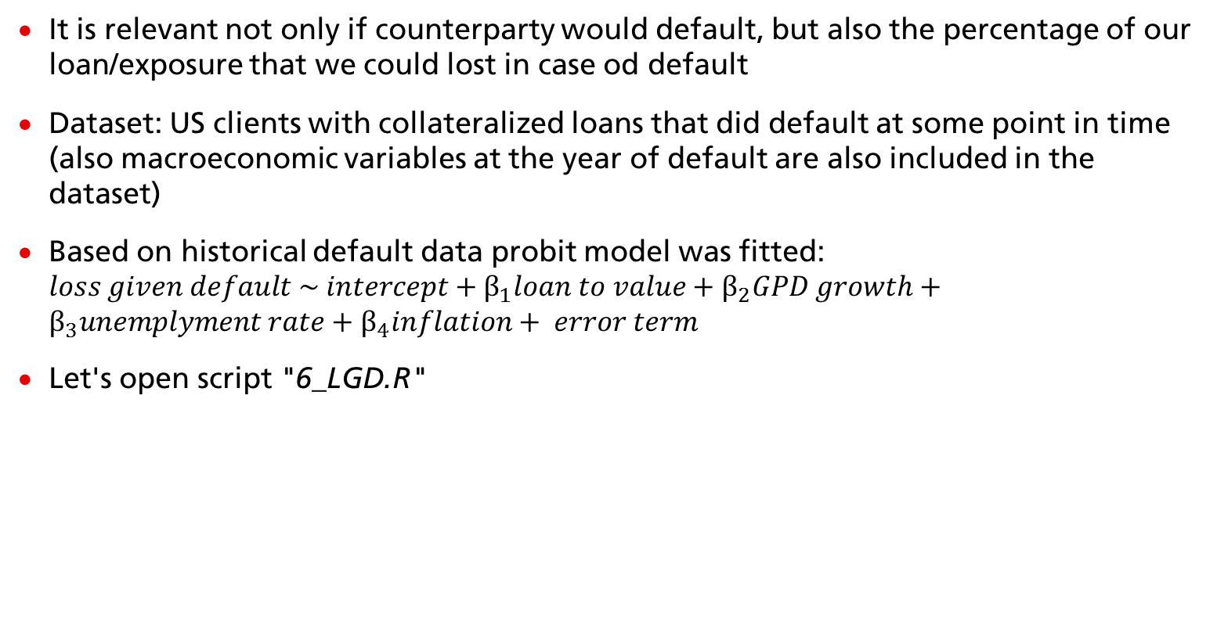
Problem 6
Loss Given Default (LGD) model – building benchmark model
It is relevant not only if counterparty would default, but also the percentage of our loan/exposure that we could lost in case od default
Dataset: US clients with collateralized loans that did default at some point in time (also macroeconomic variables at the year of default are also included in the dataset)
Based on historical default data probit model was fitted: $loss given default \sim intercept+β_{1}loan to value+β_{2}GPD growth+β_{3}unemplyment rate+β_{4}inflation+ error term$
Let's open script "6_LGD.R"

Slide 14
Problem 7
Stress model – are all variables stressed in appropriate manner?
We would like to know how much we could lost if another crisis would hit us (alternatively any other scenario)
One approach to model the loss is to use build PD and LGD models and then stress their inputs:
increased unemployment rate
decreased growth of gross domestic product
drop of the house prices
Let's open script "7_Stress_model.R"

Slide 15
Sum up
What are the most important takeaways?
Appling model without checking it could result in an mis-representation of risk or underestimation of required capital buffer.
Which could create incentive to get into more risky transitions. On single bank perspective it could lead to huge losses and potential bankruptcy. While on a whole financial system level it could result in crisis.
There is a huge universe of models and if you enjoy getting to understand every one of them then model validation is an areas that is worth considering.
Notes:
Powerbanks ;)

Slide 16
Contact information
dr Piotr Morawski
UBS Krakow, Risk Control Specialist
Tel. +48 12 399 81 79
piotr-a.morawski@ubs.com
Adam Wróbel
UBS Krakow, Risk Modelling & Analytics Specialist
Tel. + 48 12 399 69 65
adam.wrobel@ubs.com
ubs.com/polandcareers

