Slide 1
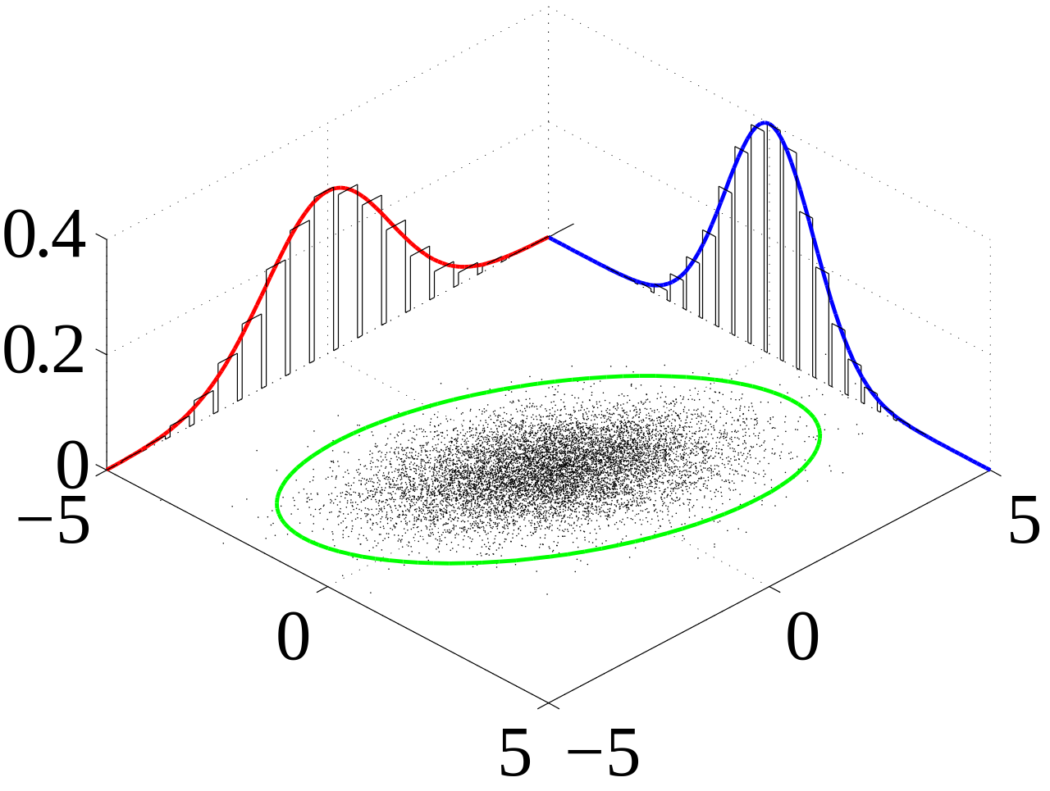

Simulation with Copulas in R
After inserting a picture, you can move the picture in the frame, or crop or enlarge it. Click with your right mouse button in the picture and choose Format image. Then click on Crop. In the right part of the screen you can change Picture or Crop position. If your picture has no round edges, select the picture. Then click with your right mouse button in the picture and choose Send to Back.
Format the title text in three colours according to the house style guide: use the macro in the NN Text formatting menu
Adam Wróbel, Poland
Do not change or add other logos
2015-11-18

Slide 2
Problem
Use ‘formatting text-styles’ in the NN PowerPoint-menu
We want to calculate assets VAR on our risk drivers with incorporation of their dependence:
IR YR1 (PLN government bond IR at maturity of one year)
EQ index (WIG – index of stocks listed in Poland Stock Market)
What approach could be applied for such a problem?
Do not change or add other logos

Slide 3
Solve our problem with copula approach
Use ‘formatting text-styles’ in the NN PowerPoint-menu
We need VAR of our assets
To calculate it we need distibution of changes in value of assets.
Since we are exposed only to those two risk drivers this distibution that we are seeking for will be joint distibution of changes in those risk drivers
To construct joint distibution we need some framwork (in our case copulas) and marginal distibution for each risk driver
To obtain marginal distibution of given risk driver we need to fit some teoretical distibution to our data
Do not change or add other logos

Slide 4
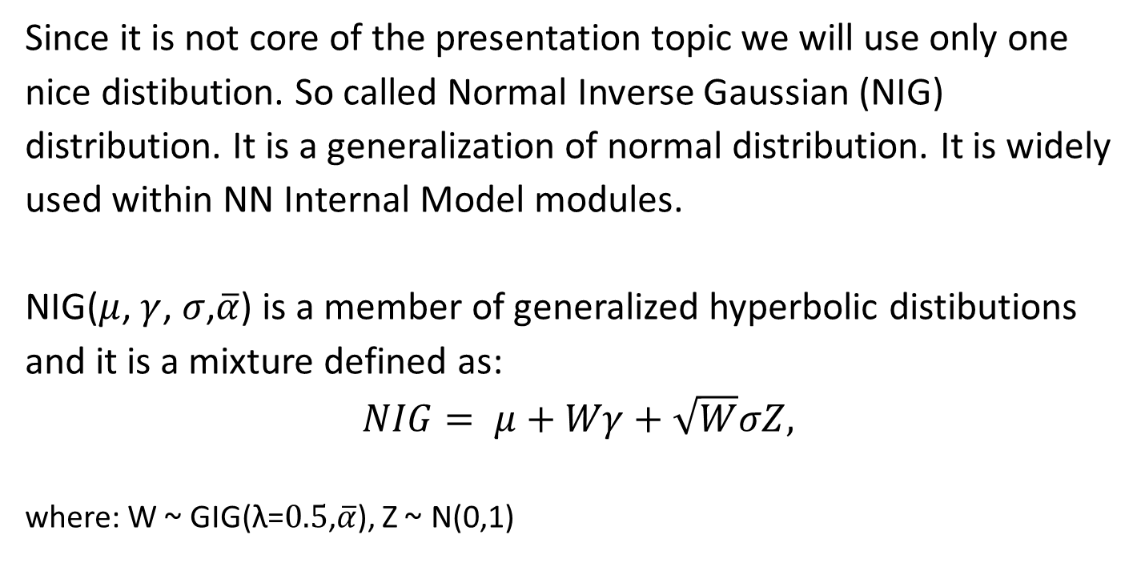
Distribution fitting - risk drivers as random variables
Use ‘formatting text-styles’ in the NN PowerPoint-menu
Since it is not core of the presentation topic we will use only one nice distibution. So called Normal Inverse Gaussian (NIG) distribution. It is a generalization of normal distribution. It is widely used within NN Internal Model modules.
NIG($μ$, $γ$, $σ$,$\overline{α}$) is a member of generalized hyperbolic distibutions and it is a mixture defined as:
$$NIG= μ+Wγ+\sqrt{W}σZ,$$
where: W ~ GIG(λ=$0.5$,$\overline{α}$), Z ~ N(0,1)
Do not change or add other logos

Slide 5
Simulate from fitted distibutions
Use ‘formatting text-styles’ in the NN PowerPoint-menu
If we know that X has continuous cumulative density function F then F(X) ~ U(0,1).
Moreover by the inversion method X = F⁻¹(U). This function is also called quantile function.
Those transformations are denoted in R by a) pnorm and b) qnorm functions (example for normal distribution). We will use those extensively.
U denotes uniform distribution on (0,1) interval
Do not change or add other logos

Slide 6
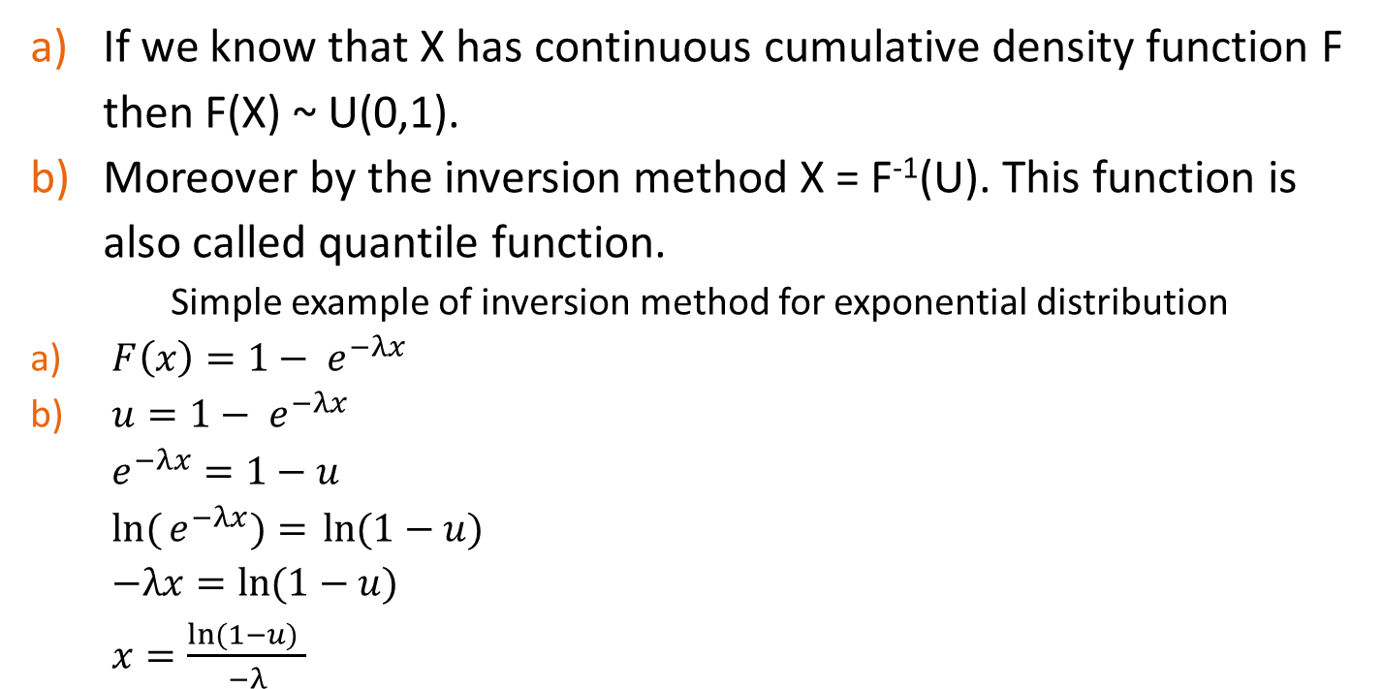
Simulate from fitted distributions
Use ‘formatting text-styles’ in the NN PowerPoint-menu
If we know that X has continuous cumulative density function F then F(X) ~ U(0,1).
Moreover by the inversion method X = F⁻¹(U). This function is also called quantile function.
Simple example of inversion method for exponential distribution
$F\left(x\right)=1− e^{−λx}$
$u=1− e^{−λx}$ $e^{−λx}=1−u$ $ln({e^{−λx})=} ln⁡(1−u)$ $−λx=ln⁡(1−u)$ $x=\frac{ln⁡(1−u) }{−λ}$
Do not change or add other logos

Slide 7
Simulate from fitted distribution
Use ‘formatting text-styles’ in the NN PowerPoint-menu
Other function that has to be mentioned in contexts of simulation is function to simulate observation from given distribution.
It is denoted as:
rnorm (for normal distribution)
runif (for uniform distribution)
rghyp (for generalized hyperbolic distributions)
Do not change or add other logos

Slide 8
Obtain joint distribution with Copulas
Use ‘formatting text-styles’ in the NN PowerPoint-menu
Copula is an function to capture complex dependency between variables. It could be perceived an extension of the concept of multivariate distribution. Why copulas approach is often better than multivariate distribution one?
Modelling with use of copula allows us to break down modelling process into two parts:
Choice of arbitrary marginal distribution for all variables
Choice of arbitrary copula function
Estimation of marginal distribution and copula can be done separately. This provide mass flexibility.
Do not change or add other logos

Slide 9
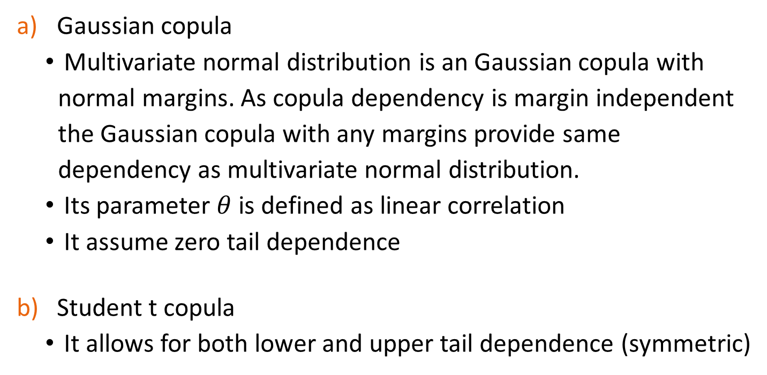
Elliptical copulas
Use ‘formatting text-styles’ in the NN PowerPoint-menu
Gaussian copula
Multivariate normal distribution is an Gaussian copula with normal margins. As copula dependency is margin independent the Gaussian copula with any margins provide same dependency as multivariate normal distribution.
Its parameter $θ$ is defined as linear correlation
It assume zero tail dependence
Student t copula
It allows for both lower and upper tail dependence (symmetric)
Do not change or add other logos

Slide 10
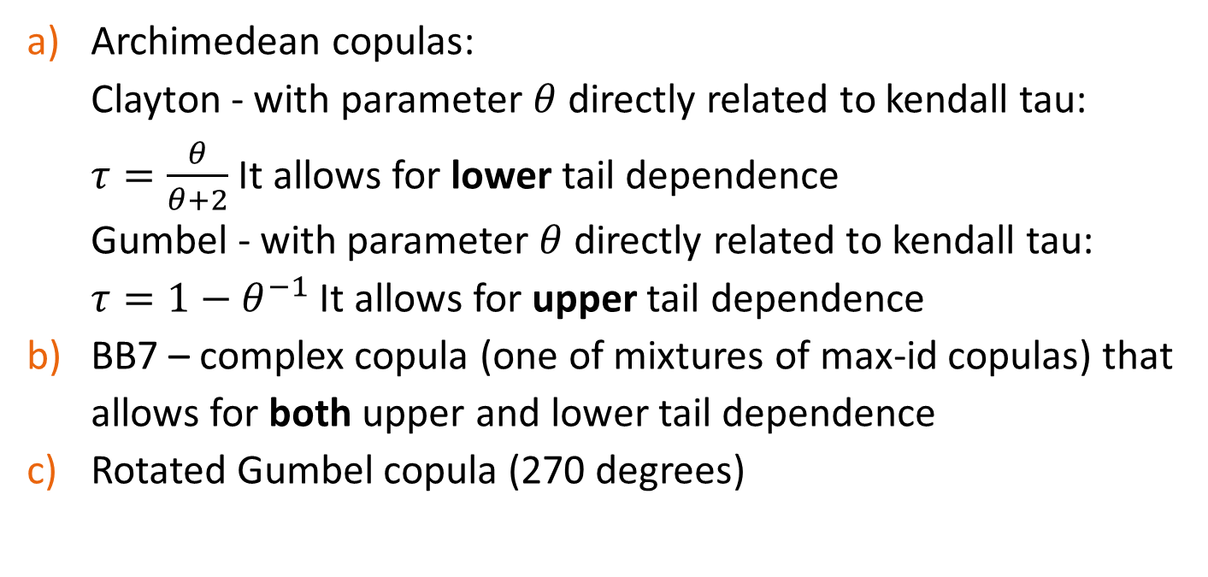
Parametric copulas applied in presentation
Use ‘formatting text-styles’ in the NN PowerPoint-menu
Archimedean copulas: Clayton - with parameter $θ$directly related to kendall tau: $τ=\frac{θ}{θ+2}$ It allows for lower tail dependence Gumbel - with parameter $θ$directly related to kendall tau: $τ=1−θ^{−1}$ It allows for upper tail dependence
BB7 – complex copula (one of mixtures of max-id copulas) that allows for both upper and lower tail dependence
Rotated Gumbel copula (270 degrees)
Do not change or add other logos

Slide 11
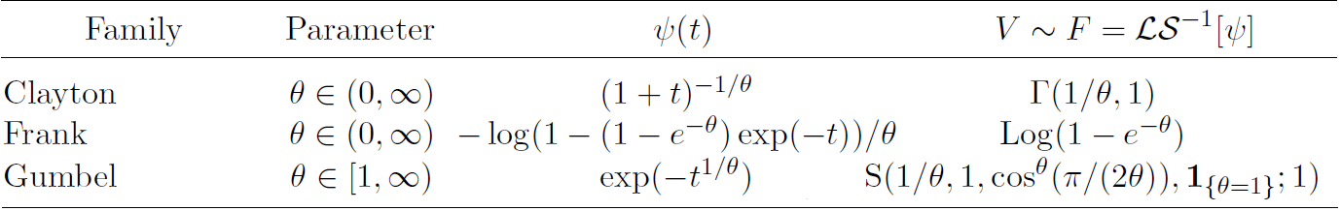

Algorithm for simulation of Clayton copula [6]
Use ‘formatting text-styles’ in the NN PowerPoint-menu
Sample $V\sim F={ℒS}^{−1}\left[ψ\right]$
Sample $R_{j}\sim Exp\left(1\right), j ∈\left\{1,…,d\right\}$
Set $U_{j}= ψ\left(\frac{R_{j}}{V}\right),j ∈\left\{1,…,d\right\}$
Do not change or add other logos

Slide 12
References
Use ‘formatting text-styles’ in the NN PowerPoint-menu
U. Schepsmeier, E. C. Brechmann, Modeling dependence with C- and D-vine copulas: The R package CDVine, 2013
U. Schepsmeier, E. C. Brechmann, CDVine, 2013 https://cran.r-project.org/web/packages/CDVine/
H. Joe, Dependence Modeling with Copulas, 2014 (not yet published on CRAN package CopulaModel - copula.stat.ubc.ca)
C. Genest, A.-C. Favre, Everything You Always Wanted to Know about Copula but Were Afraid to Ask, 2007
H. Joe, H. Li, A. K. Nikoloulopoulos, Tail dependence functions and vine copulas, 2010
M. Hofer, M.Machler, Nested Archimedean Copulas Meet R – Vignette, https://cran.r-project.org/web/packages/copula/vignettes/nacopula-pkg.pdf
Do not change or add other logos

Slide 13
Use ‘formatting text-styles’ in the NN PowerPoint-menu
Questions & Answers
Do not change or add other logos

Slide 14
Use ‘formatting text-styles’ in the NN PowerPoint-menu
Exercises – instructions in code
Do not change or add other logos

Slide 15
Do not change or add other logos

