Slide 1
Performance of Multiple Types of Numerical MR Simulation using MRiLab
Fang Liu¹, Alexey Samsonov¹, Richard Kijowski², and Walter F. Block^{1,3}
¹Department of Medical Physics, University of Wisconsin-Madison, United States
²Department of Radiology, University of Wisconsin-Madison, United States
³Department of Biomedical Engineering, University of Wisconsin-Madison, United States
ISMRM 2014
Milan, Italy
Contact: leoliuf@gmail.com

Slide 2

Declaration of Conflict of Interest or Relationship
Presenter Name: Fang Liu
I have no conflicts of interest to disclose with regard to the subject matter of this presentation.

Slide 3
MRI Simulation
Digital simulation can dramatically speed the understanding and development of new MR imaging methods.
To numerically simulate spin evolution for large spin system, current available simulation packages typically employ dedicated computation architecture (e.g. computer grid and cluster) which is expensive and thus limited for convenient use.
Limited functions were provided in previous tools for modeling multiple receiving and transmitting coil relevant experiments.
No tools were provided capable of simulating complex spin models such as those existing in realistic tissue exhibiting multi-pool water exchange environment.

Slide 4
MRI Lab - MRiLab
We have developed a novel simulation package named ‘MRiLab’ for performing fast 3D parallelized MRI numerical simulation on a simple desktop computer. MRiLab features:
Highly interactive program-free graphic user-interface
RF and gradient modules for B1 and B0 field analysis
Graphical pulse sequences design and analysis
Fast parallelized simulation for tissue response in 3D
Low computation power requirement
✓
✓
✓
✓
✓

Slide 5
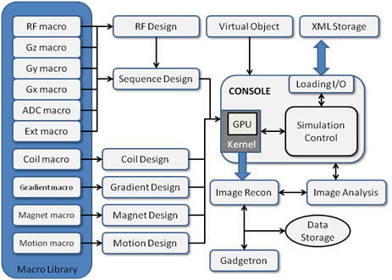
Architecture & Software Design
A main simulation control console
Additional toolboxes and macro libraries
Parallelized computing kernels for solving discrete Bloch-equations
Image reconstruction module and image analysis tools

Slide 6
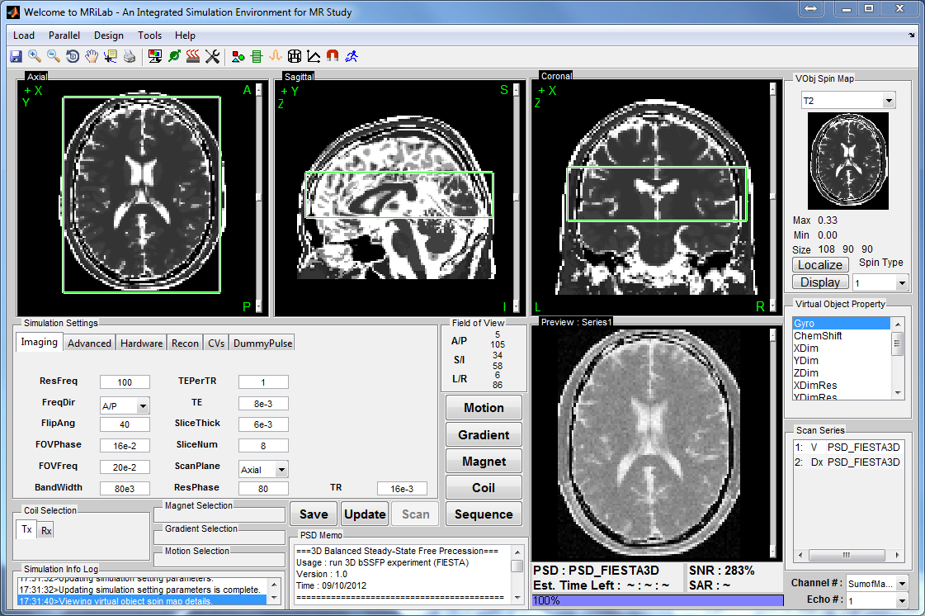
Simulation Control Console
A main simulation control console is designed to provide a graphical interface for adjusting imaging parameters and conducting simulation control

Slide 7
Additional Toolboxes
Additional toolboxes consist of individual interfaces for
RF pulse design
MR sequence design
Coil array design
Magnetic field design
Gradient design
Motion pattern design

Slide 8
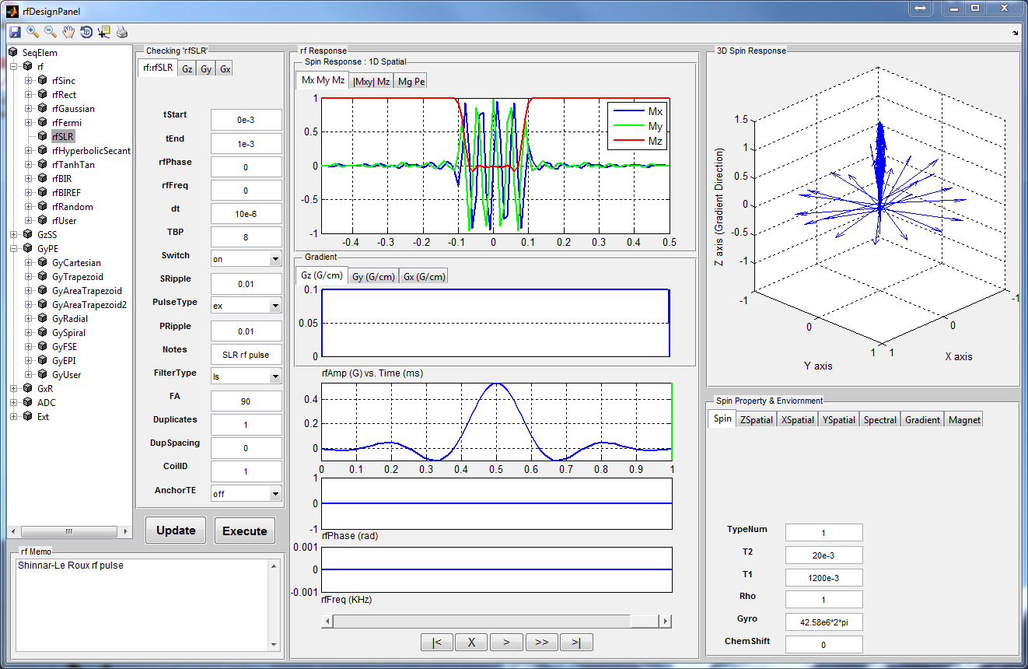
Additional Toolboxes
Additional toolboxes consist of individual interfaces for
RF pulse design
MR sequence design
Coil array design
Magnetic field design
Gradient design
Motion pattern design
Virtual Object design

Slide 9
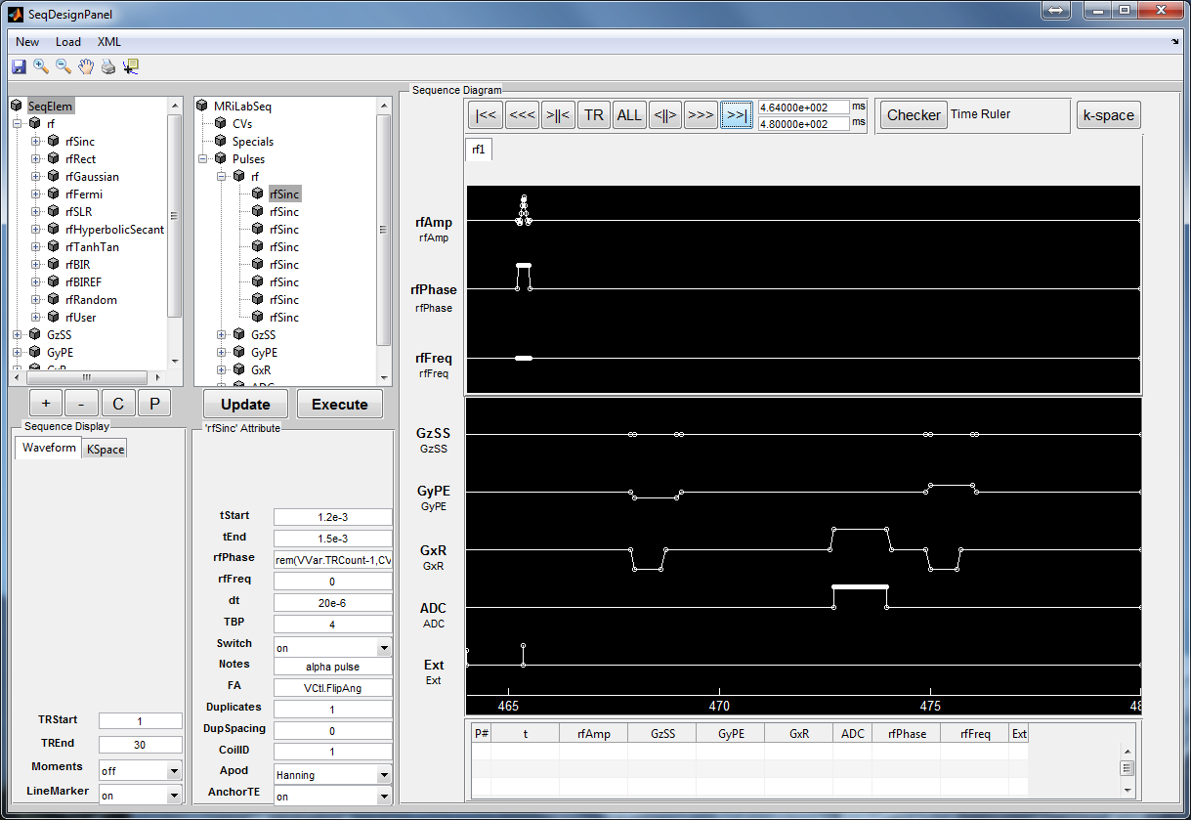
Additional Toolboxes
Additional toolboxes consist of individual interfaces for
RF pulse design
MR sequence design
Coil array design
Magnetic field design
Gradient design
Motion pattern design
Virtual Object design

Slide 10
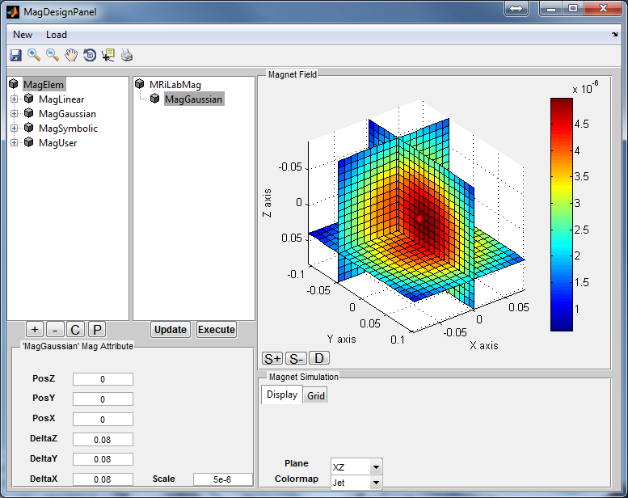
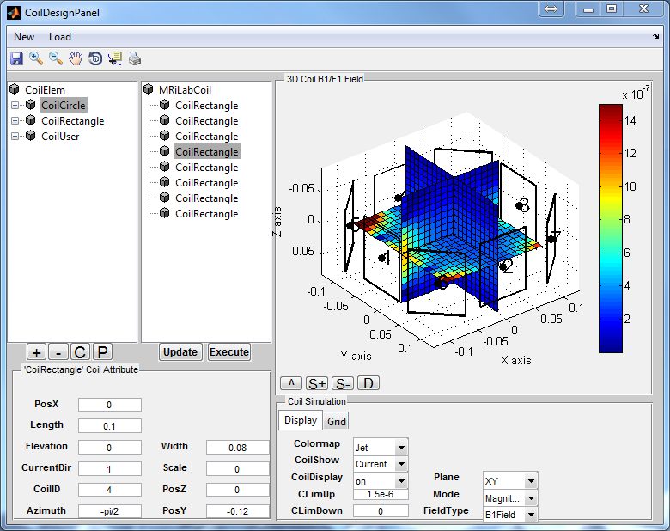
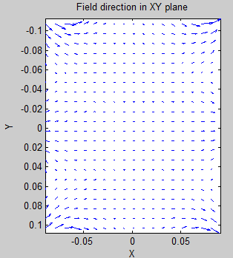
Additional Toolboxes
Additional toolboxes consist of individual interfaces for
RF pulse design
MR sequence design
Coil array design
Magnetic field design
Gradient design
Motion pattern design
Virtual Object design

Slide 11
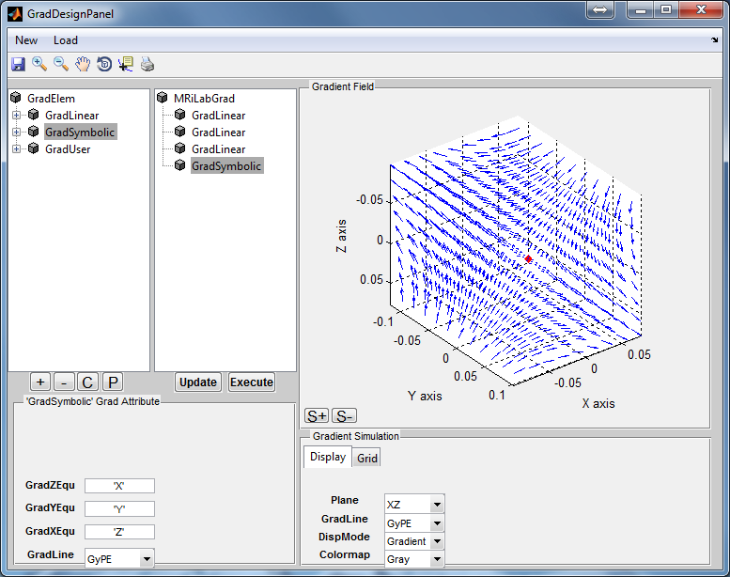
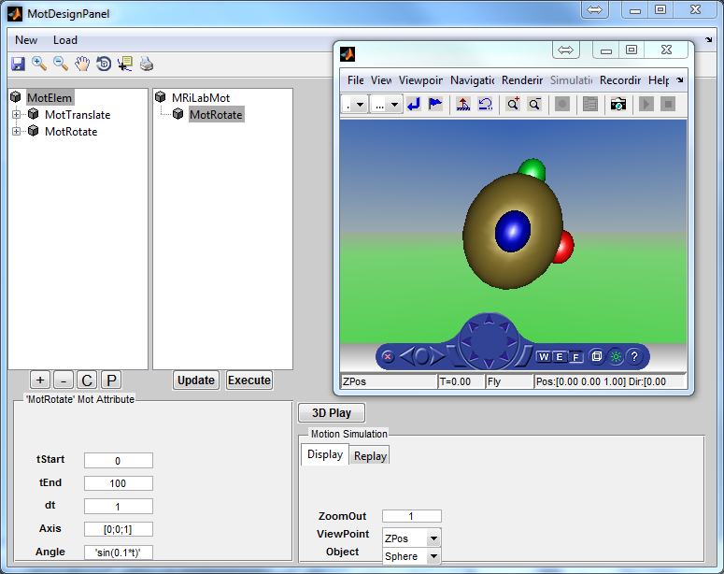
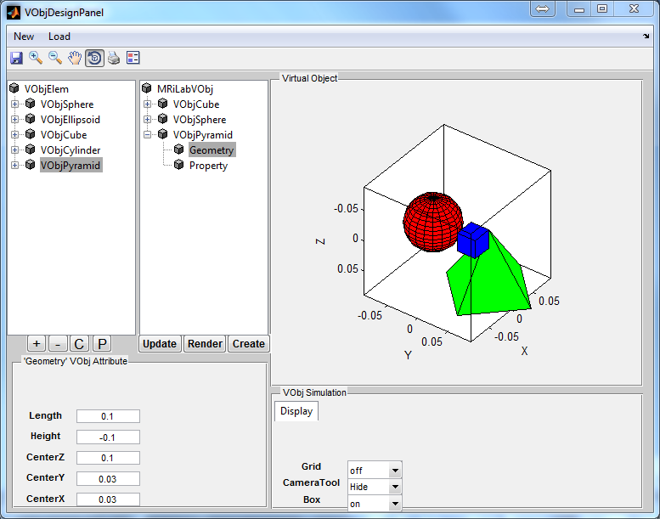
Additional toolboxes
Additional toolboxes consist of individual interfaces for
RF pulse design
MR sequence design
Coil array design
Magnetic field design
Gradient design
Motion pattern design
Virtual Object design

Slide 12
Parallelized Computing Kernels
The MRiLab computing kernels are designed using C++ language for high computing performance for solution of discrete Bloch-equations including
Standard Bloch-equations
Bloch-McConnell equations for multiple spin exchange model
Bloch-equations with Magnetization Transfer (MT) exchange
The computing kernels are memory and time efficient, are capable of handling large scale multi-dimensional multi-spin system for mimicking realistic tissue response at given MR experimental setup

Slide 13
Parallelized Computing Kernels
The MRiLab computing kernels are parallelized by implementing latest GPU computing model and multi-threading CPU model
Nvidia CUDA
OpenMP
Intel Integrated Performance Primitives
AMD Framewave
The MRiLab rendering engines are optimized by using high-performance graphical libraries
Kitware Visualization Toolkit (VTK)
Java Swing Components
Matlab 3D rednering

Slide 14
Image Reconstruction Module
The MRiLab provides built-in image reconstruction module which reconstructs Cartesian (e.g. FSE, EPI) and Non-Cartesian (e.g. Radial, Spiral) k-space data.
Support multi-species multi-dimensional images
Support multi-echo multi-channel images
Support multiple RF transmitting
The MRiLab also provides functions to link MRiLab reconstruction with external image reconstruction methods (e.g. Gadgetron)

Slide 15
Image Reconstruction Module
The MRiLab provides built-in image reconstruction module which reconstructs Cartesian (e.g. FSE, EPI) and Non-Cartesian (e.g. Radial, Spiral) k-space data.
Support multi-species multi-dimensional images
Support multi-echo multi-channel images
Support multiple RF transmitting
The MRiLab also provides functions to link MRiLab reconstruction with external image reconstruction methods (e.g. Gadgetron)

Slide 16
Image Analysis Tools
MatrixUser
manipulating and analyzing multidimensional imaging space data
SpinWatcher
monitoring signal evolution of spins in a single voxel
SARWatcher
monitoring local SAR distribution
arrayShow *
evaluate complex k-space data
*Courtesy of Tilman Johannes Surmpf, PhD

Slide 17
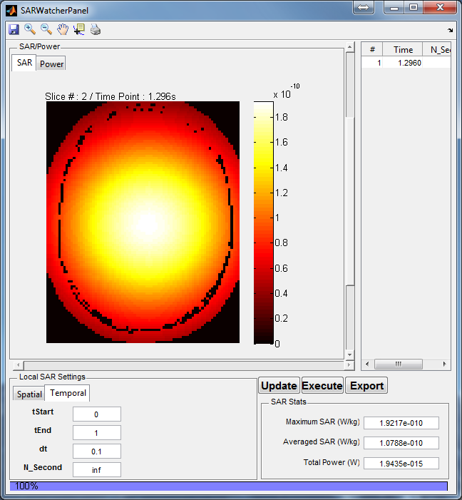
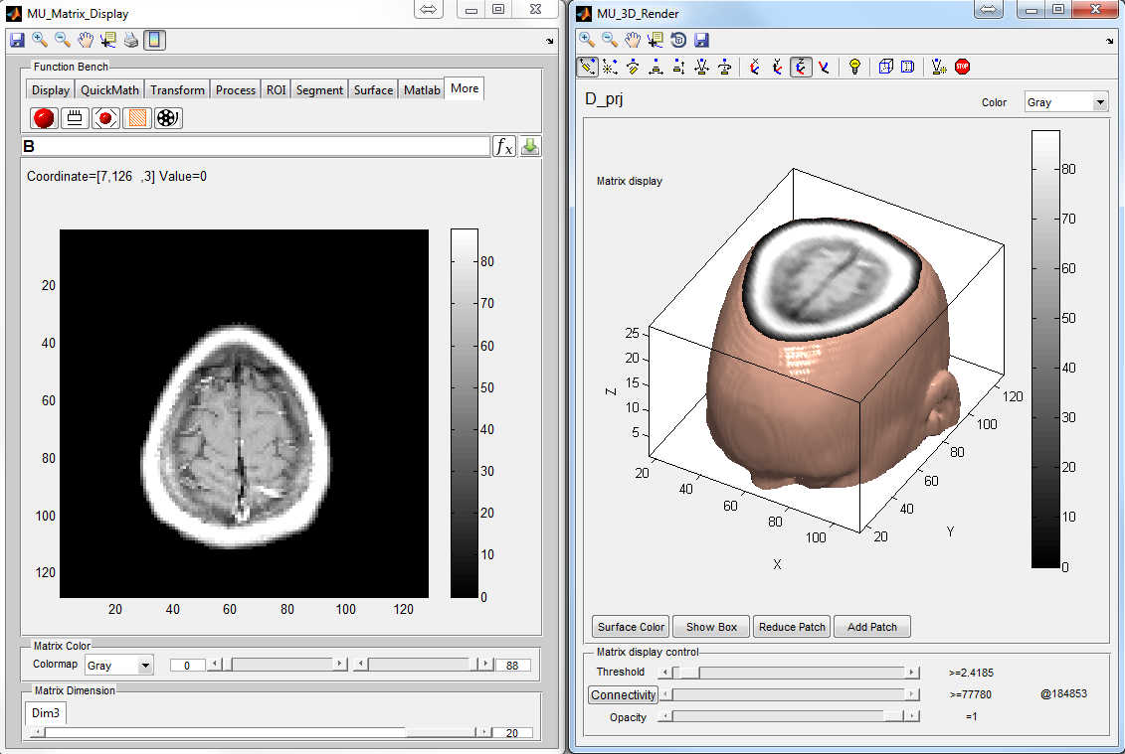
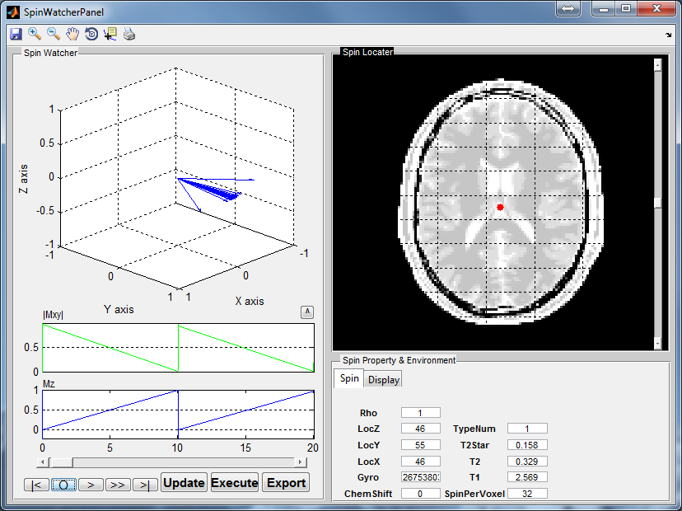
Image Analysis Tools
MatrixUser
SARWatcher
SpinWatcher

Slide 18

Simulation Examples

Slide 19
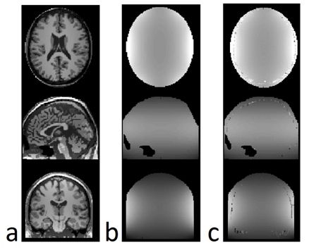
Actual Flip Angle Imaging
Fast B₁ mapping using AFI technique. The imaging parameters are TR₁/TR₂/TE = 7.4/37/2.3 ms, α_{norm}= 45°, FOV =20×16 cm, axial in-plane, slice thickness = 2 mm. a: Obtained images from the TR₁. b: Nominal B₁ map from the coil array, normalized to the B₁ value for producing nominal FA as actual/nominal B₁ Ratio with the range of grayscale values between 0.3 and 1.5. c: Estimated B₁ map using AFI, normalized to the nominal FA as actual/nominal FA ratio with the same range of b.

Slide 20
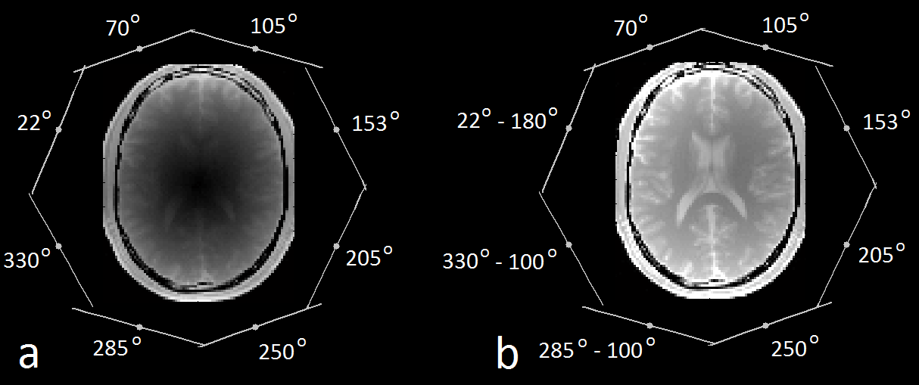
Parallel RF transmission
The effect of the RF transmission phase on bSSFP image homogeneity at 7.0T simulated with MRiLab. The imaging parameters are TR/TE =16/8 ms, α_{norm}= 40°, FOV =20×16 cm, axial in-plane, slice thickness = 6 mm. a: A bSSFP image of a head inside an eight channel Biot-Savart transmission only RF coil array. The loss of signal at the center of the head region is caused by the destructive interference of the individual B1+ field. The relative transmit phase of each coil element is labeled beside the coil element (indicated as a line). b: By optimizing the relative transmit phase of the three coil elements on the left side via individual RF phase adjustment, the signal loss is largely reduced.

Slide 21
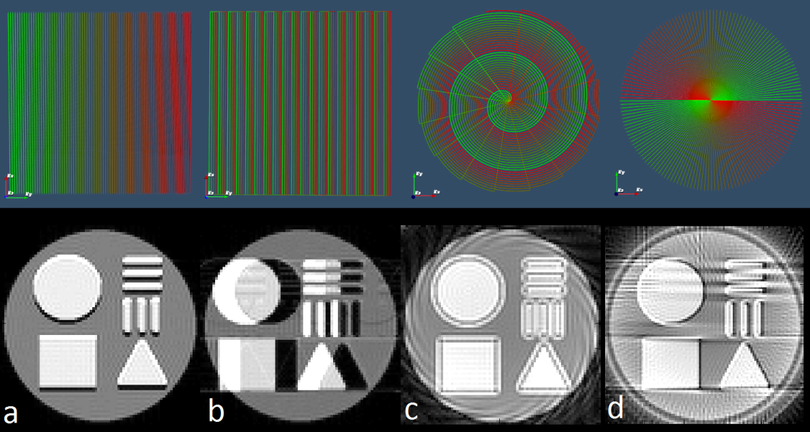
Chemical Shift
The fat chemical shift at different k-space encoding scheme at 3.0T. The 80×80 gradient echo images are obtained from an axial view of a digital phantom with irregular shapes of oil (3.5ppm signal peak fat component) within a cylinder of water. The k-space at the top traverses from green color to red color for each image at the bottom. a: Image obtained with regular Cartesian readout with parameters TE/TR/α° = 50ms/10s/90°, receiver BW = 20kHz, frequency readout is in the up-down direction. b: Image obtained with EPI readout with parameters TE/TR/α° = 50ms/10s/90°, receiver BW = 100kHz, 4 shots, echo train length = 20, echo spacing = 1ms, frequency readout is in the up-down direction. c: Image obtained with Spiral readout with parameters TE/TR/α° = 50ms/10s/90°, receiver BW = 200kHz, 16 shots, designed slew rate = 150T/m/s, designed gradient amplitude = 20mT/m. d: Image obtained with Radial readout with parameters TE/TR/α° = 50ms/10s/90°, 80 spokes with 100 samples per spoke. Sample angle linearly ranges from 0 to π.

Slide 22
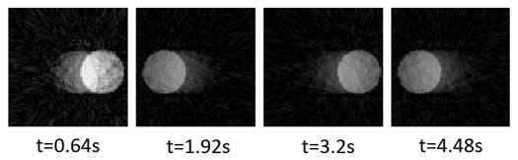
4D Dynamic MRI
Simulating 2D 80×80 image acquisition for an oscillating sphere using a bSSFP sequence with continuous golden angle radial sampling for 4.5 s. Each image is reconstructed with 80 radial spokes. The imaging parameters are TE/TR/α° = 8ms/16ms/40°, continuous radial sampling at 111.246°golden angle increment with 80 samples per spoke. Notice that this sequence and reconstruction is for demonstration purpose, thus is not necessarily optimized for real 4D acquisition.

Slide 23
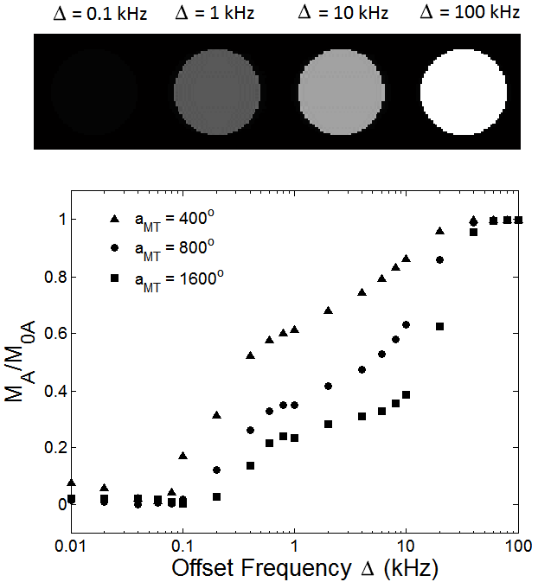
MT Saturation
Magnetization transfer measurements for a cartilage MT phantom. The imaging parameters are TR/TE = 60/8 ms, excitation flip angle α= 10° with the 20 ms Fermi MT saturation pulse. Images are displayed for MT flip angle α_{MT}= 800°, offset frequency = 0.1, 1, 10 and 100 KHz. Z-Spectrum is measured for α_{MT}= 400°, 800° and 1600°, offset frequency range from 0.01 to 100 kHz.

Slide 24
Conclusion
Demonstrate the features of MRiLab simulation for :
simulating various types of MR phenomena
capable of handling efficient simulation in parallel
enriched functions for MR experiment design, image reconstruction and analysis
finally, a fun tool to use
✓
✓
✓
✓
The MRiLab is released as an open source free software, and can be downloaded at
http://mrilab.sourceforge.net/

Slide 25
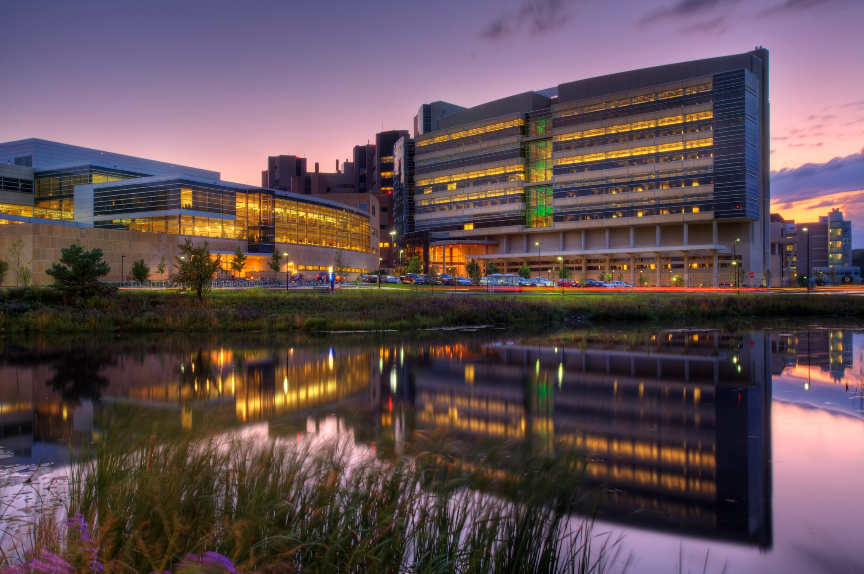
Thank you
Wisconsin Institute for Medical Research
University of Wisconsin - Madison
Contact: leoliuf@gmail.com

