Slide 1
SPM and some of its Maths An Introduction
Joana Leitão
MRes Advanced Brain Imaging, 2013

Slide 2
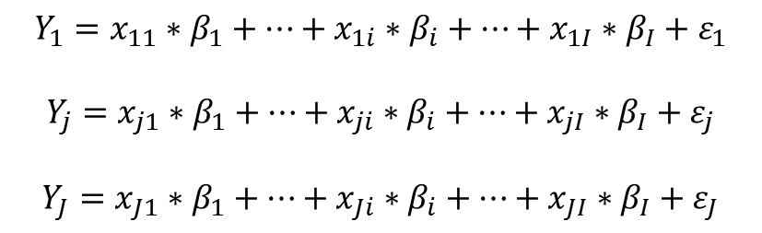
Linear Algebra – What is a matrix?
System of equations are very common in science and mathematics
Matrices are a compact and convenient way of writing down systems of linear equations
They allow for computational implementations
Time-series in one single voxel
$$Y_{1}=x_{11}∗β_{1}+…+x_{1i}∗β_{i}+…+x_{1I}∗β_{I}+ε_{1}$$
$$Y_{j}=x_{j1}∗β_{1}+…+x_{ji}∗β_{i}+…+x_{jI}∗β_{I}+ε_{j}$$
$$Y_{J}=x_{J1}∗β_{1}+…+x_{Ji}∗β_{i}+…+x_{JI}∗β_{I}+ε_{J}$$
…
…
…
…
…
…
…
…
…
…
Y_{j} – intensity in one voxel at time/scan j
x_{ji} – value of regressor i at time/scan j
β_{i} – value of beta parameter for regressor i
ε_{j} – error term associated with the jth scan
time/scan

Slide 3
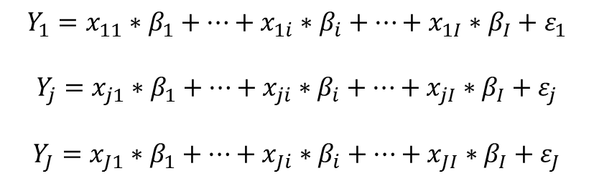
Linear Algebra – What is a matrix?
Time-series in one single voxel
$$Y_{1}=x_{11}∗β_{1}+…+x_{1i}∗β_{i}+…+x_{1I}∗β_{I}+ε_{1}$$
$$Y_{j}=x_{j1}∗β_{1}+…+x_{ji}∗β_{i}+…+x_{jI}∗β_{I}+ε_{j}$$
$$Y_{J}=x_{J1}∗β_{1}+…+x_{Ji}∗β_{i}+…+x_{JI}∗β_{I}+ε_{J}$$
…
…
…
…
…
…
…
…
…
…
Notes:
If J = I -> matrix is squared
Scalar -> vector -> matrix

Slide 4
Linear Algebra – What is a matrix?
Time-series in one single voxel
$$Y_{1}=x_{11}∗β_{1}+…+x_{1i}∗β_{i}+…+x_{1I}∗β_{I}+ε_{1}$$
$$Y_{j}=x_{j1}∗β_{1}+…+x_{ji}∗β_{i}+…+x_{jI}∗β_{I}+ε_{j}$$
$$Y_{J}=x_{J1}∗β_{1}+…+x_{Ji}∗β_{i}+…+x_{JI}∗β_{I}+ε_{J}$$
…
…
…
…
…
…
…
…
…
…
Notes:
If J = I -> matrix is squared
Scalar -> vector -> matrix

Slide 5

Linear Algebra – What is a matrix?
Time-series in one single voxel
$$Y_{1}=x_{11}∗β_{1}+…+x_{1i}∗β_{i}+…+x_{1I}∗β_{I}+ε_{1}$$
$$Y_{j}=x_{j1}∗β_{1}+…+x_{ji}∗β_{i}+…+x_{jI}∗β_{I}+ε_{j}$$
$$Y_{J}=x_{J1}∗β_{1}+…+x_{Ji}∗β_{i}+…+x_{JI}∗β_{I}+ε_{J}$$
…
…
…
…
…
…
…
…
…
…
$$\left[\begin{matrix}Y_{1} \\ \begin{matrix}⋮ \\ Y_{j} \\ ⋮\end{matrix} \\ Y_{J}\end{matrix}\right]$$
=
Notes:
If J = I -> matrix is squared
Scalar -> vector -> matrix

Slide 6
Linear Algebra – What is a matrix?
Time-series in one single voxel
$$Y_{1}=x_{11}∗β_{1}+…+x_{1i}∗β_{i}+…+x_{1I}∗β_{I}+ε_{1}$$
$$Y_{j}=x_{j1}∗β_{1}+…+x_{ji}∗β_{i}+…+x_{jI}∗β_{I}+ε_{j}$$
$$Y_{J}=x_{J1}∗β_{1}+…+x_{Ji}∗β_{i}+…+x_{JI}∗β_{I}+ε_{J}$$
…
…
…
…
…
…
…
…
…
…
$$\left[\begin{matrix}Y_{1} \\ \begin{matrix}⋮ \\ Y_{j} \\ ⋮\end{matrix} \\ Y_{J}\end{matrix}\right]$$
=
vector
(Jx1)
Notes:
If J = I -> matrix is squared
Scalar -> vector -> matrix

Slide 7
Linear Algebra – What is a matrix?
Time-series in one single voxel
$$Y_{1}=x_{11}∗β_{1}+…+x_{1i}∗β_{i}+…+x_{1I}∗β_{I}+ε_{1}$$
$$Y_{j}=x_{j1}∗β_{1}+…+x_{ji}∗β_{i}+…+x_{jI}∗β_{I}+ε_{j}$$
$$Y_{J}=x_{J1}∗β_{1}+…+x_{Ji}∗β_{i}+…+x_{JI}∗β_{I}+ε_{J}$$
…
…
…
…
…
…
…
…
…
…
$$\left[\begin{matrix}Y_{1} \\ \begin{matrix}⋮ \\ Y_{j} \\ ⋮\end{matrix} \\ Y_{J}\end{matrix}\right]$$
=
vector
(Jx1)
Notes:
If J = I -> matrix is squared
Scalar -> vector -> matrix

Slide 8

Linear Algebra – What is a matrix?
Time-series in one single voxel
$$Y_{1}=x_{11}∗β_{1}+…+x_{1i}∗β_{i}+…+x_{1I}∗β_{I}+ε_{1}$$
$$Y_{j}=x_{j1}∗β_{1}+…+x_{ji}∗β_{i}+…+x_{jI}∗β_{I}+ε_{j}$$
$$Y_{J}=x_{J1}∗β_{1}+…+x_{Ji}∗β_{i}+…+x_{JI}∗β_{I}+ε_{J}$$
…
…
…
…
…
…
…
…
…
…
$$\left[\begin{matrix}Y_{1} \\ \begin{matrix}⋮ \\ Y_{j} \\ ⋮\end{matrix} \\ Y_{J}\end{matrix}\right]$$
$$\left[\begin{matrix}ε_{1} \\ \begin{matrix}⋮ \\ ε_{j} \\ ⋮\end{matrix} \\ ε_{J}\end{matrix}\right]$$
=
+
vector
(Jx1)
vector
(Jx1)
Notes:
If J = I -> matrix is squared
Scalar -> vector -> matrix

Slide 9
Linear Algebra – What is a matrix?
Time-series in one single voxel
$$Y_{1}=x_{11}∗β_{1}+…+x_{1i}∗β_{i}+…+x_{1I}∗β_{I}+ε_{1}$$
$$Y_{j}=x_{j1}∗β_{1}+…+x_{ji}∗β_{i}+…+x_{jI}∗β_{I}+ε_{j}$$
$$Y_{J}=x_{J1}∗β_{1}+…+x_{Ji}∗β_{i}+…+x_{JI}∗β_{I}+ε_{J}$$
…
…
…
…
…
…
…
…
…
…
$$\left[\begin{matrix}Y_{1} \\ \begin{matrix}⋮ \\ Y_{j} \\ ⋮\end{matrix} \\ Y_{J}\end{matrix}\right]$$
$$\left[\begin{matrix}ε_{1} \\ \begin{matrix}⋮ \\ ε_{j} \\ ⋮\end{matrix} \\ ε_{J}\end{matrix}\right]$$
=
+
vector
(Jx1)
vector
(Jx1)
Notes:
If J = I -> matrix is squared
Scalar -> vector -> matrix

Slide 10

Linear Algebra – What is a matrix?
Time-series in one single voxel
$$Y_{1}=x_{11}∗β_{1}+…+x_{1i}∗β_{i}+…+x_{1I}∗β_{I}+ε_{1}$$
$$Y_{j}=x_{j1}∗β_{1}+…+x_{ji}∗β_{i}+…+x_{jI}∗β_{I}+ε_{j}$$
$$Y_{J}=x_{J1}∗β_{1}+…+x_{Ji}∗β_{i}+…+x_{JI}∗β_{I}+ε_{J}$$
…
…
…
…
…
…
…
…
…
…
$$\left[\begin{matrix}Y_{1} \\ \begin{matrix}⋮ \\ Y_{j} \\ ⋮\end{matrix} \\ Y_{J}\end{matrix}\right]$$
$$\left[\begin{matrix}β_{1} \\ \begin{matrix}⋮ \\ β_{i} \\ ⋮\end{matrix} \\ β_{I}\end{matrix}\right]$$
$$\left[\begin{matrix}ε_{1} \\ \begin{matrix}⋮ \\ ε_{j} \\ ⋮\end{matrix} \\ ε_{J}\end{matrix}\right]$$
=
+
vector
(Jx1)
vector
(Ix1)
vector
(Jx1)
Notes:
If J = I -> matrix is squared
Scalar -> vector -> matrix

Slide 11
Linear Algebra – What is a matrix?
Time-series in one single voxel
$$Y_{1}=x_{11}∗β_{1}+…+x_{1i}∗β_{i}+…+x_{1I}∗β_{I}+ε_{1}$$
$$Y_{j}=x_{j1}∗β_{1}+…+x_{ji}∗β_{i}+…+x_{jI}∗β_{I}+ε_{j}$$
$$Y_{J}=x_{J1}∗β_{1}+…+x_{Ji}∗β_{i}+…+x_{JI}∗β_{I}+ε_{J}$$
…
…
…
…
…
…
…
…
…
…
$$\left[\begin{matrix}Y_{1} \\ \begin{matrix}⋮ \\ Y_{j} \\ ⋮\end{matrix} \\ Y_{J}\end{matrix}\right]$$
$$\left[\begin{matrix}β_{1} \\ \begin{matrix}⋮ \\ β_{i} \\ ⋮\end{matrix} \\ β_{I}\end{matrix}\right]$$
$$\left[\begin{matrix}ε_{1} \\ \begin{matrix}⋮ \\ ε_{j} \\ ⋮\end{matrix} \\ ε_{J}\end{matrix}\right]$$
=
+
vector
(Jx1)
vector
(Ix1)
vector
(Jx1)
Notes:
If J = I -> matrix is squared
Scalar -> vector -> matrix

Slide 12

Linear Algebra – What is a matrix?
Time-series in one single voxel
$$Y_{1}=x_{11}∗β_{1}+…+x_{1i}∗β_{i}+…+x_{1I}∗β_{I}+ε_{1}$$
$$Y_{j}=x_{j1}∗β_{1}+…+x_{ji}∗β_{i}+…+x_{jI}∗β_{I}+ε_{j}$$
$$Y_{J}=x_{J1}∗β_{1}+…+x_{Ji}∗β_{i}+…+x_{JI}∗β_{I}+ε_{J}$$
…
…
…
…
…
…
…
…
…
…
$$\left[\begin{matrix}Y_{1} \\ \begin{matrix}⋮ \\ Y_{j} \\ ⋮\end{matrix} \\ Y_{J}\end{matrix}\right]$$
$$\left[\begin{matrix}x_{11} & \begin{matrix}… & x_{1i} & …\end{matrix} & x_{1I} \\ \begin{matrix}⋮ \\ x_{j1} \\ ⋮\end{matrix} & \begin{matrix}\begin{matrix}⋱ & ⋮ & ⋱\end{matrix} \\ \begin{matrix}… & x_{ji} & …\end{matrix} \\ \begin{matrix}⋱ & ⋮ & ⋱\end{matrix}\end{matrix} & \begin{matrix}⋮ \\ x_{jI} \\ ⋮\end{matrix} \\ x_{J1} & \begin{matrix}… & x_{Ji} & …\end{matrix} & x_{JI}\end{matrix}\right]$$
$$\left[\begin{matrix}β_{1} \\ \begin{matrix}⋮ \\ β_{i} \\ ⋮\end{matrix} \\ β_{I}\end{matrix}\right]$$
$$\left[\begin{matrix}ε_{1} \\ \begin{matrix}⋮ \\ ε_{j} \\ ⋮\end{matrix} \\ ε_{J}\end{matrix}\right]$$
=
+
vector
(Jx1)
matrix
(JxI)
vector
(Ix1)
vector
(Jx1)
Notes:
If J = I -> matrix is squared
Scalar -> vector -> matrix

Slide 13
Linear Algebra – What is a matrix?
Time-series in one single voxel
$$Y_{1}=x_{11}∗β_{1}+…+x_{1i}∗β_{i}+…+x_{1I}∗β_{I}+ε_{1}$$
$$Y_{j}=x_{j1}∗β_{1}+…+x_{ji}∗β_{i}+…+x_{jI}∗β_{I}+ε_{j}$$
$$Y_{J}=x_{J1}∗β_{1}+…+x_{Ji}∗β_{i}+…+x_{JI}∗β_{I}+ε_{J}$$
…
…
…
…
…
…
…
…
…
…
$$\left[\begin{matrix}Y_{1} \\ \begin{matrix}⋮ \\ Y_{j} \\ ⋮\end{matrix} \\ Y_{J}\end{matrix}\right]$$
$$\left[\begin{matrix}x_{11} & \begin{matrix}… & x_{1i} & …\end{matrix} & x_{1I} \\ \begin{matrix}⋮ \\ x_{j1} \\ ⋮\end{matrix} & \begin{matrix}\begin{matrix}⋱ & ⋮ & ⋱\end{matrix} \\ \begin{matrix}… & x_{ji} & …\end{matrix} \\ \begin{matrix}⋱ & ⋮ & ⋱\end{matrix}\end{matrix} & \begin{matrix}⋮ \\ x_{jI} \\ ⋮\end{matrix} \\ x_{J1} & \begin{matrix}… & x_{Ji} & …\end{matrix} & x_{JI}\end{matrix}\right]$$
$$\left[\begin{matrix}β_{1} \\ \begin{matrix}⋮ \\ β_{i} \\ ⋮\end{matrix} \\ β_{I}\end{matrix}\right]$$
$$\left[\begin{matrix}ε_{1} \\ \begin{matrix}⋮ \\ ε_{j} \\ ⋮\end{matrix} \\ ε_{J}\end{matrix}\right]$$
=
*
+
vector
(Jx1)
matrix
(JxI)
vector
(Ix1)
vector
(Jx1)
Notes:
If J = I -> matrix is squared
Scalar -> vector -> matrix

Slide 14
Linear Algebra – What is a matrix?
Time-series in one single voxel
$$Y_{1}=x_{11}∗β_{1}+…+x_{1i}∗β_{i}+…+x_{1I}∗β_{I}+ε_{1}$$
$$Y_{j}=x_{j1}∗β_{1}+…+x_{ji}∗β_{i}+…+x_{jI}∗β_{I}+ε_{j}$$
$$Y_{J}=x_{J1}∗β_{1}+…+x_{Ji}∗β_{i}+…+x_{JI}∗β_{I}+ε_{J}$$
…
…
…
…
…
…
…
…
…
…
$$\left[\begin{matrix}Y_{1} \\ \begin{matrix}⋮ \\ Y_{j} \\ ⋮\end{matrix} \\ Y_{J}\end{matrix}\right]$$
$$\left[\begin{matrix}x_{11} & \begin{matrix}… & x_{1i} & …\end{matrix} & x_{1I} \\ \begin{matrix}⋮ \\ x_{j1} \\ ⋮\end{matrix} & \begin{matrix}\begin{matrix}⋱ & ⋮ & ⋱\end{matrix} \\ \begin{matrix}… & x_{ji} & …\end{matrix} \\ \begin{matrix}⋱ & ⋮ & ⋱\end{matrix}\end{matrix} & \begin{matrix}⋮ \\ x_{jI} \\ ⋮\end{matrix} \\ x_{J1} & \begin{matrix}… & x_{Ji} & …\end{matrix} & x_{JI}\end{matrix}\right]$$
$$\left[\begin{matrix}β_{1} \\ \begin{matrix}⋮ \\ β_{i} \\ ⋮\end{matrix} \\ β_{I}\end{matrix}\right]$$
$$\left[\begin{matrix}ε_{1} \\ \begin{matrix}⋮ \\ ε_{j} \\ ⋮\end{matrix} \\ ε_{J}\end{matrix}\right]$$
=
*
+
vector
(Jx1)
matrix
(JxI)
vector
(Ix1)
vector
(Jx1)
Notes:
If J = I -> matrix is squared
Scalar -> vector -> matrix

Slide 15
Linear Algebra – What is a matrix?
Time-series in one single voxel
$$Y_{1}=x_{11}∗β_{1}+…+x_{1i}∗β_{i}+…+x_{1I}∗β_{I}+ε_{1}$$
$$Y_{j}=x_{j1}∗β_{1}+…+x_{ji}∗β_{i}+…+x_{jI}∗β_{I}+ε_{j}$$
$$Y_{J}=x_{J1}∗β_{1}+…+x_{Ji}∗β_{i}+…+x_{JI}∗β_{I}+ε_{J}$$
Matrices are usually represented by capital bold letters
Vectors are usually represented by small bold letters
…
…
…
…
…
…
…
…
…
…
$$\left[\begin{matrix}Y_{1} \\ \begin{matrix}⋮ \\ Y_{j} \\ ⋮\end{matrix} \\ Y_{J}\end{matrix}\right]$$
$$\left[\begin{matrix}x_{11} & \begin{matrix}… & x_{1i} & …\end{matrix} & x_{1I} \\ \begin{matrix}⋮ \\ x_{j1} \\ ⋮\end{matrix} & \begin{matrix}\begin{matrix}⋱ & ⋮ & ⋱\end{matrix} \\ \begin{matrix}… & x_{ji} & …\end{matrix} \\ \begin{matrix}⋱ & ⋮ & ⋱\end{matrix}\end{matrix} & \begin{matrix}⋮ \\ x_{jI} \\ ⋮\end{matrix} \\ x_{J1} & \begin{matrix}… & x_{Ji} & …\end{matrix} & x_{JI}\end{matrix}\right]$$
$$\left[\begin{matrix}β_{1} \\ \begin{matrix}⋮ \\ β_{i} \\ ⋮\end{matrix} \\ β_{I}\end{matrix}\right]$$
$$\left[\begin{matrix}ε_{1} \\ \begin{matrix}⋮ \\ ε_{j} \\ ⋮\end{matrix} \\ ε_{J}\end{matrix}\right]$$
=
*
+
vector
(Jx1)
matrix
(JxI)
vector
(Ix1)
vector
(Jx1)
Note: if J = I the matrix is said to be squared
Notes:
If J = I -> matrix is squared
Scalar -> vector -> matrix

Slide 16
Linear Algebra – What is a matrix?
Time-series in one single voxel
$$Y_{1}=x_{11}∗β_{1}+…+x_{1i}∗β_{i}+…+x_{1I}∗β_{I}+ε_{1}$$
$$Y_{j}=x_{j1}∗β_{1}+…+x_{ji}∗β_{i}+…+x_{jI}∗β_{I}+ε_{j}$$
$$Y_{J}=x_{J1}∗β_{1}+…+x_{Ji}∗β_{i}+…+x_{JI}∗β_{I}+ε_{J}$$
Matrices are usually represented by capital bold letters
Vectors are usually represented by small bold letters
…
…
…
…
…
…
…
…
…
…
$$\left[\begin{matrix}Y_{1} \\ \begin{matrix}⋮ \\ Y_{j} \\ ⋮\end{matrix} \\ Y_{J}\end{matrix}\right]$$
$$\left[\begin{matrix}x_{11} & \begin{matrix}… & x_{1i} & …\end{matrix} & x_{1I} \\ \begin{matrix}⋮ \\ x_{j1} \\ ⋮\end{matrix} & \begin{matrix}\begin{matrix}⋱ & ⋮ & ⋱\end{matrix} \\ \begin{matrix}… & x_{ji} & …\end{matrix} \\ \begin{matrix}⋱ & ⋮ & ⋱\end{matrix}\end{matrix} & \begin{matrix}⋮ \\ x_{jI} \\ ⋮\end{matrix} \\ x_{J1} & \begin{matrix}… & x_{Ji} & …\end{matrix} & x_{JI}\end{matrix}\right]$$
$$\left[\begin{matrix}β_{1} \\ \begin{matrix}⋮ \\ β_{i} \\ ⋮\end{matrix} \\ β_{I}\end{matrix}\right]$$
$$\left[\begin{matrix}ε_{1} \\ \begin{matrix}⋮ \\ ε_{j} \\ ⋮\end{matrix} \\ ε_{J}\end{matrix}\right]$$
=
*
+
vector
(Jx1)
matrix
(JxI)
vector
(Ix1)
vector
(Jx1)
Note: if J = I the matrix is said to be squared
Notes:
If J = I -> matrix is squared
Scalar -> vector -> matrix

Slide 17
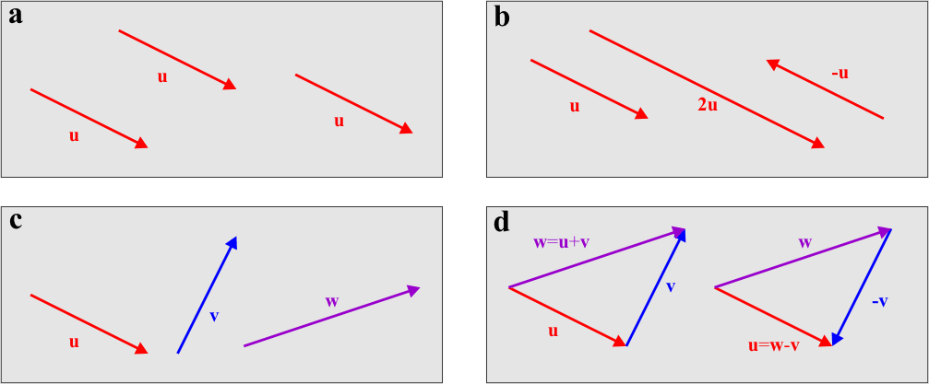
A note on vectors – geometric perspective
Vectors. a: identical vectors at different locations. b: scaled vectors (linearly dependent). c: different vectors (linearly independent). d: vector addition and subtraction

Slide 18
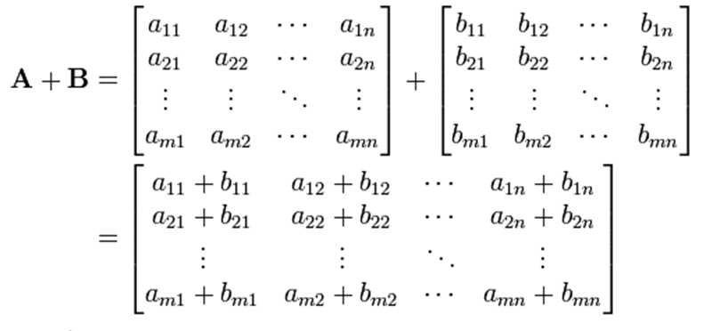
Linear Algebra – Matrix Addition
Note:
1) matrices have to have the same dimensions
2) you just have to add the corresponding entries
Notes:
Number of rows in the vector has to be the same as the number of columns in the matrix

Slide 19
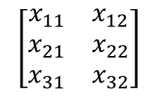

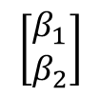
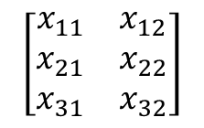

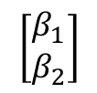



Linear Algebra – Matrix Multiplication
A smaller example
$$Y_{1}=x_{11}∗β_{1}+x_{12}∗β_{2}$$
$$Y_{2}=x_{21}∗β_{1}+x_{22}∗β_{2}$$
$$Y_{3}=x_{31}∗β_{1}+x_{32}∗β_{2}$$
$$\left[\begin{matrix}Y_{1} \\ Y_{2} \\ Y_{3}\end{matrix}\right]$$
$$\left[\begin{matrix}x_{11} & x_{12} \\ x_{21} & x_{22} \\ x_{31} & x_{32}\end{matrix}\right]$$
$$\left[\begin{matrix}β_{1} \\ β_{2}\end{matrix}\right]$$
=
*
Multiplication from (nxm)-matrix with (mx1)-vector = (nx1)-vector
For the i^{th} entry of the resulting vector:
tilt the green vector
multiply overlapping entries of the i^{th} row of the matrix and vector
- e.g. for i = 1:
Add them:
$$\left[\begin{matrix}β_{1} \\ β_{2}\end{matrix}\right]$$
$$x_{11}∗β_{1}; x_{12}∗β_{2}$$
$$\left[\begin{matrix}x_{11} & x_{12} \\ x_{21} & x_{22} \\ x_{31} & x_{32}\end{matrix}\right]$$
$$\left[\begin{matrix}β_{1} \\ β_{2}\end{matrix}\right]$$
$$Y_{11}=x_{11}∗β_{1}+x_{12}∗β_{2}$$
*
Note: number of rows in the vector has to be the same as the number of columns in the matrix
Notes:
Number of rows in the vector has to be the same as the number of columns in the matrix

Slide 20





Linear Algebra – Matrix Multiplication
Multiplication from (mxn)-matrix with (nxk)-matrix = (mxk)-matrix
For the (i,j) entry of the resulting matrix:
tilt the j^{th} column of the second matrix
- e.g. for entry (2,1):
multiply overlapping entries of the i^{th} row of the first matrix and the tilted vector
- e.g. for entry (2,1):
add them:
- e.g. for entry (2,1):
$$\left[\begin{matrix}β_{11} \\ β_{21}\end{matrix}\right]$$
$$\left[\begin{matrix}x_{11} & x_{12} \\ x_{21} & x_{22} \\ x_{31} & x_{32}\end{matrix}\right]$$
$$\left[\begin{matrix}β_{11} \\ β_{21}\end{matrix}\begin{matrix}β_{12} \\ β_{22}\end{matrix}\right]$$
*
$$x_{21}∗β_{11}; x_{22}∗β_{21}$$
$$Y_{21}=x_{21}∗β_{11}+x_{22}∗β_{21}$$
Note: number of rows in the second matrix has to be the same as the number of columns in the matrix
Notes:
Number of rows in the vector has to be the same as the number of columns in the matrix

Slide 21





Linear Algebra – Matrix Multiplication
Properties of Matrix Multiplication
Not commutative (!):
$$\left[\begin{matrix}x_{11} & x_{12} \\ x_{21} & x_{22} \\ x_{31} & x_{32}\end{matrix}\right]$$
$$\left[\begin{matrix}β_{11} \\ β_{21}\end{matrix}\begin{matrix}β_{12} \\ β_{22}\end{matrix}\begin{matrix}β_{13} \\ β_{23}\end{matrix}\right]$$
$$≠$$
$$\left[\begin{matrix}β_{11} \\ β_{21}\end{matrix}\begin{matrix}β_{12} \\ β_{22}\end{matrix}\begin{matrix}β_{13} \\ β_{23}\end{matrix}\right]$$
$$\left[\begin{matrix}x_{11} & x_{12} \\ x_{21} & x_{22} \\ x_{31} & x_{32}\end{matrix}\right]$$
*
*
(3x3) - matrix
(4x4) - matrix
Notes:
Number of rows in the vector has to be the same as the number of columns in the matrix

Slide 22
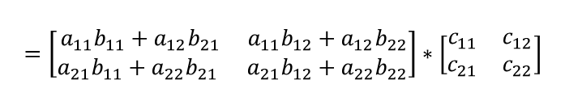


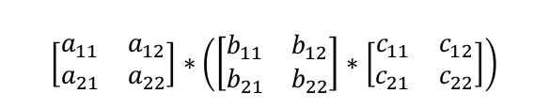
Linear Algebra – Matrix Multiplication
Properties of Matrix Multiplication
Associative: $A∗(B∗C) = (A∗B)∗C$
$$\left[\begin{matrix}a_{11} & a_{12} \\ a_{21} & a_{22}\end{matrix}\right]∗\left(\left[\begin{matrix}b_{11} & b_{12} \\ b_{21} & b_{22}\end{matrix}\right]∗\left[\begin{matrix}c_{11} & c_{12} \\ c_{21} & c_{22}\end{matrix}\right]\right)$$
$$=\left[\begin{matrix}a_{11} & a_{12} \\ a_{21} & a_{22}\end{matrix}\right]∗\left[\begin{matrix}{(b}_{11}c_{11}+b_{12}c_{21}) & \left(b_{11}c_{12}+b_{12}c_{22}\right) \\ \left(b_{21}c_{11}+b_{22}c_{21}\right) & \left(b_{21}c_{12}+b_{22}c_{22}\right)\end{matrix}\right]$$
$$=\left[\begin{matrix}a_{11}b_{11}c_{11}+a_{11}b_{12}c_{21}+a_{12}b_{21}c_{11}+a_{12}b_{22}c_{21} & a_{11}b_{11}c_{12}+a_{11}b_{12}c_{22}+a_{12}b_{21}c_{12}+a_{12}b_{22}c_{22} \\ a_{21}b_{11}c_{11}+a_{21}b_{12}c_{21}+a_{22}b_{21}c_{11}+a_{22}b_{22}c_{21} & a_{21}b_{11}c_{12}+a_{21}b_{12}c_{22}+a_{22}b_{21}c_{12}+a_{22}b_{22}c_{22}\end{matrix}\right]$$
$$=\left[\begin{matrix}a_{11}∗{(b}_{11}c_{11}+b_{12}c_{21})+a_{12}∗\left(b_{21}c_{11}+b_{22}c_{21}\right) & a_{11}∗{(b}_{11}c_{12}+b_{12}c_{22})+a_{12}∗\left(b_{21}c_{12}+b_{22}c_{22}\right) \\ a_{21}∗{(b}_{11}c_{11}+b_{12}c_{21})+a_{22}∗\left(b_{21}c_{11}+b_{22}c_{21}\right) & a_{21}∗{(b}_{11}c_{12}+b_{12}c_{22})+a_{22}∗\left(b_{21}c_{12}+b_{22}c_{22}\right)\end{matrix}\right]$$
$$=\left[\begin{matrix}{(a_{11}b}_{11}+{a_{12}b}_{21})∗c_{11}+{(a_{11}b}_{12}+{a_{12}b}_{22})∗c_{21} & {(a_{21}b}_{11}+{a_{22}b}_{21})∗c_{12}+{(a_{21}b}_{12}+{a_{22}b}_{22})∗c_{22} \\ {(a_{21}b}_{11}+{a_{22}b}_{21})∗c_{11}+{(a_{21}b}_{12}+{a_{22}b}_{22})∗c_{21} & {(a_{21}b}_{11}+{a_{22}b}_{21})∗c_{12}+{(a_{21}b}_{12}+{a_{22}b}_{22})∗c_{22}\end{matrix}\right]$$
$$=\left[\begin{matrix}{a_{11}b}_{11}+{a_{12}b}_{21} & {a_{11}b}_{12}+{a_{12}b}_{22} \\ {a_{21}b}_{11}+{a_{22}b}_{21} & {a_{21}b}_{12}+{a_{22}b}_{22}\end{matrix}\right]∗\left[\begin{matrix}c_{11} & c_{12} \\ c_{21} & c_{22}\end{matrix}\right]$$
$$=\left(\left[\begin{matrix}a_{11} & a_{12} \\ a_{21} & a_{22}\end{matrix}\right]∗\left[\begin{matrix}b_{11} & b_{12} \\ b_{21} & b_{22}\end{matrix}\right]\right)∗\left[\begin{matrix}c_{11} & c_{12} \\ c_{21} & c_{22}\end{matrix}\right]=\left(A∗B\right)∗C$$

Slide 23
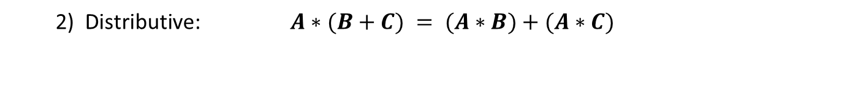

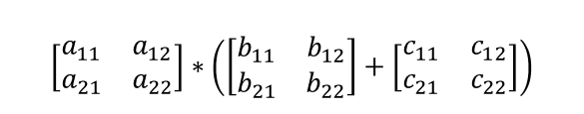
Linear Algebra – Matrix Multiplication
Properties of Matrix Multiplication
2) Distributive: $A∗(B+C) = (A∗B)+(A∗C)$
$$\left[\begin{matrix}a_{11} & a_{12} \\ a_{21} & a_{22}\end{matrix}\right]∗\left(\left[\begin{matrix}b_{11} & b_{12} \\ b_{21} & b_{22}\end{matrix}\right]+\left[\begin{matrix}c_{11} & c_{12} \\ c_{21} & c_{22}\end{matrix}\right]\right)$$
$$=\left[\begin{matrix}a_{11} & a_{12} \\ a_{21} & a_{22}\end{matrix}\right]∗\left[\begin{matrix}b_{11}+c_{11} & b_{12}+c_{12} \\ b_{21}+c_{21} & b_{22}+c_{22}\end{matrix}\right]$$
$$=\left[\begin{matrix}{a_{11}∗(b}_{11}+c_{11})+{a_{12}∗(b}_{21}+c_{21}) & {a_{11}∗(b}_{12}+c_{12})+{a_{12}∗(b}_{22}+c_{22}) \\ {a_{21}∗(b}_{11}+c_{11})+{a_{22}∗(b}_{21}+c_{21}) & {a_{21}∗(b}_{12}+c_{12})+{a_{22}∗(b}_{22}+c_{22})\end{matrix}\right]$$
$$=\left[\begin{matrix}{a_{11}b}_{11}+{a_{12}b}_{21}+{a_{11}c}_{11} +{a_{12}c}_{21} & {a_{11}b}_{12}+{a_{12}b}_{22}+{a_{11}c}_{12} +{a_{12}c}_{22} \\ {a_{21}b}_{11}+{a_{22}b}_{21}+{a_{21}c}_{11} +{a_{22}c}_{21} & {a_{21}b}_{12}+{a_{22}b}_{22}+{a_{21}c}_{12} +{a_{22}c}_{22}\end{matrix}\right]$$
$$=\left[\begin{matrix}{a_{11}b}_{11}+{a_{12}b}_{21} & {a_{11}b}_{12}+{a_{12}b}_{22} \\ {a_{21}b}_{11}+{a_{22}b}_{21} & {a_{21}b}_{12}+{a_{22}b}_{22}\end{matrix}\right]∗\left[\begin{matrix}{a_{11}c}_{11}+{a_{12}c}_{21} & {a_{11}c}_{12}+{a_{12}c}_{22} \\ {a_{21}c}_{11}+{a_{22}c}_{21} & {a_{21}c}_{12}+{a_{22}c}_{22}\end{matrix}\right]$$
$$=\left(\left[\begin{matrix}a_{11} & a_{12} \\ a_{21} & a_{22}\end{matrix}\right]∗\left[\begin{matrix}b_{11} & b_{12} \\ b_{21} & b_{22}\end{matrix}\right]\right)+\left(\left[\begin{matrix}a_{11} & a_{12} \\ a_{21} & a_{22}\end{matrix}\right]∗\left[\begin{matrix}c_{11} & c_{12} \\ c_{21} & c_{22}\end{matrix}\right]\right)=\left(A∗B\right)+(A∗C)$$
Notes:
Number of rows in the vector has to be the same as the number of columns in the matrix

Slide 24
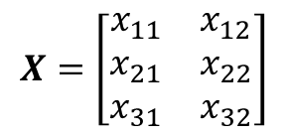
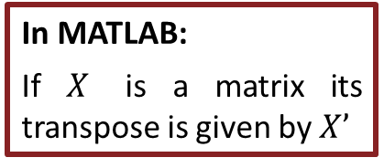



Linear Algebra – Transpose
For some matrix $X$ defined by:
$$X=\left[\begin{matrix}x_{11} & x_{12} \\ x_{21} & x_{22} \\ x_{31} & x_{32}\end{matrix}\right]$$
$$X^{T}=\left[\begin{matrix}x_{11} & x_{21} & x_{31} \\ x_{12} & x_{22} & x_{32}\end{matrix}\right]$$
its transpose $XT$ is given by:
Basically you just switch rows with columns.
In MATLAB:
If $X$ is a matrix its transpose is given by $X’$
Notes:
Number of rows in the vector has to be the same as the number of columns in the matrix

Slide 25

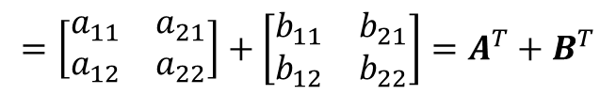
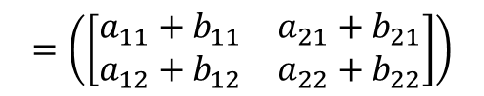
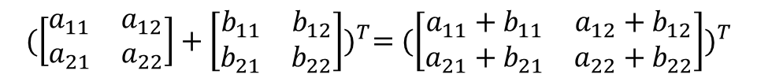
Linear Algebra – Transpose
Some properties:
$(AT)T = A$
$(A+B)T = AT+B^{T}$
$${(\left[\begin{matrix}a_{11} & a_{12} \\ a_{21} & a_{22}\end{matrix}\right]+\left[\begin{matrix}b_{11} & b_{12} \\ b_{21} & b_{22}\end{matrix}\right])}^{T}={(\left[\begin{matrix}a_{11}+b_{11} & a_{12}+b_{12} \\ a_{21}+b_{21} & a_{22}+b_{22}\end{matrix}\right])}^{T}$$
$$=\left(\left[\begin{matrix}a_{11}+b_{11} & a_{21}+b_{21} \\ a_{12}+b_{12} & a_{22}+b_{22}\end{matrix}\right]\right)$$
$$=\left[\begin{matrix}a_{11} & a_{21} \\ a_{12} & a_{22}\end{matrix}\right]+\left[\begin{matrix}b_{11} & b_{21} \\ b_{12} & b_{22}\end{matrix}\right]=A^{T}+B^{T}$$
Notes:
Number of rows in the vector has to be the same as the number of columns in the matrix

Slide 26
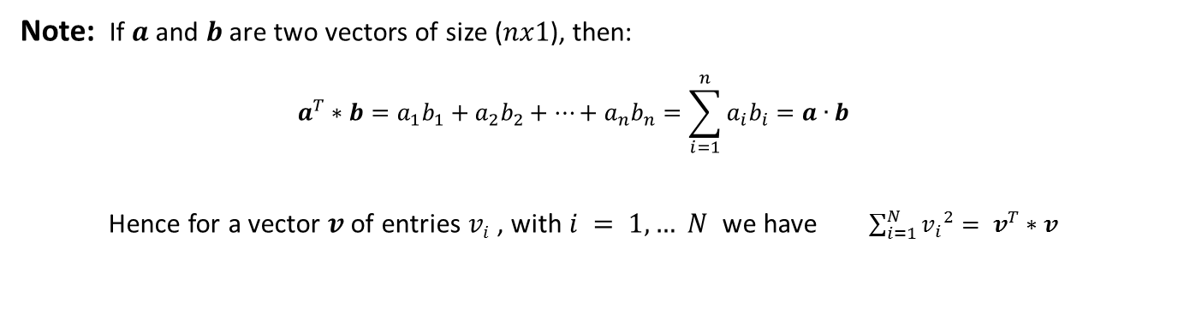


Linear Algebra – Transpose
Some properties:
3) $\left(A∗B\right)T = BT∗AT$
$${(\left[\begin{matrix}a_{11} & a_{12} \\ a_{21} & a_{22}\end{matrix}\right]∗\left[\begin{matrix}b_{11} & b_{12} \\ b_{21} & b_{22}\end{matrix}\right])}^{T}={(\left[\begin{matrix}a_{11}b_{11}+a_{12}b_{21} & a_{11}b_{12}+a_{12}b_{22} \\ a_{21}b_{11}+a_{22}b_{21} & a_{21}b_{12}+a_{22}b_{22}\end{matrix}\right])}^{T}$$
$$=\left(\left[\begin{matrix}{b_{11}a}_{11}+{b_{21}a}_{12} & b_{11}a_{21}+{b_{21}a}_{22} \\ b_{12}a_{11}+b_{22}a_{12} & {b_{12}a}_{21}+b_{22}a_{22}\end{matrix}\right]\right)$$
$$=\left[\begin{matrix}b_{11} & b_{21} \\ b_{12} & b_{22}\end{matrix}\right]∗\left[\begin{matrix}a_{11} & a_{21} \\ a_{12} & a_{22}\end{matrix}\right]=BT∗AT$$
Note: If $a$ and $b$ are two vectors of size ($nx1$), then:
$$a^{T}∗b=a_{1}b_{1}+a_{2}b_{2}+…+a_{n}b_{n}=\sum_{i=1}^{n}{a_{i}b_{i}=a∙b}$$
Hence for a vector $v$of entries $vi$ , with $i = 1, … N$ we have $\sum_{i=1}^{N}{{v_{i}}^{2}= v^{T}∗v}$
(inner product)

Slide 27
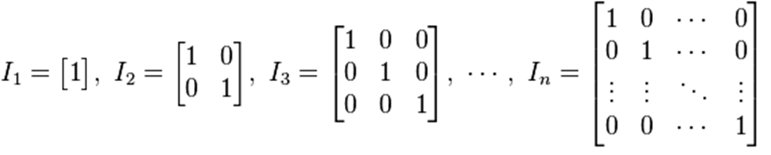
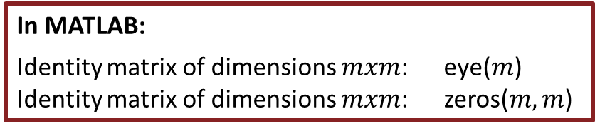
Linear Algebra – Identity and Zero Matrices
Identity matrix:
Note:
1) The identity matrix is always squared
2) The identity matrix is diagonal, i.e. its only non-zero entries are in the main diagonal
Zero matrix is a (square) matrix which entries all equal zero.
In MATLAB:
Identity matrix of dimensions $mxm$: eye($m$)
Identity matrix of dimensions $mxm$: zeros($m,m$)

Slide 28
Linear (In)dependence
A collection of vectors is a linearly independent if none of them can be written as a linear combination of finitely many other vectors in the collection.
A collection of vectors which is not linearly independent is called linearly dependent.

Slide 29

Linear (In)dependence
A collection of vectors is a linearly independent if none of them can be written as a linear combination of finitely many other vectors in the collection.
A collection of vectors which is not linearly independent is called linearly dependent.
Linearly Dependence:
The ($Ix1$)-vector $y$ is said to be a linearly dependent to the ($Ix1$)-vectors $x_{1},…,x_{N}$ if there exist non-zero constants $c_{i}$ such that
$$y=\sum_{i=1}^{N}{c_{i}x_{i}}$$

Slide 30
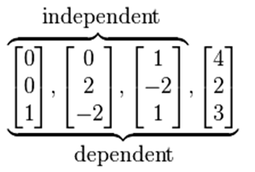
Linear (In)dependence
A collection of vectors is a linearly independent if none of them can be written as a linear combination of finitely many other vectors in the collection.
A collection of vectors which is not linearly independent is called linearly dependent.
Example:
Linearly Dependence:
The ($Ix1$)-vector $y$ is said to be a linearly dependent to the ($Ix1$)-vectors $x_{1},…,x_{N}$ if there exist non-zero constants $c_{i}$ such that
$$y=\sum_{i=1}^{N}{c_{i}x_{i}}$$

Slide 31
Linear (In)dependence
A collection of vectors is a linearly independent if none of them can be written as a linear combination of finitely many other vectors in the collection.
A collection of vectors which is not linearly independent is called linearly dependent.
Example:
Linearly Dependence:
The ($Ix1$)-vector $y$ is said to be a linearly dependent to the ($Ix1$)-vectors $x_{1},…,x_{N}$ if there exist non-zero constants $c_{i}$ such that
$$y=\sum_{i=1}^{N}{c_{i}x_{i}}$$
A square matrix is called non-singular if its columns form a linear independent set. Otherwise it is called singular.

Slide 32
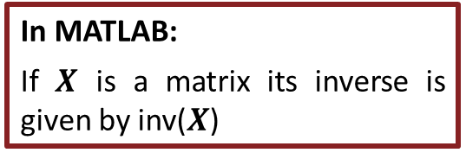
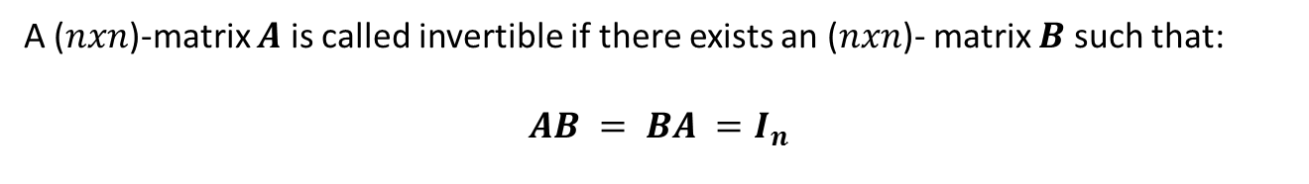
Linear Algebra – Inverse Matrix
A ($nxn$)-matrix $A$ is called invertible if there exists an ($nxn$)- matrix $B$ such that:
$$AB = BA =I_{n}$$
There are several methods to obtain the inverse of a squared matrix, as for example the Gauss-Jordan method.
Note that not all matrices are invertible. If a matrix has linearly dependent rows or columns it is not invertible.
In MATLAB:
If $X$ is a matrix its inverse is given by inv($X$)

Slide 33
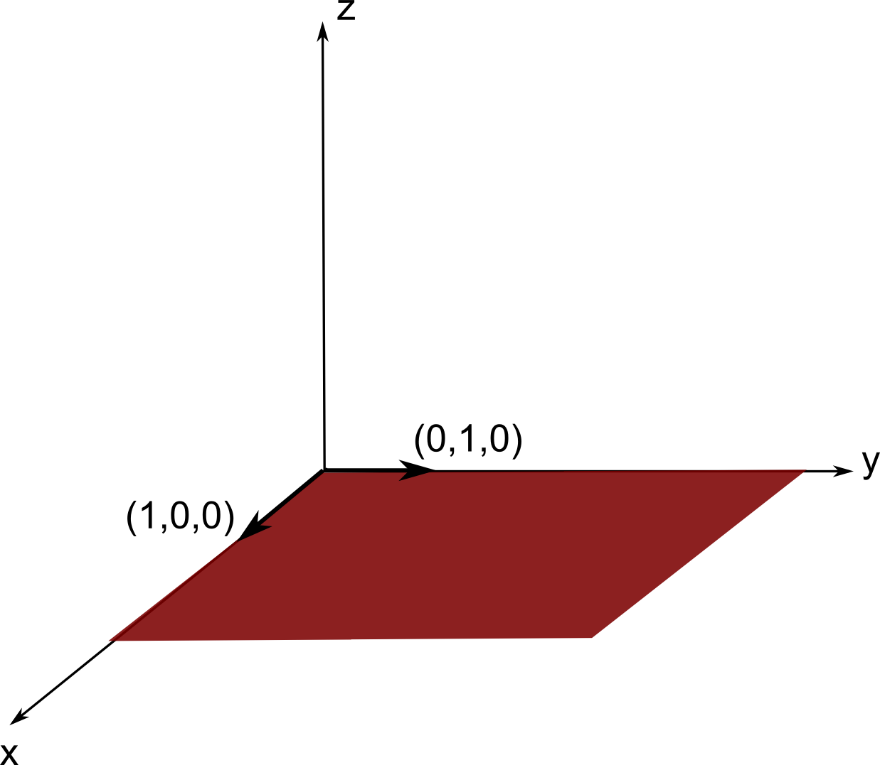
Linear Algebra – Span of a space
If you have a collection of linearly independent vectors, geometrically this means that they are not co-linear. Hence they span a certain space which consists of all possible linear combinations that you can have with these vectors.
Consider for example the two linear independent vectors in 3D space (1,0,0) and (0,1,0). These vectors span a 2D space (actually the xy-plane) in a 3D space.
Indeed, all points in the xy-plane can be written as a linear combination of these two vectors

Slide 34
CHANGE OF TOPIC!
Good time for a break!
=)
Notes:
Number of rows in the vector has to be the same as the number of columns in the matrix

Slide 35
GLM
X
y
+
=
Model is specified by
Design matrix X
Assumptions about e
N: number of scans
p: number of regressors
The design matrix embodies all available knowledge about experimentally controlled factors and potential confounds.
Notes:
One of the problems with this model - hrf

Slide 36
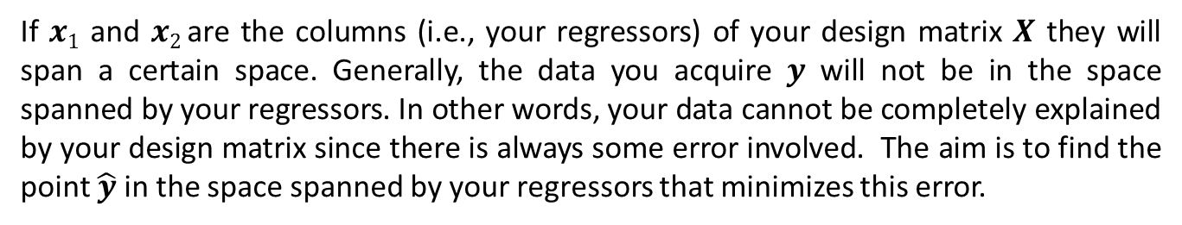
Projection matrix & Ordinary Least Squares
y
Back to our initial example:
e
x₂
x₁
If $x1$ and $x2$ are the columns (i.e., your regressors) of your design matrix $X$ they will span a certain space. Generally, the data you acquire $y$ will not be in the space spanned by your regressors. In other words, your data cannot be completely explained by your design matrix since there is always some error involved. The aim is to find the point $\hat{y}$in the space spanned by your regressors that minimizes this error.

Slide 37
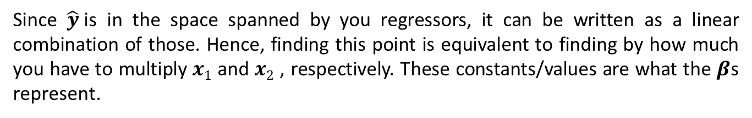
Projection matrix & Ordinary Least Squares
y
Back to our initial example:
e
x₂
x₁
If $x1$ and $x2$ are the columns (i.e., your regressors) of your design matrix $X$ they will span a certain space. Generally, the data you acquire $y$ will not be in the space spanned by your regressors. In other words, your data cannot be completely explained by your design matrix since there is always some error involved. The aim is to find the point $\hat{y}$in the space spanned by your regressors that minimizes this error.
Since $\hat{y}$is in the space spanned by you regressors, it can be written as a linear combination of those. Hence, finding this point is equivalent to finding by how much you have to multiply $x1$ and $x2$ , respectively. These constants/values are what the $β$s represent.

Slide 38
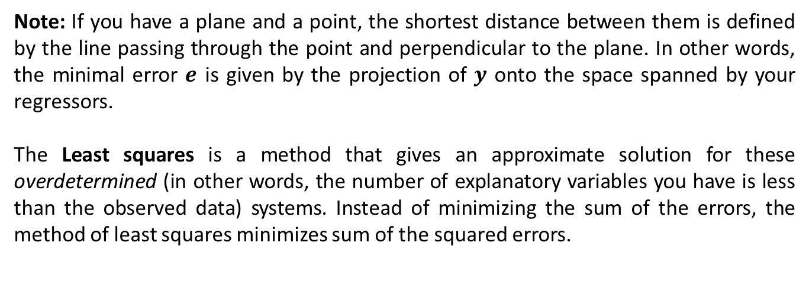
Projection matrix & Ordinary Least Squares
y
Back to our initial example:
e
x₂
x₁
Note: If you have a plane and a point, the shortest distance between them is defined by the line passing through the point and perpendicular to the plane. In other words, the minimal error $e$ is given by the projection of $y$ onto the space spanned by your regressors.
The Least squares is a method that gives an approximate solution for these overdetermined (in other words, the number of explanatory variables you have is less than the observed data) systems. Instead of minimizing the sum of the errors, the method of least squares minimizes sum of the squared errors.

Slide 39

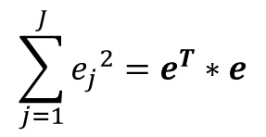
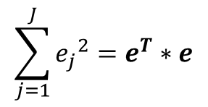


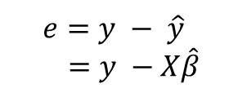


Ordinary Least Squares Derived
y
So the aim is to minimize:
$$e=y − \hat{y}$$
$$=y −X\hat{β}$$
e
$$\sum_{j=1}^{J}{{e_{j}}^{2}}=e^{T}∗e$$
x₂
x₁
This is the inner product of $e$ by itself and is hence a scalar:
$$\sum_{j=1}^{J}{{e_{j}}^{2}}=e^{T}∗e$$
$$={\left(y −X\hat{β}\right)}^{T}∗\left(y −X\hat{β}\right)$$
$$=\left(y^{T}−{\hat{β}}^{T}X^{T}\right)∗\left(y −X\hat{β}\right)$$
$$=y^{T}y−y^{T}X\hat{β}−{\hat{β}}^{T}X^{T}y+{\hat{β}}^{T}X^{T}X\hat{β}$$
Both multiplications involve the same vectors/matrices, so the same numbers/entries are involved. Since they are scalar, they are actually the same so we can just add them together
$$=y^{T}y−2{\hat{β}}^{T}X^{T}y+{\hat{β}}^{T}X^{T}X\hat{β}$$
Just try with a small example to see that’s true.
In the last equation we know everything except for the $β$, which is what we want to find out. Hence $e$ is a scalar that depends on all the betas . In other words it is a function of the betas.
Notes:
Important – columns have to be linearly independent otherwise the contrast is not estimatable

Slide 40
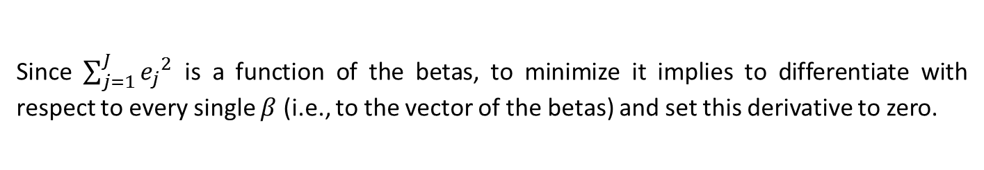

Ordinary Least Squares Derived
Since $\sum_{j=1}^{J}{{e_{j}}^{2}}$ is a function of the betas, to minimize it implies to differentiate with respect to every single $β$ (i.e., to the vector of the betas) and set this derivative to zero.
Differentiate with respect to a vector means you differentiate with respect to each component of the vector:
$$\frac{∂S}{∂β}=\left[\begin{matrix}\frac{∂S}{∂β_{1}} \\ ⋮ \\ \frac{∂S}{∂β_{I}}\end{matrix}\right]$$
Notes:
Important – columns have to be linearly independent otherwise the contrast is not estimatable

Slide 41
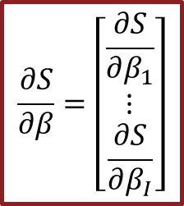
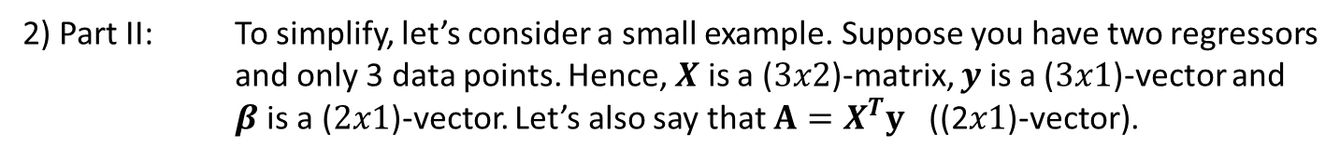


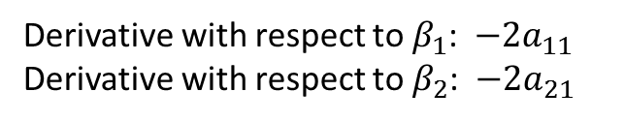

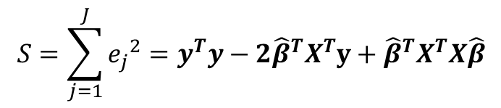

Ordinary Least Squares Derived
Let’s differentiate it by parts:
$$\frac{∂S}{∂β}=\left[\begin{matrix}\frac{∂S}{∂β_{1}} \\ ⋮ \\ \frac{∂S}{∂β_{I}}\end{matrix}\right]$$
$$S=\sum_{j=1}^{J}{{e_{j}}^{2}}=y^{T}y−2{\hat{β}}^{T}X^{T}y+{\hat{β}}^{T}X^{T}X\hat{β}$$
Part I
Part II
Part III
1) Part I: $y^{T}y$ does not depend on any $β$ so its derivative is zero.
2) Part II: To simplify, let’s consider a small example. Suppose you have two regressors and only 3 data points. Hence, $X$ is a ($3x2$)-matrix, $y$ is a ($3x1$)-vector and $β$is a ($2x1$)-vector. Let’s also say that $A=X^{T}y$ ((2$x1$)-vector).
$$−2{\hat{β}}^{T}X^{T}y=−2{\hat{β}}^{T}A=−2∗\left[\begin{matrix}β_{1} & β_{2}\end{matrix}\right]∗\left[\begin{matrix}a_{11} \\ a_{21}\end{matrix}\right]$$
$$=−2∗(a_{11}β_{1}+a_{21}β_{2})$$
Derivative with respect to $β_{1}$: $−2a_{11}$
Derivative with respect to $β_{2}$: $−2a_{21}$
Derivative $=−2∗\left[\begin{matrix}a_{11} \\ a_{21}\end{matrix}\right]$
$$=−2A=−2X^{T}y$$
Notes:
Important – columns have to be linearly independent otherwise the contrast is not estimatable

Slide 42

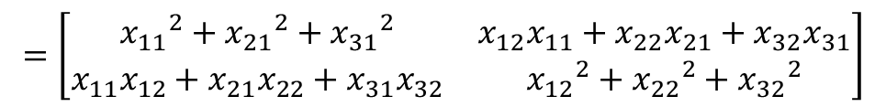
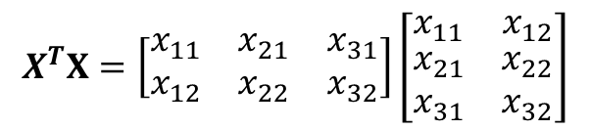
Ordinary Least Squares Derived
Let’s differentiate it by parts:
$$\frac{∂S}{∂β}=\left[\begin{matrix}\frac{∂S}{∂β_{1}} \\ ⋮ \\ \frac{∂S}{∂β_{I}}\end{matrix}\right]$$
$$S=\sum_{j=1}^{J}{{e_{j}}^{2}}=y^{T}y−2{\hat{β}}^{T}X^{T}y+{\hat{β}}^{T}X^{T}X\hat{β}$$
Part I
Part II
Part III
3) Part III: Let’s use the same small example but now with $A=X^{T}X$ (($2$x2)-matrix).
Note that this matrix $A$ is symmetrical, i.e. $a_{21}=a_{12}$. Indeed:
$$X^{T}X=\left[\begin{matrix}\begin{matrix}x_{11} & x_{21} & x_{31}\end{matrix} \\ \begin{matrix}x_{12} & x_{22} & x_{32}\end{matrix}\end{matrix}\right]\left[\begin{matrix}x_{11} & x_{12} \\ \begin{matrix}x_{21} \\ x_{31}\end{matrix} & \begin{matrix}x_{22} \\ x_{32}\end{matrix}\end{matrix}\right]$$
$$=\left[\begin{matrix}{x_{11}}^{2}+{x_{21}}^{2}+{x_{31}}^{2} & x_{12}x_{11}+x_{22}x_{21}+x_{32}x_{31} \\ x_{11}x_{12}+x_{21}x_{22}+x_{31}x_{32} & {x_{12}}^{2}+{x_{22}}^{2}+{x_{32}}^{2}\end{matrix}\right]$$
$$=\left[\begin{matrix}a_{11} & a_{12} \\ a_{21} & a_{22}\end{matrix}\right]$$
Notes:
Important – columns have to be linearly independent otherwise the contrast is not estimatable

Slide 43
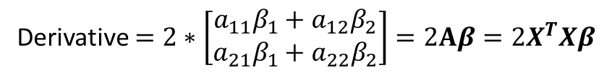





Ordinary Least Squares Derived
Let’s differentiate it by parts:
$$\frac{∂S}{∂β}=\left[\begin{matrix}\frac{∂S}{∂β_{1}} \\ ⋮ \\ \frac{∂S}{∂β_{I}}\end{matrix}\right]$$
$$S=\sum_{j=1}^{J}{{e_{j}}^{2}}=y^{T}y−2{\hat{β}}^{T}X^{T}y+{\hat{β}}^{T}X^{T}X\hat{β}$$
Part I
Part II
Part III
$${\hat{β}}^{T}X^{T}X\hat{β}={\hat{β}}^{T}A\hat{β}=\left[\begin{matrix}β_{1} & β_{2}\end{matrix}\right]∗\left[\begin{matrix}a_{11} & a_{12} \\ a_{21} & a_{22}\end{matrix}\right]∗\left[\begin{matrix}β_{1} \\ β_{2}\end{matrix}\right]$$
3) Part III:
$$=\left[\begin{matrix}β_{1} & β_{2}\end{matrix}\right]∗\left[\begin{matrix}{a_{11}β}_{1}+a_{12}β_{2} \\ {a_{21}β}_{1}+a_{22}β_{2}\end{matrix}\right]$$
$$=β_{1}∗\left({a_{11}β}_{1}+a_{12}β_{2}\right)+β_{2}∗\left({a_{21}β}_{1}+a_{22}β_{2}\right)$$
$$={a_{11}β_{1}}^{2}+2a_{21}β_{1}β_{2}+{a_{22}β_{2}}^{2}$$
$A$ is symmetrical
Derivative with respect to $β_{1}$: ${2a}_{11}β_{1}+{2a}_{21}β_{2}={2a}_{11}β_{1}+2a_{12}β_{2}$
Derivative with respect to $β_{2}$: ${2a}_{22}β_{2}+{2a}_{21}β_{1}={2a}_{21}β_{1}+{2a}_{22}β_{2}$
Derivative $=2∗\left[\begin{matrix}a_{11}β_{1}+a_{12}β_{2} \\ a_{21}β_{1}+a_{22}β_{2}\end{matrix}\right]=2Aβ=2X^{T}Xβ$
Notes:
Important – columns have to be linearly independent otherwise the contrast is not estimatable

Slide 44




Ordinary Least Squares Derived
Let’s differentiate it by parts:
$$\frac{∂S}{∂β}=\left[\begin{matrix}\frac{∂S}{∂β_{1}} \\ ⋮ \\ \frac{∂S}{∂β_{I}}\end{matrix}\right]$$
$$S=\sum_{j=1}^{J}{{e_{j}}^{2}}=y^{T}y−2{\hat{β}}^{T}X^{T}y+{\hat{β}}^{T}X^{T}X\hat{β}$$
Part I
Part II
Part III
The total Derivative is thus:
$$2X^{T}X−2X^{T}y$$
To find the minimum we have to set the derivative to zero:
$$2X^{T}Xβ−2X^{T}y=0$$
$$2X^{T}Xβ=2X^{T}y$$
$$\hat{β}={{(X^{T}X)}^{−1}X}^{T}y$$
Note: taking the inverse is only possible if there are no two linearly dependent columns in the matrix. Hence, you have to take care not to put for instance the same regressor twice.
Notes:
Important – columns have to be linearly independent otherwise the contrast is not estimatable

Slide 45
CHANGE OF TOPIC!
Good time for a break!
=)
Notes:
Number of rows in the vector has to be the same as the number of columns in the matrix

Slide 46

Convolution and Linear Time Invariant Systems
Suppose you have a system.
input
output
System
The system is like a black box to you. You don’t know anything about it except that when you put something in, something comes out.

Slide 47
Convolution and Linear Time Invariant Systems
Suppose you want to understand this system.
For that purpose you put in the simplest signal you can imagine…

Slide 48

Convolution and Linear Time Invariant Systems
Suppose you want to understand this system.
For that purpose you put in the simplest signal you can imagine…
Input
1
0
time

Slide 49
Convolution and Linear Time Invariant Systems
Suppose you want to understand this system.
For that purpose you put in the simplest signal you can imagine…
… and wait to see how the system reacts to it.
Input
1
0
time

Slide 50

Convolution and Linear Time Invariant Systems
Suppose you want to understand this system.
For that purpose you put in the simplest signal you can imagine…
… and wait to see how the system reacts to it.
Input
1
Output
1
0.5
0
time
0
1
time

Slide 51
Convolution and Linear Time Invariant Systems
Suppose you want to understand this system.
For that purpose you put in the simplest signal you can imagine…
… and wait to see how the system reacts to it.
Input
1
Output
1
0.5
0
time
0
1
time
You do this many times and realize that the system always reacts to this simple signal in the same way.
The simple input as displayed here is called impulse. How the system reacts to it, whatever its form (the output displayed here was just an example), is called impulse response function.

Slide 52

Convolution and Linear Time Invariant Systems
A note about the impulse function and signals in general:
Here we think about signals as discretized sequences of values. This means you only have discrete time points ($n=…,−1,0, 1, 2, 3…$) in which your signal assumes some value (e.g., the output signal of the previous slide assumes 1 at $n=0$ and 0.5 at $n=1$).
A reason for considering just discrete sequences is that computers actually also only deal with discrete sequences and not with continuous functions.

Slide 53

Convolution and Linear Time Invariant Systems
A note about the impulse function and signals in general:
Here we think about signals as discretized sequences of values. This means you only have discrete time points ($n=…,−1,0, 1, 2, 3…$) in which your signal assumes some value (e.g., the output signal of the previous slide assumes 1 at $n=0$ and 0.5 at $n=1$).
A reason for considering just discrete sequences is that computers actually also only deal with discrete sequences and not with continuous functions.
The impulse function is defined as assuming the value one at time point zero and the value zero at all the other time points:
$$δ\left[n\right]=\left\{\begin{matrix}0, if n≠0 \\ 1, if n=0\end{matrix}\right.$$

Slide 54



Convolution and Linear Time Invariant Systems
A note about the impulse function and signals in general:
Here we think about signals as discretized sequences of values. This means you only have discrete time points ($n=…,−1,0, 1, 2, 3…$) in which your signal assumes some value (e.g., the output signal of the previous slide assumes 1 at $n=0$ and 0.5 at $n=1$).
A reason for considering just discrete sequences is that computers actually also only deal with discrete sequences and not with continuous functions.
The impulse function is defined as assuming the value one at time point zero and the value zero at all the other time points:
$$δ\left[n\right]=\left\{\begin{matrix}0, if n≠0 \\ 1, if n=0\end{matrix}\right.$$
You can shift it by $p$ units to the left…
$$x\left[n\right]=δ\left[n+p\right]=\left\{\begin{matrix}0, if n≠0 \\ 1, if n=−p\end{matrix}\right.$$
$$x\left[−p\right]=δ\left[−p+p\right]=δ\left[0\right]=1$$

Slide 55


Convolution and Linear Time Invariant Systems
A note about the impulse function and signals in general:
Here we think about signals as discretized sequences of values. This means you only have discrete time points ($n=…,−1,0, 1, 2, 3…$) in which your signal assumes some value (e.g., the output signal of the previous slide assumes 1 at $n=0$ and 0.5 at $n=1$).
A reason for considering just discrete sequences is that computers actually also only deal with discrete sequences and not with continuous functions.
The impulse function is defined as assuming the value one at time point zero and the value zero at all the other time points:
$$δ\left[n\right]=\left\{\begin{matrix}0, if n≠0 \\ 1, if n=0\end{matrix}\right.$$
You can shift it by $p$ units to the left…
… and to the right:
$$x\left[n\right]=δ\left[n+p\right]=\left\{\begin{matrix}0, if n≠0 \\ 1, if n=−p\end{matrix}\right.$$
$$x\left[n\right]=δ\left[n−p\right]=\left\{\begin{matrix}0, if n≠0 \\ 1, if n=p\end{matrix}\right.$$
$$x\left[−p\right]=δ\left[−p+p\right]=δ\left[0\right]=1$$
$$x\left[p\right]=δ\left[p−p\right]=δ\left[0\right]=1$$

Slide 56

Convolution and Linear Time Invariant Systems
A note about the impulse function and signals in general:
Actually, the good thing about the impulse function is that any random sequence can be written as a linear combination of shifted and scaled versions of the impulse function.
Imagine a complete random sequence $x[n]$:

Slide 57

Convolution and Linear Time Invariant Systems
A note about the impulse function and signals in general:
Actually, the good thing about the impulse function is that any random sequence can be written as a linear combination of shifted and scaled versions of the impulse function.
Imagine a complete random sequence $x[n]$:
5
3
2
1
0.5
0
-2
-1
0
1
2
3
4

Slide 58
Convolution and Linear Time Invariant Systems
A note about the impulse function and signals in general:
Actually, the good thing about the impulse function is that any random sequence can be written as a linear combination of shifted and scaled versions of the impulse function.
Imagine a complete random sequence $x[n]$:
5
3
2
1
0.5
0
-2
-1
0
1
2
3
4
You can write it as:
$$x\left[n\right]=1∗δ\left[n+2\right]+5∗δ\left[n+1\right]+0∗δ\left[n\right]+3∗δ\left[n−1\right]+0.5∗δ\left[n−2\right]+2∗δ\left[n−3\right]$$

Slide 59
Convolution and Linear Time Invariant Systems
A note about the impulse function and signals in general:
Actually, the good thing about the impulse function is that any random sequence can be written as a linear combination of shifted and scaled versions of the impulse function.
Imagine a complete random sequence $x[n]$:
5
So if we know how the system reacts to the impulse, to shifted and scaled versions of it and to additions of those, we might be able to know how the system reacts to all possible sequence you may put in!!
3
2
1
0.5
0
-2
-1
0
1
2
3
4
You can write it as:
$$x\left[n\right]=1∗δ\left[n+2\right]+5∗δ\left[n+1\right]+0∗δ\left[n\right]+3∗δ\left[n−1\right]+0.5∗δ\left[n−2\right]+2∗δ\left[n−3\right]$$

Slide 60

Convolution and Linear Time Invariant Systems
In our example we already know how the signal reacts to the impulse function. Let’s see how it reacts to a shifted (in this case delayed) version of it.
You proceed as before, you put in a shifted version and see how the system reacts. You repeat this several times and see that:

Slide 61

Convolution and Linear Time Invariant Systems
In our example we already know how the signal reacts to the impulse function. Let’s see how it reacts to a shifted (in this case delayed) version of it.
You proceed as before, you put in a shifted version and see how the system reacts. You repeat this several times and see that:
Delay in input
1
0
1
time

Slide 62

Convolution and Linear Time Invariant Systems
In our example we already know how the signal reacts to the impulse function. Let’s see how it reacts to a shifted (in this case delayed) version of it.
You proceed as before, you put in a shifted version and see how the system reacts. You repeat this several times and see that:
Delay in input
1
Delay in output
1
0.5
0
1
time
0
1
2
time

Slide 63
Convolution and Linear Time Invariant Systems
In our example we already know how the signal reacts to the impulse function. Let’s see how it reacts to a shifted (in this case delayed) version of it.
You proceed as before, you put in a shifted version and see how the system reacts. You repeat this several times and see that:
Delay in input
1
Delay in output
1
0.5
0
1
time
0
1
2
time
You delayed the input by one and the output was also delayed by one. You do this for different shifts and see that the system always shifts the output by the same amount of the input shift. The system is said to be time-invariant: a shift in the input causes a corresponding shift in the output.

Slide 64
Convolution and Linear Time Invariant Systems
Let’s see how it reacts to a scaled version of it.
You put in a scaled version and see how the system reacts. You repeat this several times and with different scalings and see that:

Slide 65

Convolution and Linear Time Invariant Systems
Let’s see how it reacts to a scaled version of it.
You put in a scaled version and see how the system reacts. You repeat this several times and with different scalings and see that:
Scaled input
2
0
time

Slide 66

Convolution and Linear Time Invariant Systems
Let’s see how it reacts to a scaled version of it.
You put in a scaled version and see how the system reacts. You repeat this several times and with different scalings and see that:
Scaled output
Scaled input
2
2
1
0
time
0
1
time

Slide 67
Convolution and Linear Time Invariant Systems
Let’s see how it reacts to a scaled version of it.
You put in a scaled version and see how the system reacts. You repeat this several times and with different scalings and see that:
Scaled output
Scaled input
2
2
1
0
time
0
1
time
The system satisfies the scaling property:
If x₁[n] has output y₁[n], then x[n] = a*x₁[n] has output y[n] = a*y₁[n]

Slide 68

Convolution and Linear Time Invariant Systems
Now, let’s see how it reacts to a sum. To keep it simple, let’s consider the sum of the impulse and a shifted version of itself, for instance:

Slide 69

Convolution and Linear Time Invariant Systems
Now, let’s see how it reacts to a sum. To keep it simple, let’s consider the sum of the impulse and a shifted version of itself, for instance:
And you see the output is:
1.5
1
0.5
0
1
2
time

Slide 70
Convolution and Linear Time Invariant Systems
Now, let’s see how it reacts to a sum. To keep it simple, let’s consider the sum of the impulse and a shifted version of itself, for instance:
And you see the output is:
1.5
1
0.5
0
1
2
time
To understand better how this output came into place, let’s consider the separate contributions of each individual “stick” at any time point.

Slide 71

Convolution and Linear Time Invariant Systems
Input:
Contribution
1st impulse
Contribution
2nd impulse

Slide 72


Convolution and Linear Time Invariant Systems
Input:
time 0
Contribution
1st impulse
1
0
1
2
time
Contribution
2nd impulse
0
1
2
time

Slide 73


Convolution and Linear Time Invariant Systems
Input:
time 0
time 1
Contribution
1st impulse
1
0.5
0
1
2
time
0
1
2
time
1
Contribution
2nd impulse
0
1
2
time
0
1
2
time

Slide 74


Convolution and Linear Time Invariant Systems
Input:
time 0
time 1
time 2
Contribution
1st impulse
1
0.5
0
1
2
time
0
1
2
time
0
1
2
time
1
Contribution
2nd impulse
0.5
0
1
2
time
0
1
2
time
0
1
2
time

Slide 75
Convolution and Linear Time Invariant Systems
Input:
time 0
time 1
time 2
Contribution
1st impulse
1
0.5
+
0
1
2
time
0
1
2
time
0
1
2
time
add entry by entry
1
Contribution
2nd impulse
0.5
0
1
2
time
0
1
2
time
0
1
2
time

Slide 76
Convolution and Linear Time Invariant Systems
Input:
time 0
time 1
time 2
Contribution
1st impulse
1
0.5
+
0
1
2
time
0
1
2
time
0
1
2
time
add entry by entry
1
Contribution
2nd impulse
0.5
0
1
2
time
0
1
2
time
0
1
2
time
1.5
1
0.5
0
1
2
time

Slide 77
Convolution and Linear Time Invariant Systems
Input:
time 0
time 1
time 2
Contribution
1st impulse
1
0.5
+
0
1
2
time
0
1
2
time
0
1
2
time
add entry by entry
1
Contribution
2nd impulse
0.5
0
1
2
time
0
1
2
time
0
1
2
time
1.5
1.5
1
1
0.5
0.5
0
1
2
time
0
1
2
time

Slide 78
Convolution and Linear Time Invariant Systems
Input:
time 0
time 1
time 2
Contribution
1st impulse
1
0.5
+
0
1
2
time
0
1
2
time
0
1
2
time
add entry by entry
1
Contribution
2nd impulse
0.5
0
1
2
time
0
1
2
time
0
1
2
time
Output:
1.5
1.5
1.5
1
1
1
0.5
0.5
0.5
0
1
2
time
0
1
2
time
0
1
2
time

Slide 79

Convolution and Linear Time Invariant Systems
The output is actually just the sum of the contributions of the individual sticks at each time point.
Hence, the system satisfies the additivity property:
If $x1[n]$ has output $y1[n]$ and $x2[n]$ has output $y2[n]$,
then $x[n] = (x1[n]+x2[n])$has output $y[n] = (y1[n] + y2[n])$

Slide 80
Convolution and Linear Time Invariant Systems
The output is actually just the sum of the contributions of the individual sticks at each time point.
Hence, the system satisfies the additivity property:
If $x1[n]$ has output $y1[n]$ and $x2[n]$ has output $y2[n]$,
then $x[n] = (x1[n]+x2[n])$has output $y[n] = (y1[n] + y2[n])$
When a system satisfies the additivity and the scaling properties, it is said to be linear.
Linear and time-invariant systems are just systems that satisfy these two properties simultaneously. These two properties together allow for the system to be characterized by its impulse response function. If you know the impulse response function of a system you can calculate the output to any input by convolving your input with the impulse response function. The convolution is just another, more (computationally) practical, way of looking at the sum we saw in the previous slide.

Slide 81

Convolution and Linear Time Invariant Systems
Indeed, looking at the individual responses and then adding them is equivalent to convolution.
The convolution can be visually thought of as follows.
1
1
Input
0
1
2
time
Flipped Impulse
Response Function
Output

Slide 82

Convolution and Linear Time Invariant Systems
Indeed, looking at the individual responses and then adding them is equivalent to convolution.
The convolution can be visually thought of as follows.
1
1
Input
0
1
2
time
1
Flipped Impulse
Response Function
0.5
0
1
2
time
Output

Slide 83
Convolution and Linear Time Invariant Systems
Indeed, looking at the individual responses and then adding them is equivalent to convolution.
The convolution can be visually thought of as follows.
1
1
Input
0
1
2
time
+
multiply overlapping entries and add the results
1
Flipped Impulse
Response Function
0.5
0
1
2
time
Output

Slide 84

Convolution and Linear Time Invariant Systems
Indeed, looking at the individual responses and then adding them is equivalent to convolution.
The convolution can be visually thought of as follows.
1
1
At time point zero only the first impulse contributes to the output
Input
0
1
2
time
+
multiply overlapping entries and add the results
1
Flipped Impulse
Response Function
0.5
0
1
2
time
=
Output
1
0
1
2
time

Slide 85

Convolution and Linear Time Invariant Systems
Indeed, looking at the individual responses and then adding them is equivalent to convolution.
The convolution can be visually thought of as follows.
1
1
At time point zero only the first impulse contributes to the output
At time point one the first impulse contributes with 0.5 while the second impulse has just started to kick in and contributes with 1 to the output
Input
0
1
2
time
+
multiply overlapping entries and add the results
1
Flipped Impulse
Response Function
0.5
0
1
2
time
=
Output
1
0
1
2
time

Slide 86

Convolution and Linear Time Invariant Systems
Indeed, looking at the individual responses and then adding them is equivalent to convolution.
The convolution can be visually thought of as follows.
1
1
At time point zero only the first impulse contributes to the output
At time point one the first impulse contributes with 0.5 while the second impulse has just started to kick in and contributes with 1 to the output
Input
0
1
2
time
+
multiply overlapping entries and add the results
1
Flipped Impulse
Response Function
0.5
0
1
2
time
=
Output
1.5
1
0
1
2
time

Slide 87

Convolution and Linear Time Invariant Systems
Indeed, looking at the individual responses and then adding them is equivalent to convolution.
The convolution can be visually thought of as follows.
1
1
At time point zero only the first impulse contributes to the output
At time point two the first impulse is already quiet while the second impulse contributes with 0.5 to the output
At time point one the first impulse contributes with 0.5 while the second impulse has just started to kick in and contributes with 1 to the output
Input
0
1
2
time
+
multiply overlapping entries and add the results
1
Flipped Impulse
Response Function
0.5
0
1
2
time
=
Output
1.5
1
0
1
2
time

Slide 88

Convolution and Linear Time Invariant Systems
Indeed, looking at the individual responses and then adding them is equivalent to convolution.
The convolution can be visually thought of as follows.
1
1
At time point zero only the first impulse contributes to the output
At time point two the first impulse is already quiet while the second impulse contributes with 0.5 to the output
At time point one the first impulse contributes with 0.5 while the second impulse has just started to kick in and contributes with 1 to the output
Input
0
1
2
time
+
multiply overlapping entries and add the results
1
Flipped Impulse
Response Function
0.5
0
1
2
time
=
Output
1.5
1
0.5
0
1
2
time

Slide 89

Convolution and Linear Time Invariant Systems
Indeed, looking at the individual responses and then adding them is equivalent to convolution.
The convolution can be visually thought of as follows.
1
1
At time point zero only the first impulse contributes to the output
At time point two the first impulse is already quiet while the second impulse contributes with 0.5 to the output
At time point one the first impulse contributes with 0.5 while the second impulse has just started to kick in and contributes with 1 to the output
After that all is quiet.
Input
0
1
2
time
+
multiply overlapping entries and add the results
1
Flipped Impulse
Response Function
0.5
0
1
2
time
=
Output
1.5
1
0.5
0
1
2
time

Slide 90

Convolution and Linear Time Invariant Systems
Indeed, looking at the individual responses and then adding them is equivalent to convolution.
The convolution can be visually thought of as follows.
1
1
At time point zero only the first impulse contributes to the output
At time point two the first impulse is already quiet while the second impulse contributes with 0.5 to the output
At time point one the first impulse contributes with 0.5 while the second impulse has just started to kick in and contributes with 1 to the output
After that all is quiet.
Input
0
1
2
time
+
multiply overlapping entries and add the results
CONVOLUTION
1
Flipped Impulse
Response Function
0.5
0
1
2
time
=
Output
1.5
1
0.5
0
1
2
time

Slide 91
Convolution and Linear Time Invariant Systems
Indeed, looking at the individual responses and then adding them is equivalent to convolution.
The convolution can be visually thought of as follows.
1
1
At time point zero only the first impulse contributes to the output
At time point two the first impulse is already quiet while the second impulse contributes with 0.5 to the output
At time point one the first impulse contributes with 0.5 while the second impulse has just started to kick in and contributes with 1 to the output
After that all is quiet.
Input
0
1
2
time
+
multiply overlapping entries and add the results
CONVOLUTION
1
Flipped Impulse
Response Function
0.5
0
1
2
time
=
Output
1.5
1
A LTI is completely characterized by its
impulse response function!
0.5
0
1
2
time

Slide 92

LTIs & SPM?
SPM assumes the brain behaves like a linear time-invariant system.
input
output
System
LTI
The impulse corresponds to an event (e.g. brief flash of light). If the events don’t come too close in time, this assumption has proven to work rather well.

Slide 93
LTIs & SPM?
SPM assumes the brain behaves like a linear time-invariant system.
input
output
System
LTI
The impulse corresponds to an event (e.g. brief flash of light). If the events don’t come too close in time, this assumption has proven to work rather well.
What is the impulse response function of the brain?

Slide 94

LTIs & SPM?
SPM assumes the brain behaves like a linear time-invariant system.
input
output
System
LTI
The impulse corresponds to an event (e.g. brief flash of light). If the events don’t come too close in time, this assumption has proven to work rather well.
What is the impulse response function of the brain?
Haemodynamic Response Function
The canonical HRF is a “typical” BOLD impulse response function and is characterised by (the subtraction of) two gamma functions.
Peak
Undershoot
Stimulus Onset

Slide 95

LTIs & SPM?
So, in order to know how the brain reacts to a certain sequence of events, you have to convolve your regressors with the HRF

Slide 96

LTIs & SPM?
Limits of the HRF
- General shape of the BOLD impulse response similar across early sensory regions, such as V1 and S1
Variability across higher cortical regions, presumably due mainly to variations in the vasculature of different regions
Considerable variability across people
- HRF
- Temporal derivative
- Dispersion derivative
These types of variability can be accommodated by expanding the HRF in terms of temporal basis functions.
- Temporal derivative: captures differences in latency of
peak response
- Dispersion derivative: captures differences in duration
of peak response

Slide 97
CHANGE OF TOPIC!
Good time for a break!
=)
Notes:
Number of rows in the vector has to be the same as the number of columns in the matrix

Slide 98

Specifying Design Matrices
Different types of ANOVAs:
As the ANOVA is a generalization of the two-sample t-test for more than two groups, the repeated measures ANOVA is the generalization of the paired t-test for more than two groups.
Here the design matrices for the ANOVAs will not be presented, but they can be obtained from those of the two-sample and paired t-tests by extending the number of groups.

Slide 99



Specifying Design Matrices
One sample t-test:
Does the group (we have just one group in this case) have any significant activation?
Suppose $Y_{1j}$ is a group of random variables and assume that $Y_{1j}{}_{}^{\begin{aligned}iid \\ \sim \end{aligned}}{\text{N}} \left(μ_{1},σ^{2}\right)$.
For each member j of the group, you can write:
$Y_{1j}=μ_{1 }+ ε_{1j}$ where $ε_{1j}{}_{}^{\begin{aligned}iid \\ \sim \end{aligned}}{\text{N}} \left(0,σ^{2}\right)$
Design matrix for 8 participants:
$$y= \left[\begin{matrix}1 \\ \begin{matrix}1 \\ 1 \\ \begin{matrix}1 \\ 1 \\ \begin{matrix}1 \\ 1\end{matrix}\end{matrix}\end{matrix} \\ 1\end{matrix}\right]∗β_{1}+ε⇔\left\{\begin{matrix}Y_{11}=β_{1 }+ ε_{11} \\ \begin{matrix}Y_{12}=β_{1 }+ ε_{12} \\ \begin{matrix}Y_{13}=β_{1 }+ ε_{13} \\ \begin{matrix}Y_{14}=β_{1 }+ ε_{14} \\ Y_{15}=β_{1 }+ ε_{15}\end{matrix} \\ Y_{16}=β_{1 }+ ε_{16}\end{matrix} \\ Y_{17}=β_{1 }+ ε_{17}\end{matrix} \\ Y_{18}=β_{1 }+ ε_{18}\end{matrix} ⟹\right.$$
}
$$X$$

Slide 100

Specifying Design Matrices
One sample t-test:
Does the group (we have just one group in this case) have any significant activation?
Suppose $Y_{1j}$ is a group of random variables and assume that $Y_{1j}{}_{}^{\begin{aligned}iid \\ \sim \end{aligned}}{\text{N}} \left(μ_{1},σ^{2}\right)$.
For each member j of the group, you can write:
$Y_{1j}=μ_{1 }+ ε_{1j}$ where $ε_{1j}{}_{}^{\begin{aligned}iid \\ \sim \end{aligned}}{\text{N}} \left(0,σ^{2}\right)$
Design matrix for 8 participants:
$$y= \left[\begin{matrix}1 \\ \begin{matrix}1 \\ 1 \\ \begin{matrix}1 \\ 1 \\ \begin{matrix}1 \\ 1\end{matrix}\end{matrix}\end{matrix} \\ 1\end{matrix}\right]∗β_{1}+ε⇔\left\{\begin{matrix}Y_{11}=β_{1 }+ ε_{11} \\ \begin{matrix}Y_{12}=β_{1 }+ ε_{12} \\ \begin{matrix}Y_{13}=β_{1 }+ ε_{13} \\ \begin{matrix}Y_{14}=β_{1 }+ ε_{14} \\ Y_{15}=β_{1 }+ ε_{15}\end{matrix} \\ Y_{16}=β_{1 }+ ε_{16}\end{matrix} \\ Y_{17}=β_{1 }+ ε_{17}\end{matrix} \\ Y_{18}=β_{1 }+ ε_{18}\end{matrix} ⟹\right.$$
$Y_{1j}=μ_{1 }+ ε_{1j}$
}
$$X$$

Slide 101

Specifying Design Matrices
One sample t-test:
Does the group (we have just one group in this case) have any significant activation?
Suppose $Y_{1j}$ is a group of random variables and assume that $Y_{1j}{}_{}^{\begin{aligned}iid \\ \sim \end{aligned}}{\text{N}} \left(μ_{1},σ^{2}\right)$.
For each member j of the group, you can write:
$Y_{1j}=μ_{1 }+ ε_{1j}$ where $ε_{1j}{}_{}^{\begin{aligned}iid \\ \sim \end{aligned}}{\text{N}} \left(0,σ^{2}\right)$
Design matrix for 8 participants:
$$y= \left[\begin{matrix}1 \\ \begin{matrix}1 \\ 1 \\ \begin{matrix}1 \\ 1 \\ \begin{matrix}1 \\ 1\end{matrix}\end{matrix}\end{matrix} \\ 1\end{matrix}\right]∗β_{1}+ε⇔\left\{\begin{matrix}Y_{11}=β_{1 }+ ε_{11} \\ \begin{matrix}Y_{12}=β_{1 }+ ε_{12} \\ \begin{matrix}Y_{13}=β_{1 }+ ε_{13} \\ \begin{matrix}Y_{14}=β_{1 }+ ε_{14} \\ Y_{15}=β_{1 }+ ε_{15}\end{matrix} \\ Y_{16}=β_{1 }+ ε_{16}\end{matrix} \\ Y_{17}=β_{1 }+ ε_{17}\end{matrix} \\ Y_{18}=β_{1 }+ ε_{18}\end{matrix} ⟹\right.$$
$Y_{1j}=μ_{1 }+ ε_{1j}$
$$β_{1}=μ_{1}$$
}
$$X$$

Slide 102

Specifying Design Matrices
Two sample t-test:
You have two groups. Do these two groups have significant difference in brain activation?
Suppose $Y_{1j}$ and $Y_{2j}$ are two independent groups of random variables and assume that $Y_{qj}{}_{}^{\begin{aligned}iid \\ \sim \end{aligned}}{\text{N}} \left(μ_{q},σ^{2}\right),$for $q=1,2.$ The null hypothesis is$\text{H}\text{ : }μ_{1 }=μ_{2 }$.
For all members of group 1, you can write:
$Y_{1j}=μ_{1 }+ ε_{1j}$ where $ε_{1j}{}_{}^{\begin{aligned}iid \\ \sim \end{aligned}}{\text{N}} \left(0,σ^{2}\right)$
And for members of group 2, you can write:
$Y_{2j}=μ_{2 }+ ε_{2j}$ where $ε_{2j}{}_{}^{\begin{aligned}iid \\ \sim \end{aligned}}{\text{N}} \left(0,σ^{2}\right)$

Slide 103

Specifying Design Matrices
Two sample t-test:
Assume you have two groups of 6 participants each. You can have three possible models.
Model I:
$$y= \left[\begin{matrix}1 \\ \begin{matrix}1 \\ \begin{matrix}1 \\ \begin{matrix}1 \\ \begin{matrix}1 \\ \begin{matrix}1 \\ 0\end{matrix} \\ 0\end{matrix} \\ 0\end{matrix} \\ 0\end{matrix} \\ 0\end{matrix} \\ 0\end{matrix}\begin{matrix} 0 \\ \begin{matrix} 0 \\ \begin{matrix} 0 \\ \begin{matrix} 0 \\ \begin{matrix} 0 \\ \begin{matrix} 0 \\ 1\end{matrix} \\ 1\end{matrix} \\ 1\end{matrix} \\ 1\end{matrix} \\ 1\end{matrix} \\ 1\end{matrix}\right]∗\left[\begin{matrix}β_{1} \\ β_{2}\end{matrix}\right]+ε⇔ \left\{\begin{matrix}\begin{matrix}Y_{11}=1∗β_{1}+0∗β_{2}+ε_{11} \\ Y_{12}=1∗β_{1}+0∗β_{2}+ε_{12}\end{matrix} \\ \begin{matrix}Y_{13}=1∗β_{1}+0∗β_{2}+ε_{13} \\ \begin{matrix}Y_{14}=1∗β_{1}+0∗β_{2}+ε_{14} \\ \begin{matrix}Y_{15}=1∗β_{1}+0∗β_{2}+ε_{15} \\ \begin{matrix}Y_{16}=1∗β_{1}+0∗β_{2}+ε_{16} \\ Y_{21}=0∗β_{1}+1∗β_{2}+ε_{21} \\ Y_{22}=0∗β_{1}+1∗β_{2}+ε_{22}\end{matrix} \\ Y_{23}=0∗β_{1}+1∗β_{2}+ε_{23}\end{matrix} \\ Y_{24}=0∗β_{1}+1∗β_{2}+ε_{24}\end{matrix} \\ Y_{25}=0∗β_{1}+1∗β_{2}+ε_{25}\end{matrix} \\ Y_{26}=0∗β_{1}+1∗β_{2}+ε_{26}\end{matrix} \right. ⟹$$

Slide 104

Specifying Design Matrices
Two sample t-test:
Assume you have two groups of 6 participants each. You can have three possible models.
Model I:
$$y= \left[\begin{matrix}1 \\ \begin{matrix}1 \\ \begin{matrix}1 \\ \begin{matrix}1 \\ \begin{matrix}1 \\ \begin{matrix}1 \\ 0\end{matrix} \\ 0\end{matrix} \\ 0\end{matrix} \\ 0\end{matrix} \\ 0\end{matrix} \\ 0\end{matrix}\begin{matrix} 0 \\ \begin{matrix} 0 \\ \begin{matrix} 0 \\ \begin{matrix} 0 \\ \begin{matrix} 0 \\ \begin{matrix} 0 \\ 1\end{matrix} \\ 1\end{matrix} \\ 1\end{matrix} \\ 1\end{matrix} \\ 1\end{matrix} \\ 1\end{matrix}\right]∗\left[\begin{matrix}β_{1} \\ β_{2}\end{matrix}\right]+ε⇔ \left\{\begin{matrix}\begin{matrix}Y_{11}=1∗β_{1}+0∗β_{2}+ε_{11} \\ Y_{12}=1∗β_{1}+0∗β_{2}+ε_{12}\end{matrix} \\ \begin{matrix}Y_{13}=1∗β_{1}+0∗β_{2}+ε_{13} \\ \begin{matrix}Y_{14}=1∗β_{1}+0∗β_{2}+ε_{14} \\ \begin{matrix}Y_{15}=1∗β_{1}+0∗β_{2}+ε_{15} \\ \begin{matrix}Y_{16}=1∗β_{1}+0∗β_{2}+ε_{16} \\ Y_{21}=0∗β_{1}+1∗β_{2}+ε_{21} \\ Y_{22}=0∗β_{1}+1∗β_{2}+ε_{22}\end{matrix} \\ Y_{23}=0∗β_{1}+1∗β_{2}+ε_{23}\end{matrix} \\ Y_{24}=0∗β_{1}+1∗β_{2}+ε_{24}\end{matrix} \\ Y_{25}=0∗β_{1}+1∗β_{2}+ε_{25}\end{matrix} \\ Y_{26}=0∗β_{1}+1∗β_{2}+ε_{26}\end{matrix} \right. ⟹$$
$Y_{1j}=μ_{1 }+ ε_{1j}$

Slide 105

Specifying Design Matrices
Two sample t-test:
Assume you have two groups of 6 participants each. You can have three possible models.
Model I:
$$y= \left[\begin{matrix}1 \\ \begin{matrix}1 \\ \begin{matrix}1 \\ \begin{matrix}1 \\ \begin{matrix}1 \\ \begin{matrix}1 \\ 0\end{matrix} \\ 0\end{matrix} \\ 0\end{matrix} \\ 0\end{matrix} \\ 0\end{matrix} \\ 0\end{matrix}\begin{matrix} 0 \\ \begin{matrix} 0 \\ \begin{matrix} 0 \\ \begin{matrix} 0 \\ \begin{matrix} 0 \\ \begin{matrix} 0 \\ 1\end{matrix} \\ 1\end{matrix} \\ 1\end{matrix} \\ 1\end{matrix} \\ 1\end{matrix} \\ 1\end{matrix}\right]∗\left[\begin{matrix}β_{1} \\ β_{2}\end{matrix}\right]+ε⇔ \left\{\begin{matrix}\begin{matrix}Y_{11}=1∗β_{1}+0∗β_{2}+ε_{11} \\ Y_{12}=1∗β_{1}+0∗β_{2}+ε_{12}\end{matrix} \\ \begin{matrix}Y_{13}=1∗β_{1}+0∗β_{2}+ε_{13} \\ \begin{matrix}Y_{14}=1∗β_{1}+0∗β_{2}+ε_{14} \\ \begin{matrix}Y_{15}=1∗β_{1}+0∗β_{2}+ε_{15} \\ \begin{matrix}Y_{16}=1∗β_{1}+0∗β_{2}+ε_{16} \\ Y_{21}=0∗β_{1}+1∗β_{2}+ε_{21} \\ Y_{22}=0∗β_{1}+1∗β_{2}+ε_{22}\end{matrix} \\ Y_{23}=0∗β_{1}+1∗β_{2}+ε_{23}\end{matrix} \\ Y_{24}=0∗β_{1}+1∗β_{2}+ε_{24}\end{matrix} \\ Y_{25}=0∗β_{1}+1∗β_{2}+ε_{25}\end{matrix} \\ Y_{26}=0∗β_{1}+1∗β_{2}+ε_{26}\end{matrix} \right. ⟹$$
$Y_{1j}=μ_{1 }+ ε_{1j}$
$$β_{1}=μ_{1}$$

Slide 106

Specifying Design Matrices
Two sample t-test:
Assume you have two groups of 6 participants each. You can have three possible models.
Model I:
$$y= \left[\begin{matrix}1 \\ \begin{matrix}1 \\ \begin{matrix}1 \\ \begin{matrix}1 \\ \begin{matrix}1 \\ \begin{matrix}1 \\ 0\end{matrix} \\ 0\end{matrix} \\ 0\end{matrix} \\ 0\end{matrix} \\ 0\end{matrix} \\ 0\end{matrix}\begin{matrix} 0 \\ \begin{matrix} 0 \\ \begin{matrix} 0 \\ \begin{matrix} 0 \\ \begin{matrix} 0 \\ \begin{matrix} 0 \\ 1\end{matrix} \\ 1\end{matrix} \\ 1\end{matrix} \\ 1\end{matrix} \\ 1\end{matrix} \\ 1\end{matrix}\right]∗\left[\begin{matrix}β_{1} \\ β_{2}\end{matrix}\right]+ε⇔ \left\{\begin{matrix}\begin{matrix}Y_{11}=1∗β_{1}+0∗β_{2}+ε_{11} \\ Y_{12}=1∗β_{1}+0∗β_{2}+ε_{12}\end{matrix} \\ \begin{matrix}Y_{13}=1∗β_{1}+0∗β_{2}+ε_{13} \\ \begin{matrix}Y_{14}=1∗β_{1}+0∗β_{2}+ε_{14} \\ \begin{matrix}Y_{15}=1∗β_{1}+0∗β_{2}+ε_{15} \\ \begin{matrix}Y_{16}=1∗β_{1}+0∗β_{2}+ε_{16} \\ Y_{21}=0∗β_{1}+1∗β_{2}+ε_{21} \\ Y_{22}=0∗β_{1}+1∗β_{2}+ε_{22}\end{matrix} \\ Y_{23}=0∗β_{1}+1∗β_{2}+ε_{23}\end{matrix} \\ Y_{24}=0∗β_{1}+1∗β_{2}+ε_{24}\end{matrix} \\ Y_{25}=0∗β_{1}+1∗β_{2}+ε_{25}\end{matrix} \\ Y_{26}=0∗β_{1}+1∗β_{2}+ε_{26}\end{matrix} \right. ⟹$$
$Y_{1j}=μ_{1 }+ ε_{1j}$
$$β_{1}=μ_{1}$$
$Y_{2j}=μ_{2 }+ ε_{2j}$

Slide 107

Specifying Design Matrices
Two sample t-test:
Assume you have two groups of 6 participants each. You can have three possible models.
Model I:
$$y= \left[\begin{matrix}1 \\ \begin{matrix}1 \\ \begin{matrix}1 \\ \begin{matrix}1 \\ \begin{matrix}1 \\ \begin{matrix}1 \\ 0\end{matrix} \\ 0\end{matrix} \\ 0\end{matrix} \\ 0\end{matrix} \\ 0\end{matrix} \\ 0\end{matrix}\begin{matrix} 0 \\ \begin{matrix} 0 \\ \begin{matrix} 0 \\ \begin{matrix} 0 \\ \begin{matrix} 0 \\ \begin{matrix} 0 \\ 1\end{matrix} \\ 1\end{matrix} \\ 1\end{matrix} \\ 1\end{matrix} \\ 1\end{matrix} \\ 1\end{matrix}\right]∗\left[\begin{matrix}β_{1} \\ β_{2}\end{matrix}\right]+ε⇔ \left\{\begin{matrix}\begin{matrix}Y_{11}=1∗β_{1}+0∗β_{2}+ε_{11} \\ Y_{12}=1∗β_{1}+0∗β_{2}+ε_{12}\end{matrix} \\ \begin{matrix}Y_{13}=1∗β_{1}+0∗β_{2}+ε_{13} \\ \begin{matrix}Y_{14}=1∗β_{1}+0∗β_{2}+ε_{14} \\ \begin{matrix}Y_{15}=1∗β_{1}+0∗β_{2}+ε_{15} \\ \begin{matrix}Y_{16}=1∗β_{1}+0∗β_{2}+ε_{16} \\ Y_{21}=0∗β_{1}+1∗β_{2}+ε_{21} \\ Y_{22}=0∗β_{1}+1∗β_{2}+ε_{22}\end{matrix} \\ Y_{23}=0∗β_{1}+1∗β_{2}+ε_{23}\end{matrix} \\ Y_{24}=0∗β_{1}+1∗β_{2}+ε_{24}\end{matrix} \\ Y_{25}=0∗β_{1}+1∗β_{2}+ε_{25}\end{matrix} \\ Y_{26}=0∗β_{1}+1∗β_{2}+ε_{26}\end{matrix} \right. ⟹$$
$Y_{1j}=μ_{1 }+ ε_{1j}$
$$β_{1}=μ_{1}$$
$Y_{2j}=μ_{2 }+ ε_{2j}$
$$β_{2}=μ_{2}$$

Slide 108

Specifying Design Matrices
Two sample t-test:
Assume you have two groups of 6 participants each. You can have three possible models.
contrasts
Model I:
$$\begin{matrix} \left(1,0\right).β=μ_{1} \\ \begin{matrix} \left(0,1\right).β=μ_{2} \\ \left(1,−1\right).β=μ_{1}−μ_{2 }\end{matrix} \\ \left(0.5,0.5\right).β={mean(μ}_{1},μ_{2})\end{matrix}$$
$$y= \left[\begin{matrix}1 \\ \begin{matrix}1 \\ \begin{matrix}1 \\ \begin{matrix}1 \\ \begin{matrix}1 \\ \begin{matrix}1 \\ 0\end{matrix} \\ 0\end{matrix} \\ 0\end{matrix} \\ 0\end{matrix} \\ 0\end{matrix} \\ 0\end{matrix}\begin{matrix} 0 \\ \begin{matrix} 0 \\ \begin{matrix} 0 \\ \begin{matrix} 0 \\ \begin{matrix} 0 \\ \begin{matrix} 0 \\ 1\end{matrix} \\ 1\end{matrix} \\ 1\end{matrix} \\ 1\end{matrix} \\ 1\end{matrix} \\ 1\end{matrix}\right]∗\left[\begin{matrix}β_{1} \\ β_{2}\end{matrix}\right]+ε⇔ \left\{\begin{matrix}\begin{matrix}Y_{11}=1∗β_{1}+0∗β_{2}+ε_{11} \\ Y_{12}=1∗β_{1}+0∗β_{2}+ε_{12}\end{matrix} \\ \begin{matrix}Y_{13}=1∗β_{1}+0∗β_{2}+ε_{13} \\ \begin{matrix}Y_{14}=1∗β_{1}+0∗β_{2}+ε_{14} \\ \begin{matrix}Y_{15}=1∗β_{1}+0∗β_{2}+ε_{15} \\ \begin{matrix}Y_{16}=1∗β_{1}+0∗β_{2}+ε_{16} \\ Y_{21}=0∗β_{1}+1∗β_{2}+ε_{21} \\ Y_{22}=0∗β_{1}+1∗β_{2}+ε_{22}\end{matrix} \\ Y_{23}=0∗β_{1}+1∗β_{2}+ε_{23}\end{matrix} \\ Y_{24}=0∗β_{1}+1∗β_{2}+ε_{24}\end{matrix} \\ Y_{25}=0∗β_{1}+1∗β_{2}+ε_{25}\end{matrix} \\ Y_{26}=0∗β_{1}+1∗β_{2}+ε_{26}\end{matrix} \right. ⟹$$
$Y_{1j}=μ_{1 }+ ε_{1j}$
$$β_{1}=μ_{1}$$
$Y_{2j}=μ_{2 }+ ε_{2j}$
$$β_{2}=μ_{2}$$

Slide 109

Specifying Design Matrices
Two sample t-test:
Assume you have two groups of 6 participants each. You can have three possible models.
Model II:
$$y= \left[\begin{matrix}1 \\ \begin{matrix}1 \\ \begin{matrix}1 \\ \begin{matrix}1 \\ \begin{matrix}1 \\ \begin{matrix}1 \\ 0\end{matrix} \\ 0\end{matrix} \\ 0\end{matrix} \\ 0\end{matrix} \\ 0\end{matrix} \\ 0\end{matrix}\begin{matrix} 1 \\ \begin{matrix} 1 \\ \begin{matrix} 1 \\ \begin{matrix} 1 \\ \begin{matrix} 1 \\ \begin{matrix} 1 \\ 1\end{matrix} \\ 1\end{matrix} \\ 1\end{matrix} \\ 1\end{matrix} \\ 1\end{matrix} \\ 1\end{matrix}\right]∗\left[\begin{matrix}β_{1} \\ β_{2}\end{matrix}\right]+ε⇔ \left\{\begin{matrix}\begin{matrix}Y_{11}=1∗β_{1}+1∗β_{2}+ε_{11} \\ Y_{12}=1∗β_{1}+1∗β_{2}+ε_{12}\end{matrix} \\ \begin{matrix}Y_{13}=1∗β_{1}+1∗β_{2}+ε_{13} \\ \begin{matrix}Y_{14}=1∗β_{1}+1∗β_{2}+ε_{14} \\ \begin{matrix}Y_{15}=1∗β_{1}+1∗β_{2}+ε_{15} \\ \begin{matrix}Y_{16}=1∗β_{1}+1∗β_{2}+ε_{16} \\ Y_{21}=0∗β_{1}+1∗β_{2}+ε_{21} \\ Y_{22}=0∗β_{1}+1∗β_{2}+ε_{22}\end{matrix} \\ Y_{23}=0∗β_{1}+1∗β_{2}+ε_{23}\end{matrix} \\ Y_{24}=0∗β_{1}+1∗β_{2}+ε_{24}\end{matrix} \\ Y_{25}=0∗β_{1}+1∗β_{2}+ε_{25}\end{matrix} \\ Y_{26}=0∗β_{1}+1∗β_{2}+ε_{26}\end{matrix} \right. ⟹$$

Slide 110
Specifying Design Matrices
Two sample t-test:
Assume you have two groups of 6 participants each. You can have three possible models.
Model II:
$$y= \left[\begin{matrix}1 \\ \begin{matrix}1 \\ \begin{matrix}1 \\ \begin{matrix}1 \\ \begin{matrix}1 \\ \begin{matrix}1 \\ 0\end{matrix} \\ 0\end{matrix} \\ 0\end{matrix} \\ 0\end{matrix} \\ 0\end{matrix} \\ 0\end{matrix}\begin{matrix} 1 \\ \begin{matrix} 1 \\ \begin{matrix} 1 \\ \begin{matrix} 1 \\ \begin{matrix} 1 \\ \begin{matrix} 1 \\ 1\end{matrix} \\ 1\end{matrix} \\ 1\end{matrix} \\ 1\end{matrix} \\ 1\end{matrix} \\ 1\end{matrix}\right]∗\left[\begin{matrix}β_{1} \\ β_{2}\end{matrix}\right]+ε⇔ \left\{\begin{matrix}\begin{matrix}Y_{11}=1∗β_{1}+1∗β_{2}+ε_{11} \\ Y_{12}=1∗β_{1}+1∗β_{2}+ε_{12}\end{matrix} \\ \begin{matrix}Y_{13}=1∗β_{1}+1∗β_{2}+ε_{13} \\ \begin{matrix}Y_{14}=1∗β_{1}+1∗β_{2}+ε_{14} \\ \begin{matrix}Y_{15}=1∗β_{1}+1∗β_{2}+ε_{15} \\ \begin{matrix}Y_{16}=1∗β_{1}+1∗β_{2}+ε_{16} \\ Y_{21}=0∗β_{1}+1∗β_{2}+ε_{21} \\ Y_{22}=0∗β_{1}+1∗β_{2}+ε_{22}\end{matrix} \\ Y_{23}=0∗β_{1}+1∗β_{2}+ε_{23}\end{matrix} \\ Y_{24}=0∗β_{1}+1∗β_{2}+ε_{24}\end{matrix} \\ Y_{25}=0∗β_{1}+1∗β_{2}+ε_{25}\end{matrix} \\ Y_{26}=0∗β_{1}+1∗β_{2}+ε_{26}\end{matrix} \right. ⟹$$
$Y_{1j}=μ_{1 }+ ε_{1j}$

Slide 111
Specifying Design Matrices
Two sample t-test:
Assume you have two groups of 6 participants each. You can have three possible models.
Model II:
$$y= \left[\begin{matrix}1 \\ \begin{matrix}1 \\ \begin{matrix}1 \\ \begin{matrix}1 \\ \begin{matrix}1 \\ \begin{matrix}1 \\ 0\end{matrix} \\ 0\end{matrix} \\ 0\end{matrix} \\ 0\end{matrix} \\ 0\end{matrix} \\ 0\end{matrix}\begin{matrix} 1 \\ \begin{matrix} 1 \\ \begin{matrix} 1 \\ \begin{matrix} 1 \\ \begin{matrix} 1 \\ \begin{matrix} 1 \\ 1\end{matrix} \\ 1\end{matrix} \\ 1\end{matrix} \\ 1\end{matrix} \\ 1\end{matrix} \\ 1\end{matrix}\right]∗\left[\begin{matrix}β_{1} \\ β_{2}\end{matrix}\right]+ε⇔ \left\{\begin{matrix}\begin{matrix}Y_{11}=1∗β_{1}+1∗β_{2}+ε_{11} \\ Y_{12}=1∗β_{1}+1∗β_{2}+ε_{12}\end{matrix} \\ \begin{matrix}Y_{13}=1∗β_{1}+1∗β_{2}+ε_{13} \\ \begin{matrix}Y_{14}=1∗β_{1}+1∗β_{2}+ε_{14} \\ \begin{matrix}Y_{15}=1∗β_{1}+1∗β_{2}+ε_{15} \\ \begin{matrix}Y_{16}=1∗β_{1}+1∗β_{2}+ε_{16} \\ Y_{21}=0∗β_{1}+1∗β_{2}+ε_{21} \\ Y_{22}=0∗β_{1}+1∗β_{2}+ε_{22}\end{matrix} \\ Y_{23}=0∗β_{1}+1∗β_{2}+ε_{23}\end{matrix} \\ Y_{24}=0∗β_{1}+1∗β_{2}+ε_{24}\end{matrix} \\ Y_{25}=0∗β_{1}+1∗β_{2}+ε_{25}\end{matrix} \\ Y_{26}=0∗β_{1}+1∗β_{2}+ε_{26}\end{matrix} \right. ⟹$$
$Y_{1j}=μ_{1 }+ ε_{1j}$
$$β_{1}+β_{2}=μ_{1}$$

Slide 112
Specifying Design Matrices
Two sample t-test:
Assume you have two groups of 6 participants each. You can have three possible models.
Model II:
$$y= \left[\begin{matrix}1 \\ \begin{matrix}1 \\ \begin{matrix}1 \\ \begin{matrix}1 \\ \begin{matrix}1 \\ \begin{matrix}1 \\ 0\end{matrix} \\ 0\end{matrix} \\ 0\end{matrix} \\ 0\end{matrix} \\ 0\end{matrix} \\ 0\end{matrix}\begin{matrix} 1 \\ \begin{matrix} 1 \\ \begin{matrix} 1 \\ \begin{matrix} 1 \\ \begin{matrix} 1 \\ \begin{matrix} 1 \\ 1\end{matrix} \\ 1\end{matrix} \\ 1\end{matrix} \\ 1\end{matrix} \\ 1\end{matrix} \\ 1\end{matrix}\right]∗\left[\begin{matrix}β_{1} \\ β_{2}\end{matrix}\right]+ε⇔ \left\{\begin{matrix}\begin{matrix}Y_{11}=1∗β_{1}+1∗β_{2}+ε_{11} \\ Y_{12}=1∗β_{1}+1∗β_{2}+ε_{12}\end{matrix} \\ \begin{matrix}Y_{13}=1∗β_{1}+1∗β_{2}+ε_{13} \\ \begin{matrix}Y_{14}=1∗β_{1}+1∗β_{2}+ε_{14} \\ \begin{matrix}Y_{15}=1∗β_{1}+1∗β_{2}+ε_{15} \\ \begin{matrix}Y_{16}=1∗β_{1}+1∗β_{2}+ε_{16} \\ Y_{21}=0∗β_{1}+1∗β_{2}+ε_{21} \\ Y_{22}=0∗β_{1}+1∗β_{2}+ε_{22}\end{matrix} \\ Y_{23}=0∗β_{1}+1∗β_{2}+ε_{23}\end{matrix} \\ Y_{24}=0∗β_{1}+1∗β_{2}+ε_{24}\end{matrix} \\ Y_{25}=0∗β_{1}+1∗β_{2}+ε_{25}\end{matrix} \\ Y_{26}=0∗β_{1}+1∗β_{2}+ε_{26}\end{matrix} \right. ⟹$$
$Y_{1j}=μ_{1 }+ ε_{1j}$
$$β_{1}+β_{2}=μ_{1}$$
$Y_{2j}=μ_{2 }+ ε_{2j}$

Slide 113
Specifying Design Matrices
Two sample t-test:
Assume you have two groups of 6 participants each. You can have three possible models.
Model II:
$$y= \left[\begin{matrix}1 \\ \begin{matrix}1 \\ \begin{matrix}1 \\ \begin{matrix}1 \\ \begin{matrix}1 \\ \begin{matrix}1 \\ 0\end{matrix} \\ 0\end{matrix} \\ 0\end{matrix} \\ 0\end{matrix} \\ 0\end{matrix} \\ 0\end{matrix}\begin{matrix} 1 \\ \begin{matrix} 1 \\ \begin{matrix} 1 \\ \begin{matrix} 1 \\ \begin{matrix} 1 \\ \begin{matrix} 1 \\ 1\end{matrix} \\ 1\end{matrix} \\ 1\end{matrix} \\ 1\end{matrix} \\ 1\end{matrix} \\ 1\end{matrix}\right]∗\left[\begin{matrix}β_{1} \\ β_{2}\end{matrix}\right]+ε⇔ \left\{\begin{matrix}\begin{matrix}Y_{11}=1∗β_{1}+1∗β_{2}+ε_{11} \\ Y_{12}=1∗β_{1}+1∗β_{2}+ε_{12}\end{matrix} \\ \begin{matrix}Y_{13}=1∗β_{1}+1∗β_{2}+ε_{13} \\ \begin{matrix}Y_{14}=1∗β_{1}+1∗β_{2}+ε_{14} \\ \begin{matrix}Y_{15}=1∗β_{1}+1∗β_{2}+ε_{15} \\ \begin{matrix}Y_{16}=1∗β_{1}+1∗β_{2}+ε_{16} \\ Y_{21}=0∗β_{1}+1∗β_{2}+ε_{21} \\ Y_{22}=0∗β_{1}+1∗β_{2}+ε_{22}\end{matrix} \\ Y_{23}=0∗β_{1}+1∗β_{2}+ε_{23}\end{matrix} \\ Y_{24}=0∗β_{1}+1∗β_{2}+ε_{24}\end{matrix} \\ Y_{25}=0∗β_{1}+1∗β_{2}+ε_{25}\end{matrix} \\ Y_{26}=0∗β_{1}+1∗β_{2}+ε_{26}\end{matrix} \right. ⟹$$
$Y_{1j}=μ_{1 }+ ε_{1j}$
$$β_{1}+β_{2}=μ_{1}$$
$Y_{2j}=μ_{2 }+ ε_{2j}$
$$β_{2}=μ_{2}$$

Slide 114
Specifying Design Matrices
Two sample t-test:
Assume you have two groups of 6 participants each. You can have three possible models.
Model II:
$$y= \left[\begin{matrix}1 \\ \begin{matrix}1 \\ \begin{matrix}1 \\ \begin{matrix}1 \\ \begin{matrix}1 \\ \begin{matrix}1 \\ 0\end{matrix} \\ 0\end{matrix} \\ 0\end{matrix} \\ 0\end{matrix} \\ 0\end{matrix} \\ 0\end{matrix}\begin{matrix} 1 \\ \begin{matrix} 1 \\ \begin{matrix} 1 \\ \begin{matrix} 1 \\ \begin{matrix} 1 \\ \begin{matrix} 1 \\ 1\end{matrix} \\ 1\end{matrix} \\ 1\end{matrix} \\ 1\end{matrix} \\ 1\end{matrix} \\ 1\end{matrix}\right]∗\left[\begin{matrix}β_{1} \\ β_{2}\end{matrix}\right]+ε⇔ \left\{\begin{matrix}\begin{matrix}Y_{11}=1∗β_{1}+1∗β_{2}+ε_{11} \\ Y_{12}=1∗β_{1}+1∗β_{2}+ε_{12}\end{matrix} \\ \begin{matrix}Y_{13}=1∗β_{1}+1∗β_{2}+ε_{13} \\ \begin{matrix}Y_{14}=1∗β_{1}+1∗β_{2}+ε_{14} \\ \begin{matrix}Y_{15}=1∗β_{1}+1∗β_{2}+ε_{15} \\ \begin{matrix}Y_{16}=1∗β_{1}+1∗β_{2}+ε_{16} \\ Y_{21}=0∗β_{1}+1∗β_{2}+ε_{21} \\ Y_{22}=0∗β_{1}+1∗β_{2}+ε_{22}\end{matrix} \\ Y_{23}=0∗β_{1}+1∗β_{2}+ε_{23}\end{matrix} \\ Y_{24}=0∗β_{1}+1∗β_{2}+ε_{24}\end{matrix} \\ Y_{25}=0∗β_{1}+1∗β_{2}+ε_{25}\end{matrix} \\ Y_{26}=0∗β_{1}+1∗β_{2}+ε_{26}\end{matrix} \right. ⟹$$
$Y_{1j}=μ_{1 }+ ε_{1j}$
$$β_{1}+β_{2}=μ_{1}$$
$Y_{2j}=μ_{2 }+ ε_{2j}$
$$β_{2}=μ_{2}$$
$$⟹$$
$$β_{1}=μ_{1}−μ_{2}$$
$$β_{2}=μ_{2}$$

Slide 115
Specifying Design Matrices
Two sample t-test:
Assume you have two groups of 6 participants each. You can have three possible models.
contrasts
Model II:
$$\begin{matrix}\left(1,1\right).β=μ_{1} \\ \begin{matrix}\left(0,1\right).β=μ_{2} \\ \left(1,0\right).β=μ_{1}−μ_{2 }\end{matrix} \\ \left(0.5,1\right).β={mean(μ}_{1},μ_{2})\end{matrix}$$
$$y= \left[\begin{matrix}1 \\ \begin{matrix}1 \\ \begin{matrix}1 \\ \begin{matrix}1 \\ \begin{matrix}1 \\ \begin{matrix}1 \\ 0\end{matrix} \\ 0\end{matrix} \\ 0\end{matrix} \\ 0\end{matrix} \\ 0\end{matrix} \\ 0\end{matrix}\begin{matrix} 1 \\ \begin{matrix} 1 \\ \begin{matrix} 1 \\ \begin{matrix} 1 \\ \begin{matrix} 1 \\ \begin{matrix} 1 \\ 1\end{matrix} \\ 1\end{matrix} \\ 1\end{matrix} \\ 1\end{matrix} \\ 1\end{matrix} \\ 1\end{matrix}\right]∗\left[\begin{matrix}β_{1} \\ β_{2}\end{matrix}\right]+ε⇔ \left\{\begin{matrix}\begin{matrix}Y_{11}=1∗β_{1}+1∗β_{2}+ε_{11} \\ Y_{12}=1∗β_{1}+1∗β_{2}+ε_{12}\end{matrix} \\ \begin{matrix}Y_{13}=1∗β_{1}+1∗β_{2}+ε_{13} \\ \begin{matrix}Y_{14}=1∗β_{1}+1∗β_{2}+ε_{14} \\ \begin{matrix}Y_{15}=1∗β_{1}+1∗β_{2}+ε_{15} \\ \begin{matrix}Y_{16}=1∗β_{1}+1∗β_{2}+ε_{16} \\ Y_{21}=0∗β_{1}+1∗β_{2}+ε_{21} \\ Y_{22}=0∗β_{1}+1∗β_{2}+ε_{22}\end{matrix} \\ Y_{23}=0∗β_{1}+1∗β_{2}+ε_{23}\end{matrix} \\ Y_{24}=0∗β_{1}+1∗β_{2}+ε_{24}\end{matrix} \\ Y_{25}=0∗β_{1}+1∗β_{2}+ε_{25}\end{matrix} \\ Y_{26}=0∗β_{1}+1∗β_{2}+ε_{26}\end{matrix} \right. ⟹$$
$Y_{1j}=μ_{1 }+ ε_{1j}$
$$β_{1}+β_{2}=μ_{1}$$
$Y_{2j}=μ_{2 }+ ε_{2j}$
$$β_{2}=μ_{2}$$
$$⟹$$
$$β_{1}=μ_{1}−μ_{2}$$
$$β_{2}=μ_{2}$$

Slide 116

Specifying Design Matrices
Two sample t-test:
Assume you have two groups of 6 participants each. You can have three possible models.
contrasts
Model II:
$$\begin{matrix}\left(1,1\right).β=μ_{1} \\ \begin{matrix}\left(0,1\right).β=μ_{2} \\ \left(1,0\right).β=μ_{1}−μ_{2 }\end{matrix} \\ \left(0.5,1\right).β={mean(μ}_{1},μ_{2})\end{matrix}$$
$$y= \left[\begin{matrix}1 \\ \begin{matrix}1 \\ \begin{matrix}1 \\ \begin{matrix}1 \\ \begin{matrix}1 \\ \begin{matrix}1 \\ 0\end{matrix} \\ 0\end{matrix} \\ 0\end{matrix} \\ 0\end{matrix} \\ 0\end{matrix} \\ 0\end{matrix}\begin{matrix} 1 \\ \begin{matrix} 1 \\ \begin{matrix} 1 \\ \begin{matrix} 1 \\ \begin{matrix} 1 \\ \begin{matrix} 1 \\ 1\end{matrix} \\ 1\end{matrix} \\ 1\end{matrix} \\ 1\end{matrix} \\ 1\end{matrix} \\ 1\end{matrix}\right]∗\left[\begin{matrix}β_{1} \\ β_{2}\end{matrix}\right]+ε⇔ \left\{\begin{matrix}\begin{matrix}Y_{11}=1∗β_{1}+1∗β_{2}+ε_{11} \\ Y_{12}=1∗β_{1}+1∗β_{2}+ε_{12}\end{matrix} \\ \begin{matrix}Y_{13}=1∗β_{1}+1∗β_{2}+ε_{13} \\ \begin{matrix}Y_{14}=1∗β_{1}+1∗β_{2}+ε_{14} \\ \begin{matrix}Y_{15}=1∗β_{1}+1∗β_{2}+ε_{15} \\ \begin{matrix}Y_{16}=1∗β_{1}+1∗β_{2}+ε_{16} \\ Y_{21}=0∗β_{1}+1∗β_{2}+ε_{21} \\ Y_{22}=0∗β_{1}+1∗β_{2}+ε_{22}\end{matrix} \\ Y_{23}=0∗β_{1}+1∗β_{2}+ε_{23}\end{matrix} \\ Y_{24}=0∗β_{1}+1∗β_{2}+ε_{24}\end{matrix} \\ Y_{25}=0∗β_{1}+1∗β_{2}+ε_{25}\end{matrix} \\ Y_{26}=0∗β_{1}+1∗β_{2}+ε_{26}\end{matrix} \right. ⟹$$
Example of calculation of contrast:
$$μ_{1}−μ_{2}=β_{1}+β_{2}−β_{2}$$
$=β_{1}$
Hence, the contrast for the difference has only a weight on $β_{1}$ and equals c=(1,0)
$Y_{1j}=μ_{1 }+ ε_{1j}$
$$β_{1}+β_{2}=μ_{1}$$
$Y_{2j}=μ_{2 }+ ε_{2j}$
$$β_{2}=μ_{2}$$
$$⟹$$
$$β_{1}=μ_{1}−μ_{2}$$
$$β_{2}=μ_{2}$$

Slide 117
Specifying Design Matrices
Two sample t-test:
Assume you have two groups of 6 participants each. You can have three possible models.
Model III:
$$y= \left[\begin{matrix}1 \\ \begin{matrix}1 \\ \begin{matrix}1 \\ \begin{matrix}1 \\ \begin{matrix}1 \\ \begin{matrix}1 \\ 0\end{matrix} \\ 0\end{matrix} \\ 0\end{matrix} \\ 0\end{matrix} \\ 0\end{matrix} \\ 0\end{matrix}\begin{matrix} 0 \\ \begin{matrix} 0 \\ \begin{matrix} 0 \\ \begin{matrix} 0 \\ \begin{matrix} 0 \\ \begin{matrix} 0 \\ 1\end{matrix} \\ 1\end{matrix} \\ 1\end{matrix} \\ 1\end{matrix} \\ 1\end{matrix} \\ 1\end{matrix}\begin{matrix} 1 \\ \begin{matrix} 1 \\ \begin{matrix} 1 \\ \begin{matrix} 1 \\ \begin{matrix} 1 \\ \begin{matrix} 1 \\ 1\end{matrix} \\ 1\end{matrix} \\ 1\end{matrix} \\ 1\end{matrix} \\ 1\end{matrix} \\ 1\end{matrix}\right]∗\left[\begin{matrix}β_{1} \\ \begin{matrix}β_{2} \\ β_{3}\end{matrix}\end{matrix}\right]+ε⇔ \left\{\begin{matrix}\begin{matrix}Y_{11}=1∗β_{1}+0∗β_{2}+1∗β_{3}+ε_{11} \\ Y_{12}=1∗β_{1}+0∗β_{2}+1∗β_{3}+ε_{12}\end{matrix} \\ \begin{matrix}Y_{13}=1∗β_{1}+0∗β_{2}+1∗β_{3}+ε_{13} \\ \begin{matrix}Y_{14}=1∗β_{1}+0∗β_{2}+1∗β_{3}+ε_{14} \\ \begin{matrix}Y_{15}=1∗β_{1}+0∗β_{2}+1∗β_{3}+ε_{15} \\ \begin{matrix}Y_{16}=1∗β_{1}+0∗β_{2}+1∗β_{3}+ε_{16} \\ Y_{21}=0∗β_{1}+1∗β_{2}+1∗β_{3}+ε_{21} \\ Y_{22}=0∗β_{1}+1∗β_{2}+1∗β_{3}+ε_{22}\end{matrix} \\ Y_{23}=0∗β_{1}+1∗β_{2}+1∗β_{3}+ε_{23}\end{matrix} \\ Y_{24}=0∗β_{1}+1∗β_{2}+1∗β_{3}+ε_{24}\end{matrix} \\ Y_{25}=0∗β_{1}+1∗β_{2}+1∗β_{3}+ε_{25}\end{matrix} \\ Y_{26}=0∗β_{1}+1∗β_{2}+1∗β_{3}+ε_{26}\end{matrix} \right. ⟹$$

Slide 118

Specifying Design Matrices
Two sample t-test:
Assume you have two groups of 6 participants each. You can have three possible models.
Model III:
$$y= \left[\begin{matrix}1 \\ \begin{matrix}1 \\ \begin{matrix}1 \\ \begin{matrix}1 \\ \begin{matrix}1 \\ \begin{matrix}1 \\ 0\end{matrix} \\ 0\end{matrix} \\ 0\end{matrix} \\ 0\end{matrix} \\ 0\end{matrix} \\ 0\end{matrix}\begin{matrix} 0 \\ \begin{matrix} 0 \\ \begin{matrix} 0 \\ \begin{matrix} 0 \\ \begin{matrix} 0 \\ \begin{matrix} 0 \\ 1\end{matrix} \\ 1\end{matrix} \\ 1\end{matrix} \\ 1\end{matrix} \\ 1\end{matrix} \\ 1\end{matrix}\begin{matrix} 1 \\ \begin{matrix} 1 \\ \begin{matrix} 1 \\ \begin{matrix} 1 \\ \begin{matrix} 1 \\ \begin{matrix} 1 \\ 1\end{matrix} \\ 1\end{matrix} \\ 1\end{matrix} \\ 1\end{matrix} \\ 1\end{matrix} \\ 1\end{matrix}\right]∗\left[\begin{matrix}β_{1} \\ \begin{matrix}β_{2} \\ β_{3}\end{matrix}\end{matrix}\right]+ε⇔ \left\{\begin{matrix}\begin{matrix}Y_{11}=1∗β_{1}+0∗β_{2}+1∗β_{3}+ε_{11} \\ Y_{12}=1∗β_{1}+0∗β_{2}+1∗β_{3}+ε_{12}\end{matrix} \\ \begin{matrix}Y_{13}=1∗β_{1}+0∗β_{2}+1∗β_{3}+ε_{13} \\ \begin{matrix}Y_{14}=1∗β_{1}+0∗β_{2}+1∗β_{3}+ε_{14} \\ \begin{matrix}Y_{15}=1∗β_{1}+0∗β_{2}+1∗β_{3}+ε_{15} \\ \begin{matrix}Y_{16}=1∗β_{1}+0∗β_{2}+1∗β_{3}+ε_{16} \\ Y_{21}=0∗β_{1}+1∗β_{2}+1∗β_{3}+ε_{21} \\ Y_{22}=0∗β_{1}+1∗β_{2}+1∗β_{3}+ε_{22}\end{matrix} \\ Y_{23}=0∗β_{1}+1∗β_{2}+1∗β_{3}+ε_{23}\end{matrix} \\ Y_{24}=0∗β_{1}+1∗β_{2}+1∗β_{3}+ε_{24}\end{matrix} \\ Y_{25}=0∗β_{1}+1∗β_{2}+1∗β_{3}+ε_{25}\end{matrix} \\ Y_{26}=0∗β_{1}+1∗β_{2}+1∗β_{3}+ε_{26}\end{matrix} \right. ⟹$$
$Y_{1j}=μ_{1 }+ ε_{1j}$

Slide 119
Specifying Design Matrices
Two sample t-test:
Assume you have two groups of 6 participants each. You can have three possible models.
Model III:
$$y= \left[\begin{matrix}1 \\ \begin{matrix}1 \\ \begin{matrix}1 \\ \begin{matrix}1 \\ \begin{matrix}1 \\ \begin{matrix}1 \\ 0\end{matrix} \\ 0\end{matrix} \\ 0\end{matrix} \\ 0\end{matrix} \\ 0\end{matrix} \\ 0\end{matrix}\begin{matrix} 0 \\ \begin{matrix} 0 \\ \begin{matrix} 0 \\ \begin{matrix} 0 \\ \begin{matrix} 0 \\ \begin{matrix} 0 \\ 1\end{matrix} \\ 1\end{matrix} \\ 1\end{matrix} \\ 1\end{matrix} \\ 1\end{matrix} \\ 1\end{matrix}\begin{matrix} 1 \\ \begin{matrix} 1 \\ \begin{matrix} 1 \\ \begin{matrix} 1 \\ \begin{matrix} 1 \\ \begin{matrix} 1 \\ 1\end{matrix} \\ 1\end{matrix} \\ 1\end{matrix} \\ 1\end{matrix} \\ 1\end{matrix} \\ 1\end{matrix}\right]∗\left[\begin{matrix}β_{1} \\ \begin{matrix}β_{2} \\ β_{3}\end{matrix}\end{matrix}\right]+ε⇔ \left\{\begin{matrix}\begin{matrix}Y_{11}=1∗β_{1}+0∗β_{2}+1∗β_{3}+ε_{11} \\ Y_{12}=1∗β_{1}+0∗β_{2}+1∗β_{3}+ε_{12}\end{matrix} \\ \begin{matrix}Y_{13}=1∗β_{1}+0∗β_{2}+1∗β_{3}+ε_{13} \\ \begin{matrix}Y_{14}=1∗β_{1}+0∗β_{2}+1∗β_{3}+ε_{14} \\ \begin{matrix}Y_{15}=1∗β_{1}+0∗β_{2}+1∗β_{3}+ε_{15} \\ \begin{matrix}Y_{16}=1∗β_{1}+0∗β_{2}+1∗β_{3}+ε_{16} \\ Y_{21}=0∗β_{1}+1∗β_{2}+1∗β_{3}+ε_{21} \\ Y_{22}=0∗β_{1}+1∗β_{2}+1∗β_{3}+ε_{22}\end{matrix} \\ Y_{23}=0∗β_{1}+1∗β_{2}+1∗β_{3}+ε_{23}\end{matrix} \\ Y_{24}=0∗β_{1}+1∗β_{2}+1∗β_{3}+ε_{24}\end{matrix} \\ Y_{25}=0∗β_{1}+1∗β_{2}+1∗β_{3}+ε_{25}\end{matrix} \\ Y_{26}=0∗β_{1}+1∗β_{2}+1∗β_{3}+ε_{26}\end{matrix} \right. ⟹$$
$Y_{1j}=μ_{1 }+ ε_{1j}$
$$β_{1}+β_{3}=μ_{1}$$

Slide 120
Specifying Design Matrices
Two sample t-test:
Assume you have two groups of 6 participants each. You can have three possible models.
Model III:
$$y= \left[\begin{matrix}1 \\ \begin{matrix}1 \\ \begin{matrix}1 \\ \begin{matrix}1 \\ \begin{matrix}1 \\ \begin{matrix}1 \\ 0\end{matrix} \\ 0\end{matrix} \\ 0\end{matrix} \\ 0\end{matrix} \\ 0\end{matrix} \\ 0\end{matrix}\begin{matrix} 0 \\ \begin{matrix} 0 \\ \begin{matrix} 0 \\ \begin{matrix} 0 \\ \begin{matrix} 0 \\ \begin{matrix} 0 \\ 1\end{matrix} \\ 1\end{matrix} \\ 1\end{matrix} \\ 1\end{matrix} \\ 1\end{matrix} \\ 1\end{matrix}\begin{matrix} 1 \\ \begin{matrix} 1 \\ \begin{matrix} 1 \\ \begin{matrix} 1 \\ \begin{matrix} 1 \\ \begin{matrix} 1 \\ 1\end{matrix} \\ 1\end{matrix} \\ 1\end{matrix} \\ 1\end{matrix} \\ 1\end{matrix} \\ 1\end{matrix}\right]∗\left[\begin{matrix}β_{1} \\ \begin{matrix}β_{2} \\ β_{3}\end{matrix}\end{matrix}\right]+ε⇔ \left\{\begin{matrix}\begin{matrix}Y_{11}=1∗β_{1}+0∗β_{2}+1∗β_{3}+ε_{11} \\ Y_{12}=1∗β_{1}+0∗β_{2}+1∗β_{3}+ε_{12}\end{matrix} \\ \begin{matrix}Y_{13}=1∗β_{1}+0∗β_{2}+1∗β_{3}+ε_{13} \\ \begin{matrix}Y_{14}=1∗β_{1}+0∗β_{2}+1∗β_{3}+ε_{14} \\ \begin{matrix}Y_{15}=1∗β_{1}+0∗β_{2}+1∗β_{3}+ε_{15} \\ \begin{matrix}Y_{16}=1∗β_{1}+0∗β_{2}+1∗β_{3}+ε_{16} \\ Y_{21}=0∗β_{1}+1∗β_{2}+1∗β_{3}+ε_{21} \\ Y_{22}=0∗β_{1}+1∗β_{2}+1∗β_{3}+ε_{22}\end{matrix} \\ Y_{23}=0∗β_{1}+1∗β_{2}+1∗β_{3}+ε_{23}\end{matrix} \\ Y_{24}=0∗β_{1}+1∗β_{2}+1∗β_{3}+ε_{24}\end{matrix} \\ Y_{25}=0∗β_{1}+1∗β_{2}+1∗β_{3}+ε_{25}\end{matrix} \\ Y_{26}=0∗β_{1}+1∗β_{2}+1∗β_{3}+ε_{26}\end{matrix} \right. ⟹$$
$Y_{1j}=μ_{1 }+ ε_{1j}$
$$β_{1}+β_{3}=μ_{1}$$
$Y_{2j}=μ_{2 }+ ε_{2j}$

Slide 121

Specifying Design Matrices
Two sample t-test:
Assume you have two groups of 6 participants each. You can have three possible models.
Model III:
$$y= \left[\begin{matrix}1 \\ \begin{matrix}1 \\ \begin{matrix}1 \\ \begin{matrix}1 \\ \begin{matrix}1 \\ \begin{matrix}1 \\ 0\end{matrix} \\ 0\end{matrix} \\ 0\end{matrix} \\ 0\end{matrix} \\ 0\end{matrix} \\ 0\end{matrix}\begin{matrix} 0 \\ \begin{matrix} 0 \\ \begin{matrix} 0 \\ \begin{matrix} 0 \\ \begin{matrix} 0 \\ \begin{matrix} 0 \\ 1\end{matrix} \\ 1\end{matrix} \\ 1\end{matrix} \\ 1\end{matrix} \\ 1\end{matrix} \\ 1\end{matrix}\begin{matrix} 1 \\ \begin{matrix} 1 \\ \begin{matrix} 1 \\ \begin{matrix} 1 \\ \begin{matrix} 1 \\ \begin{matrix} 1 \\ 1\end{matrix} \\ 1\end{matrix} \\ 1\end{matrix} \\ 1\end{matrix} \\ 1\end{matrix} \\ 1\end{matrix}\right]∗\left[\begin{matrix}β_{1} \\ \begin{matrix}β_{2} \\ β_{3}\end{matrix}\end{matrix}\right]+ε⇔ \left\{\begin{matrix}\begin{matrix}Y_{11}=1∗β_{1}+0∗β_{2}+1∗β_{3}+ε_{11} \\ Y_{12}=1∗β_{1}+0∗β_{2}+1∗β_{3}+ε_{12}\end{matrix} \\ \begin{matrix}Y_{13}=1∗β_{1}+0∗β_{2}+1∗β_{3}+ε_{13} \\ \begin{matrix}Y_{14}=1∗β_{1}+0∗β_{2}+1∗β_{3}+ε_{14} \\ \begin{matrix}Y_{15}=1∗β_{1}+0∗β_{2}+1∗β_{3}+ε_{15} \\ \begin{matrix}Y_{16}=1∗β_{1}+0∗β_{2}+1∗β_{3}+ε_{16} \\ Y_{21}=0∗β_{1}+1∗β_{2}+1∗β_{3}+ε_{21} \\ Y_{22}=0∗β_{1}+1∗β_{2}+1∗β_{3}+ε_{22}\end{matrix} \\ Y_{23}=0∗β_{1}+1∗β_{2}+1∗β_{3}+ε_{23}\end{matrix} \\ Y_{24}=0∗β_{1}+1∗β_{2}+1∗β_{3}+ε_{24}\end{matrix} \\ Y_{25}=0∗β_{1}+1∗β_{2}+1∗β_{3}+ε_{25}\end{matrix} \\ Y_{26}=0∗β_{1}+1∗β_{2}+1∗β_{3}+ε_{26}\end{matrix} \right. ⟹$$
$Y_{1j}=μ_{1 }+ ε_{1j}$
$$β_{1}+β_{3}=μ_{1}$$
$Y_{2j}=μ_{2 }+ ε_{2j}$
$$β_{2}+β_{3}=μ_{2}$$

Slide 122

Specifying Design Matrices
Two sample t-test:
Assume you have two groups of 6 participants each. You can have three possible models.
contrasts
Model III:
$$\begin{matrix} \left(1,0,1\right).β=μ_{1} \\ \begin{matrix} \left(0,1,1\right).β=μ_{2} \\ \left(1,−1,0\right).β=μ_{1}−μ_{2 }\end{matrix} \\ \left(0.5,0.5,1\right).β={mean(μ}_{1},μ_{2})\end{matrix}$$
$$y= \left[\begin{matrix}1 \\ \begin{matrix}1 \\ \begin{matrix}1 \\ \begin{matrix}1 \\ \begin{matrix}1 \\ \begin{matrix}1 \\ 0\end{matrix} \\ 0\end{matrix} \\ 0\end{matrix} \\ 0\end{matrix} \\ 0\end{matrix} \\ 0\end{matrix}\begin{matrix} 0 \\ \begin{matrix} 0 \\ \begin{matrix} 0 \\ \begin{matrix} 0 \\ \begin{matrix} 0 \\ \begin{matrix} 0 \\ 1\end{matrix} \\ 1\end{matrix} \\ 1\end{matrix} \\ 1\end{matrix} \\ 1\end{matrix} \\ 1\end{matrix}\begin{matrix} 1 \\ \begin{matrix} 1 \\ \begin{matrix} 1 \\ \begin{matrix} 1 \\ \begin{matrix} 1 \\ \begin{matrix} 1 \\ 1\end{matrix} \\ 1\end{matrix} \\ 1\end{matrix} \\ 1\end{matrix} \\ 1\end{matrix} \\ 1\end{matrix}\right]∗\left[\begin{matrix}β_{1} \\ \begin{matrix}β_{2} \\ β_{3}\end{matrix}\end{matrix}\right]+ε⇔ \left\{\begin{matrix}\begin{matrix}Y_{11}=1∗β_{1}+0∗β_{2}+1∗β_{3}+ε_{11} \\ Y_{12}=1∗β_{1}+0∗β_{2}+1∗β_{3}+ε_{12}\end{matrix} \\ \begin{matrix}Y_{13}=1∗β_{1}+0∗β_{2}+1∗β_{3}+ε_{13} \\ \begin{matrix}Y_{14}=1∗β_{1}+0∗β_{2}+1∗β_{3}+ε_{14} \\ \begin{matrix}Y_{15}=1∗β_{1}+0∗β_{2}+1∗β_{3}+ε_{15} \\ \begin{matrix}Y_{16}=1∗β_{1}+0∗β_{2}+1∗β_{3}+ε_{16} \\ Y_{21}=0∗β_{1}+1∗β_{2}+1∗β_{3}+ε_{21} \\ Y_{22}=0∗β_{1}+1∗β_{2}+1∗β_{3}+ε_{22}\end{matrix} \\ Y_{23}=0∗β_{1}+1∗β_{2}+1∗β_{3}+ε_{23}\end{matrix} \\ Y_{24}=0∗β_{1}+1∗β_{2}+1∗β_{3}+ε_{24}\end{matrix} \\ Y_{25}=0∗β_{1}+1∗β_{2}+1∗β_{3}+ε_{25}\end{matrix} \\ Y_{26}=0∗β_{1}+1∗β_{2}+1∗β_{3}+ε_{26}\end{matrix} \right. ⟹$$
$Y_{1j}=μ_{1 }+ ε_{1j}$
$$β_{1}+β_{3}=μ_{1}$$
$Y_{2j}=μ_{2 }+ ε_{2j}$
$$β_{2}+β_{3}=μ_{2}$$

Slide 123

Specifying Design Matrices
Paired t-test:
You have two groups in which observations in one group can be paired with observations in the other group
Use it when:
Before-and-after observations on the same subjects
Comparison of two different methods of measurement where the measurements are applied to the same subjects
If you have 2 measures per participant and $N$ participants the $kth$ response ($k = 1,2$) from the $nth$ participant is modelled as:
$$y_{nk}=τ_{k}+π_{n}+e_{nk}$$
where $τ_{k}$ are the treatment effects, $π_{n}$ the subject effects and $e_{nk}$ the residual errors.

Slide 124



Specifying Design Matrices
Paired t-test:
Assume you perform two treatments on 6 different participants.
$$y= \left[\begin{matrix}1 \\ \begin{matrix}1 \\ \begin{matrix}1 \\ \begin{matrix}1 \\ \begin{matrix}1 \\ \begin{matrix}1 \\ 0\end{matrix} \\ 0\end{matrix} \\ 0\end{matrix} \\ 0\end{matrix} \\ 0\end{matrix} \\ 0\end{matrix}\begin{matrix} 0 \\ \begin{matrix} 0 \\ \begin{matrix} 0 \\ \begin{matrix} 0 \\ \begin{matrix} 0 \\ \begin{matrix} 0 \\ 1\end{matrix} \\ 1\end{matrix} \\ 1\end{matrix} \\ 1\end{matrix} \\ 1\end{matrix} \\ 1\end{matrix}\begin{matrix} 1 \\ \begin{matrix} 0 \\ \begin{matrix} 0 \\ \begin{matrix} 0 \\ \begin{matrix} 0 \\ \begin{matrix} 0 \\ 1\end{matrix} \\ 0\end{matrix} \\ 0\end{matrix} \\ 0\end{matrix} \\ 0\end{matrix} \\ 0\end{matrix}\begin{matrix} 0 \\ \begin{matrix} 1 \\ \begin{matrix} 0 \\ \begin{matrix} 0 \\ \begin{matrix} 0 \\ \begin{matrix} 0 \\ 0\end{matrix} \\ 1\end{matrix} \\ 0\end{matrix} \\ 0\end{matrix} \\ 0\end{matrix} \\ 0\end{matrix}\begin{matrix} 0 \\ \begin{matrix} 0 \\ \begin{matrix} 1 \\ \begin{matrix} 0 \\ \begin{matrix} 0 \\ \begin{matrix} 0 \\ 0\end{matrix} \\ 0\end{matrix} \\ 1\end{matrix} \\ 0\end{matrix} \\ 0\end{matrix} \\ 0\end{matrix}\begin{matrix} 0 \\ \begin{matrix} 0 \\ \begin{matrix} 0 \\ \begin{matrix} 1 \\ \begin{matrix} 0 \\ \begin{matrix} 0 \\ 0\end{matrix} \\ 0\end{matrix} \\ 0\end{matrix} \\ 1\end{matrix} \\ 0\end{matrix} \\ 0\end{matrix}\begin{matrix} 0 \\ \begin{matrix} 0 \\ \begin{matrix} 0 \\ \begin{matrix} 0 \\ \begin{matrix} 1 \\ \begin{matrix} 0 \\ 0\end{matrix} \\ 0\end{matrix} \\ 0\end{matrix} \\ 0\end{matrix} \\ 1\end{matrix} \\ 0\end{matrix}\begin{matrix} 0 \\ \begin{matrix} 0 \\ \begin{matrix} 0 \\ \begin{matrix} 0 \\ \begin{matrix} 0 \\ \begin{matrix} 1 \\ 0\end{matrix} \\ 0\end{matrix} \\ 0\end{matrix} \\ 0\end{matrix} \\ 0\end{matrix} \\ 1\end{matrix}\right]∗\left[\begin{matrix}β_{1} \\ \begin{matrix}β_{2} \\ β_{3} \\ \begin{matrix}β_{4} \\ β_{5} \\ \begin{matrix}β_{6} \\ β_{7} \\ β_{8}\end{matrix}\end{matrix}\end{matrix}\end{matrix}\right]+ε ⟹$$
$$\left\{\begin{matrix}β_{1}=τ_{1} \\ \begin{matrix}β_{2}=τ_{2} \\ β_{3}=π_{1} \\ β_{4}=π_{2}\end{matrix} \\ \begin{matrix}β_{5}=π_{3} \\ β_{6}=π_{4} \\ \begin{matrix}β_{7}=π_{5} \\ β_{8}=π_{6}\end{matrix}\end{matrix}\end{matrix}\right.$$
$$y_{nk}=τ_{k}+π_{n}+e_{nk}$$
treatments
participants

Slide 125
THE END
Notes:
Number of rows in the vector has to be the same as the number of columns in the matrix

