Slide 1
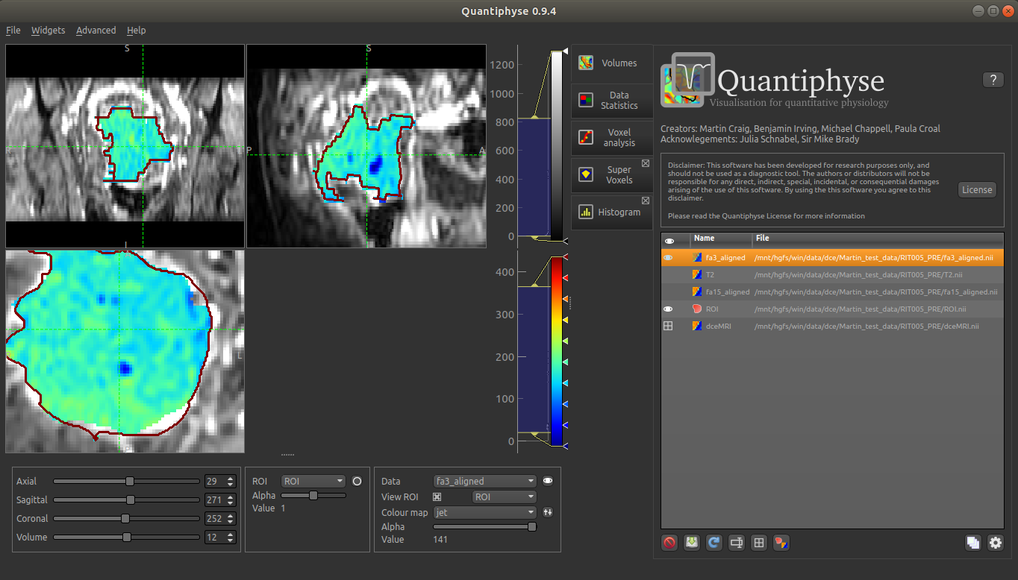
Three viewing windows show Axial, Coronal and Sagittal slices
Left click to focus a point
Left click and drag to pan the image
Right click and drag to zoom
Mouse wheel to move through the slices
Double click to maximise the current slice window
Additional widgets can be opened from the menu.
Currently opened widgets – currently the ‘Data Overview’ widget is showing.
Volumes can be loaded from the File menu, or by drag and drop
List of currently loaded data sets
Navigation sliders for the four image dimensions
Set viewer options and toggle between single/multi overlay modes
Choose between loaded regions of interest and how they should be displayed
Choose between loaded data sets and set view options
Save, delete, reload, rename data sets

Slide 2
Navigation
Displays current focus position
Change position by slice
Select visible volume for 4D data
Region of interest view options
Choose an ROI to view
Switch between shaded view, outline view or both
Change transparency of shaded overlay
Displays region value / label at the current position
Data view options
Choose a data set to view
Toggle visible / hidden
Change colour map and max/min levels
Change transparency
Displays data value at current position

