Slide 1
Understanding of Spatiotemporal Multi-Graph Convolution Network for Ride-hailing Demand Forecasting
Binqing Wu

Slide 2
Research Motivation
Spatiotemporal prediction in urban computing
One of the essential components of the intelligent transportation systems
organize vehicle fleet
improve vehicle utilization
reduce the wait-time
mitigate traffic congestion

Slide 3
Challenges
The complex spatial and temporal correlations
Complicated dependencies are observed among different regions
Non-linear dependencies also exist among different temporal observations

Slide 4
Proposed Method ST-MGCN
Spatial dependency modeling
Encode different types of correlations among regions using multiple graphs
neighborhood graph
functional similarity graph
transportation connectivity graph
Multi-graph convolution for spatial dependency modeling
K order polynomial function of the graph Laplacian L (K-ChebNet)
Aggregate the convolutional result from multiple graphs into a single graph

Slide 5
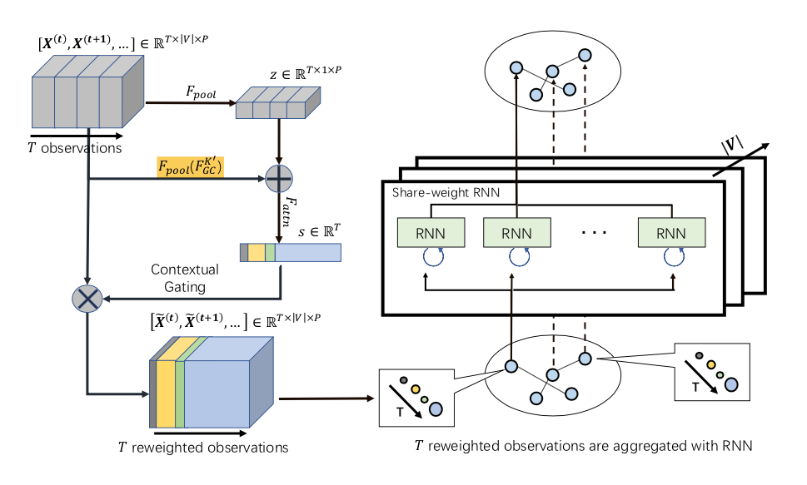
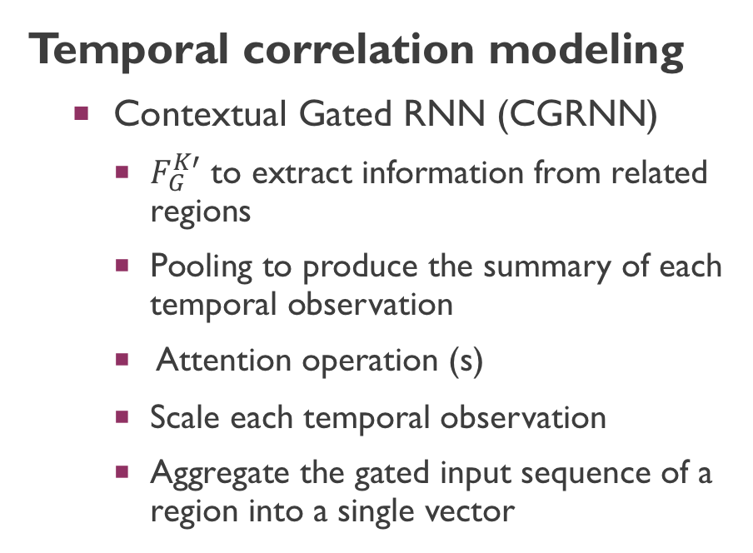
Proposed Method ST-MGCN
Temporal correlation modeling
Contextual Gated RNN (CGRNN)
$F_{G}^{K′}$ to extract information from related regions
Pooling to produce the summary of each temporal observation
Attention operation (s)
Scale each temporal observation
Aggregate the gated input sequence of a region into a single vector

Slide 6
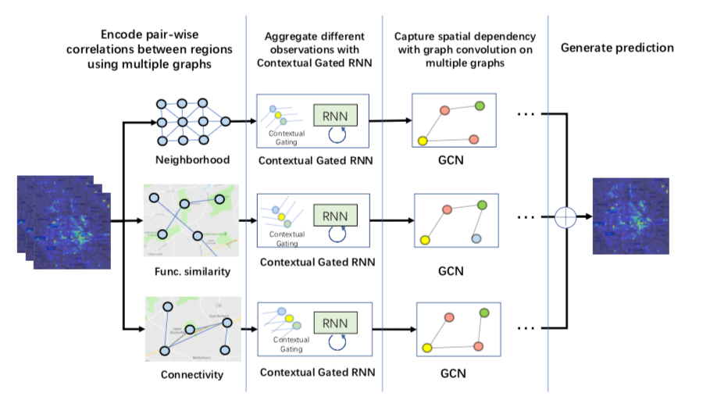
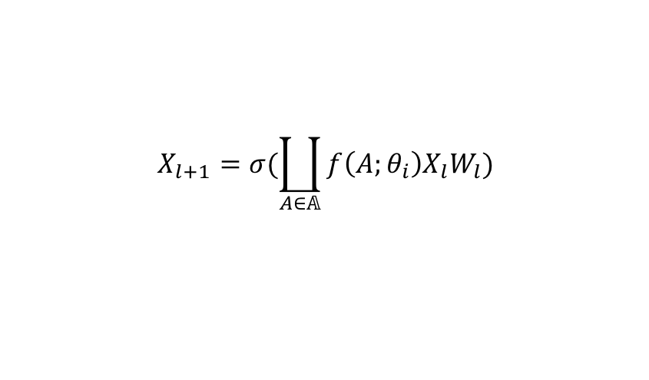
Proposed Method ST-MGCN
Gain the temporal information:
$H_{i,:}= RNN(X_{i,:}^{1},X_{i,:}^{2},…,X_{i,:}^{T};W)$ for t = 1,2, …, |V|
Use the temporal features as the input of the first layer of GCN:
$$X_{l+1}=σ(\coprod_{A∈𝔸}{f\left(A;θ_{i}\right)X_{l}W_{l}})$$

Slide 7
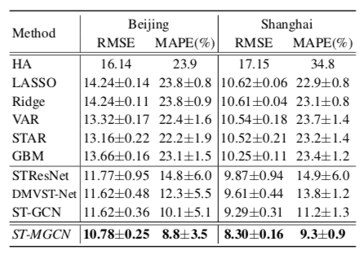
Experimental Evaluation
Dataset
Two real-world large scale ride-hailing datasets collected in cities: Beijing and Shanghai within the time period from Mar 1st, 2017 to Dec 31st, 2017
Training : Mar 1st 2017 to Jul 31st 2017
Validation : Aug 1st 2017 to Sep 30th 2017
Testing : Oct 1st 2017 to Dec 31st 2017

Slide 8
Experimental Evaluation
Performance comparison
Effect of spatial correlation modeling Removing different components causes a significant error increase
Effect of adding multi-graph design to existing methodologies ST-MGCN best!
Effect of temporal correlation modeling CGRNN best!
Effect of number of layers and the polynomial order K of the graph convolution 3 layer, K=4 best!
The proposed approach achieved significantly better results than state-of- the-art baselines

Slide 9
Future Work
Evaluate the proposed model on other spatiotemporal forecasting tasks
Extend the proposed approach for multiple step sequence forecasting.

Slide 10
Research Contributions
Identified its unique spatiotemporal correlation
A novel deep learning based model which encoded the non-Euclidean correlations among regions using multiple graphs and explicitly captured them using multi-graph convolution
Further augmented the recurrent neural network with contextual gating mechanism to incorporate global contextual information in the temporal modeling procedure

Slide 11
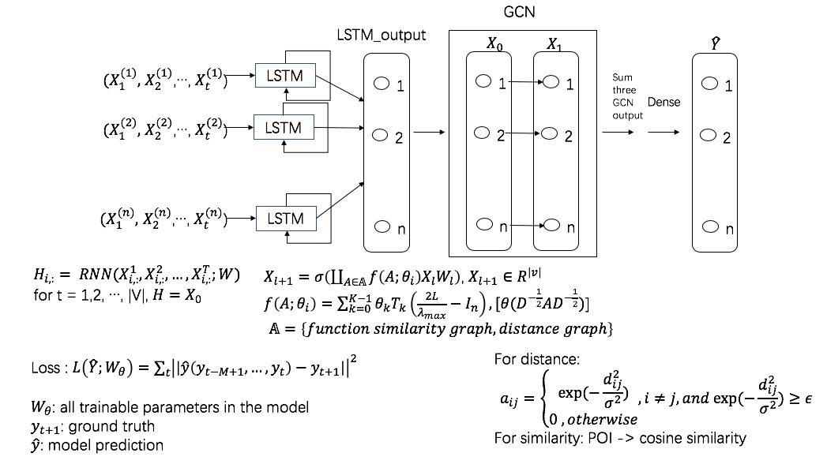
My work
Ref:
Spatiotemporal Multi-Graph Convolution Network for Ride-hailing Demand Forecasting (Xu Geng, 2019)
Spatiotemporal Graph Convolutional Networks: A Deep Learning Framework for Traffic Forecasting (Bing Yu, 2018)
Semi-supervised classification with graph convolutional networks (Thomas N. Kipf, 2017)

Slide 12
results
LSTM: Test RMSE: 33.40
GCN (1)+GRU: Test RMSE: 43.82

Slide 13


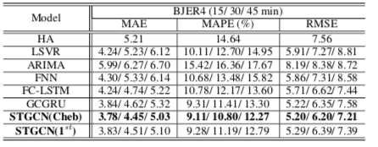
Critical thinking
ST-MGCN : CGRNN
ST-GCN : CN

