Slide 1

Football Forecast
By Adam Fairlie

Slide 2

Overview
“Football Forecast” is an application where football fans can test their knowledge of the game against friends, family and the rest of the world. Users will be able to view a list of ongoing and future tournaments and provide their own score predictions for each future match, as well as predict the eventual winner of the tournament. These match predictions and winning team predictions will be converted into a number of points, which may be compared against the users friends or the rest of the world. In addition, they will be able to join public or private leagues to directly compare their performance in a tournament to their friends, family or a specific group of people. Admins have control of creating the teams, tournaments and matches as well as entering results and tournament wins.

Slide 3

Core Requirements
The user must be able to create, edit and delete an account
The user must be able to sign in to and log out of their account
The user must be able to see a list of future tournaments
The user must be able to join a tournament and predict a winner
The user must be able to predict all upcoming matches from a tournament by entering the number of goals of both teams
The user must be able to create a league and set a password
The user must be able to join a league with the correct password
Admin users must be able to create new teams, tournaments and matches

Slide 4
Stretch Requirements
The user should be able to see a list of ongoing and previous tournaments
The user should be able to see other players recent predictions in their league
The user should be able to see their rank on the overall leaderboard
Admin users should be able to ban accounts
Admin users should be able to delete leagues
Admin users should be able to update points by changing match results and tournament winners
The user could see a page of a previous tournament showing the winner
The user could see an overall leaderboard of points across all tournaments

Slide 5

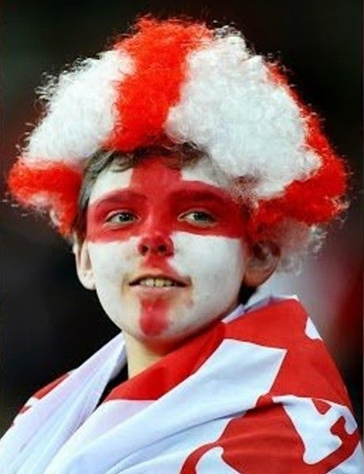
Persona 1
Ryan is a teenage high school student who is particularly into athletics and participates in many school clubs for sports. His favourite sport to play and watch is football. He loves to keep track of different leagues around the world, as well as watch the best players and up and coming talents. He has a group chat with his football loving friends, where they discuss during and after these games, give their opinions on teams and players and predict the results of the tournaments they watch. With many of the group chat being competitive, they would love a place to keep track of their predictions and keep a score against each other to see who can get more matches correct.

Slide 6
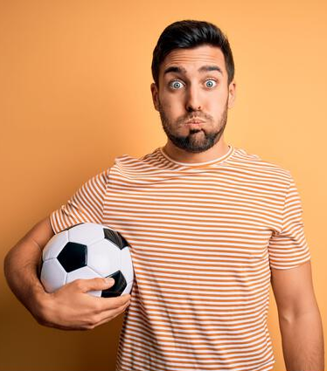
Persona 2
Mike is passionate about football, and runs a YouTube channel discussing previous and upcoming matches, transfer rumours, and anything else related to the sport. He has cultivated an audience of football superfans and wants to let them get involved in competitions, as well as give back for their support. He would like a place to host a fun competition, where he can create a league for any of his fans to predict the upcoming world cup and give away prizes to the winners.

Slide 7

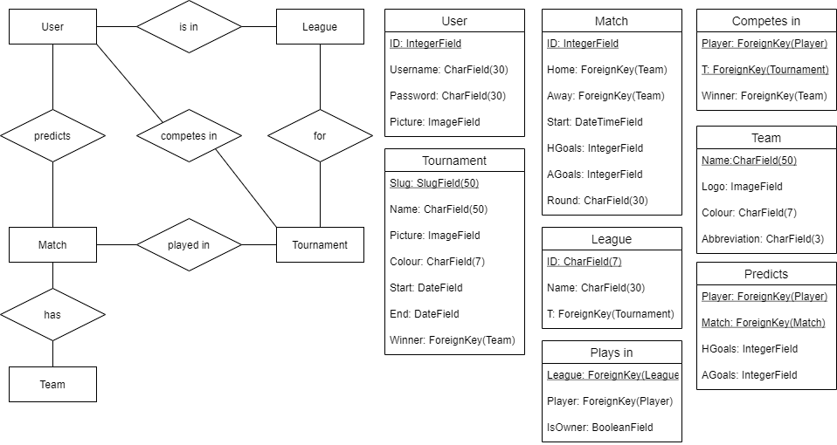
ER Diagram

Slide 8

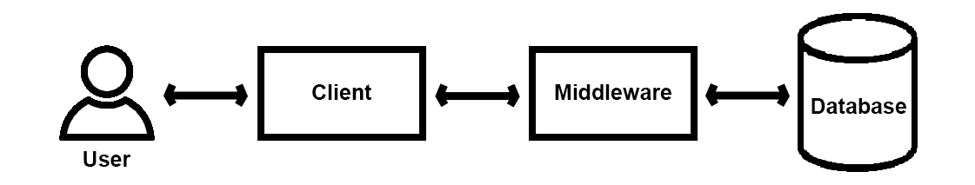
System Architecture Diagram

Slide 9

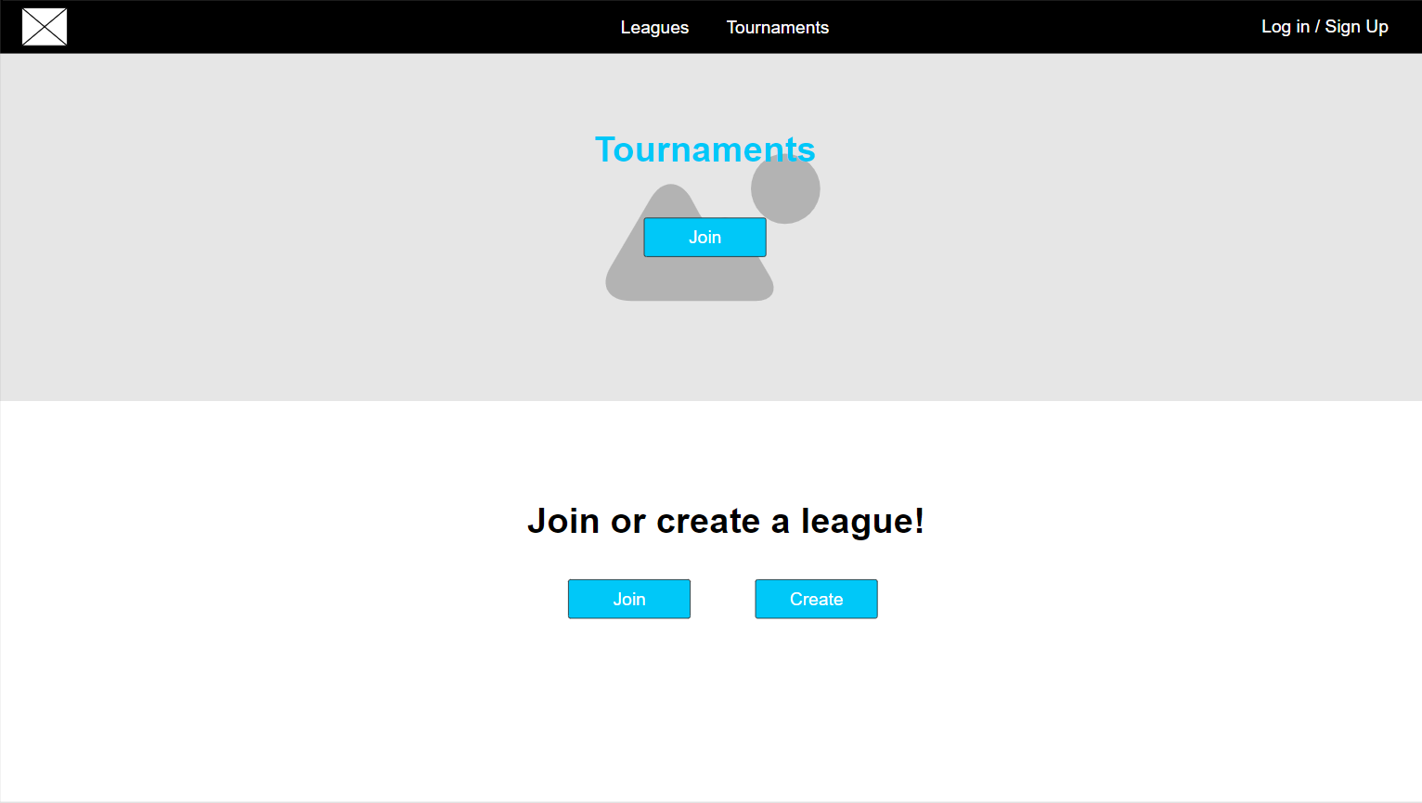
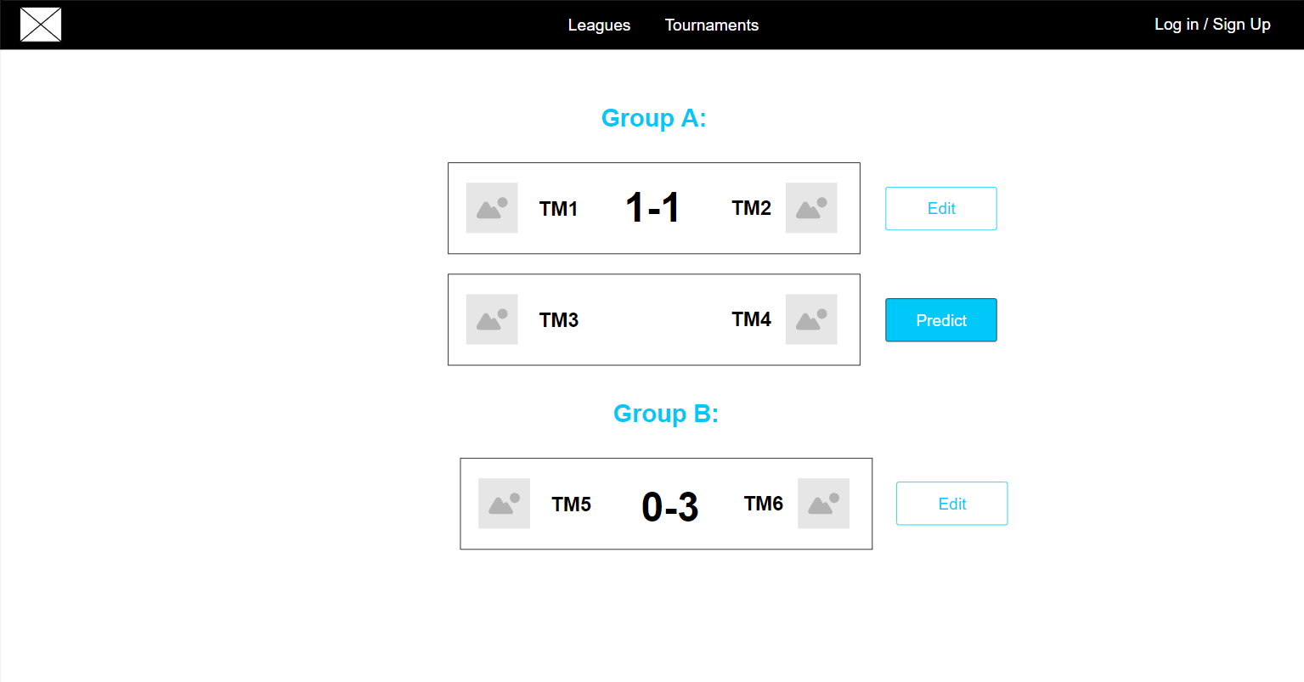
Wireframe
Here is a link to view the interactive wireframe online
Note: The light blue used in the design will be replaced with a random colour either changing every time the page is loaded or based on the colour of the current tournament on tournament pages

Slide 10

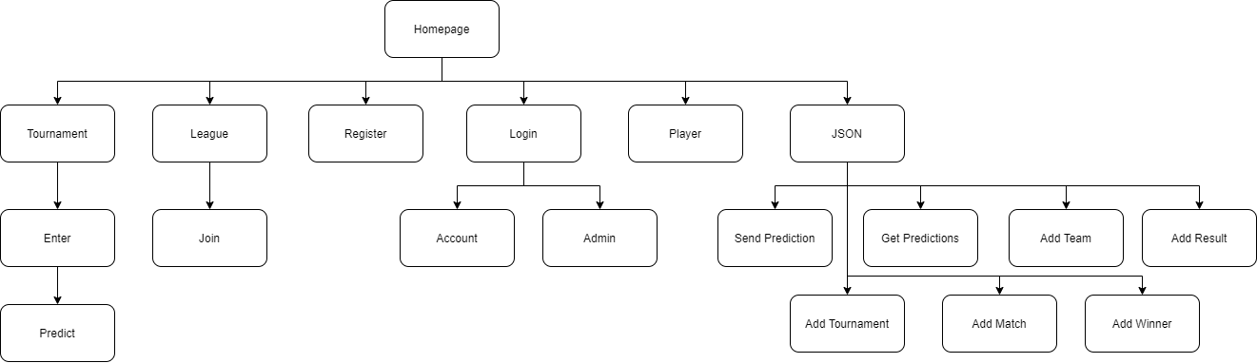
Sitemap

Slide 11

Site URLs
/ (homepage)​
/login/​
/register/
/player/{username}/
/league/
/league/join/{ID}
/league/{id}/
/tournaments/
/tournaments/{tour_name}/
/tournaments/{tour_name}/enter/
/tournaments/{tour_name}/predict/
/json/​
/json/send_prediction/
/json/get_predictions/
/json/add_team/
/json/add_result/
/json/add_tournament/
/json/add_match/
/json/add_winner/

