Slide 1
The value of systems analysis and design
Study Unit 1
Chapter 1

Slide 2
Objectives (Study Guide):
Describe seven types of information system applications; (p.16 - 22)
Describe an information system and the role of the systems analyst; (p. 11 - 12)
Describe what systems analysis and design is; (p. 32 -33)
Explain how modern business and technologies influence systems development; (p. 22 - 30)
Describe the role of each role player in the SDLC (Systems Development Life Cycle); (p. 7 - 16)
Explain what knowledge and skills are required to become a successful systems analyst; and (p. 14 - 15)
Approach the role of systems analyst with the ethically correct and responsible attitude. (p. 15 - 16)

Slide 3
Objectives continue:
distinguish between the waterfall and iterative / incremental approaches to system development;
describe business and technology drivers influencing development; and
describe a simple process for the development of IS.

Slide 4
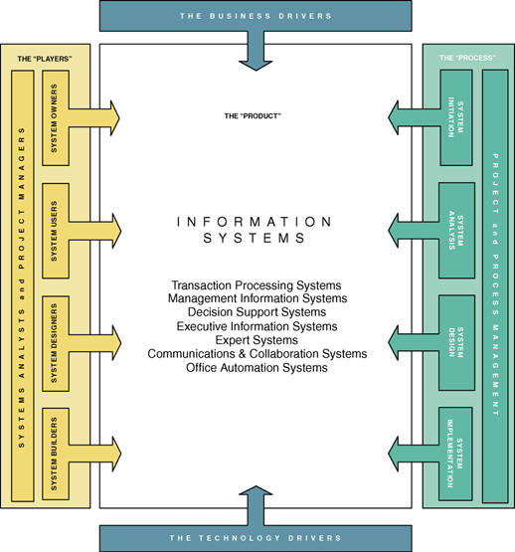
Notes:
Teaching Notes
This is the first “chapter map” for the book.
Each chapter will include a chapter map that visually maps the chapter to our adaptation of John Zachman’s Framework for Information Systems Architecture.
The complete map will be built over the course of the first three chapters.
Chapter 1 emphasizes the stakeholders column.
Conversion Notes
The map is presented in a larger format than in earlier editions.

Slide 5
A Framework for Systems Analysis and Design
A system is a group of interrelated components that function together to achieve a desired result.
An information system (IS) is an arrangement of people, data, processes, and information technology that interact to collect, process, store, and provide as output the information needed to support an organization.
Information technology is a contemporary term that describes the combination of computer technology (hardware and software) with telecommunications technology (data, image, and voice networks).
Notes:
Conversion Notes
The definition of system is new to this edition, and was added to reinforce systems thinking.
This is a more concise definition of “information system” than in previous editions. It better reflects what information systems are and do rather than how they are used.
Some books use the term “computer technology.” We prefer the more contemporary term “information technology” as a superset of computer technology.

Slide 6
Types of Information Systems
A transaction processing system (TPS) is an information system that captures and processes data about business transactions.
A management information system (MIS) is an information system that provides for management-oriented reporting based on transaction processing and operations of the organization.
A decision support system (DSS) is an information system that either helps to identify decision making opportunities or provides information to help make decisions.
Notes:
Teaching Notes
These definitions can be useful to help students understand what an information system is in all its varieties and flavors. Depending on the prerequisites of your course, you may want to cover these in more or less detail.

Slide 7
Types of Information Systems (cont.)
An expert system is an information system that captures the expertise of workers and then simulates that expertise to the benefit of non-experts.
A communications and collaboration system is an information system that enables more effective communications between workers, partners, customers, and suppliers to enhance their ability to collaborate.
An office automation system is an information system that supports the wide range of business office activities that provide for improved work flow between workers.
Notes:
See notes on prior slide.

Slide 8
Stakeholders: Players in the Systems Game
A stakeholder is any person who has an interest in an existing or proposed information system. Stakeholders can be technical or nontechnical workers. They may also include both internal and external workers.
Information workers are those workers whose jobs involve the creation, collection, processing, distribution, and use of information.
Knowledge workers are a subset of information workers whose responsibilities are based on a specialized body of knowledge.
Notes:
Teaching Notes
Give examples of information workers and knowledge workers to reinforce the difference.
Footnote – Information workers (sometimes called “white-collar workers”) have outnumbered blue-collar workers since 1957.
Typically a knowledge worker has a degree or credential in some subject area (hence, they are often called “subject area experts”). Examples include engineers, scientists, accountants, lawyers, etc.
Briefly describe a typical information system that students would be familiar with, such as an enrollment system for the college. Invite the class to brainstorm who the stakeholders would be and which of them would be information workers or knowledge workers.

Slide 9
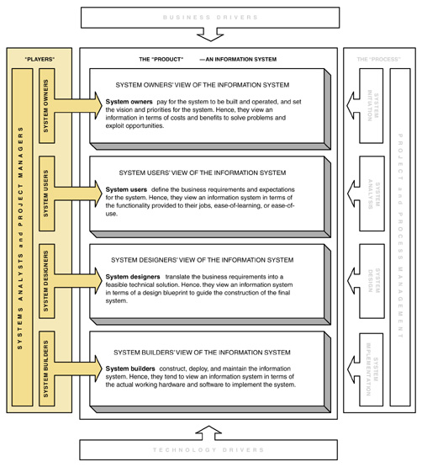
Stakeholders' Perspectives on an Information System
Notes:
Teaching Notes
This map emphasizes how each kind of stakeholder interacts with the information system.
Note that the systems analyst role overlaps the roles of all the other stakeholders. The systems analyst is a facilitator to all the other roles.

Slide 10
System Owners
System owners – an information system’s sponsor and executive advocate, usually responsible for funding the project of developing, operating, and maintaining the information system.
Notes:
Teaching Notes
Using the information system described earlier (enrollment system or other) for the college, invite the class to identify individuals who might play the system owner role.

Slide 11
System Users
System users – a “customer” who will use or is affected by an information system on a regular basis – capturing, validating, entering, responding to, storing, and exchanging data and information.
Notes:
Teaching Notes
Using the information system described earlier (enrollment system or other) for the college, invite the class to identify individuals who might play the system user role.
Note that a person could be both a system owner and system user.

Slide 12
Internal System Users
Clerical and service workers
Technical and professional staff
Supervisors, middle managers, and executive managers
Notes:
Teaching Notes
If your course takes more of management approach, you may want to focus more on the varying roles of supervisors, middle managers, and executives.

Slide 13
External System Users
Customers
Suppliers
Partners
Employees
Remote users - users who are not physically located on the premises but who still requires access to information systems.
Mobile users - users whose location is constantly changing but who requires access to information systems from any location
Notes:
Teaching Notes
Update students on the trend of “telecommuting.” Telecommuting falls into our “Remote” users category.
Some students may confuse “remote users” and “external users.” The difference is that remote users work for the organization in question, while external users work for some other organization (or are direct consumers).
The growth of the Web is driving the increase in both remote and external users.

Slide 14
Classwork
Problems and Exercises No 1 P 37
The internal users of the system might include the cashier, store manager, store owner, salesperson, stock clerks, and the “back office” accounting
staff.
The external users of the system might include credit card companies, the retail point of sale system vendor, federal and state tax agencies, suppliers and customers.

Slide 15
System Designers and System Builders
System designer – a technical specialist who translates system users’ business requirements and constraints into technical solution. She or he designs the computer databases, inputs, outputs, screens, networks, and software that will meet the system users’ requirements.
System builders – a technical specialist who constructs information systems and components based on the design specifications generated by the system designers.
Notes:
Teaching Notes
Using the information system described earlier (enrollment system or other) for the college, invite the class to identify individuals who might play the system designer or system builder role.
Programmers are typically viewed as system builders, but in fact, they are also system designers since good programmers design the software they build.
You might want to remind students that a single individual can play multiple roles in a project. For example:
Many systems analysts are also system designers and builders.
In reality, most technical specialists serve in most roles. For instance, database specialists typically design and construct databases.

Slide 16
Systems Analysts
Systems analyst – a specialist who studies the problems and needs of an organization to determine how people, data, processes, and information technology can best accomplish improvements for the business.
A programmer/analyst (or analyst/programmer) includes the responsibilities of both the computer programmer and the systems analyst.
A business analyst focuses on only the non-technical aspects of systems analysis and design.
Notes:
Teaching Notes
Business analyst is becoming more popular because of the number of end-users and other knowledge workers being assigned to systems analysts roles in organizations.

Slide 17
The Systems Analyst as a Problem-Solver
By "Problems" that need solving, we mean:
Problems, either real or anticipated, that require corrective action
Opportunities to improve a situation despite the absence of complaints
Directives to change a situation regardless of whether anyone has complained about the current situation
Notes:
Teaching Notes
It can be useful to present examples of each scenario from the instructor’s personal experiences.
The classification scheme is not mutually exclusive; that is,
a project can be driven by multiple instances and combinations of problems, opportunities, and directives.
a problem might be classified as both a true problem an opportunity, or an opportunity plus directive.

Slide 18
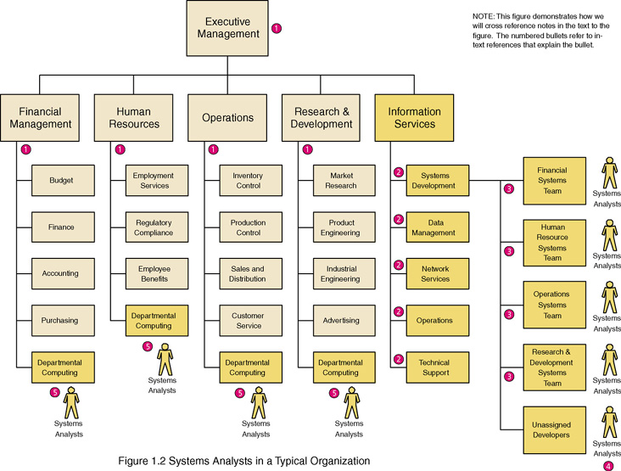
Where Do Systems Analysts Work?
Notes:
Teaching Notes
Note that every organization structures itself uniquely
Systems Analysts also work for:
Outsourcing businesses
Consulting businesses
Commercial software developers

Slide 19
Skills Needed by the Systems Analyst
Working knowledge of information technology
Computer programming experience and expertise
General business knowledge
General problem-solving skills
Good interpersonal communication skills
Good interpersonal relations skills
Flexibility and adaptability
Character and ethics
Notes:
Teaching Notes
One way to underscore the need for these skills by bringing in job ads for analysts and programmers from a local newspaper. In almost all cases they will request non-technical skills as much or more as they request technical skills.

Slide 20
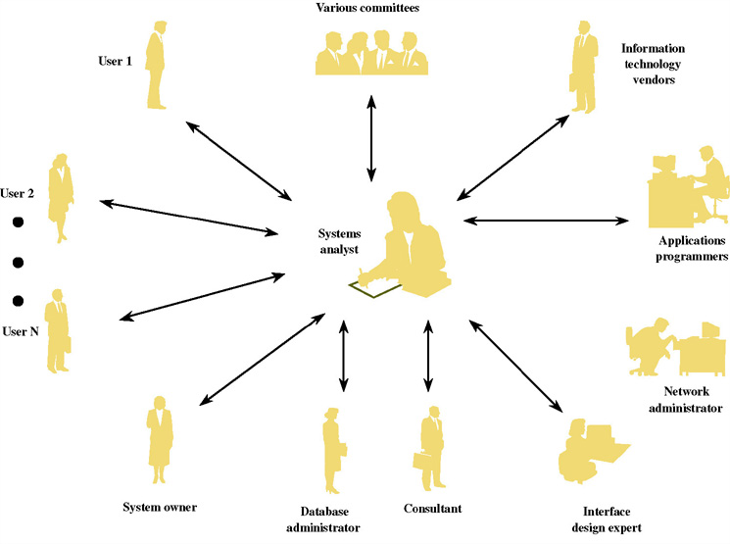
The Systems Analyst as a Facilitator
Notes:
Teaching Notes
In this diagram the systems analyst is literally the person in the middle - the person who must be able to communicate with everyone else in everyone's language.

Slide 21
Classwork
Minicases No 4 P 40
Answer examples: listening, observing body language, respecting differing
views, sharing knowledge (as appropriate) to help the customer understand
possibilities, changing terminology to fit client’s (technology) background
and awareness, etc.

Slide 22
The Ten Commandments of Computer Ethics
1. Thou shalt not use a computer to harm other people.
2. Thou shalt not interfere with other people’s computer work.
3. Thou shalt not snoop around in other people’s computer files.
4. Thou shalt not use a computer to steal.
5. Thou shalt not use a computer to bear false witness.
6. Thou shalt not copy or use proprietary software for which you have not paid.
7. Thou shalt not use other people’s computer resources without authorization or proper compensation.
8. Thou shalt not appropriate other people’s intellectual output.
9. Thou shalt think about the social consequences of the program you are writing or the system you are designing.
10. Thou shalt always use a computer in ways that insure consideration and respect for your fellow human
Source: Computer Ethics Institute
Notes:
Teaching Notes
See the suggested readings for a book of ethics scenarios that could be introduced, tested, and analyzed as part of a lecture on computer ethics.
We have always considered it important to emphasize that a person’s ethical integrity is “earned.” More significantly, if that ethical integrity is in any way compromised, it is difficult to repair the image.

Slide 23
Other Stakeholders
External Service Provider (ESP) – a systems analyst, system designer, or system builder who sells his or her expertise and experience to other businesses to help those businesses purchase, develop, or integrate their information systems solutions; may be affiliated with a consulting or services organization.
Project Manager – an experienced professional who accepts responsibility for planning, monitoring, and controlling projects with respect to schedule, budget, deliverables, customer satisfaction, technical standards, and system quality.
Notes:
No additional notes

Slide 24
The S D L C Traditional Waterfall Problems
Once one phase ends another begins, going downhill until complete
Makes it difficult to go back
Results in great expense to make changes
Role of system users or customers narrowly defined
Focused on deadlines

Slide 25
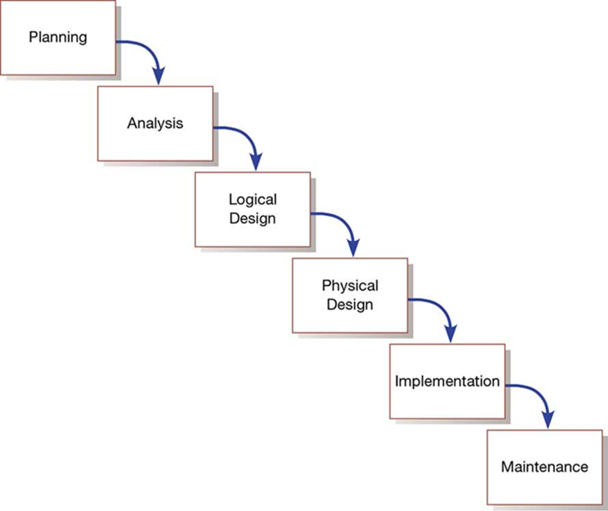
Figure 1-8: Traditional Waterfall S D L C

Slide 26
Agile Methodologies
Agile methodologies share three key principles:
A focus on adaptive rather than predictive methodologies
A focus on people rather than roles
A focus on self-adaptive processes

Slide 27
Table 1-2: The Agile Manifesto (1 of 3)
The agile methodologies group argues that software development methodologies adapted from engineering generally do not fit with real world software development
The Manifesto for Agile Software Development (Table 1-2)
Seventeen anarchists agree
We are uncovering better ways of developing software by doing it and helping others do it. Through this work we have come to value:
Individuals and interactions over processes and tools
Working software over comprehensive documentation
Customer collaboration over contract negotiation
Responding to change over following a plan

Slide 28
Table 1-2: The Agile Manifesto (2 of 3)
That is, while we value the items on the right, we value the items on the left more. We follow the following principles:
The highest priority is to satisfy the customer through early and continuous delivery of valuable software.
Welcome changing requirements, even late in development. Agile processes harness change for the customer’s competitive advantage.
Deliver working software frequently, from a couple of weeks to a couple of months, with a preference to the shorter timescale.
Businesspeople and developers work together daily throughout the project.
Build projects around motivated individuals. Give them the environment and support they need and trust them to get the job done.
The most efficient and effective method of conveying information to and within a development team is face-to-face conversation.
Working software is the primary measure of progress.

Slide 29
Table 1-2: The Agile Manifesto (3 of 3)
Continuous attention to technical excellence and good design enhances agility.
Agile processes promote sustainable development. The sponsors, developers, and users should be able to maintain a constant pace indefinitely.
Simplicity—the art of maximizing the amount of work not done—is essential.
The best architectures, requirements, and designs emerge from self-organizing teams.
At regular intervals, the team reflects on how to become more effective, then tunes and adjusts its behavior accordingly.
-- (www.AgileAlliance.org)

Slide 30
Agile Methodologies—Not for Every Project
Agile methodologies are not for everyone
Fowler recommends an agile process if your project involves
unpredictable or dynamic requirements
responsible and motivated developers
customers who understand the process and will get involved

Slide 31
Table 1-3: Five Critical Factors that Distinguish Agile and Traditional Approaches to System Development
Factor | Agile Methods | Traditional Methods
Size | Well matched to small products and teams Reliance on tacit knowledge limits scalability | Methods evolved to handle large products and teams Hard to tailor down to small products
Criticality | Untested on safety-critical products Potential difficulties with simple design and lack of documentation | Methods evolved to handle highly critical products Hard to tailor down to products that are not critical.
Dynamism | Simple design and continuous refactoring are excellent for highly dynamic environments but a source of potentially expensive rework for highly stable environments | Detailed plans and Big Design Up Front, excellent for highly stable environment but a source of expensive rework for highly dynamic environments
Personnel | Requires continuous presence of a critical mass of scarce experts Risky to use non-agile people | Needs a critical mass of scarce experts during project definition but can work with fewer later in the project, unless the environment is highly dynamic
Culture | Thrives in a culture where people feel comfortable and empowered by having many degrees of freedom (thriving on chaos) | Thrives in a culture where people feel comfortable and empowered by having their roles defined by clear practices and procedures (thriving on order)

Slide 32
eXtreme Programming (1 of 2)
Short, incremental development cycles
Focus on automated tests written by programmers
Emphasis on two-person programming teams
Customers to monitor the development process
Relevant parts of eXtreme Programming that relate to design specifications are
How planning, analysis, design, and construction are all fused into a single phase of activity
Its unique way of capturing and presenting system requirement and design specifications

Slide 33
eXtreme Programming (2 of 2)
Coding and testing are related parts of the same process
Advantages include
Increased communications among developers
Higher levels of productivity
Higher quality code
Reinforcement of other practices in eXtreme Programming
Include code-and-test discipline

Slide 34
Scrum (1 of 3)
Originated in 1995 by Sutherland and Schwaber
Most popular methodology for agile (58%)
Scrum framework includes
Scrum teams with associated roles, events, artifacts, and rules
Each team consists of three roles
Product owner
Development team
Scrum master

Slide 35
Scrum (2 of 3)
Scrum designed for speed and multiple functional product releases
Primary unit is the Sprint (runs two weeks to a month)
Starts with an eight-hour planning meeting
What needs to be delivered by the end of the sprint
How will the team accomplish that work
Daily Standup: A 15-minute meeting held to evaluate progress made within the past 24 hours and what needs to be done

Slide 36
Scrum (3 of 3)
At the end of the sprint, two additional meetings
The Sprint Review: (4 hours) focusing on the product, what has been accomplished, and what needs to be done
The Sprint Retrospective: (3 hours) focusing on team performance and how it can improve
Three primary artifacts in the Scrum process
Product Backlog: Listing of potential requirements
Sprint Backlog: Listing of only items to be addressed in a particular sprint
Increment: Represents the sum of all the Product Backlog items completed during a sprint.

Slide 37
Agile in Practice
Three primary factors critical for success
Delivery strategy: Continuous delivery of working software in short time scales
Following agile software engineering practices
Team capability: Agile principle of building projects around motivated individuals
Agile development offers managers and programmers more choice in their efforts to produce good systems that come in on time and under budget

Slide 38
Object-Oriented Analysis and Design (O O A D)
Based on objects rather than data or processes
Combines data and processes (called methods) into single entities call objects
Object: A structure that encapsulates attributes and methods that operate on those attributes
Inheritance: Hierarchical arrangement of classes enabling subclasses to inherit properties of superclasses
Object Class: Logical grouping of objects that have the same attributes and behaviors

Slide 39
Relational Unified Process (R U P)
Relational Unified Process (R U P) is an object-oriented systems development methodology
Based on an iterative, incremental approach to systems development
R U Ps four phases (each can be further divided)
Inception
Elaboration
Construction
Transition

Slide 40
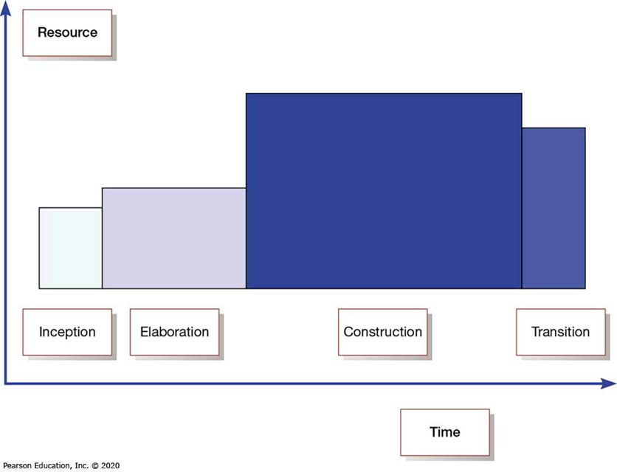
Figure 1-9: Phases of O O A D-Based Development

Slide 41
Our Approach to Systems Development
Criticisms of the S D L C include
Forced timed phases on intangible and dynamic processes were doomed to fail
Life-cycle reliance has resulted in massive amounts of process and documentation
Cycles are not necessarily waterfalls

Slide 42
Business Drivers for Today’s Information Systems
Globalization of the Economy
Electronic Commerce and Business
Security and Privacy
Collaboration and Partnership
Knowledge Asset Management
Continuous Improvement and Total Quality Management
Business Process Redesign
Notes:
Teaching Notes
See the following slides for detailed explanations.

Slide 43
Globalization of the Economy
Global Economy brings
New and expanded international markets
New international competitors
Impact on information systems
Require support of multiple languages, currency exchange rates, business cultures
Require consolidation of international data
Demand for players who can communicate, orally and in writing, with management and users that speak different languages
Notes:
Teaching Notes
If you use an in-class computer and project, go to www.amazon.co.uk or a similar international e-commerce site to demonstrate the globalization of commerce.

Slide 44
Electronic Commerce and Business
E-Commerce – the buying and selling of goods and services by using the Internet.
E-Business – the use of the Internet to conduct and support day-to-day business activities.
Types of e-commerce and e-business
Marketing of corporate image, products, and services
Business-to-consumer (B2C)
Business-to-business (B2B)
Impact on information systems
Most new information systems are being designed for an Internet (or intranet) architecture
Since the only client-side software is a web browser, the choice of client operating system is becoming less important
Notes:
Teaching Notes
Since the Internet is global, the Internet drives globalization and vice-versa.

Slide 45
Classwork
Problems and Exercises No 6 P 38
B2C applications are designed and used by businesses to sell products or
services directly to consumers. They may or may not have a brick-and mortar,
i.e., physical store(s), presence also. Well-known examples include
www.amazon.com, which started as a web-only business and does not have
a physical sales presence, and traditional brick-and-mortar stores which
have added a website, such as www.sears.com.
Similarly, businesses may also use B2B applications to target other businesses
for their products or services. Examples include information services
such as www.gartner.com or industrial supply companies such as
www.vikingofficesupply.com
Some companies may have hybrid applications which target both consumers
and businesses. Examples include home and office supply houses such
as www.staples.com or high-technology companies such as
www.microsoft.com.

Slide 46
Security and Privacy
Security
How will the business continue in the event of a security breach, terrorist attack, or disaster?
How can the business protect its digital assets from outside threats?
Privacy
Consumer demands for privacy in e-commerce transactions
Government requirements
Impact on information systems
Need to incorporate stringent security and privacy controls
Notes:
Teaching Notes
With the growth of e-commerce and e-business, security and privacy have become much more important.
With globalization information systems must comply with security and privacy laws of multiple countries. What if the security laws of one country conflicts with the privacy laws of another?

Slide 47
Collaboration and Partnership
Organizations seek to break down the walls that separate organizational departments and functions.
Organizations collaborate with outside business partners and even competitors.
Impact on information systems
Need to provide secure, external access
Need to pass data between different information systems
Notes:
Teaching Notes
Since the Internet is global, it has both driven and enabled collaboration and partnership.

Slide 48
Knowledge Asset Management
Data – raw facts about people, places, events, and things that are of importance in an organization.
Information – data that has been processed or reorganized into a more meaningful form for someone.
Knowledge – data and information that is further refined based on the facts, truths, beliefs, judgments, experiences, and expertise of the recipient.
Knowledge Asset Management
Recognizes that data, information, and knowledge are critical business resources
Asks: “How can the organization manage and share knowledge for competitive advantage?”
Strives to integrate the data and information that can create and preserve knowledge
Notes:
No additional notes

Slide 49
Continuous Improvement and Total Quality Management
Business Processes – Tasks that respond to business events (e.g., an order). Business processes are the work, procedures, and rules required to complete the business tasks, independent of any information technology used to automate or support them.
Continuous process improvement (CPI) – The continuous monitoring of business processes to effect small but measurable improvements in cost reduction and value added.
Total quality management (TQM) – a comprehensive approach to facilitating quality improvements and management within a business.
Notes:
Teaching Notes
Weinberg: “If builders built buildings the same way that programmers wrote programs, the first woodpecker would destroy civilization.”

Slide 50
Business Process Redesign
Business process redesign (BPR) is the study, analysis, and redesign of fundamental business processes to reduce costs and/or improve value added to the business.
More substantial changes and improvements than CPI
Usually complemented by CPI
Notes:
No additional notes

Slide 51
Technology Drivers for Today’s Information Systems
Networks and the Internet
Mobile and Wireless Technologies
Object Technologies
Collaborative Technologies
Enterprise Applications
Notes:
Teaching Notes
Students often perk up when the discussion turns to new, sexy technologies. Use that interest to get students thinking about the information system ramifications of these technologies.

Slide 52
Networks and the Internet
Networks include mainframe time-sharing systems, network servers, and a variety of desktop, laptop, and handheld client computers.
The most used networking technologies are based on the Internet.
XHTML and XML
Scripting languages
Web-specific programming languages
Intranets
Extranets
Portals
Web services
Notes:
Teaching Notes
The text quotes Scott McNealy of Sun Computer saying, “The network has become the computer.” Invite students to agree or disagree with that statement.
Could that statement be taken further to say that the Internet has become the computer?

Slide 53

Mobile and Wireless Technologies
Some mobile and wireless technologies
PDAs
Smart phones
Bluetooth
Wireless networking
Impact on information systems
Wireless connectivity must be assumed
Limitations of mobile devices and screen sizes must be accommodated
Notes:
Teaching Notes
Some students may be familiar with web surfing through mobile devices. Ask for their experiences.

Slide 54
Object Technologies
Object technology – a software technology that defines a system in terms of objects that consolidate data and behavior (into objects).
Objects are reusable
Objects are extensible
Object-oriented programming languages include C++, Java, Smalltalk, and .NET
Object-oriented analysis and design – a collection of tools and techniques for systems development that will utilize object technologies to construct a system and its software.
Agile development – a system development strategy in which system developers are given the flexibility to select from a variety of tools and techniques to best accomplish the tasks at hand.
Notes:
Conversion Notes
Object-oriented analysis and design tools are more integrated into the 7th edition. At the same time, the importance of structured tools and techniques is also recognized and will continue to be covered.

Slide 55
Classwork
Problems and Exercises No 15 P 38
The two main advantages of object oriented software over structured software are
1) Objects are reusable. Once developed, objects can be used in multiple applications, reducing the implementation time and cost of future projects.
2) objects are extensible. They can be changed or expanded easily without impacting previously developed applications, which can reduce
future system maintenance costs.

Slide 56
Collaborative Technologies
Collaborate technologies are those that enhance interpersonal communications and teamwork.
E-mail
Instant messaging
Groupware
Work flow
Notes:
No additional notes

Slide 57
Enterprise Applications
Virtually all organizations require a core set of enterprise applications
Financial mgmt, human resources, sales, etc.
Frequently purchased
Frequently need to have custom elements added
Systems Integration - the process of building a unified information system out of diverse components of purchases software, custom-built software, hardware, and networking.
Notes:
Conversion Notes
The 7th edition adds this definition for systems integration, recognizing its growing importance.

Slide 58
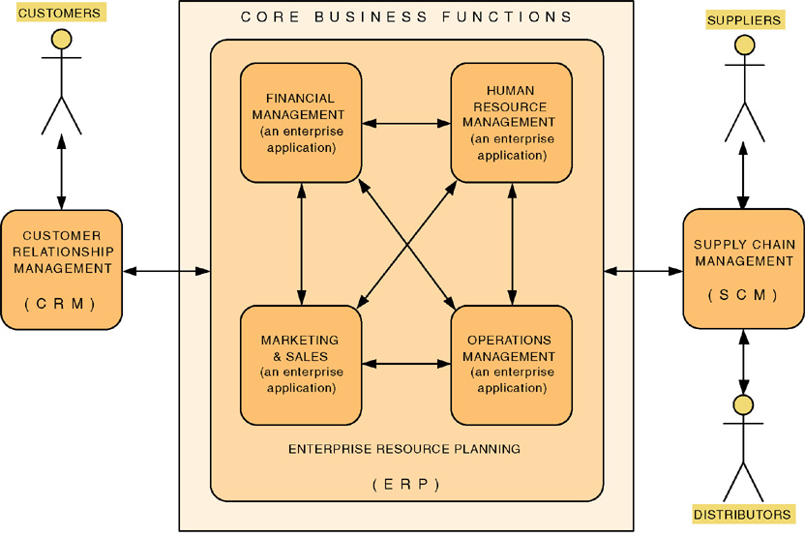
Enterprise Applications
Notes:
Teaching Notes
The trend is for these core enterprise applications to be purchased.
These purchased applications are never sufficient to meet all the information needs of the organization. Thus systems analysts and other developers are asked to develop value-added applications to meet additional needs.

Slide 59
Enterprise Applications - ERP
Enterprise Resource Planning (ERP) – a software application that fully integrates information systems that span most or all of the basic, core business functions.
An ERP solution is built around a common database shared by common business functions.
Representative ERP vendors:
SSA
Oracle/Peoplesoft
SAP AG
Notes:
Teaching Notes
ERP is dramatically changing the role of the modern systems analyst. Instead of spending effort on requirements planning and systems design, ERP redirects effort to activities such as customization, business process redesign and alignment, and system implementation.
Systems analysts who work on ERP projects are almost always called systems integrators.

Slide 60
Enterprise Applications - EAI
Enterprise Application Integration (EAI) – the process and technologies used to link applications to support the flow of data and information between those applications.
Middleware – software (usually purchased) used to translate and route data between different applications.
Representative EAI vendors:
BEA Systems
IBM (MQSeries)
Mercator Software
TIBCO Software
Notes:
No additional notes

Slide 61
System Development Process
System development process – a set of activities, methods, best practices, deliverables, and automated tools that stakeholders use to develop and maintain information systems and software.
Notes:
Teaching Notes
This is not an actual system development life cycle or methodology but simply general problem-solving steps.

Slide 62
A Simple System Development Process
Our Simplified System Development Process | General Problem-Solving Steps
System initiation | Identify the problem.
System analysis | Analyze and understand the problem. Identify solution requirements or expectations.
System design | Identify alternative solutions and choose the “best” course of action. Design the chosen solution.
System implementation | Implement the chosen solution. Evaluate the results. If the problem is not solved, return to step 1 or 2 as appropriate.
Notes:
Teaching Notes
This relates the problem-solving steps to the classic SDLC phases. Neither of these, though, are a methodology (as will be discussed in chapter 3).

Slide 63
Classwork
Problems and Exercises No 14 P 38
a. System Design
b. System Initiation
c. System Implementation
d. System Analysis

Slide 64
System Development Process Overview
System initiation – the initial planning for a project to define initial business scope, goals, schedule, and budget.
System analysis – the study of a business problem domain to recommend improvements and specify the business requirements and priorities for the solution.
System design – the specification or construction of a technical, computer-based solution for the business requirements identified in a system analysis.
System implementation – the construction, installation, testing, and delivery of a system into production.
Notes:
Teaching Notes
This is essentially the traditional System Development Life Cycle (SDLC) without the system support phase. We elected not to use that term because it invokes negative connotation for many instructors. Some associate it with a pure waterfall development approach (which we consider unfair). We differentiate between development and operation (sometimes called production).
System support is presented in the 7th edition as a separate project – a maintenance or enhancement project that should follow the exact same problem-solving approach, though on a more limited scale.

Slide 65
Project and Process Management
Project management – the activity of defining, planning, directing, monitoring, and controlling a project to develop an acceptable system within the allotted time and budget.
Process management – the ongoing activity that defines, improves, and coordinates the use of an organization’s chosen methodology (the “process”) and standards for all system development projects.
Notes:
No additional notes

Slide 66
Objectives (Study Guide):
Describe seven types of information system applications; (p.16 - 22)
Describe an information system and the role of the systems analyst; (p. 11 - 12)
Describe what systems analysis and design is; (p. 32 -33)
Explain how modern business and technologies influence systems development; (p. 22 - 30)
Describe the role of each role player in the SDLC (Systems Development Life Cycle); (p. 7 - 16)
Explain what knowledge and skills are required to become a successful systems analyst; and (p. 14 - 15)
Approach the role of systems analyst with the ethically correct and responsible attitude. (p. 15 - 16)

Slide 67
Objectives continue:
distinguish between the waterfall and iterative / incremental approaches to system development;
describe business and technology drivers influencing development; and
describe a simple process for the development of IS.

Slide 68
Homework
Read the summary on p. 34 – 37
Problems and Exercises: no. 1, 3, 6, 14 & 15 (p. 37 – 38)
Create a 2 page summary of Chapter 1.
Finalise the group members of your team and decide on possible topics for your project.
Watch the following videos: https://www.youtube.com/watch?v=Qujsd4vkqFI https://www.youtube.com/watch?v=jdFQBYZSEiQ

