Slide 1
South Africa built the rail and did not build the adoption
Instant payments: India, Brazil and the South African decade

Slide 2
Three rails, three outcomes: the divergence is four decisions, not the technology
UPI is the largest system by volume, Pix the largest by value relative to GDP, PayShap carries less in a year than Pix carries in four days.
 | UPI (India), FY26 | Pix (Brazil), 2025 | PayShap (South Africa), 2026
Launch and operator | Aug 2016; NPCI, bank-owned non-profit | Nov 2020; Banco Central do Brasil | Mar 2023; PayInc, 50% SARB 50% banks
Participation | Voluntary, 741 banks | Mandatory above 500k accounts, 816 | Voluntary, 12 banks
Annual volume | 241.6bn | 79.8bn | c. 0.7bn run rate
Annual value | c. $3.6trn, c. 1x GDP | c. $6.5trn, c. 3x GDP | c. $42bn, c. 0.1x GDP
Adult reach | c. 55% | 93% | c. 13% (registered)
Consumer fee | Zero by law | Zero by regulation | Charged, above R50 on larger transfers
Merchant fee | Zero since 2020; law to reintroduce passed Aug 2026 | Market-set, c. 0.33% | Not the primary channel
Subsidy | Rs 8,276 crore cumulative | None | None
Interface | Third-party apps, two at 79% | Account providers | Bank apps
Launch shock | Demonetisation, Jio | Pandemic | None
Sources: NPCI, RBI, BCB, Febraban, PayInc statements; EY analysis. Companion papers: UPI at ten, Pix at five, PayShap at three (September 2026).

Slide 3
Operator, mandate, pricing and timing explain the gap; South Africa chose the incumbents' answer on all four
Operator
Mandate
Brazil's central bank built and runs Pix. India's bank-owned non-profit runs UPI. South Africa's bank-owned clearing house ran PayShap until the SARB bought half in November 2025. Where the operator's incentive was volume, volume came.
The BCB made participation compulsory above 500,000 accounts; every account was reachable on day one. UPI reached 741 banks through voluntary onboarding driven by the apps. PayShap reached 12 of 39 banks.
Pricing
Timing
India banned merchant fees and paid a subsidy it has since cut to a tenth of stated cost. Brazil banned consumer and interparticipant fees and let merchant pricing compete to 0.33%. South Africa banned nothing and priced the rail through the incumbents, above the alternatives.
UPI launched three months before demonetisation and alongside Jio. Pix launched in the second pandemic wave. PayShap launched into a stable cash economy with no forcing event, and adoption had to be earned on price and use case, where it was weakest.
Pricing and mandate decide whether a rail leaves the floor; demand and income decide the ceiling. South Africa has a floor problem, which is the one a regulator can fix.

Slide 4
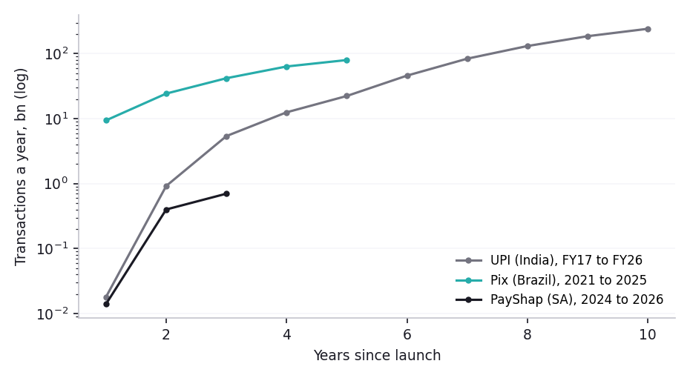
Measured at the same age, PayShap is two orders of magnitude behind the comparators
Intensity is the constraint, not the rail
Pix and UPI both settle near 460 transactions per user a year. The UK's Faster Payments and Sweden's Swish sit nearer 90 to 130 per adult. PayShap runs at about 117. Users times intensity sets the ceiling; price and acceptance decide which end of the bracket a rail reaches.
The evidence base is uneven
The Indian and Brazilian series are regulator-published. PayInc publishes no monthly series, the SARB publishes PayShap only inside charts, and there is no fraud series. Year two for South Africa is interpolated.
Sources: NPCI product statistics via PIB; BCB via Febraban and CNN Brasil; PayInc statements via TechCentral and Business Day. Log scale.

Slide 5
Five scenarios for 2036, sorted by who prices the rail; the stall is the outcome if nothing is decided
 | A: Stall | B: Regulator's rail | C: Non-bank breakout | D: Incumbent pre-emption* | E: State as originator*
Who prices the rail | Banks | SARB by directive; market for merchants | Non-bank interface owner | First-mover acquirer | State pays at zero; interfaces compete
Trigger | Licensing slow; cards and fintechs hold the till | Mandate plus zero P2P fee, 2027 | Non-bank licence plus grant or wage flow | Acquirer zero-rates the rail, 2027 | SASSA G2P gateway on the rail, Q4 2027
Users 2036 | 12m (27%) | 30m (70%) | 36m (80%+) | 28m (64%) | 30m (70%)
Volume 2036 | 1.4bn | 10.8bn | 16.2bn | 9.5bn | 9.0bn
Merchant rate on rail | c. 1.5% | c. 0.6% | c. 0.4% | c. 0.5% | c. 0.5%
Cash share by number (from 45%) | c. 36% | c. 17% | c. 10% | c. 20% | c. 20%
Interface | Bank apps, cards, big-tech | Account providers, terms equalised | Non-bank wallets | First-mover bank app and QR | Recipient's preferred account or wallet
Primacy outcome | Unchanged; mass market in cash | Contested on cost between banks | Separated from balance sheet | Held by the first mover | Grant landing point made contestable
Comparator | United Kingdom | Brazil | India, Kenya | None; both comparators waited | India's direct benefit transfer
* D and E are contingent on a single actor's decision; their paths are illustrative. E now follows the government's digital roadmap: SASSA pays grants over the rail to the recipient's preferred account or wallet from 2027, making the grant landing point contestable rather than nationalised. A sixth scenario, F, Capitec's on-us loop, is in the working papers. Signal: a zero consumer P2P rate in the 2027 fee schedule.

Slide 6
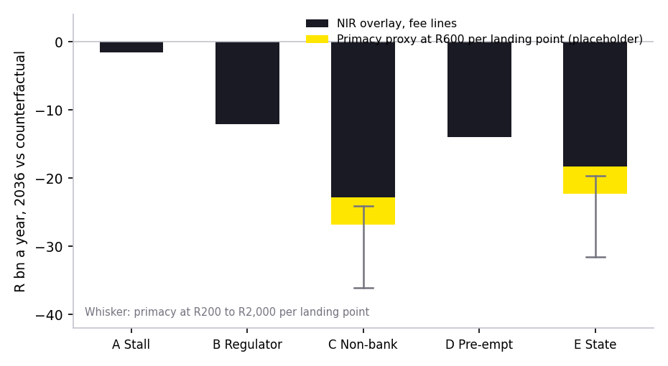
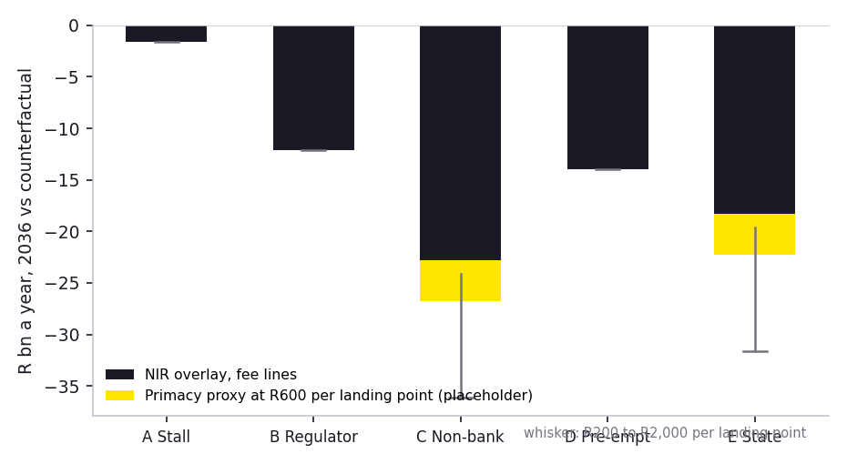
The rail erodes 0% to 6% of six-bank NIR by 2036; the interface, not the fee pool, is what is at stake
Fee lines are the floor
Consumer transfer fees, debit interchange at the SARB rate of 0.44%, acquirer margin, new merchant fees at the banks' share and cash handling fees, against a R386bn counterfactual. Worst case C at R23bn a year; cash handling cost savings claw back a quarter.
The primacy proxy is adjustable
Landing points lost by the banks, valued per landing point per year. R600 is a placeholder; the whisker shows R200 to R2,000. Sizing on the mass-market unsecured book is the outstanding number.
B versus C is the merchant interface
The R6bn gap is the banks' share of rail merchant fees, 70% against 25%, and the reason an incumbent might move first.
Source: EY NIR scenario overlay v3 on the six-bank FY2025 baseline of R225.8bn. Orders of magnitude; three fee pools remain assumptions.

Slide 7
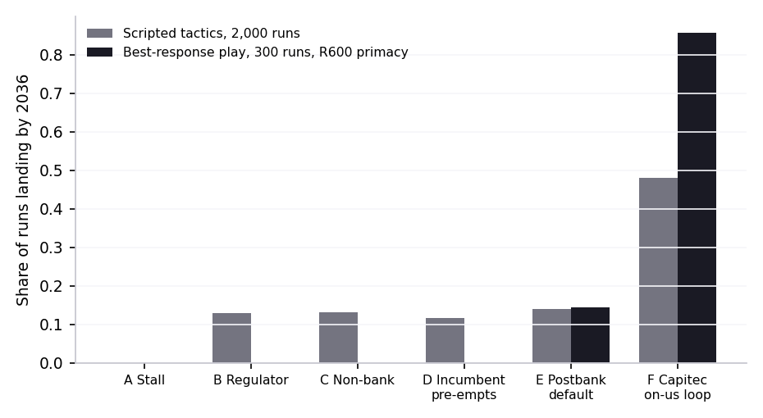
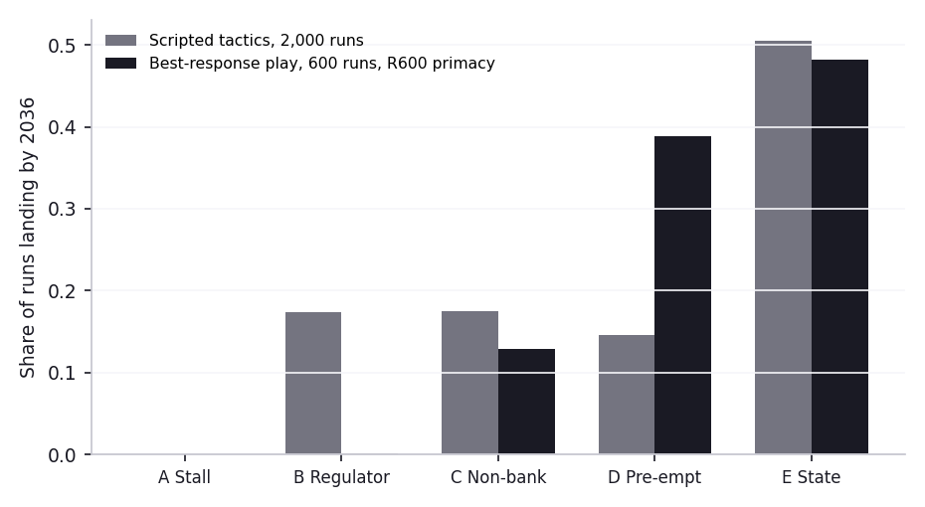
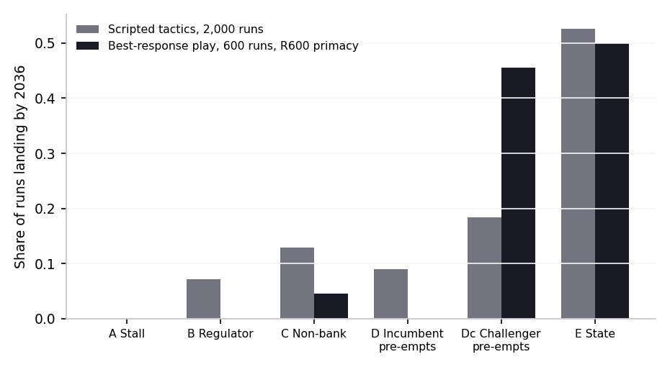
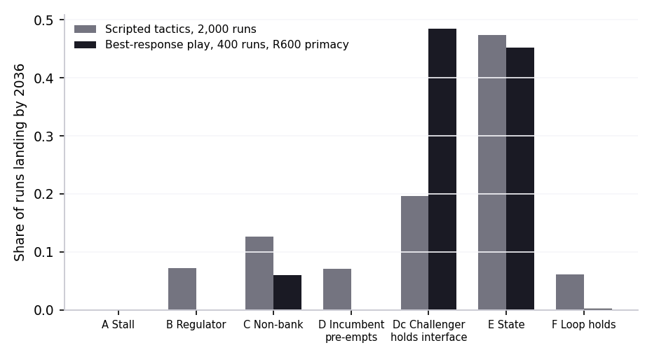
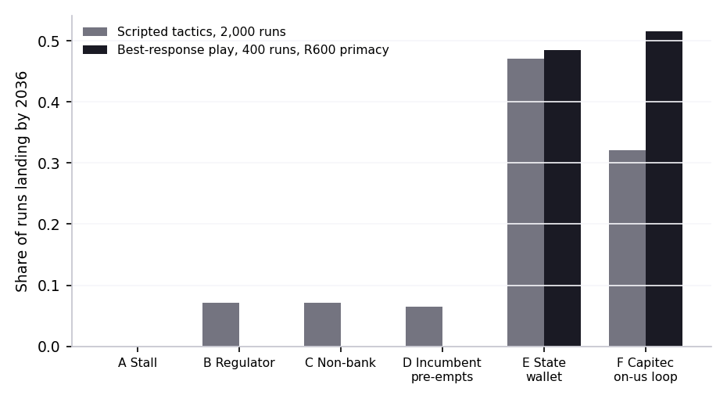
When every archetype plays its own tactic, the grant follows the interface and the mass market ends in Capitec's loop
The stall fails as a strategy
Across 2,000 scripted runs the market never lands on A: the regulator's gentle path reaches zero fee and mandate by 2030, SASSA's gateway is on the rail by 2029, and the market moves whether or not the issuer-heavy banks match.
The on-us loop holds
Capitec settles its own customers' payments on its own books and never on PayShap. Under best-response play the loop starts in 2027, takes a third of A2A volume off the rail and well over half the mass-market interface, and nothing opens it.
The state pays to the interface
The digital roadmap has SASSA paying grants over the rail into the recipient's preferred account or wallet from 2027, not a Postbank wallet. The grant lands where the recipient already banks, which is mostly Capitec; a Postbank default is a 15% variant.
Source: EY market game v8, levers in levers.xlsx. Scripted and best-response players; myopic best responses, not equilibria. Roadmap milestones are stated intent, In Development v0.1.0.

Slide 8
What it takes to compete differs by archetype, and each faces one decision
Archetype | Starting position | Build | Best / threat | The single decision
Incumbent banks | Balance sheet, merchant book, wrong cost base | Real-time core, native rail, API layer, rail-embedded fraud, two-sided data; one P&L owner, quarterly pricing, manufacturer capability | A or D / C, E | Compete for the interface or manufacture behind it, by segment
Challenger banks | Cost base, consumer; Capitec has an acquiring base (R98.6bn merchant turnover, 456k business clients), the others do not | Rail-native acceptance on own devices (Capitec) or via fintechs (others); fraud and recovery; sponsor-bank wallet architecture | B, or D as pre-emptor / D if pre-empted | Take the merchant ground on the rail now, or reach it via fintechs, or wait
Payment fintechs | Merchant, checkout, no licence | Balance ledger, safeguarding, direct PayInc connection; float, credit and data on the merchant book | B or C / D | Take the licence or stay sponsored
Card schemes | Network, wallet position, most to lose | Real-time A2A over own network, credit on the rail; concede debit, defend credit | A / B, C, D | Fight the rail or run on it
Retailers and telcos | Till, float, reach, no machinery | Ledger, alias, rail connection, sponsor bank, all buyable; regulated-entity function | C / D | Pursue the licence and the flow
PayInc and SARB | The rail, half state-owned | Rate card, open standard, open directory, return mechanism, statistics series | B / A | Mandate and zero consumer fee in the 2027 cycle
SASSA and Postbank | 28m grants a month; G2P gateway on the rail by 2027 (roadmap, indicative) | SASSA-owned disbursement stack on SARB rails; domestic card scheme under study | E, which settles C against F / none | Whether the gateway lands on time and who holds the interface when it does
Unit cost governs all of it: Pix costs the BCB one centavo per ten transactions; UPI about 40 paise a transaction. A participant whose cost per payment is measured in rand cannot price at zero for the consumer or at half a percent for the merchant.

Slide 9
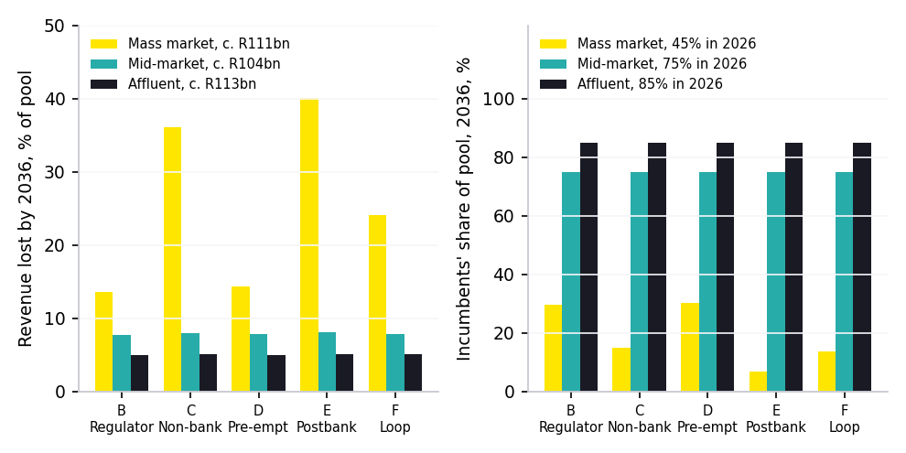
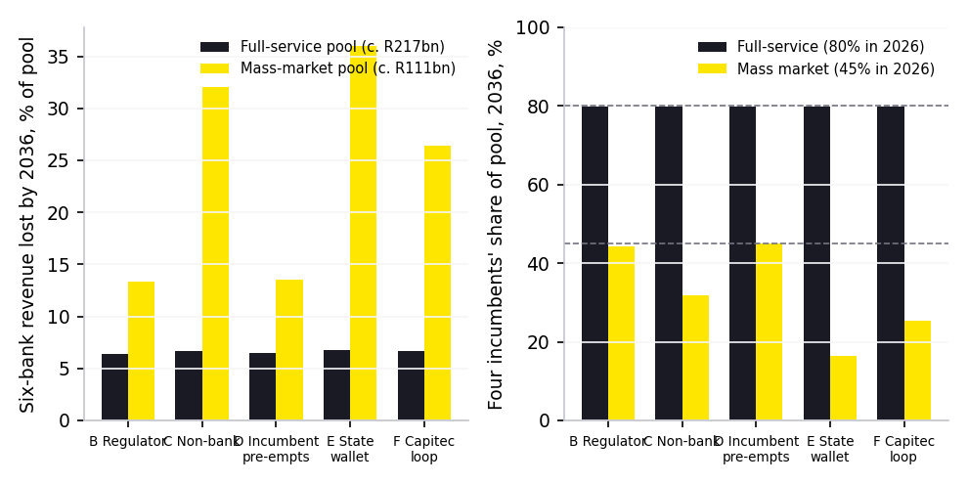
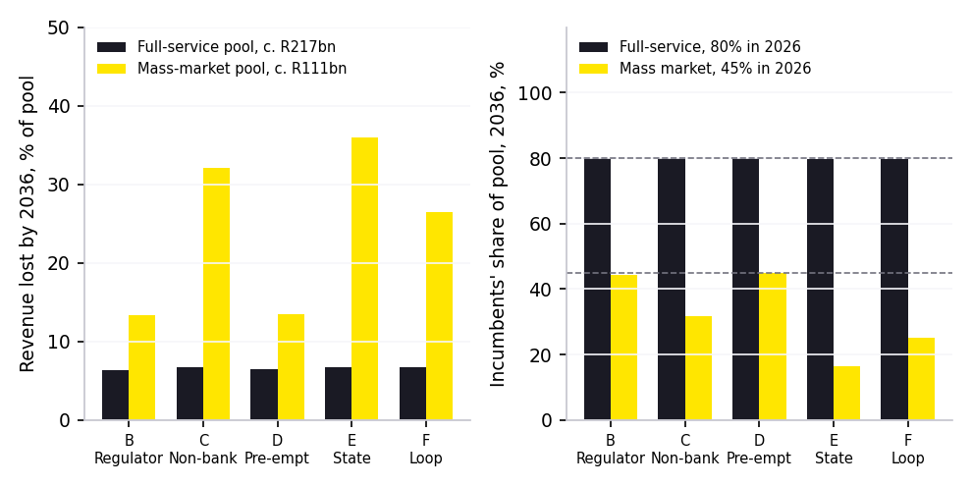
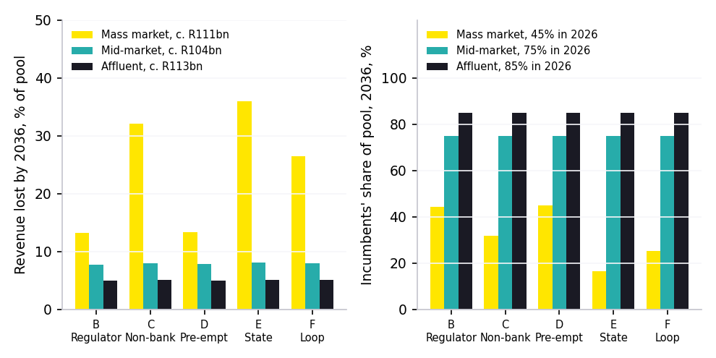
By revenue the market favours the incumbents: two thirds of the pool is full-service and it moves 5% to 8% in every scenario
The bifurcation is a third of the market
Capitec's loop and the state's wallet decide the mass-market interface and pool, about R111bn of a R328bn six-bank total by 2036. The mid-market and affluent pools move 8% and 5% in every scenario and stay with the incumbents.
Full-service loses fees, not the franchise
Almost all of the mid-market and affluent loss is transaction and account fees going to zero as the price war spreads up-market. Credit interchange loses under R1bn; secured and unsecured lending income do not move.
Payments do not hollow the middle
The incumbents hold 86% of the mid-market interface and all of the anchored landing points. What would hollow the middle is the price of credit and of the account, and the cost to serve a relationship customer; those are outside this game.
Source: EY market game v8, three-segment revenue board, 2,000 scripted runs. Revenue pools and the K-shaped split are assumptions flagged in levers.xlsx.

