Slide 1
Centralisation at Absa Financial Services: what it is worth, where the money is and what it will cost
Point of view for the managing executive, Absa Financial Services
7 October 2026. Draft, not for distribution.

Slide 2
Centralisation is worth a hypothesis range of R276m to R806m a year, base R505m, about a third of Insurance SA profit before tax. The money is in the non-life book, the head office and the advice business, not in life and not in acquisition. Most of it needs no centralisation: a cost programme on the present structure is worth R254m to R552m, base R396m, in two years; centralisation adds R22m to R254m plus the economic value, at more cost and a year longer. The programme runs in three waves, and the structural wave opens only on that decision.

Slide 3
What AFS is: the licence map and three corrections to the client description
The public record corrects the client description in three places, and each one changes the cost tree.
Rest of Africa still underwrote at December 2025: Absa Life Assurance Kenya and First Assurance Kenya carry solo covers of 1.18 and 1.75, and the Kenyan sale was signed only in August 2026. Kenya is stripped from every South African number here.
The investment licences are narrower than described: the asset manager, multi-manager and unit trust manager went to Sanlam Investment Holdings in 2022 (Absa holds 13 percent) and the market LISP to Glacier in 2023. What remains is a fee and platform business.
There are four South African insurance licences, with one just closed: Absa Risk Transfer Insurance Company was licensed as a cell captive in January 2024 and Absa Insurance Risk Management Services closed in 2025. A R6.4m penalty in October 2025 shows class boundaries between licences are enforced.
The Insurance SA segment perimeter changed three times in three years; no series is read across booklets without the head office adjustment.
Entity | Role | Licence | Solo cover Dec 2025
Absa Life Limited | Life underwriter | I121; FSP 36116 | 1.51
Absa Insurance Company | Non-life underwriter | Non-life; FSP 8030 | 1.81
Absa Risk Transfer Insurance Co | Non-life cell captive | Licensed Jan 2024 | 2.11
Absa Insurance Risk Mgmt Services | Former underwriter | Closed 2025 | n/a
AIFA; Instant Life; AIMS | Advisers; online life; admin FSP | FSP 4012; 42569; 524 | n/a
Stockbrokers; Absa Trust | Trading; fiduciary | JSE member; trust co | n/a
AFS insurance group | Designated 30 Jan 2019 | Insurance Act | 1.49
Source: Absa Group annual financial statements FY2025 notes 45.4 and 57.7 (AFS-449, AFS-460, AFS-461, AFS-466, AFS-467, AFS-468); Prudential Authority notices; 01_framework.md section 1.

Slide 4
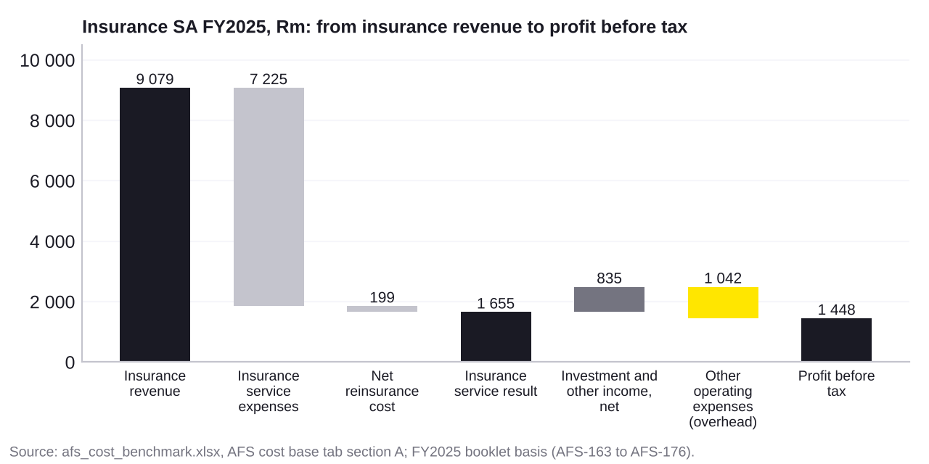
The cost base: Insurance SA FY2025 from insurance revenue to profit before tax
Insurance SA earned R9 079m of revenue and spent R7 225m inside insurance service expenses and R1 042m of overhead to make R1 448m before tax.
Insurance service expenses hold the claims, the amortised acquisition cost, onerous losses and an undisclosed block of attributable expense bracketed at R363m to R999m, base R726m.
Overhead of R1 042m splits Life R212m, Non-Life R504m and the head office R326m; the head office grew 18 percent in a year and lost R288m before tax.
The advice and investment businesses sit outside this segment and last reported R1 724m of cost against R1 104m of income in FY2023.
The reported 40 percent cost-to-income ratio divides overhead by income after claims; it is a bank metric and is not compared with any peer expense ratio.
Source: afs_cost_benchmark.xlsx, AFS cost base tab section A (AFS-163, AFS-164, AFS-176, AFS-006) and section B (AFS-070, AFS-106, AFS-140); FY2025 booklet basis.

Slide 5
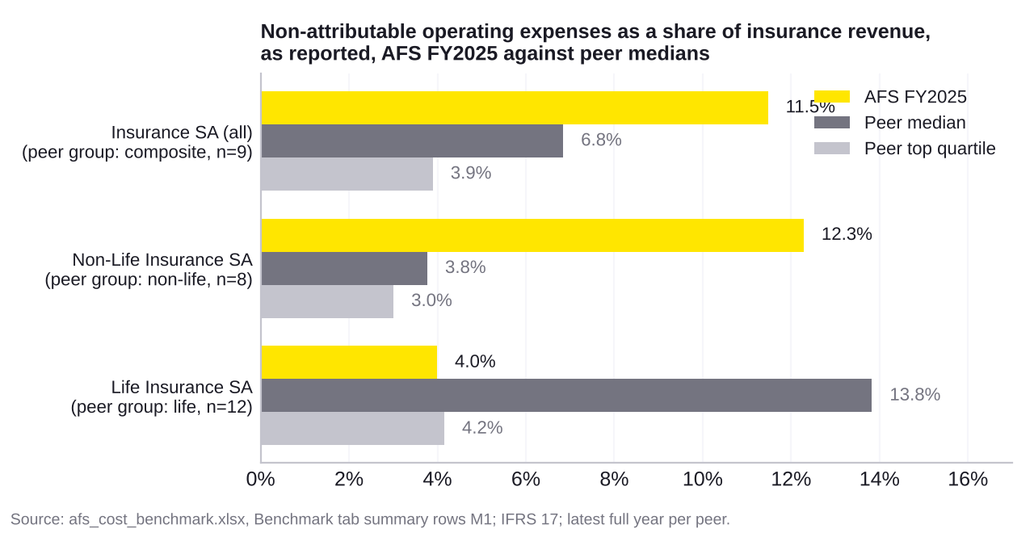
The overhead is in the non-life book and the head office, not in life
Non-Life SA carries overhead of 12.3% of revenue against a non-life peer median of 3.8%, while Life SA at 4.0% sits below its peers at 13.8%.
Insurance SA as a whole reports 11.5% against a composite median of 6.8% (n=9); the whole of the gap is non-life and head office.
The non-life gap to median is worth R349m a year on FY2025 revenue and R381m to top quartile; it maps to pool 3 in policy administration and claims.
The levers are a single policy administration and claims platform across Absa Life, Instant Life and AIC (directly enabled by centralisation) and contact centre and claims productivity (adjacent).
As-reported overhead depends on how each insurer allocates cost between attributable and non-attributable lines, so the comparable measure on the next slide is the check.
Source: afs_cost_benchmark.xlsx, Benchmark tab summary M1 and Gap sizing tab; IFRS 17; latest full year per peer.

Slide 6
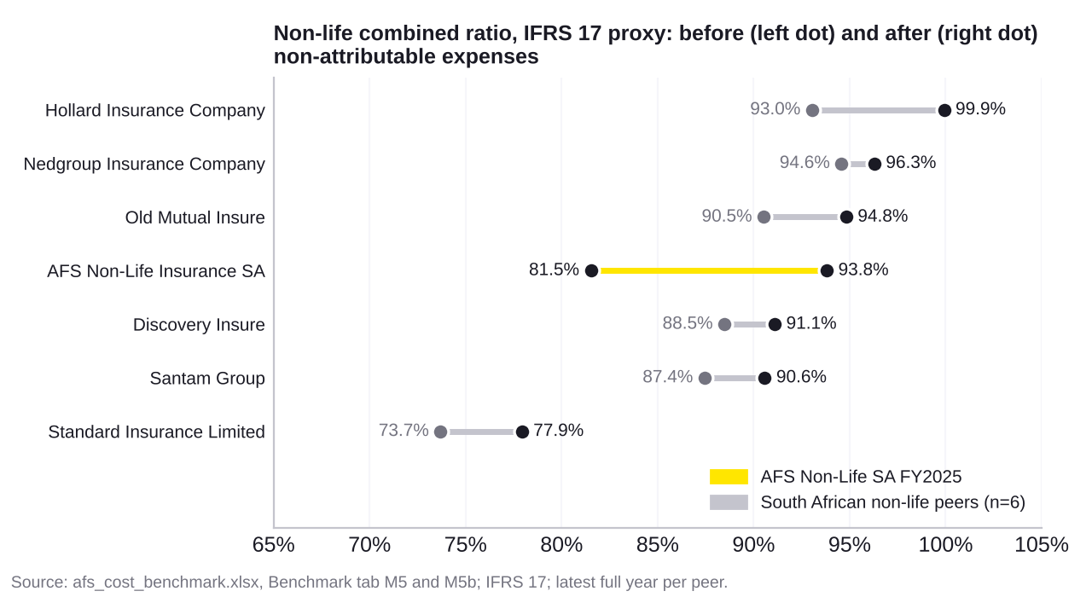
The underwriting is good and the overhead spends the advantage
Before overhead Non-Life SA runs a combined ratio of 81.5%, best of the South African set whose median is 89.5%; after overhead it is 93.8% against 93.0%.
Twelve points of overhead sit between a best-in-set underwriter and a mid-pack insurer.
The gap to top quartile after overhead is R127m a year; it belongs to pools 1 and 3 in claims.
Claims leakage at 1 to 3 percent of net claims is worth R55m to R183m and does not depend on centralisation; group-wide reinsurance placement is worth R10m to R30m and does.
The comparable expense ratio across 15 IFRS 17 entities puts AFS at 19.5 percent against a median of 22.1 percent and a top quartile of 13.3 percent, on an assumed 8 percent attributable share.
Source: afs_cost_benchmark.xlsx, Benchmark tab M5, M5b and M2 summaries; Gap sizing tab; Normalisation assumptions for leakage and reinsurance.

Slide 7
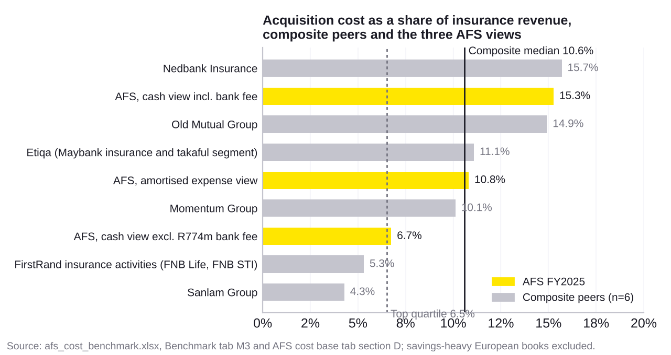
Acquisition cost is a transfer price, not a saving
Absa Bank received R774m of insurance commission in FY2025, 56 percent of the acquisition cash flows allocated to South Africa; without it AFS acquires at 6.7% of revenue, at the composite top quartile of 6.5%.
Including the fee, the cash acquisition ratio is 15.3% against a composite median of 10.6%.
The fee eliminates on consolidation. Renegotiating it moves profit between Absa Bank and AFS and changes the AFS return on equity of 18.2 percent without creating value for the Group.
The point of view must say where the economics of centralisation land, in AFS or in the bank, before it sizes anything in pool 2.
Binder and commission regulations cap what can be paid to an associate, so the price lever here is adjacent, not direct.
Source: afs_cost_benchmark.xlsx, AFS cost base tab section D (AFS-1267) and Benchmark tab M3; savings-heavy European books excluded from the median.

Slide 8
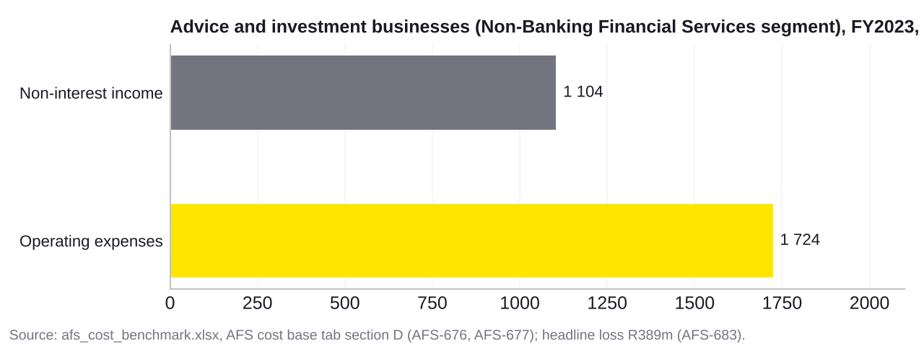
The advice and investment businesses are the bigger cost problem
The advice and investment businesses last reported R1 724m of cost against R1 104m of income and a R389m headline loss, more than the underwriters’ entire reported overhead.
The FY2023 Non-Banking Financial Services segment housed AIFA, AIMS, Absa Trust and the stockbroker; in FY2024 it was merged with a head office and lost R515m, and from FY2025 it is no longer visible.
A captive broker reference, BB Corretora in Brazil, runs at 5.6 percent operating cost to brokerage revenue. The models differ; the direction does not.
The block is carried in the addressable base at R1 500m to R1 900m, an assumption anchored on the FY2023 fact, where the precedent range is worth R90m to R247m.
The first management information request is the FY2025 income statement of this block, with adviser headcount and premium per adviser.
Source: afs_cost_benchmark.xlsx, AFS cost base tab section D (AFS-676, AFS-677, AFS-683); Benchmark tab M11 (EM-337).

Slide 9
What centralisation touches: 18 of 54 lever cells are directly enabled, 25 adjacent and 11 independent
Function | Structural | Consolidation | Productivity | Demand | Price | Leakage
Product and pricing | One product forum [A] | One pricing team and data [D] | Model automation [A] | Retire legacy versions [A] | Data vendors [I] | Rating errors [I]
Distribution | Fewer FSP licences [D] | One sales and lead platform [D] | Digital advice, STP [A] | Cut not-taken-up rework [A] | Bank fee and binder terms [A] | Commission clawback [I]
Underwriting and onboarding | None [I] | Shared KYC and onboarding [D] | Automated rules [A] | Fewer questions and exceptions [A] | Evidence vendors [A] | Anti-selection [I]
Policy administration | None [I] | One admin platform, one contact centre [D] | Self-service, robotics, spans [A] | Failure demand [A] | TPA and call centre fees [A] | Premium collection [I]
Claims | Group reinsurance placement [D] | One claims platform and fraud analytics [D] | Straight-through adjudication [A] | Fewer reopens [A] | Repairer and reinsurance pricing [A] | Claims leakage [I]
Investments | One wealth FSP [D] | One mandate structure [D] | Automated investment accounting [A] | Fewer mandates [A] | Fee basis points on combined assets [D] | Cash and custody slippage [I]
Technology | None [I] | Platform and vendor rationalisation [D] | Cloud, decommissioning [A] | Less change demand [A] | Licence renegotiation [A] | Unused licences [I]
Finance, actuarial, risk | Shared control functions, one audit, group ORSA [D] | One IFRS 17 engine and reporting stack [D] | Close and model automation [A] | Fewer entity returns [D] | Audit and consulting fees [A] | Trapped capital [D]
Governance and corporate | Fewer boards and licences [D] | Shared secretarial, legal, HR, premises [D] | Management spans and layers [A] | Fewer committees [A] | Premises and professional fees [A] | VAT on recharges, levies [D, can be negative]
Yellow: directly enabled by centralisation [D]. Grey: adjacent [A]. White: independent of the operating model [I]. The independent cells are almost all leakage, which is often the fastest money.
Source: 01_framework.md section 5; levers derived from cost = volume x unit cost, with the structural versus consolidation boundary rule.

Slide 10
What will not centralise cleanly: seven constraints that shape the structural levers
Seven facts about the regime decide how far licences, control functions and platforms can be brought together, and one of them can move the wrong way.
Life and non-life cannot share a licence, so two boards, two heads of actuarial function, two audits, two ORSAs and two solvency capital requirements remain.
Control functions may be shared through intra-group outsourcing, but each board stays accountable and the regulator can require a function back in-house.
FAIS licences are entity-bound with their own key individuals, compliance officers and representative registers; consolidating FSPs is a regulatory project.
Policy transfers between insurers need statutory approval; Absa did this with Guardrisk in 2020 and 2021, and it costs time, actuarial and legal effort.
The cell captive is ring-fenced with its own licence conditions; collapsing it into AIC is a Prudential Authority decision.
Binder and outsourcing rules cap and condition what can be paid to an associate for distribution.
South Africa has no group VAT registration, so recharging a shared service into exempt entities can create irrecoverable VAT that did not exist before. Tax input comes before any shared service case is signed off.
Source: 01_framework.md section 7; Insurance Act 18 of 2017 and Prudential Authority standards; Absa policy transfer notices 2020 and 2021.

Slide 11
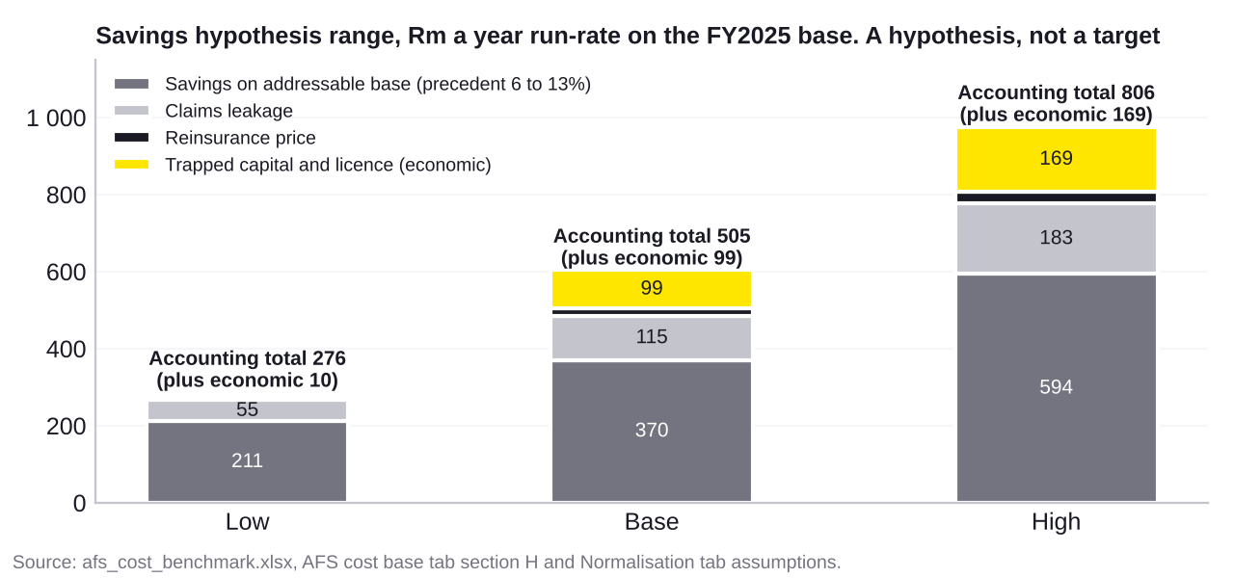
The size of the prize: a hypothesis range, not a target
The envelope is R276m to R806m a year on accounting lines, base R505m, with R10m to R169m of economic value from capital and licences kept separate.
Addressable base of R3 524m to R4 566m (operating expense, acquisition excluding the bank fee, shareholder investment cost) at precedent percentages of 6 to 13 percent gives R211m to R594m.
Claims leakage adds R55m to R183m; reinsurance repricing adds R10m to R30m.
The benchmark route on the overhead pools alone gives R210m to R556m; two independent routes, one order of magnitude.
Every input sits on the Normalisation tab with its rationale, low, base and high; management information replaces each one in turn.
Source: afs_cost_benchmark.xlsx, AFS cost base tab section H, Gap sizing tab and Normalisation tab.

Slide 12
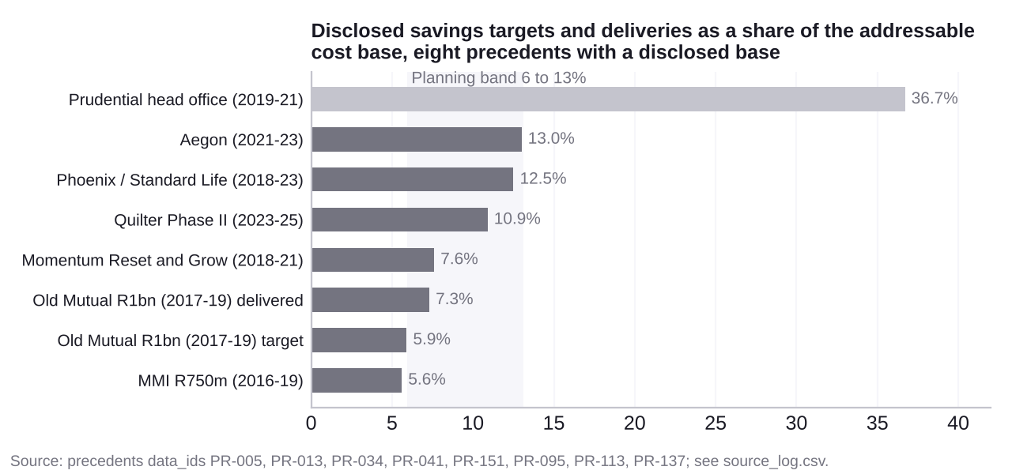
What it costs and how long it takes: the precedent record
Twenty disclosed programmes delivered 6 to 13 percent of the addressable base in two to three years, at 0.25 to 0.7 times run-rate savings for shared services and 1.5 to 2 times where licences and platforms were consolidated; for AFS that is R138m to R1 451m.
Old Mutual targeted 5.9 percent of a R16 960m base and delivered 7.3 percent; Momentum targeted R700m on R9 200m and delivered R900m after tax by March 2021.
Removing a holding layer after a separation released 36.7 percent at Prudential, the closest analogue to collapsing duplicated licence and control-function cost in the head office.
Year one builds the shared services and takes the leakage and procurement money; years two and three carry the platform and licence work, where the capital case helps pay for it.
Delivery overshoots were common; the risk in the record is cost to achieve, not the saving.
Source: Precedents cluster (PR-002, PR-005, PR-013, PR-039, PR-041, PR-045, PR-137, PR-009, PR-097, PR-158); primary documents in source_log.csv.

Slide 13
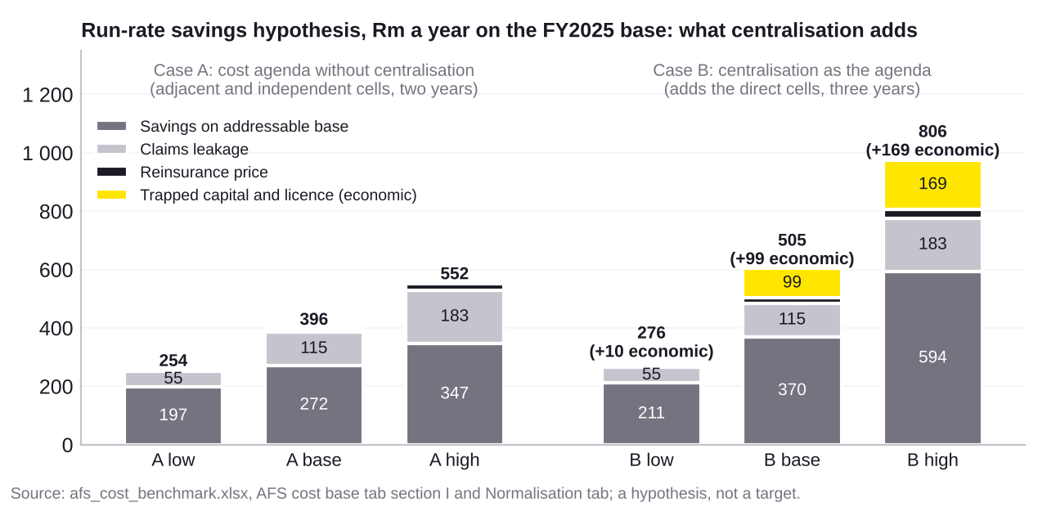
The counterfactual: what the cost agenda is worth without centralisation
A cost programme on the present structure captures R254m to R552m a year, base R396m, 78 percent of the base-case prize; centralisation adds R22m to R254m, base R109m, plus R10m to R169m of economic value.
Case A applies the South African operating-programme precedents of 5.6 to 7.6 percent of base (MMI, Old Mutual, Momentum) to the addressable base, with leakage in full and reinsurance at the entity-level share; it costs R64m to R387m to achieve over two years.
Case B is section H: the full precedent range, group reinsurance placement and the capital and licence line; on the lever-mix basis it costs R96m to R895m, base R359m, over three years.
The increment costs R32m to R508m more to achieve, base R185m, takes a year longer and carries the licence, transfer and VAT risk; it maps to the 18 direct cells, of which the non-life platform estate and the head office are the sized ones.
Without the centralisation frame the work starts from unit costs, runs leakage, collections, procurement and spans and layers first, and defers platform and licence decisions to a gate inside the programme.
Source: afs_cost_benchmark.xlsx, AFS cost base tab section I and Normalisation tab (pct_nocentral, cta_nocentral, cta_struct, reins_entity); section H unchanged.

Slide 14
The programme: three waves, two gates, one frozen baseline
The money comes in three waves sequenced from the lever grid, and the structural wave opens only at a gate with a frozen baseline, a tax ruling and the regulatory path in hand.
The managing executive sponsors and chairs a monthly steering committee; the chief financial officer owns the baseline and signs every saving; nine lever owners, one per function, carry the cells; a small programme office runs cadence, risks and the benefits register.
Benefits are run-rate against a frozen FY2025 base by entity and by nature, net of cost to achieve, in-year and run-rate apart, attributable and non-attributable apart; one-offs, revenue effects, the bank fee and recharges that stay inside the Group are outside the count.
The regulatory and tax workstream runs from day one: licence map, section 50 transfers, outsourcing notifications, FAIS re-registration, binder caps and a VAT ruling on recharges. It holds the wave three gate.
Most of waves two and three is headcount; the Old Mutual split of 48 percent people, 18 percent IT and 7 percent procurement is the planning assumption until management information replaces it.
Months from launch
Wave one, 0 to 9: independent money. R125m
Wave two, 3 to 18: adjacent money, the operating programme. R272m
Wave three, 6 to 36: direct money, opens only on the structural decision. Platform estate, control functions, FSPs, group reinsurance, licences. R109m plus economic value
Regulatory and tax workstream from day one: licence map, section 50 transfers, outsourcing notifications, FAIS, binder caps, VAT ruling
0
6
12
18
24
30
36
Gates (diamonds). Gate one, about month 1.5: frozen baseline signed by the chief financial officer. Gate two, month 6: tax ruling on recharges, regulatory path per licence action, structural decision by the steering committee. Run-rate figures are the base case at full delivery.
Source: 05_pov_afs_centralisation.docx section 8; waves and gates from the lever grid in 01_framework.md section 5; precedents PR-009, PR-010, PR-012, PR-014 to PR-016, PR-045.

Slide 15
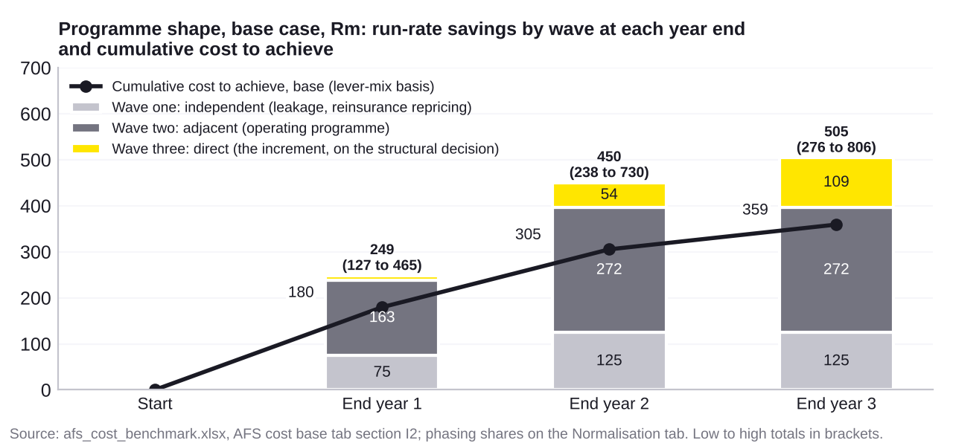
The three-year shape: what is banked by when, and what it costs
Run-rate reaches R249m by the end of year one and R450m by the end of year two in the base case, against cumulative cost to achieve of R180m and R305m; the programme is cash positive on a run-rate basis inside year two.
Year one banks the independent money and the first half of the operating programme: R75m from wave one and R163m from wave two, with R11m from wave three; the range is R127m to R465m.
By month twelve the measures live are leakage as a share of claims paid, failed debit orders not recovered in the month, unit prices on the top vendor contracts, the straight-through rate, the managers to staff ratio and the quarterly peer check on the expense and combined ratios.
Year three carries the structural wave to R109m if the gate opens; the full envelope of R276m to R806m lands by the end of year three at a lever-mix cost of R96m to R895m.
Precedents overshot their targets in year two; the risk in the record is cost and time, not the size of the saving.
Source: afs_cost_benchmark.xlsx, AFS cost base tab section I2; phasing shares oper_y1, oper_y2, struct_y1, struct_y2, cta_y1 and cta_y2 on the Normalisation tab with their precedent data_ids.

Slide 16
What we need from management: ten items, the first three starred
Ten management information items turn the hypothesis range into a target; the public record cannot close any of them.
* Expense by nature by legal entity and for the insurance head office, FY2023 to FY2025.
* The split of insurance service expenses into incurred claims and other directly attributable expenses, by entity and function.
* The FY2025 income statement of the advice and investment businesses, with adviser headcount and premium per adviser.
Headcount by function and entity with spans and layers; in-force policy counts and product versions.
Commission and fees paid to Absa Bank by product and the distribution agreement; group recharges by service with VAT treatment.
The reinsurance programme by entity; board target covers, own funds and SCR by entity.
The platform and vendor inventory with contract values, and the cost of each licence (board, head of actuarial function, audit, levies).
Source: 02_afs_cost_structure.md section 5.

Slide 17
Decisions and the next 90 days
Two decisions come before any number is committed to, a third waits for the wave three gate, and 90 days of management information turn the range into a target.
Decision one: measure the economics on AFS as legal entities, with the bank fee as a cost, or on bancassurance as an activity, where it nets to nil. We recommend sizing on the entity view and showing the activity view alongside.
Decision two: collapse licences and platforms, or stop at shared services. The structural value sits behind the first; the cost to achieve roughly doubles with it.
Decision three, taken at the wave three gate and not now: run the operating programme alone or the structural programme, on the evidence from the frozen baseline, the tax ruling and the regulatory path.
Weeks 1 to 6 collect the ten items and freeze the baseline; weeks 7 to 10 replace each assumption with a fact and set a target with a confidence band per pool; weeks 11 to 13 take the two decisions, launch wave one and stand up the regulatory and tax workstream.
Week | Item | Owner
2 | Expense by nature; attributable split | CFO; chief actuary
3 | Headcount; policy counts; adviser data | HR; COO; head of advice
4 | Bank fees and agreement; recharges and VAT | CFO; group finance and tax
5 | Reinsurance programme; target covers and SCR | Chief actuary
6 | Platform and vendor inventory; licence costs; advice P&L | COO; CFO
7 to 10 | Rebuild and re-benchmark | EY and AFS finance
11 to 13 | Decisions and plan | Managing executive
Source: 02_afs_cost_structure.md section 5; 01_framework.md section 12 for the scoping decisions already taken.

Slide 18
Appendix: assumptions register and sources
Assumption | Low | Base | High | Basis
Cost of equity (Absa Group, FY2025) | 14.5% | 15.1% | 16.0% | Fact for base: Absa Group Integrated Report 2025 p40 states cost of equity 15.1 percent (source AFS:IR25)
Other directly attributable expenses inside insurance service expenses, as share of insurance r | 4.0% | 8.0% | 11.0% | Absa does not split attributable expenses from incurred claims (AFS notes.md). Peer evidence for the band
Target solvency cover for a South African AFS insurer (SAM SCR cover) | 1.25x | 1.35x | 1.50x | Judgement. Reported solo covers at 31 Dec 2025: Absa Life 1.51, AIC 1.81, ARTIC 2.11, AFS insurance group
Own funds as a multiple of IFRS equity (approximation) | 1.00x | 1.00x | 1.00x | SAM own funds are not disclosed; IFRS equity is used as the proxy. Held at 1.0 in all cases; the gap to t
Claims leakage as a share of net claims paid | 1.0% | 2.0% | 3.0% | Judgement. No public disclosure exists for AFS or peers. The metric is evidenced by a claims leakage audi
Achievable saving on net reinsurance cost from group-wide placement | 5.0% | 10.0% | 15.0% | Judgement. Applied to the net expense from reinsurance contracts held for Insurance SA.
Annual cost of one avoidable insurance licence (board, head of actuarial function, audit, levie | 10 Rm | 20 Rm | 40 Rm | Judgement. Scale reference: First Assurance Kenya audit fees KES 7.6m (AFS-1477) and professional fees KE
Investment management cost on shareholder funds, basis points | 20 bps | 30 bps | 40 bps | Judgement for a short-dated shareholder portfolio. Only the shareholder-borne fee is in scope; policyhold
Realisation factor applied to the gap to peer median | 50.0% | 75.0% | 1.00x | Judgement. A benchmark gap is a hypothesis, not a target; the factor expresses how much of the gap to med
Realisation factor applied to the gap to peer top quartile | 25.0% | 50.0% | 75.0% | Judgement, as above but for the stretch case.
Intermediary and investments block (AIFA, AIMS, Trust, Stockbrokers) operating expenses, FY2025 | 1,500 Rm | 1,724 Rm | 1,900 Rm | Fact anchor: Non-Banking Financial Services segment operating expenses R1 724m in FY2023 and R1 871m in F
Precedent savings as share of addressable cost base (from Phase 3 precedents) | 6.0% | 9.0% | 13.0% | Derived from the precedents cluster: Old Mutual 5.9 percent target and 7.3 percent delivered (PR-005, PR-
Cost to achieve as a multiple of run-rate savings | 50.0% | 1.00x | 1.80x | From precedents: 0.25x to 0.7x for headcount and procurement programmes (PR-009, PR-082, PR-076, PR-089);
Counterfactual: precedent savings as share of addressable base, programmes that did not consoli | 5.6% | 6.6% | 7.6% | Derived from the three South African operating programmes: MMI R750m on R13 444m, 5.6 percent (PR-034); O
Counterfactual: cost to achieve multiple for headcount and procurement programmes without struc | 25.0% | 44.0% | 70.0% | From precedents without licence or platform consolidation: Manulife 0.25x (PR-082), Old Mutual 0.26x (PR-
Counterfactual: cost to achieve multiple on the increment where licences or platforms are conso | 1.50x | 1.70x | 2.00x | From precedents that consolidated entities or platforms: Quilter 1.54x (PR-158), Aegon 1.62x (PR-116), Pr
Counterfactual: share of the reinsurance price saving achievable by entity-level repricing with | 25.0% | 50.0% | 75.0% | Judgement. Group-wide placement under the insurance group designation is a direct (structural) cell; enti
Years to full run-rate, operating programme (waves one and two) | 2 years | 2 years | 3 years | Old Mutual two years (PR-006); Momentum Reset and Grow three years (PR-042); Old Mutual 2020 programme tw
Years to full run-rate, structural programme (wave three added) | 3 years | 3 years | 4 years | Aegon 2021 to 2023 (PR-111); Phoenix transition programme 2018 to 2023 (PR-092); Zurich four years (PR-07
Share of operating run-rate delivered by end of year one | 50.0% | 60.0% | 75.0% | Phoenix 44 percent of target in year one (PR-099 over PR-094); Aegon 61 percent (PR-117 over PR-112); Old
Share of operating run-rate delivered by end of year two | 90.0% | 1.00x | 1.00x | Aegon 92 percent (PR-118 over PR-112); Old Mutual 124 percent (PR-012 over PR-004); Momentum at target (P
Share of structural (wave three) run-rate delivered by end of year one | 0.0% | 10.0% | 20.0% | Judgement. Wave three opens at month six behind the tax ruling and the regulatory path; little run-rate l
Share of structural (wave three) run-rate delivered by end of year two | 40.0% | 50.0% | 70.0% | Judgement anchored on Phoenix (44 percent in year one, full by year five, PR-099) and Aegon (92 percent b
Share of cost to achieve spent in year one | 50.0% | 50.0% | 50.0% | Judgement. Programmes front-load restructuring and platform cost; Aegon spent most of its EUR 650m in the
Share of cost to achieve spent in year two | 35.0% | 35.0% | 35.0% | Judgement, as above.
Planning split: share of savings from people and operating model | 48.0% | 48.0% | 48.0% | Fact anchor: Old Mutual R1bn programme, 48 percent people and operating model (PR-014). Planning assumpti
Planning split: share of savings from IT and IT processes | 18.0% | 18.0% | 18.0% | Fact anchor: Old Mutual, 18 percent (PR-015).
Planning split: share of savings from consultants and procurement | 7.0% | 7.0% | 7.0% | Fact anchor: Old Mutual, 7 percent (PR-016). The remaining 27 percent was not attributed in the disclosur
Source: afs_cost_benchmark.xlsx, Normalisation tab section B (28 assumptions, the 15 added for sections I and I2 marked Counterfactual, phasing or planning split); 249 sources with URLs and pages in source_log.csv; verification pass of 327 checks in verification_report.md.

Slide 19
Boilerplate
EY | Building a better working world
EY is building a better working world by creating new value for clients, people, society and the planet, while building trust in capital markets.
Enabled by data, AI and advanced technology,
EY teams help clients shape the future with confidence and develop answers for the most pressing issues of today and tomorrow.
EY teams work across a full spectrum of
services in assurance, consulting, tax, strategy and transactions. Fueled by sector insights,
a globally connected, multidisciplinary network and diverse ecosystem partners, EY teams can provide services in more than 150 countries
and territories.
All in to shape the future with confidence.
EY refers to the global organization, and may refer to one or more, of the member firms of Ernst & Young Global Limited, each of which is a separate legal entity. Ernst & Young Global Limited, a UK company limited by guarantee, does not provide services to clients. Information about how EY collects and uses personal data and a description of the rights individuals have under data protection legislation are available via ey.com/privacy. EY member firms do not practice law where prohibited by local laws. For more information about our organization, please visit ey.com.
[Optional sector or service line descriptor — refer to The Branding Zone]
© 2024 [member firm name].
All Rights Reserved.
XXXXX-XXXGbl
ED MMYY
[Optional environmental statement — refer to The Branding Zone]
[Required legal disclaimer — refer to The Branding Zone]
ey.com

