Slide 1
Classification of Sequential Data
Katharina Kann
Tech Frontiers – Machine Learning

Slide 2

Who Am I?
Assistant professor in the computer science department
Joined CU Boulder in January 2020
My research is in the areas of natural language processing and deep learning
I was born in Germany (Mainz)

Slide 3
What is Sequential Data?
Sequences of data points
Order matters!
Examples:
Average daily temperature
59 degrees, 63 degrees, 62 degrees, 60 degrees is a likely sequence
40 degrees, 43 degrees, 48 degrees, 53 degrees is a likely sequence
65 degrees, 38 degrees, 67 degrees, 40 degrees is not a likely sequence
Natural language text
“the cat sat on the mat” is a likely sequence
”the mat sat on the cat” is not a likely sequence
“sat the the on mat cat” is not a likely sequence
DNA sequences
…

Slide 4
What Can We Do with Sequential Data?
Predict a label for a sequence
Sequence classification
Example: Predict a tweet’s sentiment as positive/neutral/negative
That movie was really great!!
I don’t like the burger, but I like the other food they have
I like the burger, but I don’t like the other food they have
The worst phone I ever owned

Slide 5
What Can We Do with Sequential Data?
Predict the next (or a missing) element in a sequence
Sequence Classification
Examples:
Predict the next word in a sequence of words
After work she directly went _____
Yesterday, my dog didn’t eat her _____
Predict tomorrow’s average temperature
59 degrees, 60 degrees, 60 degrees, _____
39 degrees, 44 degrees, 41 degrees, _____

Slide 6
What Can We Do with Sequential Data?
Predict a label for each element in a sequence
Sequence labeling
Example: Classify words as belonging or not to named entities in text
Crawford County is a county located in the U.S. state of Indiana.
Which models can be used for sequence labeling?

Slide 7
Markov Chains

Slide 8








Markov Chain
A model that tells us something about the probabilities of sequences of random variables (states)
Each of those variables can take on values from a predefined set
0.7
cold
0.1
0.1
0.2
0.1
warm
hot
0.8
0.3
0.6
0.1

Slide 9
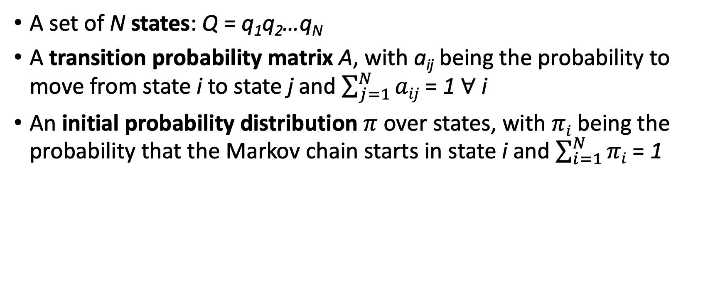
Markov Chain – Formal Definition
A set of N states: Q = q₁q₂…q_{N}
A transition probability matrix A, with a_{ij} being the probability to move from state i to state j and $\sum_{j=1}^{N}{aij}$ = 1 $∀$ i
An initial probability distribution $π$over states, with $πi$ being the probability that the Markov chain starts in state i and $\sum_{i=1}^{N}{πi}$ = 1

Slide 10
Computing the Probability of a Sequence
P(q₁, …, q_{T}) = P(q_{T}|q₁, …, q_{T-1}) * P(q_{T-1}|q₁, …, q_{T-2}) * … * P(q₁)
Markov assumption:
The probability of each state P(q_{i}) only depends only on one previous state: P(q_{i}|q₁, …, q_{i-1}) = P(q_{i}|q_{i-1})
P(q_{T}|q₁, …, q_{T-1}) = P(q_{T}|q_{T-1})
P(q_{T-1}|q₁, …, q_{T-2}) = P(q_{T-1}|q_{T-2})

Slide 11
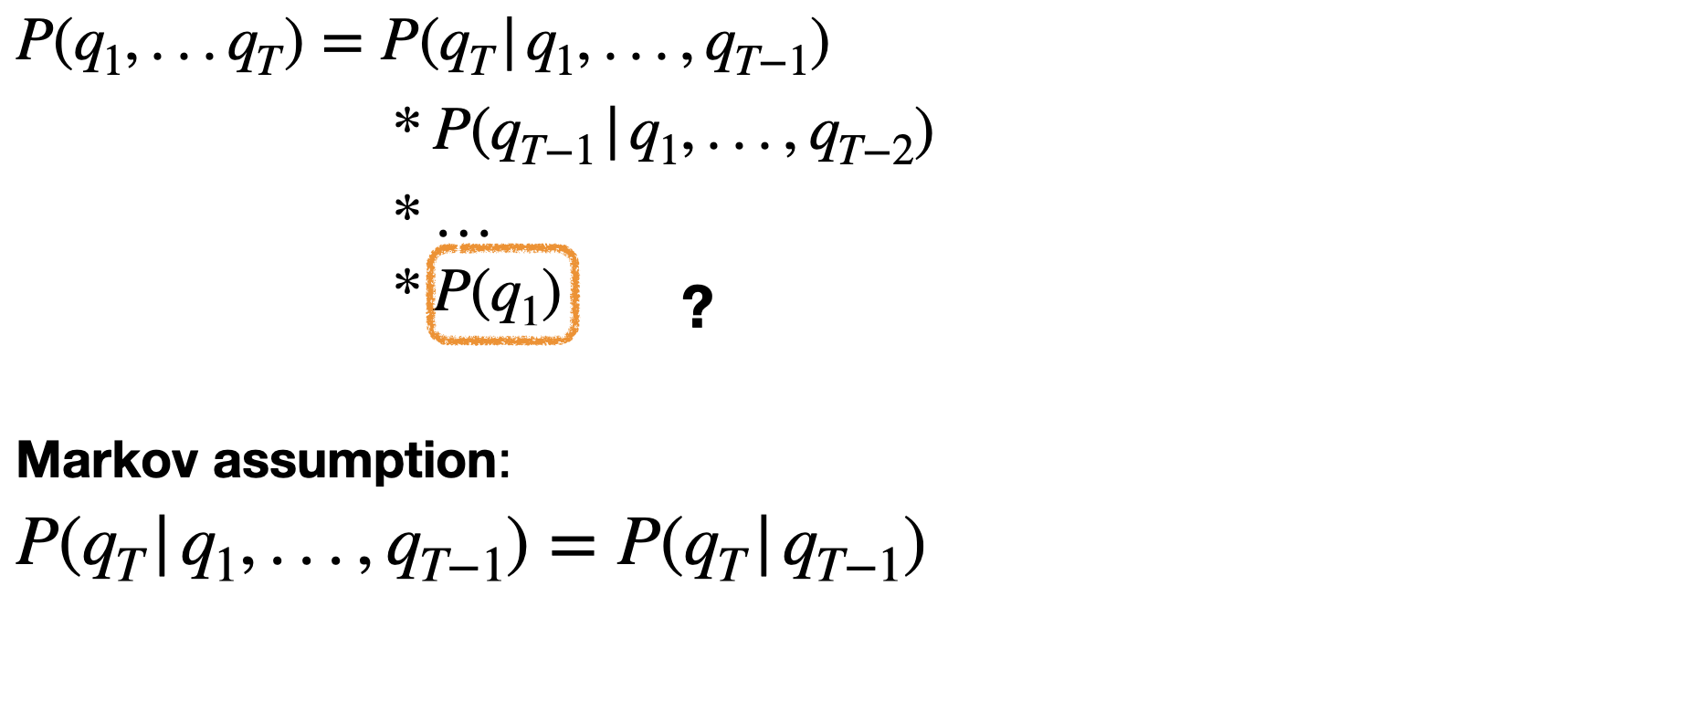
Markov Chain

Slide 12
Markov Chain
We further have an initial probability distribution over states.
The probability that each state is the first state!
For example: π = [0.1, 0.7, 0.2] for the states hot, warm, and cold

Slide 13
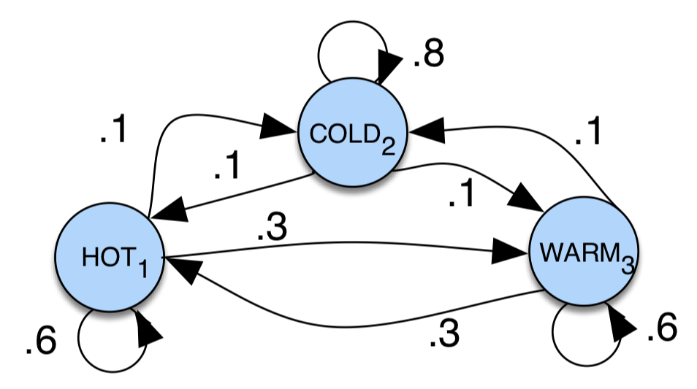
Example: Markov Chain
π = [0.1, 0.7, 0.2] for the states hot, warm, and cold
Compute the probability of:
Warm, hot, warm
cold, hot, cold, hot

Slide 14
Example: Markov Chain
0.7
cold
π = [0.1, 0.7, 0.2] for the states hot, warm, and cold
Compute the probability of:
Warm, hot, warm
cold, hot, cold, hot
0.1
0.1
0.2
0.1
warm
hot
0.8
0.3
0.6
0.1

Slide 15
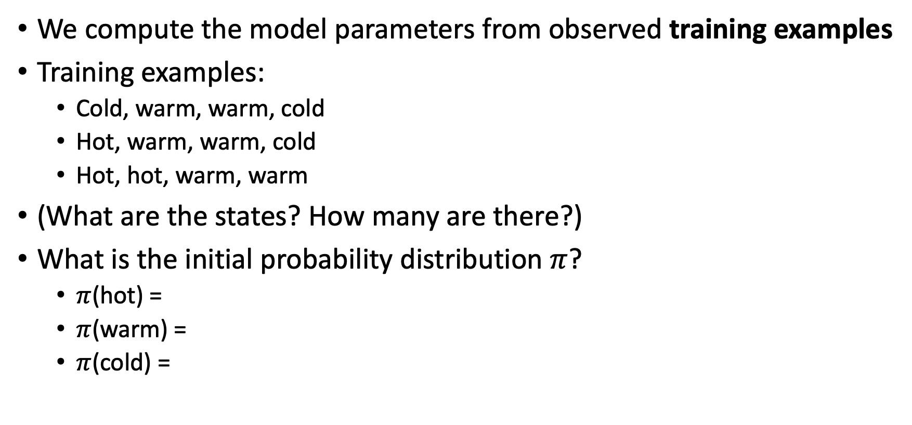
Where Do the Parameters Come from?
We compute the model parameters from observed training examples
Training examples:
Cold, warm, warm, cold
Hot, warm, warm, cold
Hot, hot, warm, warm
(What are the states? How many are there?)
What is the initial probability distribution $π$?
$π$(hot) =
$π$(warm) =
$π$(cold) =

Slide 16

Where Do the Parameters Come from?
We compute the model parameters from observed training examples
Training examples:
Cold, warm, warm, cold, cold
Hot, warm, warm, cold, warm
Hot, hot, warm, warm, hot
What is the transition probability matrix A?
$π$(hot|warm) = $\frac{count(warm, hot)}{count(hot)}=$ $π$(hot|cold) = $π$(hot|hot) =
$π$(warm|warm) = $π$(warm|cold) = $π$(warm|hot) =
$π$(cold|warm) = $π$(cold|cold) = $π$(cold|hot) =

Slide 17
Exercise
In this exercise you will build your own Markov chain and use it to compute the probability of 3 sequences
Open module4_data_1.csv and familiarize yourself with the format
Then open module4_part1.ipynb
There are multiple TODOs: find them and complete the code, such that it can run!
What are the outputs of the last cell?

Slide 18
Hidden Markov Models

Slide 19
Generative vs. Discriminative Models
Generative models define the joint probability distribution P(X, Y)
Discriminative models model the conditional probability of Y given X: P(Y|X)

Slide 20
Hidden Markov Models
Markov chains can compute a probability for a sequence of observable events.
However, we often don’t observe the events we are interested in.
Hidden Markov models!
Example:
Assume that you talk to a friend every day and they tell you their daily activities (but nothing about the weather) and you want to infer the weather in their home town

Slide 21
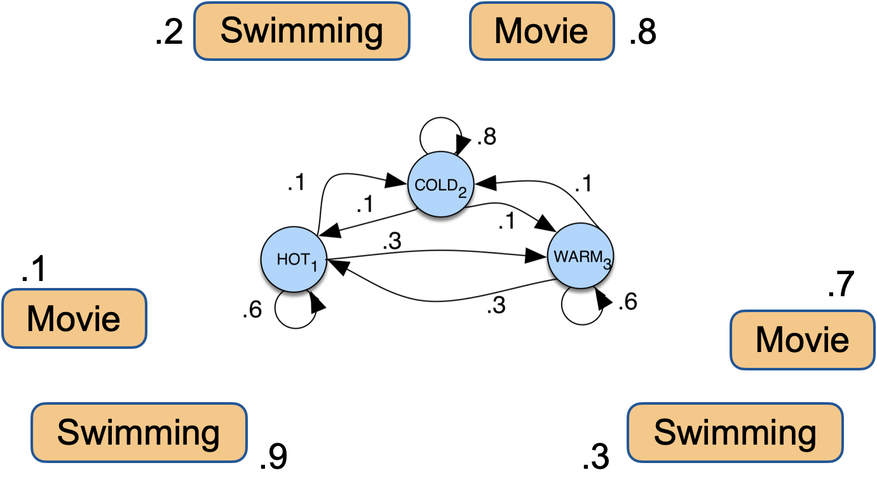
Hidden Markov Model

Slide 22


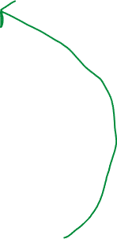



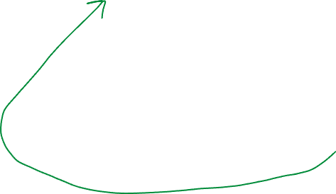
Hidden Markov Model
movie
swimming
0.9
0.7
cold
0.1
0.8
0.3
0.2
0.7
0.1
0.1
0.2
0.1
warm
hot
0.8
0.3
0.6
0.1

Slide 23

Hidden Markov Model
A set of N states: Q = q₁q₂…q_{N}
A transition probability matrix A, with a_{ij} being the probability to move from state i to state j and $\sum_{j=1}^{N}{aij}$ = 1 $∀$ i
An initial probability distribution $π$over states, with $πi$ being the probability that the Markov chain starts in state i and $\sum_{i=1}^{N}{πi}$ = 1
A set of T observations: O = o₁o₂…o_{T}
A matrix of observation likelihoods or emission probabilities B, with b_{i}(o_{j}) expressing the probability that observation o_{j} is generated from state q_{i}

Slide 24
Simplifying Assumptions
A first-order Markov model makes 2 simplifying assumptions
Markov assumption (as for the Markov chain!):
The probability of each state P(q_{i}) only depends only on one previous state: P(q_{i}|q₁, …, q_{i-1}) = P(q_{i}|q_{i-1})
Output independence:
The probability of an observation P(o_{i}) only depends on the current state: P(o_{i}|q₁, …, q_{i}, …, q_{T}, o₁, …, o_{i-1}, o_{i+1}, …, o_{T}) = P(o_{i}|q_{i})

Slide 25
Where Do the HMM Parameters Come from?
We compute the model parameters from observed training examples
Training examples:
(Cold, movie), (warm, movie), (warm, movie), (cold, movie)
(Hot, swimming), (warm, swimming), (warm, movie), (cold, movie)
(Hot, movie), (hot, swimming), (warm, swimming), (warm, movie)
States, initial probability distribution, transition probability matrix: as for the Markov chain!
(What are the observations?)

Slide 26
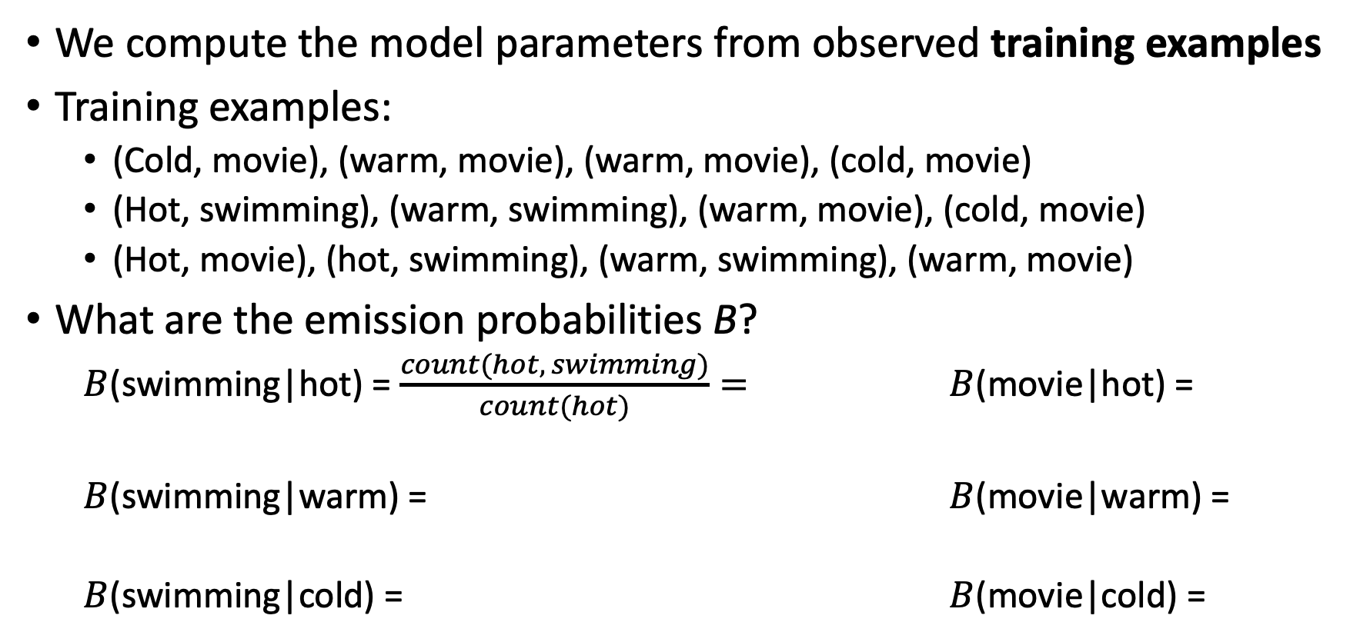
Where Do the HMM Parameters Come from?
We compute the model parameters from observed training examples
Training examples:
(Cold, movie), (warm, movie), (warm, movie), (cold, movie)
(Hot, swimming), (warm, swimming), (warm, movie), (cold, movie)
(Hot, movie), (hot, swimming), (warm, swimming), (warm, movie)
What are the emission probabilities B?
$B$(swimming|hot) = $\frac{count(hot, swimming)}{count(hot)}=$ $B$(movie|hot) =
$B$(swimming|warm) = $B$(movie|warm) =
$B$(swimming|cold) = $B$(movie|cold) =

Slide 27
Real-world Use Cases
TODO

Slide 28
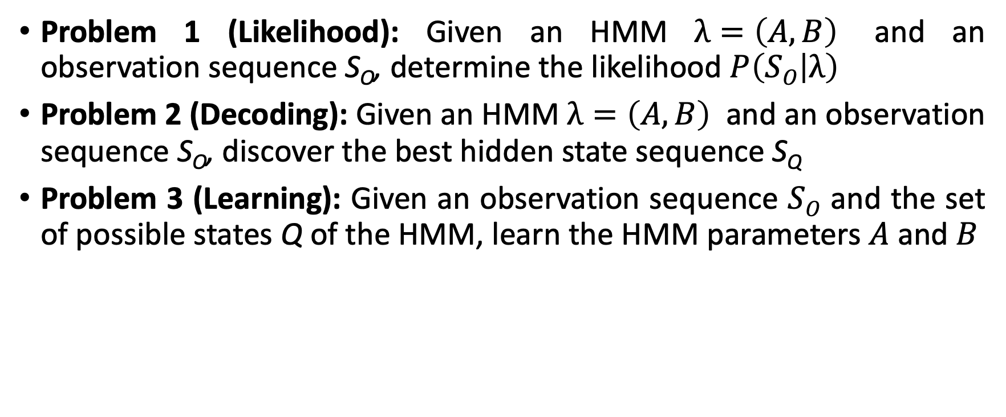
Hidden Markov Model
Problem 1 (Likelihood): Given an HMM $λ=\left(A,B\right)$ and an observation sequence S_{O}, determine the likelihood $P\left(SO | λ\right)$
Problem 2 (Decoding): Given an HMM $λ=\left(A,B\right)$ and an observation sequence S_{O}, discover the best hidden state sequence$\text{S}\text{Q}$
Problem 3 (Learning): Given an observation sequence $SO$ and the set of possible states Q of the HMM, learn the HMM parameters $A$ and $B$

Slide 29
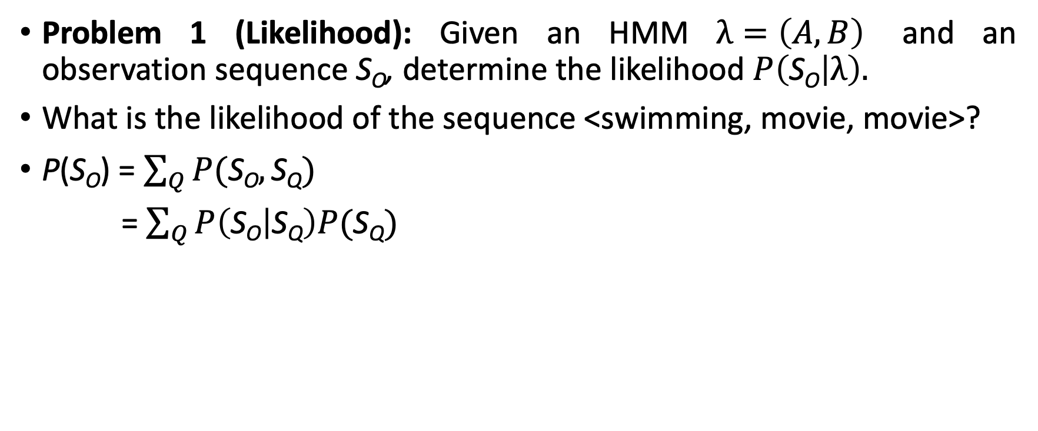


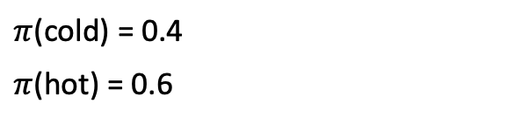


Likelihood
Problem 1 (Likelihood): Given an HMM $λ=\left(A,B\right)$ and an observation sequence S_{O}, determine the likelihood $P\left(\text{S}\text{O} | λ\right).$
What is the likelihood of the sequence <swimming, movie, movie>?
P(S_{O}) = $\sum_{Q}{P(\text{S}\text{O},\text{S}\text{Q})}$
= $\sum_{Q}{P\left(\text{S}\text{O} | \text{S}\text{Q}\right)P(\text{S}\text{Q})}$
0.2
cold
hot
0.8
0.7
0.3
0.9
0.8
0.1
0.2
movie
swimming
$π$(cold) = 0.4
$π$(hot) = 0.6

Slide 30
Likelihood
P(<s, m, m>) = P(<s, m, m>, <hot, hot, hot>)
+ P(<s, m, m>, <hot, hot, cold>)
+ P(<s, m, m>, <hot, cold, cold>)
+ P(<s, m, m>, <hot, hot, cold>)
+ …
For a HMM with N hidden states and an observation sequence of T observations, there are N^{T} possible hidden sequences
Not easy to compute in practice!
The forward algorithm is a more efficient alternative

Slide 31
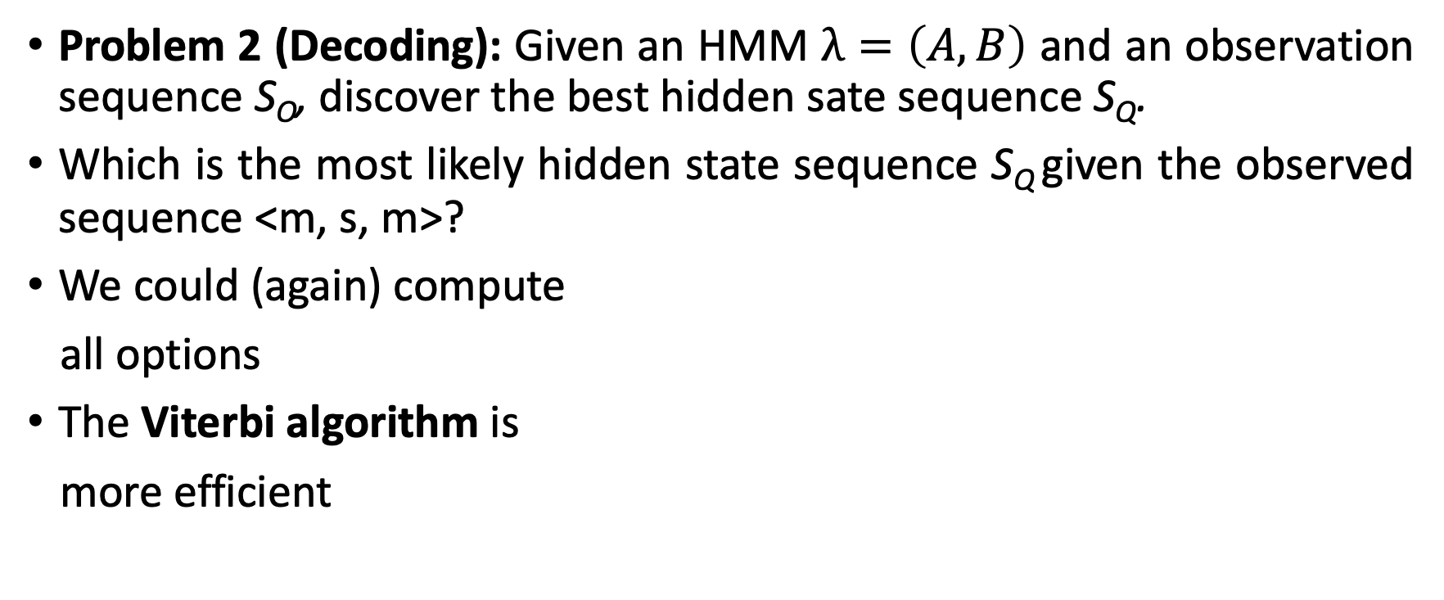
Decoding
Problem 2 (Decoding): Given an HMM $λ=\left(A,B\right)$ and an observation sequence S_{O}, discover the best hidden sate sequence S_{Q}.
Which is the most likely hidden state sequence S_{Q} given the observed sequence <m, s, m>?
We could (again) compute
all options
The Viterbi algorithm is
more efficient
0.2
cold
hot
0.8
0.7
0.3
0.9
0.8
0.1
0.2
movie
swimming
$π$(cold) = 0.4
$π$(hot) = 0.6

Slide 32
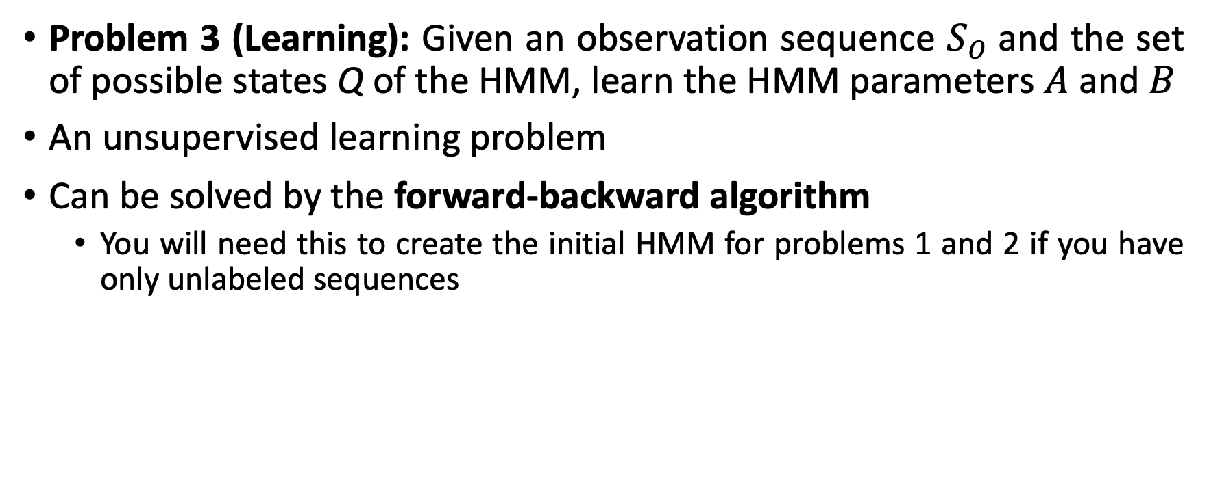
Learning
Problem 3 (Learning): Given an observation sequence $SO$ and the set of possible states Q of the HMM, learn the HMM parameters $A$ and $B$
An unsupervised learning problem
Can be solved by the forward-backward algorithm
You will need this to create the initial HMM for problems 1 and 2 if you have only unlabeled sequences

Slide 33
Exercise
In this exercise, you will build a HMM and use it to compute the likelihood of a sequence
Open module4_data_2.csv and familiarize yourself with the format
Then open module4_part2.ipynb
There are multiple TODOs: find them and complete the code, such that it can run!
What’s the output of the last cell?

