Slide 1
M-protein diagnostics using generative active learning
Hanyu Li
Advisor: Prof. Junsong Yuan

Slide 2
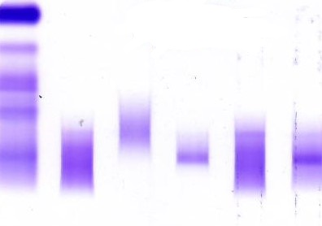
Background Knowledge(1) IFE image and M-protein
G A M κ λ
M-protein
= Myeloma protein
= Paraprotein
= Monoclonal component
= M spike
SPE
IFE
Serum protein electrophoresis
Immunofixation
electrophoresis
Notes:
M-Protein stands for Myeloma protein, which can be identified by applying immunofixation electrophoresis (IFE) because its sharp monoclonal band in the image. Electrophoresis will separate different kind of protein, so the same kind of protein(the monoclonal group) will stay in the same position thus creating a sharp and significant band. In IFE, each column represents a type of protein, the first three is heavy chain protein, the last two is light chain protein. Matchings can be found between a pair of heavy and light chain.

Slide 3
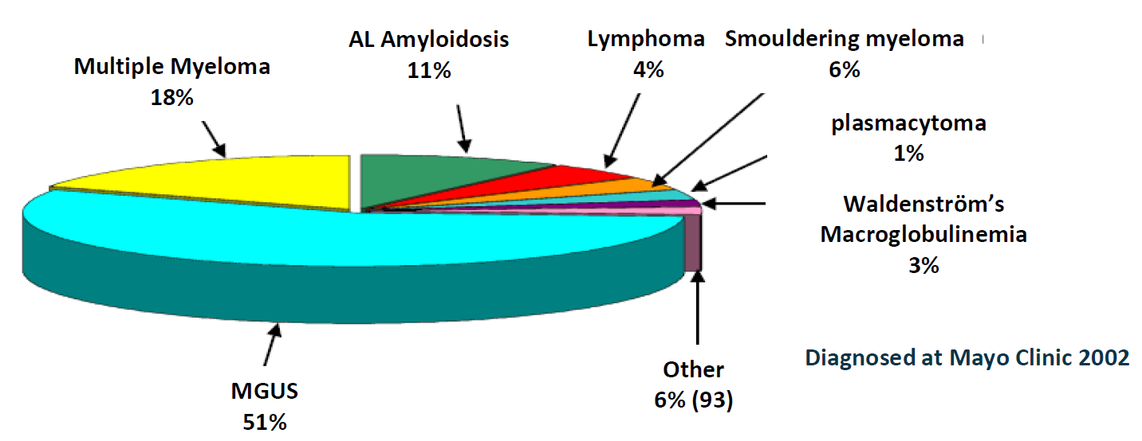
Background Knowledge(1) IFE image and M-protein
Notes:
Different categories of results may indicate MGUS, smouldering myeloma (sMM), or multiple myeloma (MM).

Slide 4
Problem Description
Mild polyclonal band
G A M κ λ
Sharp monoclonal band
[1,0,0,0,0,0,1,0,0,1,0,1]
Overall abnormal
M and λ same position
M peak sharp
λ peak sharp
SPE
IFE
Serum protein electrophoresis
Immunofixation
electrophoresis
Notes:
The first component is the overall judgement(1 if abnormal and 0 if normal).
The next 6 components are the links between heavy chain(lgG, lgA, lgM) and light chain(kappa and lambda). For example, if lgM and lambda has the same peak position, then the 7th component will be 1, because the order is: G kappa, G lambda, A kappa, A lambda, M kappa, M lambda.
The last 5 components are whether hard and strong edges(obvious monoclonal peak) are detected in the corresponding column of IFE.

Slide 5
Motivation
The task should be clear, and labeled data is needed. Should be easily transformed in to classification or regression
ML-involved part:
Binary classification of one column.
Hand-crafted rule: approximately 90% accuracy
Generalization!
The rules should be clear and the number of parameters involved should be as small as possible
Notes:
The task should be clear, and labeled data is needed. Should be easily transformed in to classification or regression
Machine learning are involved in the binary classification of one column.
The rules should be clear and the number of parameters involved should be as small as possible
Finding the position of bands and matching between columns can be done by rules.
Hand crafted rules based on edge detection and GMM have achieved 90% accuracy, but fine-tuning of the parameters can only be done in a tiny dataset, thus its generalization is poor.

Slide 6
Motivation
Few labeled data
Low dimension representation to avoid overfitting
How IFE images were formed physically
GMM based representation
Active learning

Slide 7
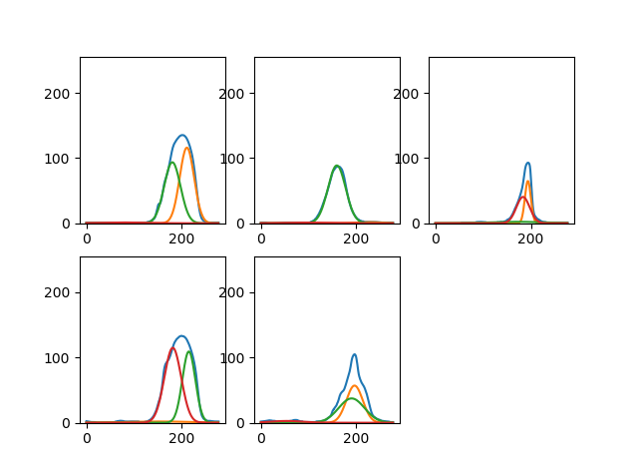
Background Knowledge GMM(Gaussian Mixture Model)
Notes:
A cluster method assuming that data is sampled from the mixture of a few Gaussian distributions.
Use EM algorithm to optimize the parameters of Gaussian in order to maximize the posterior likelihood of given data sample.
The blue one in the picture on the right is the density curve that is derived directly from the IFE image on the left.
We can treat the density as the data sample, and thus find out the latent parameters of Gaussian distribution. In other words, we assume that the density curve is the summation of a few Gaussian components that correspond to the polyclonal or monoclonal bands in the original image. Finally, a density curve that has length 300 can be represented by(empirically) 3 Gaussian components, or 9 Gaussian parameters.

Slide 8
Background Knowledge Other Pervasive Generative models
GAN
VAE
Random N(0,1) seed
Random seed
Real Images
Real Images
Encoder
multiply
Generator
Latent variance
Fake Images
add
Discriminator
Latent average
Decoder
Reconstructed images
Loss
Loss
Notes:
GAN plays a minimax game between the generator and the discriminator by training them simultaneously but with different goals. The discriminator tries to distinguish fake images generated by generator while the generator tries to generate images as real as possible to fool the discriminator.
VAE tries to develop a generative model in a variation inference kind of way. It tries to capture the most important latent variables that determine how real data are formed. Although more robust to small perturbations in latent space, VAE tends to lose more graphic details(more blurry) when reconstructing the input data compared to GAN due to its pixel-wise reconstruction loss.

Slide 9
Background Knowledge Active Learning
Classifier
and
labeled dataset
Train classifier
Draw data from unlabeled dataset
Expert label drawn data and
add to labeled dataset
returned classifier
Acquisition function?
Generate?
Notes:
active learning tries to pick the most informative data to label so that models can learn better when the total number of labeled data is limited
As you can see this is the iterative process of active learning.
Pool-based active learning gather a large pool of unlabeled data and ranks their informativeness according to an acquisition function that may coevolve with the task learner in the training process.
However, if we generate new data instead of picking data from the pool, if the generative model is assured to be effective, then we may achieve results with better quality and quantity.

Slide 10
Proposed Method Filter Stage
[1,300] density curve
Subproblem:
a filter to get rid of normal columns for the matching stage
Input: 300*1
Output: 0/1
Representation
Large unlabeled data to train representation, or GMM case no need of data
[1,9]
Latent vector
Classifier
Active learning process with expert labeling
0/1 result:
if this column is normal
Notes:
First we need to filter those normal columns so that we will not waste time trying to match the polyclonal bands in these columns with others.
On the right is the process of the filter. If the representation is GAN or VAE etc., it will be trained on the large unlabeled dataset. The representation should be bidirectional because expert cannot label the latent vector, which means that we should transform it back to data space for them. The classifier receives 9 dimension latent vector and returns 0/1. 9 dimension is empirical(3 Gaussian component is 9 dimensions).
Our framework consists of two steps: the first one is to train of a bidirectional generative model; and next we iteratively conduct the active learning process where we sample data points in latent space according to the acquisition function, transform it to 300 dimension signal for human experts to label, then put the labeled latent space data back to training set. Generative model will be fixed after the first step. All the data picking process are conducted in the latent variable space.

Slide 11
Proposed Method Filter Stage
Representation candidates
GMM
VAE
AE
Bi-GAN
PCA
Classifier candidates
Hand crafted rules(only for GMM)
Linear SVM
Rbf SVM
Decision tree
Random forest
Notes:
The choice of Representation is determined by its reconstruction error, best accuracy among all classifiers, and explainability.
The classifier we choose should be compatible with active learning process, which means that it should yield uncertainty or imformativeness.
For now active learning is not enabled, and representation are trained on synthetic data, and the best combination is GMM and hand crafted rules.

Slide 12
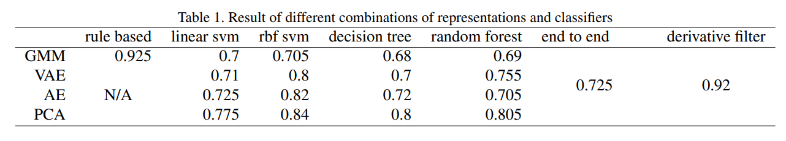
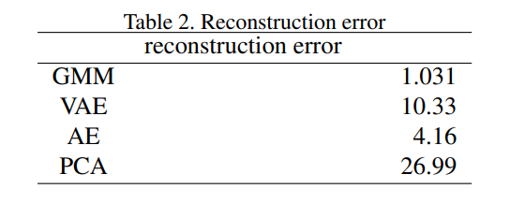
Proposed Method Filter Stage
All the results are on very limited data(12 pics or 60 columns)

Slide 13
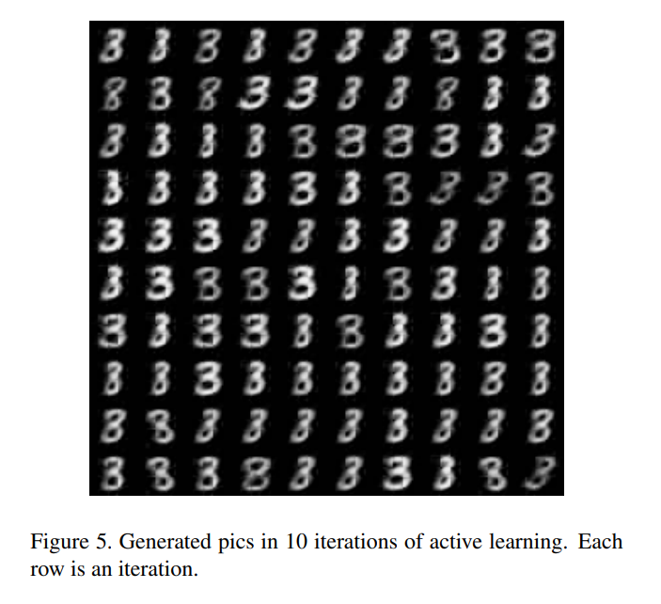
Proposed Method Filter Stage-Active learning with svm on the low dimension latent space
Select some data points that is close to the decision hyperplane, and calculate the projection on the hyperplane. This projection will be decoded into the data space by the bidirectional generative model.
Experiments on MNIST: 3&8 binary classification

Slide 14
Proposed Method Filter Stage-New thoughts
Using BNN as the classifier, and we can gain uncertainty of any feature point we desire. This uncertainty is calibrated and reliable, and we can apply it to any NN. Maybe we can fuse it with the generating process(generate from the most uncertainty place in the latent space according to the BNN uncertainty and provide the decoded pic in data space to the experts)?
We can set the variance term as the log of variance in GMM latent space thus it will take value over all R.

Slide 15
Proposed Method Matching Stage
[1,0,0,0,0,0,1,0,0,1,0,1]
Notes:
After we suppressed the normal columns, we need to find out the matching between heavy chains and light chains.
An advantage of the GMM is that the means of the Gaussian components is already calculated, so that rule-based method based on GMM is effective.

