Slide 1


Romanian NMA Training Placement Scheme
Third semestrial scientific report, March 2026
Claudiu Adam
Bucharest, March 25th 2026

Slide 2
Contents
Contents
1
Data gathering
Data preprocessing
Data statistics
Qualitative and quantitative results
Future work
Extra activities
2
3
4
5
Bucharest, March 25th 2026
2

Slide 3
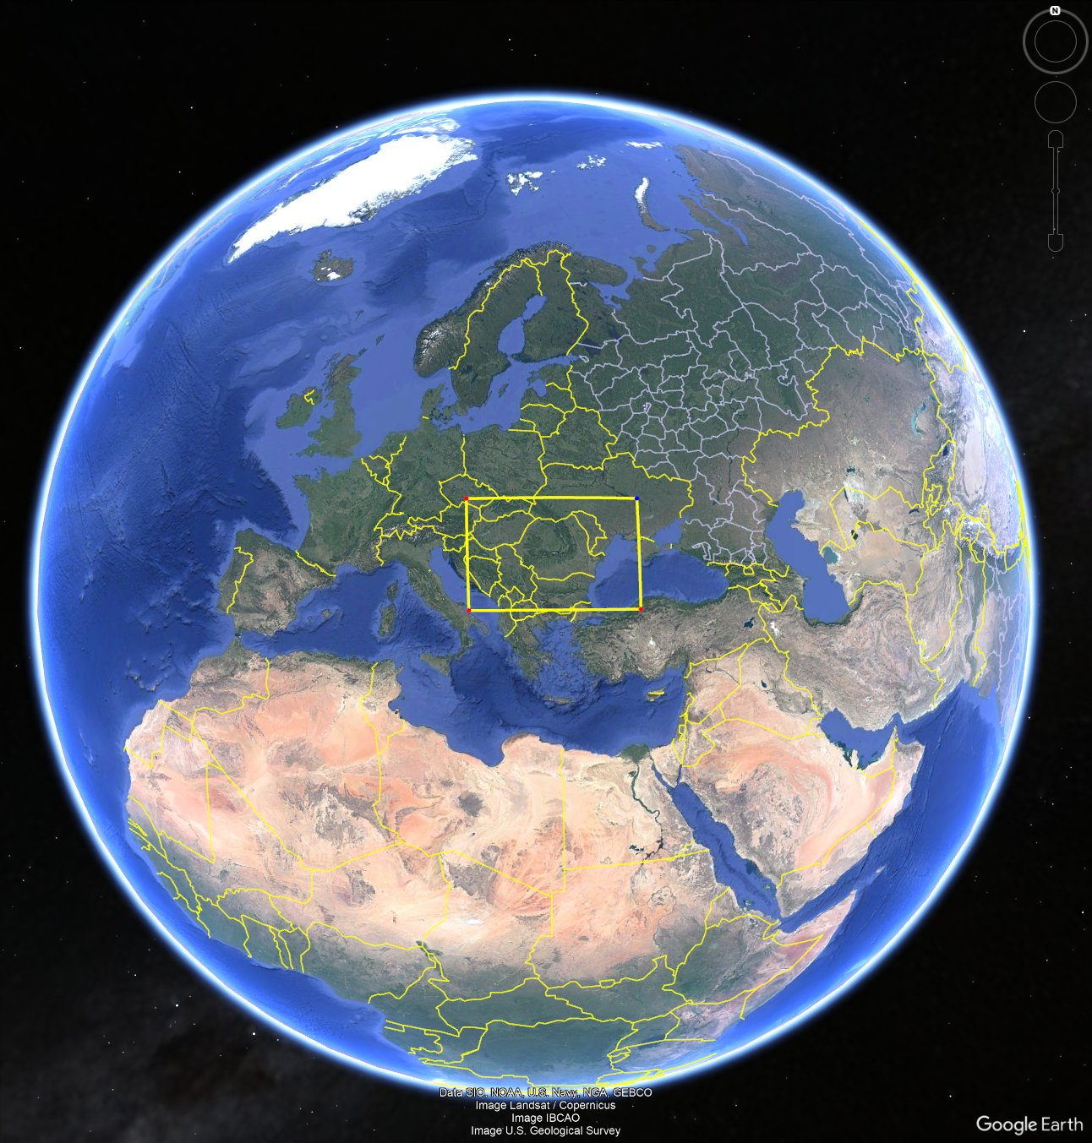
Data gathering — satellite data acquisition
Full disk at 10-min cadence, 5 channels. Romania intersects only chunks 34–38 out of 41 total — 92% download reduction.
Study area lat/lon bounds are projected into the geostationary scanning frame to compute row indices. Only the chunk subset covering Romania is downloaded, with one additional chunk N/S as a safety buffer.
Study area (yellow box over Romania)
MTG FCI full disk scanning
Bucharest, March 25th 2026
3

Slide 4
Data gathering — data sources
“What multi-source observational streams feed the nowcasting pipeline?”
2 training datasets generated – one using radar, LINET, MSG SEVERI, NWCSAF and one using radar, LINET, MTG FCI, NWCSAF
Romanian national radar mosaic products reprojected to EPSG:31700 Stereo70 at 1 km resolution: RZC (rain rate), CZC (composite reflectivity), EZC-20 (echo top at 20 dBZ), LZC (VIL), and CPCH (precipitation accumulation).
Three LINET derived products at 15-min resolution: stroke density, peak current, and binary occurrence maps over Romania.
Cloud top height (ctth_alti), cloud top temperature (ctth_tempe), cloud microphysics phase (cmic_phase), and cloud optical thickness (cmic_cot) derived from MSG.
MSG SEVIRI (5 channels, 3 km, 15-min cadence): VIS006 (0.6 µm, cloud optical thickness proxy), IR_039 (3.9 µm, cloud phase discrimination), IR_108 (10.8 µm, cloud top temperature), WV_062 (6.2 µm, upper-tropospheric moisture), WV_073 (7.3 µm, mid-tropospheric moisture).
MTG FCI (5 equivalent channels, 1–2 km, 10-min cadence): vis_06, ir_38, ir_105, wv_63, wv_73 — spectral equivalents of the MSG channels above. Higher spatial resolution and 10-min native cadence, synthesized to 15-min via optical flow interpolation.
Bucharest, March 25th 2026
4

Slide 5
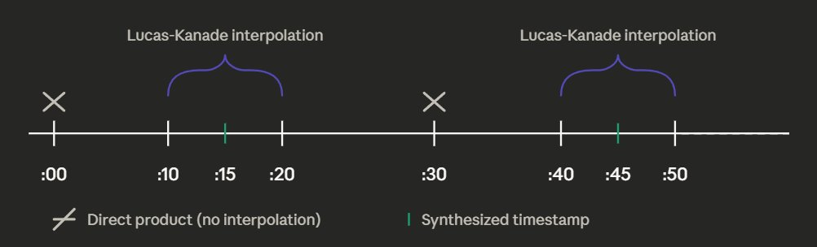
Data reprocessing — temporal alignment
“How do we harmonize the 10-min MTG FCI cadence to the 15-min COALITION grid?”
Direct products at :00 and :30 require no interpolation. Synthesized timestamps at :15 and :45 are generated via Lucas-Kanade optical flow or Farnebäck’s applied to (:10, :20) and (:40, :50) pairs using pysteps and OpenCV, respectively.
Why Lucas-Kanade over alternatives?
LK assumes locally constant motion, making it efficient on the sparse gradient structure of IR channels. Dense methods would estimate motion everywhere including noise-dominated clear-sky regions, introducing artifacts. Radar fields, however, contain dense, spatially continuous reflectivity gradients with sharp precipitation boundaries — Farnebäck's dense polynomial expansion captures the full motion field across these structures, preserving the fine-scale displacement of convective cells that LK's sparse feature tracking would miss.
Interpolation strategy
Bucharest, March 25th 2026
5

Slide 6
Data preprocessing — labels & loss functions
“How are prediction targets structured for the radar and lightning branches?”
Raw RZC (mm/h) is discretized into 5 classes via fixed thresholds: R<10, 10≤20, 20≤30, 30≤40, R≥40 mm/h. Each pixel becomes a one-hot vector. This classification formulation aligns with the SepConv-ens approach (Czibula et al. 2024, KES2024) which demonstrated effective radar nowcasting as classification on Romanian data.
Loss -> Categorical Crossentropy
Lightning labels are binary (1 = lightning present, 0 = absent).
Loss -> Weighted Focal Loss (γ=2), where γ downweights confident clear-sky predictions, focusing gradient updates on ambiguous storm-boundary pixels
Within each day, samples are split into contiguous temporal blocks following Czibula et al. (2024) and the SepConv-ens work: the first 10% of each 6-hour period goes to testing, the next 10% to validation, and the remaining 80% to training. This preserves temporal ordering within each block and prevents data leakage from correlated consecutive timesteps.
Bucharest, March 25th 2026
6

Slide 7
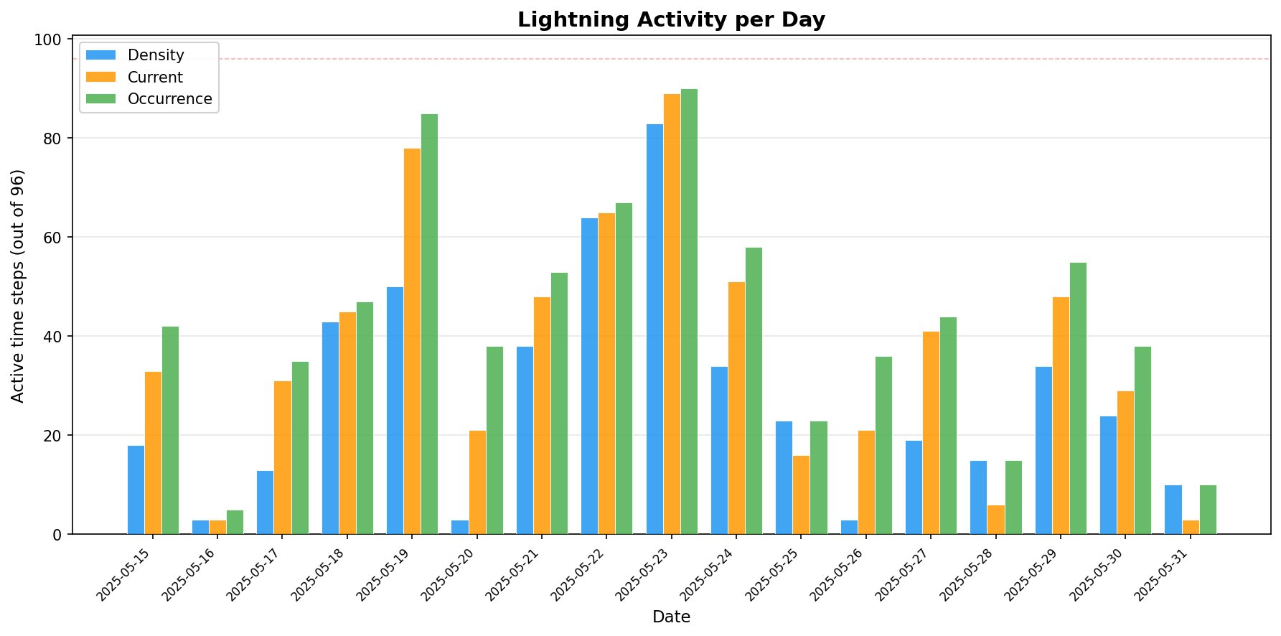
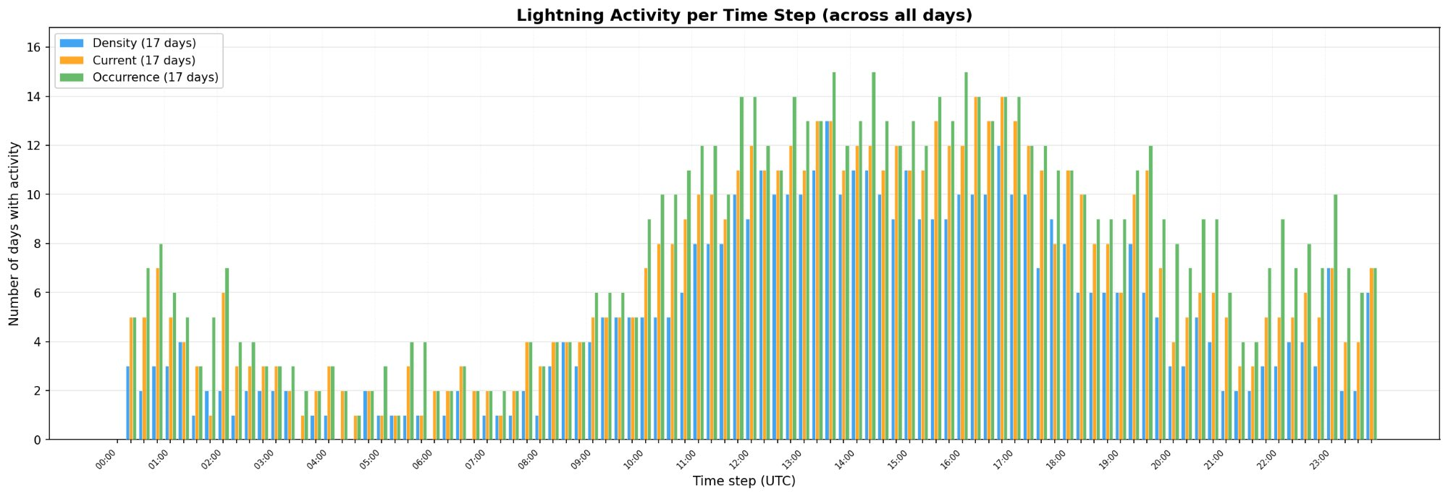
Data statistics — lightning activity
“When and how does lightning occur across the study period?”
Key observations (15–31 May 2025):
Three LINET products: density, current, occurrence across 17 days.
Peak activity on 23 May with >80 active timesteps out of 96 for all three products.
Clear diurnal signal: activity increases from 10 UTC, peaks between 12–18 UTC, then decays.
Occurrence product shows highest counts, followed by current and density.
Low-activity days (16 May, 20 May, 31 May).
Bucharest, March 25th 2026
7

Slide 8
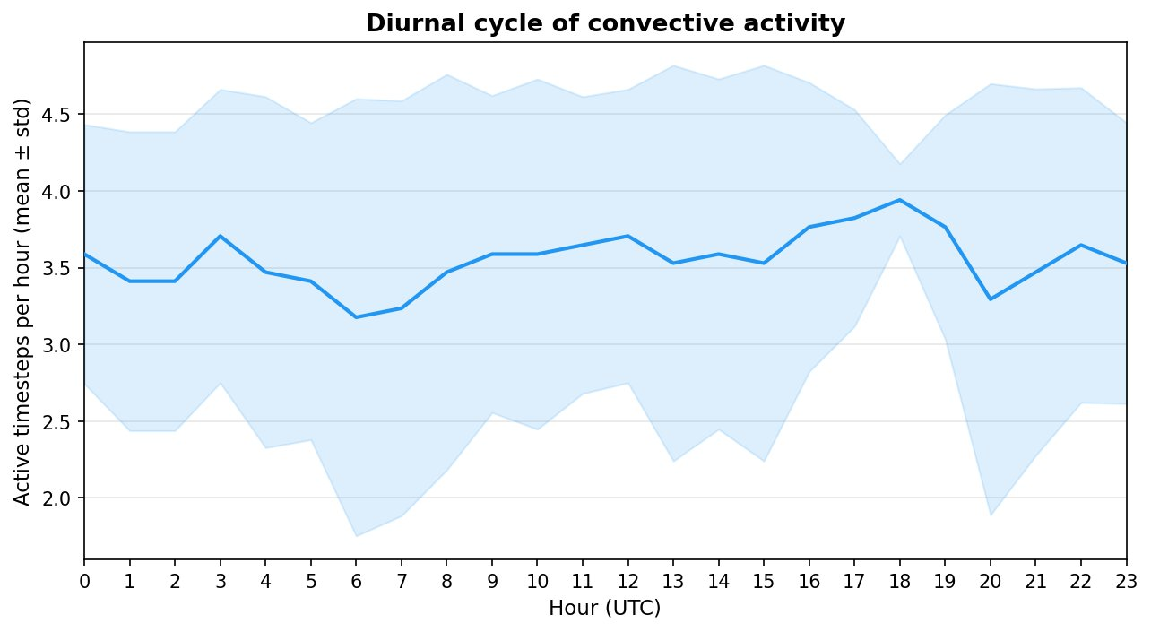
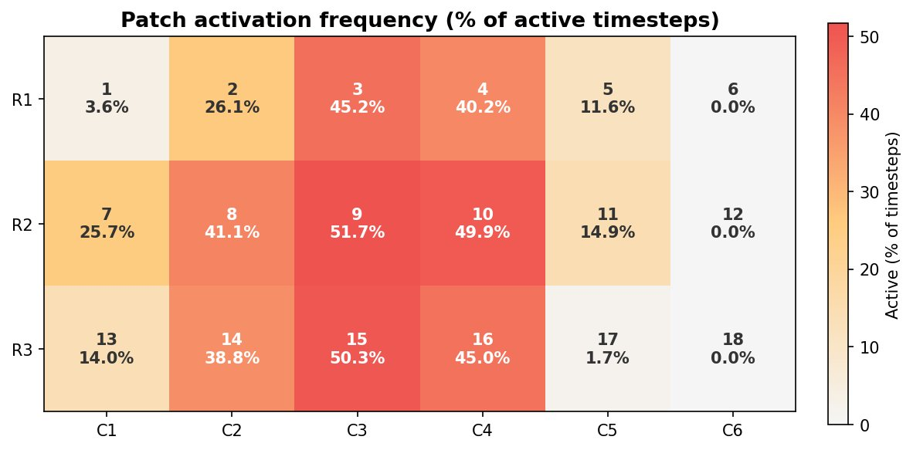
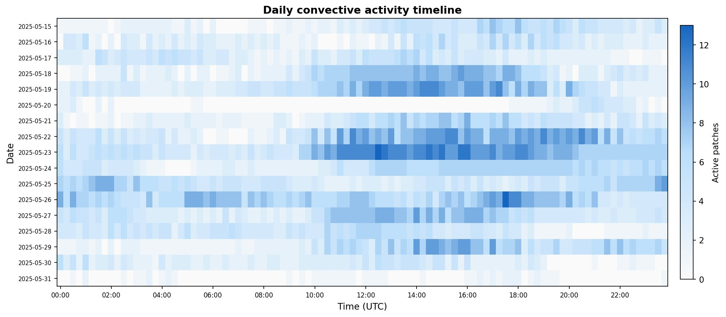
Data statistics — convective activity
“What is the spatio-temporal structure of convective events?”
Bucharest, March 25th 2026
8

Slide 9
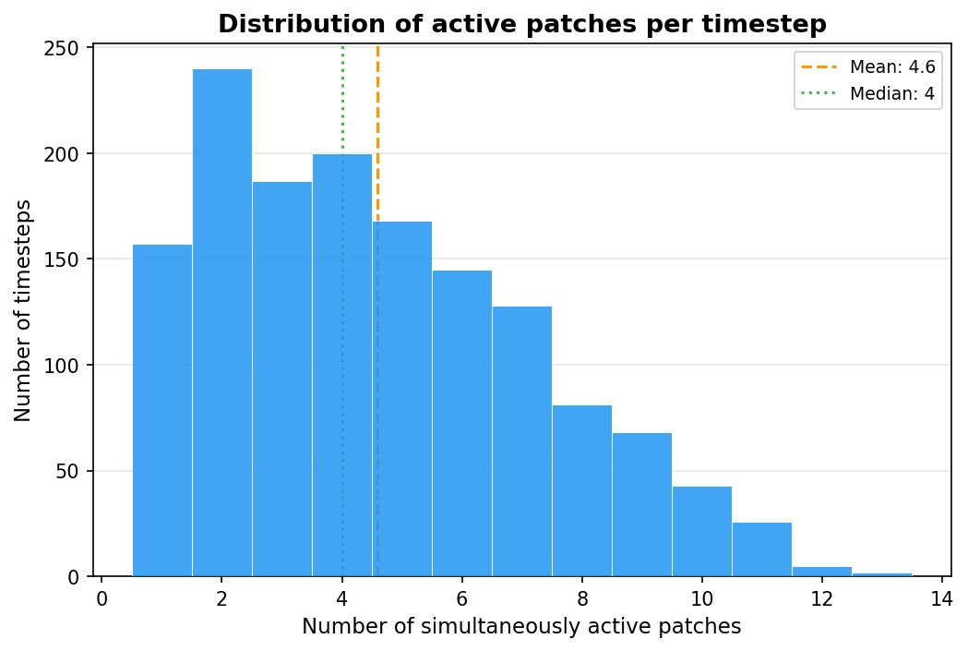
Data statistics — patch extraction and distribution
“How many concurrent convective patches exist and how are they distributed?”
RZC regridded field with DBSCAN binary mask for patch activation
(stream line the extraction of neighboring patches)
DBSCAN clustering applied on rain rate identifies active regions per timestep.
Bucharest, March 25th 2026
9

Slide 10
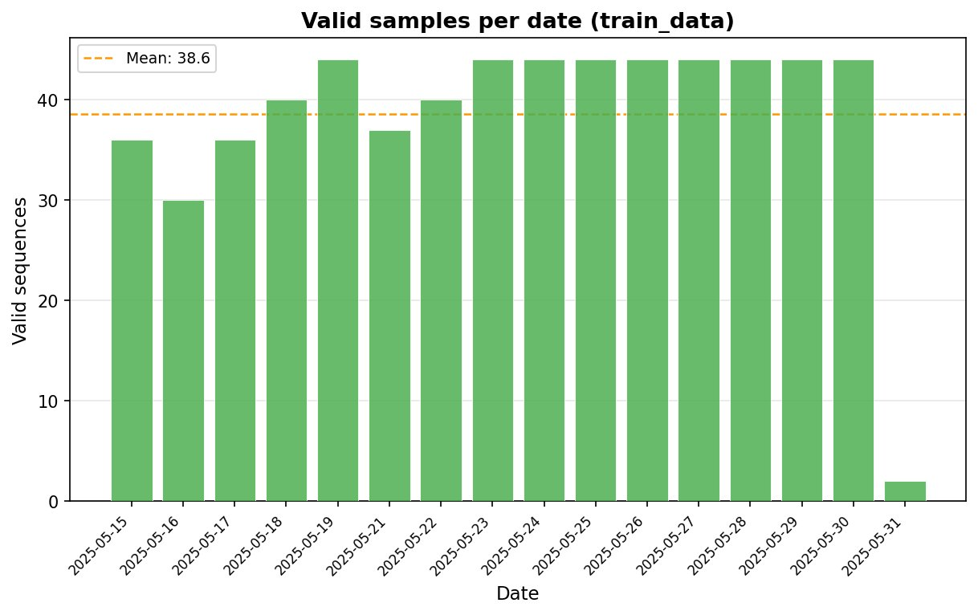
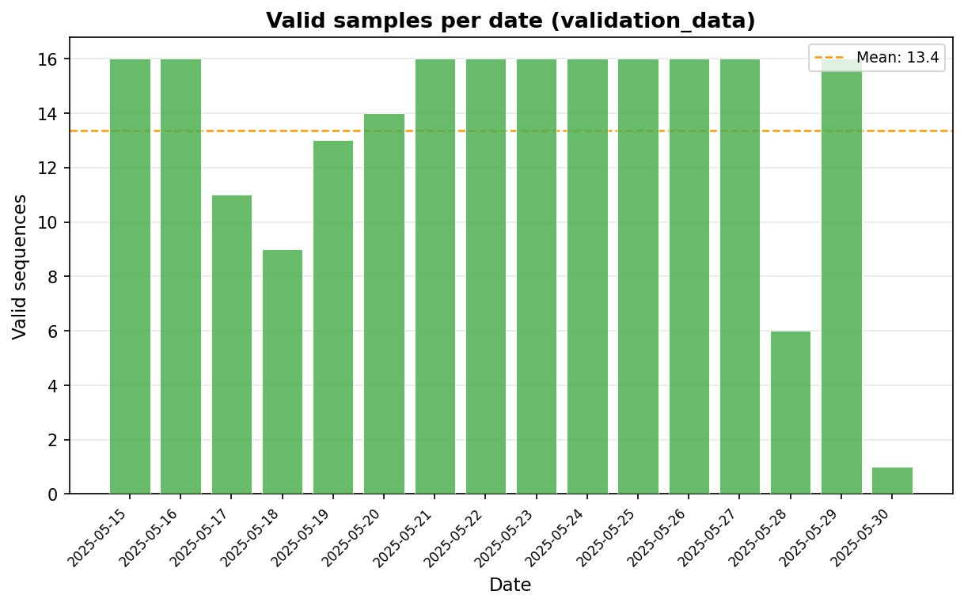
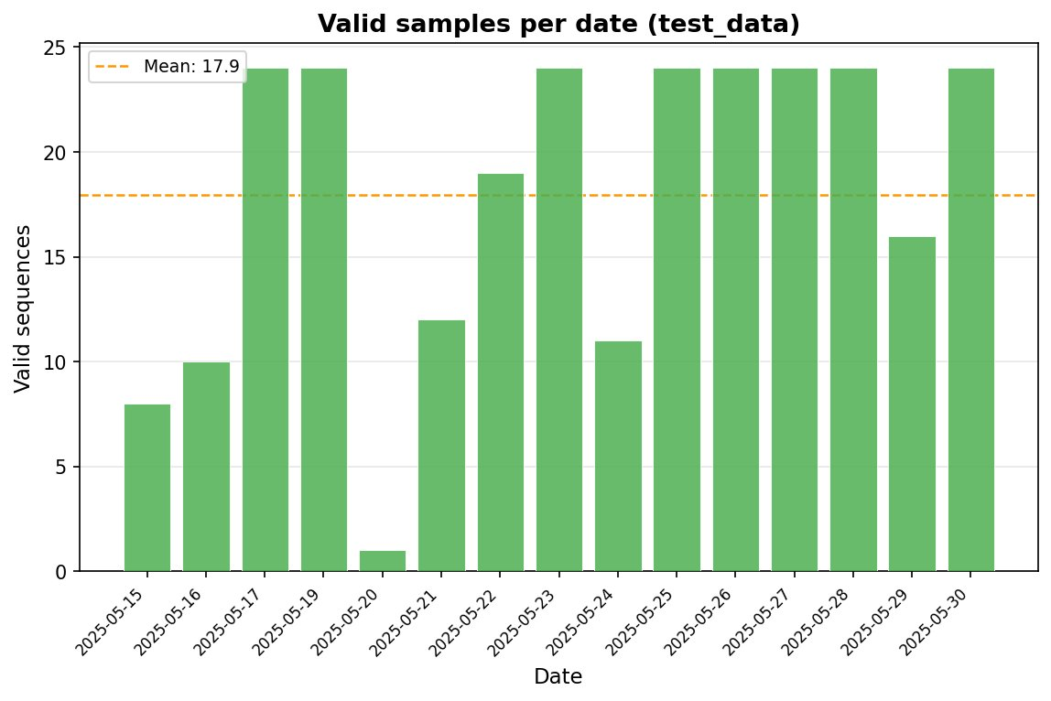
Data statistics — dataset split
“How are training samples distributed across the study period?”
Bucharest, March 25th 2026
10

Slide 11
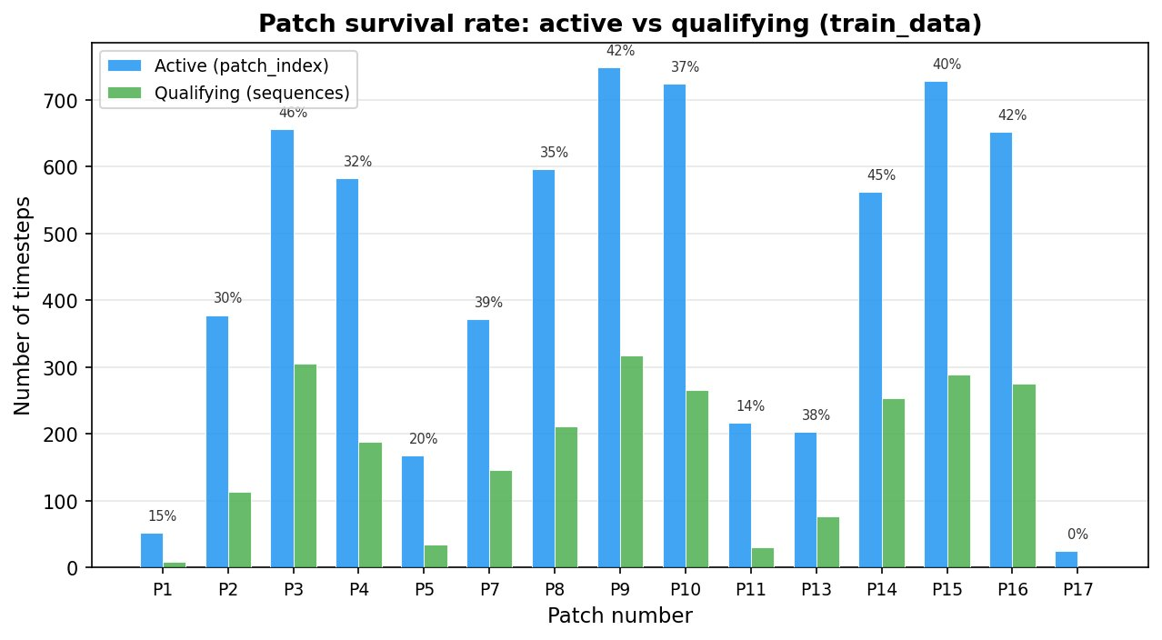
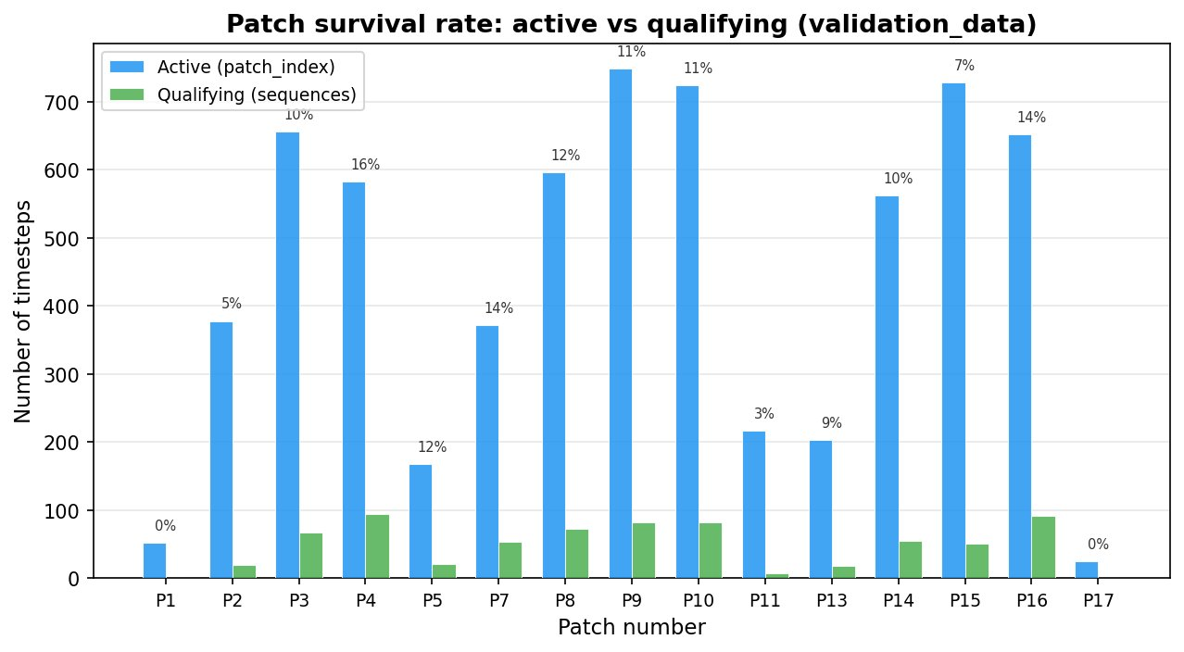
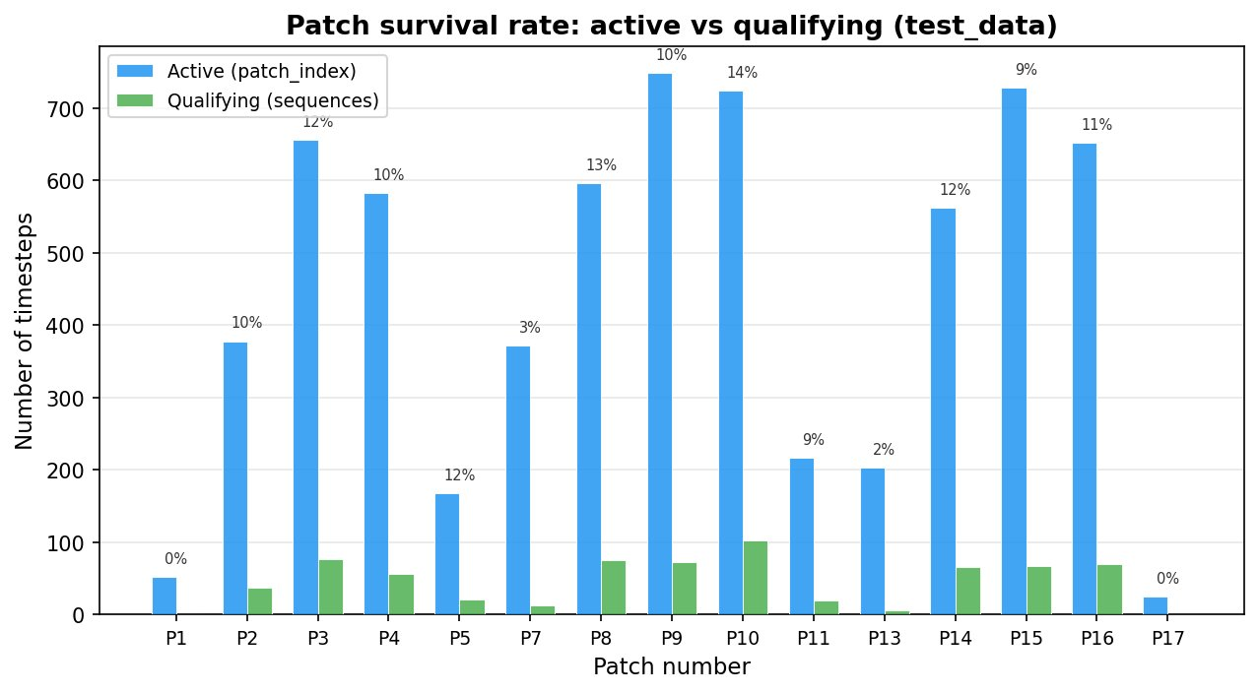
Data statistics — patch statistics
“What fraction of active patches produce valid training sequences?”
Bucharest, March 25th 2026
11

Slide 12
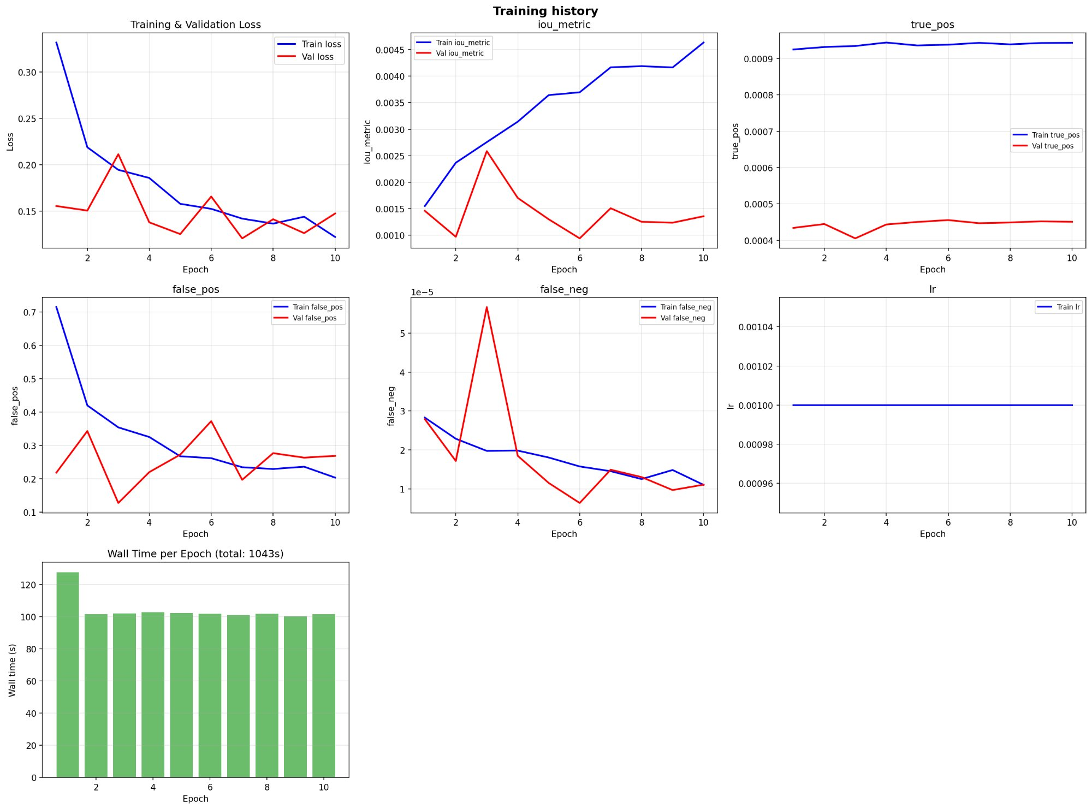
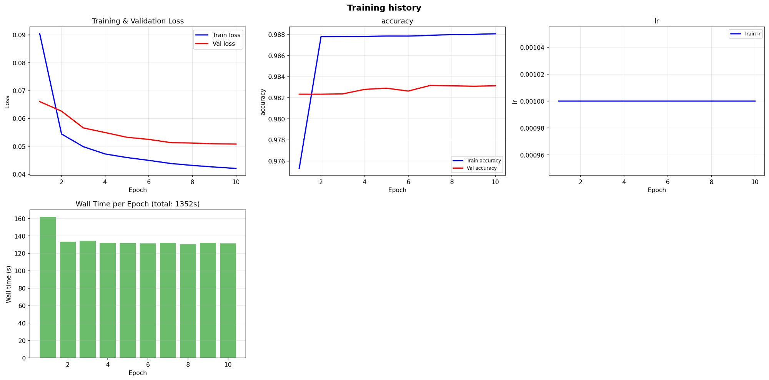
Qualitative and quantitative results — training curves (MSG SEVIRI)
MSG Lightning (Weighted Focal Loss)
MSG Radar (Categorical Crossentropy)
Bucharest, March 25th 2026
12

Slide 13
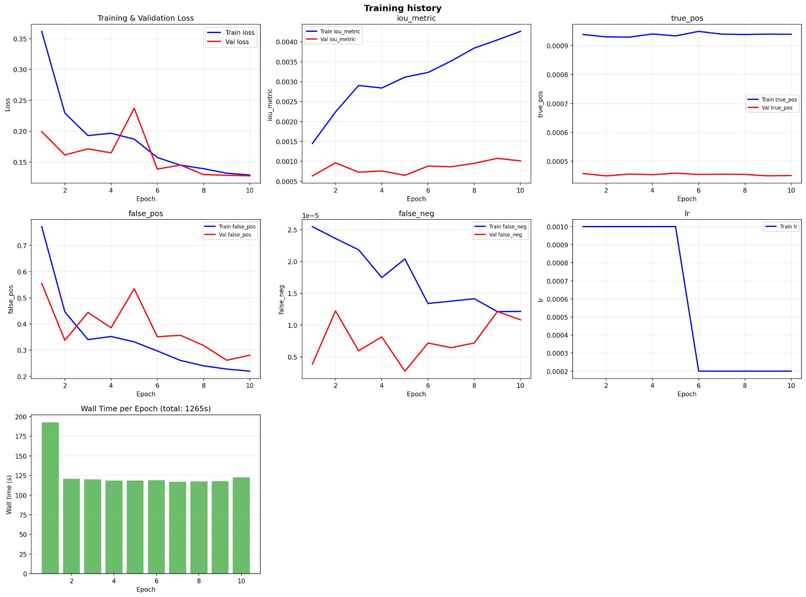
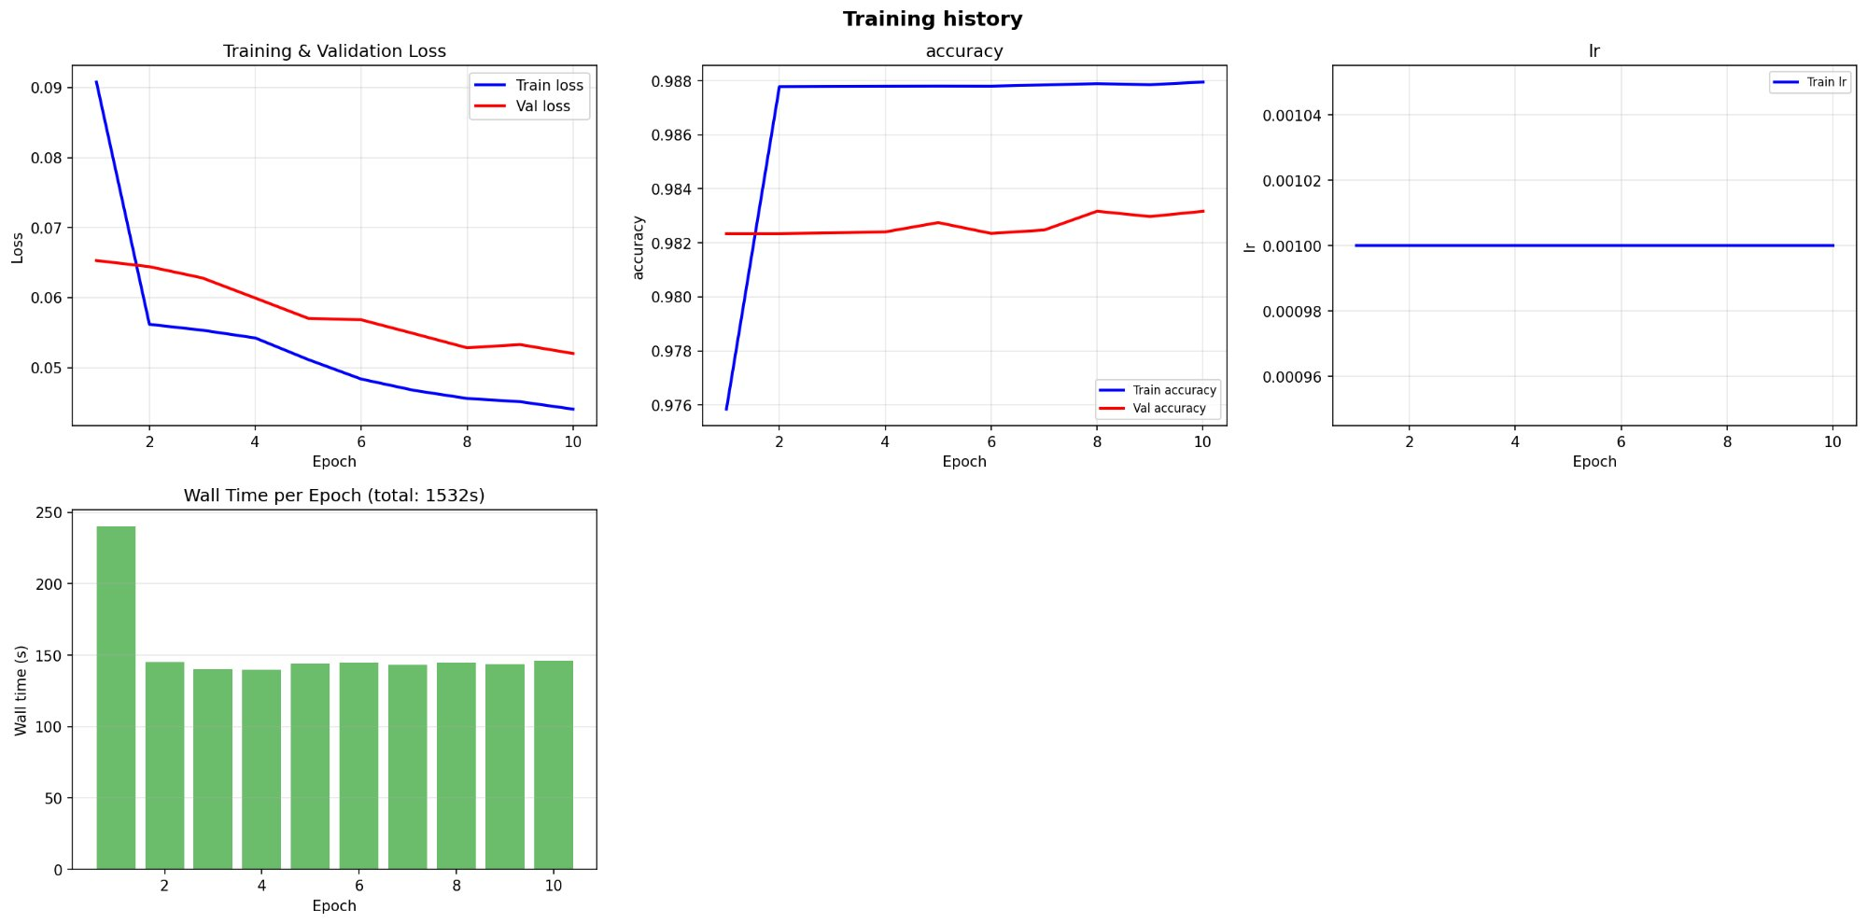
Qualitative and quantitative results — training curves (MTG FCI)
MTG Lightning (Weighted Focal Loss)
MTG Radar (Categorical Crossentropy)
Bucharest, March 25th 2026
13

Slide 14
Qualitative and quantitative results — Lightning predictions and rain rate prediction using MSG SEVIRI data
Bucharest, March 25th 2026
14

Slide 15
Qualitative and quantitative results — Lightning predictions and rain rate prediction using MTG FCI data
Bucharest, March 25th 2026
15

Slide 16
Qualitative and quantitative results — MSG vs MTG
“What are the observed advantages and current drawbacks of MTG over MSG?”
MTG advantages
Current drawbacks
Higher spatial resolution
Enhanced multi-spectral information for convective signatures
Comparable training convergence and accuracy to MSG despite shorter operational history
Lightning predictions show slightly more spatially coherent probability fields
Shorter operational data availability (MTG-I1 launched Dec 2022 compared to decades of MSG archive)
Larger file sizes require chunk-filtering strategy for efficient data ingestion
Optical flow interpolation introduces synthetic timestamps Radar predictions still dominated by the R<10 class — model struggles to predict higher-intensity classes in both MSG and MTG
Lightning prediction overestimates spatial extent (high false positive area)
Bucharest, March 25th 2026
16

Slide 17
Future work
Increase the dataset size with sample diversity.
Improve generalization across different synoptic regimes.
Refine the knowledge distillation pipeline for seamless integration of the student model into the operational chain.
Investigate attention-based options derived from Transformer self-attention to capture long-range spatial dependencies.
Apply optical flow-based guidance (similar to the NWP inputs from the original COALITION-4 work) to model predictions as a post-processing step to increase nowcasting skill scores.
Deploy the trained models within ANM’s operational framework, conducting real-time evaluation during the 2026 convective season.
Bucharest, March 25th 2026
17

Slide 18
Extra activities — EUMETNET E-AI bursary proposal
“Does Generative AI Map the Hail Trajectory Using Geostationary Satellite, Radar, and Auxiliary Data?”
This project aims to improve meteorological training datasets to better represent extreme hail events.
A generative, autoregressive framework for synthesizing physically plausible satellite and radar observations of severe convective hail events, addressing class imbalance in training data for downstream nowcasting systems.
Module A — TRecViT U-Net
Recurrent temporal encoder (gated Linear Recurrent Units) coupled with a conditioned diffusion U-Net decoder for radar reflectivity prediction from FCI imagery, with Gaussian noise perturbation as conditioning.
Module B — Masked Diffusion Transformer
Generates multi-channel FCI observations conditioned on radar reflectivity. Masking driven by predicted radar field at 30 dBZ threshold, reducing computational cost and focusing generation on active convective regions.
Data sources: MTG FCI (10 channels at 1 km), EUMETNET OPERA CIRRUS composites, ESWD hail reports.
Bucharest, March 25th 2026
18

Slide 19
Extra activities — upcoming conferences and workshops
5th ECMWF-ESA Machine Learning Workshop 13–17 April 2026 | Bologna, Italy
European Nowcasting and Weather Forecasting Conference (ENWFC-2026) 18–21 May 2026 | Copenhagen, Denmark
EUMETSAT Meteorological Satellite Conference 2026 21–25 September 2026 | Darmstadt, Germany
Bucharest, March 25th 2026
19

