Slide 1
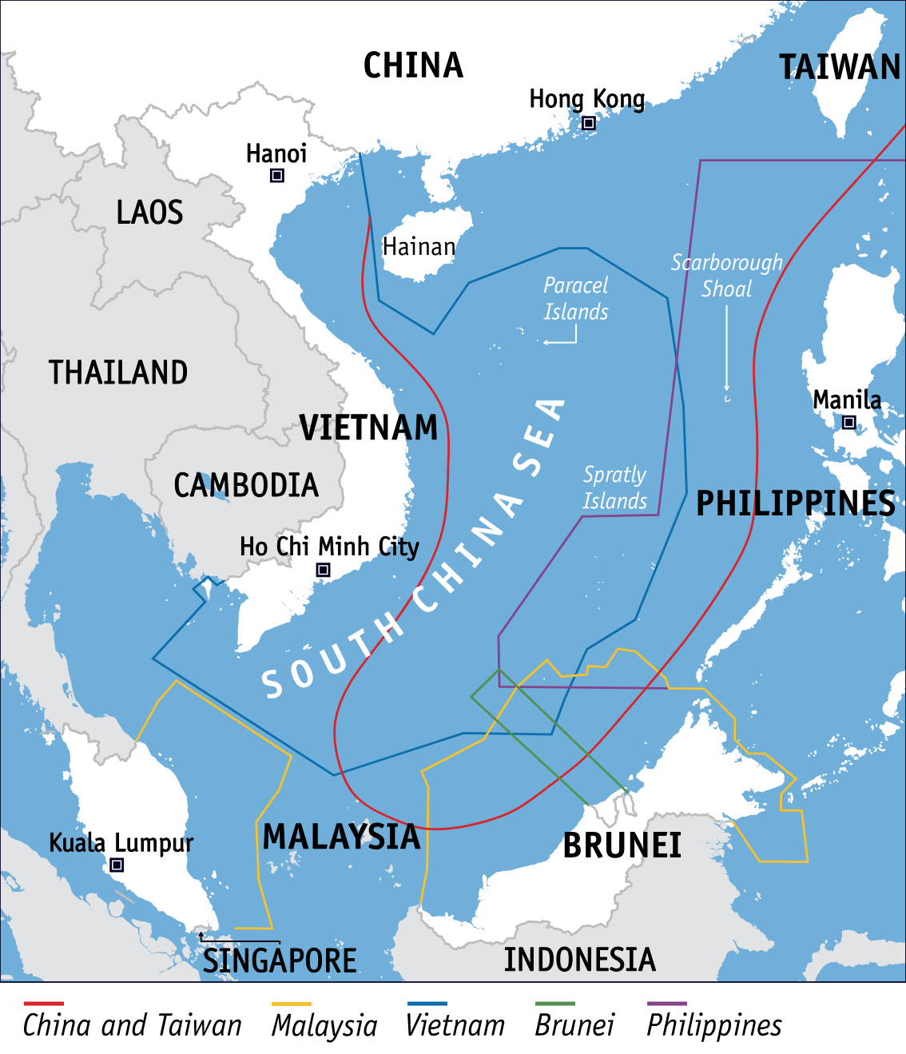
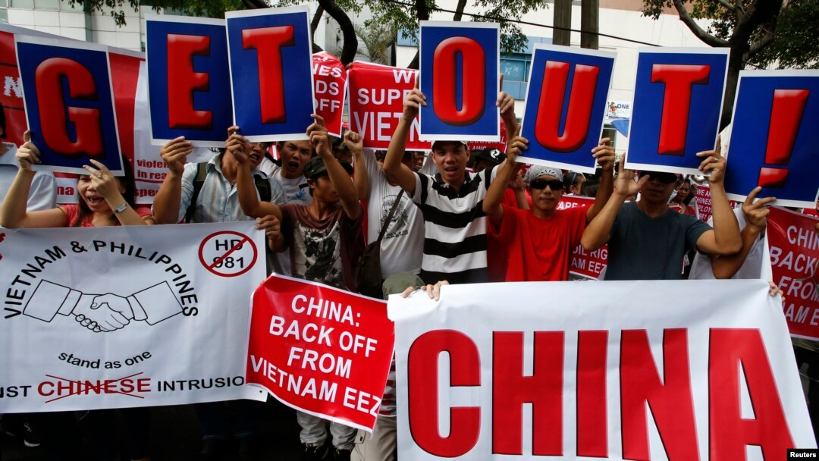
The South China Sea Dispute: A Geopolitical Hotspot

Slide 2
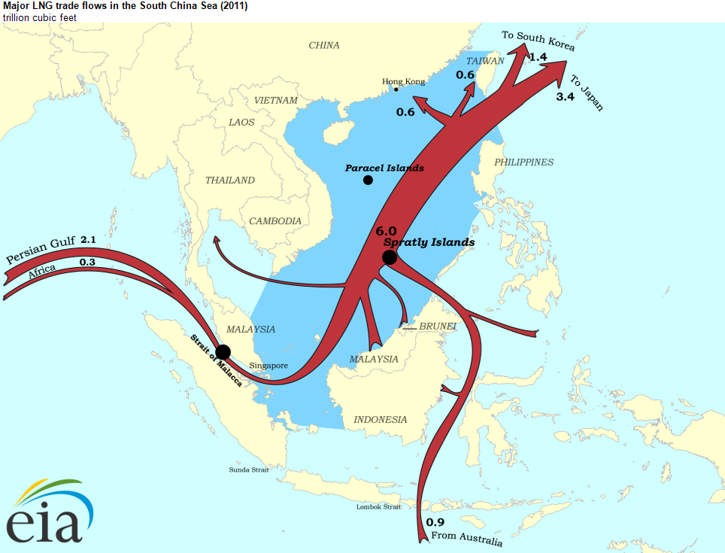
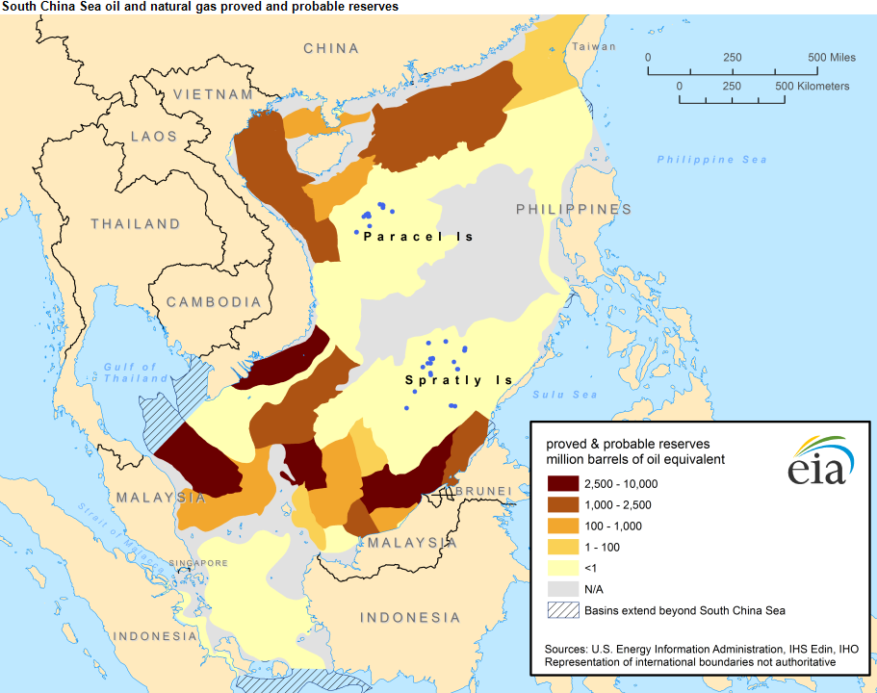
Why is the South China Sea so important ?
Trade routes : 30% of global maritime trade
Natural resources : vast reserves of oil and natural gas
Strategic military position

Slide 3
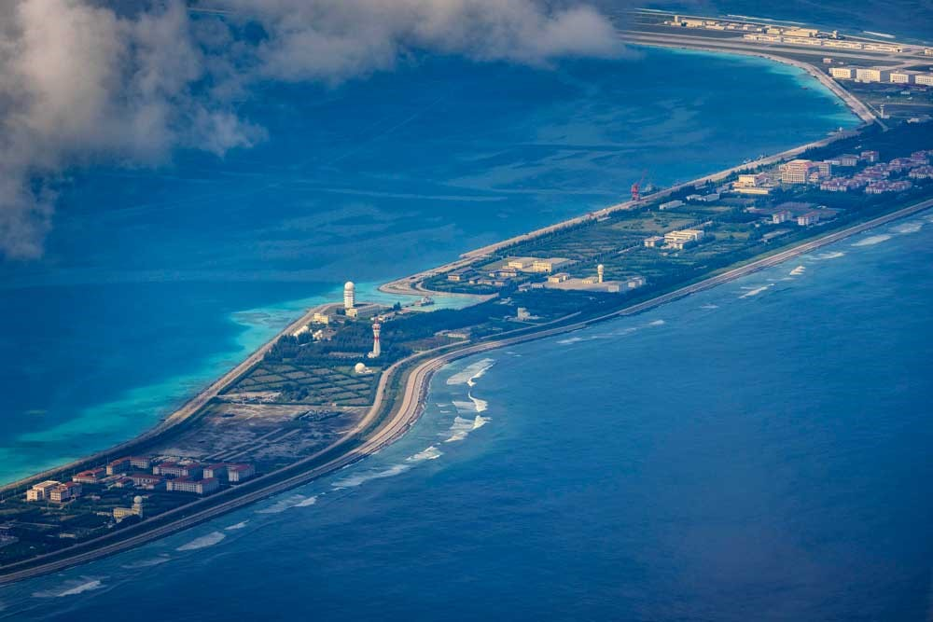
The territorial claims and disputes
China: Beijing claims almost 90% of the South China Sea, based on historical maps. It has built artificial islands and military bases on disputed reefs, such as in the Spratly and Paracel Islands.

Slide 4
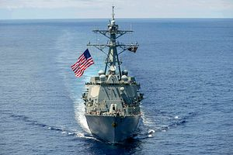
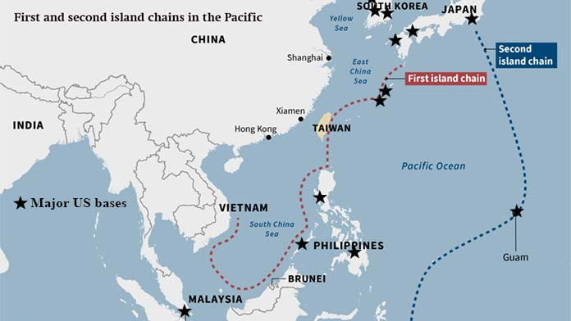
The role of the United States and international responses
The United States does not have territorial claims in the region, but it strongly opposes China's expansion. The US Navy regularly conducts "freedom of navigation" operations (FONOPs) to challenge China's claims.

Slide 5
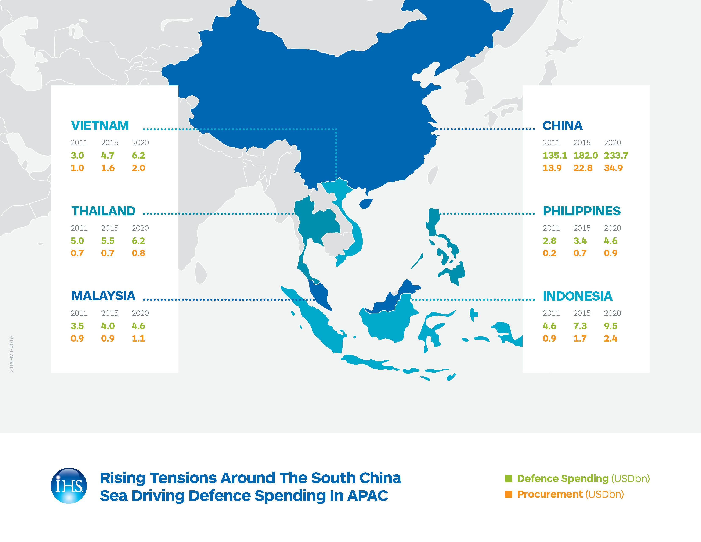
Potential consequences of the conflict
Increased militarization
Economic impacts
Diplomatic challenges

Slide 6
1. Why is the South China Sea so strategic?
A) It has large oil and gas reserves
B) It is a key maritime trade route
C) It is an important fishing zone
D) All of the above
2. Which countries, besides China, have territorial claims in the South China Sea?
A) The Philippines, Vietnam, Malaysia, Brunei, and Taiwan
B) Japan, South Korea, and Indonesia
C) Russia, India, and Australia
D) The United States and Canada
3. What is the main reason for the international rejection of China's claims?
A) China signed an agreement with the United Nations to give up its claims
B) The South China Sea is part of the United States' exclusive economic zone
C) The 2016 ruling by an international tribunal stated China's claims had no legal basis
D) The Chinese government voluntarily withdrew its claims
Quizz
4. How does the United States respond to China’s claims in the South China Sea?
A) By supporting China’s territorial expansion
B) By conducting "freedom of navigation" operations
C) By blocking access to the South China Sea
D) By signing a treaty with China
5. What is a major potential consequence of the South China Sea dispute?
A) A war between China and India
B) A rise in oil prices
C) A regional military conflict that could disrupt global trade
D) The disappearance of maritime borders

Slide 7
Questions
Should the international community take stronger actions against China’s claims in the South China Sea, or should diplomacy remain the primary approach ?
How do you think the South China Sea dispute will evolve in the next decade ? Could it lead to a major conflict, or will countries find a peaceful resolution ?

