Slide 1
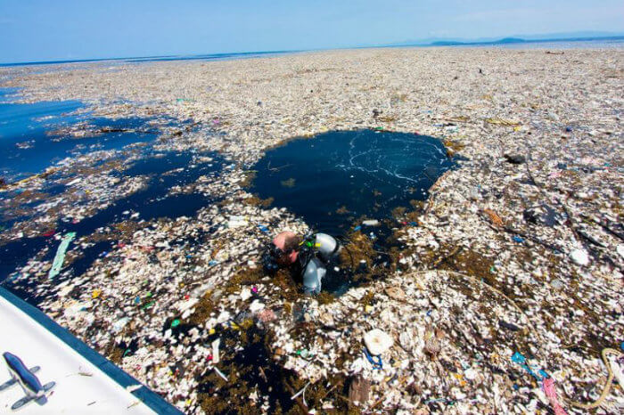
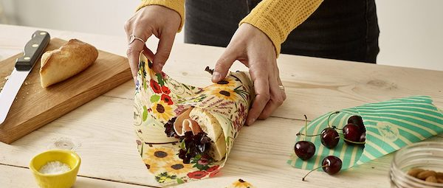
💚 Beeswax Food Wraps: The Eco-Friendly Alternative to Plastic 💚
How to reduce plastic waste with beeswax food wraps ?

Slide 2
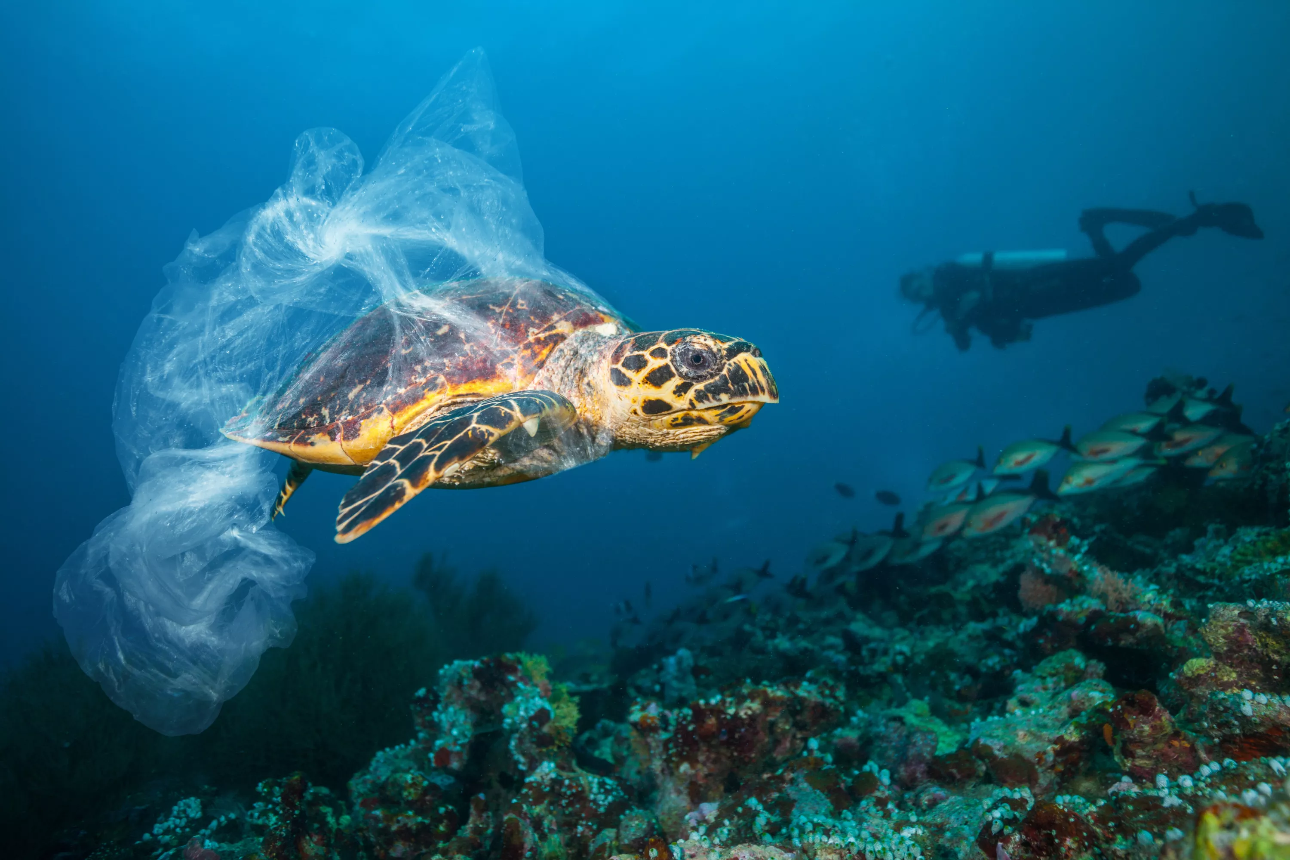
The Problem of Plastic Waste ♻️
🌍 8 million tons of plastic enter the ocean every year.
🐢 Marine animals mistake plastic for food.
⚠️ Plastic wrap takes hundreds of years to decompose.

Slide 3
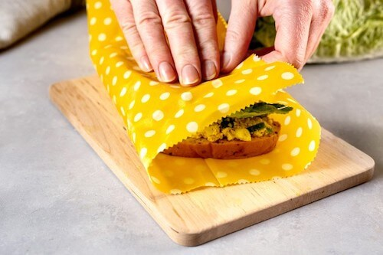
What Are Beeswax Wraps ? 🍯
🌿 Made from organic cotton, beeswax, jojoba oil, and tree resin.
🖐️ Moldable with the warmth of your hands.
🔄 Reusable for up to a year and compostable.

Slide 4
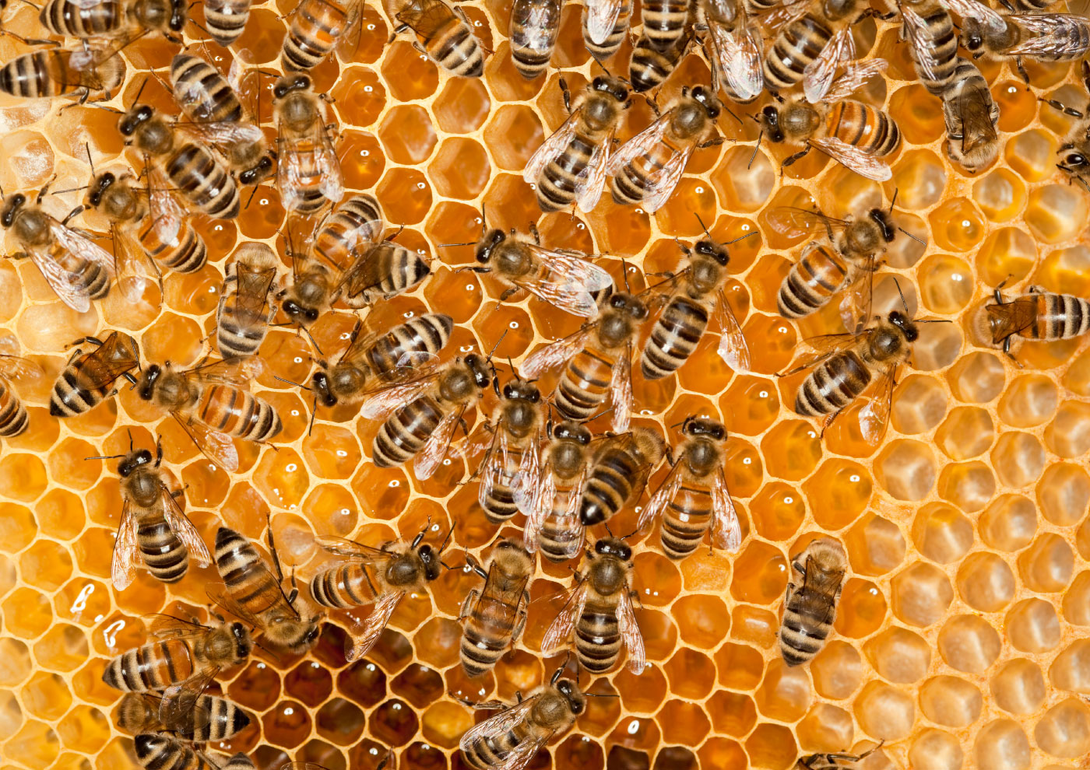
How They Help the Environment 🌱
✅ Reduces plastic waste → no more single-use plastic wrap!
✅ 100% natural → No toxic chemicals in food.
✅ Supports bees and biodiversity → Encourages sustainable beekeeping.

Slide 5
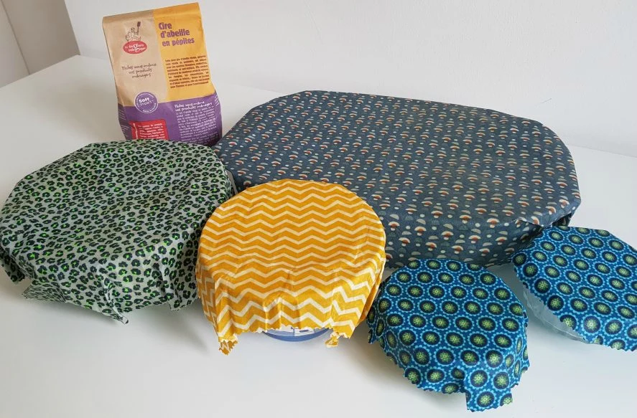
Why Should People Buy It ? 💰
🔄 Saves money → One wrap lasts 1 year, unlike plastic wrap.
🎨 Stylish and customizable → Many patterns and sizes available.
🏕️ Perfect for home & outdoor use → Great for picnics, travel, and school lunches.

Slide 6
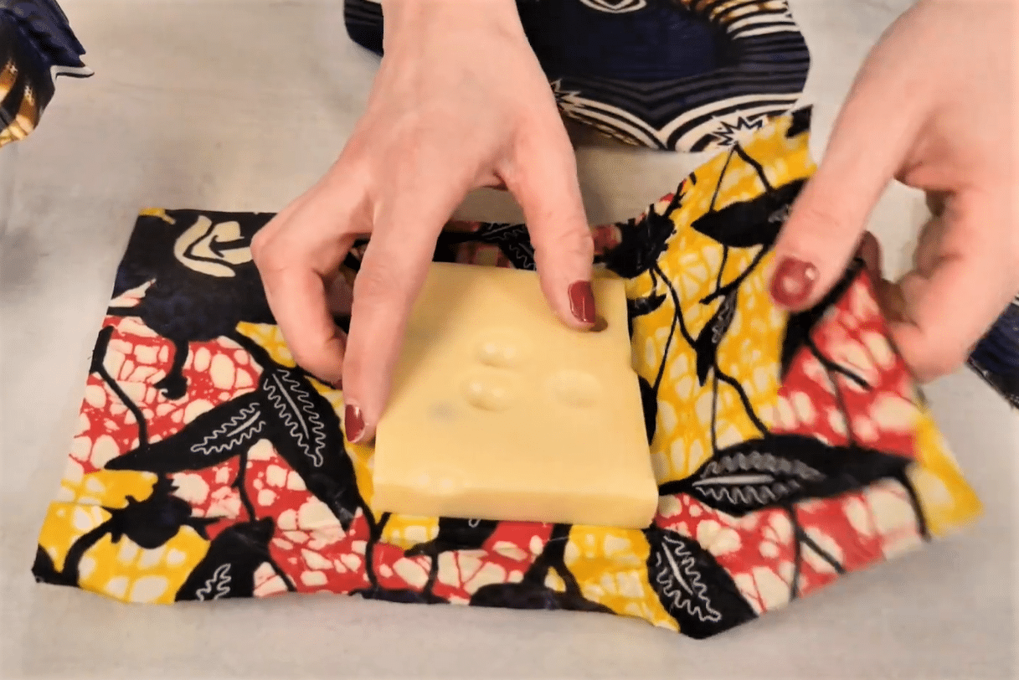
Conclusion & Call to Action 🚀
💡 Every small action counts! Switching to beeswax wraps is an easy step toward a sustainable lifestyle.
📢 Challenge: Try replacing plastic wrap for a month and see the difference!
🛒 Where to find them? Available in eco-friendly stores, online shops, or even as a DIY project.
🤝 Spread the word! Share this idea with friends and family to reduce plastic waste together.

