Slide 1
JAVA123
SOPHIE WALKER
OLIVIA ROCHE
ADAM O’ CEALLAIGH
EMMA LOONEY
SEAN O’ SULLIVAN

Slide 2
Did you know?
Of UCC’s 21,204 Undergraduate and Post-graduate students, 9,966 of them commute daily to campus.
Over 4000 students applied for the total of 1,277 beds available in UCC’s student accommodation for the 2018/2019 academic year.

Slide 3
TUTORTINDER
Peer to Peer Grinds Platform

Slide 4


Slide 5


Slide 6


Slide 7


Slide 8
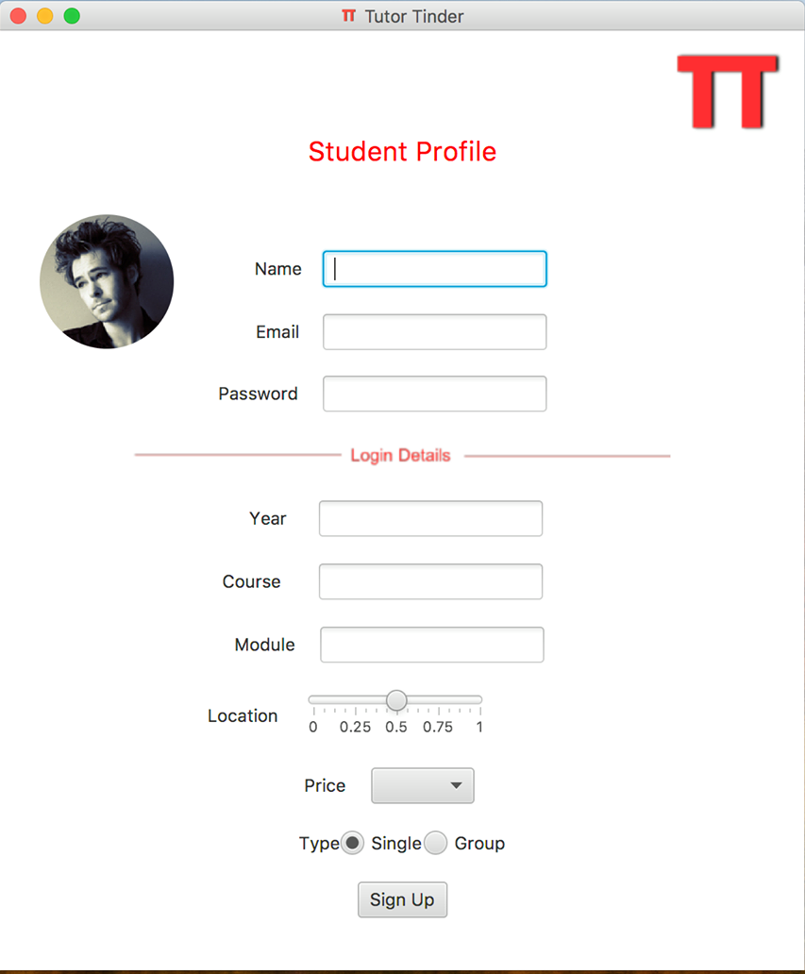

Slide 9
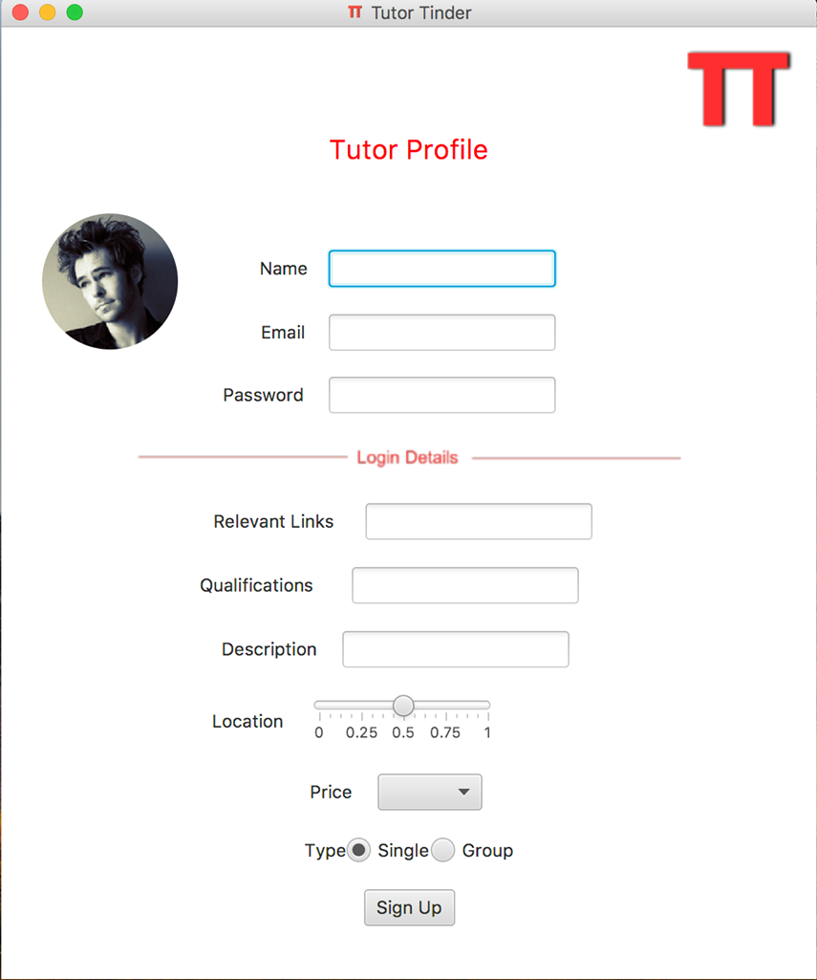

Slide 10
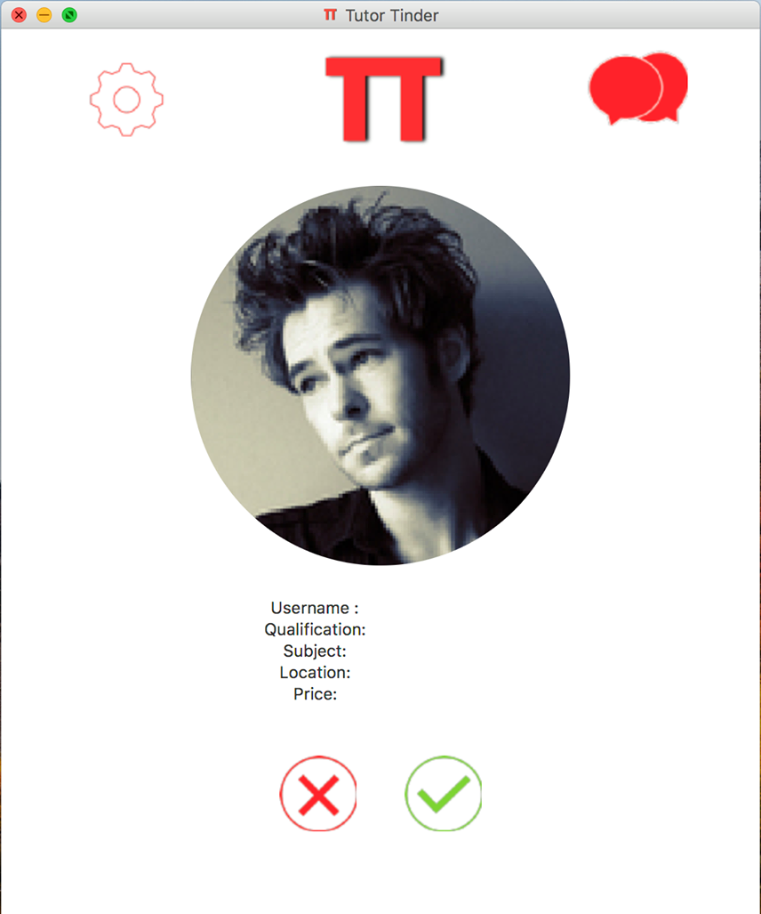

Slide 11


Slide 12


Slide 13


Slide 14
References
http://greencampus.ucc.ie/commuting-business-travel/how-were-doing/
https://www.echolive.ie/corknews/Demand-for-student-housing-at-critical-point-95fa31bc-0ac6-48b3-a441-08fc11cd1e44-ds

