Slide 1
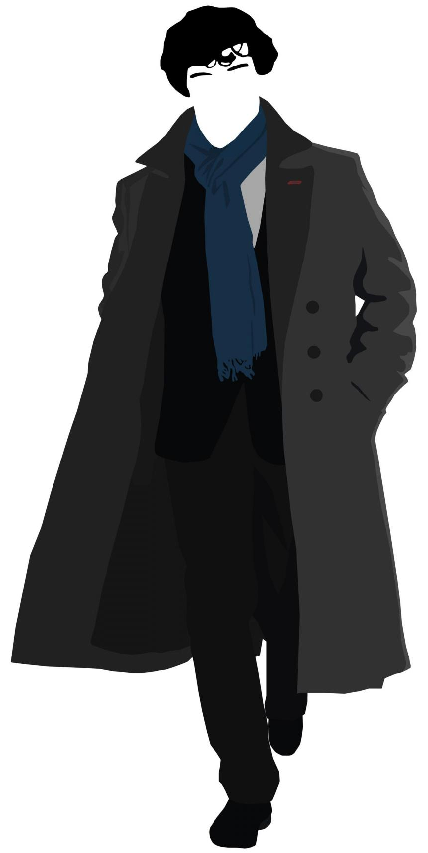
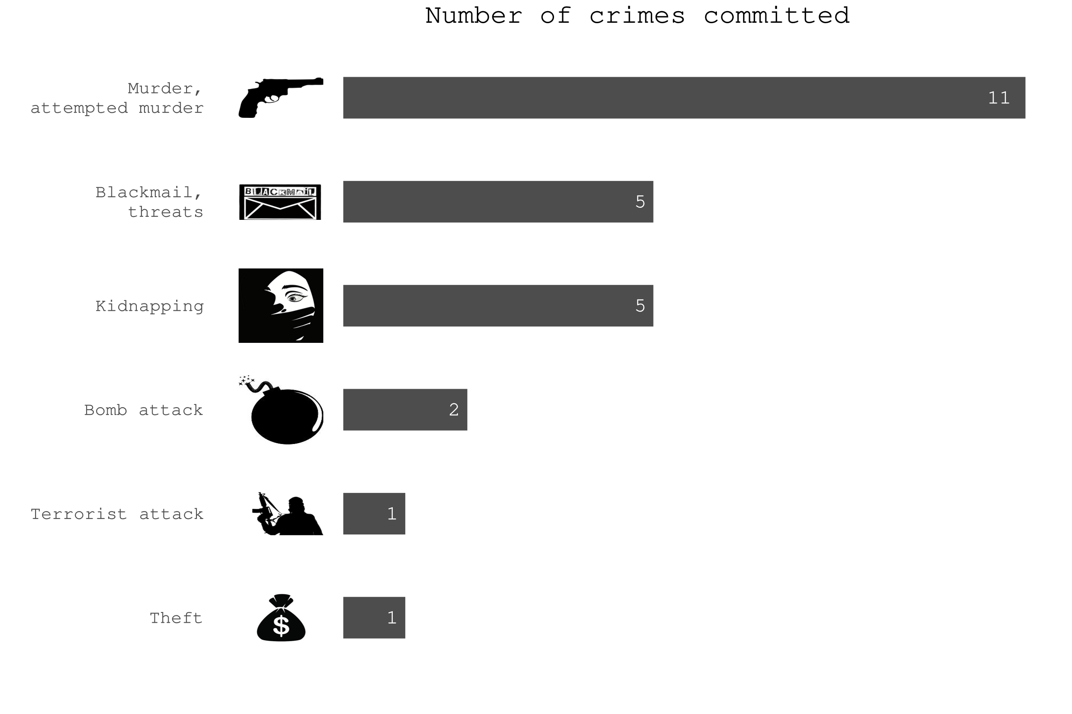
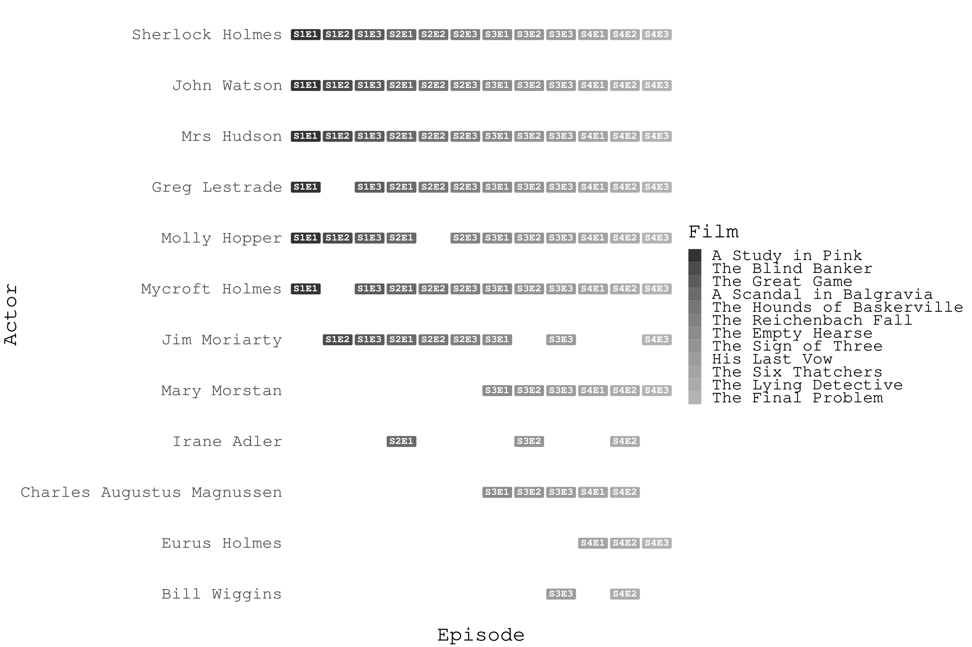

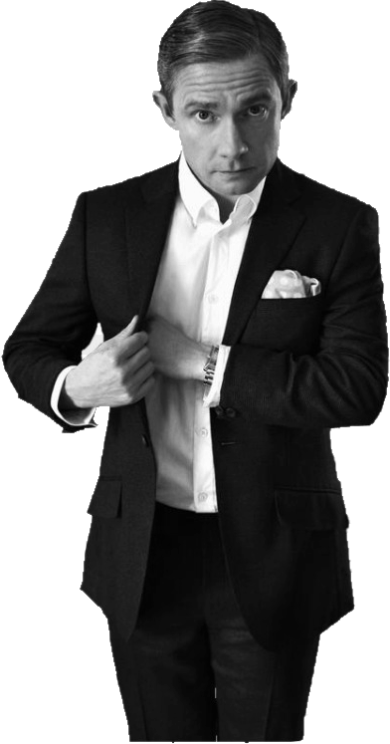

I AM
S H E R
LOCKED
Aleksandra Gacek
Daria Hubernatorova
Piotr Storożenko
Sherlock is a BBC series loosely based on Sir Arthur Conan Doyle’s books. It shows adventures of Sherlock Holmes and Dr James Watson in XXI century London. Did you ever Wonder what type of crimes he solves and who helps him???

