Slide 1
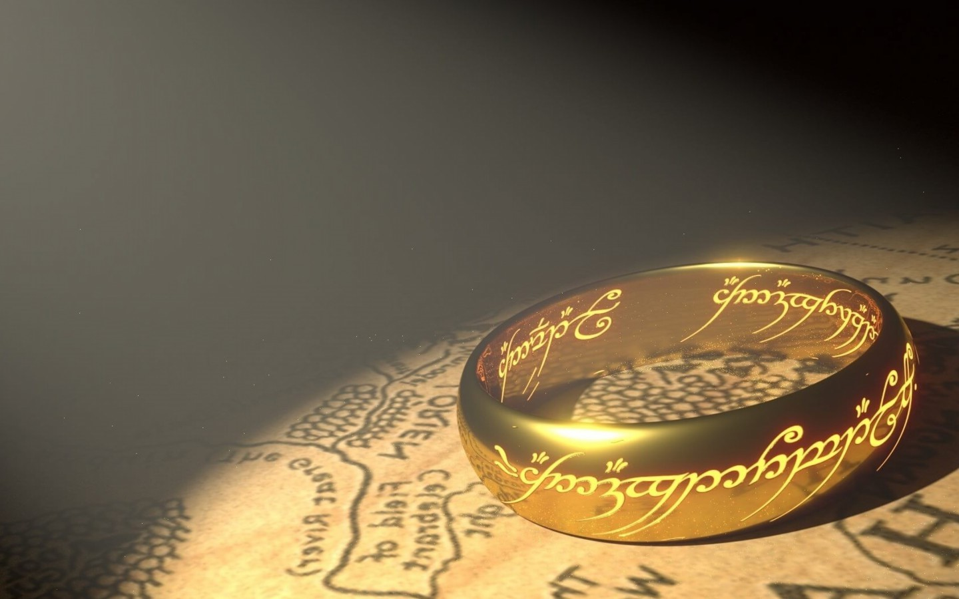
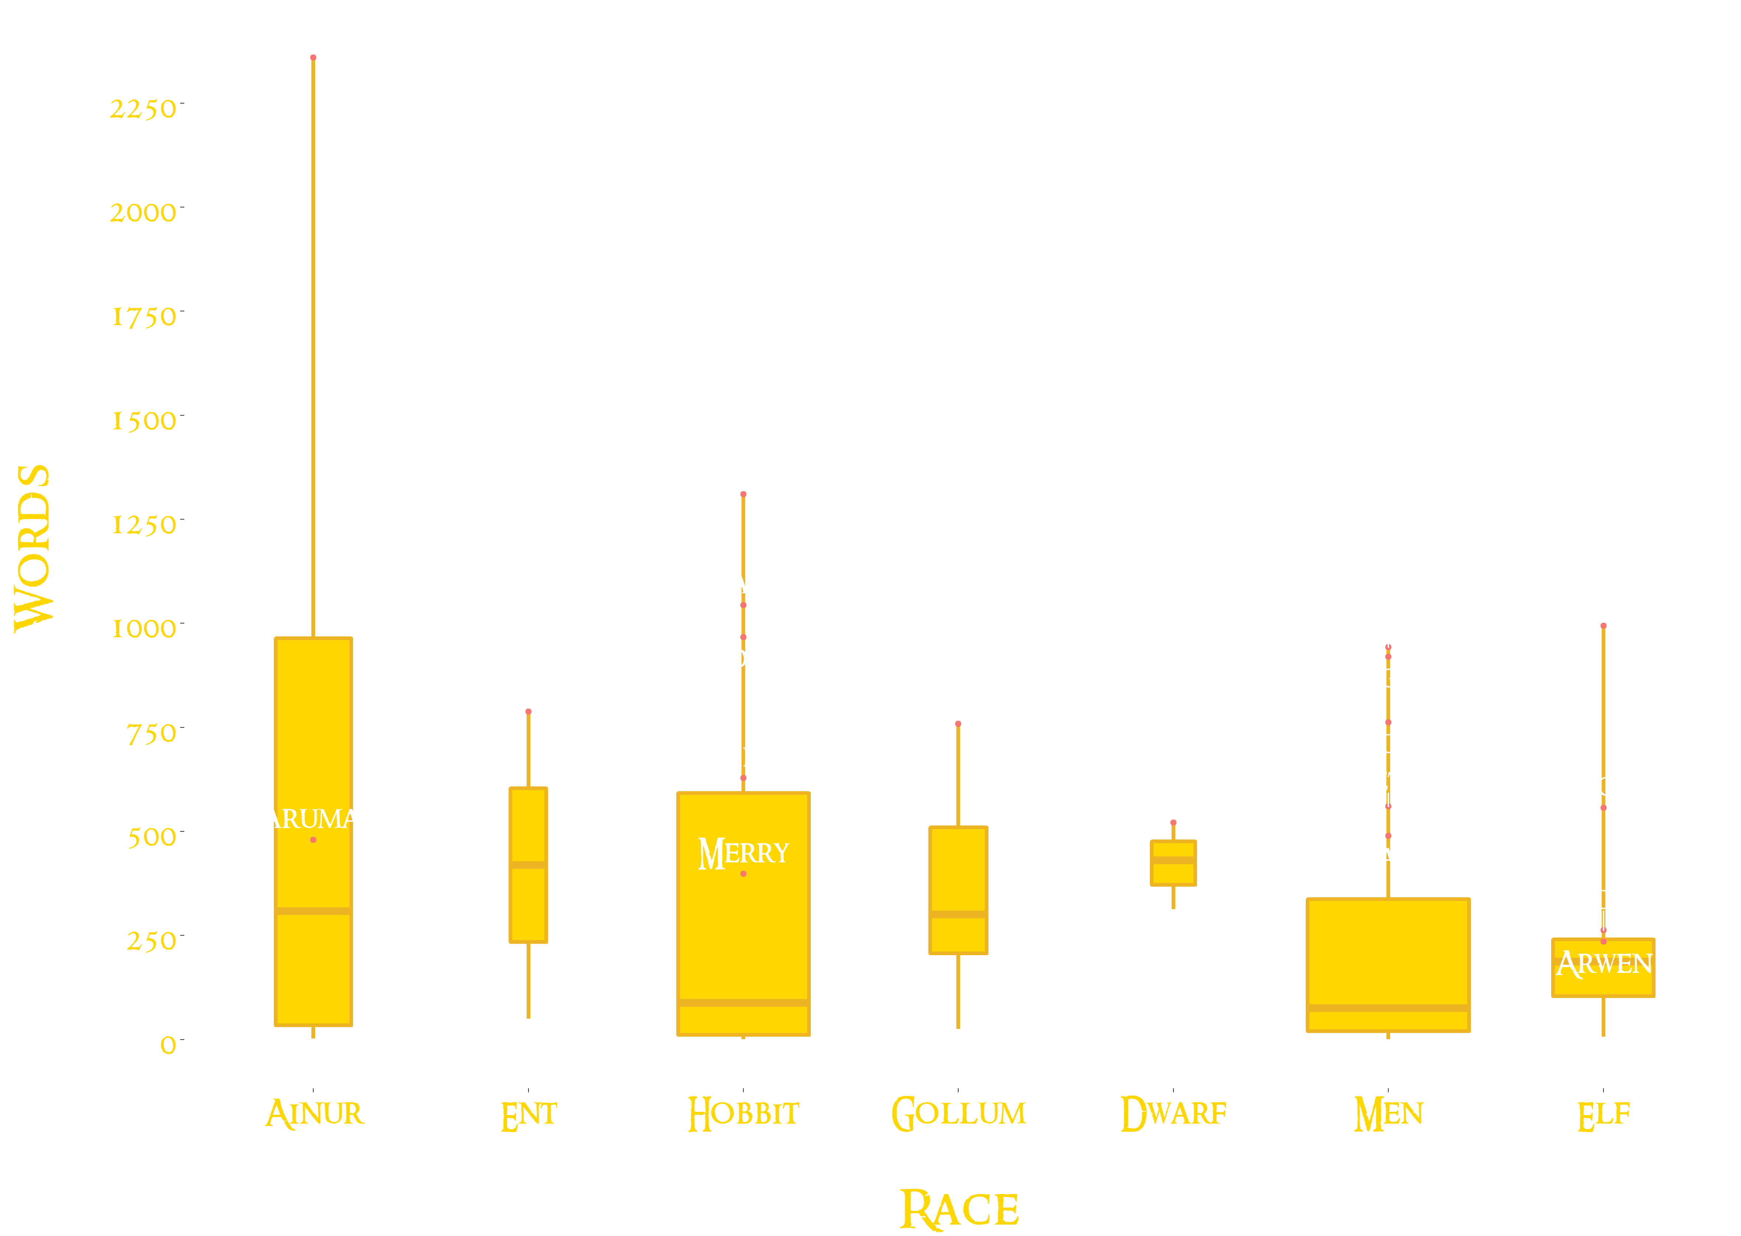
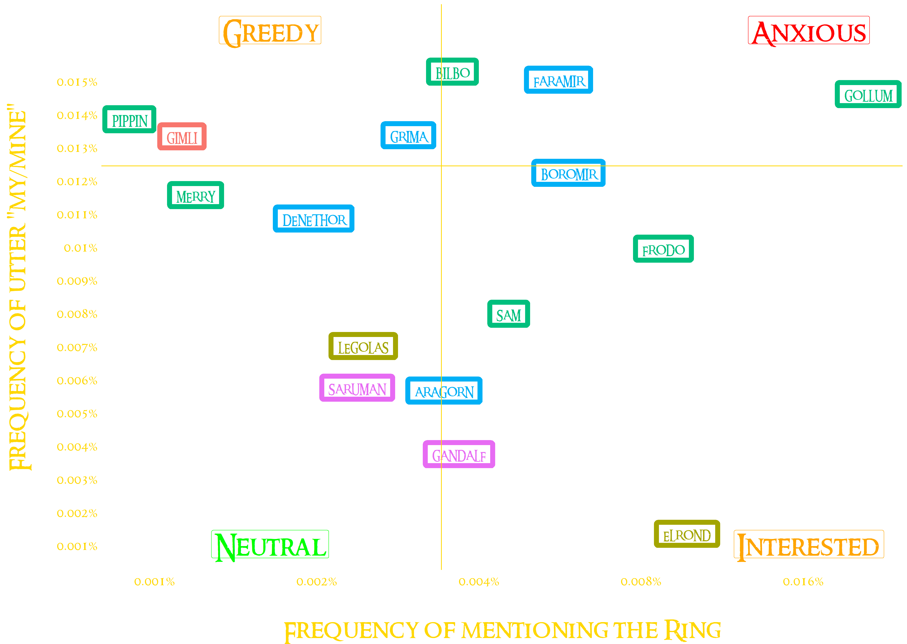
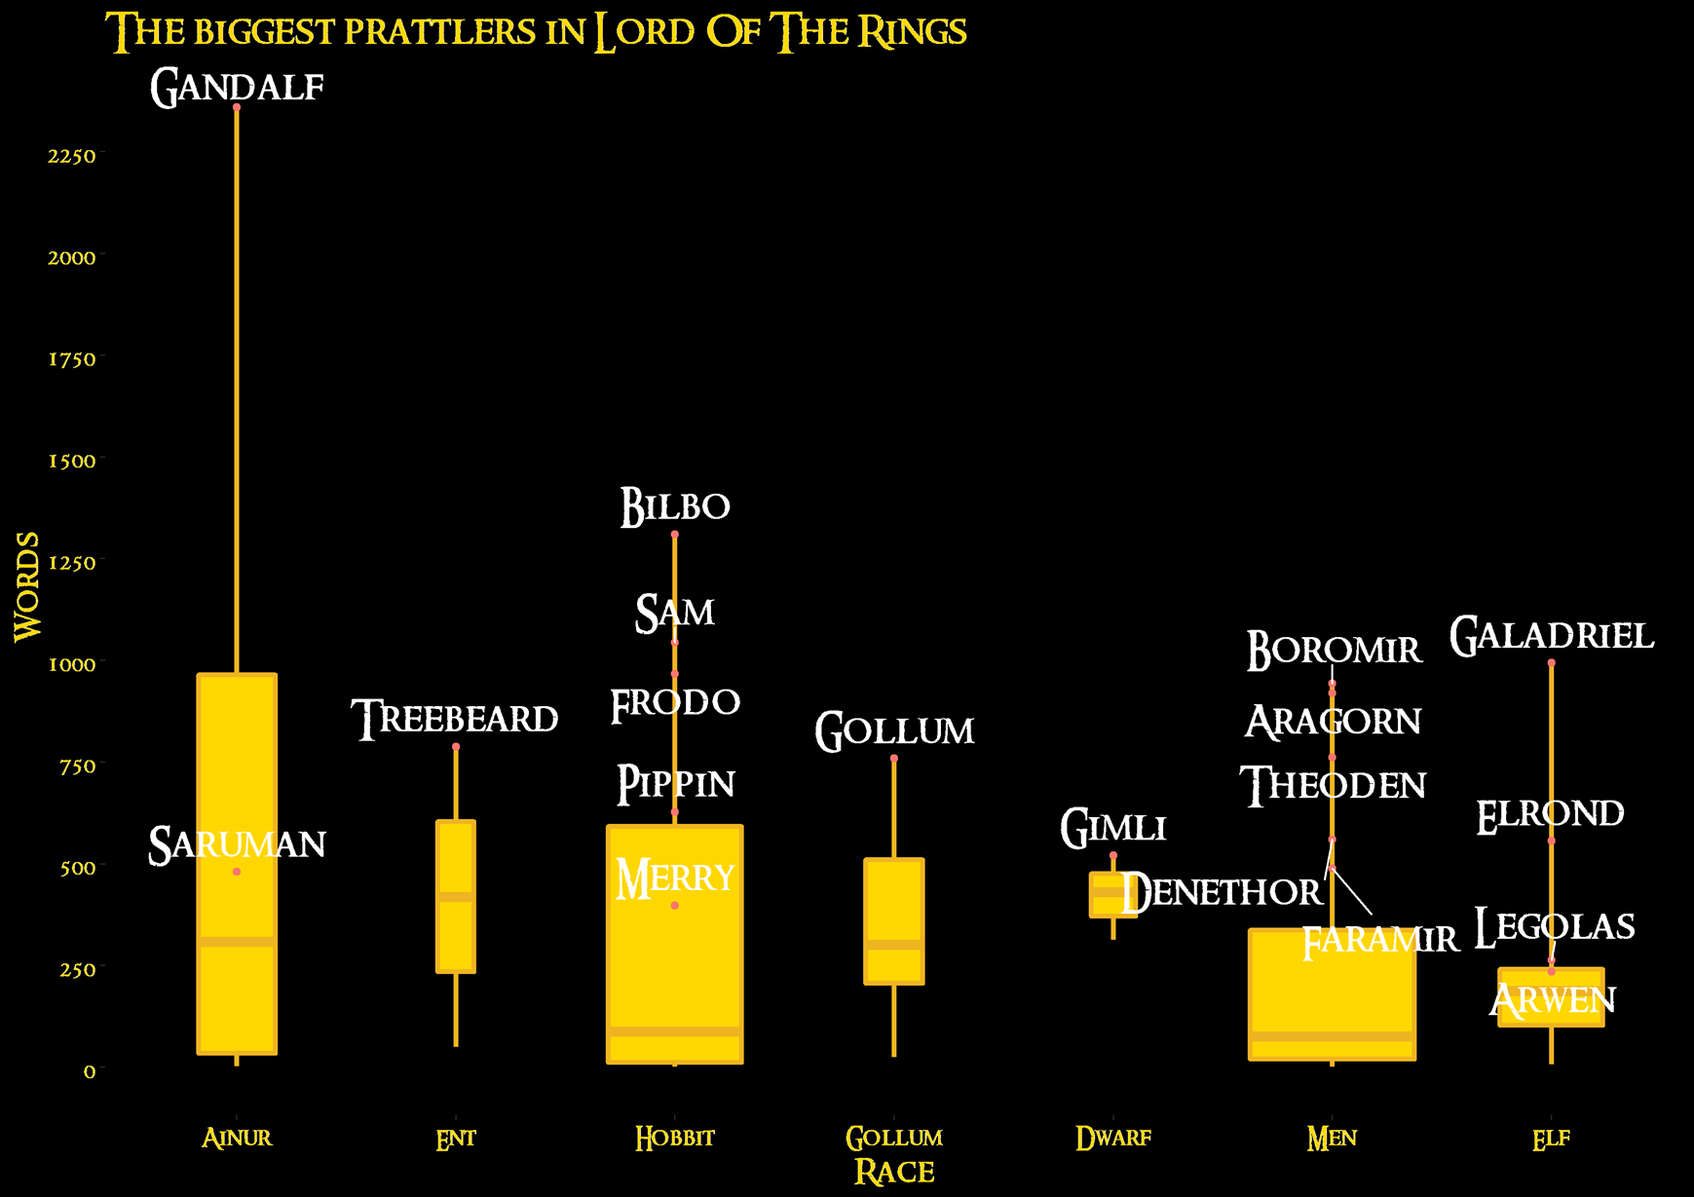
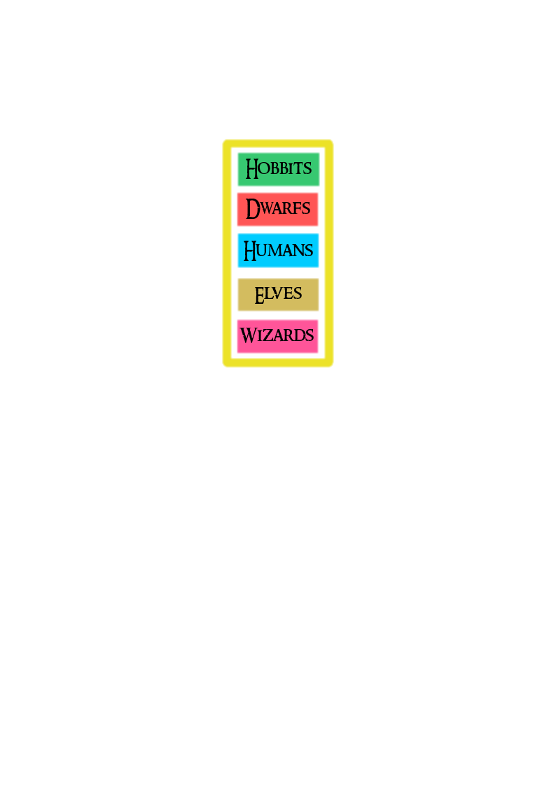
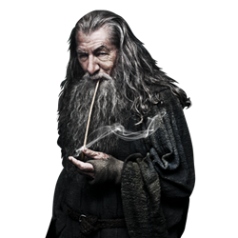
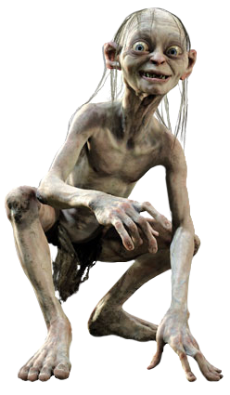
Words, words, words in The Lord of the Rings
The Lord of the Rings movie series was one of the biggest and most ambitious film projects ever undertaken. In the whole trilogy charcters have spoken 31 969 words, what equals to over 57 words per minute. 119 characters said at least one word. With that in mind, we’ve decided to find the biggest prattler in The Lord of the Rings world and answer the question: who covets the ring the most’? Was it Gollum, Gandalf or Frodo? Well, lets find out!
The first plot shows information about the ammount of words spoken by characters of different races. Boxplots* show six races and their most known representatives. So, who is the biggest prattler in the lord of the rings?
The second plot shows how frequently main charcters of the trilogy mentioned the ring (percentage of all their words) and how often they claim its possesion.
Who is the biggest prattler in the Lord of The Rings?
How much did characters covet the ring?
*How to read a boxplot:
Character point
Maximum
third quartile
Median
First quartile
Minimum
Race population
Legend
The answer is Gandalf! That old and wise wizard said 2360 words. Well, he’s got lots of knowledge to pass on. Another interesting fact is that Ents have the highest median . They dont move quickly but they’ve got a lot to say, thats for sure.
As we all expected, Gollum was the most obsessed with the ring. His anxiety was followed by Faramir and Bilbo, which also does not surprise. Overall the desire for the ring was the highest amongs hobbits and man.
Authors:
Adam Rydelek, Piotr Miziński, Wojciech Kretowicz

