Slide 1
MCD
0,n
1,1
HAS POSTED
FRIENDS
-DateTime (-Level)
0,n
USER
-UserID -UserName -Name -Firstname -Mail -City -Country -Telephone -BirthDate -Sex -Admin -Premium -Theme
POST
-PostID -DateTime -NumberofShares -NumerofLikes -NumberOfMedias -Content
0,n
0,5
CONTAINS
0,n
0,n
HAS LIKED -DateTime
0,1
0,n
0,n
0,n
0,n
0,n
SEND
DateTime
HAS SHARED -DateTime
MEDIA
-MediaID -Path -Type
RECEIVE
0,n
BELONGS TO
0,n
HAS MADE
1,1
1,1
CONVERSATION -Content
HAS MADE
1,1
COMMENT
-CommentID -DateTime -Content
0,1
1,1
1,1
COMMENT_ANSWER -AnswerID -DateTime -Content
1,1
BELONGS TO
CONTAINS
0,n
0,1

Slide 2
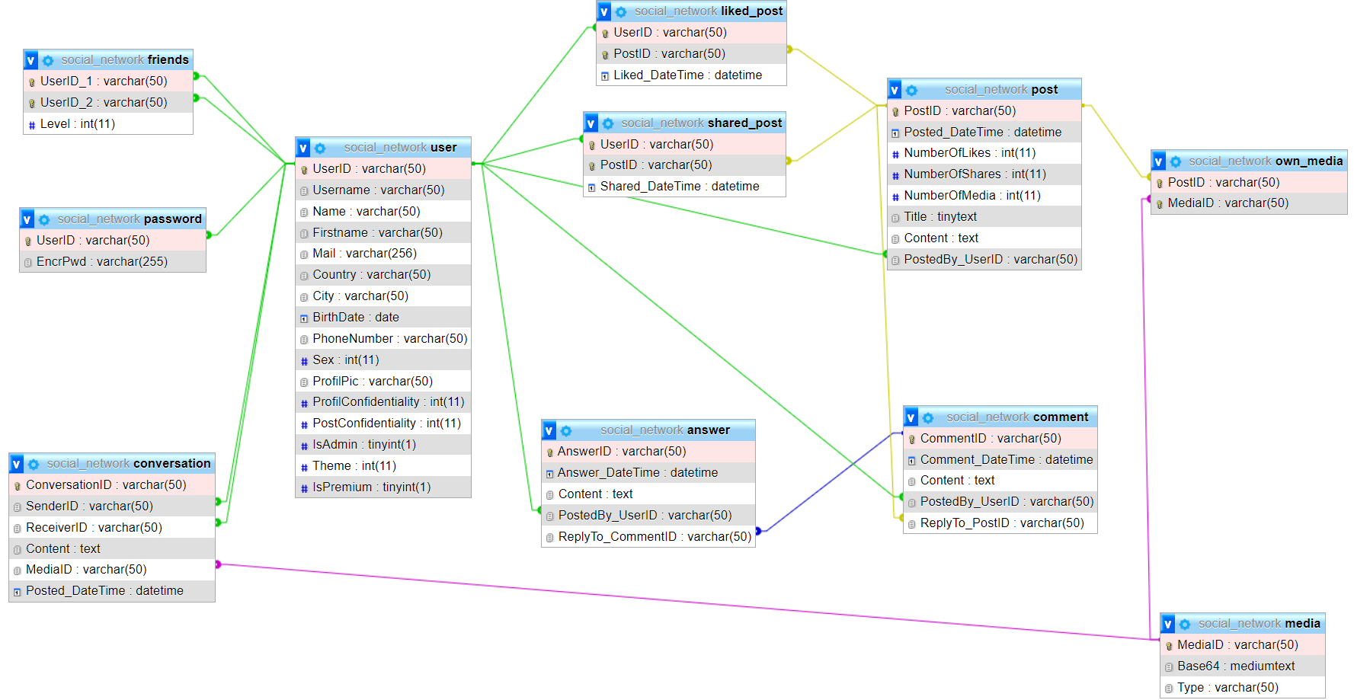
FINAL DESIGN

Slide 3
MLD
USER(UserID, Username, Name, Firstname, Mail, Country, City, Telephone, BirthDate, Sex, IsAdmin, Theme, IsPremium)
POST(PostID, #PostedByUserID, Content, DateTime, NumberOfShares, NumberOfLikes, NumberOfMedias)
FRIENDS(#UserID1, #UserID2, DateTime, Level)
LIKED_POST(#UserID, #PostID, DateTime)
SHARED_POST(#UserID, #PostID, DateTime)
COMMENT(CommentID, #UserID, #PostID, Content, DateTime)
OWN_MEDIA(#PostID, #MediaID)
MEDIA(MediaID, #PostID, Path, Type)
CONVERSATION(ConversationID, #SenderID, #ReceiverID, Content, #MediaID, DateTime)
COMMENT_ASWER(AnswerID, #CommentID, #UserID, Content, DateTime)
PASSWORD(#UserID , EncrPwd)

Slide 4
SQL Requests (1)
USER
. CREATE TABLE USER ( UserID NVARCHAR(50) NOT NULL DEFAULT 'NaU’, Username NVARCHAR(50) NOT NULL, Name NVARCHAR(50) NOT NULL, Firstname NVARCHAR(50) NOT NULL , Mail NVARCHAR(256) NOT NULL, Country NVARCHAR(50) NOT NULL, City NVARCHAR(50) NOT NULL, BirthDate DATE NOT NULL, Sex INT NOT NULL DEFAULT -1, IsAdmin BOOLEAN NOT NULL DEFAULT FALSE, Theme INT NOT NULL DEFAULT 0, IsPremium BOOLEAN NOT NULL DEFAULT FALSE, PRIMARY KEY(UserID) )
NaU : Not a User Sex : 0 : Woman 1 : Man
2 : Other
-1 : Undefined THEME : 0 : light 1 : dark Theme, IsAdmin, IsPremium don’t have to be set up on the creation of a user. Their default are compatible with code.
INSERT INTO USER (UserID, Name, Surname, Mail, Country, City, Sex) VALUES( ('2', 'Bouhrara', 'Adam', 'adam@gmail.com', 'France', 'Cergy', 1), ('1' , 'Legrand', 'Joan', 'joan.legrand8@gmail.com', 'France', 'Paris', 1) )
IsAdmin has to be set up directly in the database not with a php function. Theme and IsPremium will be default at the creation of a user and will be change with other features.

Slide 5
SQL Requests (2)
POST
. CREATE TABLE POST ( PostID VARCHAR(50) NOT NULL DEFAULT 'NaP', Posted_DateTime DATETIME NOT NULL DEFAULT NOW(), NumberOfLikes INT NOT NULL DEFAULT 0, NumberOfShares INT NOT NULL DEFAULT 0, NumberOfMedia INT NOT NULL DEFAULT 0, Content VARCHAR(2048) NOT NULL DEFAULT '' , PostedBy_UserID VARCHAR(50) NOT NULL, PRIMARY KEY(PostID), FOREIGN KEY(PostedBy_UserID) REFERENCES USER(UserID) )
NaP : Not a Post NumberOfLikes/Shares : set up to default when a post is insert. Actualise when someone will like/share it. NumberOfMedias : 0 to 5, contain the info of how many Medias are link to the Post DateTime : datetime when the post has been posted by the user (id user : PostedByUserID)
INSERT INTO POST (PostID, Posted_DateTime, NumberOfLikes, NumberOfShares, NumberOfMedia, Content, PostedBy_UserID)
VALUES ('P2', '2023-02-20 10:30:00', 0, 0, 1, 'Ceci est mon deuxième post!', 'U1');

Slide 6
SQL Requests (3)
FRIENDS
. CREATE TABLE FRIENDS ( UserID_1 VARCHAR(50) NOT NULL, UserID_2 VARCHAR(50) NOT NULL, Level INT NOT NULL DEFAULT 0, FOREIGN KEY(UserID_1) REFERENCES USER(UserID), FOREIGN KEY(UserID_2) REFERENCES USER(UserID), PRIMARY KEY(UserID_1, UserID_2) )
Level : 0 : Classic Friend 1 : Closed Friend
INSERT INTO POST (UserID_1, UserID_2) VALUES( () )

Slide 7
SQL Requests (4)
LIKED/SHARED_POST
. CREATE TABLE LIKED_POST / SHARED_POST ( UserID VARCHAR(50) NOT NULL, PostID VARCHAR(50) NOT NULL, Liked/Shared_DateTime DATETIME NOT NULL DEFAULT NOW(), FOREIGN KEY(UserID) REFERENCES USER(UserID), FOREIGN KEY(PostID) REFERENCES POST(PostID), PRIMARY KEY(UserID, PostID) )
INSERT INTO POST (UserID_1, UserID_2) VALUES( () )

Slide 8
SQL Requests (5)
COMMENT
. CREATE TABLE COMMENT ( CommentID VARCHAR(50) NOT NULL DEFAULT ‘NaC’, Comment_DateTime DATETIME NOT NULL DEFAULT NOW(), Content VARCHAR(2048) NOT NULL DEFAULT ‘’ “, PostedBy_UserID VARCHAR(50) NOT NULL, ReplyTo_PostID VARCHAR(50) NOT NULL, PRIMARY KEY(CommentID), FOREIGN KEY(PostedBy_UserID) REFERENCES USER(UserID), FOREIGN KEY(ReplyTo_PostID) REFERENCES POST(PostID) )
NaP : Not a Comment DateTime : datetime when the comment has been posted by the user (id user : PostedByUserID)
INSERT INTO COMMENT (CommentID, Comment_DateTime, Content, PostedBy_UserID, ReplyTo_PostID) VALUES( (), () )

Slide 9
SQL Requests (6)
ANSWER
. CREATE TABLE ANSWER ( AnswerID VARCHAR(50) NOT NULL DEFAULT ‘NaC’, Answer_DateTime DATETIME NOT NULL DEFAULT NOW(), Content VARCHAR(2048) NOT NULL DEFAULT '' , PostedBy_UserID VARCHAR(50) NOT NULL, ReplyTo_CommentID VARCHAR(50) NOT NULL, PRIMARY KEY(AnswerID), FOREIGN KEY(PostedBy_UserID) REFERENCES USER(UserID), FOREIGN KEY(ReplyTo_CommentID) REFERENCES COMMENT(CommentID) )
NaC : Not a Comment DateTime : datetime when the answer has been posted by the user (id user : PostedByUserID)
INSERT INTO COMMENT_ANSWER (AnswerID, Answer_DateTime, Content, PostedBy_UserID, ReplyTo_CommentID) VALUES( (), () )

Slide 10
SQL Requests (8)
MEDIA
. CREATE TABLE MEDIA ( MediaID VARCHAR(50) NOT NULL DEFAULT ‘NaM’, Path VARCHAR(256) NOT NULL DEFAULT ‘’, Type VARCHAR(50) NOT NULL DEFAULT ‘jpg’, PRIMARY KEY(MediaID), FOREIGN KEY(PostID) REFERENCES POST(PostID) )
NaP : Not a Media
INSERT INTO MEDIA (MediaID, Path, Type) VALUES( (‘M1’,‘./test’, ‘image’) )

Slide 11
SQL Requests (7)
OWN MEDIA
. CREATE TABLE OWN_MEDIA ( PostID VARCHAR(50) NOT NULL, MediaID VARCHAR(50) NOT NULL, FOREIGN KEY(PostID) REFERENCES POST(PostID), FOREIGN KEY(MediaID) REFERENCES MEDIA(MediaID) )
INSERT INTO OWN_MEDIA (PostID, MediaID) VALUES( (‘P1’,’M1’) )

Slide 12
SQL Requests (9)
CONVERSATION
. CREATE TABLE CONVERSATION ( ConversationID VARCHAR(50) NOT NULL DEFAULT ‘NaCV’, SenderID VARCHAR(50) NOT NULL, ReceiverID VARCHAR(50) NOT NUL, Content VARCHAR(2048) NOT NULL DEFAULT ‘’ , MediaID VARCHAR(50) NOT NULL, Posted_DateTime DATETIME NOT NULL DEFAULT NOW(), PRIMARY KEY(ConversationID), FOREIGN KEY(SenderID) REFERENCES USER(UserID), FOREIGN KEY(ReceiverID) REFERENCES USER(UserID), FOREIGN KEY(MediaID) REFERENCES MEDIA(MediaID) )
NaCV : Not a Conv
INSERT INTO CONVERSATION (ConversationID, SenderID, ReceiverID, Content, MediaID, Posted_DateTime)
VALUES(‘CV1’, ‘U1’, ‘U2’, ‘Conv entre U1 et U2’, ‘M5’, ‘2022-06-01’)

Slide 13
SQL Requests (10)
PASSWORD
. CREATE TABLE PASSWORD ( UserID VARCHAR(50) NOT NULL, EncrPwd VARCHAR(256) NOT NULL DEFAULT ‘’, FOREIGN KEY(UserID) REFERENCES USER(UserID)
)
INSERT INTO PASSWORD (UserID, EncrPwd)
VALUES(‘U1’, ‘123456789’)

Slide 14
FINAL DESIGN

Slide 15
ON CASCADE DELETION SATATEMENT
ALTER TABLE `answer` ADD FOREIGN KEY (`PostedBy_UserID`) REFERENCES `user` (`UserID`) ON DELETE CASCADE; ALTER TABLE `answer` ADD FOREIGN KEY (`ReplyTo_CommentID`) REFERENCES `comment` (`CommentID`) ON DELETE CASCADE; ALTER TABLE `comment` ADD FOREIGN KEY (`PostedBy_UserID`) REFERENCES `user` (`UserID`) ON DELETE CASCADE; ALTER TABLE `comment` ADD FOREIGN KEY (`ReplyTo_PostID`) REFERENCES `post` (`PostID`) ON DELETE CASCADE; ALTER TABLE `conversation` ADD FOREIGN KEY (`SenderID`) REFERENCES `user` (`UserID`) ON DELETE CASCADE; ALTER TABLE `conversation` ADD FOREIGN KEY (`ReceiverID`) REFERENCES `user` (`UserID`) ON DELETE CASCADE; ALTER TABLE `conversation` ADD FOREIGN KEY (`MediaID`) REFERENCES `media` (`MediaID`) ON DELETE CASCADE; ALTER TABLE `friends` ADD FOREIGN KEY (`UserID_1`) REFERENCES `user` (`UserID`) ON DELETE CASCADE; ALTER TABLE `friends` ADD FOREIGN KEY (`UserID_2`) REFERENCES `user` (`UserID`) ON DELETE CASCADE; ALTER TABLE `liked_post` ADD FOREIGN KEY (`UserID`) REFERENCES `user` (`UserID`) ON DELETE CASCADE; ALTER TABLE `liked_post` ADD FOREIGN KEY (`PostID`) REFERENCES `post` (`PostID`) ON DELETE CASCADE; ALTER TABLE `own_media` ADD FOREIGN KEY (`PostID`) REFERENCES `post` (`PostID`) ON DELETE CASCADE; ALTER TABLE `own_media` ADD FOREIGN KEY (`MediaID`) REFERENCES `media` (`MediaID`) ON DELETE CASCADE; ALTER TABLE `post` ADD FOREIGN KEY (`PostedBy_UserID`) REFERENCES `user` (`UserID`) ON DELETE CASCADE; ALTER TABLE `shared_post` ADD FOREIGN KEY (`UserID`) REFERENCES `user` (`UserID`) ON DELETE CASCADE; ALTER TABLE `shared_post` ADD FOREIGN KEY (`PostID`) REFERENCES `post` (`PostID`) ON DELETE CASCADE;

